Slide 1
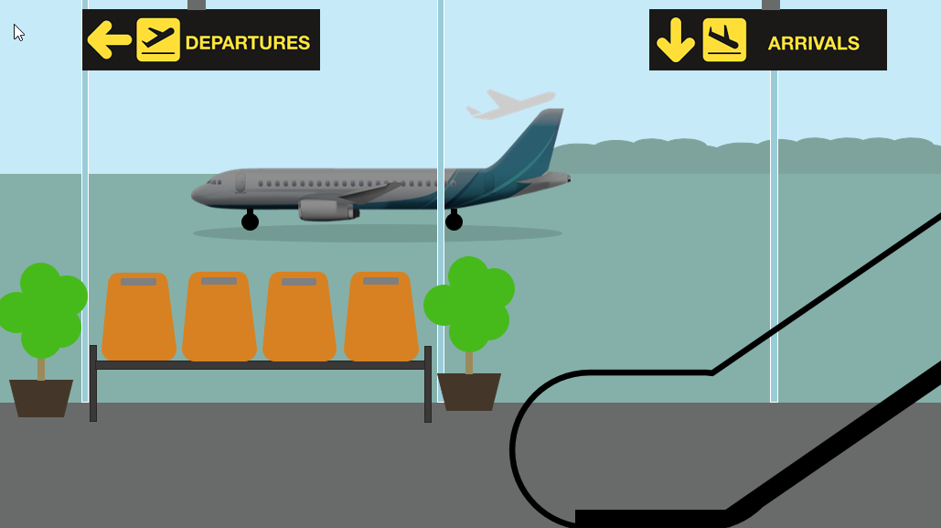
AIRIPORT MANAGEMENT SYSTEM
Team – Panchatantra
Abhishek Shankar - 002751339
Manikanta TR – 002704579
Sushmitha Prathap - 002774283
Anvi Jain - 002657150
Harshitha Ranganath - 002778541

Slide 2

Code Structure
Onboarding Packages
Scripts to insert data along with validations
Scripts to ensure data is updated correctly for different roles
Deleting Packages
Scripts to delete data in respective tables based on permissions.
Roles and permissions
Updating Packages
Script to create roles and assign permissions.
Executing Scripts
Log in as each role and execute the respective scripts

Slide 3

Team Contributions
Each team member was assigned entities and the respective packages.
Abhishek Shankar – Passengers , Orders, Permissions and roles along with respective packages (Insert Update and Delete)
Anvi Jain – Airline along with respective packages (Insert Update and Delete) and Validation checks, Views
Sushmitha Prathap – Tickets, Baggage, Flight and Staff along with respective packages and exception Handling
Harshitha Ranganath – Terminal, Airline Staff along with respective packages and reports/view creation, Views
Manikanta Reddy Thikkavarapu – Airport along with resepective packages and overall script testing, Views

Slide 4
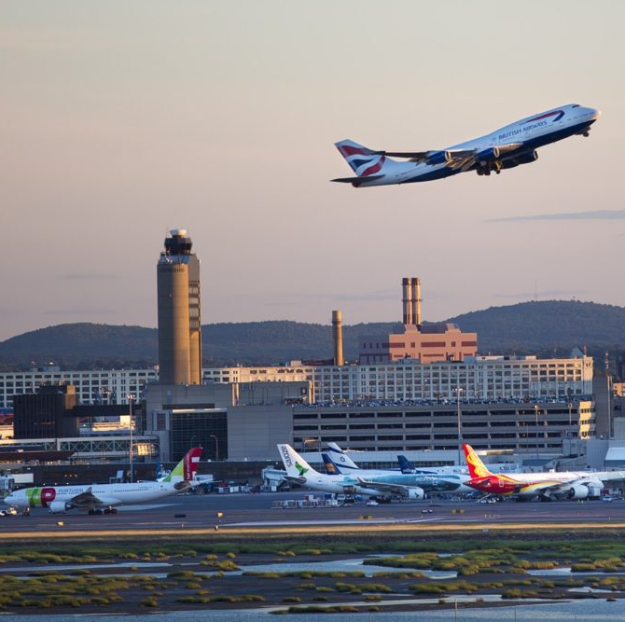
Problem Statement
To implement an airport management system, which simulates various functions of an airport. This system is designed used to manage and coordinate the various functions and operations of an airport. Our system is designed to manage flight schedules, gate assignments, baggage handling, and passenger check-in and boarding.

Slide 5

The main objectives of the envisioned system are
Design flight ticketing system.
Allow passengers to book flights
Track number of arriving and departing flights.
Monitor shifts of various airport and airline staff.
Assigning gates for passengers.
Robust billing process.
Control the everyday functioning of an airport.

Slide 6

Team Solution
The solution to the problem presented by the team involves a simple database architecture which comprises of some of the most important components of the airport. These entities work both independently and together to enable seamless flow of data to cater to its users. We have implemented the solution bearing in mind and implementing the following points.
The System is used to manage only a single airport.
Each passenger can purchase tickets individually or as a group and each booking is uniquely identified by a order_id.
Only the passenger traveling can book the ticket.
Tickets are assigned to passengers and uniquely identified by a combination of order_id and ticket_id.
Each ticket is associated with 1 or more baggage and each piece of baggage is uniquely identifiable by a baggage_id.
All flights to and from the airport are tracked with each flight having a unique flight ID, source, and destination.
Flights are operated by airlines with specific airline_id and route numbers to track their corridors.
The airport is managed by airline staff who can be tracked by their staff_id. Their basic details like first name, last name, and email address must be given.
All the cities connected to the airport are managed by the airport_code to track which airport the flight is arriving from.

Slide 7
SQL Concepts Implemented
The entire code has been written in PLSQL and uses the following concepts
Packages
Functions
Stored Procedures
Triggers
Views
Sequences
Permission Handling
Reports

Slide 8
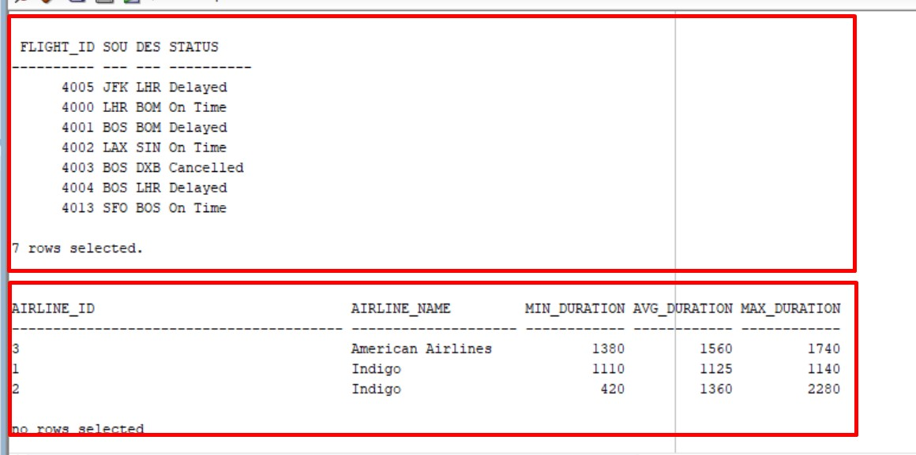
Sample Views

Slide 9
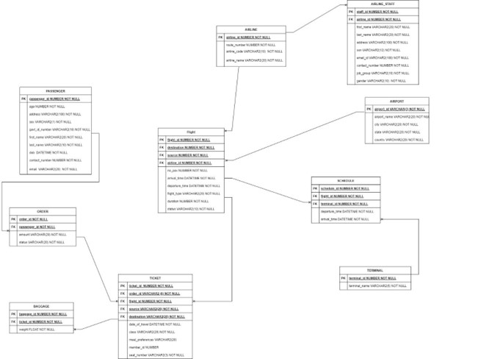
Entity Relation Diagram

Slide 10

THANK YOU

