Slide 1
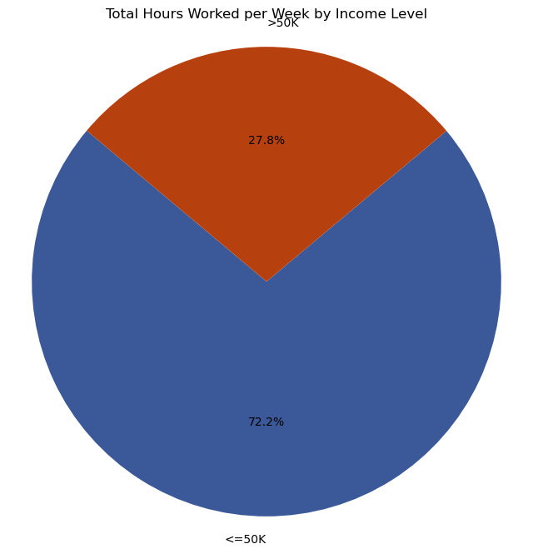
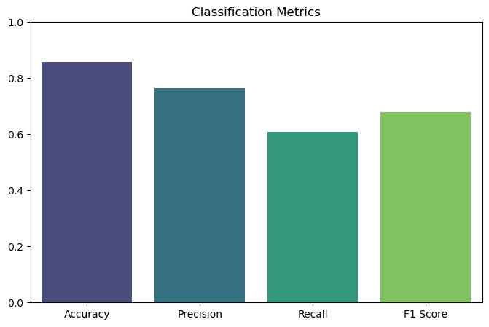
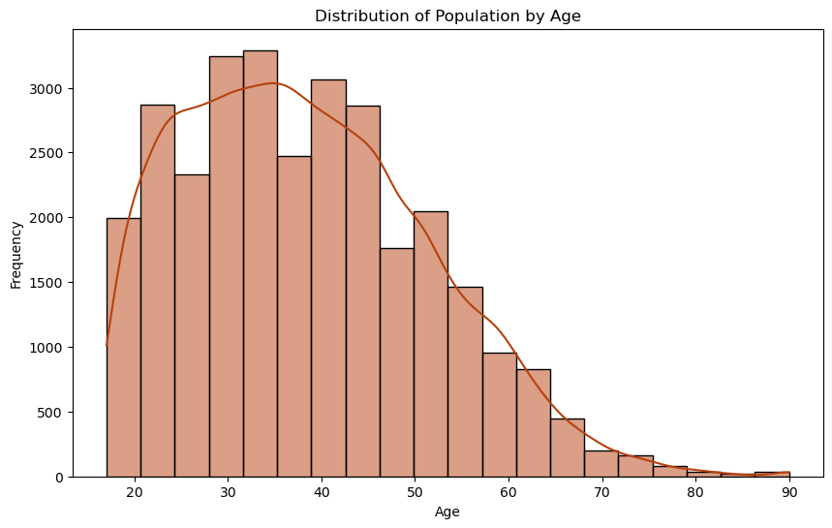
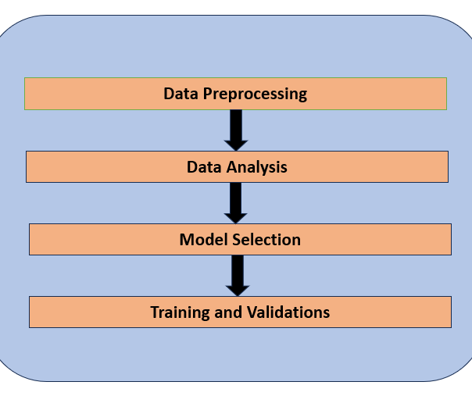
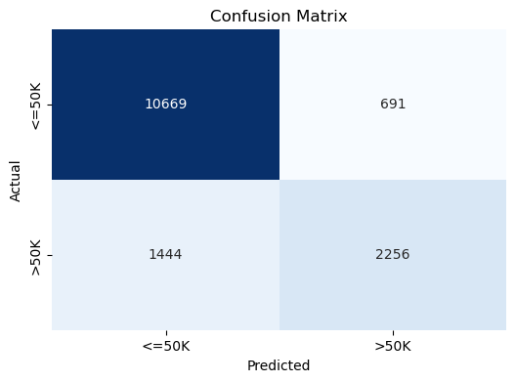
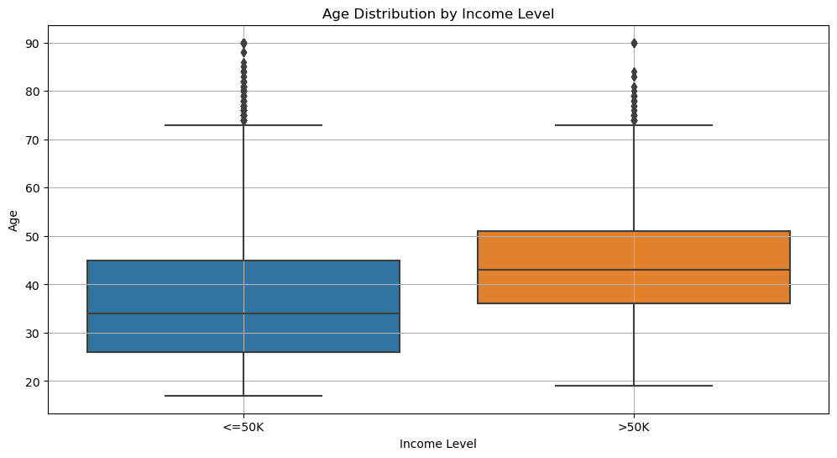
Predictive Modeling of Income Using Adult Dataset
A Machine Learning Approach to Income Prediction
Sushmitha Manjunatha
In this project we undertake the task of predicting
In this project we undertake the task of predicting an individual’s income using Adult dataset [1]
considering parameters such as age, education, occupation and marital status. It was found that income level can be predicted using a supervised machine learning model. The model we built classifies income as either over or under $50,000 annually. This model helps to identify trends present in the data and gives an explanation on the demographic factors that affect income making us appreciate the social forces behind income inequality further.
Exploratory Data Analysis
Introduction
The visualizations highlight population dynamics, showing trends in age distribution, income disparities, and the link between age and earning potential, revealing socioeconomic patterns and inequality.
1. Population Age Distribution: The population peaks between ages 30-50, with fewer individuals in older age groups.
2. Income Distribution by Gender: Males earning >50K significantly outnumber females, indicating income disparities.
3. Age Distribution by Income Level: Higher earners (>50K) are typically older, while lower earners are generally younger.
4. Hours worked per week by Income Level:
4
B
Bar Plot for Accuracy
In this project, we followed these steps to clean the data and develop our predictive model:
Data Preprocessing
Replaced missing values ("?") with Na, dropped affected rows, and encoded categorical variables (e.g., occupation, education).
Data Analysis
Created visualizations (bar charts, histograms) to explore income distribution and analyzed feature importance to identify key predictors of income.
Model Selection
Selected a RandomForestClassifier for its effectiveness in handling both categorical and numerical data.
Training and Validation
Split the dataset into training and test sets, trained the model, and calculated accuracy on the test data.
Methodology
1
A Random Forest Classifier was used to classify individuals as earning either less than or more than USD 50,000 annually.
Confusion Matrix: The model correctly classified 10,669 individuals earning <=50K and 2,256 earning >50K, with 691 false positives and 1,444 false negatives.The model performs well for the <=50K group but struggles with higher earners, as reflected by the false negative rate.
Bar plot for Accuracy:
Accuracy: 85.82% — The model meets the accuracy target, distinguishing income brackets effectively.
Precision: 0.77 — 77% of those predicted to earn >50K actually do.
Recall: 0.61 — The model misses some individuals earning >50K.
F1 Score: 0.68 — A balance between precision and recall, reflecting the model’s overall performance for higher-income individuals.
Model Evaluation and Results
Conclusion
Random Forest classifier which was implemented in this did perform well, achieving an accuracy of 85.82. The model performs well in predicting individuals who earn more than 50k, while the spread is lower. On the other hand, there is a low recall and there is potential on finding ways to minimize the amount of false negatives. In general, the model should be used in predicting an individual’s income type reliably, and there are prospects of increasing the recall score with further tuning or using other classifiers. In fact, it is evident that the model behaved adequately as it captured the patterns in the data, however, it would be even better if this could achieve comprehensive detection of high-income individuals. For now, the model can be said to be precision dominant but in addition of having the same degree of command over recall, wider applications of the model can be achieved, especially in areas where misclassifying of high-income people is of no less importance than the others.
C
3
References
[1].“ Becker, B. & Kohavi, R. (1996). Adult [Dataset].
UCI Machine Learning Repository.
https://doi.org/10.24432/C5XW20.”
Methods followed for this project
Engineering Science Data Science State University of New York at Buffalo
buffalo.edu

