Slide 1

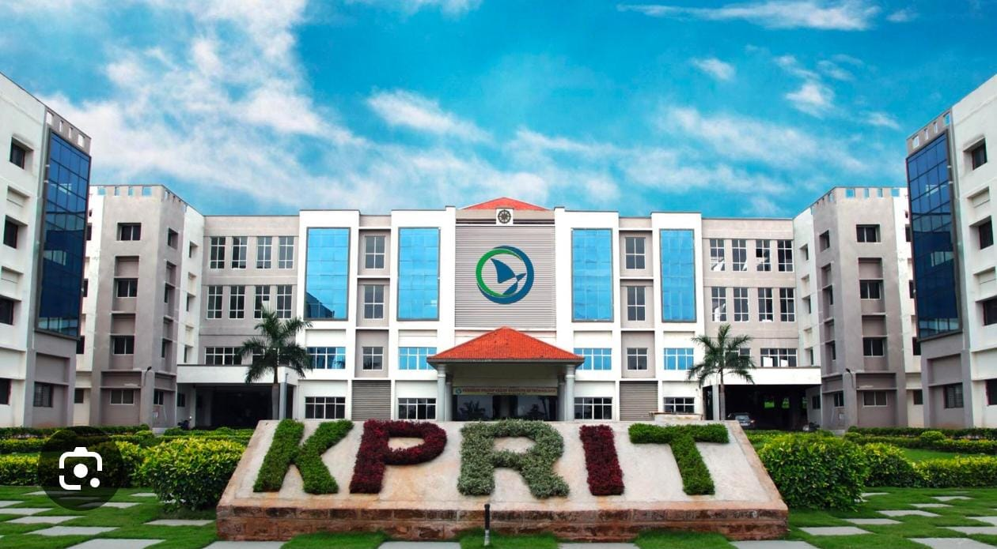
KOMMURI PRATAP REDDY
INSTITUTE OF TECHNOLOGY
Department of Computer Science & Engineering
MAJOR PROJECT REVIEW
IV B.Tech – CSE | A.Y. 2026 – 2027
PROJECT TITLE
HUMAN BODY DIGITAL TWIN
GUIDE
SECTION
TEAM
Mr. M. Rakesh
IV-I CSE – C
4 Members
REVIEW
11-11-2026

Slide 2
Team Details
2
S. No. | Name | Roll No. | Role / Responsibility
1 | M. Sushmitha | 23RA1A05F8 | Backend Developer
2 | A. Prem Kumar | 24RA5A0514 | Frontend Developer
3 | D. Yugender | 24RA5A0517 | Security & Authentication Lead
4 | R. Vinay | 23RA1A05H1 | Testing / Documentation Lead
PROJECT GUIDE
SECTION
Mr. M. Rakesh | Assistant Professor
IV-I CSE – C
Department of Computer Science & Engineering | KPRIT | A.Y. 2026–2027

Slide 3
Project Title
3
AI-POWERED HUMAN BODY DIGITAL TWIN
A 3D virtual representation of the human body for real-time health monitoring, analysis and prediction
DOMAIN
APPLICATION AREA
KEY TECHNOLOGIES
Artificial Intelligence / Machine Learning
Healthcare / Digital Health
AI/ML • 3D Visualization • IoT
Department of Computer Science & Engineering | KPRIT | A.Y. 2026–2027

Slide 4
Abstract
4
AI-Powered Human Body Digital Twin is a healthcare-focused software solution that creates a 3D virtual representation of the human body to monitor and analyze an individual’s health condition.
The system integrates real-time health data collected through IoT sensors and other sources — heart rate, blood pressure, oxygen level, medical history and other patient information.
This data is processed using AI and Machine Learning techniques to identify health patterns, monitor changes and provide personalized health insights.
Workflow: the user registers and logs in → the system displays the digital human body → live parameters and AI insights are shown on an interactive dashboard.
ABSTRACT
Department of Computer Science & Engineering | KPRIT | A.Y. 2026–2027

Slide 5
Problem Statement
5
Problem
Statement
Traditional healthcare systems rely on periodic check-ups and separate health records, so there is no continuous and personalized monitoring of an individual’s health using real-time data.
Heart rate, blood pressure and oxygen level are tracked individually, with no single view of the whole body.
Early warning signs can be missed because data, AI analysis and visualization are not combined in one platform.
Our solution: a 3D Human Body Digital Twin that integrates health data and supports AI-based health monitoring and prediction.
Department of Computer Science & Engineering | KPRIT | A.Y. 2026–2027

Slide 6
Objectives
6
OBJECTIVE 01
OBJECTIVE 02
Build a 3D virtual model of the human body (digital twin) using existing AI and 3D technologies.
Integrate real-time health data (heart rate, BP, SpO₂) — initially using sample / simulated data.
OBJECTIVE 03
OBJECTIVE 04
Apply AI/ML to detect abnormal patterns and generate personalized health insights and predictions.
Ensure data accuracy, privacy and security with validation, authentication and reliable AI models.
Department of Computer Science & Engineering | KPRIT | A.Y. 2026–2027

Slide 7
Scope
7
✓ IN SCOPE
✕ OUT OF SCOPE / FUTURE WORK
3D virtual representation of the human body
Real-time (simulated) integration of health data
AI/ML-based health analysis and pattern identification
Interactive health monitoring dashboard
User registration, login and secure access
Highly accurate AI models for complex disease prediction
Treatment simulation using real patient-specific medical data
Integration with advanced medical devices and hospital systems
Integration with Electronic Health Records (EHRs)
Department of Computer Science & Engineering | KPRIT | A.Y. 2026–2027

Slide 8
Literature Survey
8
Paper / Year | Approach / Key Finding | Limitation / Gap
Digital Twin Technology – 2020 | Virtual representation for monitoring and simulation | Limited real-time human health integration
AI & Machine Learning – 2021 | Identifies patterns in health data | Accuracy depends on quality of data
3D Visualization – 2022 | Makes organs and health changes easier to understand | Limited integration with real-time health data
IoT & Sensors – 2023 | Enables real-time health-data collection | Privacy and data-security challenges
Research gap: no single platform combines IoT data, AI analysis and 3D body visualization — this project bridges that gap.
Department of Computer Science & Engineering | KPRIT | A.Y. 2026–2027

Slide 9
Existing System
9
Monitoring mainly depends on periodic check-ups and separate health records.
Heart rate, blood pressure and oxygen level are often monitored individually.
Real-time data, AI analysis and 3D visualization are rarely available in a single platform.
No dynamic digital representation of the body for continuous monitoring and prediction.
EXISTING SYSTEM FLOW
PATIENT
HEALTH RECORDS
MONITORING
LIMITED INTEGRATION
OUTCOME
Visits hospital for periodic check-ups
Separate records and medical history maintained
Heart rate, BP, SpO₂ monitored individually
No real-time data, AI analysis or 3D view combined
No continuous monitoring or prediction
Department of Computer Science & Engineering | KPRIT | A.Y. 2026–2027

Slide 10
Proposed System
10
Develop a 3D virtual model of the human body as a Digital Twin.
Integrate real-time health data: heart rate, blood pressure, oxygen level.
Use AI/ML to analyze data and identify abnormal patterns.
Interactive dashboard with personalized insights and predictions.
Supports early detection, treatment simulation (future) and remote healthcare.
PROPOSED SYSTEM FLOW
INPUT
DATA PROCESSING
3D DIGITAL TWIN
AI ANALYSIS
OUTPUT
Patient profile, heart rate, BP, SpO₂, medical history
Validate, clean and prepare health parameters
Human body and organ visualization
Detect trends and identify health risks
Interactive dashboard and personalized insights
Department of Computer Science & Engineering | KPRIT | A.Y. 2026–2027

Slide 11
System Architecture
11
User / Client
(Web / Mobile)
Presentation Layer
React.js • Three.js (3D UI)
Application Layer
Business Logic + REST API
Data Layer
Database / Health Records
Authentication /
Access Control
AI/ML Processing &
Prediction Engine
Data Validation &
Processing
Analytics /
Reporting
IoT Sensors / Simulated Data (heart rate, BP, SpO₂)
Data Flow: Input → Validation → Processing / Model → Storage → Result / Report
Department of Computer Science & Engineering | KPRIT | A.Y. 2026–2027

Slide 12
Modules
12
1
User & Profile Management
2
Health Data Acquisition
3
Data Processing
Manages user profiles, personal details and medical history.
Collects heart rate, blood pressure, oxygen level and other patient data.
Validates, cleans and prepares health data for analysis.
4
3D Digital Twin
5
AI/ML Analysis
6
Health Dashboard
Creates and displays a 3D virtual representation of the body and organs.
Analyzes data, identifies patterns, detects changes and predicts health risks.
Displays parameters, 3D visualization, AI insights and personalized information.
Department of Computer Science & Engineering | KPRIT | A.Y. 2026–2027

Slide 13
Data Flow Diagram — Level 0
13
Context diagram: the whole system as a single process with its external entities
Sensors / IoT
(Simulated Data)
PROCESS 0
HUMAN BODY DIGITAL TWIN SYSTEM
Profile & medical history • Data collection & validation • AI/ML analysis • 3D human body visualization
Health readings
Register / login, view request
User / Patient
3D twin, dashboard, AI insights
Administrator
Manage users / config
Department of Computer Science & Engineering | KPRIT | A.Y. 2026–2027

Slide 14
Data Flow Diagram — Level 1
14
Decomposition of the main system process into numbered sub-processes and data stores
User
1.0 Registration
& Login
2.0 Data Acquisition
& Validation
3.0 AI/ML Analysis
& Prediction
4.0 3D Twin &
Dashboard
D1 User & Profile DB
D2 Health Data Store
D3 Results & Reports
3D view, dashboard & insights returned to user
Typical flow: capture input → validate → process / predict → store → generate result
Department of Computer Science & Engineering | KPRIT | A.Y. 2026–2027

Slide 15
Technology Stack & Requirements
15
FRONTEND
BACKEND
AI / ML
DATA
React.js (UI)
Three.js (3D human body & organ visualization)
Python / Node.js REST API
Authentication & access control
Python • scikit-learn / TensorFlow
Anomaly & pattern detection
Database for profiles and health records
Simulated / synthetic health dataset
Software Requirements
Hardware / Data Sources
Windows / Linux, modern web browser
VS Code, Node.js, Python, Git
Standard PC / laptop (8 GB RAM recommended)
IoT sensors (future) / simulated sensor data
Department of Computer Science & Engineering | KPRIT | A.Y. 2026–2027

Slide 16
Methodology / Implementation Plan
16
1
Requirement Analysis
2
Design
3
Development
Study needs, health parameters, datasets
Architecture, DFDs, UI & 3D model design
Frontend, backend, 3D twin, database
4
AI/ML Integration
5
Testing
6
Deployment
Train & integrate pattern/anomaly models
Unit, integration, security & validation
Dashboard release & documentation
Department of Computer Science & Engineering | KPRIT | A.Y. 2026–2027

Slide 17
Expected Outcomes & Applications
17
Expected Outcomes
Applications
Working 3D digital twin of the human body
Live display of heart rate, BP and oxygen level
AI-based detection of abnormal health patterns
Personalized health insights on an interactive dashboard
Secure registration, login and data handling
Continuous personal health monitoring
Early detection of health risks
Remote healthcare and tele-consultation
Medical education and patient awareness
Foundation for treatment simulation (future)
Department of Computer Science & Engineering | KPRIT | A.Y. 2026–2027

Slide 18
Conclusion & Future Work
18
The AI-Powered Human Body Digital Twin brings real-time health data, AI/ML analysis and 3D visualization into one platform, enabling continuous, personalized and easy-to-understand health monitoring.
Future Work
Real devices
Better AI
EHR integration
Simulation
Connect wearables and medical IoT sensors
Accurate models for complex disease prediction
Link with hospital systems and health records
Patient-specific treatment simulation
Department of Computer Science & Engineering | KPRIT | A.Y. 2026–2027

Slide 19
References
19
[1]
Corral-Acero, J. et al., “The ‘Digital Twin’ to enable the vision of precision cardiology,” European Heart Journal, vol. 41, no. 48, 2020.
[2]
Fuller, A. et al., “Digital Twin: Enabling Technologies, Challenges and Open Research,” IEEE Access, vol. 8, 2020.
[3]
Dataset — Simulated human health dataset (self-generated / synthetic data).
[4]
Official documentation — React.js (frontend UI) and Three.js (3D human body visualization).
[5]
World Health Organization (WHO) — Digital Health documentation; Digital Twin Consortium (DTC) — framework and technical documentation.
Department of Computer Science & Engineering | KPRIT | A.Y. 2026–2027

Slide 20
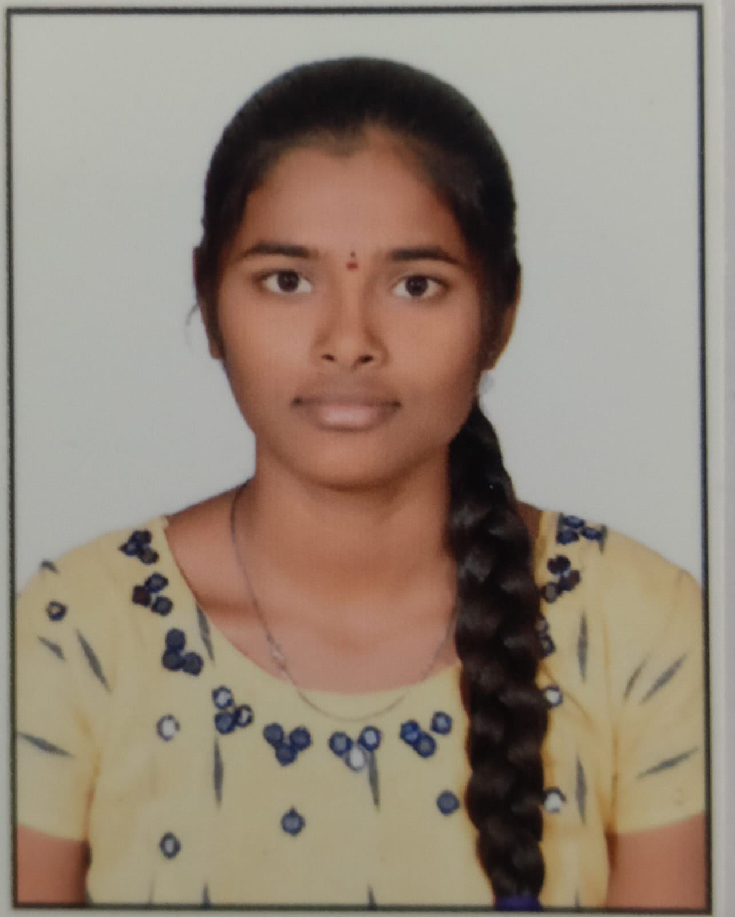
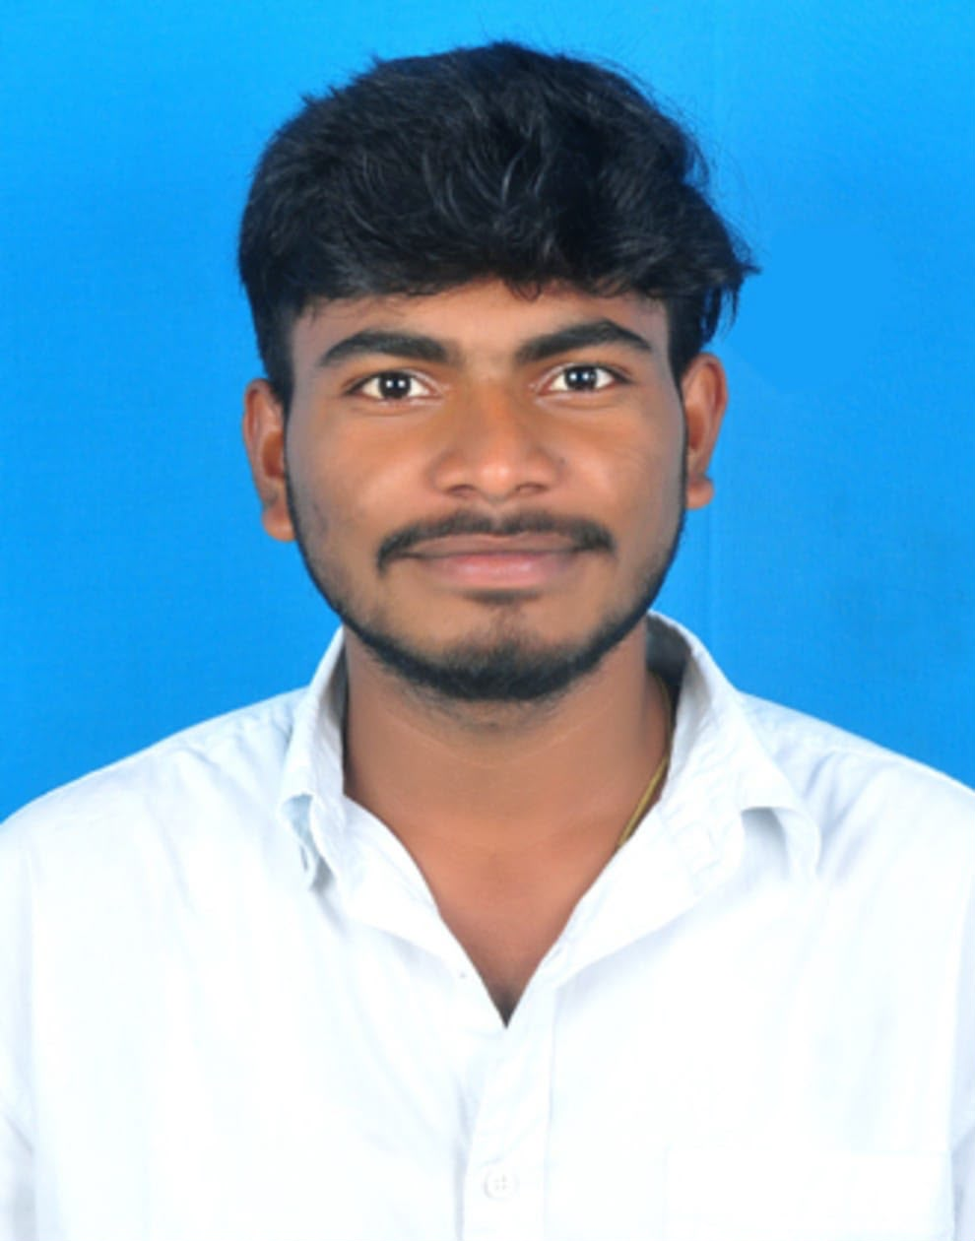



KOMMURI PRATAP REDDY
INSTITUTE OF TECHNOLOGY
M.Sushmitha
DEPARTMENT OF COMPUTER SCIENCE & ENGINEERING
A.Prem Kumar
Thank You
For Your Valuable Attention
D. Yugender
Guide: Mr. M. Rakesh • Section: C • Review-II
IV B.Tech CSE | A.Y. 2026–2027
R. Vinay

