Slide 1
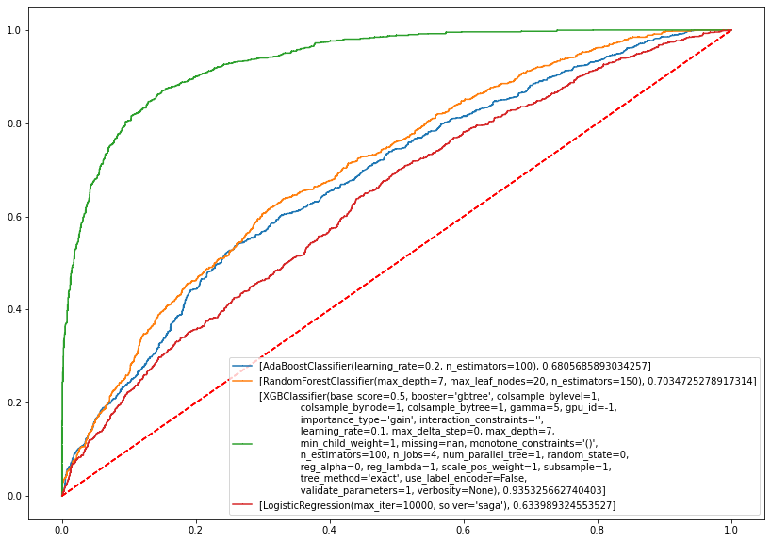
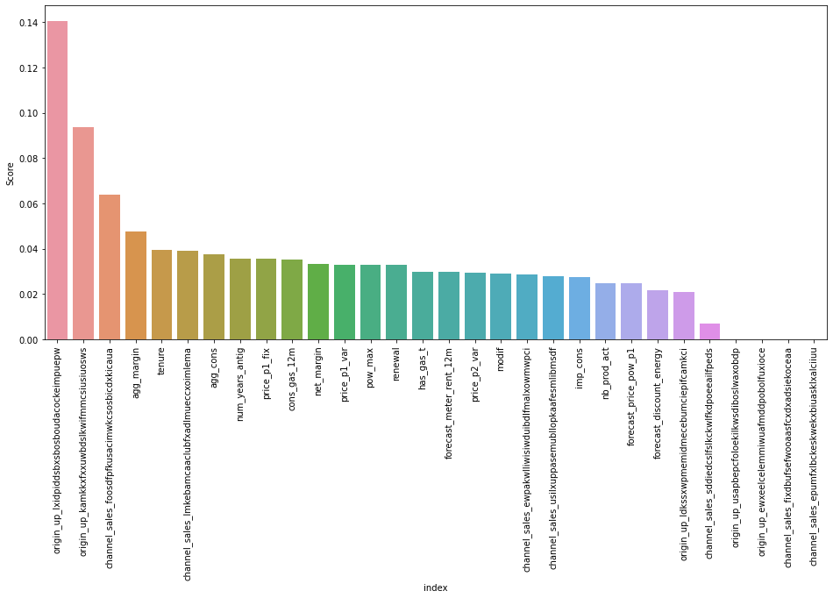
Insight 1
Gross/Net Margin on power Subscription , tenure and consumption are the important numeric features to looks on, as well as our most important features stand out as electricity campaign customer first subscribed to and channel of sales as the most important features
Insight 2
XGB model fabricated found out to have .93 ROC score , effectively identifying our Churn (fi score .86)
Insight 3
H0: 20% discount is ineffective
Ha: 20 % discount is effective
We have observed that 20 percent discount has no effect on the churning , hence proposing more effort on subscription campaign and sales channel should be more effective

