Slide 1
Phase 3B: Multi-Task Neural PK-PD with Neural ODE
Technical deep dive | 18-slide deck

Slide 2
Agenda
Problem framing and motivation for a unified model.
Theory behind multi-task learning and Neural ODE dynamics.
Data construction and feature schema across tasks.
Detailed architecture, loss design, and training protocol.
Results interpretation, risks, and next experimental plan.

Slide 3
Problem Framing
Drug programs require simultaneous modeling of efficacy and ADMET endpoints.
Single-task pipelines underuse transferable molecular information.
PK-PD decisions require interpretable trajectory behavior, not only endpoint scores.
Goal: combine predictive power and mechanistic consistency in one stack.

Slide 4
Why Multi-Task Learning
A shared encoder transfers supervision across related endpoints.
Hard sharing regularizes low-sample tasks and can improve robustness.
Task-specific heads preserve endpoint-specific decision boundaries.
This architecture balances generalization and specialization.

Slide 5
Why Neural ODE
PK concentration behavior is naturally continuous-time.
Neural ODE permits trajectory queries at any time grid.
Dynamics can embed mechanistic priors such as first-order elimination.
This improves plausibility versus purely discrete latent updates.

Slide 6
Data Pipeline Overview
Phase 3A processed artifacts and bridge outputs are loaded reproducibly.
Task arrays are split into train, validation, and test partitions.
DataLoaders are rebuilt per task with consistent batch semantics.
Scaling preserves differences between regression and classification targets.

Slide 7
Feature Space Details
Input vector combines descriptors, fingerprints, and docking_quality.
One unified input dimension is maintained for all four tasks.
Structure-derived docking signal is injected into downstream learning.
Consistent schema enables strict encoder sharing across tasks.

Slide 8
Structure-to-Binding-to-PK Bridge
RapidDock geometry quality is aggregated at protein-target level.
Binding samples receive target-informed docking_quality augmentation.
Other ADMET tasks are zero-padded to preserve shared schema.
Bridge design injects structural signal without task-format drift.

Slide 9
Shared Encoder Architecture
Block 1: Linear(input_dim, hidden_dim) + LayerNorm + ReLU + Dropout.
Block 2 repeats hidden transformation for richer nonlinear features.
Projection layer maps hidden representation to latent_dim.
LayerNorm is preferred over BatchNorm for interleaved task batches.

Slide 10
Model Hyperparameters
Architecture: input_dim, hidden_dim, latent_dim, dropout.
Head capacity: reg_head_hidden and reg_head_dropout for binding.
Optimization: learning_rate, weight_decay, batch_size, epochs, patience, grad_clip.
Loss: task weights, focal_gamma, and class positive weights.
Data split: test_size, val_size, and fixed random seed.

Slide 11
Why This Architecture Was Chosen
Shared encoder + task heads balances transfer and endpoint specialization.
LayerNorm was selected for stable interleaved multi-task training.
A deeper binding head addresses harder regression complexity.
Logits-based heads support stable optimization and calibration.
Neural ODE adds mechanistic PK trajectories, not only scalar predictions.

Slide 12
Task Heads
DeepRegressionHead is used for the harder binding regression task.
RegressionHead is used for clearance prediction.
ClassificationHead produces logits for hERG and Caco-2.
Head-level asymmetry matches endpoint complexity and data profile.

Slide 13
PKODEFunc Internals
Latent representation predicts PK parameters CL and V.
Exponentiation enforces positive-valued pharmacokinetic parameters.
Elimination rate is defined as k = CL / V.
Dynamics follow dC/dt = -kC and are integrated over time.

Slide 14
Training Protocol
Train/validation/test splits are prepared task-wise.
Training interleaves task updates inside each epoch.
Minimum-batch scheduling avoids repeated oversampling of small tasks.
Gradient clipping is applied each optimization step for stability.

Slide 15
Loss Design
Objective is a weighted sum across all tasks.
MSE is used for binding and clearance regression.
Weighted BCE-with-logits or focal logits is used for classification.
Positive-class weighting mitigates imbalance effects.

Slide 16
Optimization and Early Stopping
Adam optimizer is used with weight decay regularization.
ReduceLROnPlateau adapts learning rate from validation behavior.
Early stopping monitors aggregated validation loss with patience.
Best checkpoint is persisted for reproducible handoff.

Slide 17
Evaluation Protocol
Regression quality is tracked with RMSE, MAE, and R2.
Classification quality is tracked with AUROC, accuracy, and F1.
Decision thresholds are selected on validation using Youden criterion.
Task-level targets support consistent go/no-go monitoring.

Slide 18
Architecture Blocks Table
Module | Inputs | Computation | Output | Purpose
SharedEncoder | features | 2x Linear+LayerNorm+ReLU+Dropout | latent | Shared molecular representation
DeepRegressionHead | latent | 2 hidden layers + dropout | binding score | Harder regression task
RegressionHead | latent | Compact MLP | clearance score | Stable regression mapping
ClassificationHead | latent | MLP logits | hERG/Caco-2 logits | Binary endpoints
PKODEFunc | latent + C(t) | predict CL,V -> k; dC/dt=-kC | PK curve | Mechanistic PK dynamics

Slide 19
Loss and Weighting Table
Task | Loss | Weight | Class Handling | Why
Binding | MSE | w_binding=1.8 | N/A | Primary efficacy regression
hERG | BCE/Focal logits | w_herg=1.0 | pos_weight + focal | Safety class imbalance
Caco-2 | BCE/Focal logits | w_caco2=2.0 | pos_weight + focal | Permeability emphasis
Clearance | MSE | w_clearance=1.0 | N/A | PK endpoint accuracy
Physics | Penalty term | w_physics=0.1 | N/A | Monotonic/non-negative PK curves

Slide 20
Hyperparameter Table Snapshot
Hyperparameter | Value | Role | Expected Impact
input_dim | 2051 | Input feature width | Capacity and memory footprint
hidden_dim | 128 | Shared encoder width | Representation power vs overfit risk
latent_dim | 64 | Latent bottleneck size | Compression vs transfer
dropout | 0.2 | Encoder regularization | Generalization stability
batch_size | 64 | Batch granularity | Gradient stability / throughput
learning_rate | 1e-3 | Optimizer step size | Convergence speed and stability
weight_decay | 1e-4 | L2 regularization | Prevents parameter blow-up
patience | 40 | Early stopping tolerance | Avoids premature stopping
grad_clip | 1.0 | Gradient clipping threshold | Prevents exploding gradients
focal_gamma | 2.0 | Focal loss focus | Emphasizes hard samples

Slide 21
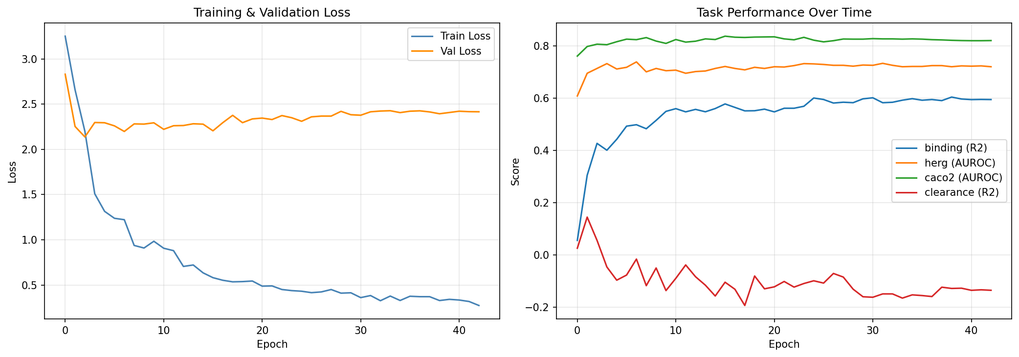
Training Dynamics
Loss curves characterize convergence and potential overfitting gap.
Task metric trends identify faster and slower learning tasks.
Plateau points indicate where task-specific fine-tuning is needed.

Slide 22
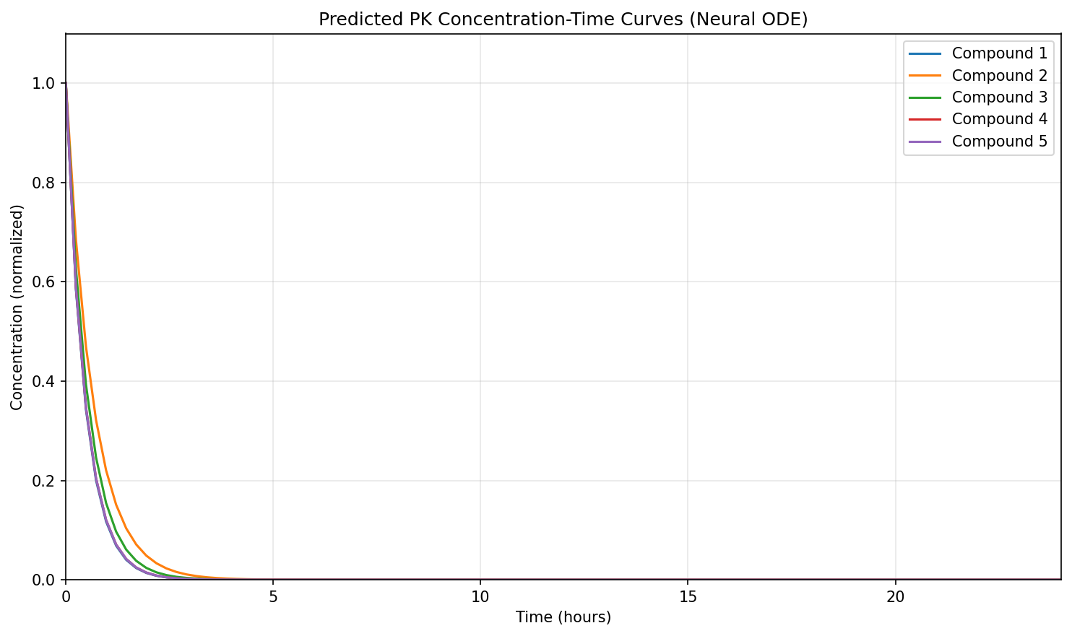
Neural ODE PK Curves
Curves are generated from continuous-time ODE integration.
Monotonic decay aligns with first-order elimination assumptions.
Inter-compound variation reflects inferred CL and V differences.

Slide 23
Summary and Next Work
Phase 3B delivers a complete and reproducible baseline pipeline.
Main technical risks are task interference, imbalance sensitivity, and threshold dependence.
Phase 3C will focus on targeted fine-tuning, loss-weight sweeps, and calibration.
The current system is ready for controlled optimization rather than redesign.

