Slide 1
RapidDock Paper-Aligned Prototype
Copy-paste-ready technical deck | structure-aware PK-PD bridge

Slide 2
Motivation and Research Gap
QSAR-only approaches miss explicit 3D geometry.
Docking outputs are often disconnected from downstream PK-PD models.
Need an interpretable structure -> binding -> PK-PD bridge.

Slide 3
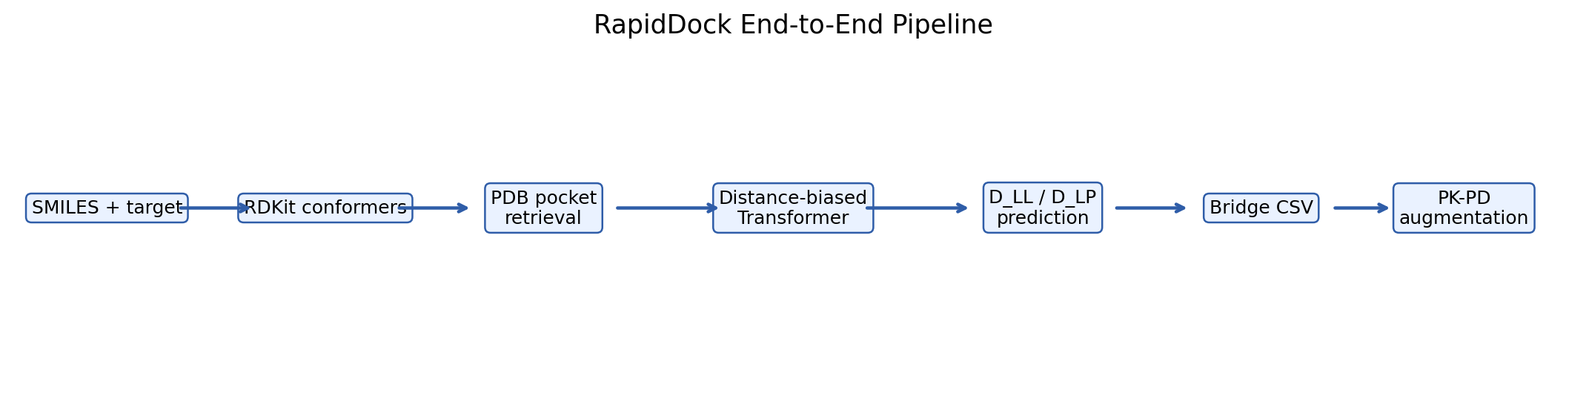
End-to-End Pipeline Diagram
Pipeline from SMILES and PDB pocket context to PK-PD feature augmentation.

Slide 4
Data Sources and Assumptions
Component | Source | In Prototype | Why
Ligand identity | ChEMBL | Real | Real medicinal chemistry input
Ligand 3D | RDKit MMFF | Generated | Fast reproducible geometry
Protein pocket | RCSB PDB | Real if mapped | Target-aware context
Protein features | Synthetic | Placeholder | Keep prototype runnable

Slide 5
Distance-Biased Transformer Theory
Attention score = QK^T/sqrt(d_h) - alpha * D_joint.
Distance bias encourages local geometric interactions.
Model predicts ligand-ligand and ligand-protein squared distances.

Slide 6
Architecture Blocks
Block | Input | Operation | Output | Purpose
Token projection | lig/prot features | Linear + type embed | joint tokens | Unify modalities
DB-MHA | tokens + D_joint | distance-biased attention | context tokens | Geometry-aware mixing
FFN | context tokens | MLP + residual | refined tokens | Nonlinear transformation
Distance heads | lig/prot token slices | squared distance compute | D_LL^2, D_LP^2 | Stable targets

Slide 7
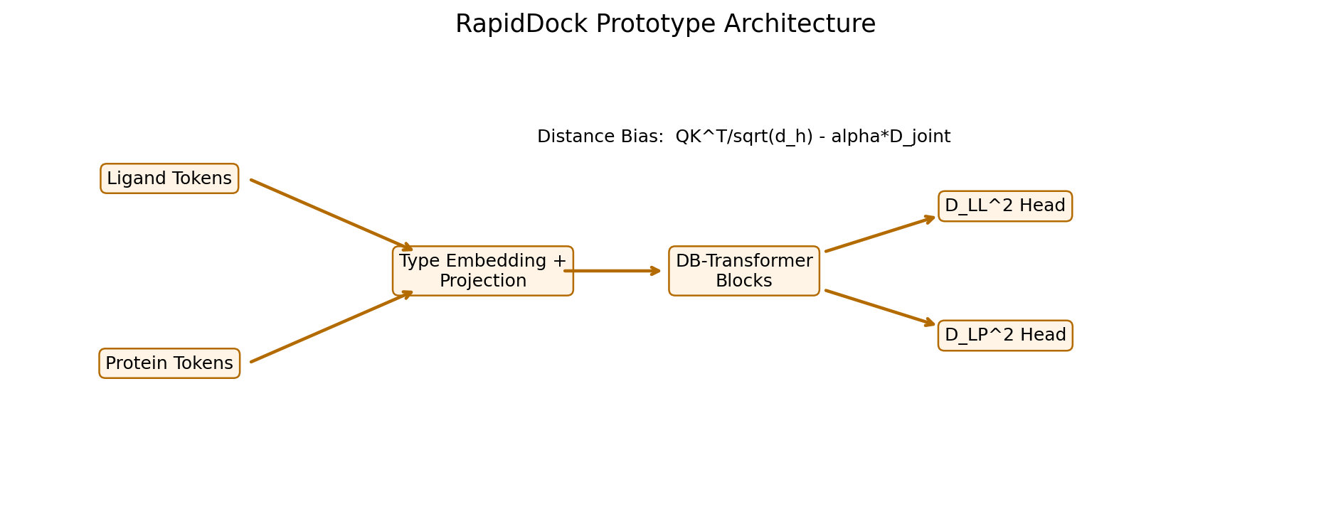
Architecture Diagram
Joint token encoder with distance-biased transformer blocks and dual distance heads.

Slide 8
Symmetry-Aware Loss
Repeated atom types create equivalent index permutations.
Evaluate candidate permutations and select minimum loss.
Backprop only on best permutation to respect molecular symmetry.

Slide 9
Training Setup
Item | Setting
Epochs | 50
Optimizer | Adam
LR schedule | CosineAnnealingLR (1e-3 to 1e-5)
Gradient clipping | 1.0
Checkpoint | best validation loss

Slide 10
Reconstruction Objective (L-BFGS)
Reconstruct ligand coordinates from predicted distances and fixed protein points.
Optimize coordinate set to match D_LL and D_LP under robust distance objective.
Evaluate with raw RMSD and Kabsch-aligned RMSD.

Slide 11
Reconstruction Metrics
Metric | Meaning | Use
Raw RMSD | Direct coordinate error | Absolute geometric fit
Kabsch RMSD | Alignment-invariant error | Shape fidelity
CDF thresholds | Fraction below 1/2/3A | Quality distribution

Slide 12
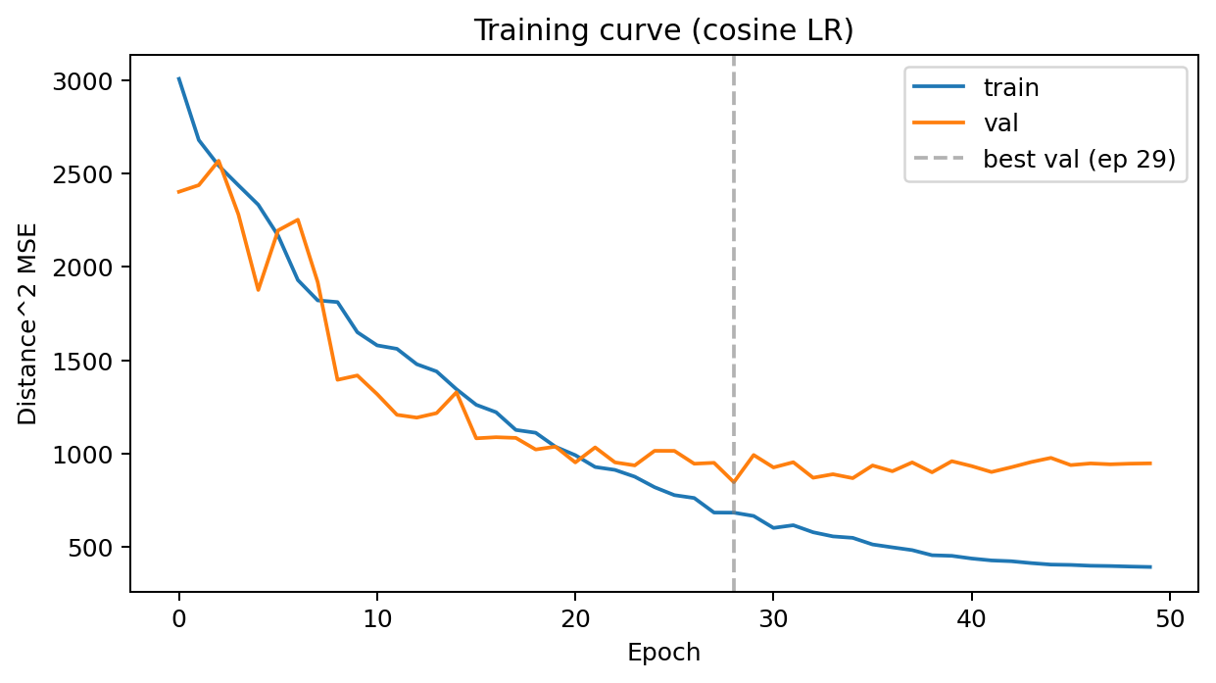
Training Curve (Runtime)
Training and validation distance-squared MSE across epochs.

Slide 13
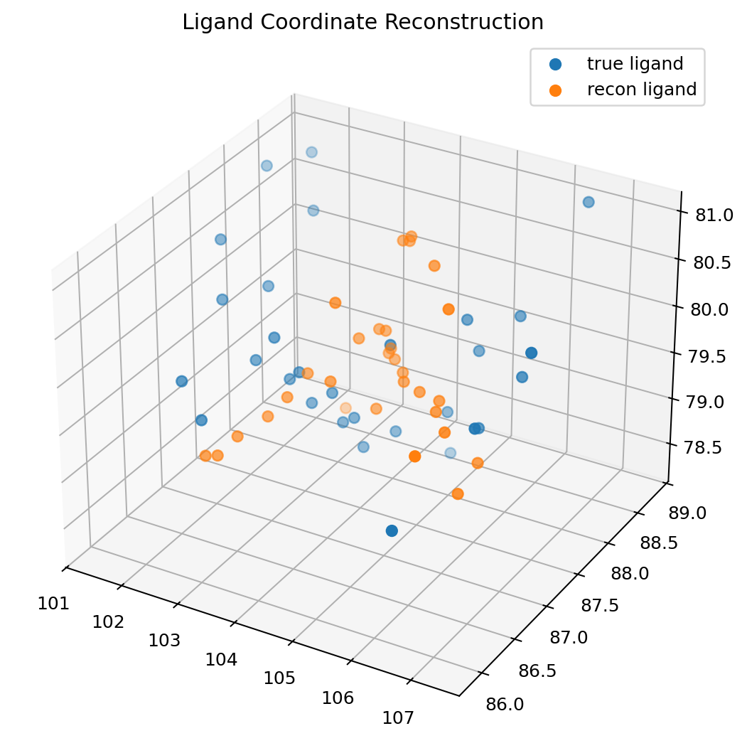
Ligand Reconstruction Scatter (Runtime)
3D comparison of true ligand coordinates and reconstructed coordinates.

Slide 14
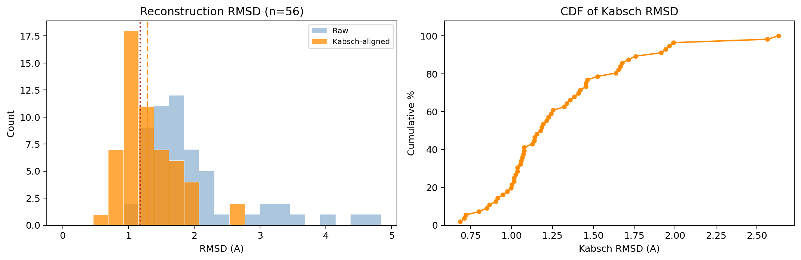
RMSD Histogram and CDF (Runtime)
Distribution-level reconstruction quality using Kabsch-aligned RMSD.

Slide 15
Structure-to-Binding Bridge
docking_score = mean predicted ligand-protein distance.
docking_quality = -docking_score for higher-is-better interpretation.
Correlate docking score with measured pChEMBL globally and per-target.

Slide 16
Bridge Dataset Schema
Field | Definition | Direction
target_chembl_id | Target identifier | categorical
pchembl_value | Measured affinity | higher is better
docking_score | Mean predicted L-P distance | lower is better
docking_quality | -docking_score | higher is better
real_pocket | PDB-backed context flag | boolean

Slide 17
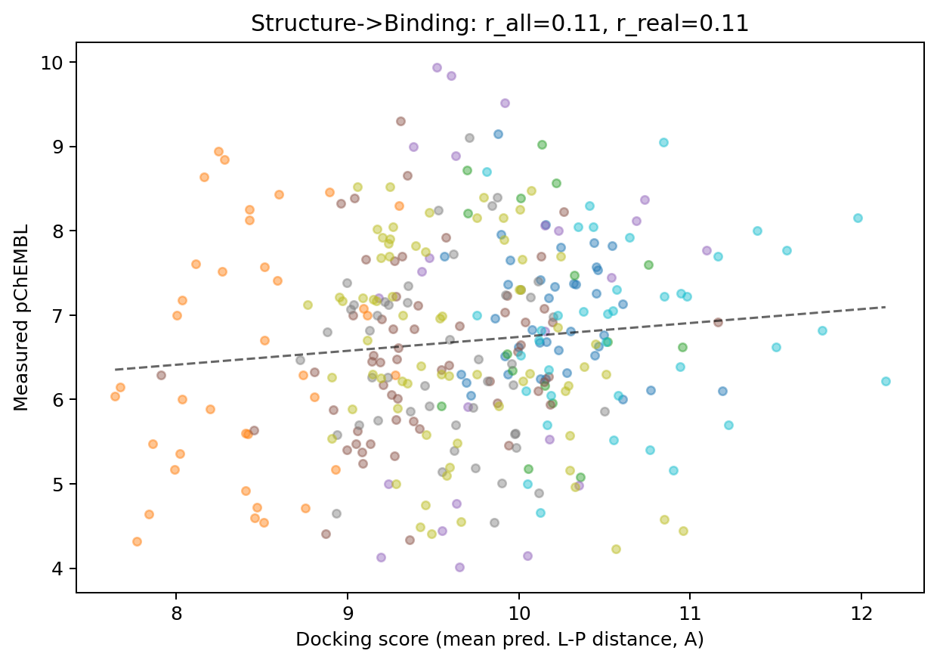
Bridge Correlation Plot (Runtime)
Docking score versus pChEMBL with per-target visual separation.

Slide 18
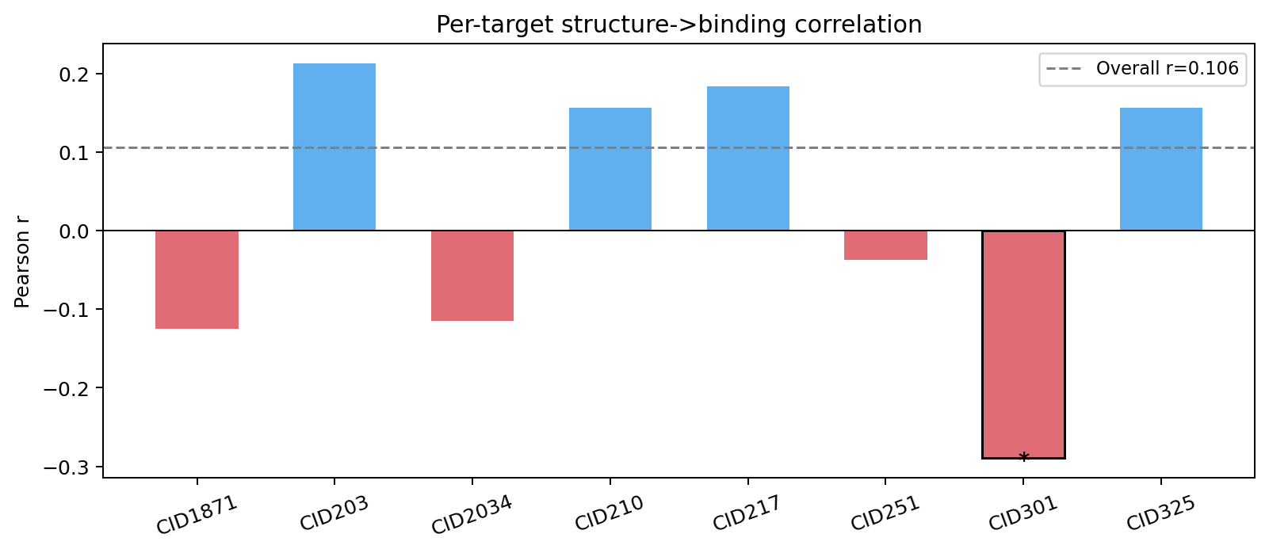
Per-Target Correlation Plot (Runtime)
Target-level Pearson correlation summary for structure-to-binding signal.

Slide 19
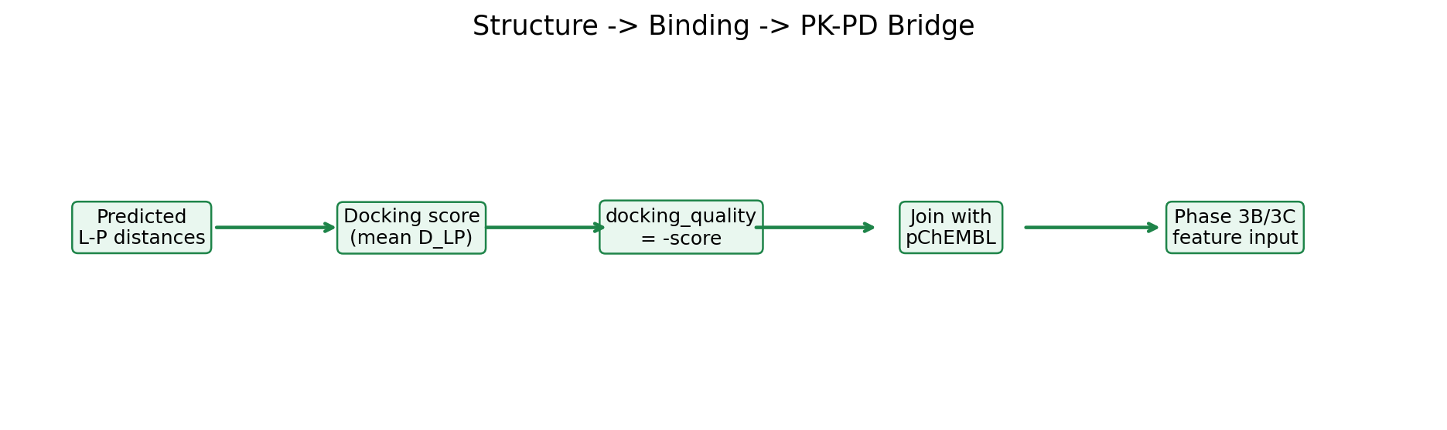
PK-PD Integration Diagram
Bridge from predicted geometric signal to binding and downstream PK-PD model features.

Slide 20
Limitations and Upgrade Path
Limitation | Current | Risk | Upgrade
Protein features | Random vectors | Missing residue signal | ESM-2 embeddings
Pose realism | Conformer translation | Geometry gap | Vina/DiffDock
Atom encoding | simple one-hot type | low chemistry richness | richer atom features
Scale | lightweight | underfitting complex regimes | larger model/training

Slide 21
Key Takeaways
Prototype preserves core RapidDock geometry-learning ideas.
Produces actionable bridge artifact: structure_binding_pkpd_bridge.csv.
Enables structure-informed features for downstream Neural ODE PK-PD model.

