Slide 1
DPRPy 2022/2023
Homework Assignment# 3
By: Sushree Smaranika Pradhan

Slide 2
Dataset
In this assignment below data set has been used
Android.stackexchange.com.7z (link)
Aviation.stackexchange.com.7z (link)
Health.stackexchange.com.7z (link)
Note: All data files are downloaded from https://archive.org/details/stackexchange

Slide 3
Dataset Description
This is an anonymized dump of all user-contributed content on the Stack Exchange network. Each site is formatted as a separate archive consisting of XML files zipped via 7-zip. Each site archive includes below data points
Posts
Users
Votes
Comments
PostHistory
PostLinks
Badges
Tags

Slide 4
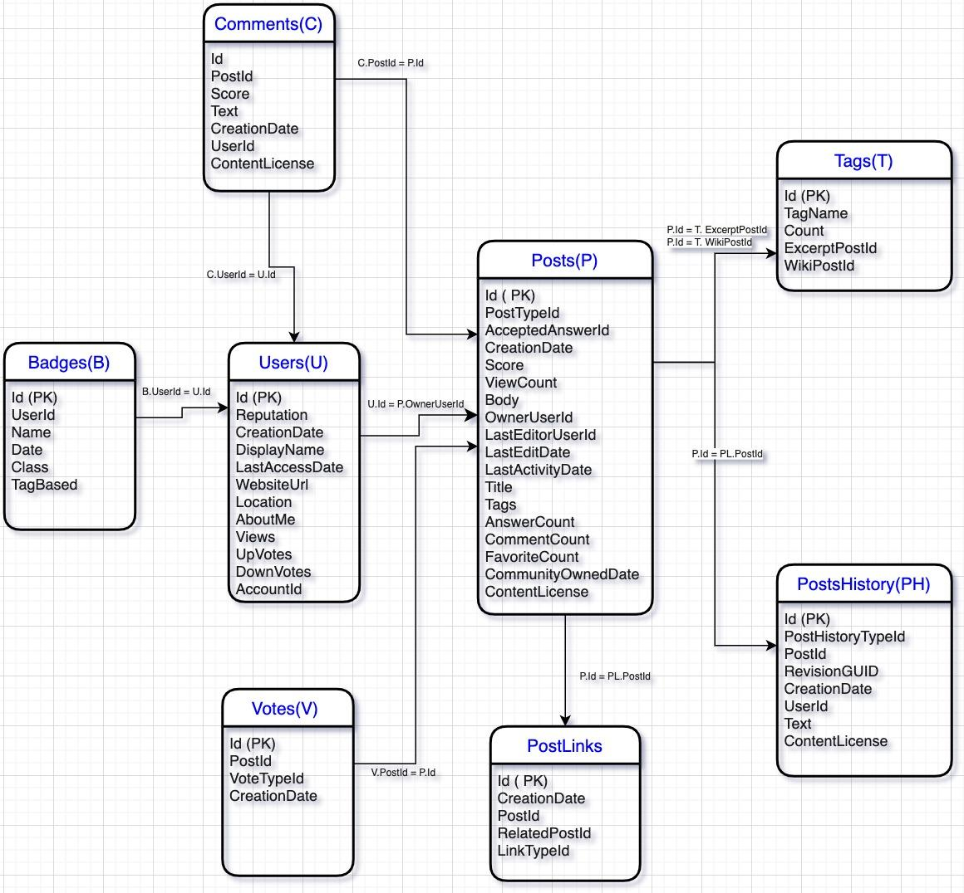
Dataset Relationship Diagram

Slide 5
Libraries used
Library Name | Uses
numpy | Numerical Python
matplotlib.pyplot | Graphical Plotting library
xml.etree.ElementTree | Xml file parsing library
pandas | Python Data Analysis library
os | Operating System

Slide 6
User Defined Functions
Function | Uses
xml_2_dataframe | It parses the xml file and load the data into panda dataframe
read_xml_files | It will generate the a dictionary of dataframes from the xml files present with the data directory

Slide 7
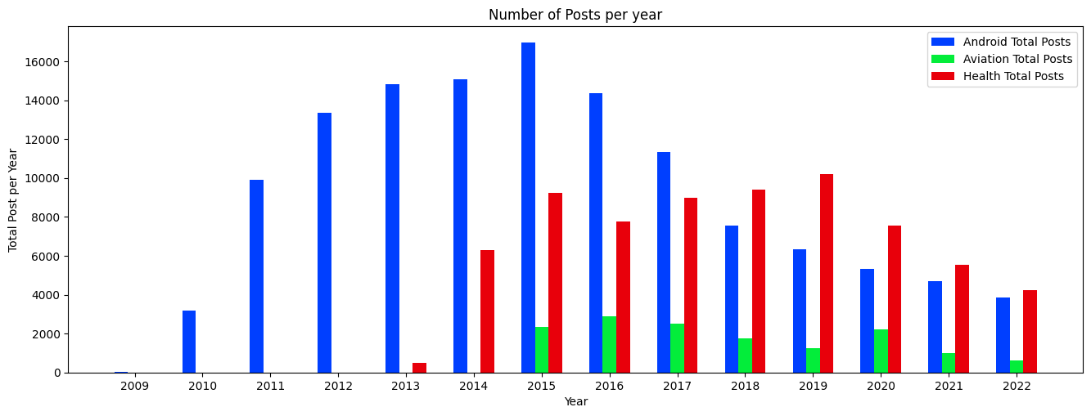
Data Analysis on Posts Datasets
Goal: Identify the Number of Posts over the years
Conclusion: Most of the Posts created in 2015 for Android, 2019 for Health and 2016 for Aviation. And the overall trend the number of Posts are reducing over the years.

Slide 8
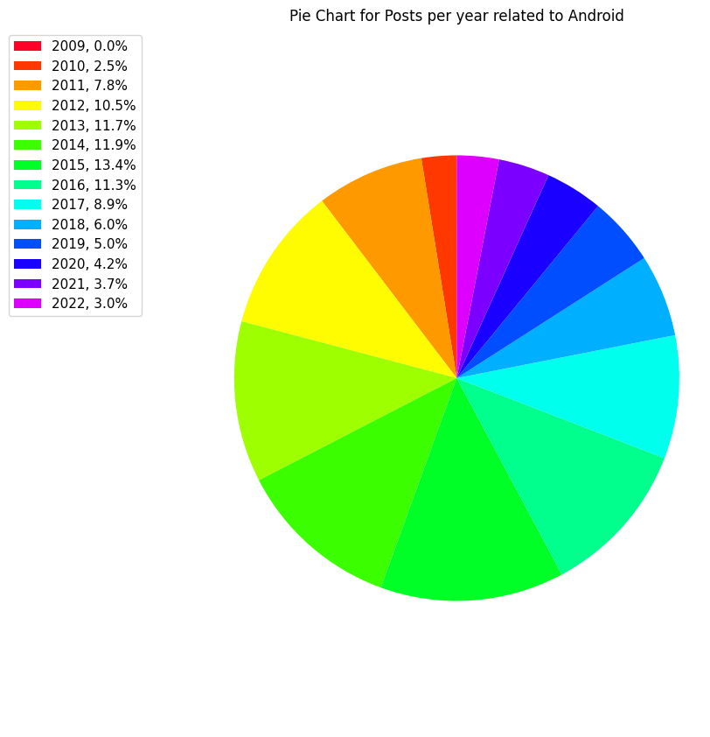
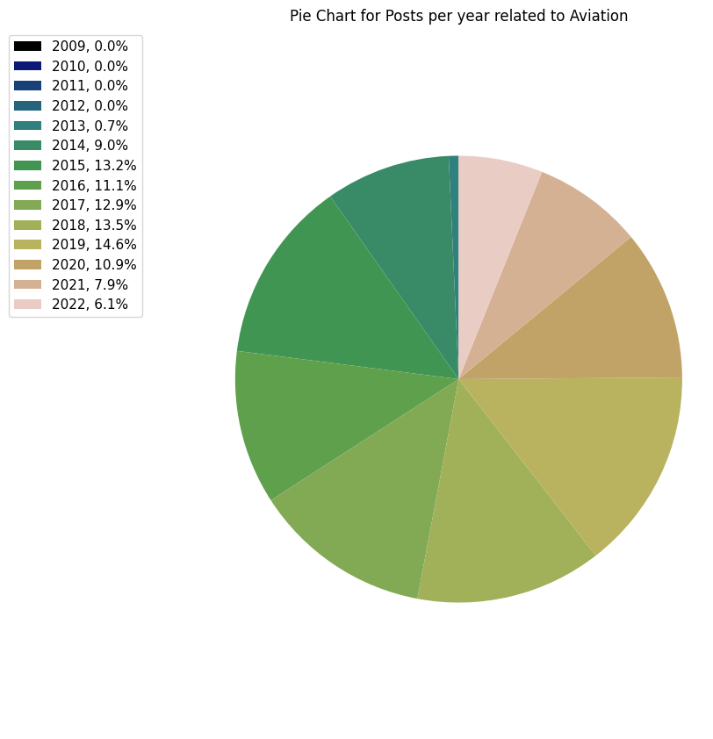
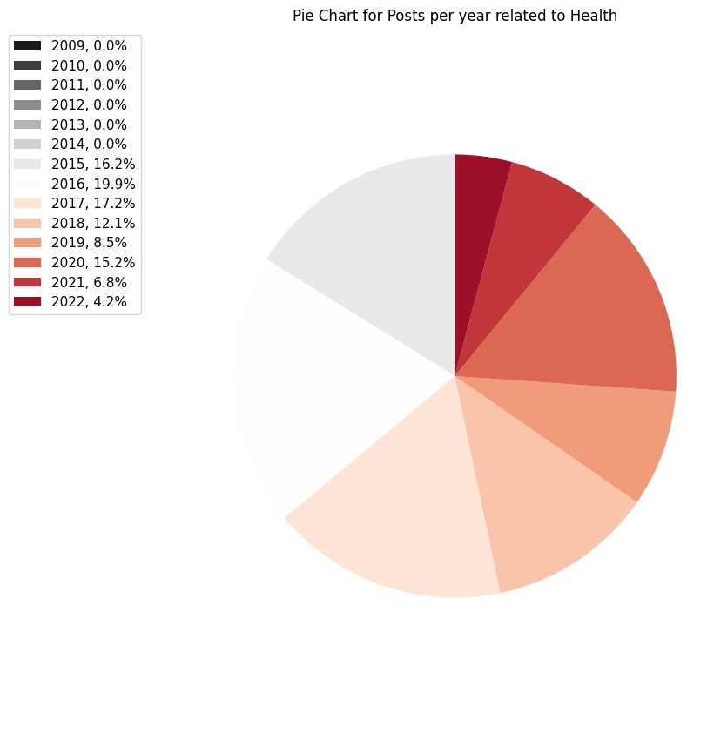
Data Analysis on Posts Datasets
Goal: Represent the dataset in pie chart

Slide 9
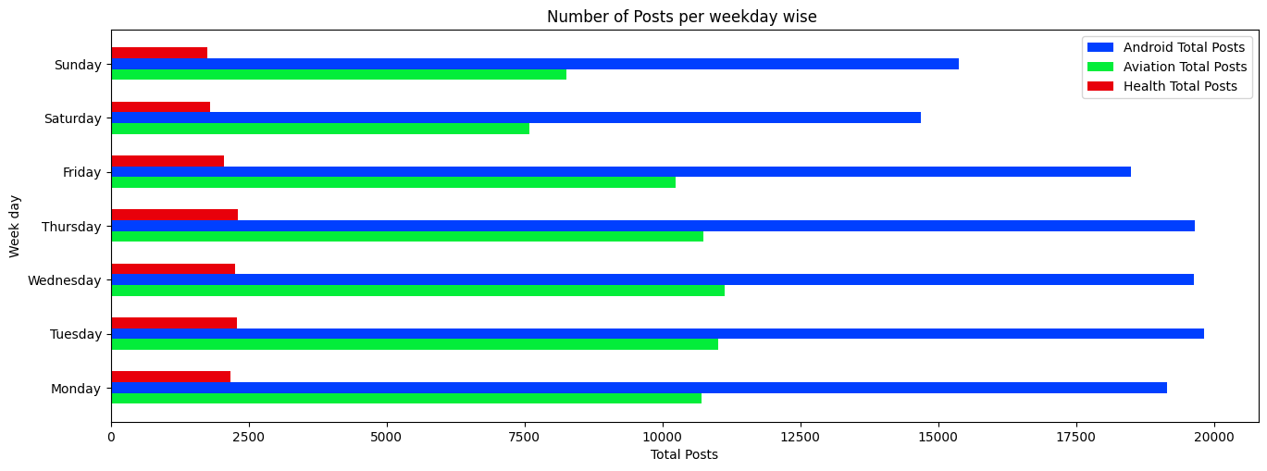
Data Analysis on Posts datasets
Goal: Identify the Number of Posts over weekdays
Conclusion: There are less number of Posts in weekend as compared to week days

Slide 10
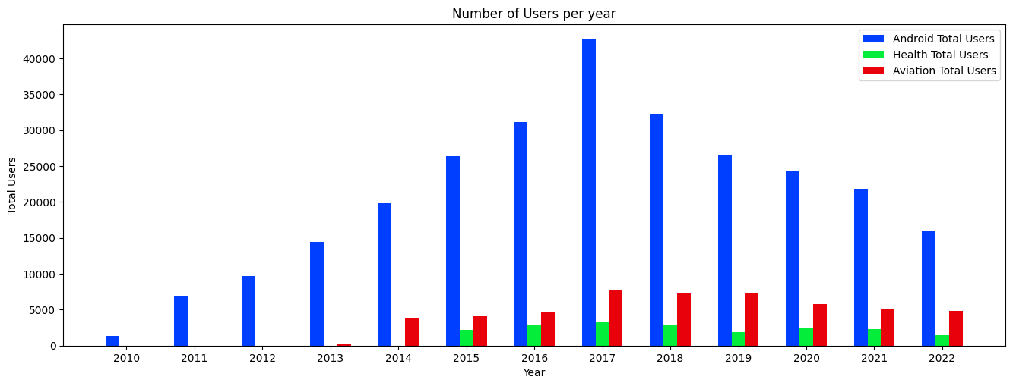
Data Analysis on Users datasets
Goal: Identify the Number of Users created over the Year
Conclusion: Most of the users created in 2017 for Android, Health and Aviation.

Slide 11
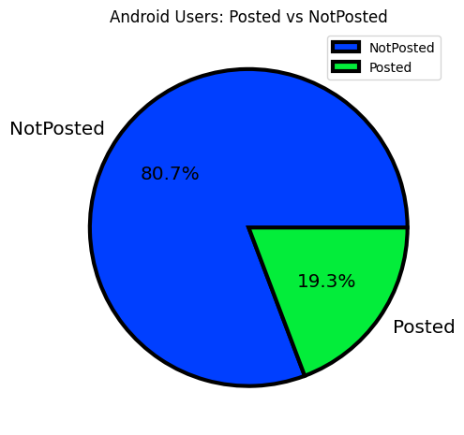
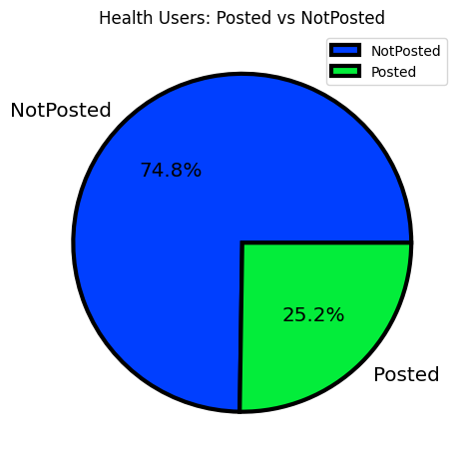
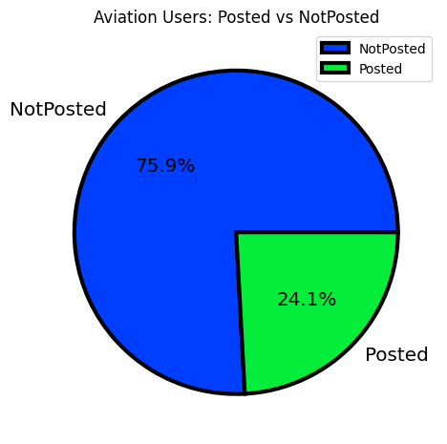
Data Analysis on Users datasets
Goal: Pie chart for Number of users who Posted vs Not-Posted in the Portal

Slide 12
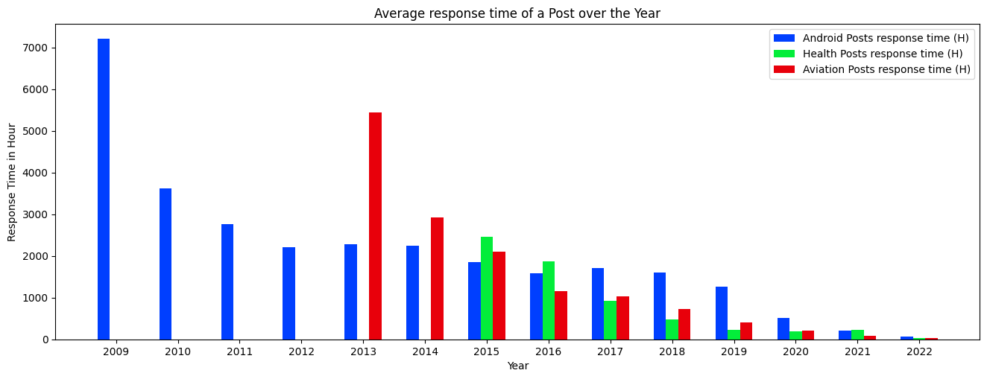
Data Analysis on Comments vs Posts
Goal: Identify the avg response time of a post over the year
Conclusion: From the analysis it has been observed that the response time of a post is reducing over the time.

Slide 13
Thank You !!

