Slide 1
MAVEN MOVIES DATABASE ANALYSIS
Presented by:
Sushree Deepa Jena
S7615

Slide 2
OBJECTIVE:
To analyze rental trends, identify popular films, and assess store performance using the Maven Movies Sakila database.
1. Rental Trends:
Analyze the monthly rental trends over the available data period.
Determine the peak rental hours in a day based on rental transactions.
2. Film Popularity:
Identify the top 10 most rented films.
Determine which film categories have the highest number of rentals.
3. Store Performance:
Identify which store generates the highest rental revenue.
Determine the distribution of rentals by staff members to assess performance.

Slide 3
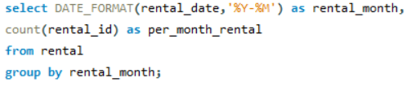
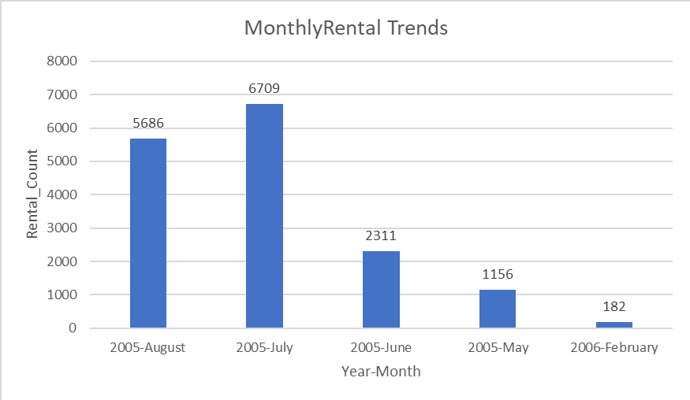
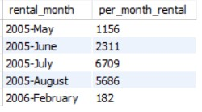
1.1 Analyze the monthly rental trends over the available data period
QUERY:
OUTPUT:

Slide 4
FINDINGS:
Rentals increased steadily between May and July of 2005.
July saw the highest rental count of 6709, while February had the lowest count of 182.
A decline in rentals over time can be linked to a shift in customer’s preferences.
RECOMMENDATIONS:
Sufficient inventory and workforce management are necessary during peak rental seasons.
We must stay current with the evolving needs of individuals over time.
Customers' current tastes can be ascertained through surveys and feedback forms.

Slide 5
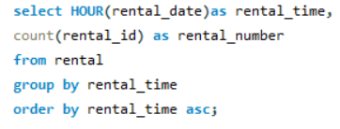
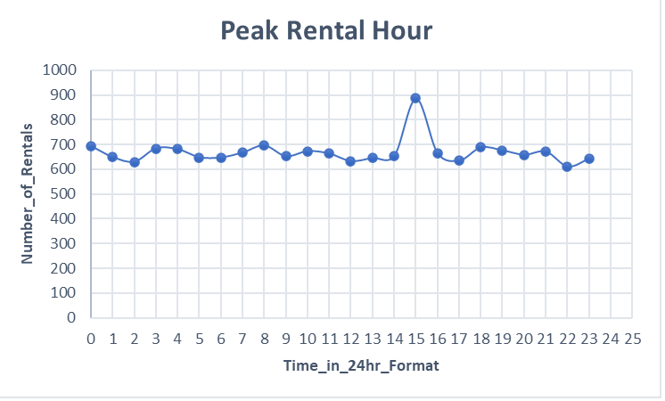
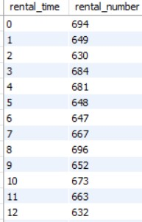
1.2 Determine the peak rental hours in a day based on rental transactions.
QUERY:
OUTPUT:

Slide 6
FINDINGS:
Rentals peak at 3:00 pm, indicating a significant volume of patronage.
The lowest times for rentals are between 5 and 10 p.m.
Between five and ten in the morning, rental prices consistently rise.
RECOMMENDATIONS:
During peak hours, staff members must make sure there is enough inventory.
Reduced rental activity after 5 p.m. indicates that consumers have few options, necessitating improved scheduling throughout the aforementioned window of time.
Consider consumer feedback when making necessary implementations.

Slide 7
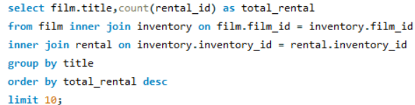
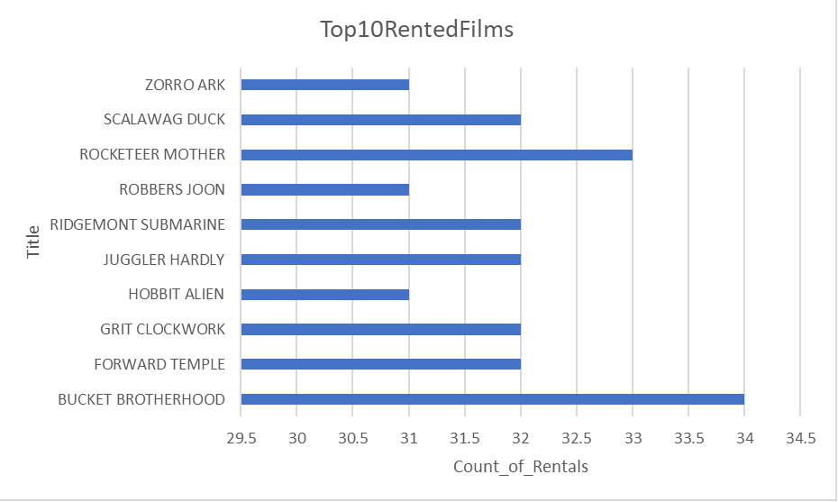
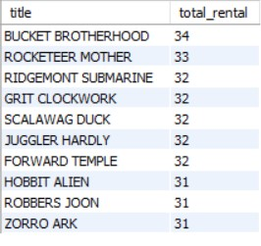
2.1 Identify the top 10 most rented films.
QUERY:
OUTPUT:

Slide 8
FINDINGS:
The least-rented films are Hobbit Alien, Robbers Joon, and Zorro Ark.
The two most often rented films are Rocketeer Mother and Bucket Brotherhood.
Top rented selections indicate that customers like comedy and action/adventure genres.
RECOMMENDATIONS:
Make sure there are enough top-rental movies in stock, particularly in the action-adventure genre.
Use advertising to promote the top ten films in the most sought-after genre.
Create a successful marketing plan and provide feedback.

Slide 9
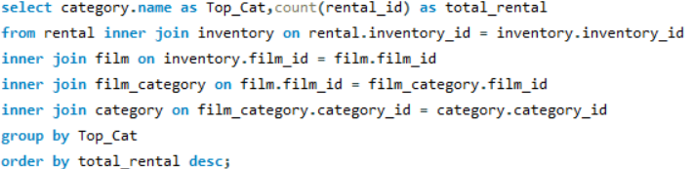
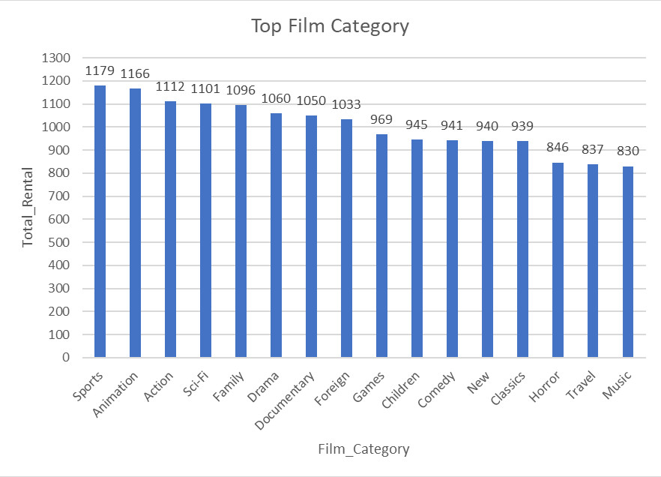
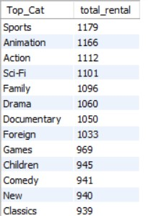
2.2 Determine which film categories have the highest number of rentals.
QUERY:
OUTPUT:

Slide 10
FINDINGS:
The most popular genres to rent are sports and animations, indicating that teens and young adults make up the bulk of the clientele.
Horror and music are two of the least popular genres, indicating that audiences' interest in these films is waning.
RECOMMENDATIONS:
Stock up on the most popular genre movies to satisfy consumer demand.
It is necessary to run targeted marketing strategies to entice consumers to return to less popular genres.

Slide 11
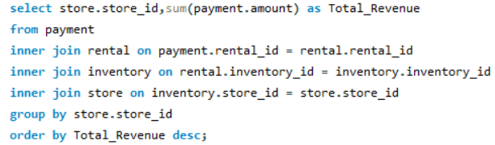
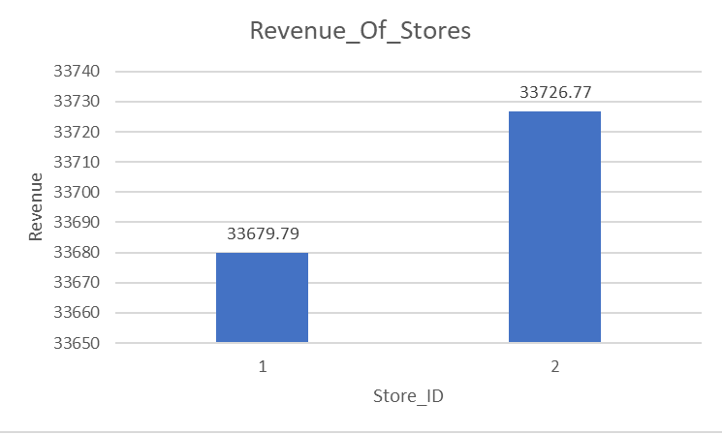

3.1 Identify which store generates the highest rental revenue
QUERY:
OUTPUT:

Slide 12
FINDINGS:
The combined revenue of Stores 1 and 2 is $33679.99 and $33726.77, respectively.
Higher revenue indicates improved staff management of the rental operation by taking pricing strategies and customer base size into account
RECOMMENDATIONS:
Use marketing techniques like discounts and vouchers for loyal customers.
Use marketing tactics inspired by well-known movies to achieve strong rental drives.

Slide 13
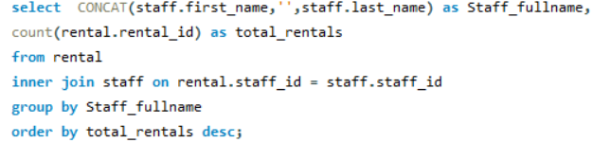
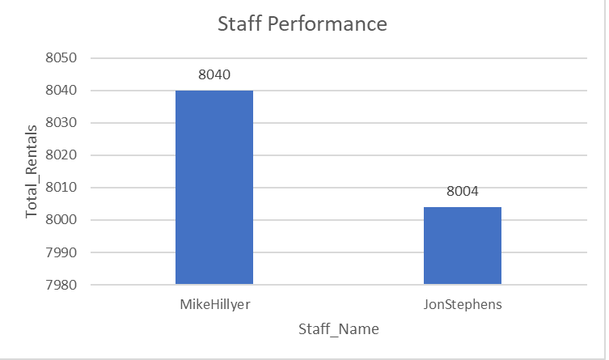

3.2 Determine the distribution of rentals by staff members to assess performance.
QUERY:
OUTPUT:

Slide 14
FINDINGS:
Jon Stephens has a worse rental history than Mike Hillyer.
RECOMMENDATIONS:
Jon Stephens should receive incentives for more sales in addition to receiving updated marketing techniques and retraining.

