Slide 1

EARLY-STAGE ALZHEIMER’S DISEASE PREDICTION USING MACHINE LEARNING
1

Slide 2
GROUP MEMBERS INFORMATION
Mahendra Kumar Reddy Narapureddy (700741313)
Shiny Sherly Katuru (700744314)
Sushrithareddy Sangam (700742861)
Praveena Goli (700743010)

Slide 3
CONTRIBUTIONS and Roles & Responsibilities
Mahendra Kumar Reddy: K- nearest neighbors and working on the website, Data collection and worked on Random Forest.
Shiny sherly katuru: GaussianNaivebayes and working on the website, exploratory data analysis and worked on decision tree. .
Praveen goli: adaboost and working on the website, data visualization and worked on support vector machine.
Sushritha: XG boost and working on the website, comparing the accuracies and worked on logistic regression.

Slide 4
INTRODUCTION
Alzheimer's Disease (AD) is a progressive neurological condition that leads toshort-term memory loss, paranoia, and delusional ideas that are mistaken for theeffects of stress or aging. In the United States, this Disease affects about 5.1 millionpeople. AD does not have proper medical treatment. In order to control AD,continuous medication is necessary. AD (1) is chronic so that it can last for years orthe rest of your life. Therefore, it is most important to prescribe medication at theappropriate stage so that the brain is not damaged to a great extent. Early detectionof this Disease is a tedious and costly process since we must collect a lot of dataand use sophisticated tools for prediction and have an experienced doctor involved.Automated systems are more accurate than human assessment and can be used inmedical decision support systems because they are not subject to human errors.Based on previous research on AD, researchers have applied images (MRI scans), biomarkers (chemicals, blood flow), and numerical data extracted from the MRI scans to study this Disease.

Slide 5

MOTIVATION
Alzheimer’s disease is one of the neurodegenerative disorders .Early diagonosis, can helps to take preventive measures ( changing the life style or medication)
This proposed paper uses ML algorithms to predict Alzheimer’s disease using PSYCHOLOGY PARAMETERS like age, number of visits, MMSE & Education
Diagnosis primarily associated with detecting Mild Cognitive Impairment (MCI)
by extracting Neuroimaging Biomarkers like MRI & PET.
2

Slide 6
OBJECTIVES
Predictions of Alzheimer's disease are
based on Open Access Series of Imaging
Studies (OASIS) data, and performance is
measured with parameters like Precision,
Recall, Accuracy, and F1-score for ML
models. The proposed classification
scheme can be used by clinicians to
make diagnoses of these diseases.

Slide 7
Related work
Implement the algorithms in the real problems by understanding the decision tree algorithm & support vector Machine.
The use of hybrid algorithms and a combination of supervised with unsupervised and ML with DL methods are promising to provide better results.

Slide 8
Problem statement
Implement the algorithms in the real problems by understanding & familiar with the concepts like decision tree algorithm & support vector Machine. Some other insights are drawn from papers that are examined.
Working on different algorithms, to get better accuracy.
Comparing the accuracies and plotting graphically.

Slide 9
Proposed solution
K-NEAREST NEIGHBOURS
SUPPORT VECTOR MACHINE
GAUSSIAN NAÏVE BYES
ADABOOST
XG BOOST
DECISION TREE
RANDOM FOREST
LOGISTIC REGRESSION

Slide 10
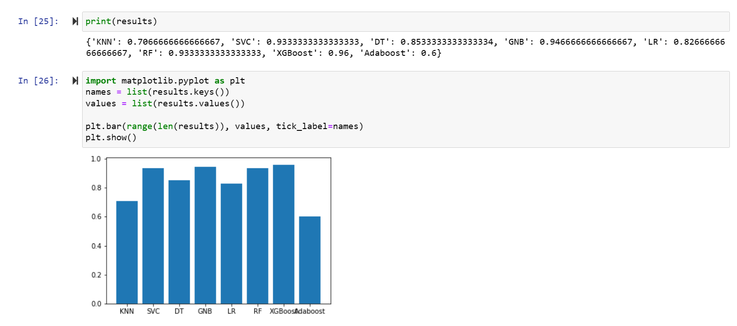
Results & simulations

Slide 11
REFERENCES
[1] G. McKhann, D. Drachman, et al., "Clinical diagnosis of Alzheimer's disease Report of the NINCDS‐ADRDA Work Group* under the auspices of Department of Health and Human Services Task Force on Alzheimer's
Disease," Neurology, vol. 34, pp. 939-939, 1984.
[2] R. Brookmeyer, E. Johnson, K. Ziegler-Graham, and H. M. Arrighi, "Forecasting the global burden of Alzheimer’s disease," Alzheimer's & dementia, vol. 3, pp. 186-191, 2007.
[3] S. Gauthier, B. Reisberg, M. Zaudig, R. C. Petersen, K. Ritchie, et al., "Mild cognitive impairment," The Lancet, vol. 367, pp. 1262-1270, 2006.
[4] E. D. Roberson and L. Mucke, "100 years and counting: prospects for defeating Alzheimer's disease," Science, vol. 314, pp. 781-784, 2006.
[5] Ronghui Ju , Chenhui Hu, Pan Zhou , and Quanzheng Li, “Early Diagnosis of Alzheimer’s Disease Based on Resting-State Brain Networks and Deep Learning”, IEEE/ACM transactions on computational biology and bioinformatics, vol. 16, no. 1, January/February 2019.

Slide 12

32

