Slide 1
ML and Discrete Mathematics Based Satellite Anomaly Detection
Identifying unusual satellite orbital patterns using machine learning and Discrete Mathematics.
Team members:
Sushrut Deshmukh · Shubham Vadar · Nidhi Agrawal · Kushi Wanjari

Slide 2


Problem Statement and Objectives
Problem Statement
Objectives
  The number of satellites and space debris in Low Earth Orbit (LEO) is increasing.
  More objects in orbit make space traffic harder to monitor and increase the possibility of collisions.
  Finding unusual satellite behaviour across a large catalogue is difficult to do manually.
  Analyse satellite orbital data from CelesTrak.
  Use Machine Learning to find satellites with unusual orbital features.
  Use Discrete Mathematics to find unusual relationships between satellites.
  Combine both results to flag satellites for further inspection.

Slide 3

Existing System
Existing Approach
Our Project's Focus
  Satellite tracking systems use orbital data to monitor satellite positions and movements.
  Collision assessment systems use orbital information to estimate potential close approaches.
  These tasks differ from identifying unusual patterns across a satellite catalog.
  It’s expensive to perform an orbital maneuver after a collision probability is detected.
  Examine unusual orbital features and relationships between satellites.
  Combine ML and DM results to identify satellites flagged by one or both methods, rather than relying on a single method
  Provide a dashboard where users can search individual satellites, inspect their results, and understand why they were flagged.

Slide 4
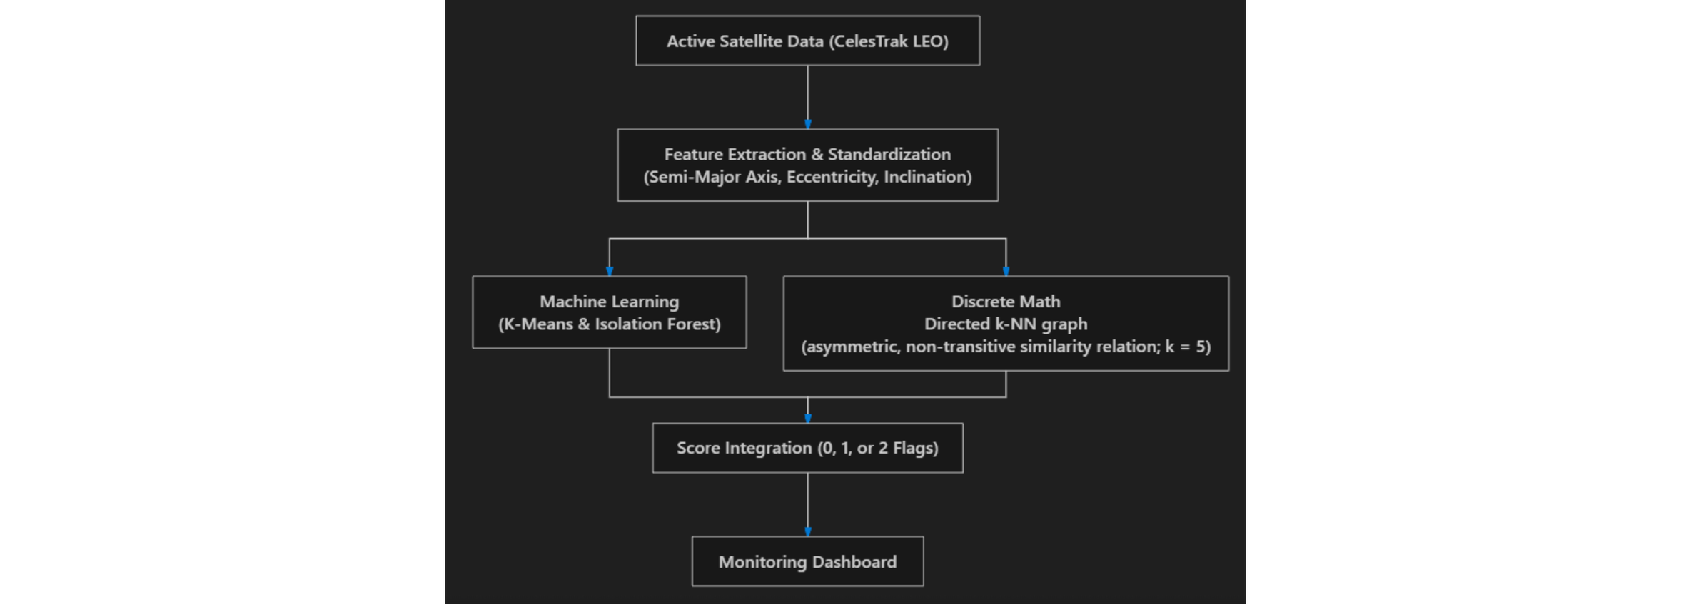
Proposed System Workflow
Diagram 1: System workflow

Slide 5



Machine Learning Analysis
  K-Means: Groups satellites with similar semi-major axis, eccentricity, and inclination.
  Isolation Forest: Identifies satellites that appear unusual within their group.
  ML Flag: Indicates whether the ML detector identified a satellite as unusual.

Slide 6
Discrete Mathematics: Orbital Similarity Graph
  Vertices and edges: Each satellite is a vertex; directed edges connect it to its five nearest orbital-feature neighbours.
  Directed graph: A connection from satellite A to B does not require a reverse connection from B to A.
  Similarity relation: Connections use distance between standardized orbital features, not physical distance in space.
  In-degree: Counts how many other satellites point to a given satellite.
  DM Flag: Flag when in-degree is zero and average distance to the five nearest neighbours is greater than the dataset-wide average.
Directed k-NN graph with a relation that is not necessarily symmetric or transitive.

Slide 7
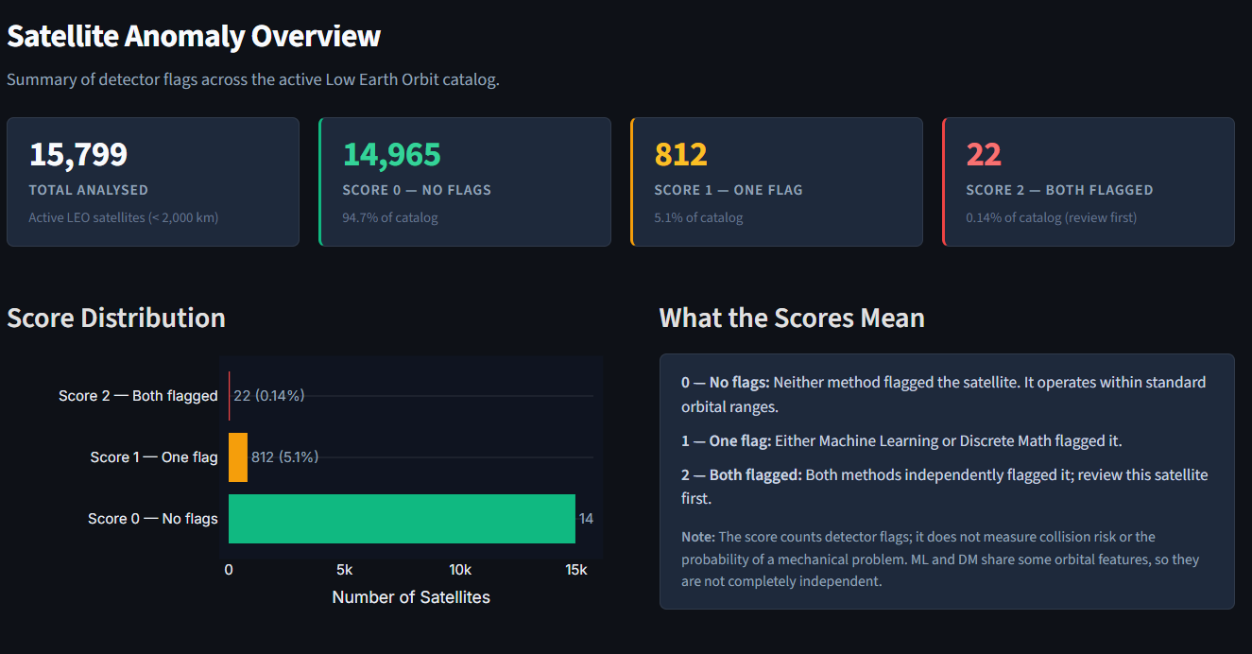
Results and Prototype Application
Diagram 2: Satellite analysis overview

Slide 8
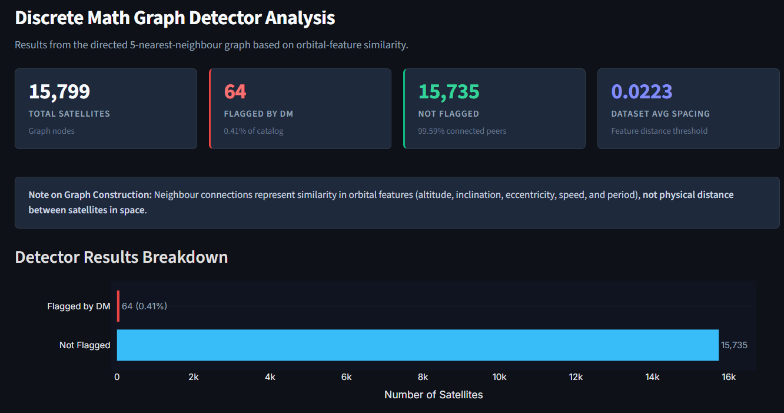
Results and Prototype Application
Diagram 3: Graph based analysis

Slide 9


Limitations and Future Scope
Limitations
Future Scope
  An anomaly flag indicates an unusual pattern, not a confirmed problem.
  The system does not predict collisions or calculate collision probability.
  The two methods use some of the same orbital features, so their results are not fully independent.
  The prototype depends on the available data and selected detection methods.
  Evaluate the methods on additional orbital datasets.
  Improve the way flagged satellites are reviewed and compared.
  Explore additional orbital features and detection methods.

