Slide 1
Agenda
Topics | Time
Microsoft Azure introduction & Architecture | 5 Min
Azure Data Factory introduction Architecture | 5 Min
Azure Data Lake Storage | 5 Min
Azure SQL Datawarehouse/ Database | 5 Min
Azure Analysis Service | 5 Min
Data Bricks | 5 Min
Cosmos Database | 5 Min
Data Security | 5 Min
Known Limitations/ Risks/ Issues | 5 Min
Q&A and Feedback | 10 Min

Slide 2
Microsoft Azure
Microsoft Azure was chosen to be the enterprise analytics tool of choice for Shell due to its integration with Office 365, cost saving capability, and alignment with the market standard/cloud strategy.
Azure supports both PaaS and IaaS.
Azure products and services are designed to meet all needs of business.
Azure can be used as database and application.
Azure supports both ELT (Extract – Transform - Load) and ETL (Extract – Load – Transform) tools.

Slide 3
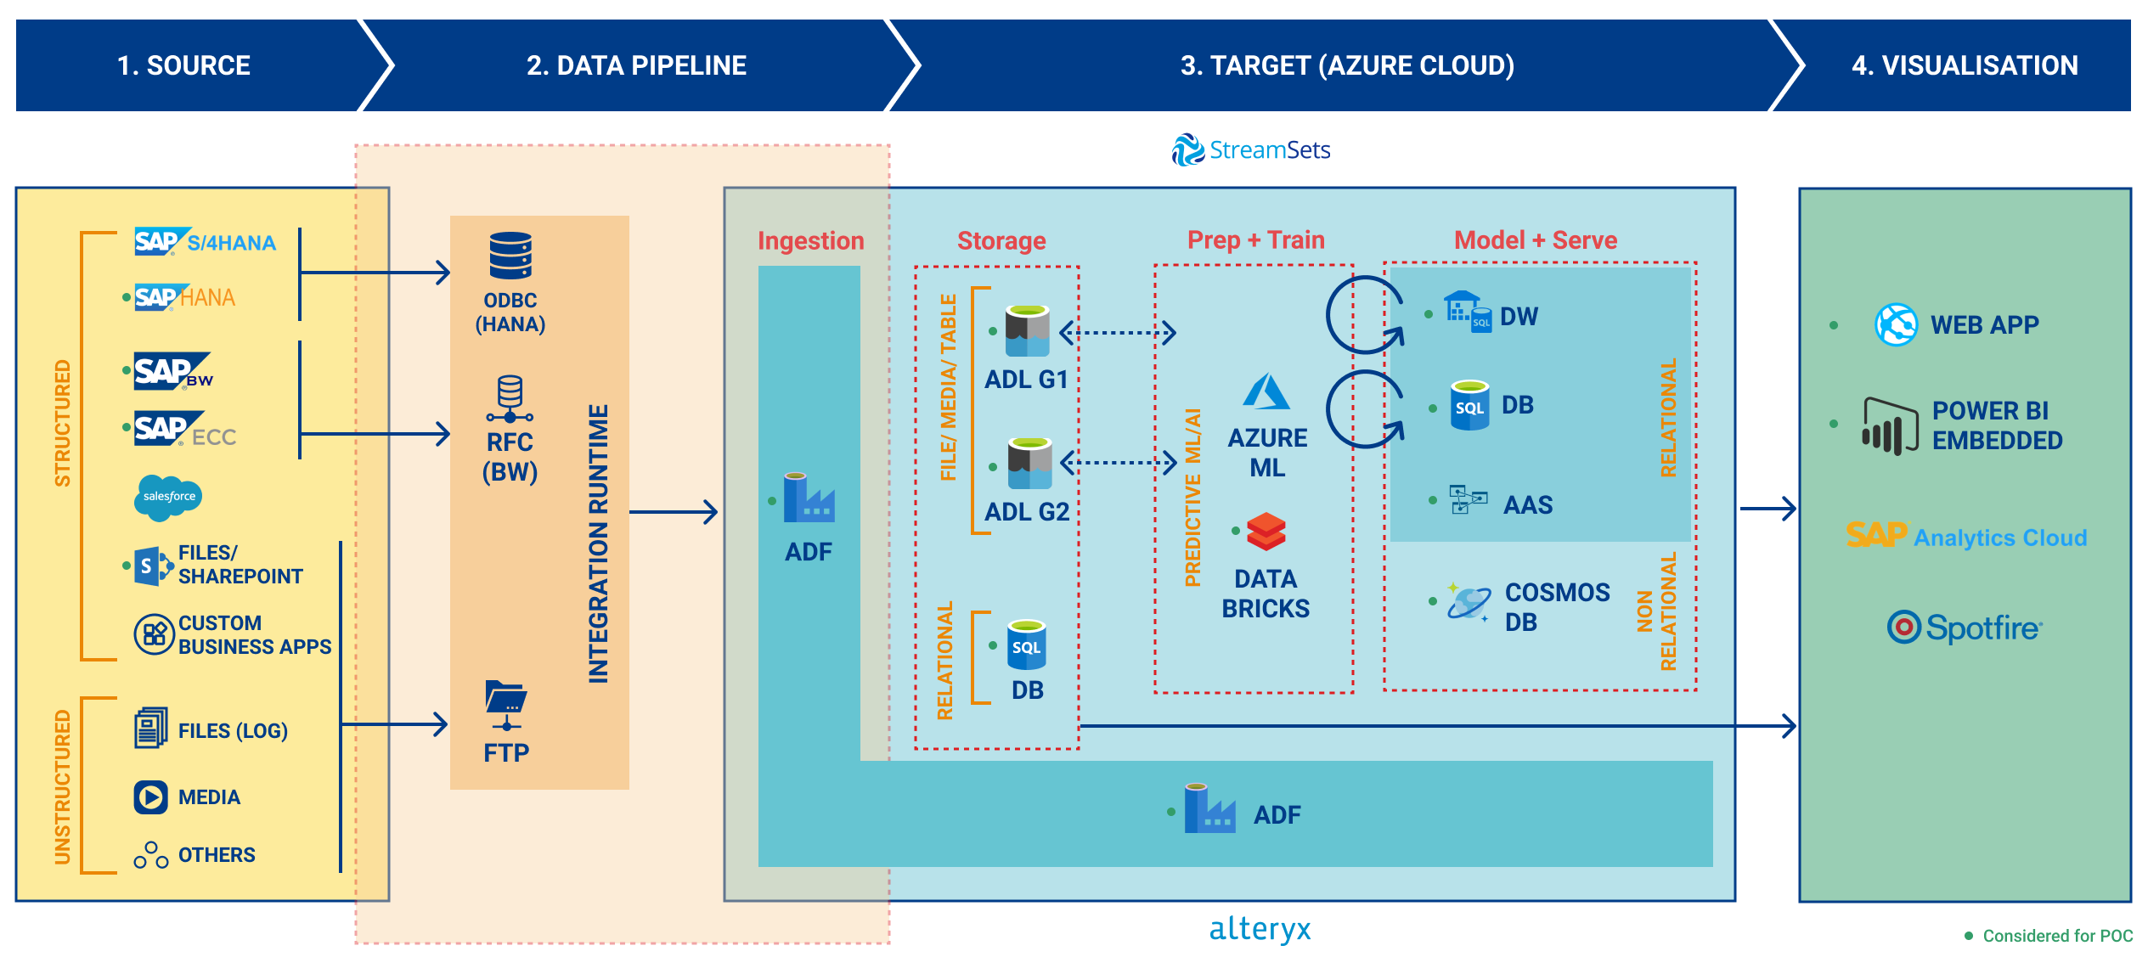
MI & Analytics Azure Architecture
Notes:
1. This is an Azure architecture analyzed and aligned with Architect team.
2. We recommend downstream to follow this architecture in projects.
3. If Source is HANA, Azure connect using ODBC connector.
4. If source is BW/ECC, Azure connect using RFC connector.

Slide 4
Azure Data Factory
ADF is cloud-based data integration tool that allows to create workflows/ pipelines in the cloud for orchestrating and automating data movement and data transformation.
It Supports 81 Data source connectors as on Date.
All connection credentials in ADF are secured using Azure Key Vault.
Azure Data Factory doesn’t Persist any data, data movement is handled using Azure IR (for Internal Scenarios) & Self-hosted IR (For Hybrid Scenarios).
Data should ingest into Azure before transformation applied. It is a ELT tool not a ETL tool, but new version ADF Data Flow (which is in preview version) will provide ETL functionality.

Slide 5
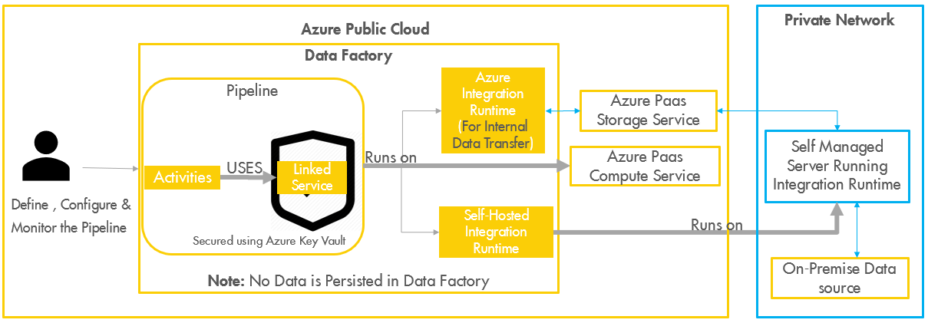
Azure Data Factory Architecture
Notes:
HANA use SLT to load data, similarly Azure use ADF to load data.
ADF do not store data, it only send commands to Integration runtime.
Integration Runtime will connect to source and transfer data to Azure.

Slide 6
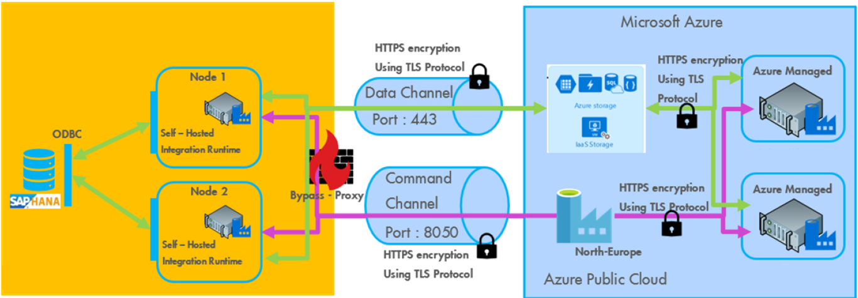
Integration Runtime Architecture (Self hosted)

Slide 7
Azure Data Lake
Azure Data Lake is a hyper-scale data repository which supports big data analytics. It can store file of any size & any format.
ADL contains folders which stores data in it(Hierarchical file system).
ADL stores structured, semi-structured, and unstructured data.
Access control, access can be defined at folder & file level.
Encryption key is stored using Azure Key Vault.
Transparent encryption can be done in Rest & HTTPS can be done at transit.
Data can be uploaded and downloaded manually using ADL explorer.
ADL Instance can be created in 4 Regions(Central US, East US 2, North Europe, West Europe).

Slide 8





Azure Data Lake Storage
Azure Public Cloud
Data Ingestion
Data Repository
Azure Data Lake Storage Gen1
Data Visualization
Azure Logic Apps
Azure Data Factory
Power BI Embedded
Azure Data Bricks
Data Transformation

Slide 9
Azure SQL Database
Azure SQL Database is SQL Server in the cloud, fully managed and scalable.
Maintaining any infrastructure, tweaking database files, or patching operating systems will get as IaaS.
No need to worry about SQL Server licensing, it includes in Azure SQL Pricing.
Azure SQL Database can almost do anything that on-premises SQL Server can do.
Azure SQL Database offers intelligent features like Dynamic Data masking, Geo-replication, Automatic tuning, Threat detection, Data encryption and Azure Active Directory integration.
Azure SQL Datawarehouse
SQL Server with Data Warehouse feature in the cloud. It is a dedicated service that allows you to build a data warehouse solution.
Azure SQL Data Warehouse is often used as a traditional data warehouse solution (Massive amounts of data, using data schema of tables and columns, connecting to data Visualization tool).

Slide 10
Azure SQL Db vs. SQL Data Warehouse features and limits
Features | Azure SQL Database | Azure SQL Data Warehouse
Data type | Relational | Relational
Active geo-replication | Yes | No
Dynamic Data Masking | Yes | No
Data Encryption at rest | Yes | Yes
Polybase T-SQL queries | Yes | Yes
Automatic Tuning | Yes | No
Massive Parallel Processing (MPP) | No | Yes
Ability to pause and resume | No | Yes
Max amount of data per database | 4TB | 1PB
Max concurrent open sessions | 30000 | 1024
Max concurrent queries | 6400 | 32

Slide 11
What to Use and When (SQL DB Vs SQL DWH)
 | Azure SQL Database | Azure SQL Data Warehouse
Use for application database | X
Use for data warehouse with large amounts of data and small amounts of users |  | X
Use for data warehouse with data max 4TB and large amount of users | X

Slide 12
Azure Analysis Service
Analysis service is used manage/ create enterprise data models in the cloud.
Analysis service use advanced mashup and modeling features to combine data from multiple data sources, define metrics, and secure your data in a single trusted tabular semantic data model.
The data model provides an easier and faster way for users to browse massive amounts of data for ad hoc data analysis.
Analysis service store data in In-Memory and supports up to 400GB compressed data.
Azure Analysis Services integrates with many Azure services enabling you to build sophisticated analytics solutions.
Integration with Azure Active Directory provides secure, role-based access to your critical data
Integrate with Azure Data Factory pipelines by including an activity that loads data into the model

Slide 13
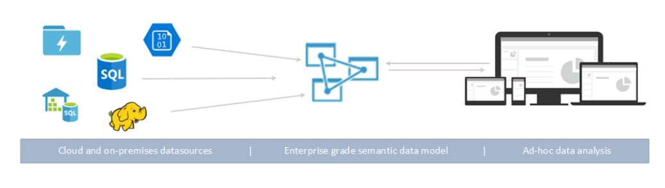
Azure Analysis Service Architecture

Slide 14
Azure Databricks
It is a cloud-based service that provides a unified analytics platform to Speed up the preparation of high-quality data, essential for best-in-class ML applications, at scale.
It a tool that provide processing power for complex Data analytics and Data Science scenarios with pre-configured runtime at scale.
It Provides clusters with maximum memory of 640 GB and 80 cores of single node can be scaled up to the maximum based on the subscription limit defined for the service.
It can also process data from streaming sources.
The GPU clusters are currently available in Beta version.
All credentials can be stored and retrieved securely from Azure Key Vault.
The Runtime supported in Notebook are Scala , R ,SQL and Python.
Execution of notebook can be automated using ADF.
The Azure Storage services like Azure data lake gen1 & 2 and blob storage can be accessed easily using service to service authentication.

Slide 15
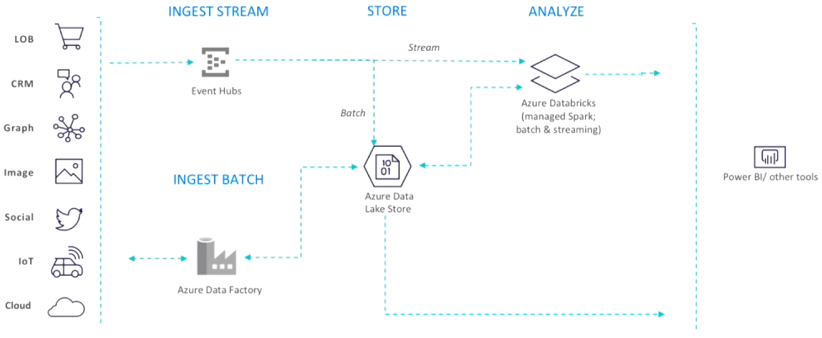
Azure Data Bricks work flow

Slide 16
Azure Cosmos DB
Azure Cosmos DB is Microsoft's globally distributed, multi-model database service.
Cosmos DB enables you to elastically and independently scale throughput and storage across any number of Azure regions world wide can also process data from streaming sources.
Cosmos DB enables you to build highly responsive and highly available applications worldwide.
Cosmos DB transparently replicates your data wherever your users are, so your users can interact with a replica of the data that is closest to them.
Cosmos DB is used by many external customers and mission-critical applications that require elastic scale, turnkey global distribution, multi-master replication for low latency and high availability of both reads and writes.

Slide 17
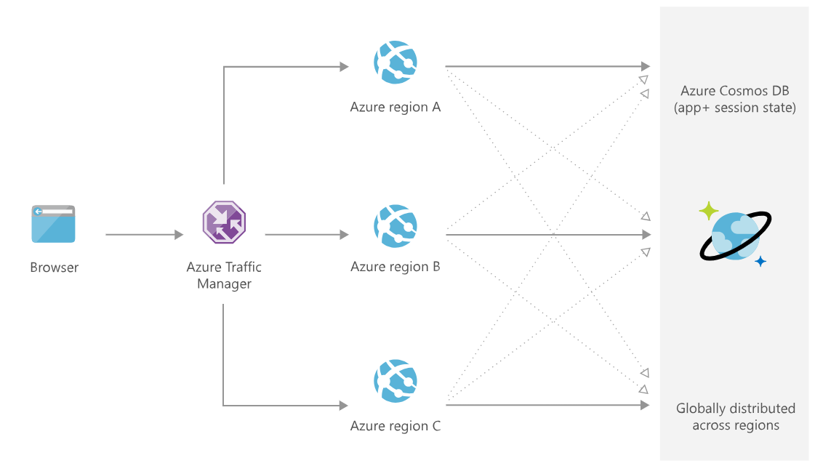
Globally distributed mission critical applications Cosmos DB

Slide 18
Data Security Matrix - Azure Storage Services
Service Name | Storage Type | Object Level Security | Data Level Security | Data Encryption (Rest) | Data Encryption (Transit) | Identity Authentication method
Azure Data lake store (G1) | File | Yes | No | Transparent Data Encryption | HTTPS (TLS 1.2) | Azure Active Directory
Blob | File | Yes | No | Storage service encryption (SSE) | HTTPS (TLS 1.2) | Azure Active Directory
SQL Database | Relational | Yes | No | Transparent Data Encryption | TLS 1.2 | SQL Server Azure Active Directory
SQL Datawarehouse | Relational | Yes | No | Transparent Data Encryption | TLS 1.2 | SQL Server Azure Active Directory
Note: 256-bit AES and 3DES encryption algorithms are used for performing encryption in TDE and SSE
Notes:
1. Data stored in Azure is secured, even though Azure is cloud (private/ public).
2. The above matrix is the evidence about security models that Azure using for data storage and movement.

Slide 19
Azure Limitations & Risks
S. No | Object type | Remarks | Limitation | Risk
1 | ADF | Access Control for Pipeline is not available | x
2 | ADF | Data should ingest into Azure before transformation applied. It is a ELT tool not a ETL tool, but ADF Data Flow feature will provide ETL | x
3 | ADF | Standard Delta logic is not available for the Hana Connector, as work around delta is possible based on a timestamp or some unique identity column by writing script | x
4 | ADF | Parallel data Copy is not available for Hana Data source , but is available now only with BW Open-Hub Connector | x
5 | ADF | Integration runtime supports only HTTPS security for data transfer, other security methods are not possible | x
6 | ADF | Query generated using browse SAP feature of SAP Hana Connector doesn’t generate right query for calculation view with input parameter/ exception aggregation, as work around need to manually write the query | x
7 | ADF | ADF do not have option to control Packet Size of the fetch from SAP Hana using the Hana Connector | x
8 | ADF | Azure takes 3 to 4 times more to process blob data type column |  | x
9 | ADF | SAP Hana connector only supports a query to copy data from HANA CV, not directly from table in HANA DB. As work around need to manually write the query | x

Slide 20
Azure Limitations & Risks
S. No | Object type | Remarks | Limitation | Risk
10 | ADF | Loading data directly from HANA to SDWH/SDB require to open port 1433 which is high security risk | x
11 | ADF | ADF supports only to load into Azure DB not be used generic data ingestion tool | x
12 | ADF | ADF do not have inbuilt transformation services, complex transformation requires to use Data bricks service | x
13 | ADF | Data Factory is recommended to load less than 2TB data at a time | x
14 | ADLS G1 | Max number of Data Lake Storage Gen1 accounts, per subscription, per region – 10 (Shell Restriction) | x
15 | ADLS G1 | Supports only Locally-redundant storage(LRS) as Geo-redundancy | x
16 | ADLS G1 | Azure Data Lake Gen1 is available only in 4 Regions (Central US, East US 2, North Europe, West Europe) | x
17 | Blob | Blob is not recommended for Analytics due to performance issues | x
18 | Blob | Access can not be given at file level. | x
19 | Blob | It can’t have data in Hierarchical file system. | x

Slide 21
ADF V2 Issues
SL No | Area | Description of the Issue | Resolution Details | Status
1 | ADF | Identified a bug in data load from HANA → ADL using staging option (Blob). Data load failed | Reported to MS, they included in their roadmap | Open
2 | ADF | BW to Azure data load using Bex query connector is having performance issues | Reported to MS, they agreed and recommended to use Open hub connector | Closed
3 | ADF | We have not seen through put size more than 11 MB/S during data load from HANA → Azure | Reported to MS, it depends on Network traffic and IR configuration | Open
4 | ADF | Not able to load 80 GB data from BW → Azure | MS suggested to install new VM and install SAP .Net connectors, working with IR team | Open

Slide 22
Recommendations
Azure Data factory is recommend for loading data from multiple sources to Azure storage only. It is not recommended for external targets. (ex: Amazon)
On premise and cloud sources data can be loaded using ADF to Azure. As of now 81 sources are supported.
Data Factory also recommended to load data from Azure ADLS to HANA.
Data Factory is recommended for complex Hybrid ETL,ELT and data integration projects.
Data load speed is dependent on Integration Run time. It is recommended to configure IR with multiple nodes and supported RAM size (Micrsoft is recommending 500 GB and we have tested with 30GB RAM)
To mitigate risk of data security in SQL/SQL DWH, use BLOB as staging. With usage of BLOB data will be transferred through secured port. (443)
If target store is SQL Datawarehouse/ Database, enable staging (Blob). Data will transfer via HTTPS security on port 443 to Blob first, not require to open port 1433.

Slide 23
Azure POC Scope and timelines
Phase I (29th Mar 2019) | Phase II (17th May 2019) | Phase III (28th Jun 2019)
Azure Data Factory using Integration Run time | Load data to ADLS using Alteryx | Security testing on services (ADL G2, AAS and PBI)
load data HANA → Azure (ADLS, Blob & SDWH) | Performance (stress) testing BW → Azure (ADLS, Blob & SDWH) | Assess on Service SQL Database
Performance (stress) testing HANA → Azure (ADLS) | Pricing model document for other services (EPBI, ADL G2, ADF (dataflow), Data Bricks & Cosmos DB | Assess on Cosmos DB
Load data BW → Azure (ADLS, Blob & SDWH) | Power BI (desktop) | Test possible patterns
ADLS G1 (Azure Data Lake store) | Delta images test scenarios | Host React in Azure
Blob | Assess services SQL Datawarehouse | Implement like to like data flow
Data security (ADL, Blob, SDWH & SDB) | Configure and load from ECC → Azure (ADLS, Blob & SDWH)
Load data to ADLS using stream sets. | Azure Data Factory (Data Flow)
Pricing Model (ADL, ADF, SDWH and Bandwidth charges) | Load data HANA → using SLT
Azure Analysis Service (In-progress)
Data Bricks (In-progress)
ADLS G1 (Azure Data Lake store) (In-progress)

Slide 24
ADF Performance statistics HANA → ADL (Azure data lake Gen1)
Scenario | Records count/ Columns/ Size | Time (HH:MM:SS) | Throughput | Hana System load Analysis
Load DBTABLOG with blob column | 813 K /14 columns / 708.387(MB) | 00:02:07 | 5.67 (MB/S) | Fetch count 707 records per data pack.
Load DBTABLOG wo blob column | 813 K/ 13 columns/ 128.325 (MB) | 00:00:21 | 6 (MB/S) | Fetch count 2.4 k records per data pack.
Load DBTABLOG wo blob column | 312,443 K/ 13 columns/ 88.468 (GB) | 02:11:12 | 11 (MB/S) | Fetch count 2.4 k records per Data Pack.
Load EKPO all columns | 356 K / 402 columns/ 731.525 (MB) | 00:04:10 | 3 (MB/S) | Fetch count 204 records per Data Pack.
Summary: ADF is taking less time to ingest data, it is recommended to handle larger data volume transfer.

Slide 25
Performance Comparison with Streamsets & Alteryx
Scenario | Records count/ Columns/ Size | ADF (HH:MM:SS) | Stream sets (HH:MM:SS) | Alteryx (HH:MM:SS)
Load DBTABLOG with blob column | 813 K /14 columns / 708.387(MB) | 00:02:07 | 00:39:00 | TBD
Load DBTABLOG wo blob column | 813 K/ 13 columns/ 128.325 (MB) | 00:00:21 | 00:00:53 | TBD
Load DBTABLOG wo blob column | 312,443 K/ 13 columns/ 88.468 (GB) | 02:11:12 | 06:54:00 | TBD
Load EKPO all columns | 356 K / 402 columns/ 731.525 (MB) | 00:04:10 | 00:09:07 | TBD
Summary: Comparing to Azure data load timings, stream set is taking more time. Stream set performance is poor.
Notes:
Stream sets performance is poor when loading table with Blob data type column.
Stream sets need finisher step to complete job.
Alteryx data load need to be tested, there is bug in Alteryx designer and working with Alteryx product team.

Slide 26
Feature Validation Summary
Area | Status | Comments
Azure Data Factory V2 | Completed | ADF is only to ingest data with in Azure ADF supports to write back data into HANA ADF supports complex ELT solutions
Azure Data lake Storage (Gen1) | Completed | Supports data stored as folders and files (Hierarchical file system). 2.No limits on account sizes, file sizes or number of files.
Blob | Completed | Snapshot can be created in BLOB 2.BLOB has various options available for Replication (Geo redundancy)
Configuration, load HANA → Azure (ADLS, Blob & SDWH) | On going | ADLS is recommended to load directly in Azure Loading directly to SDWH will open PORT 1433 (High risk)
Performance Testing (HANA → Azure) | On going | Data loads time are better than stream sets time 88 GB data loaded in 2 hrs. 17 mins
Configure, load from BW → Azure (ADLS, Blob & SDWH) | Completed | Can load from Bex query/ OHD → Azure Parallel data copy working Standard delta logic available OHD as source is recommended

Slide 27
Feature Validation Summary
Area | Status | Comments
Pricing Model (ADL, ADF, SDWH and Bandwidth charges) | On going | Create services in same region of same zone. Better to use Self Hosted integrated runtime to avoid huge cost Inactive pipeline should delete, else costing will continue
Security on storage (ADL, SDWH & SDB) | Completed | At rest supports SSE and at transit supports HTTPS SQL DWH & DB supports using SQL server and AAD authentication

Slide 28
Microsoft Azure
Going forward no future to on-premise data center, need to replace by cloud solutions.
Combination of MS IT infrastructure, Application and services, presence in global IT presence made
Azure is right choice.
Microsoft Azure is a cloud platform for building, deploying, and managing services and applications.
Azure supports PaaS and IaaS.
Azure products and services are designed to meet all needs of business.
Azure can be used as database and application.
Azure supports both ELT (Extract – Transform - Load) and ETL (Extract – Load – Transform) tools.

Slide 29
Data Security Matrix - Azure Storage Services
Service Name | Storage type | Object level Access | Data level Access | Data Encryption (Rest) | Data Encryption (Transit) | Identity Authentication method | Access Control
Azure Data lake (G1) | File | Yes | No | Transparent | HTTPS | AAD | RBAC ACL based on posix IP based restriction
Blob | File | Yes | No | Storage service encryption (SSE) | Client side HTTPS | AAD | RBAC Shared Access Signature IP based restriction
SQL Database | Relational Database | Yes | No | Transparent | FIPS 140-2 validated 256-bit AES subscription | SQL Server AAD | Role memberships and object level permissions IP based restriction
SQL Datawarehouse | Relational Database | Yes | No | Transparent | FIPS 140-2 validated 256-bit AES subscription | SQL Server AAD | Role memberships and object level permissions IP based restriction

Slide 30
Azure Data Factory V2 (ADF)
It is a cloud-based data integration service that allows you to create data-driven workflows (pipelines) in the cloud for orchestrating and automating data movement and data transformation.
It Supports 81 Data source connectors as on date (57 Production and 24 Beta Version).
ADF process and transform the data by using compute services such as HDInsight Hadoop, Spark, Azure Data Lake Analytics, Azure Machine Learning and Data bricks.
All connection credentials in ADF can be secured using Azure Key Vault.
Azure Data Factory doesn’t persist any data rather all data movement is handled using Azure IR (for Internal Scenarios) & Self-hosted IR (For Hybrid Scenarios).
The ADF Instance can be created in 9 Regions , but it can utilize service that is available globally within Azure and on On-Premise using Self Hosted IR.

Slide 31
Use of Azure Data Factory and Security
To copy data from Multiple Source located globally anywhere on On-Premise / Cloud Source ( Relational , non –Relational ) to Azure and perform Analytics using them.
To automate Schedule / Trigger data movements based on Events in Azure / On – Regular time Intervals.
To train your ML Model using input Data from Streaming / Non – Streaming Source.
To transform & process data using different Transformation & Compute Services available on Azure.
Azure Data Factory does not store any data except for linked service credentials for cloud data stores.
All Credentials in ADF are secured by default by using Certificates. It also supports Azure Key Vault.
Data Factory has been certified like CSA STAR Certification, ISO 27017:2015, ISO 9001:2015, e.t.c.

Slide 32
Azure Data Lake Gen1
Data at Rest:
When you create a new Data Lake Storage Gen1 account, encryption is on by default.
The type of encryption that is followed is transparent data encryption (TDE). Data Lake Storage Gen1 automatically encrypts data prior to persisting, and decrypts data prior to retrieval.
The encryption is configured and managed at the Data Lake Storage Gen1 account level by an administrator.
Data in transit
The data is also always secured in transit by using HTTPS over TLS 1.2 . HTTPS is the only protocol that is supported for the Data Lake Storage Gen1.
Note: Encryption(both at rest & in transit) for Data Lake Storage Gen1 is set up during account creation, and it is always enabled by default. You can either manage the keys yourself, or allow Data Lake Storage Gen1 to manage them for you (by default).

Slide 33
Azure Blob
Data at Rest:
Storage Service Encryption (SSE) is used for Azure Blob and File storage using Microsoft Managed Keys or Customer Managed keys.
Data is automatically encrypted(on by default).
All data that is written into Azure storage will be automatically encrypted by Storage Service Encryption prior to persisting, and decrypted prior to retrieval.
Data in transit
The data is also always secured in transit by using HTTPS over TLS 1.2 . HTTPS is the only protocol that is supported for the Data Lake Storage Gen1.
Note: Encryption(both at rest & in transit) for Data Lake Storage Gen1 is set up during account creation, and it is always enabled by default. You can either manage the keys yourself, or allow Data Lake Storage Gen1 to manage them for you (by default).

Slide 34
Azure SQL Datawarehouse/Database
Data at Rest:
This is for encrypting an entire database.
Uses transparent data encryption and performs real-time I/O encryption and decryption of the data and log files.
You can select TDE option in portal or encrypt the database by writing T-SQL commands. This is not on by default.
Data in transit
Uses TLS 1.2 encryption. (not HTTPS)
Note: 256-bit AES and 3DES encryption algorithms are used for performing encryption in TDE and SSE. These encryption algorithms are block ciphers (this is on a program level). TLS is used to encrypt HTTPS protocol. So when we say that HTTPS is available for ADLS and Blob we mean it is HTTPS over TLS, i.e., HTTPS is secured with TLS 1.2.

