Slide 2

High level deployment of Cloud Services & Integrations
3rd party Cloud Products
Integrations
CLOUD COMPUTING
BIG DATA & ANALYTICS
SaaS Apps
Non-SAP Clouds
Cloud2Cloud
Non-SAP Clouds
Integrate2Cloud
AWS
Azure Cloud
FAAS
Salesforce
Non-SAP Clouds
Non-SAP Clouds
Non-SAP Clouds
External
DTL
…
VNET
Identity
Office365
User2Cloud
PoC
Cloud Applications
OP2Cloud
Cloud Integration Platform
Cloud Health
Service Now
On-Premise (OP) Applications
OP2Cloud ExpressRoute
OP2OP
B2B
Zscalar / Splunk
Azure Stack (2018+)
Partner
DCS
Secure Hosting
User2OP
MOBILITY & CONSUMERISATION
ENTERPRISE APPLICATIONS
Integrate with OP
Future Services
Version – 2017-05-04
Notes:
Add DTL / PoC

Slide 3


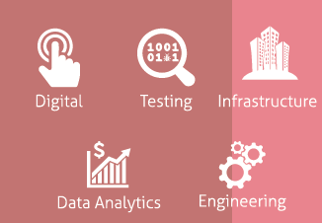




Cloud Deployment Patterns – Pipeline / Journey
Cloud Governance, Monitoring
Setup Cloud governance such as Access rules, public endpoints, monitoring and backups
Business Requirements
Requirement Analysis
Business, Technical, Data and Application Analysis per TOE standards
PaaS (Preferred) Build
Re-architect / Refactor the application for PaaS and pick deployment patterns
Operations
Support and Manage the Cloud Infra and Applications
IaaS Build
Decide on IaaS HA / Cross – region patterns and Build
Cloud Deployment
Patterns (Microsoft aligned)
Decide the Azure Platform – Public, VNET and pick the patterns for deployment
Version – 2016-12-07

Slide 4







Deployment Patterns – View Points
Availability
Data Management
Design
Integrations
Defines the proportion of time the system is functional & working.
Points to availability of Cloud Provider and Application
Data is the most critical component of Cloud hosted applications.
Points to performance, scalability, availability, durability, encryption, compression, caching
Focuses on consistency and approved standards.
Points to deployment, maintainability, operability, application and business requirements
Defines integrations between Azure VNET, DCS, Azure VNET, AWS
Points to integrations using Cloud Integration Platform and FAAS
Performance
Resiliency
Security
Management
Indication of responsiveness of a application distributed across layers and servers.
Points to scalability, ability to handle load
Ability of a system to gracefully handle and recover from failures.
Points to Traffic management, load balancers and probe management
Prevention of systems from malicious or accidental actions to prevent loss of information
Points to having RBAC, Vnet, Isolation and governance
Ability to control the Infrastructure / application workloads for build, configure, monitor and terminate
Points to access control, tools for
Version – 2016-12-07

Slide 5
Azure Limits to know
For updated Azure Limits from Microsoft – Click Here
Azure Service | Limit
Storage Account per Subscription | 200*
TB per Storage Account | 500 TB
Max size of a Page Blob (VM Disk) | 1 TB
Max size of File Share | 5 TB
Virtual Machines in Availability / Scale Set | 100
Deployments per Resource Group | 800
Number of Tags per resource | 15
Virtual Networks per Subscription | 100
NSG Rules per NSG | 400
* - Soft limit from Azure. Can be increased by contacting Microsoft support
Version – 2016-12-07

Slide 6






Azure Storage – Good to know points
Standard Storage – Pay for what you use
Premium Storage – Pay for what you provision
Storage Type
Azure Standard Storage
Azure Premium Storage
Block Blob | File Store | Azure Queue | Azure Table | Page Blob (VM Disk)
195 GB | 5 TB |  |  | 8 TB
60 MB/s | 1000 IOPS or 60 MB/s | 2000 message/ second | 2000 Entities/ second | 500 IOPS per disk
Page Blob (VM Disk)
1 TB
5000 IOPS per Disk, 200 MB/s
Usage
Usage
Limits
Limits
Performance
Performance
Supported Replication Type
LRS
Local Replication
3
LRS | ZRS** | GRS | RA-GRS
Local Replication | Zone Replication | Geo Replication | Read-Access GRS
3 | 3 | 6 | 6
Supported Replication Type
Copies
Copies
Use as Data Disk for high disk intensive applications. Require specific Azure VMs - DS For Production workloads such as Databases, Datawarehouse, real-time analytics, Big Data, Streaming data, response time affected applications. E.g. Hadoop, Oracle / SQL Servers, IoT / Analytics applications
OS Disk for all workloads including servers that use Premium storage. All Non-production, QA, UAT workloads. Specific Production workloads that require lesser Disk IOPS (500 per disk) and up to 8000 IOPS when striped. E.g. Web Servers, App Servers, less-frequently used servers / data
Typical Use Case
Version – 2016-12-07

Slide 7
Azure Storage – Decision Tree
Service | Limit
Azure Block Blob | 195 GB
Azure Files | 5 TB
Azure Queues
LRS, ZRS, GRS, RA_GRS
Standard Storage
LRS, GRS, RA_GRS
Less IOPS
Intensive (HDD)
Block Blob
(Video, Images)
Standard Storage
Standard Storage
Multi-Geo
Replication
Files
Not Supported
More IOPS
(SDD)
Tables /
Queues
Production
Local
replication
Premium Storage
Storage
Purpose
Virtual
Machine
Non-Prod
>5 TB File Services,
> 64 TB VM Data
Standard Storage
ADLS
Version – 2016-12-07

Slide 8
Azure SQL Database
Feature | Basic | Standard | Premium
Max Database Size | 2 GB | 250 GB | 4 TB
Maximum number of databases | 400 | 400 | 50
Max DTUs | 5 | 100 | 4000
Max concurrent sessions | 300 | 2400 | 30000
Max concurrent logins | 30 | 200 | 6400
Version – 2016-12-26

Slide 9
Compare SQL IaaS vs Azure SQL
For complete list of features comparison – Click Here
Feature | SQL IaaS | Azure SQL
Active Geo-Replication | SQL AlwaysON | Supported
Attach a Database | Supported | Not Supported
Auto Scale | Not Supported | Supported
Database Mirroring | Supported | Not Supported
Auditing | Supported | Supported
Always Encrypted | Supported | Supported
Data Compression | Supported | Supported
Cross Database queries | Supported | Elastic queries
SQL Jobs | Supported | Supported
Version – 2016-12-26

Slide 10
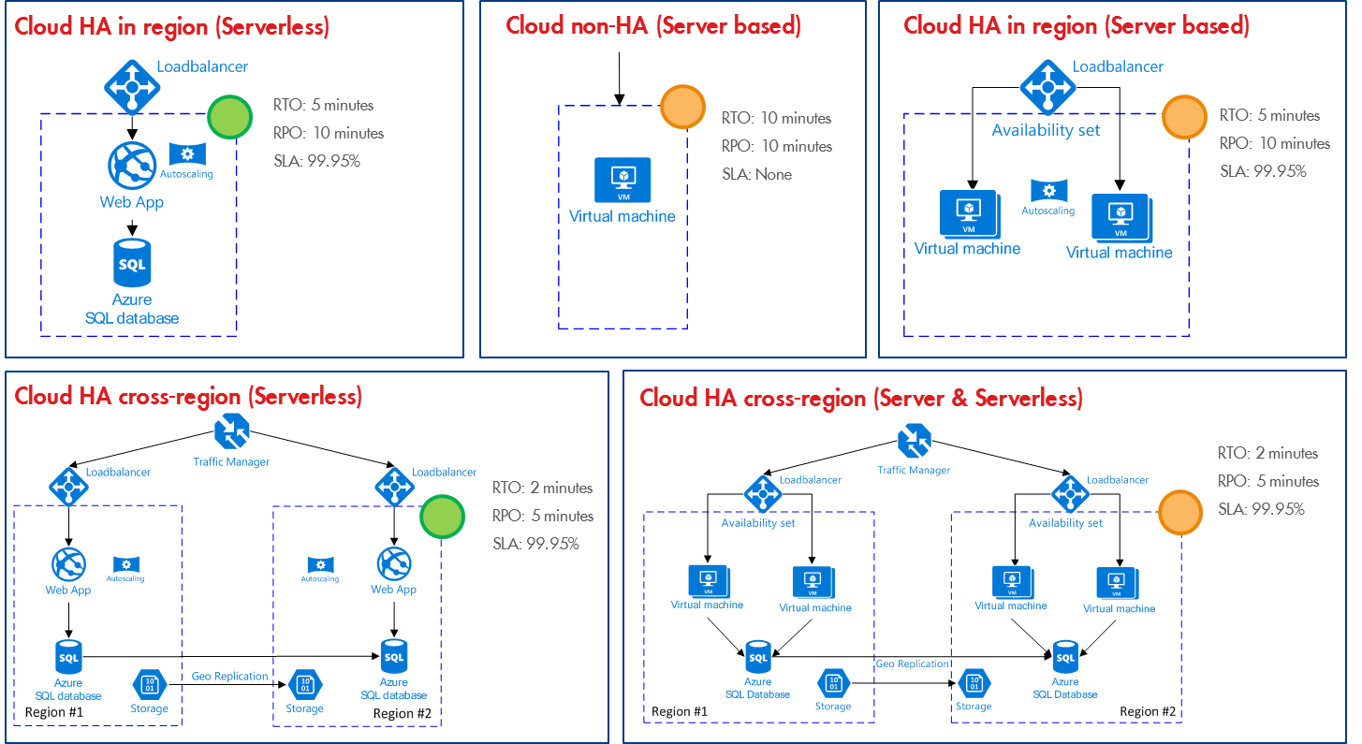
Deployment Patterns – common use cases – At a Glance
Azure Patterns.
Work in progress.
Version – 2016-12-07

Slide 11
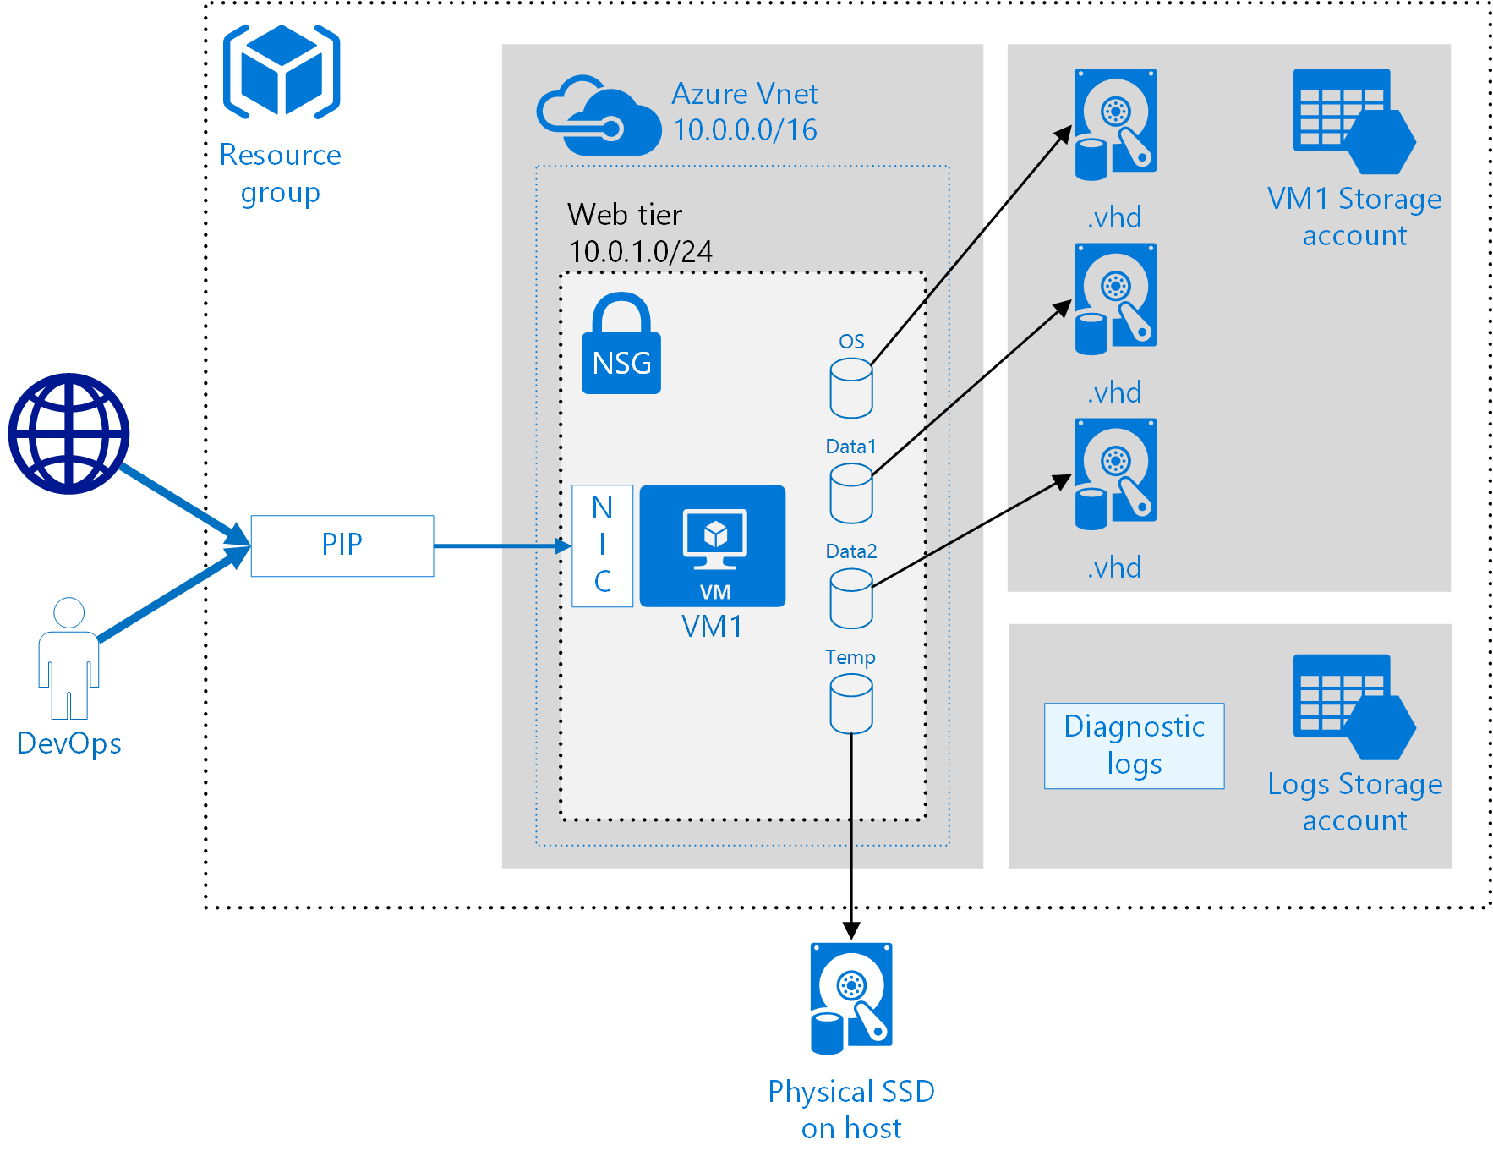

Deployment Pattern – Standalone VM Single storage account
Use Case
For Non-Production workloads such as Web / Application Servers and Database Servers. Low to moderate Disk Performance The patterns will deploy IIS with .NET Framework etc.
Focus Areas | Supported
Availability
Performance
Resiliency
Availability Set
Click here for Microsoft Reference Architecture
Version – 2016-12-07
Go to Deployment Pattern Index

Slide 12

Deployment Pattern – Standalone VM Single storage account
Use Case
For Non-Production workloads such as Web / Application Servers and Database Servers. Low to moderate Disk Performance The patterns will deploy IIS with .NET Framework etc.
Focus Areas | Supported
Availability
Performance
Resiliency
Availability Set
Version – 2016-12-07
Go to Deployment Pattern Index

Slide 13






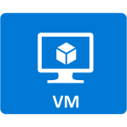
Deployment Pattern - Standalone VM multiple storage accounts
AzureNetwork
Use Case
For Non-Production workloads such as Web / Application Servers and Database Servers. Improved Disk Performance Risk involved when used in Production.
Resource
Group
OS Disk
Standard Storage Account
Web/App Subnet
OS Disk
Data
Disk 1
Premium Storage Account 1
Data Disk 1
Focus Areas | Supported
Availability
Performance
Resiliency
Data
Disk 2
Premium Storage Account 2
Data Disk 2
Availability Set
Diagnostics Logs
Version – 2016-12-07
Go to Deployment Pattern Index

Slide 14
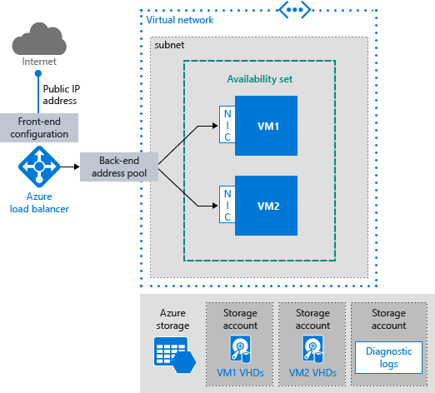


Deployment Pattern – Highly Available VM
Azure Patterns.
Work in progress.
Use Case
Used by Production workloads such as external facing web servers and Internal App Servers that are designed to handle Active/Active connections
Focus Areas | Supported
Availability
Performance
Resiliency
Auto Scaling
Click here for Microsoft Reference Architecture
Version – 2016-12-07
Go to Deployment Pattern Index

Slide 15

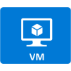

Deployment Pattern – N-Tier non-HA VM Stack
Azure Patterns.
Work in progress.
Resource
Group
Web Tier
Business Tier
DB Tier
Use Case
Used by decoupled non-production workloads that deploy Web, Application and Database on separate servers.
Subnet A
Subnet B
Subnet C
Public IP
Address
Availability
Set
Availability
Set
Availability
Set
Focus Areas | Supported
Availability
Performance
Resiliency
DevOps
Jump host
Version – 2016-12-07
Go to Deployment Pattern Index

Slide 16
Deployment Pattern – N-Tier non-HA VM Stack
Azure Patterns.
Work in progress.
Resource
Group
Web Tier
Business Tier
DB Tier
Use Case
Used by decoupled non-production workloads that deploy Web, Application and Database on separate servers.
Availability
Set
Availability
Set
Availability
Set
Focus Areas | Supported
Availability
Performance
Resiliency
DevOps
Jump host
Azure Subnet A
Version – 2016-12-07
Go to Deployment Pattern Index

Slide 17
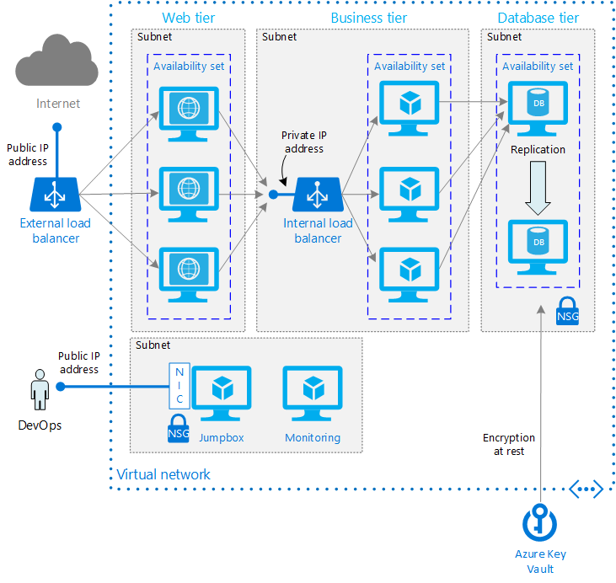


Deployment Patterns – N-tier Architecture Windows
Use Case
Focus Areas | Supported
Availability
Performance
Resiliency
Click here for Microsoft Reference Architecture with Deviation (no AD here)
Version – 2016-12-07
Go to Deployment Pattern Index

Slide 18
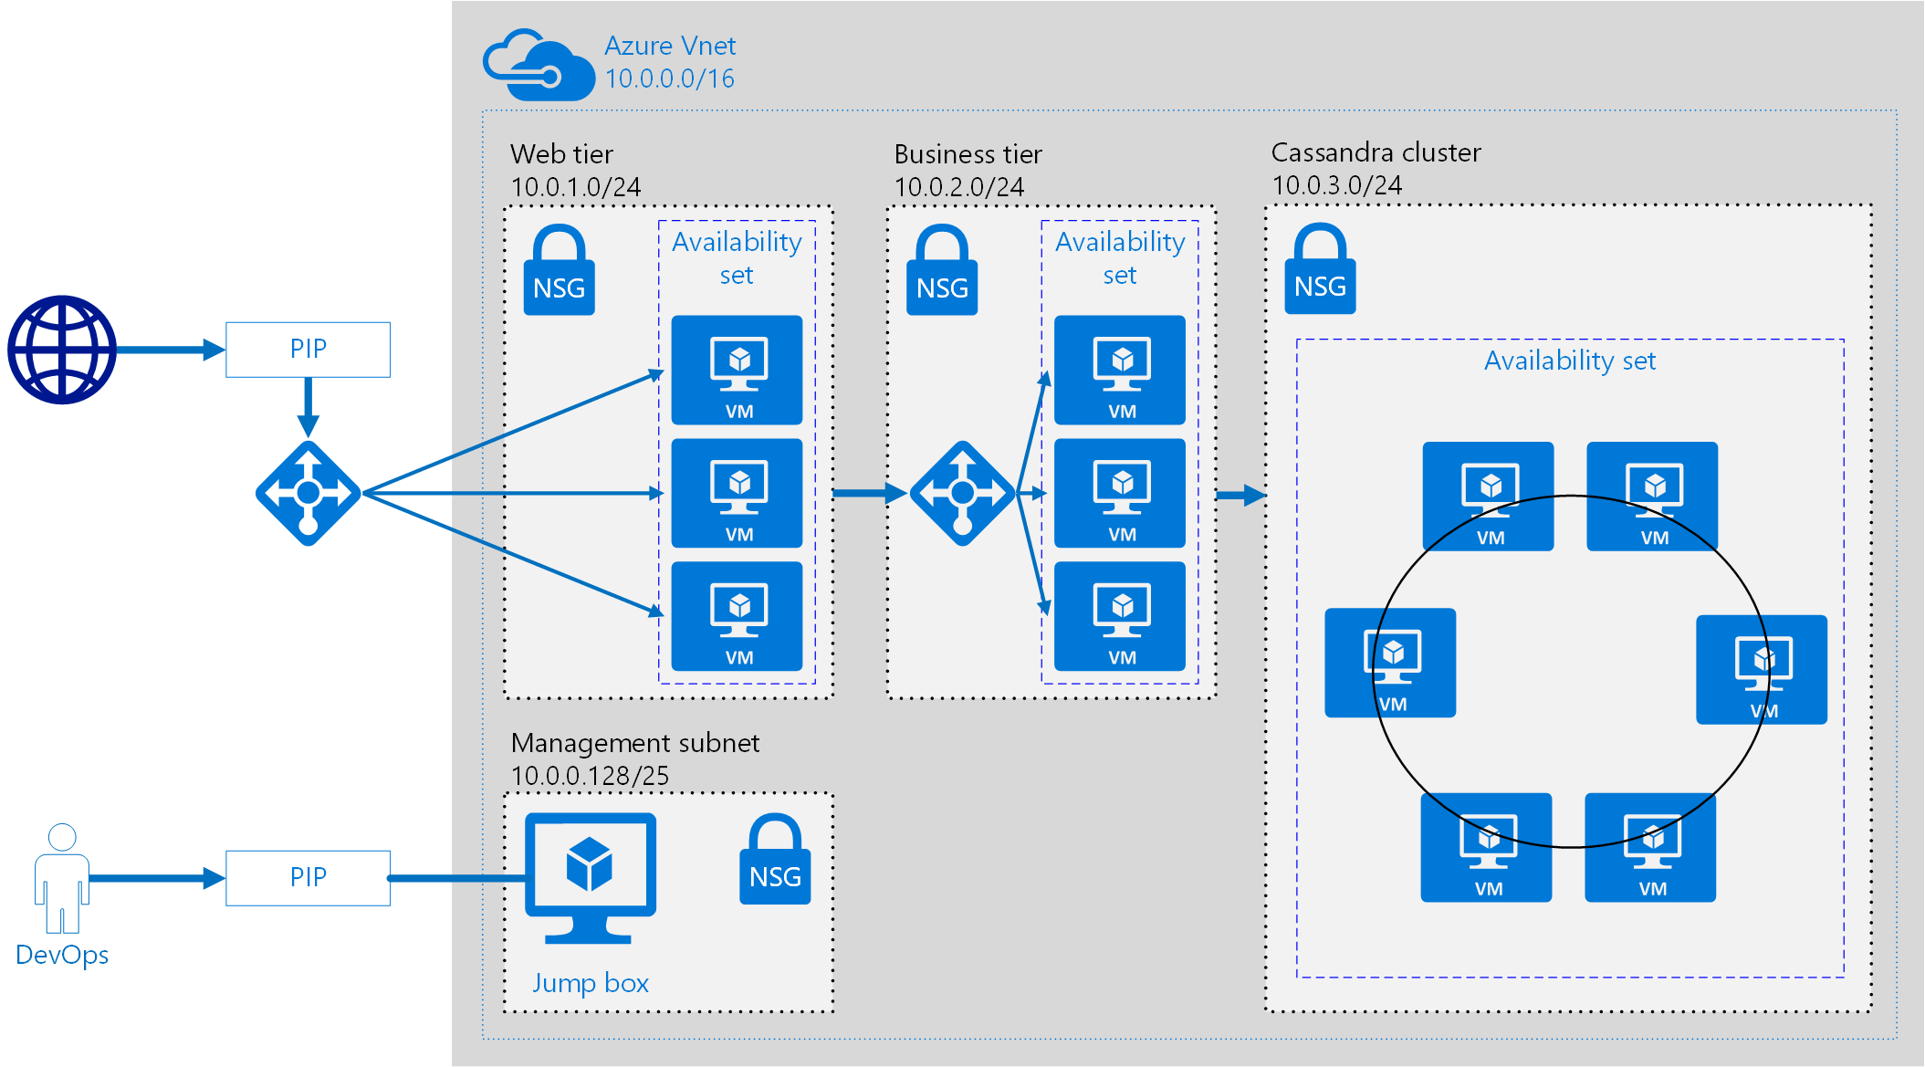
Deployment Patterns – N-tier Architecture Linux
Use Case
Focus Areas | Supported
Availability
Performance
Resiliency
Click here for Microsoft Reference Architecture
Version – 2016-12-07
Go to Deployment Pattern Index

Slide 19


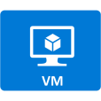
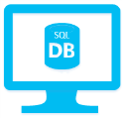
Deployment Patterns – Cross Region HA Simple Architecture
Use Case
For Non-Production workloads such as Web / Application Servers and Database Servers. Low to moderate Disk Performance Risk involved when used in Production.
Traffic Manager
Load Balancer
Load Balancer
Availability Set
Availability Set
Focus Areas | Supported
Availability
Performance
Resiliency
Virtual Machine
Web Tier
Virtual Machine
Web Tier
Virtual Machine
Web Tier
Virtual Machine
Web Tier
SQL Database
SQL Replication
SQL Database
Region 1
Region 2
Version – 2016-12-07
Go to Deployment Pattern Index

Slide 20






Deployment Patterns – Cross Region HA - N-tier Architecture
Internal Load Balancer
Web Tier
Business Tier
DB Tier (SQL AlwaysON
External Load Balancer
Use Case
SQL Server (Primary)
SQL Server (Secondary)
Availability Set
Availability Set
SQL Replication
FSW
Traffic Manager
Availability Set
Focus Areas | Supported
Availability
Performance
Resiliency
Jump host
VPN Gateway
Azure VNet
DevOps
Azure VNet
Jump host
VPN Gateway
SQL Replication
FSW
SQL Server (Secondary)
Click here for Microsoft Reference Architecture with Deviation (no AD here)
SQL Server (Primary)
Availability Set
Availability Set
Version – 2016-12-07
Go to Deployment Pattern Index
Web Tier
Business Tier
DB Tier (SQL AlwaysON

Slide 21
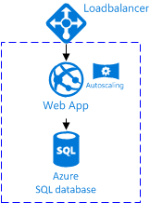
Deployment Pattern - Simple Azure Web App with DB
Azure Managed
Use Case
For Non-Production workloads such as Web / Application Servers and Database Servers. Low to moderate Disk Performance Risk involved when used in Production.
Focus Areas | Supported
Availability
Performance
Resiliency
Availability Set
Click here for Microsoft Reference Architecture
Version – 2016-12-07
Go to Deployment Pattern Index

Slide 22
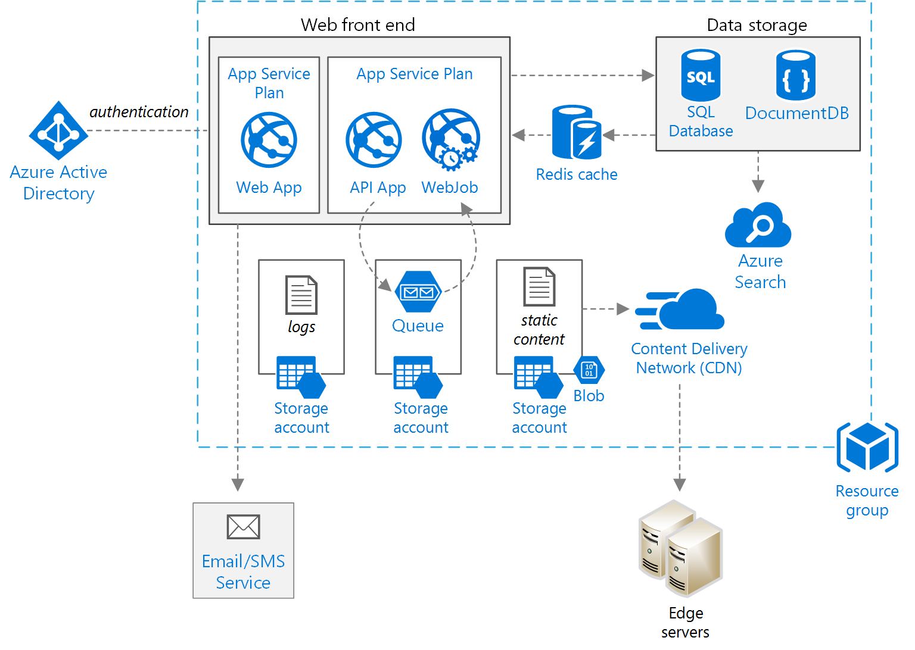

Deployment Pattern – Highly Available Azure Web App with DB
Not supported Azure VNET
Use Case
Focus Areas | Supported
Availability
Performance
Resiliency
Click here for Microsoft Reference Architecture
Version – 2016-12-07
Go to Deployment Pattern Index
Notes:
Azure VNET can’t leverage capabilities of CDN, Traffic Manager as it requires external end-point for connectivity.

Slide 23
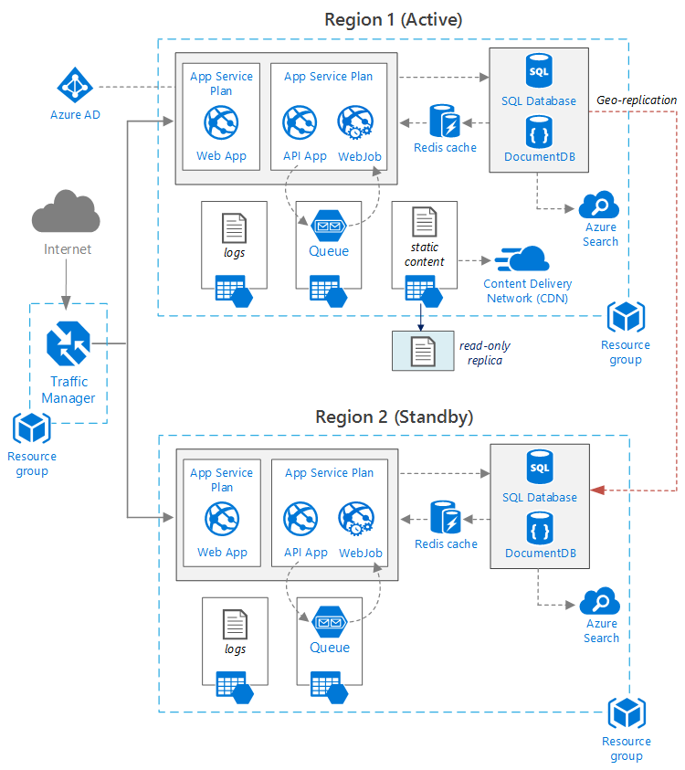
Deployment Pattern – Cross Region - Azure Web App with DB – HA
Not supported Azure VNET
Use Case
For Non-Production workloads such as Web / Application Servers and Database Servers. Low to moderate Disk Performance Risk involved when used in Production.
Focus Areas | Supported
Availability
Performance
Resiliency
Click here for Microsoft Reference Architecture
Version – 2016-12-07
Go to Deployment Pattern Index
Notes:
Azure VNET can’t leverage capabilities of CDN, Traffic Manager as it requires external end-point for connectivity.

Slide 24


Deployment Pattern – Simple IaaS Web, App & PaaS DB
Azure VNet
Resource
Group
Web Tier
Business Tier
DB Tier
Use Case
Public IP
Address
Azure SQL
Focus Areas | Supported
Availability
Performance
Resiliency
DevOps
Jump host
Azure VNet
Version – 2016-12-07
Go to Deployment Pattern Index

Slide 25
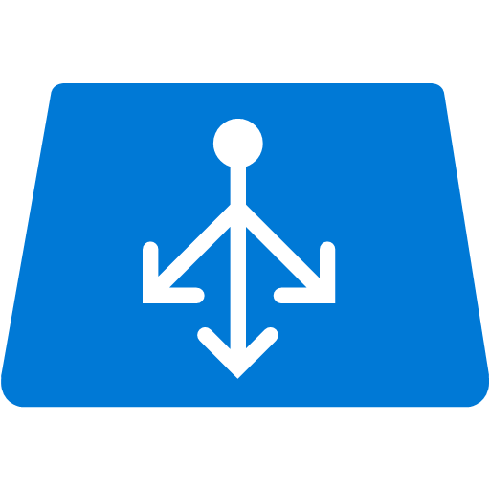
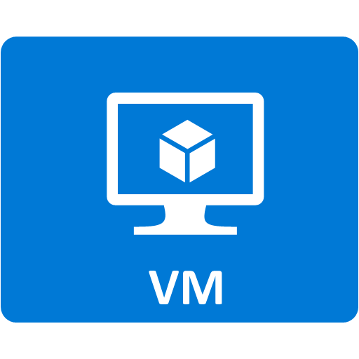
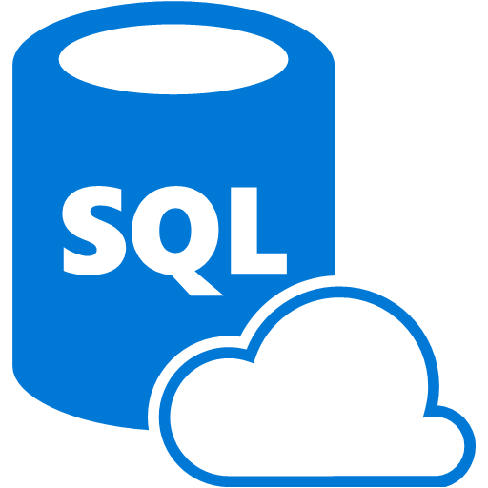
Deployment Pattern – IaaS Web / PaaS DB - HA
Public IP
Use Case
Application VM
Application VM
Focus Areas | Supported
Availability
Performance
Resiliency
Azure SQL
Version – 2016-12-07
Go to Deployment Pattern Index

Slide 26
Deployment Pattern – IaaS Web / PaaS DB - HA
Use Case
Application VM
Application VM
Focus Areas | Supported
Availability
Performance
Resiliency
Azure SQL
Version – 2016-12-07
Go to Deployment Pattern Index

Slide 27
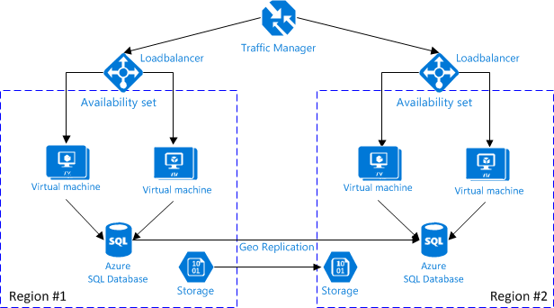
Deployment Pattern – IaaS Web / PaaS DB - HA
Azure External
Azure VNET
Focus Areas | Supported
Availability
Performance
Resiliency
Version – 2016-12-07
Go to Deployment Pattern Index

