Slide 1
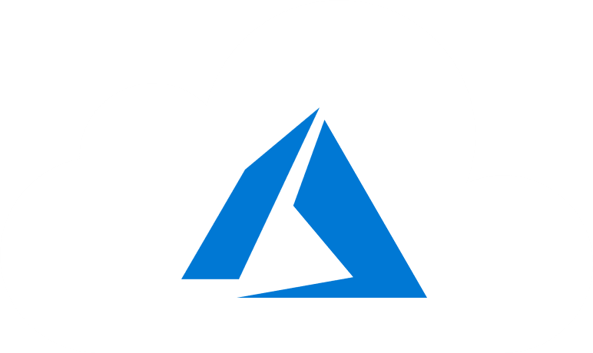
Course Outline
Module 1: Design a Compute Solution
Module 2: Design a Network Solution
Module 3: Design for Migration
Module 4: Design Authentication and Authorization
Module 5: Design Governance
Module 6: Design a Solution for Databases
Module 7: Select an Appropriate Storage Account
Module 8: Design Data Integration
Module 9: Design a Solution for Logging and Monitoring
Module 10: Design a Solution for Backup and Recovery
Module 11: Design for High Availability
Module 12: Design for Cost Optimization
Module 13: Design an Application Architecture
Module 14: Design Security for Applications
NOTE: The module order listed above aligns with the learning objectives described on the AZ-304: Microsoft Azure Architect Design certification page.

Slide 2
AZ-304: Microsoft Azure Architect Design

Slide 3
Module 1: Design a Compute Solution
Azure Compute Service, Compute Infrastructure, and Scalability

Slide 4
Learning Objectives
Choose an Azure Compute Service
Determine Appropriate Compute Technologies
Recommend a Solution for Containers
Provisioning Solutions for Azure Compute Infrastructure
Module Review Questions

Slide 5

Choose an Azure Compute Service

Slide 6
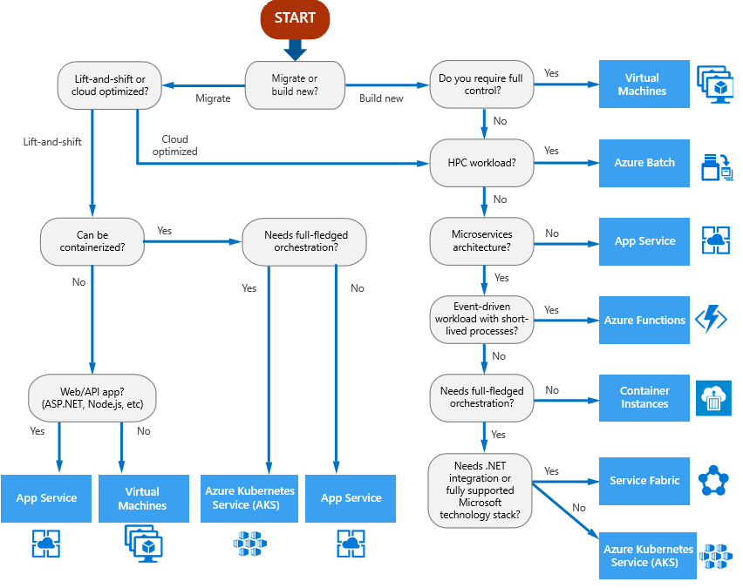
Choosing an Azure Compute Service
"Lift and shift“ – (rehosting) - migrating a without redesigning the application or making code changes
Cloud optimized - take advantage of cloud-native features and capabilities
Notes:
The output of the flowchart is a starting point. Next, perform a detailed evaluation of the service to address the needs.
"Lift and shift" is a strategy for migrating a workload to the cloud without redesigning the application or making code changes. Also called rehosting.
Cloud optimized is a strategy for migrating to the cloud by refactoring an application to take advantage of cloud-native features and capabilities.

Slide 7


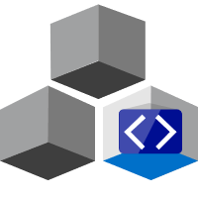
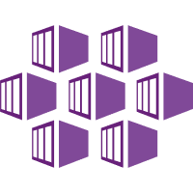
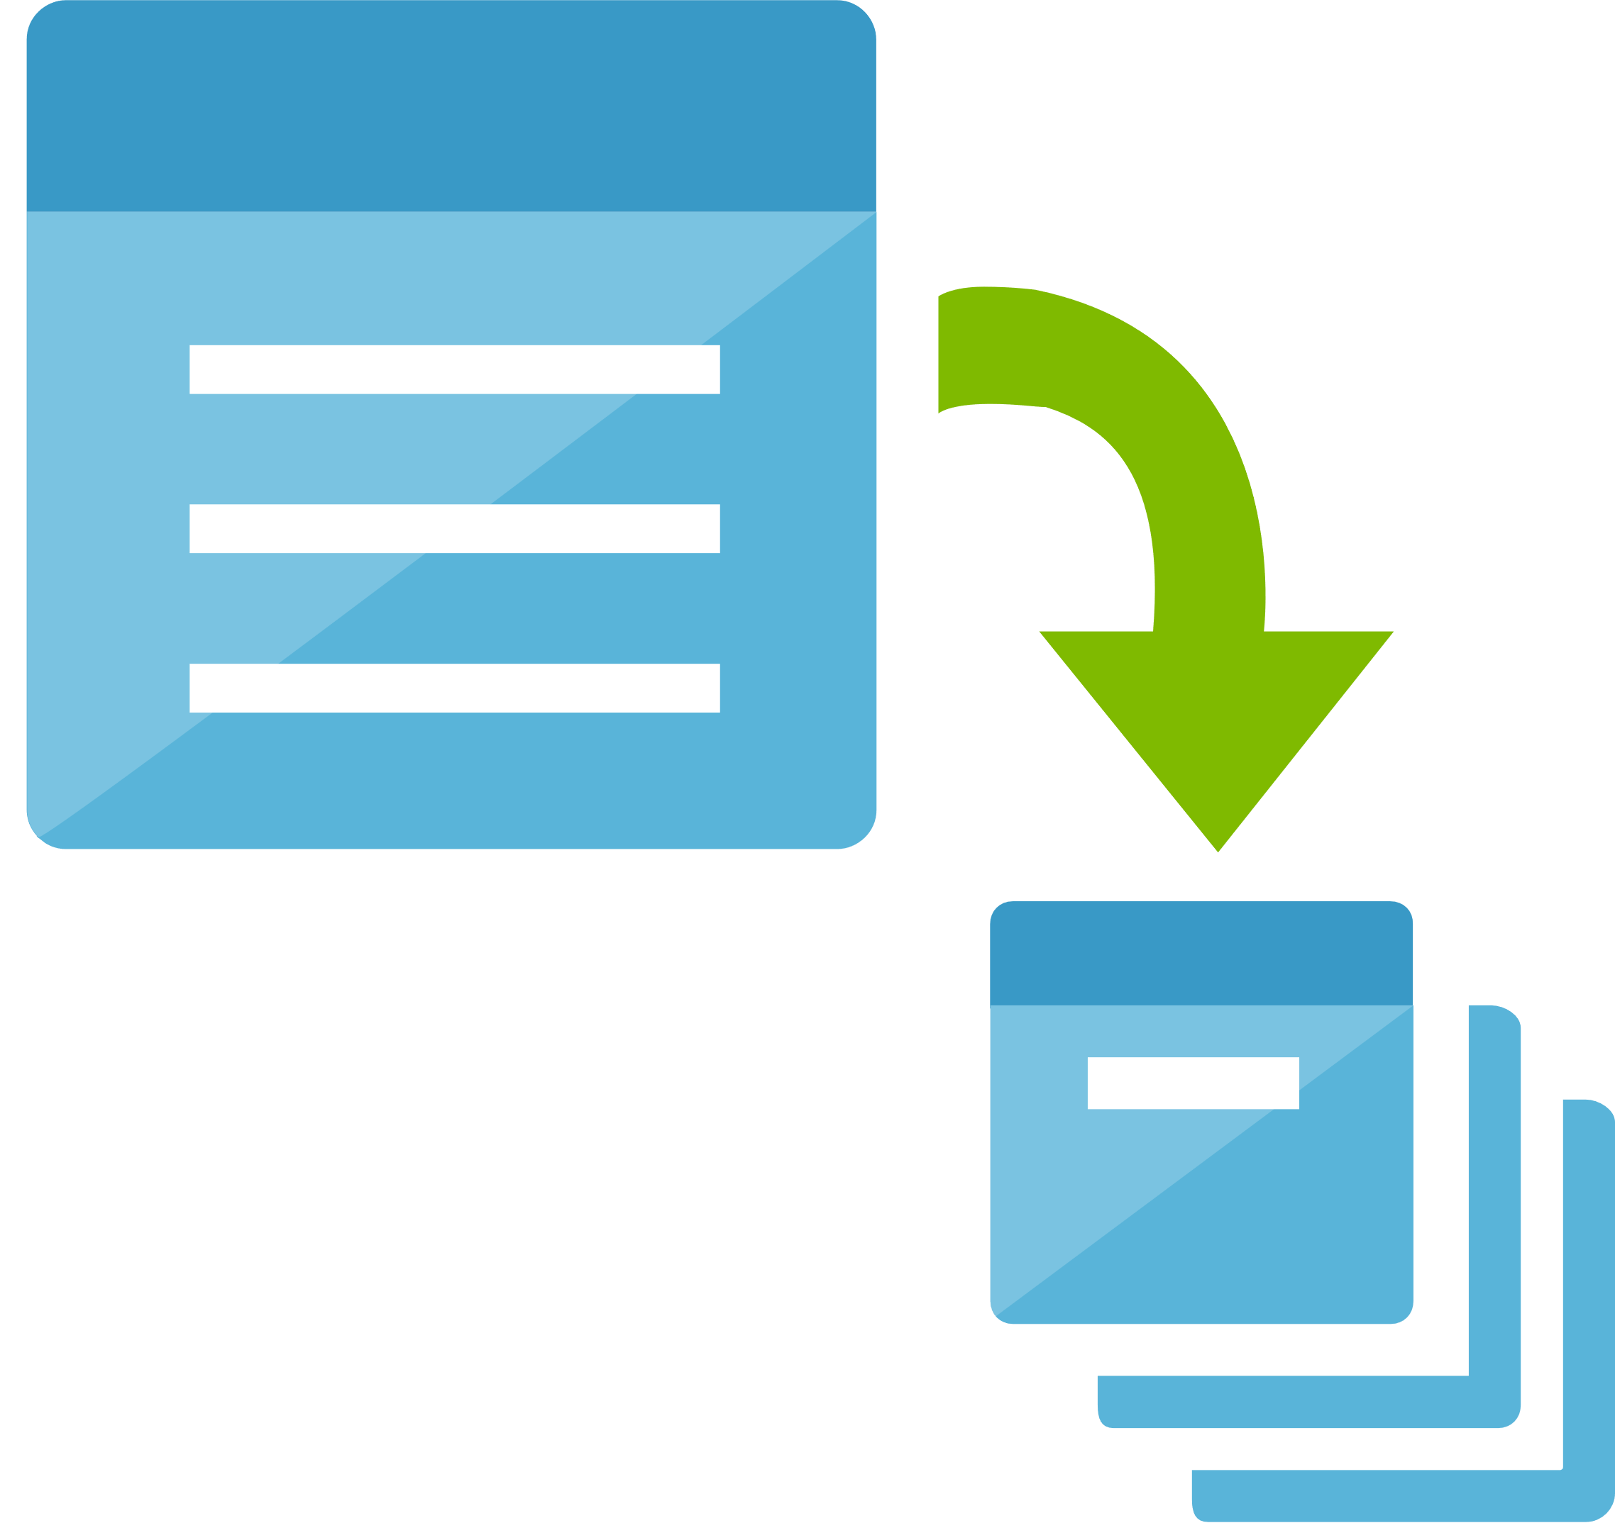
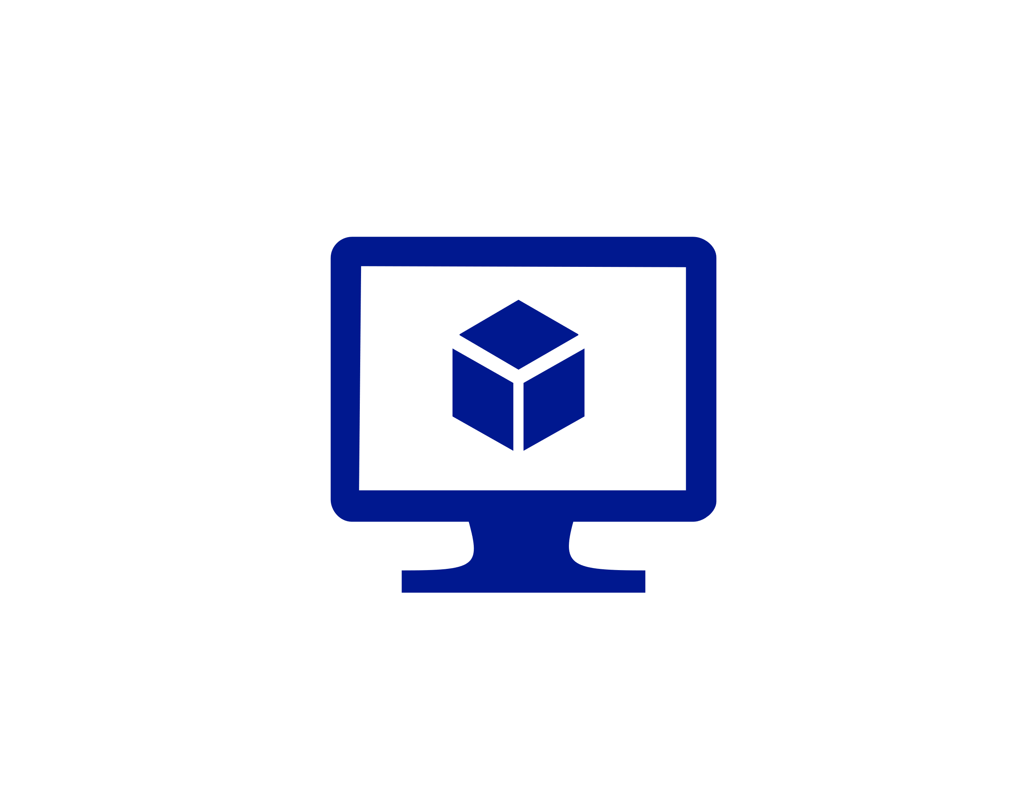
Review - Features
App Service. A managed service for hosting web apps, mobile app back ends, RESTful APIs, or automated business processes.
Functions . A managed PaaS service.
Batch . A managed service for running large-scale parallel and high-performance computing (HPC) applications
Azure Kubernetes Service (AKS). A managed Kubernetes service for running containerized applications.
Container Instances . The fastest and simplest way to run a container in Azure, without having to provision any virtual machines and without having to adopt a higher-level service.
Virtual machines . Deploy and manage VMs inside an Azure virtual network.

Slide 8
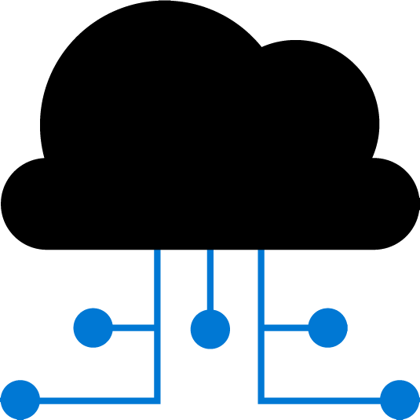

Review - Hosting Models
Infrastructure-as-a-Service (IaaS) lets you provision individual VMs along with the associated networking and storage components
IaaS gives the most control, flexibility, and portability
Platform-as-a-Service (PaaS) is a complete development and deployment environment in the cloud, with resources that enables delivery of everything from simple cloud-based apps to sophisticated, cloud-enabled enterprise applications
Notes:
IaaS gives the most control, flexibility, and portability, but you provision, configure and manage the VMs and network components.
PaaS services fall somewhere in between.

Slide 9
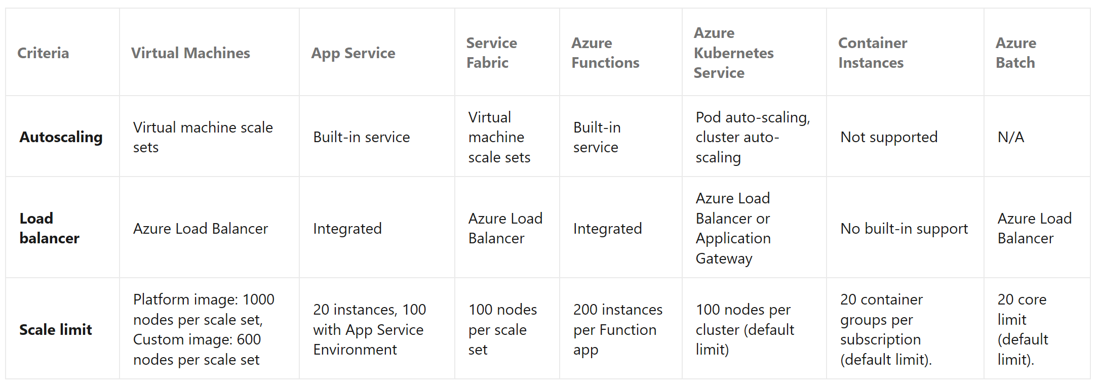
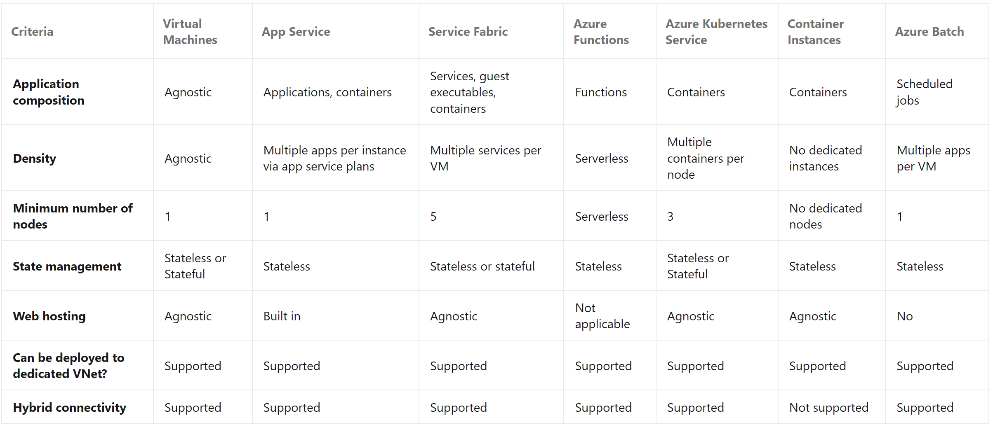
Service Limits and Cost
Consider the following aspects of the service:
Service limits
Cost
SLA
Regional availability
Notes:
Discuss Subscription Service limits, soft limits and hard limits
https://docs.microsoft.com/en-us/azure/azure-resource-manager/management/azure-subscription-service-limits

Slide 10
Scalability

Slide 11
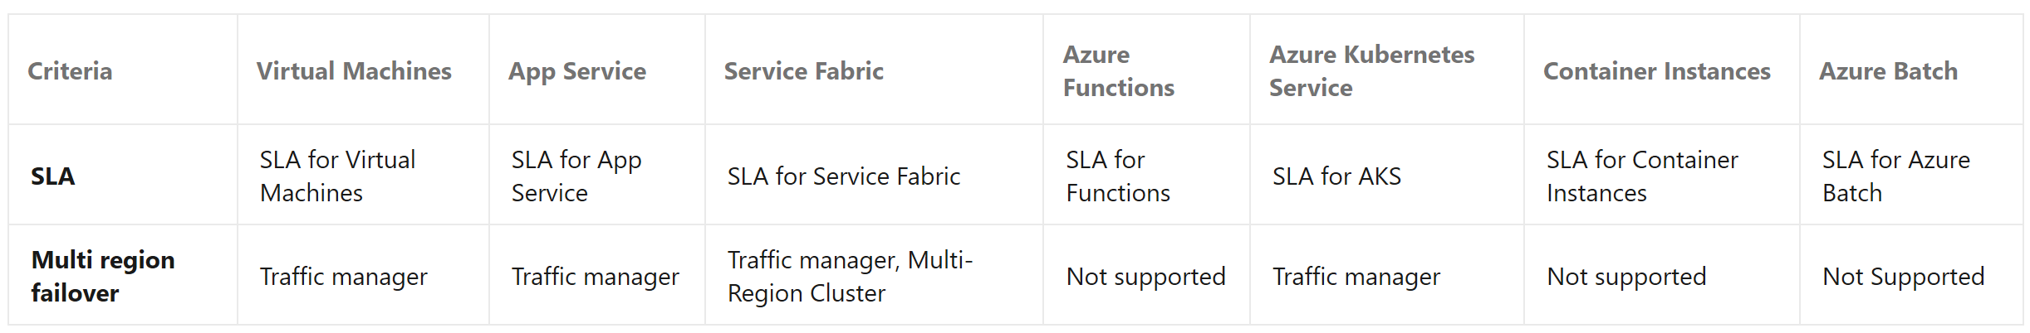
Availability
Lesson summary: The output from the flowchart at the beginning of this lesson is a starting point for consideration.
Next: Perform a more detailed evaluation of the service to see if it meets your needs.

Slide 12
Determine Appropriate Compute Technologies

Slide 13
Choosing an Azure Compute Option for Microservices
A service orchestrator that manages services running on dedicated nodes (VMs).
A serverless architecture using functions as a service (PaaS).
Notes:
Compute refers to the hosting model for the computing resources that applications run on.
The two options are: Containers with Orchestration PaaS.
With a serverless architecture, you don't manage the VMs or the virtual network infrastructure… you deploy code and the hosting service handles putting that code onto a VM and executing it.
This approach tends to favor small granular functions that are coordinated using event-based triggers.
Azure Functions is a serverless compute service that supports various function triggers, including HTTP requests, Service Bus queues, and Event Hubs events.
See : https://docs.microsoft.com/en-us/azure/architecture/microservices/design/compute-options

Slide 14
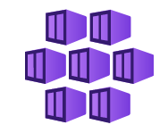
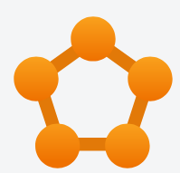

Containers with Orchestration
Azure Kubernetes Service (AKS): AKS provisions Kubernetes and exposes the Kubernetes API endpoints
Service Fabric: Distributed systems platform for packaging, deploying, and managing microservices
Also: Docker Enterprise Edition and Mesosphere DC/OS can run in an IaaS environment on Azure.
Notes:
AKS:
Hosts and manages the Kubernetes control plane, performing automated upgrades, automated patching, autoscaling, and other management tasks.
Service Fabric:
Microservices can be deployed to Service Fabric as containers, as binary executables, or as Reliable Services.

Slide 15



Containers
Portability
Agility
Density
Resource isolation
Notes:
Portability. A container image is a standalone package that runs without needing to install libraries or other dependencies.
Containers can be started and stopped quickly—spin up new instances to handle more load or to recover from node failures.
Density. Packing multiple containers onto a single node is useful when the application consists of many small services.
Resource isolation. Limit the amount of memory and CPU that is available to a container to ensure that a runaway process doesn't exhaust the host resources.

Slide 16
Serverless
Orchestrator or Serverless?
Manageability
Flexibility and control
Portability
Application integration
Cost
Scalability
Notes:
Orchestrator or Serverless?
Manageability
Serverless apps easy to manage—the platform manages all the of compute resources.
Orchestrator—you must keep an eye on load balancing, CPU and memory usage, and networking.
Flexibility and control. With serverless architecture—give up some degree of control because management details are abstracted.
Portability. Orchestrators can run on-premises or in multiple public clouds.
Application integration. Use Azure Logic Apps to coordinate a set of Azure Functions.
Cost. Serverless apps—Pay for the actual compute resources consumed. Serverless and Orchestrator require paying for additional resources (storage, databases, etc…)
Scalability. An orchestrator scales out by increasing the number of service instances running in the cluster, or, adding additional VMs to the cluster.

Slide 17
Recommend a Solution for Containers

Slide 18
When to use Azure Kubernetes Service
Feature | Considerations and Decisions
Identity and Security | AD Integration
Logging and Monitoring | Azure Monitor for Containers, custom monitoring solutions
Auto Scaling | Manual and Auto, scheduled and programmatically, horizontal and vertical
Cluster Node Upgrade | Azure managed cluster upgrade and software updates
GPU support | GPU enabled node pools
Storage Volumes | Static and dynamic storage volumes
Virtual Network (Vnet) | Can be deployed into existing Vnet.
HTTP Routing | Add-on HTTP application routing support
Docker Image | Default support for docker file image support
Private Container Registry | Integrates with ACR (Azure Container Registry), public and private repositories
Notes:
There are two ways to scale an application: up or out. The former refers to adding capacity to a single resource, while the latter refers to adding more resources to increase capacity.
Increase/decrease the number of pods/nodes not the capacity of a single pod/node. https://docs.microsoft.com/en-us/azure/aks/cluster-autoscaler

Slide 19
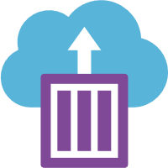
When to use Azure Container Instances
Fast startup times:
ACIs start containers in seconds—no need to provision and manage VMs.
Container access:
ACIs expose container groups directly to the internet with an IP address and a fully qualified domain name (FQDN).
Hypervisor-level security:
ACIs guarantee apps are as isolated in a container as they would be in a VM.
Custom sizes:
ACIs optimum utilization to exact specifications of CPU cores and memory. Pay based on need and billed by the second.
Linux and Windows containers:
ACIs can schedule Windows and Linux containers with the same API. Specify the OS type when you create container groups.
Persistent storage:
Retrieve and persist state ACIs—direct mounting of Azure Files shares backed by Azure Storage.

Slide 20
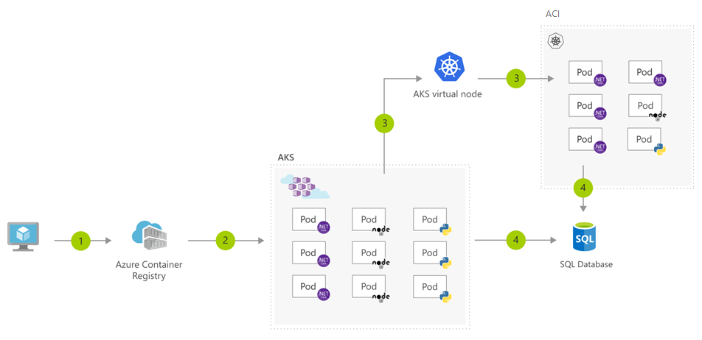
Bursting from AKS with ACI
1
User registers container in Azure Container Registry
2
Container images are pulled from the Azure Container Registry
3
AKS virtual node, a Virtual Kubelet implementation, provisions pods inside ACI from AKS when traffic comes in spikes
4
AKS and ACI containers write to shared data store

Slide 21
Provisioning Solutions for Azure Compute Infrastructure

Slide 22

Provisioning Solutions for Azure Compute Infrastructure
Why automate compute provisioning?
Faster Deployment
Automated provisioning provides…
Reduce complexity
Notes:
Why automate compute provisioning?
It takes time to implement an architecture with many servers manually. Configure OS, install software, configure that software, etc…
Redeployment to recover from an attack or software testing. Note: manual deployment takes time.
Automated provisioning provides
Reduced complexity of a deployment configuration by creating a complete architecture using a script or a configuration file.
Deployment it in a single operation that automates configuration and accelerate deployment.

Slide 23
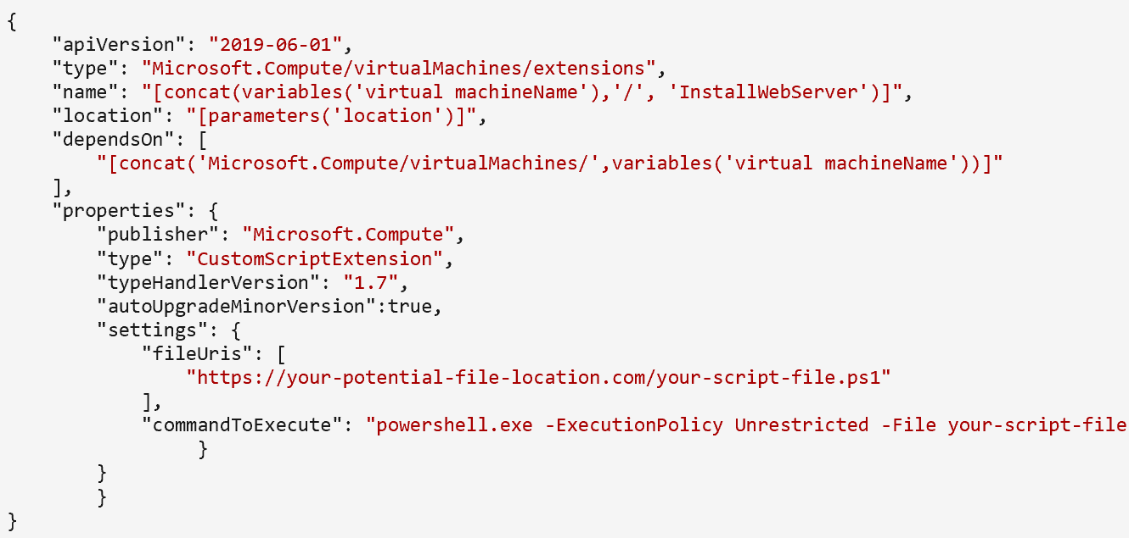
Custom Script Extension
PowerShell scripts on a file server, GitHub, Azure Storage, or other location can be accessible to a VM
An extension looks for a script that should be run on the VM
The script is downloaded and executed on the target VM to apply the changes described in the script
Add a custom script extension to a virtual machine through Azure Resource Manager templates, PowerShell, or the Azure CLI

Slide 24
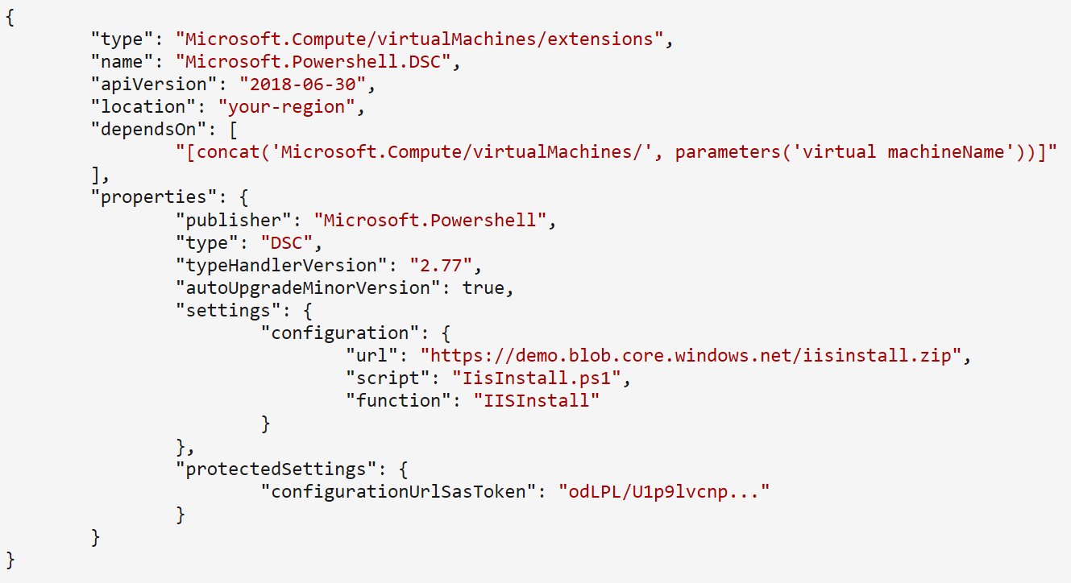
Desired State Configuration (DSC) Extensions
DSC defines a state for machines instead of writing manual instructions on how to achieve a state for each machine
A DSC extension handler can enforce states
The configurations for states can be in various locations– Azure Blob storage, internal file storage
The DSC extension handler grabs the configuration and implements the state on the target VM
If reboots are necessary, DSC continues to execute the state configuration after the reboots are completed

Slide 25
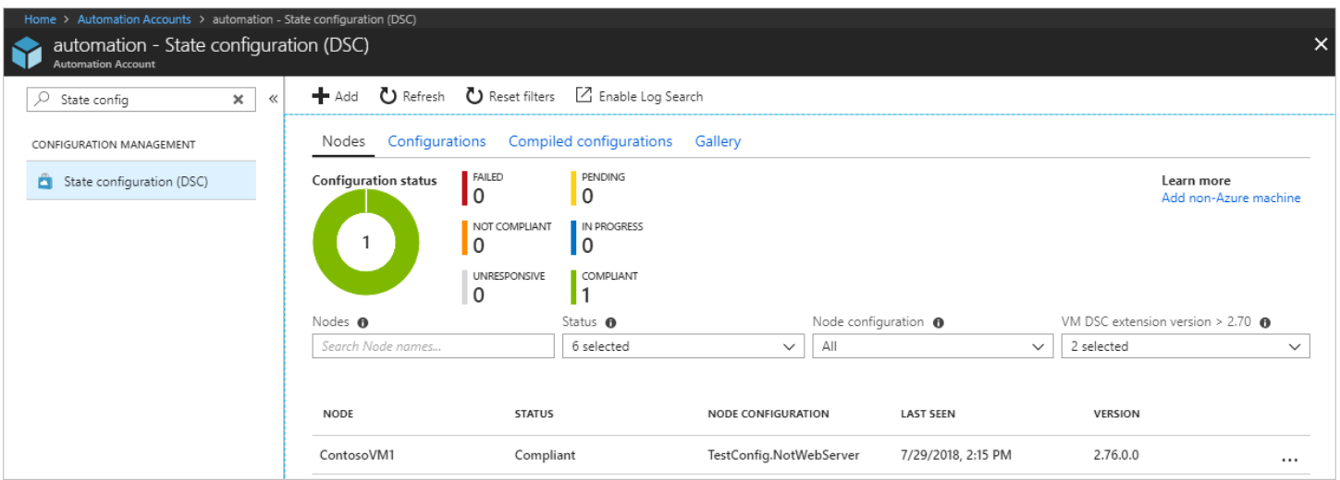
Azure Automation State Configuration
A service to manage and deploy DSC Configurations
Azure VMs, on-premises and other clouds
Ensures VMs are assigned the correct configurations automatically.
Each VM reports back on what its current state is and shows whether it has achieved the desired state
Use Azure portal or Azure PowerShell for implementation

Slide 26

Chef
Chef server can handle 10,000 nodes (machines) at a time
Automates infrastructure deployment on-premises or in the cloud
Chef is hosted and runs as a service
Chef server to manage your recipes
Recipes are commands to run configurations
Chef's knife tool is used to deploy VMs and simultaneously apply recipes to VMs
Knife tool is installed on the admin workstation—the machine where policies are created—running knife commands from the admin workstation

Slide 27
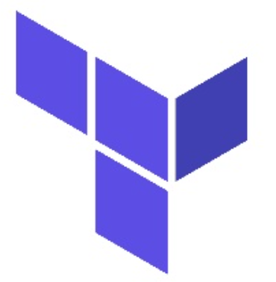
Terraform
Open-source infrastructure-as-code software tool
Executes Terraform scripts
Use Hashicorp Configuration Language (HCL) or Json
Easy-to-read script templates defining resources to create
Different cloud service providers (Azure,AWS)
Requires Terraform installation (VM/CloudShell)

Slide 28
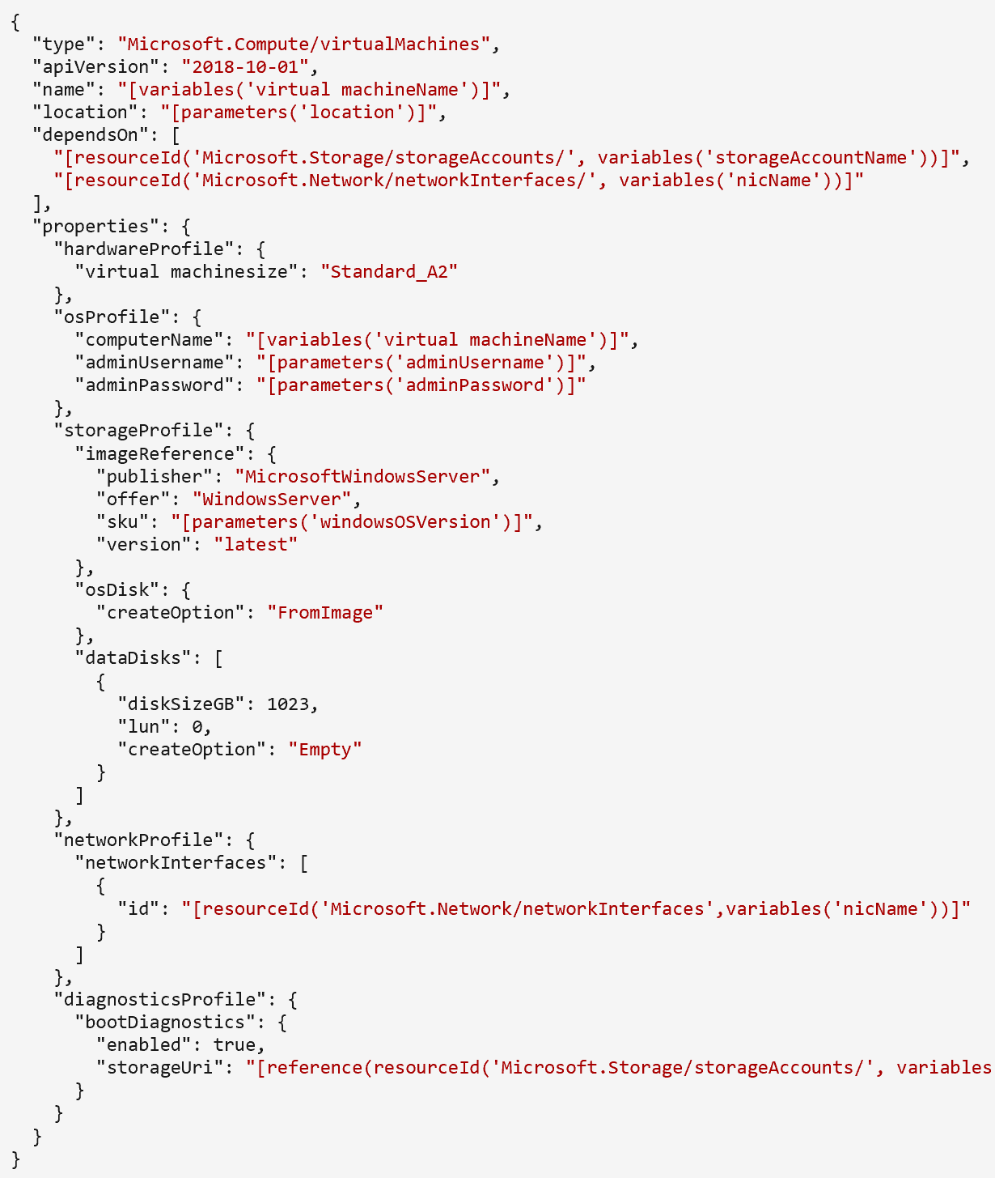
Azure Resource Manager (ARM) Templates
ARM templates are JSON files used to define the Azure resources for deployment
Enables embedding extensions into VMs
Deployment via Azure PowerShell, the Azure CLI, or the Azure portal.
Allow for testing ARM templates before deployment
Notes:
Test toolkit:
https://docs.microsoft.com/en-us/azure/azure-resource-manager/templates/test-toolkit

Slide 29
Module 1 Review Questions

Slide 30
Online Role-based training resources: Microsoft Learn https://docs.microsoft.com/en-us/learn/

Slide 31
Thank you.

