Slide 1

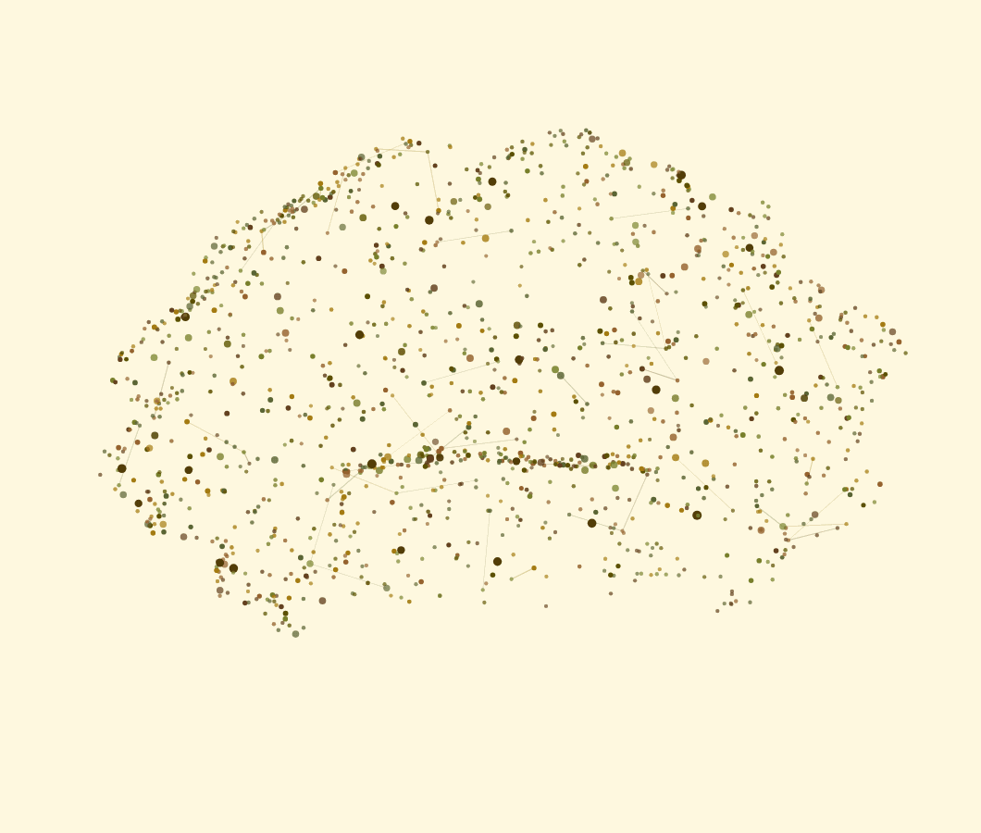
BY
TEAM BIERBYTES
NEUROBYTES
EEG-TO-VIDEO RETRIEVAL
See what the brain
watched.
From three seconds of EEG over the visual cortex, NeuroBytes ranks 102 candidate videos and finds the one the person was watching. The model never sees which video was watched: it compares the brain activity with the 102 candidate videos.
36.0%
top‑1, chance 0.98%
67.2%
top‑5, chance 4.9%
5.99
mean rank of 102
Sushruth Shivaraju and Ayush Shetty
SchubKI National AI Hackathon 2026, EEG mind-reading challenge (Constructor Technology)
1 / 7

Slide 2
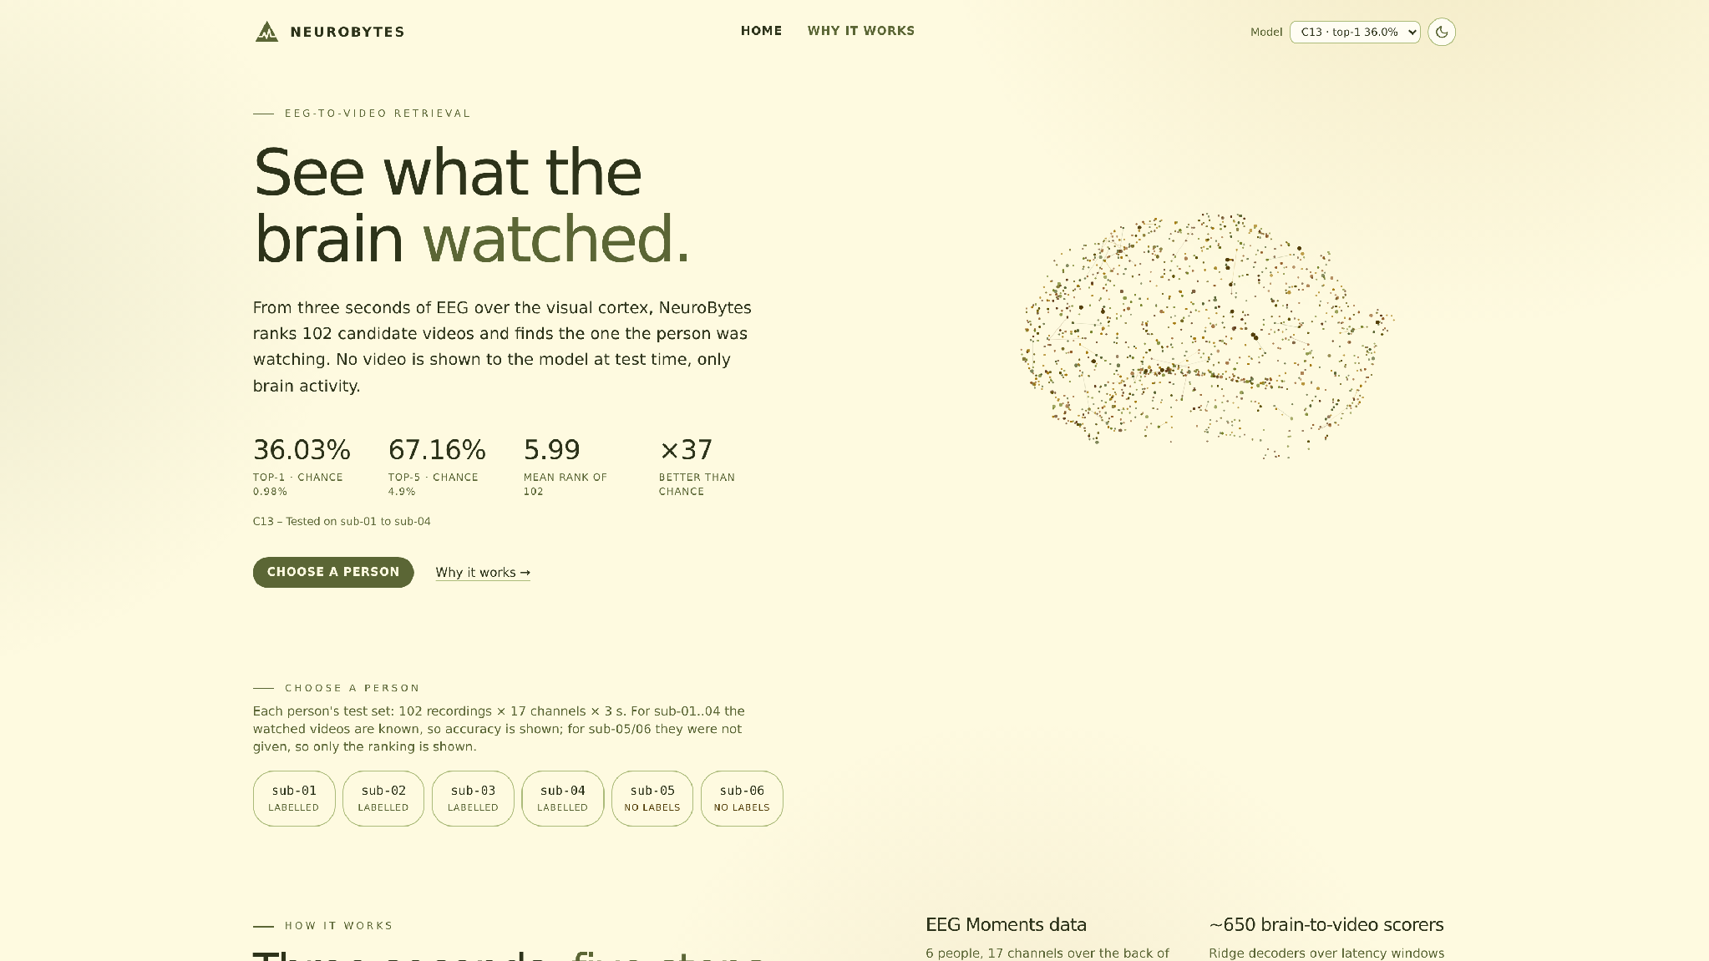
NeuroBytes
THE CHALLENGE
3 seconds of brain activity,
102 possible videos.
3 s
of EEG per recording, while a clip plays
17
posterior channels over the visual cortex
102
candidate videos to rank
408
development recordings, sub‑01..04
Chance level
top‑1 0.98% | top‑5 4.90% | mean rank 51.5 of 102
Data: organizers' EEG Datasets, 6 people, 850-970 training clips each.
2 / 7

Slide 3
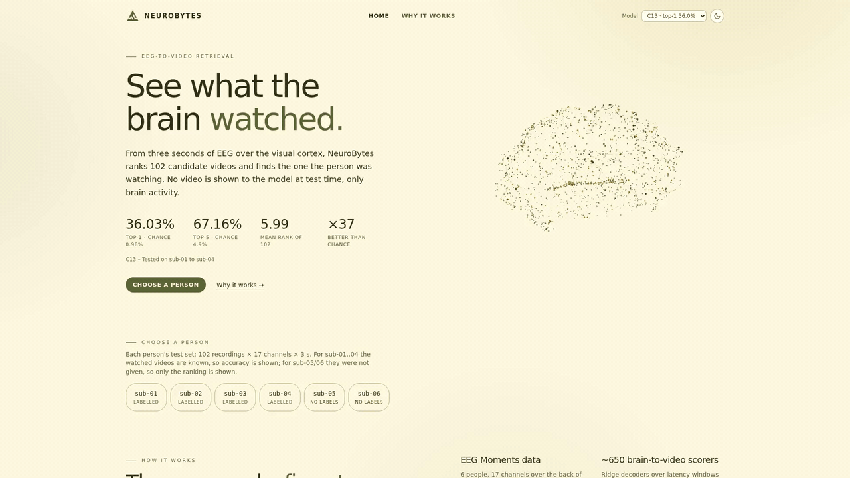
NeuroBytes
HOW IT WORKS
Three seconds, five steps.
01
Record
3 s of EEG while a clip plays
02
Window
0 to 700 ms after the clip starts
03
Decode
EEG to V-JEPA, CLIP, DINOv2, audio features
04
Fuse
rank fusion of ~590 scorers
05
Balance
CSLS hub removal + Sinkhorn
Final Pipeline: C13
3 / 7

Slide 4
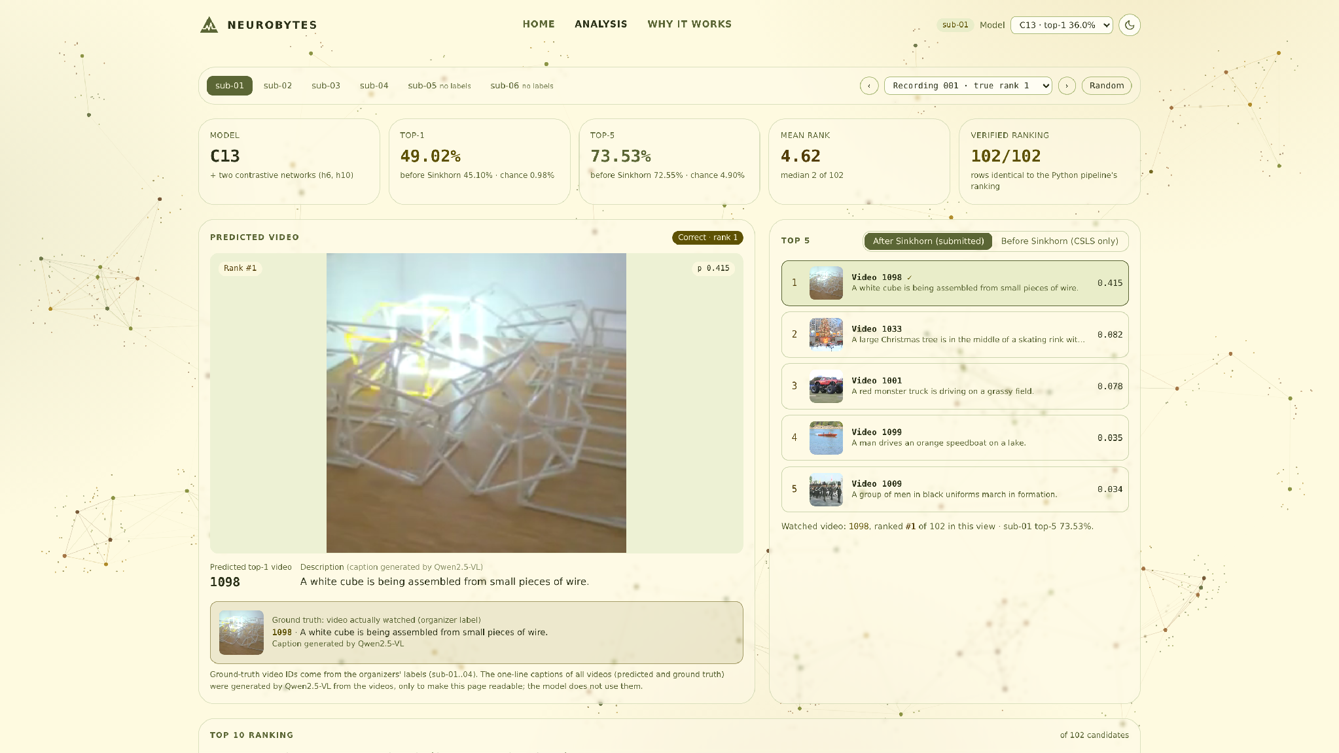
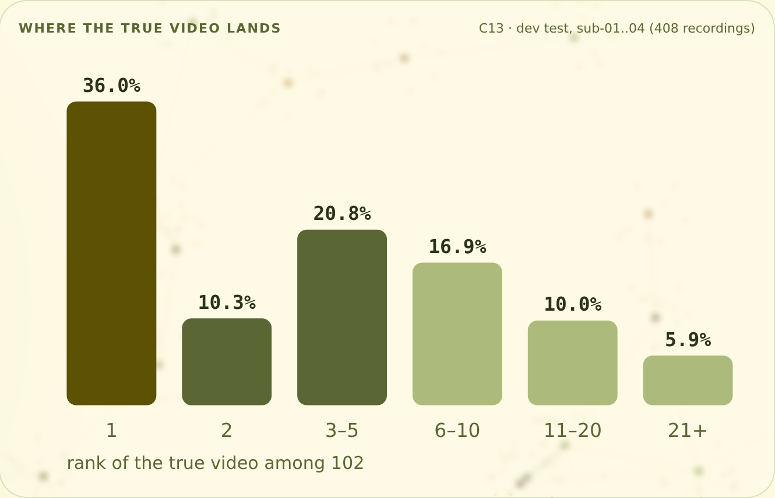
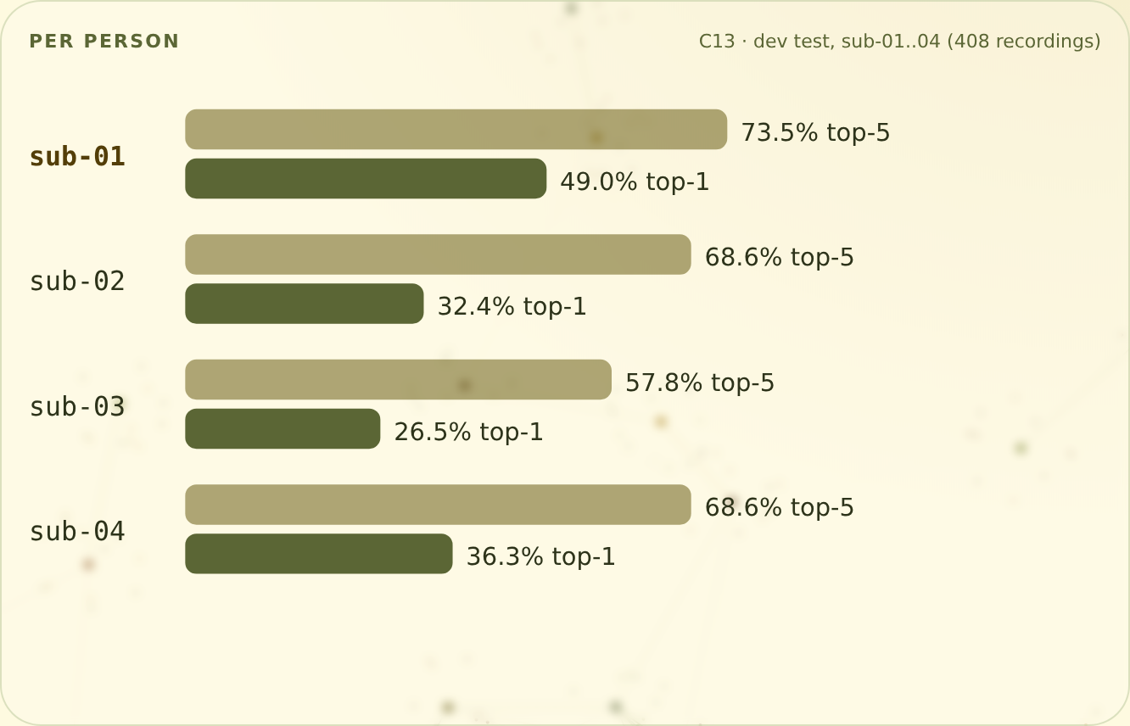
NeuroBytes
THE ANALYSIS SCREEN
Select a subject and recording to view the score breakdown.
Predicted video with the true clip highlighted. Top 5 with Qwen2.5-VL captions (display only, not used for ranking). Per-person ranks from the same 408 recordings.
4 / 7

Slide 5
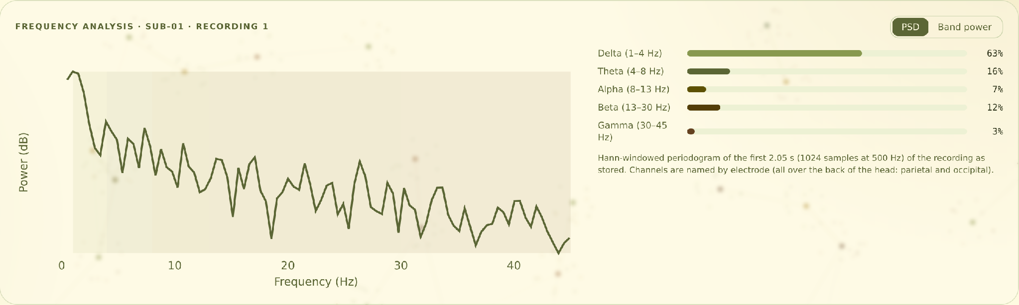
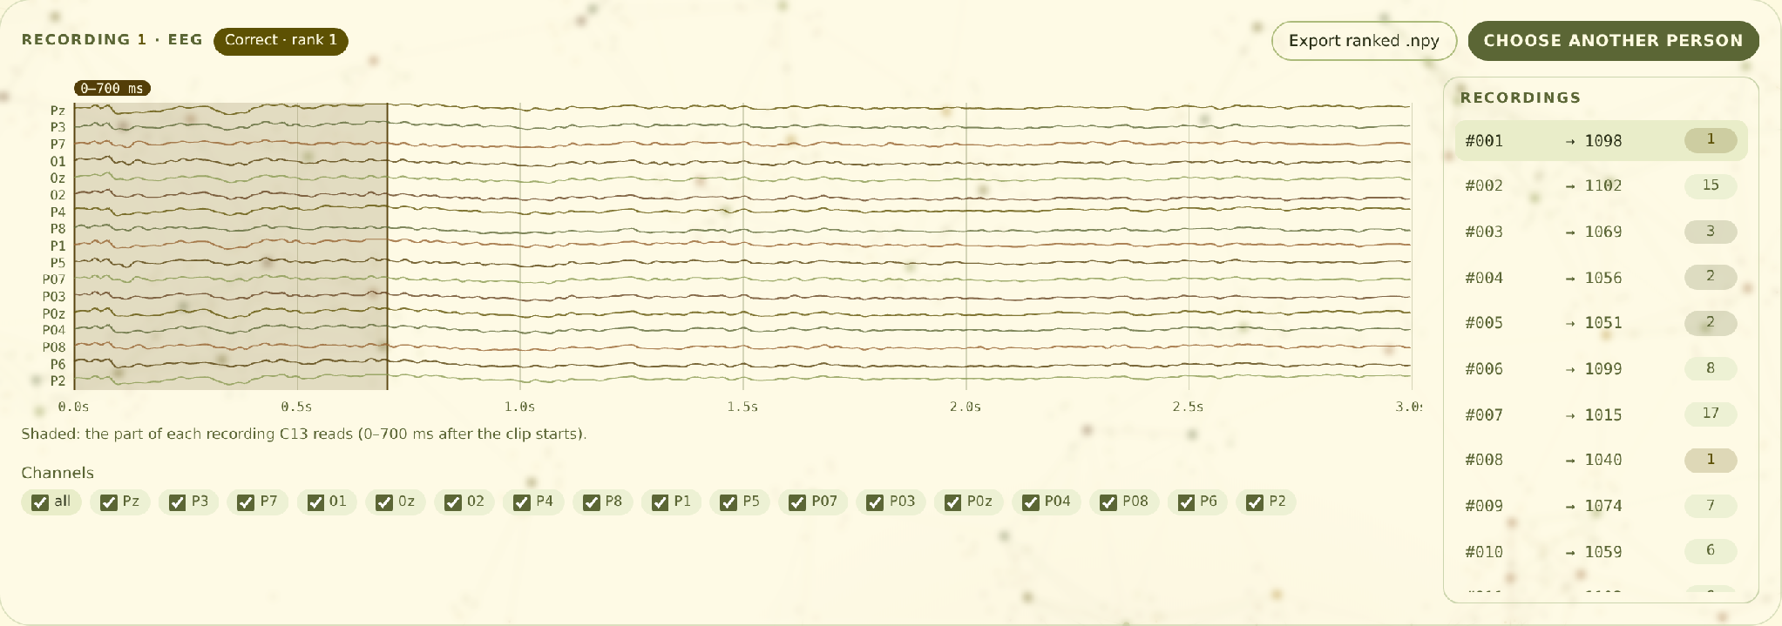
NeuroBytes
FREQUENCY AND EEG
Look at the right moment.
Each recording is 3 seconds long, but almost everything that identifies the video arrives
in the first fraction of a second.
The decodable signal sits in the first 800 ms, the classic visual ERP window: P1 (about 80 to 130 ms), N1 (about 120 to 200 ms), object categories from 130 to 170 ms, peaking at the N170.
The biggest win came from knowing when to look, not from a bigger video model.
5 / 7

Slide 6
NeuroBytes
ROBUSTNESS AND HONESTY
What holds, and what we disclose.
Run | Top-1 % | Top-5 % | Mean rank
Final C13 | 36.03 | 67.16 | 5.99
Without Sinkhorn | 32.35 | 66.67 | 6.34
New seeds 5-9 | 34.31 | 67.65 | 5.98
Cross-validation (held-out training videos) | 14.95 | 39.67 | 16.85
Chance | 0.98 | 4.90 | 51.5
Disclosures
• Development labels (sub‑01..04) were used to report results and to compare final candidates.
• EEG z-score statistics were fitted on all of a participant's training recordings, including validation folds (no labels, no test data).
• CSLS and Sinkhorn are batch post-processing over each participant's test recordings; a no-Sinkhorn fallback exists (it still applies CSLS).
• Qwen2.5-VL captions are display only and do not affect the ranking.
• Ranking among 102 known candidates, not unrestricted mind reading.
Same-seed rebuild is bit-identical.
Mean rank 6.00 on the CPU/Docker path. Validation uses held-out training videos and is a harder, different split.
6 / 7

Slide 7
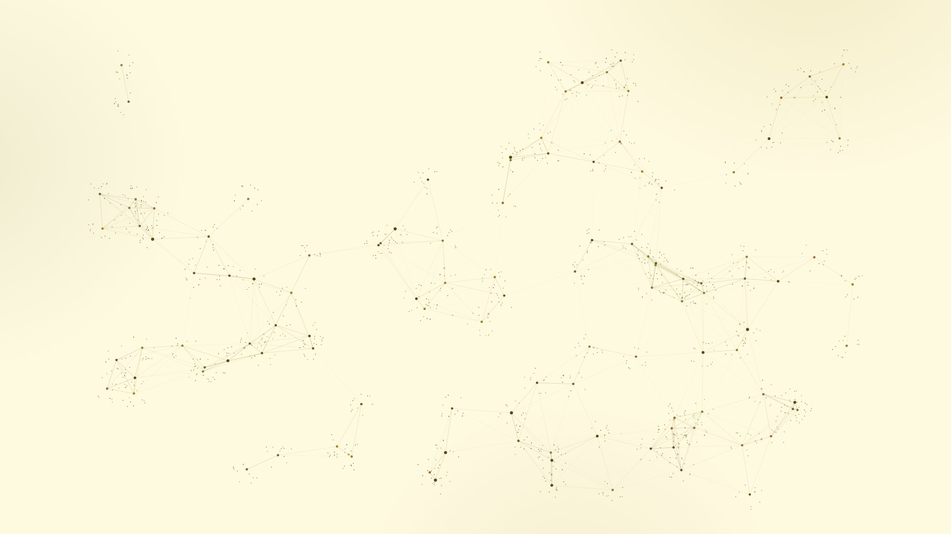
NEUROBYTES
BY
TEAM BIERBYTES
Thank you.
Three seconds of EEG, 102 candidates: the right video first 36.0% of the time, in the top 5 67.2% of the time.
Code github.com/Sushruths04/neurobytes
Weights release v1.0
Docker ghcr.io/sushruths04/neurobytes
Sushruth Shivaraju and Ayush Shetty
SchubKI National AI Hackathon 2026, EEG mind-reading challenge (Constructor Technology)
7 / 7

Slide 8
Backup
NeuroBytes
RESULTS
Every person well above chance.
Top-1 %
Top-5 %
36.0%
top‑1 pooled, 408 recordings
100
75
73.5
67.2%
top‑5 pooled
68.6
68.6
57.8
50
49.0
32.4
36.3
5.99
mean rank of 102 (6.00 CPU/Docker)
26.5
25
0
Chance: 0.98% top‑1, 4.90% top‑5, mean rank 51.5. Development test labels were used to report and compare final candidates.
sub‑01
sub‑02
sub‑03
sub‑04
B01

Slide 9
Backup
NeuroBytes
PROGRESSION
From 11% to 36% top‑1, one step at a time.
Top-5 %
Top-1 %
80
66.7
66.2
67.4
67.2
62.2
60
57.4
52.5
35.5
38.7
35.0
36.0
40
30.9
32.6
34.6
29.7
26.5
23.0
20
11.0
11.5
14.0
0
J1
T1
T2
WF1
C3
C5
C10
C11
C12
C13
Development-test top‑1 / top‑5 (%) per milestone, 408 recordings. J1, T1, T2: single pipelines; WF1: window fusion; C3 to C13: combined candidates. Comparing candidates on development labels is disclosed.
B02

