Slide 1
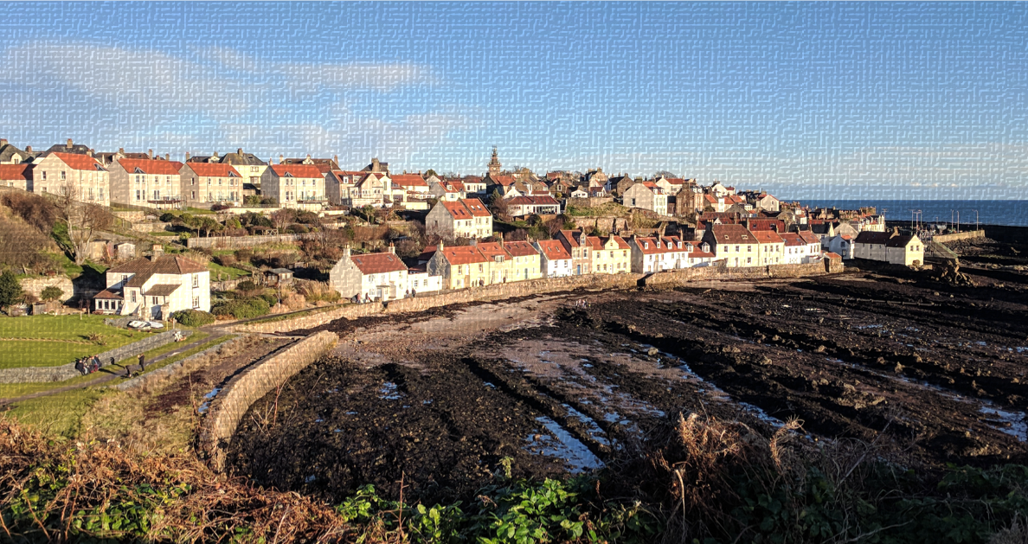
Ceremony: Cellardyke Town Hall
or Cellardyke Harbour
2:00 pm
Evening Doo: Anstruther Town Hall
7:30 pm

