Slide 1
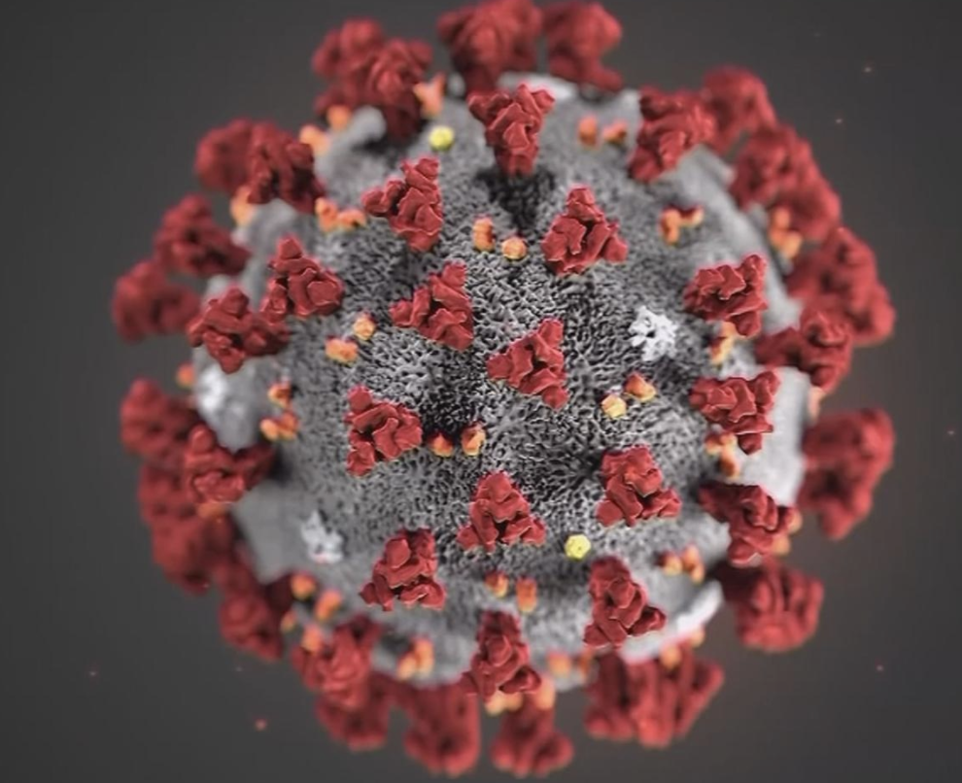
Capstone Project
Finding the Best Locations for New Covid19 Testing Sites

Slide 2
Business Problem
As the coronavirus (Covid-19) outbreaks this spring 2020, total confirmed cases are over one million in the United States and total death is over 70K by May 3rd, 2020. San Diego is the 8th largest city in the US with population over 1.5 million. By May 3rd, the reported Covid-19 cases in San Diego has been over 4000 and the number keeps increasing. Covid-19 is an infectious disease. The Covid-19 virus spreads primarily through discharge from the nose when an infected person coughs or sneezes. Currently, there is no preventive vaccine for Covid-19.
Due to the rapidly increasing number of Covid-19 cases, city government of San Diego plans to setup new Covid-19 testing sites.
This project is to find the best locations for coronavirus testing sites in San Diego, California.

Slide 3
Data
Number of coronavirus cases by zip code are from SanDiegoCounty.gov. Tabula library is imported to read data from the pdf file. COVID-19 Summary of Cases by Zip Code
San Diego zip code and corresponding neighborhoods are from Superior Court of California. Beautifulsoup is used to scrape the web data Zipcode and Neighborhoods
Google Geocode is used to pull out latitude and longitude information at each zip code
Foursquare API is used to search nearby medical or clinic centers at each zip code

Slide 4
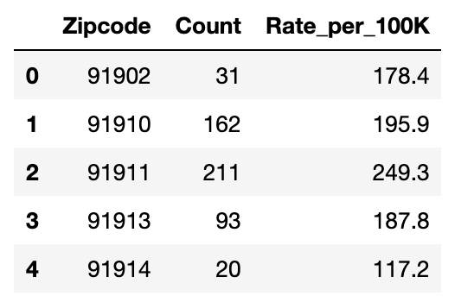
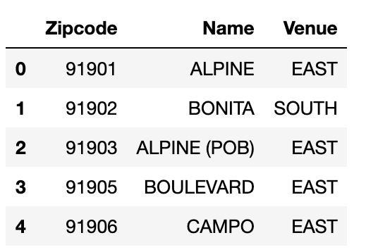
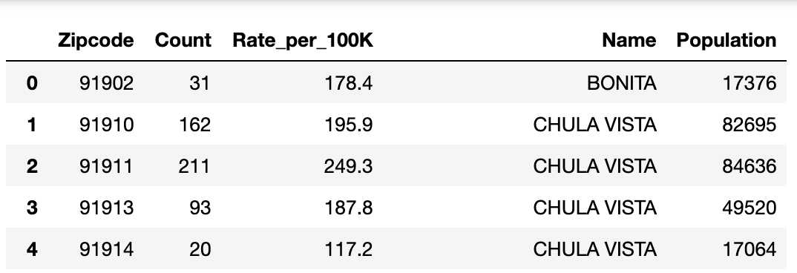
Data - Covid19 cases
Table1 below summarized number of reported coronavirus cases by ‘Count’ and ‘ Rate_per_100K population’ by zip code.
Table2 summarized zip code and neighborhoods in San Diego area.
Table3 combined table1 and table2 data based on same zip code. Population is calculated based on Count and Rate_per_100K.
Table1. Number of coronavirus cases by zip code (top 5 rows)
Table2. Zip code and corresponding neighborhood
Table3. number of coronavirus cases by zip code

Slide 5
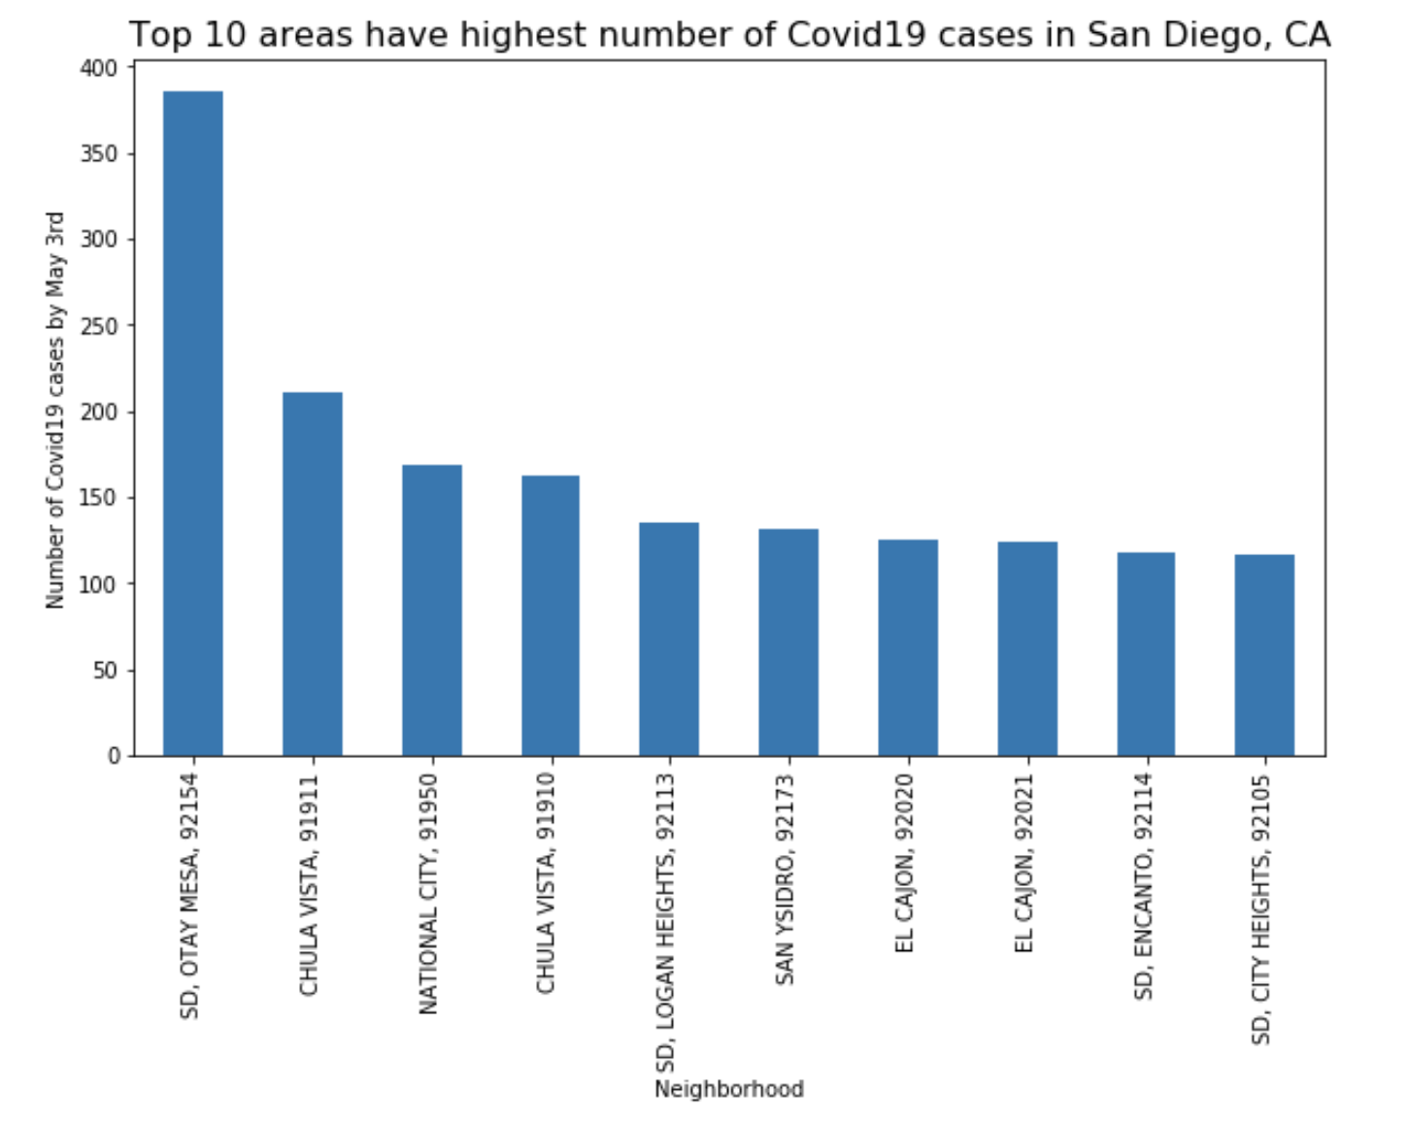
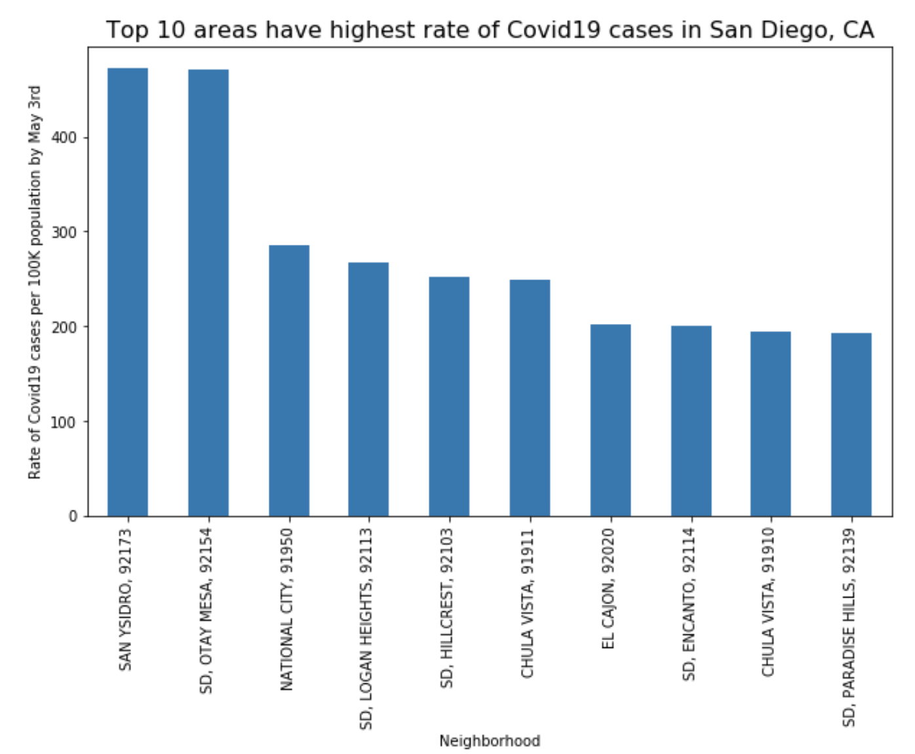
Data - Covid19 cases plots
Plots above show top 10 areas have highest Covid19 cases and highest Covid19 Rate.
From the plots above, Otay Mesa, 92154 has highest number of Covid19 cases, while San Ysidro, 92173 has highest rate of cases.

Slide 6
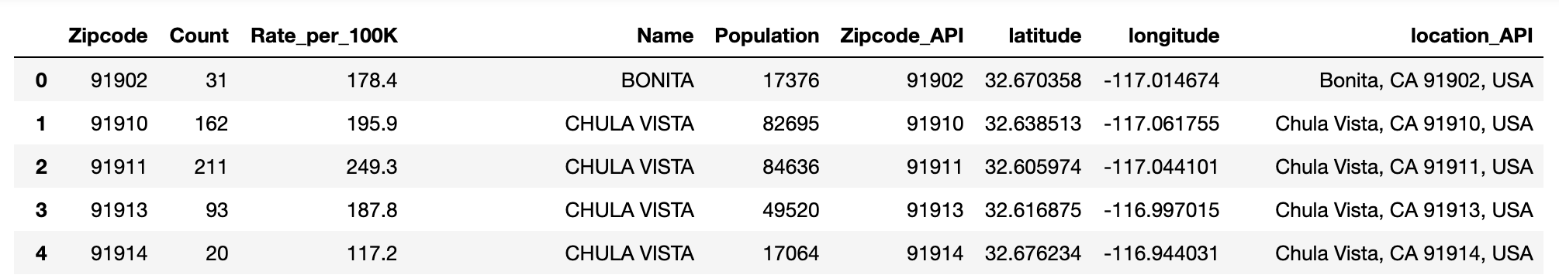
DATA – Covid19 cases with latitudes and longitude
Table4. Number of coronavirus cases by zip code with latitude and longitude
Google geocode is used to find location data for each zip code.

Slide 7
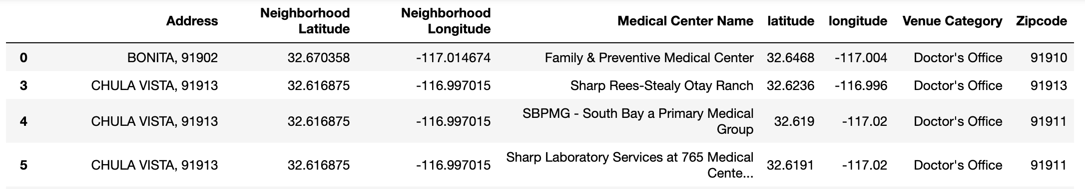
Data – Medical facilities
Foursquare API is used to search medical related venues in each zip code.
Since medical centers can provide test service and treatments, we plan to locate new test sites in areas lacks of medical service.

Slide 8
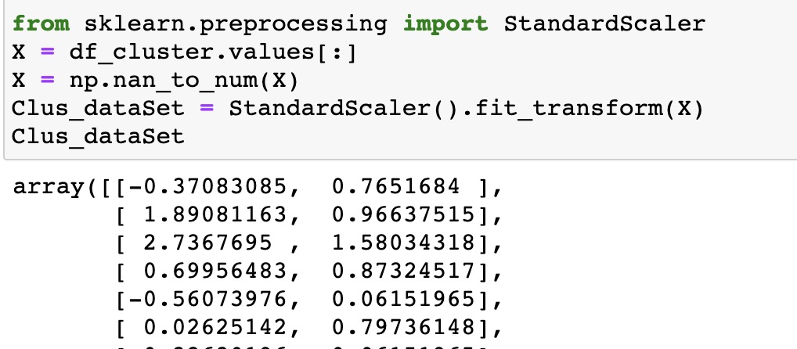
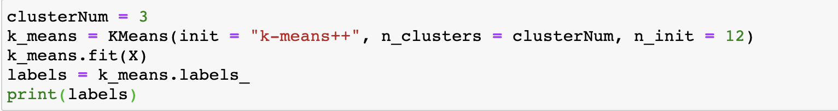
Methodology
Civid19 testing sites are built for potential patients. Both count and rate of Covid19 cases are important features while evaluating the testing site locations. Before modeling, standard scaler is used to normalize data with different magnitudes.
After normalization, machine learning k-means clustering algorithm is applied to the unsupervised Covid19 data. Cluster number is set at 3.

Slide 9
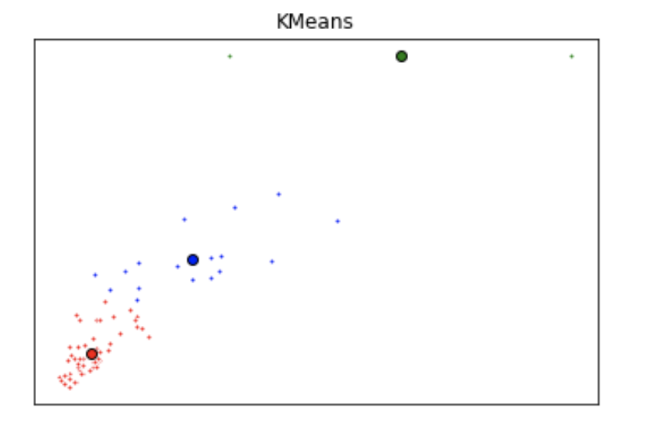
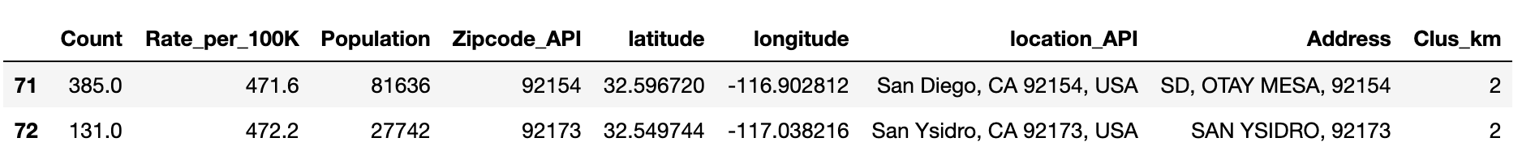
Results
Cluster | mean of Count | mean of Rate
0 | 28 | 71
1 | 104 | 199
2 | 258 | 272
Covid19 data was grouped into three clusters. k-Means visual plot is created. Covid19 data is well clustered to three groups.
Cluster2 is the group has highest mean values of Covid19 count and rate.
It is recommended to setup new Covid19 testing sites in cluster2 areas.

Slide 10
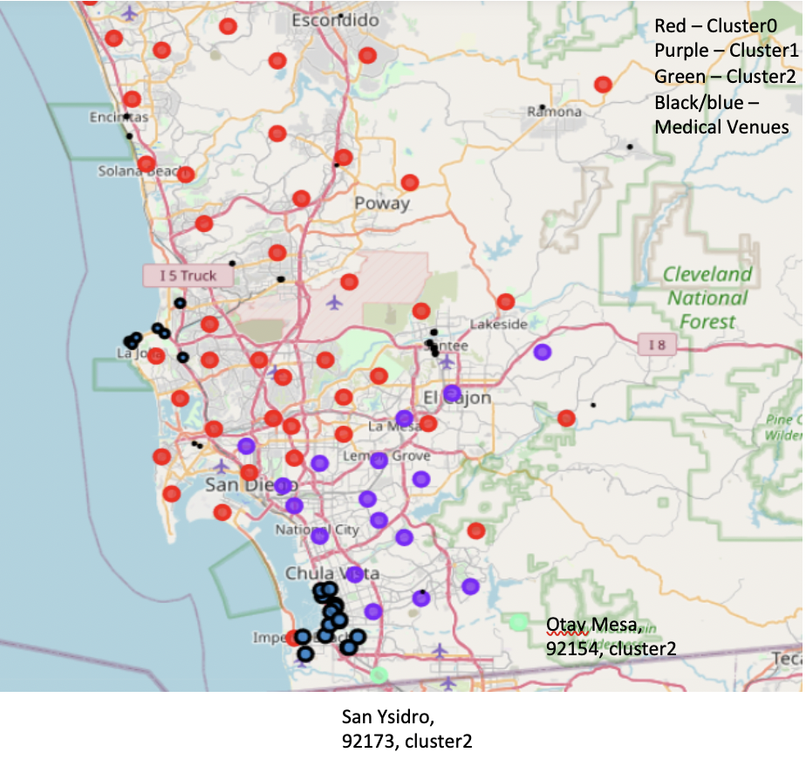
Results
A folium map is created with three clusters in red, purple, and green colors. Medical venues data is in black circle with blue filling, bigger size circle represents a greater number of medical venues in that area.
Cluster2 green has highest count and rate of Covid19. and there are no medical venues (black circles) near Otay Mesa, 92154 (green bottom right).
It is highly recommended to set up a new testing site in Otaytes Mesa, 92154.

Slide 11
Discussion
From Foursquare API, it only returns medical venues within search range of each zip code. Medical venues out of range are not counted.
Since the Covid-19 is highly infectious, drive-thru testing sites are recommended. With drive-thru sites, people do not come in contact with other patients, which limits opportunities for disease transmission.

Slide 12
Conclusion
k mean clustering is used to analyze Covid19 cases in San Diego area. Cluster2 is the group has highest count and rate of Covid19 cases.
Foursquare API is used to search for medical venues in San Diego area.
Otay Mesa, 92154 is belong to cluster2, and there is no medical venues near this area.
It is highly recommended to set up a testing site in Otaytes Mesa, 92154.

