Slide 1

How to make a successful movie
in terms of high rating & high grossing?
Time
Genre
Budget
Actor
Successful Movie
Genre
REvenue
Rating
Actor
Budget
Director
Director
PPP
ROI
* The bubble with dotted line will be presented in this PPT

Slide 2
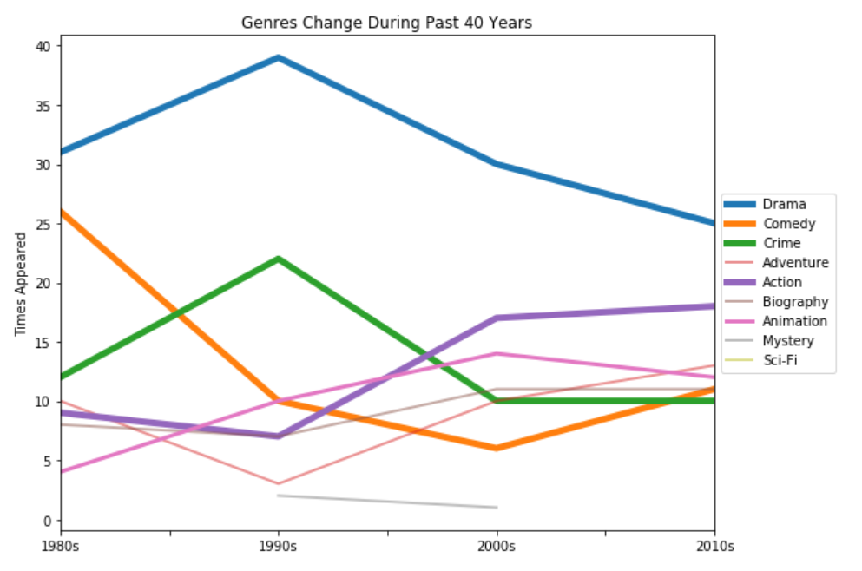
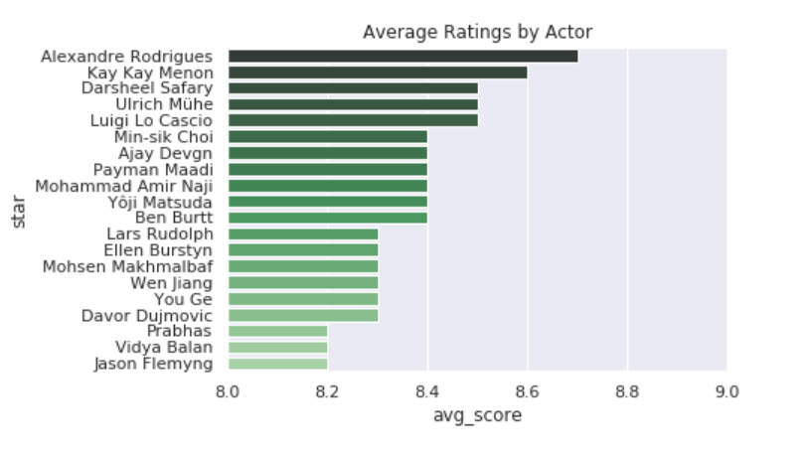
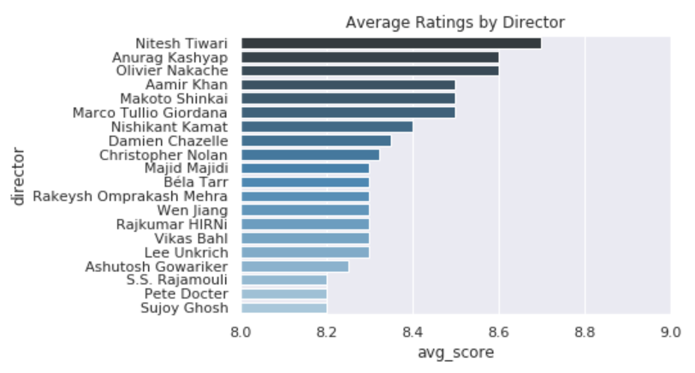
Genre → Rating
Director & actor → Rating
Drama (blue line): always highly appear but goes down. Comedy (orange line): popular genre in the 1980s but it dropped a lot. Crime (green line) was very popular in the 1990s, but it was not that popular in other decades.
Action (purple line): becomes more and more popular these years. Animation (pink line) also shows a upward sloping trend.
Actors and directors may also affect the ratings of movies. Alexandre Rodrigues shows to be the actor with highest ratings, and Nitesh Tiwari shows to be the director with highest ratings.

Slide 3
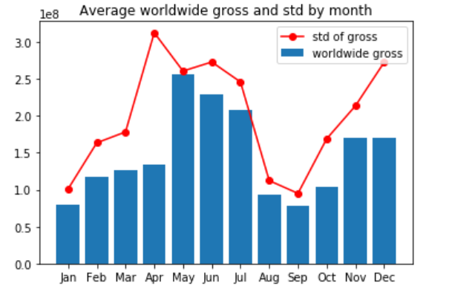
Releasing time → Gross
 | For all | For famous directors | For unknown directors
Best release time | May, June, July | May and July. High gross, highly competitive | Nov, Feb and Mar are less competitive and moderately profitable
Worst release time | Sep, Oct, Nov. | Aug, Sep, Oct has little gross | April is highly competitive with little gross

Slide 4
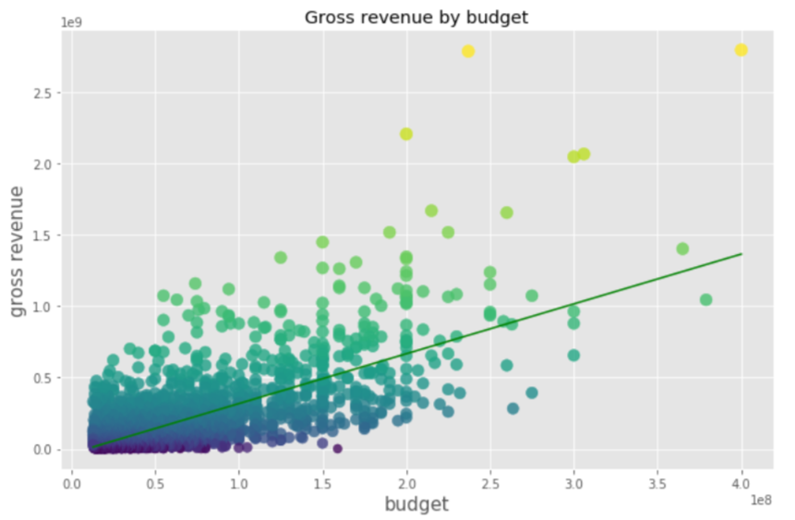
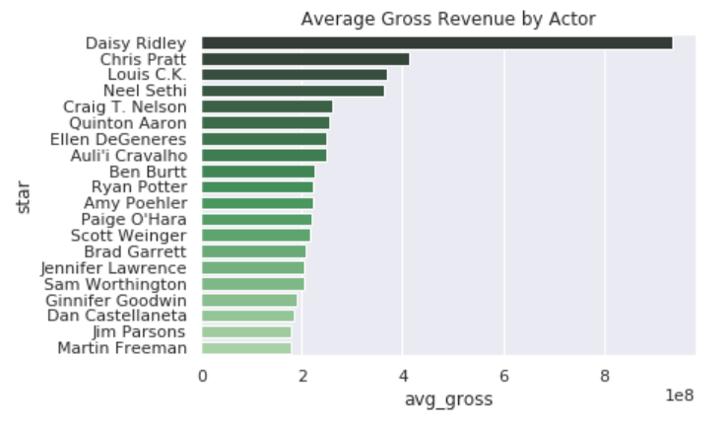
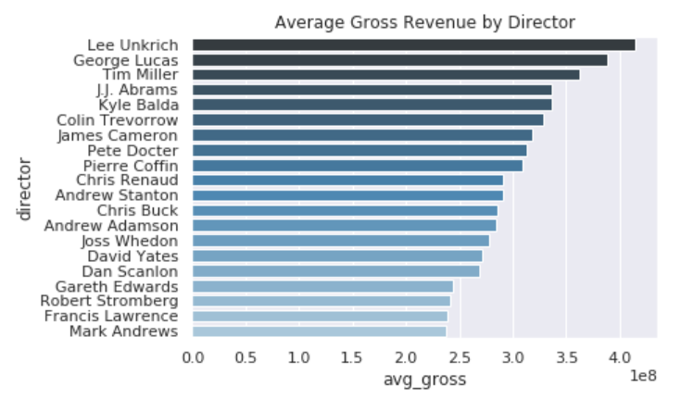
Budget → Gross
Director & actor → Gross
Run linear regression on production budget and worldwide gross.
worldwide_gross_hat = 3.5budget-32m
There are other features that determine the gross such as director, main actors, time of release,genre etc.
Actors and directors may also affect the gross revenues of movies. Daisy Ridley shows to be the actor with highest average gross revenues and Lee Unkrich shows to be the director with highest average gross revenues.

Slide 5
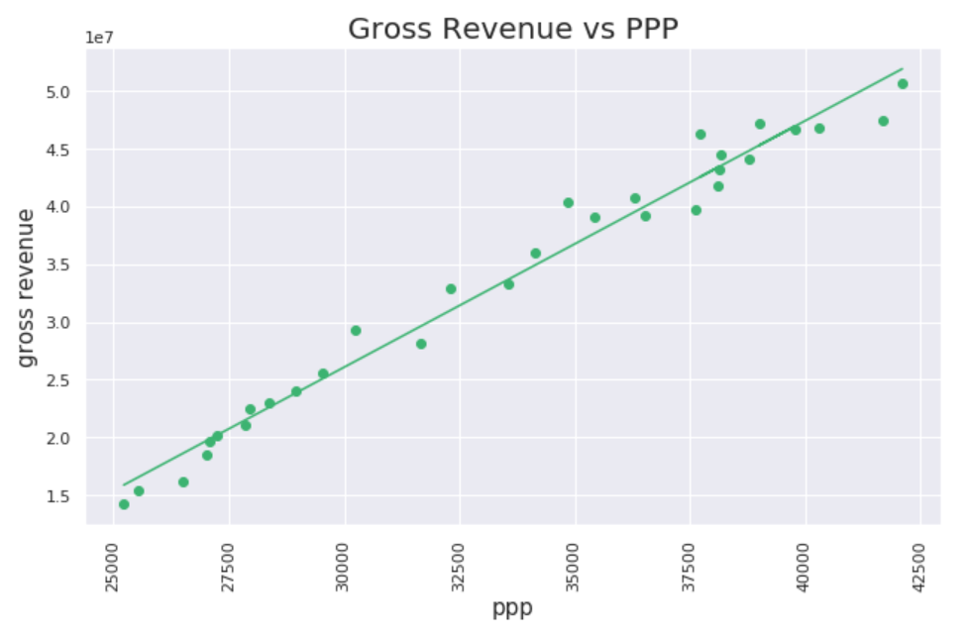
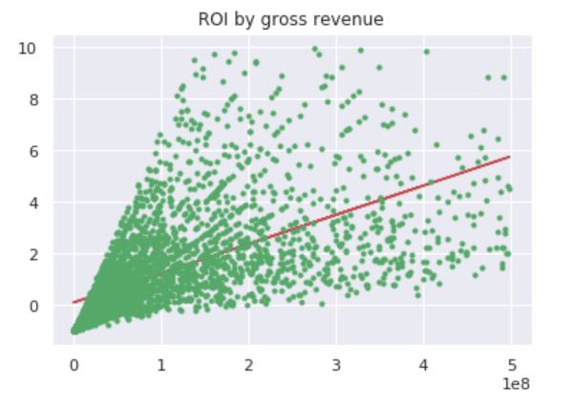
PPP → Gross
Gross → ROI
The linear relationship between gross revenue and income (ppp) shows to be statistically significant. As real disposable income grows over the years, the gross revenue of movies increases.
From our regression result, gross revenue alone can hardly define profitability. We believe budget also plays a significant role. However, for young and new directors, it is more important to gain fame instead of a one-time profit. In this case, gross revenue is a better indicator for popularity since high revenue means that many people have seen the film.

