Slide 1

Library Management System using C++
Explore the power of C++ in building a comprehensive library management system. Streamline book inventory circulation with this robust software solution.
Team Member
Sarad Chandra Acharya
Susmita Dangal
Prajita Thapa

Slide 2

Features
Offers a robust set of features to efficiently manage library operations
Includes user and resource management
Provides book issue and deposit functionality
Comprehensive CRUD (Create, Read, Update, Delete) functionality for book records

Slide 3

Objectives
The key objectives of this library management system are to streamline book circulation, improve resource tracking, and simplify administrative tasks. It aims to provide an efficient, user-friendly platform for managing book inventory, and book lending activities.

Slide 4
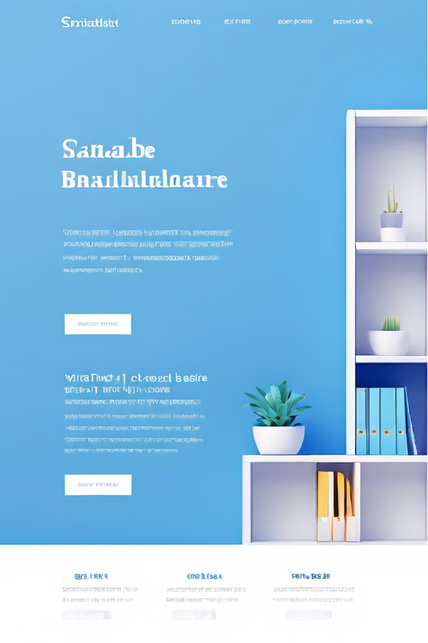

Limitations of Library Management System
A C++ Library Management System often has a console-based interface, limited scalability, basic file storage, weak security, and lacks advanced features and multi-user support. It faces cross-platform issues, complex error handling, and challenges integrating with modern applications, impacting overall usability and scalability.

Slide 5



Flowchart Overview
User Login
1
Access main menu
Main Menu
2
Book Issue, Book Deposit, Administrative, Exit
Administrative Menu
3
CRUD operations on book records
The flowchart overview illustrates the key steps in the library management system application built with C++. The central focus is on the main menu, which can only be accessed after a successful user login. The main menu offers 4 options: Book Issue, Book Deposit, Administrative, and Exit. When users choose the Administrative menu, the user can perform various CRUD operations on book records.

Slide 6
CRUD Operations for Book Records
1
Create
2
Read
Add new book records to the system, capturing all necessary details such as student information, book titles, authors, and availability status.
Retrieve and display existing book records, allowing users to search and view specific information.
3
Update
4
Delete
Modify existing book records, such as updating contact information, changing book details, or marking books as issued or returned.
Remove book records from the system, ensuring proper handling of associated data, such as issued books and student enrollment.

Slide 7
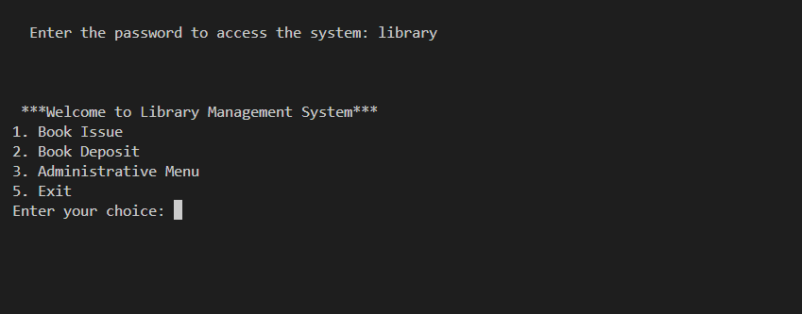
Login panel

Slide 8
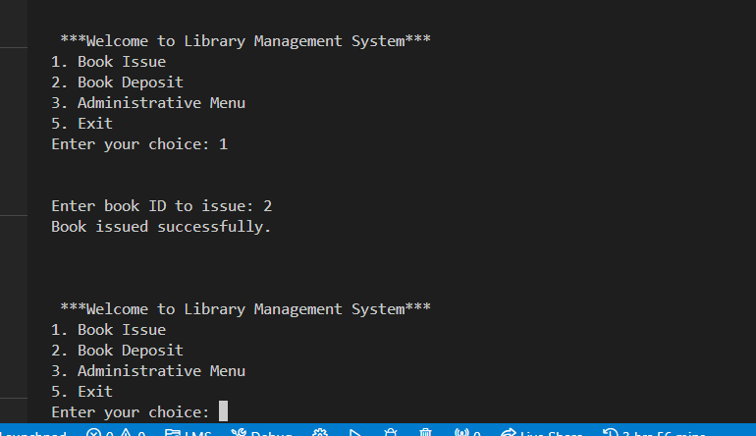
Book Issue

Slide 9
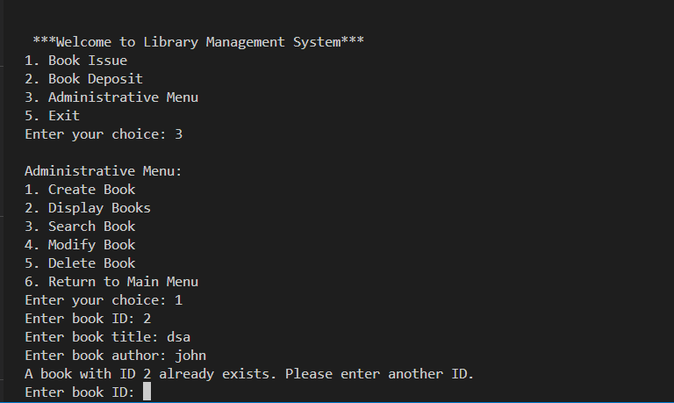
Administrative Menu

Slide 10
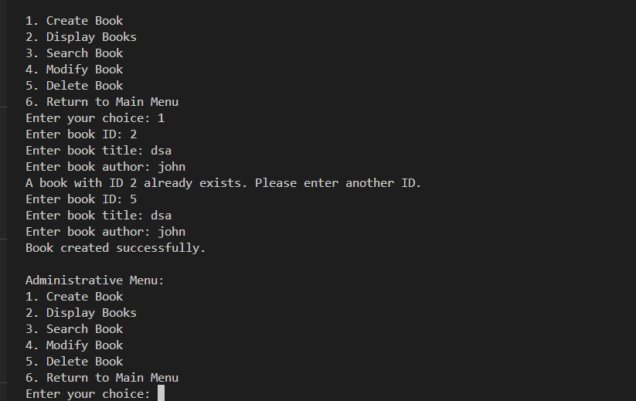
Create Book

Slide 11
Conclusion
In conclusion, our Library Management System (LMS) represents a significant step forward in enhancing the efficiency, accessibility, and overall user experience within the library environment. By integrating all the manual interaction of the librarian into a interactive system developed using C++ which streamlines essential functions such as adding, updating, deleting and student record management. This system not only facilitates better resource management but also ensures seamless interactions between users/students and library staff.

