Slide 1
Career_Track_Dashboard
File created on: 19-03-2025 21:55:30

Slide 2
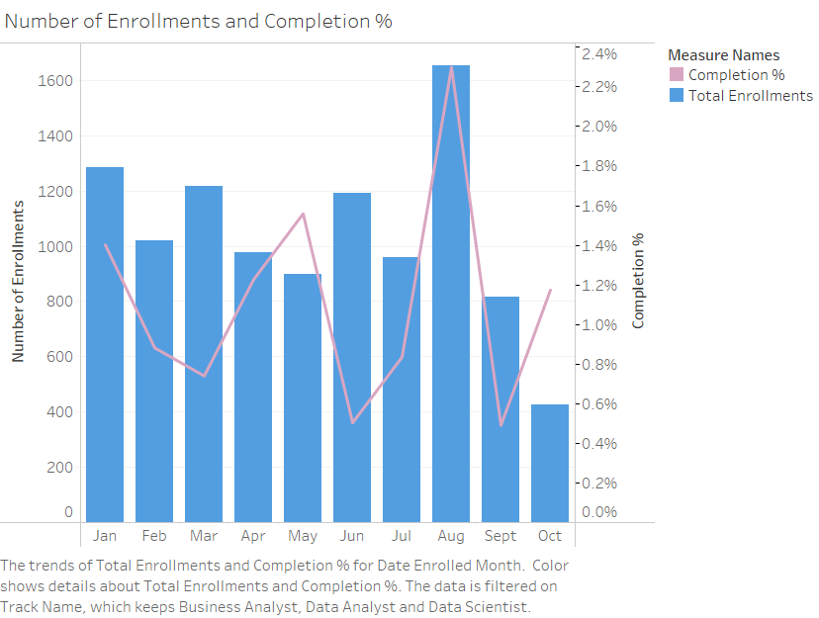

Slide 3
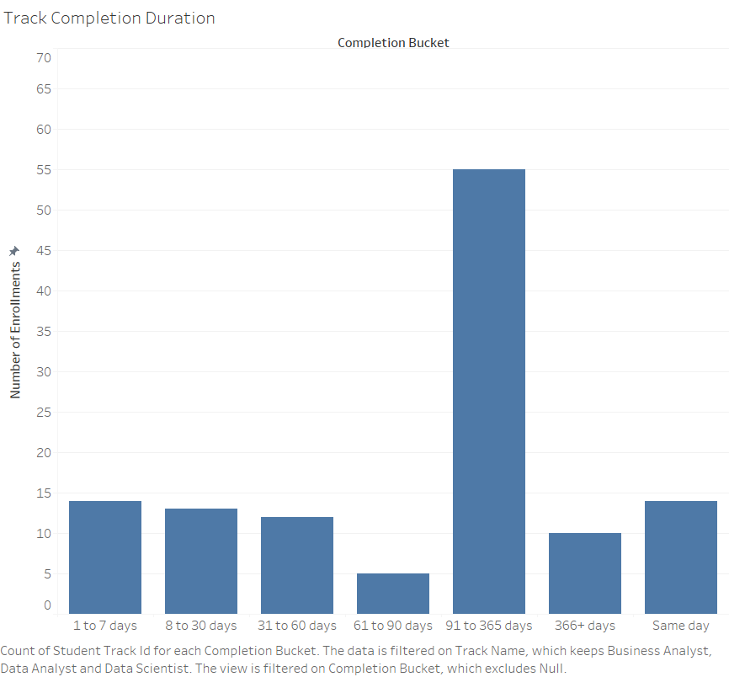

Slide 4
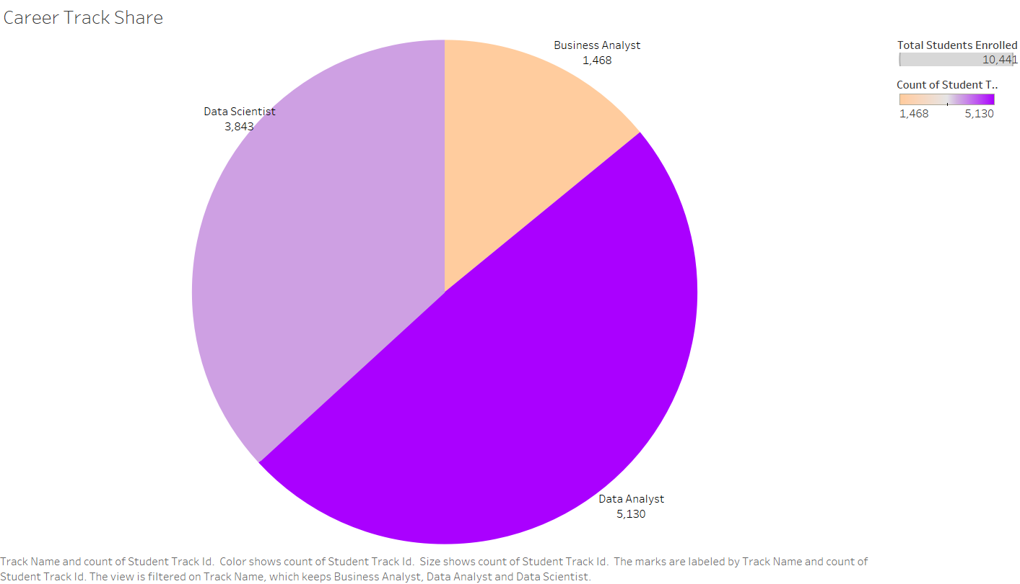

Slide 5
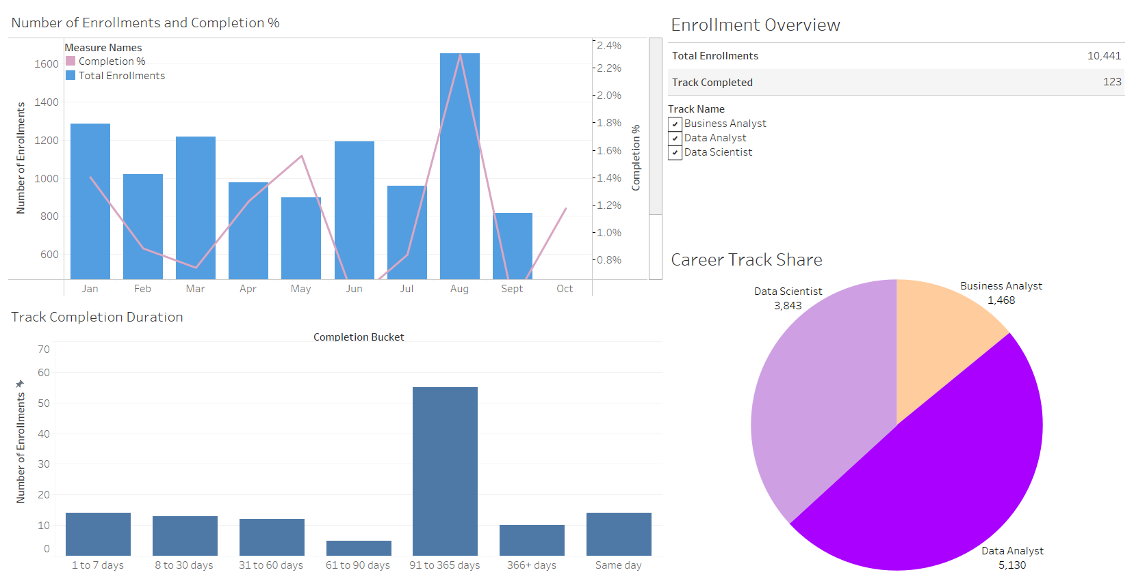

Slide 6
