Slide 1


DEPARTMENT OF COMPUTER SCIENCE & ENGINEERING
INTERNSHIP PROJECT REPORT ON
ANDRIOD APPLICATION DEVELOPMENT
Under The Esteemed Guidance Of
Mr. n. Moulali

Slide 2

The Boy Flying Game App
SUBMITTED BY
M. MUSHKAN ---22E91A1214
T. PRAVALLIKA ---22E91A1221
G. AJAY KRISHNA ---22E91A1209
P.SUSMITHA PADMA ---22E91A1220

Slide 3
Contents
Introduction to the Boy Playing Game
About Android Studio
Programming Language Used (java)
User Interface
Game Overview
Graphics & Design
Key Features
2D Animation
Rules of Game
Results
Conclusion
Thank you

Slide 4
Introduction to the Boy Flying Game
Experience
Controls Effects
Stunning Visuals
Discover a vibrant, imaginative world where the laws of gravity are defied, and the possibilities are endless.
Source effortlessly by guiding the boy with simple, responsive controls that allow you to maneuver through the skies with grace.
Feast your eyes on breathtaking environments, where each scene is a masterpiece of color, light, and attention to detail.

Slide 5

About Android Studio
Introduction
Android studio is the official integrated development
Environment (IDE) for Google’s android operating system, built on Jet Brains’ IntelliJ IDEA software and designed specifically for Android development. It was announced in 2013 at the Google I/O conference and has since become the primary tool for Android app development.
Key Features Of Android Studio
1) INTELLIGENT CODE EDITOR:
Offers advanced code completion, refactoring, and real time code analysis.
2) FAST EMULATOR:
Provides a fast and feature-rich emulator to test and debug apps in various
environments.
3) FLEXIBLE BUILD SYSTEM:
Based on Gradle, it allows for more custom build configuration and automation.
4) LAYOUT EDITOR:
A powerful tool for designing and previewing app UIs, with support for drag-and
-drop components and real-time rendering.
Android Versions in Order
A-Alpha G-GingerBread
B-Beta H-HoneyComb
C-Cupcake I-Ice Cream Sandwich
D-Donut J-Jellybean
E-Éclair K-Kit Kat
F-Froye L-Lollypop
M-Marshmallow N-Nought
O-Oreo P-pie

Slide 6

Programming Language Used (java)
Android application development in Java refers to the process of creating mobile applications for Android devices using the Java programming language. These apps are then compiled and run on Android smartphones, tablets, or other devices. Java is one of the primary languages used for Android development.
1. Java as the Primary Language (Legacy or Option)Java is one of the two main programming languages supported by Android Studio for Android app development. Java is typically used to write the logic behind your Android app, defining activities, services, user interfaces, etc.
2. Structure of an Android Project in Java, Java Code: Your core Java files are typically located in the src folder (within src/main/java).XML Files: The layout and resources for your app are defined in XML files located in the res folder (e.g., res/layout/ for UI layouts).AndroidManifest.xml: Defines essential information about your app, such as components and permissions.
project structure:-
app/
- src/
- main/
java/
com/example/myapp/ - MainActivity.java - res/
- layout/
- activity_main.xml - AndroidManifest.xml
Example (MainActivity.java):
package com.example.myapp;
import android.os.Bundle;
import androidx.appcompat.app.AppCompatActivity;
public class MainActivity extends AppCompatActivity
{
@Override protected void onCreate(Bundle savedInstanceState)
{
super.onCreate(savedInstanceState);
setContentView(R.layout.activity_main);
}}

Slide 7
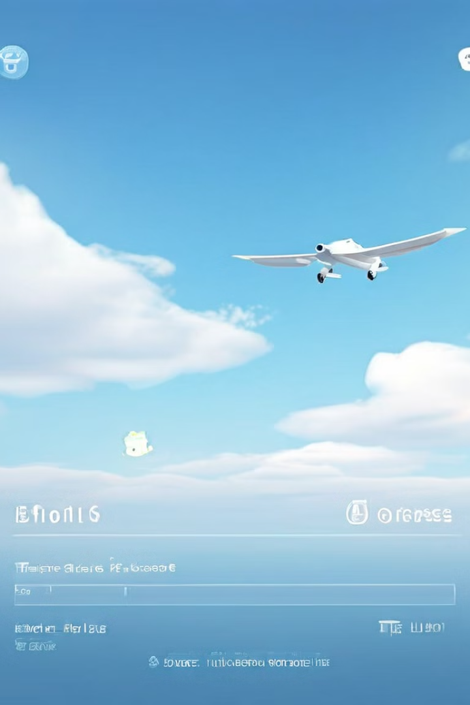
User Interface
1
Clean and Intuitive
2
Customizable Options
The user interface is designed to be seamless and unobtrusive, allowing you to focus on the gameplay.
Tailor the game to your preferences, adjusting settings such as camera angles, control sensitivity, and more.
3
In-Game Guidance
On-screen prompts and tutorials ensure a smooth, guided experience for both new and experienced players.

Slide 8

Game Overview
1
Explore
Soar through vibrant, fantastical landscapes, game design through the game developement
2
Challenge
It challenge the player to kill the birds which has been coming at the flight boy . So, that the flight boy must kill the birds.
3
Game view
In this game view ,it contains all background , birds, sound effects, flight,and like this some features obtain in this game.

Slide 9

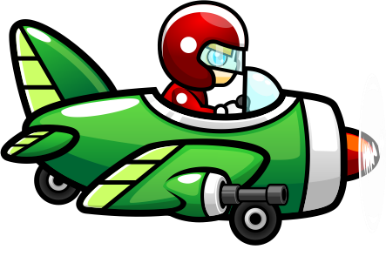
Graphics and Design
Captivating Characters
Stunning Environments
The main protagonist, a young boy with whimsical, ethereal wings, is brought to life through exquisite 2D modeling and animation.
The game's world is a feast for the senses, featuring masterfully crafted, visually stunning environments that transport players to a realm of pure imagination.

Slide 10

Key Features
Game Exploration
Challenge Obstacles
Overview
Freely explore a vast ,detailed world filled with diverse environments
The flight boy tires to kill all birds appear before him & it doen’t have any time limit.
Discover the captivating story behind the boy's journey, as you navigate through a world of wonder and imagination.

Slide 11




2D Animation
Fluid Movements
Enchanting Interactions
Dynamic Obstacles
The boy's wings flap gracefully, creating a mesmerizing aerial display that enhances the sense of weightlessness and freedom.
As the boy navigates the world, he interacts with magical crystals with his flight and other interactive elements, bringing the game to life with charming 2D animations.
All the design of the game, are brought to life through captivating 2D animations that add to the thrill of the gameplay.

Slide 12




Rules of the Game
If you touch right side of the screen then the flight will shoot the bullets.
If you touch left side of the screen then we can control the flight to move up and down.
If the boy misses any bird to kill (Or) bird passes through the boy side then the game will be over.
If the flight boy and flying bird collide (Or) hit each other then also game will be over.

Slide 13

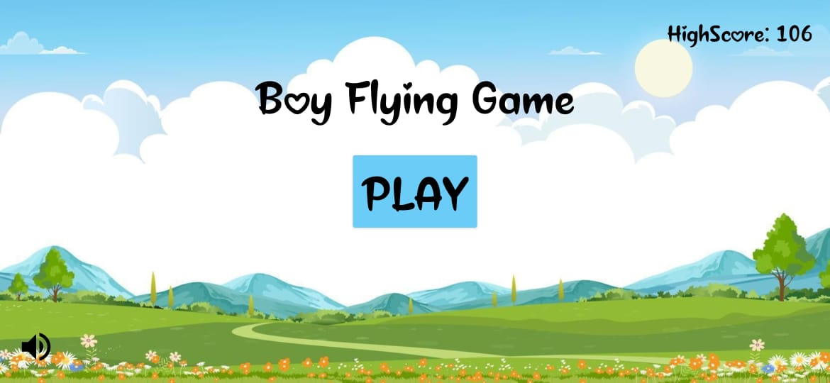
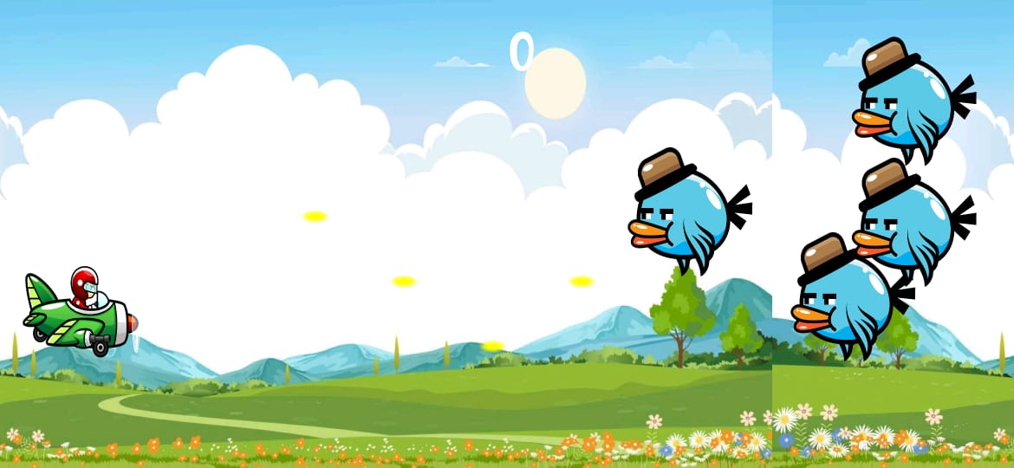
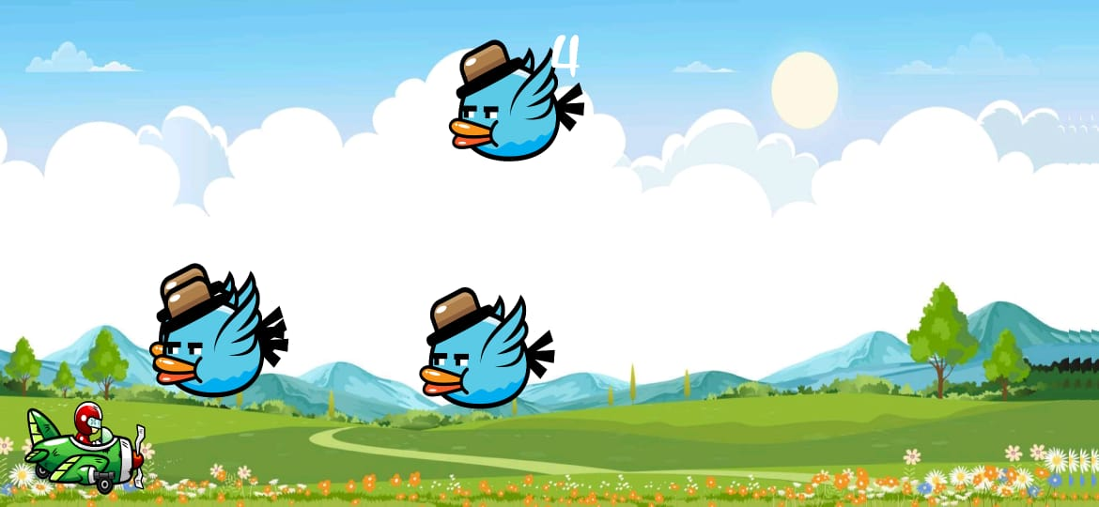
Results
Game Over
Playing Game

Slide 14

Conclusion
The Boy Flying Game offers a truly imperssive and captivating experience, blending stunning visuals, intuitive controls, and a sense of wonder and adventure. Embark on a magical journey with the young protagonist, soaring through a realm of imagination and discovery, where the only limit is your own aerial process.
And it is a Simple, Addictive, Challenging, & Endless game to attract the children.

Slide 15


