Slide 1
SAP BTP AI CAPSTONE
JouleOps @ NorthWind Manufacturing
Enterprise Operations Assistant using SAP HANA Cloud, FastAPI, MCP and SAP BTP
AI
AI-assisted operations
A governed integration pattern that turns operational questions into structured, auditable responses.
MCP
API
HANA
Susmitha Boga • August 2026
JOULEOPS / NORTHWIND / SAP BTP AI
01

Slide 2
01 / CONTEXT
Problem → solution
Why JouleOps was designed this way
Problem
Risk
JouleOps
Operational data and actions are spread across inventory, orders, customers, invoices and tickets.
An AI assistant should not have unrestricted database access or uncontrolled write operations.
Expose only defined business capabilities through FastAPI + MCP, with authorization and audit logging.
JOULEOPS / NORTHWIND / SAP BTP AI
02

Slide 3
02 / ARCHITECTURE
JouleOps integration blueprint
The complete request path
USER
JOULE
MCP
BTP
FASTAPI
HANA
Business logic stays in the backend; MCP provides a controlled AI-facing tool interface.
JOULEOPS / NORTHWIND / SAP BTP AI
03

Slide 4
03 / FOUNDATION
Technology stack & data model
Focused responsibilities across the solution
HANA Cloud
FastAPI
MCP
Operational data + tables
REST capability layer
AI-facing tools
ngrok
BTP Destinations
Joule / Skills
Temporary HTTPS bridge
Connectivity configuration
Capability selection
Core tables: MATERIALS • CUSTOMERS • SALES_ORDERS • INVOICES • TICKETS • AUDIT_LOG
JOULEOPS / NORTHWIND / SAP BTP AI
04

Slide 5
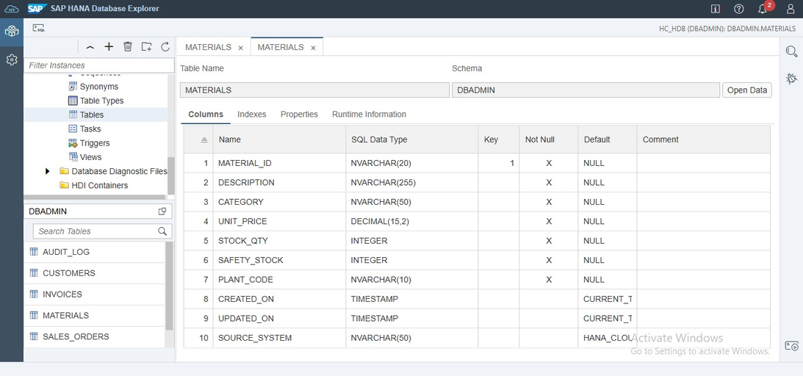
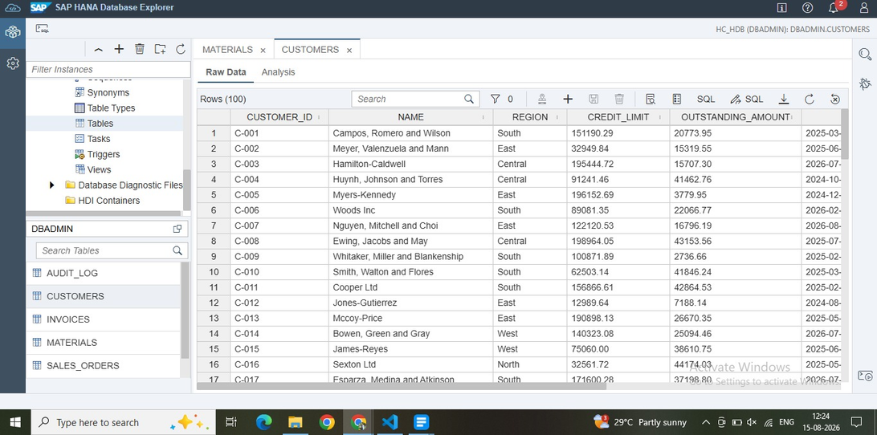
04 / EVIDENCE
HANA Cloud — tables & demo data
Actual database evidence
HANA Cloud tables
Representative records
JOULEOPS / NORTHWIND / SAP BTP AI
05

Slide 6
05 / APIS
Business capabilities
Five explicit operations exposed to the assistant
01
Material details
POST /api/material/details
Stock + safety stock + plant
02
Open sales orders
POST /api/sales/orders
Regional order aggregation
03
Customer summary
POST /api/customer/summary
Customer + invoice exposure
04
Create ticket
POST /api/ticket/create
Governed maintenance write
05
Overdue invoices
POST /api/invoices/overdue
Overdue value + recommendation
JOULEOPS / NORTHWIND / SAP BTP AI
06

Slide 7
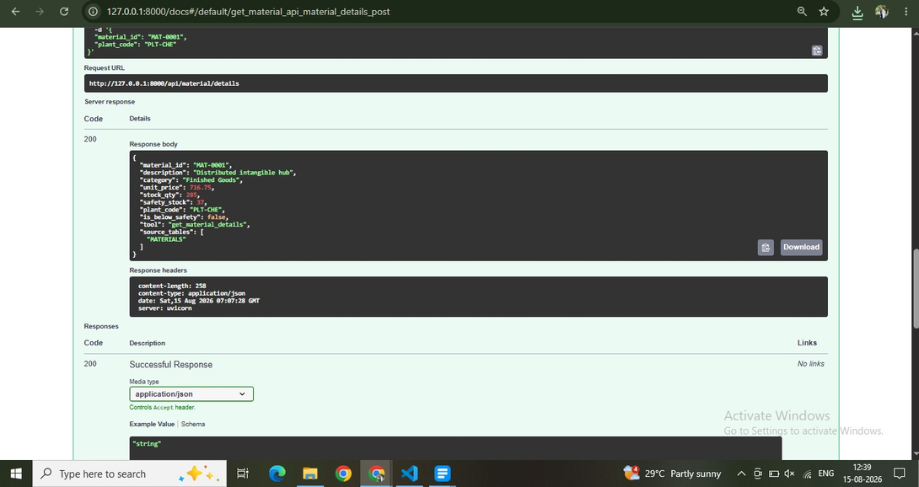
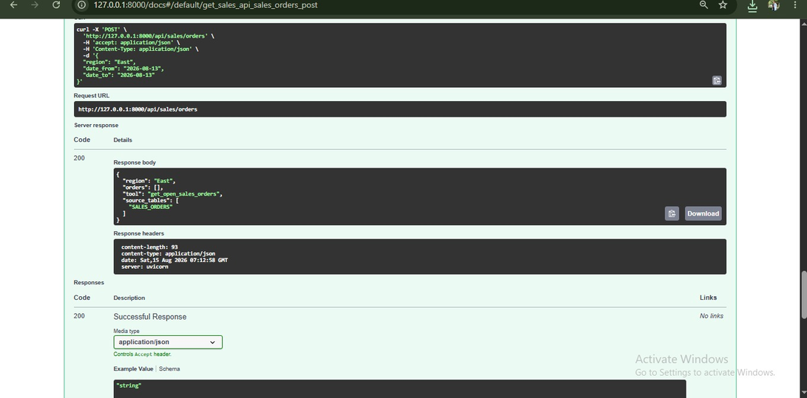
06 / EVIDENCE
Material + Sales outputs
Two high-value operational queries, shown with their actual responses
Material API response
Sales Orders API response
JOULEOPS / NORTHWIND / SAP BTP AI
07

Slide 8
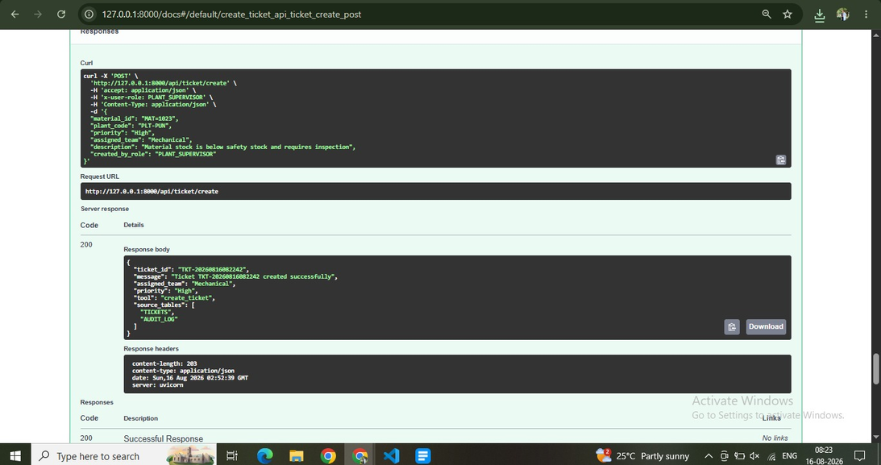
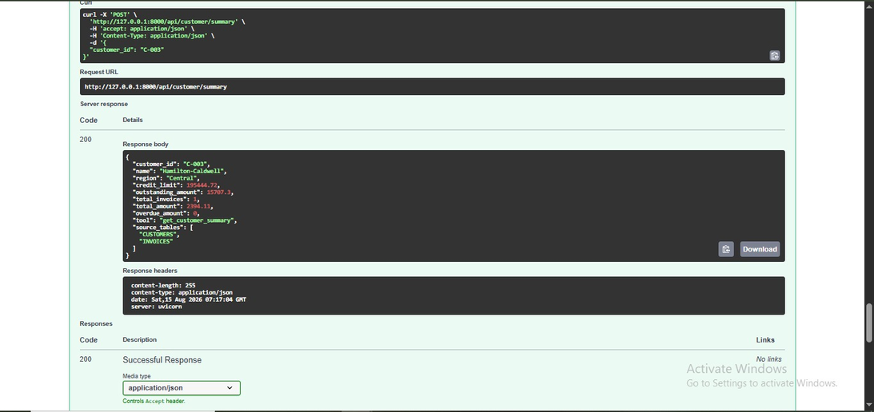
07 / EVIDENCE
Customer + Ticket outputs
Read and governed-write evidence
Customer summary response
Ticket creation response
JOULEOPS / NORTHWIND / SAP BTP AI
08

Slide 9
08 / GOVERNANCE
Controlled ticket creation
A write operation is protected by role validation and audit logging
REQUEST
ROLE CHECK
CREATE
AUDIT
Ticket details enter the service.
Only approved business roles can create.
Ticket is inserted into the operational table.
Outcome is recorded with masked parameters.
This separates AI intent from authorization and database writes.
JOULEOPS / NORTHWIND / SAP BTP AI
09

Slide 10
09 / MCP
MCP tool facade
The same backend capabilities are made reusable for AI
get_material_details
get_open_sales_orders
FASTAPI
HANA
get_customer_summary
create_ticket
summarize_overdue_invoices
Tool names remain explicit and map to defined backend capabilities.
JOULEOPS / NORTHWIND / SAP BTP AI
10

Slide 11
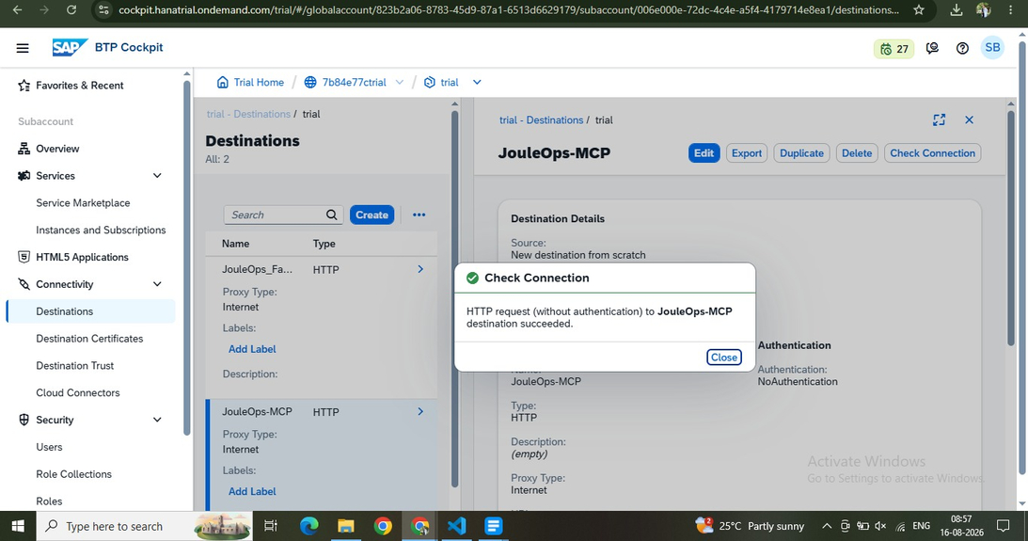
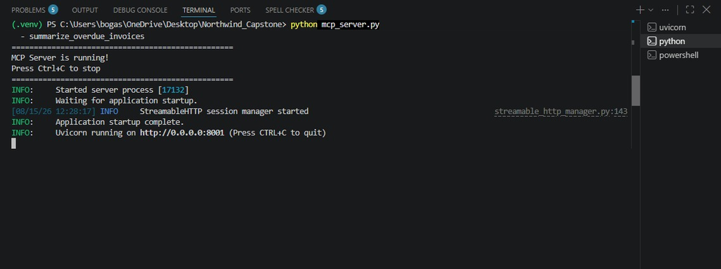
09 / EVIDENCE
MCP runtime
Tool configuration + running server
MCP tools
MCP server runtime
JOULEOPS / NORTHWIND / SAP BTP AI
11

Slide 12
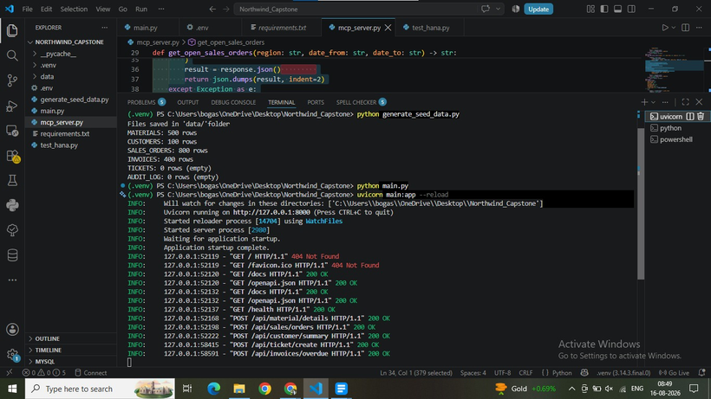
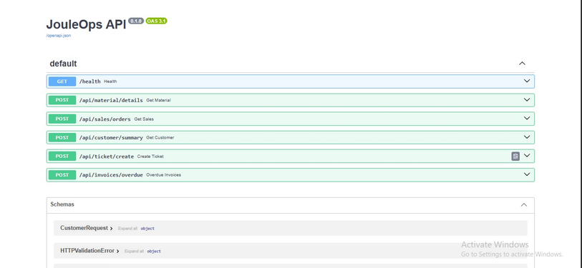
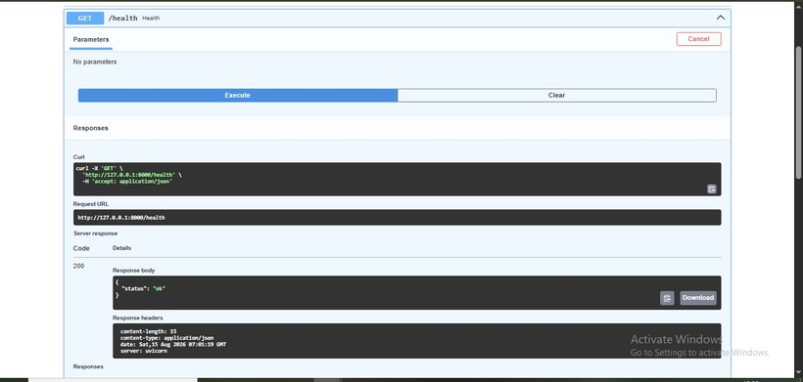
10 / RUNTIME
FastAPI validation
Local server, Swagger endpoints and health response
Uvicorn / FastAPI
Swagger endpoints
Health response
JOULEOPS / NORTHWIND / SAP BTP AI
12

Slide 13
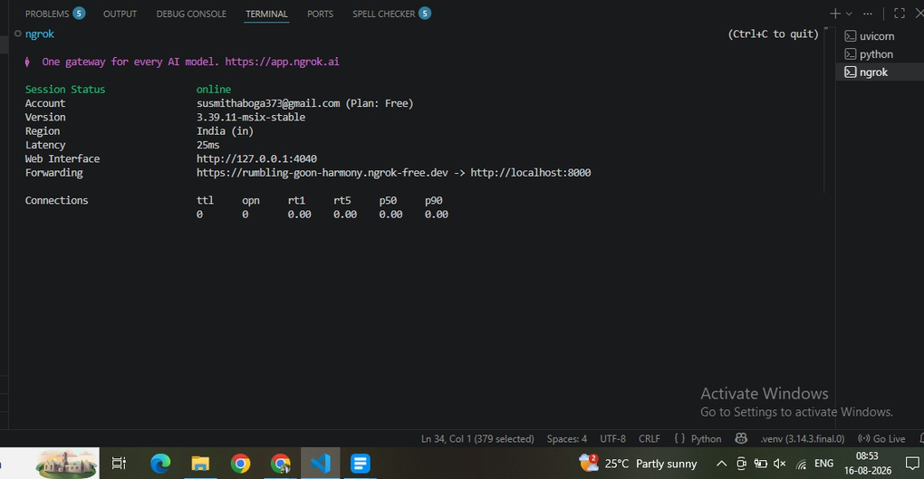
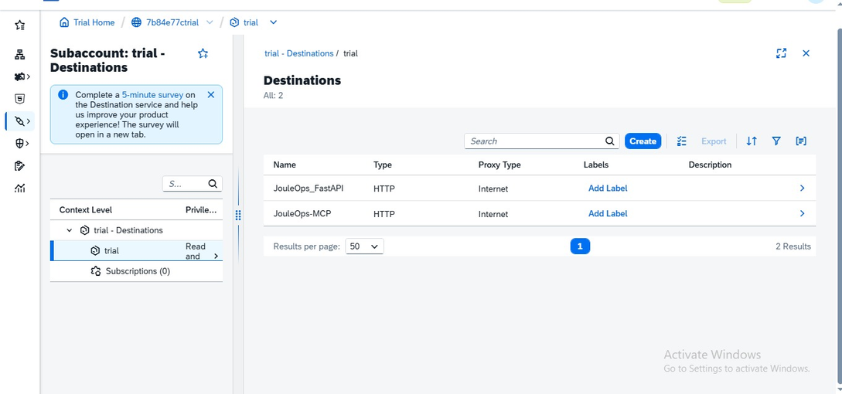
11 / CONNECTIVITY
ngrok + BTP destinations
Move from local services to BTP connectivity
ngrok HTTPS forwarding
BTP destinations
JOULEOPS / NORTHWIND / SAP BTP AI
13

Slide 14
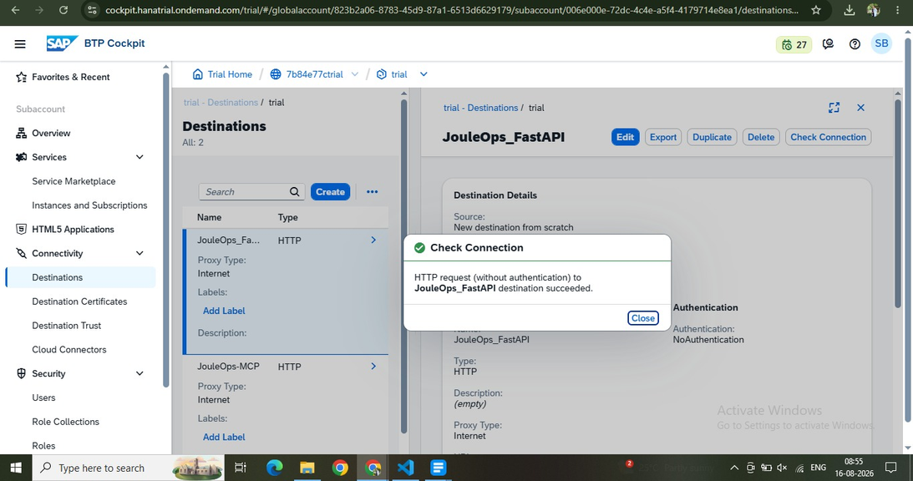
12 / FINAL VALIDATION
Check Connection — both succeeded
Final BTP connectivity evidence
✓ JouleOps_FastAPI — HTTP request succeeded
✓ JouleOps-MCP — HTTP request succeeded
Both BTP destinations passed their connection checks.
JOULEOPS / NORTHWIND / SAP BTP AI
14

Slide 15
13 / END-TO-END
One request → one governed path
The complete project flow
USER
JOULE
MCP
BTP
FASTAPI
HANA
JSON
Question → selected tool → governed backend operation → structured response
JOULEOPS / NORTHWIND / SAP BTP AI
15

Slide 16
14 / QUALITY
Validation & results
What was verified before presentation
HANA
FastAPI
Tables and seed records verified
Swagger endpoints return structured JSON
MCP
Connectivity
Tools exposed by the running server
ngrok + BTP destinations validated
Governance
Evidence
Ticket role check + audit path implemented
Actual screenshots captured from the running project
JOULEOPS / NORTHWIND / SAP BTP AI
16

Slide 17
15 / OUTCOME
Key outcomes
What the capstone demonstrates
Centralized business logic
REST and MCP paths reuse the FastAPI implementation.
Controlled writes
Authorization and audit logging protect ticket creation.
Structured integration
HANA is accessed through defined capabilities.
SAP BTP readiness
Destinations and HTTPS connectivity complete the integration path.
JOULEOPS / NORTHWIND / SAP BTP AI
17

Slide 18
16 / CLOSING
Conclusion
A concise enterprise AI integration story
JouleOps connects operational data, governed business capabilities and AI-facing tools through a layered SAP BTP architecture.
HANA → FastAPI → MCP → BTP → Joule
Thank you
Susmitha Boga • SAP BTP AI Development
JOULEOPS / NORTHWIND / SAP BTP AI
18

