Slide 1



Driver OnBoarding
-Presented By Susmitha Boggavarapu Software Engineer III, Walmart

Slide 2
Functional Requirements
Driver Registration
Trigger Onboarding Process
Ready To Drive

Slide 3
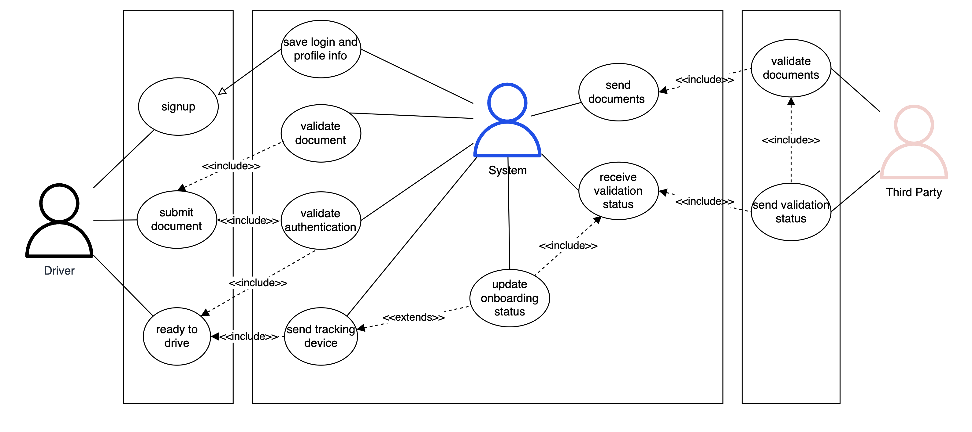
Use CASE DIAGRAM

Slide 4
1. Driver registration
The following profile details are to be provided for registration
Firstname - Mandatory
Lastname
Email
Mobile - Mandatory
Password - Mandatory
Address
City
State
Pincode

Slide 5
1. REGISTER API
Success Response Body: {
"status": "SUCCESS",
"payload": {
"firstname": ""<firstname>",
"lastname": "<lastname>",
"email": ”<email>",
"mobile": "<mobile_number>",
"password": "<password>",
"address": {
"city": "<city>",
"state": "<stage>",
"pincode": "<pincode>"
}
}
}
Response Status : 201
HttpMethod – POST URL - {baseurl}/register Request Body - JSON
{ "firstname" : "<firstname>", "lastname" : "<lastname>", "email": "<email>", "mobile" : "<mobile_number>", "password" : "<password>", "address" : { "city" : "<city>", "state" : "<stage>", "pincode" : "<pincode>" } }

Slide 6
1.REGISTER API - FAILURE - 400
{
"error": "REG_UR_1",
"errorDescription": "user with mobile already exists"
}
{
"error": "BAD_REQUEST",
"errorDescription": "firstname is required "
}

Slide 7
2. SUBMIT DOCUMENTS
Driver should be able to submit the following mandatory documents
PAN
VEHICLE RC
VEHICLE PERMIT
DRIVING LICENCE
VEHICLE INSURANCE

Slide 8
2A.SUBMIT DOCUMENT API
Success Response Body: {
"status": "SUCCESS",
"payload": "vehicle_rc.pdf"
}
Response Status : 201 (first time creation)
Response Status: 200
HttpMethod – PUT URL - {baseurl}/register/documents/{document_type}
Headers
Authorization-<auth_token>
Request Body – FORM DATA
{ ”file" : ”<file.extention>", }

Slide 9
2.SUBMIT DOCUMENTS API - FAILURE - 400
{ "error": "REG_DC_1",
"errorDescription": "empty file Failed to store empty file "
}
{
"error": "REG_DC_4",
"errorDescription": "unsupported document type"
}
{
"error": "REG_DC_5",
"errorDescription": "unsupported file format xlsx"
}

Slide 10
2.COnT..
{
"error": "REG_DC_4",
"errorDescription": "unsupported document type"
}
{
"error": "REG_DC_5",
"errorDescription": "unsupported file format xlsx"
}

Slide 11
2B.SUBMIT DOCUMENT API
Success Response Body:
<file content>
Response Status: 200
Failure Scenarios:
Response Status: 204 (In case No document found)
Response Status: 400
{
"error": "REG_DC_4",
"errorDescription": "unsupported document type"
}
HttpMethod – GET URL - {baseurl}/register/documents/{document_type}
Headers
Authorization-<auth_token>

Slide 12
3. ONBOARD
Driver should be able to trigger onboarding process
The submitted documents are sent for verification process
Able to activate for taking ride requests

Slide 13
3a. ONBOARD API
Success Response Body: {
"status": "SUCCESS",
"payload": "initiated onboarding process"
}
Response Status : 200
HttpMethod – POST URL - {baseurl}/onboard/trigger
Headers
Authorization-<auth_token> Request Body - NONE

Slide 14
3a.ONBOARD API - FAILURE - 400
{
"error": "REG_DC_2",
"errorDescription": "missing documents [PAN, DRIVING_LICENCE, VEHICLE_INSURANCE, VEHICLE_PERMIT]"
}

Slide 15
3b.ONBOARD API
Success Response Body: {
"status": "SUCCESS",
"payload": "initiated onboarding process"
}
Response Status : 200
HttpMethod – POST URL - {baseurl}/onboard/activate
Headers
Authorization-<auth_token> Request Body - NONE

Slide 16
3b.ONBOARD API - FAILURE - 400
{
"error": "OB_RQ_1",
"errorDescription": "either tracking device not sent / documents are not validated"
}

Slide 17
4. VALIDATION API
Success Response Body:
Response Status : 200
HttpMethod – POST URL - {baseurl}/onboard/documents/validate Request Body – JSON
{
"requestId": ”<request_id>",
"mobile": ”<mobile>",
"status": [
{
"type": ”<doc_type_1>",
"valid": true
},
…….. for other doc types
]
}

Slide 18
5. MARk READY- API
Success Response Body: {
"status": "SUCCESS",
"payload": "ready to drive"
}
Response Status : 200
Failure Response:
Response Code - <Failure Response Code>
{
"error": ”<error_code>",
"errorDescription": ”<error_description>"
}
HttpMethod – PATCH URL - {baseurl}/onboard/activate
Headers
Authorization-<auth_token>
Request Body – NONE

Slide 19
COMMON API - FAILURE - 401
{
"error": "AUTH_UR_1",
"errorDescription": "unauthorized user "
}
{
"error": "AUTH_UR_2",
"errorDescription": ”empty auth token "
}

Slide 20
Non Functional Requirements
The drivers are onboarded based on region.
Ex, the documents to verify, varies from one country to another
The storage calculations change based on the region.
Storage For One Driver
Driver Profile Information – 20KB
Documents 6 * 10 = 60MB
6 Document Types and each max of 10 MB
Average Number of Drivers registering per month – 6,00,000 (India)
Per Day – 6,00,000 / 30 = 2000
11AM – 3PM more number of registrations – 2000/4 – 500 /hr
Notes:
Presently Driver Profile Information is 20KB, if vehicle details are added it can be more

Slide 21
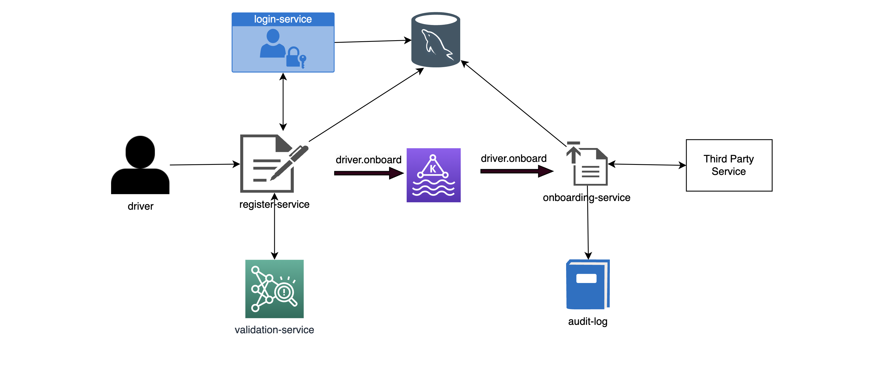
HLD

Slide 22
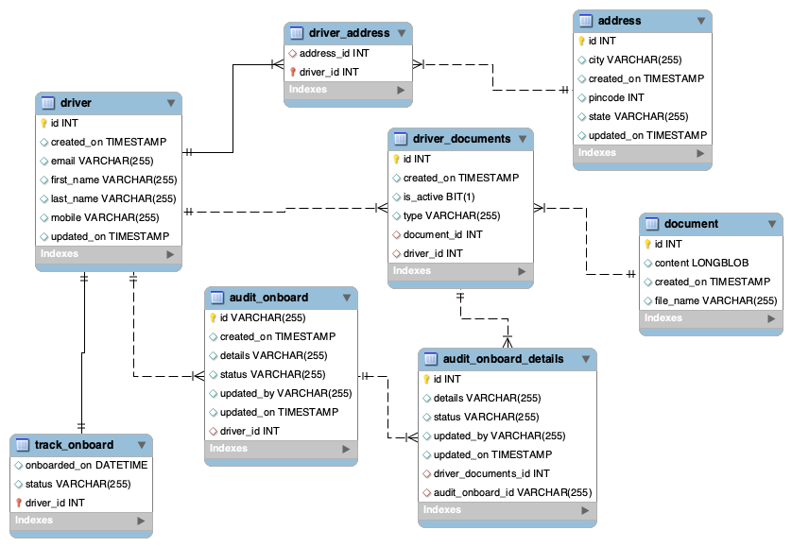

ER Diagram
driver and address entities are mapped by driver_address table
driver and document are mapped by driver_documents table
audit_onboard and audit_onboard_details tables are populated for each onboarding request
Track_onboard maintains onboarding status of driver

Slide 23
ASSUMPTIONS
When registering there can be two options
Have Vehicle
Need Vehicle
The assumption is, driver has vehicle already and required to submit documents related to vehicle
The document types to be submitted are fixed for a region
The documents are sent for verification via APIs
Other option can be documents are to be put in secure location and taken for verification on specified intervals

Slide 24
IMPROVEMENTS
Ability to login via email using SSO
Notify drivers about verification updates
Store files in S3 / azure any storage service and provide path details in document tables
Archival Based on year of inactivation
Authorization mechanism among apis
Caching of auth details
Get vehicle details and validations like not allowing cars older than 15 years
Schedule an appointment for Vehicle Inspection

Slide 25
Future Scope
Registered driver details can also be extended to Uber Eats or Package Delivery
Ability to chose Car / Auto / Moto for driving
Referral Code for registration
Fraud detection service or validation service before sending to third party to avoid cost
Bank Details Registration

Slide 26


