Slide 1
Ravel data challenge
Susmitha Manda

Slide 2

INTRODUCTION
GIVEN DATA:
10 Judicial Opinions:
Each Opinion contains the following data:
The set of ​law firms​ that represent the company (if any)
The company’s ​party type(s) ​in the litigation (as ​plaintiff, defendant,...​)
GOAL:
Design a system that automatically extracts relationships between entities - ‘Party Name’ ‘Party Type’ and ‘Law Firm’ which are mentioned in Natural Language.

Slide 3
Design:
Raw Text
Sentence Segmentation
Tokenization
POS Tagging
Entity Detection
Relation Detection
Notes:
Entity detection: process of identifying and classifying key elements from text into pre-defined categories. In this way, it helps transform unstructured data to data that is structured. retrieving information, extracting facts and question answering

Slide 4
IMPLEMENTATION
Example
Raw Text:
For {partyA_}ZENITH ELECT CORPORATION{/partyA_}, a Delaware corporation, plaintiff: John M. Calimafde, {firm1_}Hopgood, Calinafde, Kalil, Blaustein & Judlowe{/firm1_}, New York, NY. Joel S. Feldman, {firm2_}Sachnoff & Weaver, Ltd.{/firm2_}, Chicago, IL.
Sentence Segmentation:
['For _company__A a Delaware corporation plaintiff: John M. Calimafde _firm__1 New York NY.
Joel S. Feldman _firm__2 Chicago IL.’]
{partyA_}ZENITH ELECT CORPORATION{/partyA_} _company__A {firm1_}Hopgood, Calinafde, Kalil, Blaustein & Judlowe{/firm1_} _firm__1 {firm2_}Sachnoff & Weaver, Ltd.{/firm2_} _firm__2
Notes:
Raw text – unstructured, and contains tags for companies and firms. No tags for party types.

Slide 5
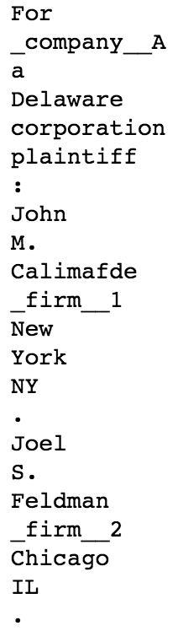
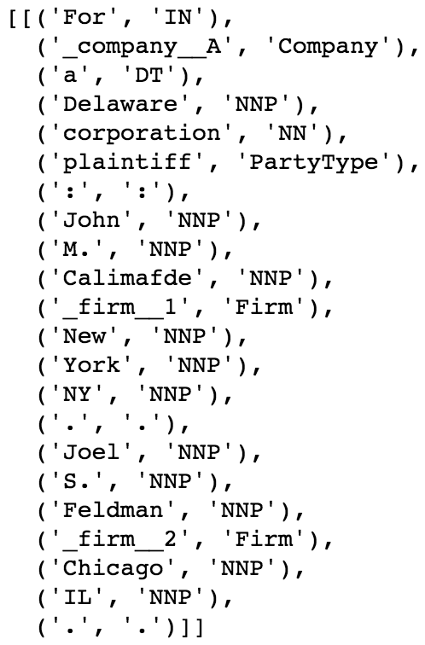
Tokenization:
POS Tagging:
[
]

Slide 6
Entity Extraction
Chunking: Chunking segments and labels multi-token sequences
Chunking and Grammar Rules
Result : For [{partyA_}ZENITH ELECT CORPORATION{/partyA_}, a Delaware corporation], plaintiff: [John M. Calimafde], {firm1_}Hopgood, Calinafde, Kalil, Blaustein & Judlowe{/firm1_}, [New York, NY]. [Joel S. Feldman], {firm2_}Sachnoff & Weaver, Ltd.{/firm2_}, [Chicago, IL].
C1: {<DT>?<N.*>*} C1: {<IN><:>?} C1: {<CC><C1>} R1: {(<C1>+<.>?)+} CompanyN: {<IN>?<Company><R1>?} CompanyN: {(<CompanyN><CC>?)+} Againist: {<CompanyN><versus><CompanyN>} PartyType: {<PartyType><:>?} | PartyType: {<IN>+<PartyType>} PartyType: {<JJ>+<PartyType>} CompanyAndType: {(<CompanyN><PartyType>)|(<PartyType><CompanyN>)} firmN: {<R1>*<Firm><R1>*} firmN: {(<firmN><CC>?)+} FirmAndType: {<PartyType><.>?<firmN>|<firmN><.>?<PartyType>} FirmAndCompany: {<firmN><CompanyN>} RuleN: {<CompanyAndType><firmN>}
Notes:
Opinion7 example:
When I observerved the raw docs, I observed that few sentences are trying to explain the relations btw companies and firms, firm and their acting party types, companies and party types and a combination of any of them. So based on that I have created few rules, in order to group them in order to create a parse tree. Those parse trees help me to identify any useful data to relate entities.

Slide 7
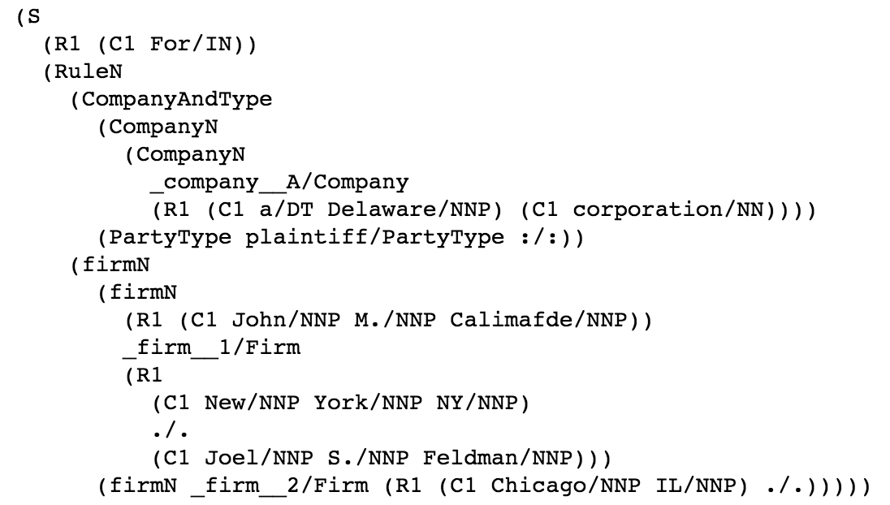
Relation Detection
Representing Chunk structure using Trees.
Tree leaves contains word and its respective tag.
Tree Representation of Chunk Structures
Parsed Sentence Structure

Slide 8
Observations:
Assumed that Party_types are fixed, therefore taken from the table provided in the question.
Observed that if a law firm/s acts for 1 party_type and law firm represents 2 companies and if a party_type is given for 1 company, then we can count the same party_type for 2nd company that represents the same firm.
If given firm1 acts for partyType1 and company1 is partytype1 then we can link firm1 with company1
Example:
Sentence1 : firm1_}Law Office of Andrew R. Wiener{/firm1_}, Louis N. Haas, Esq., {firm2_}Haas & Najarian{firm2_}, San Francisco, CA, for Plaintiff.
Sentence2 : with plaintiff {partyA_}625 3rd Street Associates{/partyA_}
Challenges:
Highly unstructured data
Incorrect tag names in many cases (missing’_’,’\’)
Ambiguity in relating party types.
Limited time
Improvements:
Can build a better model with time and research.,
Better rules for relation detection.

Slide 9
Final result
Final Result

Slide 10


