Slide 1

WEB PAGE SEARCH ENGINE
COMP8547 – Advanced Computing Concepts Final Project

Slide 2
OUR INSTRUCTOR Dr. Mahdi Firoozjaei
TEAM MEMBERS
Divya Thanigaimani | 110097685
Renuka Sai Telu | 110096549
Kavya Seeramsetty | 110099222
Susmitha Chandramohan | 110100921

Slide 3
OUTLINE
01
02
03
INTRODUCTION
OBJECTIVE
PROJECT FLOW
04
FEATURES
05
WORKING SCREENSHOTS
06
FUTURE SCOPE / CONCLUSION

Slide 4

INTRODUCTION
A web page search engine is a tool that allows users to search for information on the internet by entering keywords or phrases.
The search engine then retrieves web pages that match those keywords or phrases and presents them to the user in a list, usually in order of relevance.
Search engines use complex algorithms to crawl and index web pages, which allows them to quickly and efficiently search through vast amounts of data and return relevant results to users.

Slide 5

OBJECTIVE
As existing web search engines provide extensive coverage of the internet, including relevant information within the overwhelming number of search results.
The aim of this project is to develop a Web search engine that uses advanced computing concepts such as Pattern Matching, HTML to TEXT, Web Scraper, Edit Distance, Ranking web pages using sorting, heaps or other data structures, and Using large dictionaries/datasets, sorting techniques, search trees, spellchecking keywords or HTML files, and many others

Slide 6
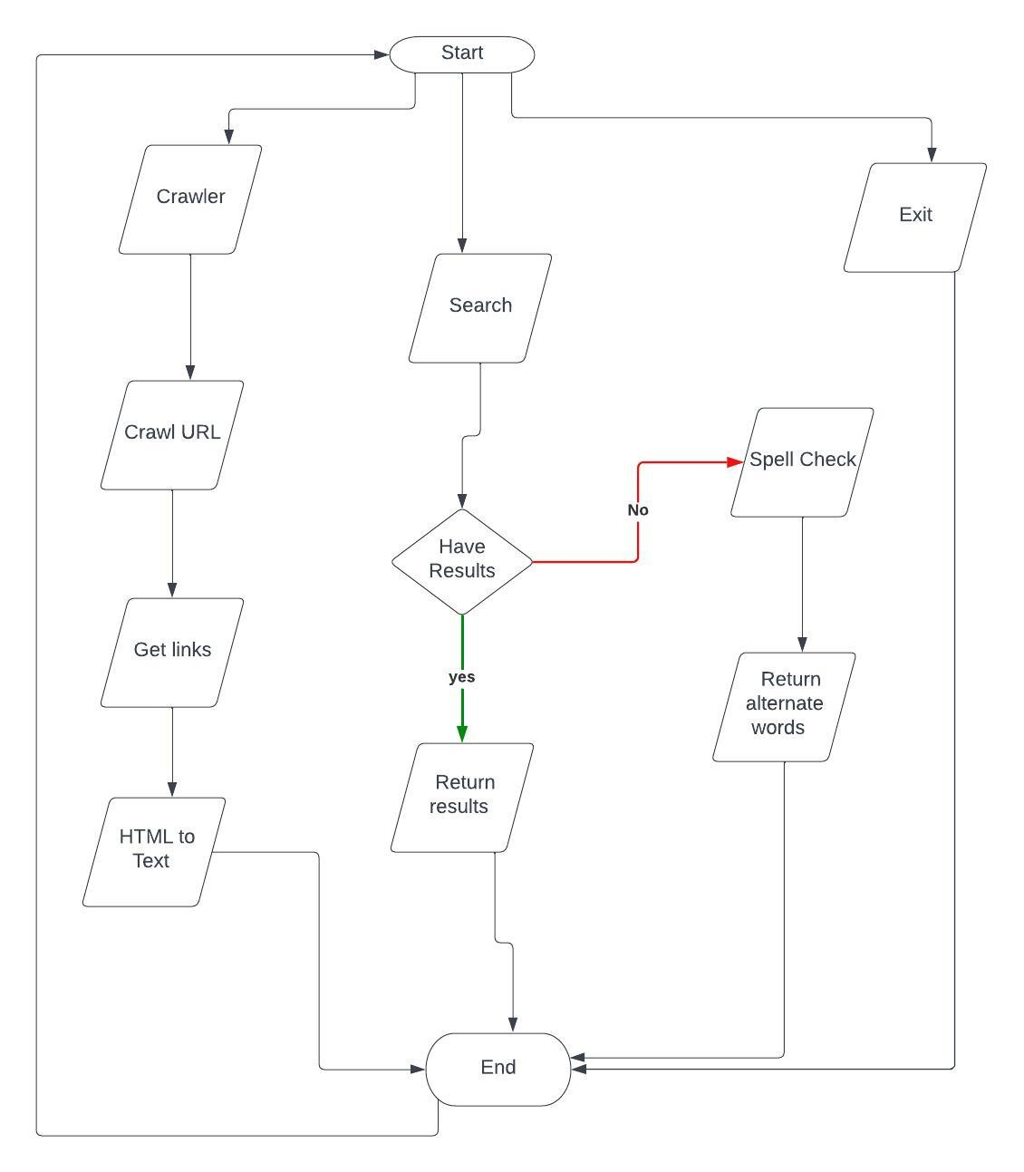
PROJECT FLOW

Slide 7
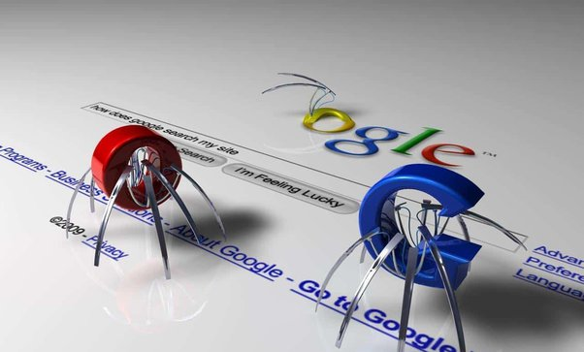

FEATURES
CRAWLING
Web search engines find and gather data about web pages on the internet through the process of crawling. In order for search engines to give users relevant search results, a search index must be built through the process of crawling.
KAVYA SEERAMSETTY
HTML PARSER
RENUKA SAI
Search engines, web browsers, and other software applications that need to extract data from online pages use HTML parsers. These scan a web page's HTML code, recognizes the different elements on the page.

Slide 8
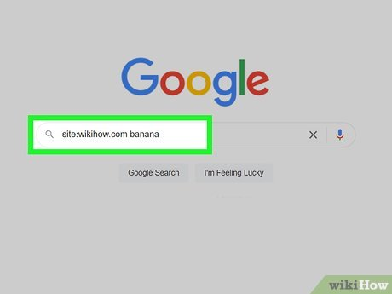
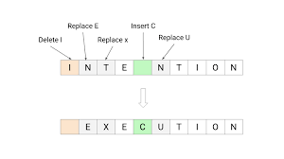
FEATURES
WORD SEARCH
When a user enters a query into a search engine, the search engine uses a algorithm to search through the vast number of web pages indexed in its database to find those that are most relevant to the user's query.
DIVYA THANIGAIMANI
EDIT DISTANCE
SUSMITHA CHANDRAMOHAN
When a user misspells a word in their query, the search engine can use edit distance to suggest corrected spellings. By comparing the misspelled word with a list of known words in the database and calculating the edit distance between them.

Slide 9
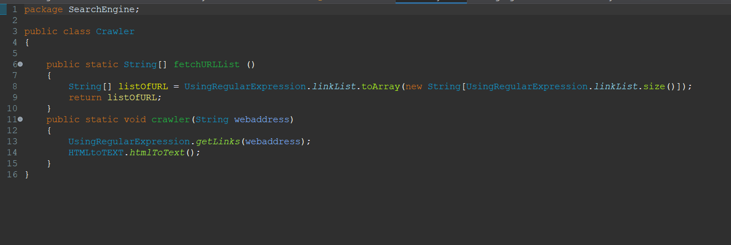
CRAWLING
Crawling refers to the process of systematically browsing the internet, typically with the goal of collecting and indexing information from web pages. Specifically, web crawling involves the use of software programs (known as web crawlers or spiders) that automate the process of visiting web pages, following links, and collecting data.
The data collected by web crawlers is then typically used for a variety of purposes, such as creating search engine indexes, data mining, content aggregation, and website testing.

Slide 10
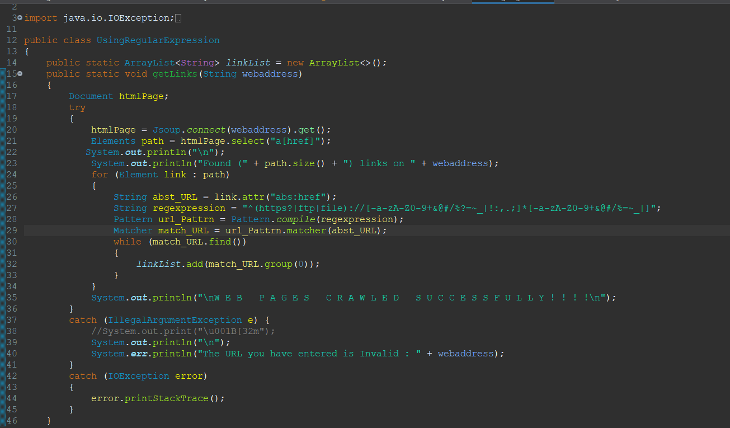
CRAWLING

Slide 11
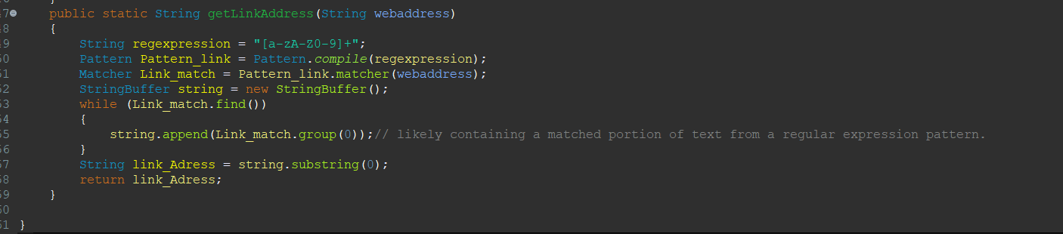
HTML PARSER
The HTML parser in a web search engine is responsible for extracting meaningful information from web pages and organizing it in a way that can be indexed and searched.
The HTML parser begins by scanning the text file and identifying the HTML tags and their attributes. The parser creates a document object model (DOM) tree that represents the structure of the web page. The parser extracts the textual content from the web page and removes any HTML tags, stylesheets.

Slide 12
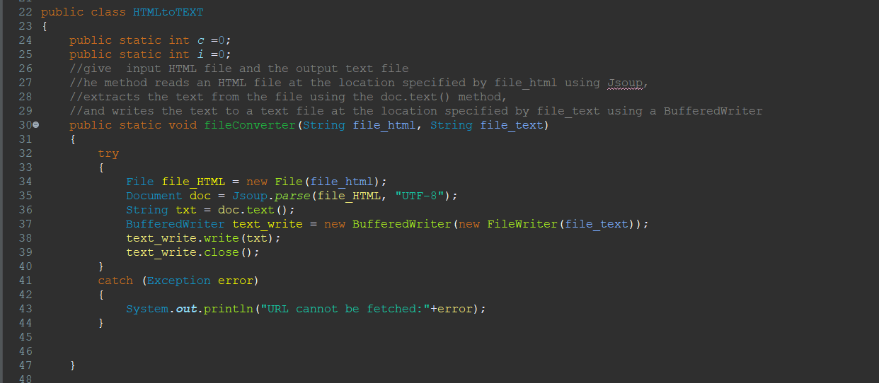
HTML PARSER

Slide 13
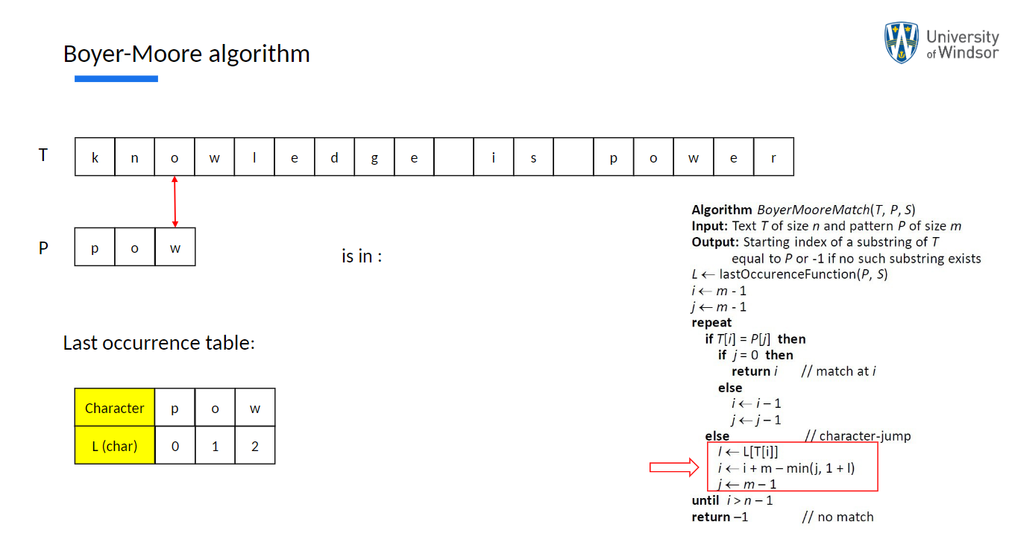
WORD SEARCH- BOYER MOORE
Word search is an essential component in Search engine. It uses Boyer Moore algorithm to search the words. Boyer Moore algorithm is a string searching algorithm used to find occurrences of a pattern in a text. The algorithm uses two main techniques to speed up the search process: last occurrence and the good suffix rule.

Slide 14
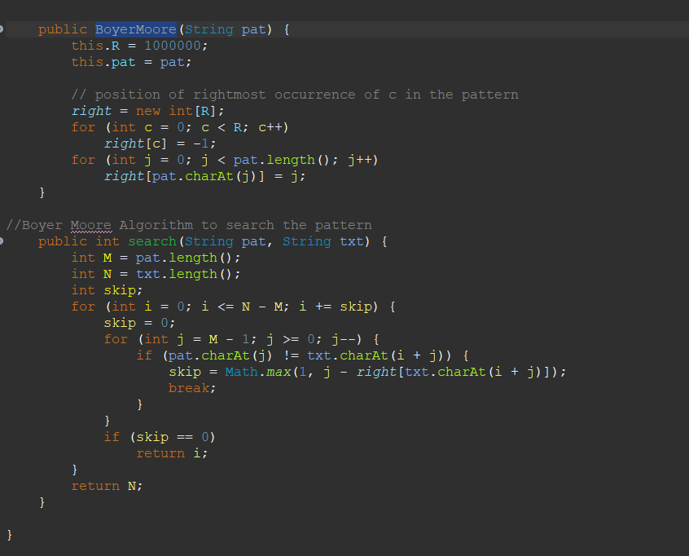
BOYER MOORE

Slide 15
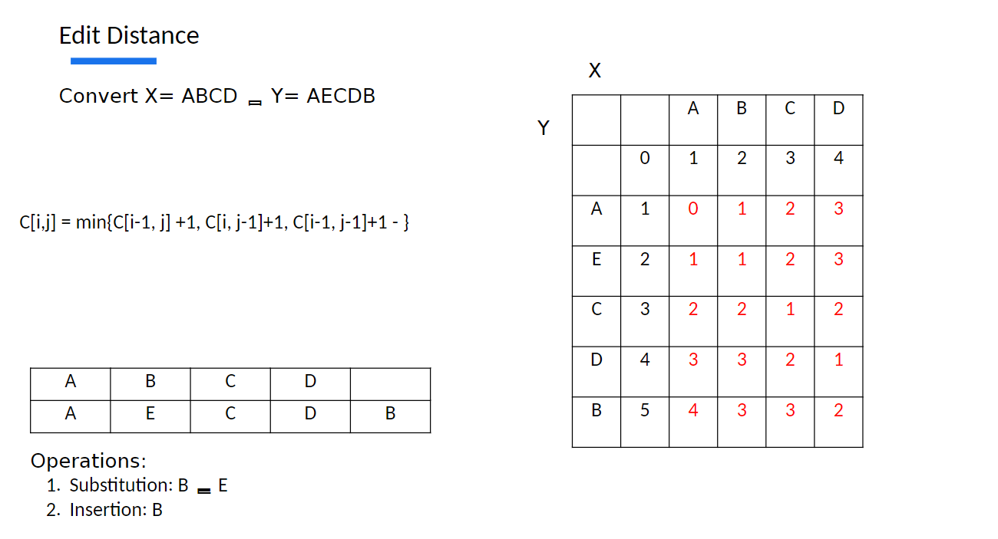
EDIT DISTANCE
Edit distance is a measure of the minimum number of insertions, deletions, and substitutions required to transform one string into another. The three types of edits that are allowed are:
Insertion: Adding a new character to one of the strings.
Deletion: Removing a character from one of the strings.
Substitution: Replacing a character in one of the strings with a different character.

Slide 16
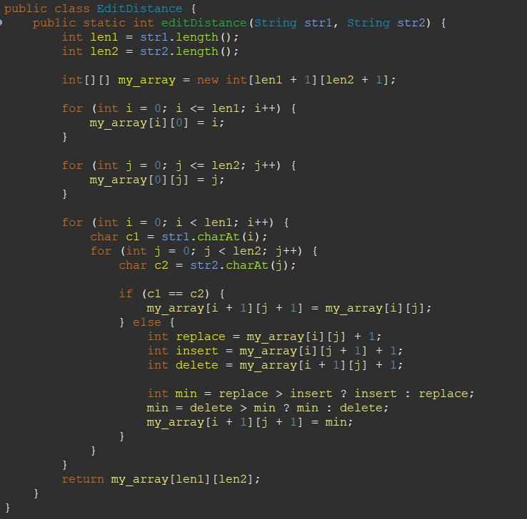
EDIT DISTANCE

Slide 17
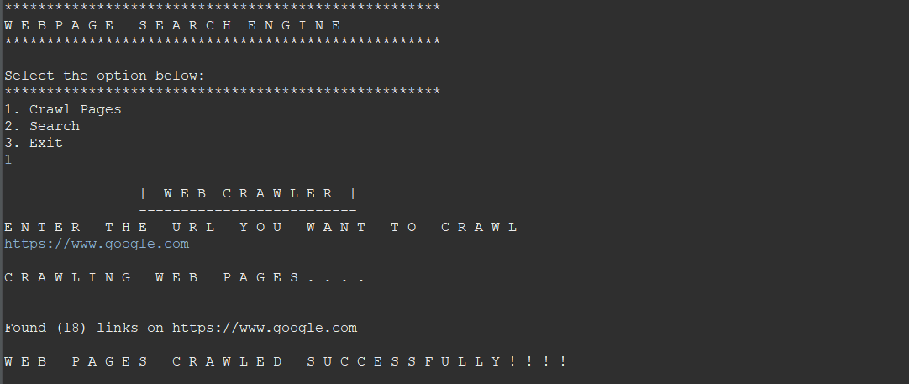
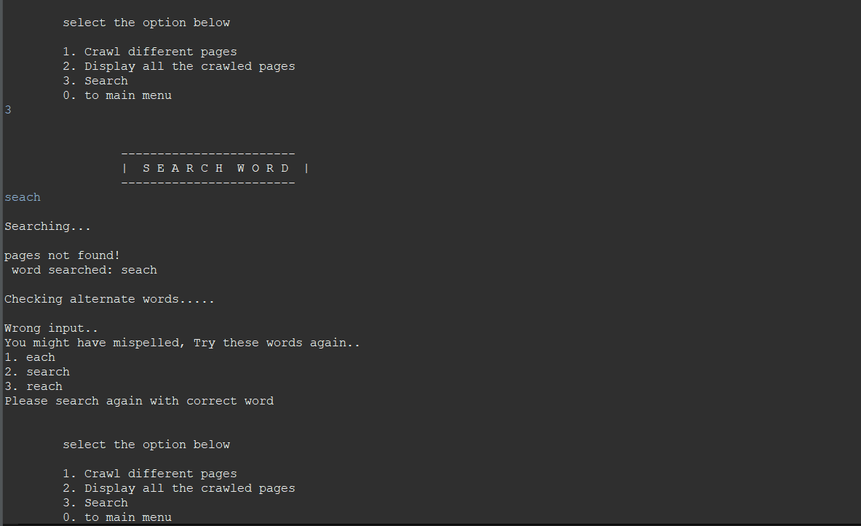
WORKING SCREENSHOTS

Slide 18
FUTURE SCOPE
Include GUI to improve user experience
Adding more regex options for a customized web search
Developing an application for mobile users.
CONCLUSION
A web search engine called a web page search engine is designed to find terms on web pages and give users exact and accurate information.
With the help of this project, we gained information about how to create a system that uses regular expressions, programming languages, and data structures and algorithms.

