Slide 1








COLLEGE REGULATIONS & SYLLABUS
RAG CHATBOT
Ask Your Query
Syllabus
Retrieval-Augmented
Regulations
Get Answers
Generation (RAG) Chatbot
for College Regulations and Syllabus Queries
Core contribution: Hybrid Retrieval-Based RAG Algorithm – TF-IDF + Character N-Grams + MiniLM Sentence Embeddings (FAISS)
AI Mini-Capstone Project · Artificial Intelligence (25CS301) · Category 3.4 – LLMs and Transformer Models
Team Members
1.
VURA NAGAMANI SUSMITHA
251FA04D58
2.
VUYYURU MADHURI
251FA04D62
3.
VUYYURU HASINI
251FA04D60
4.
CHATLA BARGHAVA REDDY
251FA04E70
Learn + Ask + Grow
Notes:
Introduce the project: a RAG chatbot that answers college regulation and syllabus questions only from a verified CSV knowledge base. Core contribution: the hybrid retrieval algorithm (TF-IDF + character N-grams + MiniLM embeddings with FAISS).

Slide 2



2. Problem Statement
Information about college rules and syllabus is scattered across many documents. Students cannot find answers quickly, staff answer the same questions again and again, and general chatbots may guess wrong rules (hallucination).
Minimum attendance required to write exams?
Can I write the exam with 72% attendance?
How do I apply for revaluation?
Problem definition
Design an AI chatbot that takes a student’s question on college regulations or syllabus, finds the answer in a knowledge base using Retrieval-Augmented Generation (RAG), and says “not found” when the question is outside it.
Input
Process
Output
Student question
(spelling mistakes allowed)
Clean → search 5,000 stored Q&As → best match → check score
Answer + matched question + confidence, or “not found”
Goal: quick, accurate and reliable answers for every student.
From Confusion → To Clarity
Notes:
Information about rules and syllabus is scattered; students cannot find answers quickly and staff repeat the same answers. General chatbots may hallucinate, so the answer must come from the official knowledge base. Input = question; process = clean, search 5,000 stored questions, best match, check score; output = answer + matched question + confidence, or not found.

Slide 3



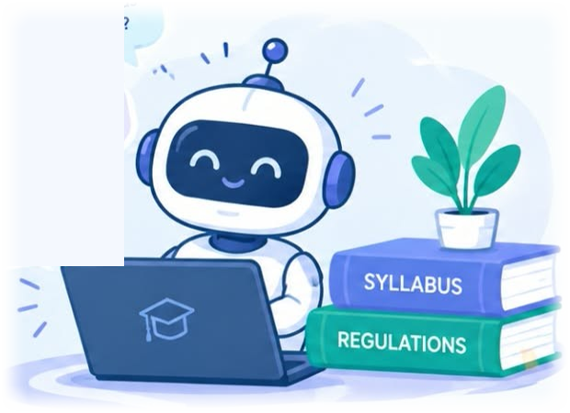



3. Motivation
Better Information → Better Decision → Brighter Future
Scattered Information
Attendance, grading, CGPA, backlog, exam, fee, hostel and library rules plus the syllabus of 16 subjects sit in different documents.
Repeated Questions
Teachers and the college office answer the same questions every semester. A 24×7 chatbot gives the same answer to every student.
Real Typing Behaviour
Students write “attendence”, use short forms and ask in different words. A useful chatbot must handle spelling and wording changes.
Trust
A wrong answer about attendance or exams has a real effect. Return only stored answers and refuse low-confidence matches.
The right information, right on your fingertips!
Exact-word search breaks on typos and an LLM alone may guess → we designed a hybrid retrieval algorithm that combines word, letter and meaning matching.
Notes:
Four everyday observations in our college motivated this project: scattered information, repeated questions, real typing behaviour with spelling mistakes, and trust. These needs cannot be met by one simple search method, so we designed a hybrid retrieval algorithm.

Slide 4







4. Objectives
Right Information → Right Answer → Better Decisions
Your Questions – Our Priority
1
Understand LLMs, Transformers & RAG
Learn how attention, retrieval and generation work together.
2
Create a Knowledge Base
CSV of 5,000 questions and answers on college regulations and syllabus (12 categories).
3
Design the Hybrid Retrieval Algorithm
TF-IDF + character N-Grams + MiniLM with FAISS, built in Python (Google Colab).
4
Be Robust to Spelling & Wording
Find the right answer even with spelling mistakes or different wording.
5
Say “Not Found” Safely
Use a confidence threshold (0.35) so unknown questions are refused.
6
Test, Compare & Document
Measure accuracy and speed, compare with word matching; prepare report, PPT and poster.
A smarter way to access college information!
Notes:
Our objectives: understand LLMs/Transformers/RAG; build a 5,000-row CSV knowledge base; design the hybrid retrieval algorithm and build the chatbot in Google Colab; handle typos; refuse unknown questions with a threshold; test accuracy and speed and compare with word matching; prepare report, PPT and poster.

Slide 5







5. Existing Approach / Background
Existing methods help… but they are not enough!
Three common ways of building a question-answering chatbot for college information
Existing Approaches
The Gap We Fill
Normal Keyword Search
Exact-word matching. Fast, but fails on spelling mistakes or changed words – only 76.9% Top-1 in our test.
Robust to Spelling & Wording
Letter groups and meaning vectors survive typos.
Only an LLM (like ChatGPT)
Answers from training data. Does not know our college rules; may give confident but wrong answers.
Uses Only Verified Answers
Answers come only from the CSV – nothing invented.
Training Our Own LLM
Would know our rules, but needs very costly computers and must be retrained whenever rules change.
Cheap to Run, Easy to Update
Edit the CSV and run again – no training needed.
So, we propose RAG with hybrid search – accurate, fast, and answering only from the CSV knowledge base.
Notes:
We studied three common ways to build a college QA chatbot. Keyword search was fast but reached only 76.9% Top-1. An LLM alone does not know our rules and may hallucinate. Training our own LLM is costly and must be repeated whenever rules change. The gap: robust to spelling, verified answers only, cheap, easy to update.

Slide 6







5. Proposed Solution
Find the right information in the right way at the right time!
A RAG chatbot with a hybrid retriever over a college syllabus and regulations CSV knowledge base
1. Knowledge Base
college_rag_qa_5000.csv – 5,000 Q&As in 12 categories.
How It Works?
Why This Solution Works?
Student types a question
Pre-processing
lower-case, no filler words/symbols
Accurate
97.6% Top-1 on 800 tough test questions
2. Hybrid Retrieval
Word + letter + meaning matching, combined into one score.
Fast
About 3 ms per question
HYBRID RETRIEVER
TF-IDF word matching → S_word
Character N-Gram (3–5 letters) → S_char
Reliable
Stored answers only – no hallucination
3. Answer from CSV
Best match’s stored answer is shown – no made-up text.
MiniLM + FAISS semantic search → S_sem
Score combination (weighted sum → best match)
Easy to Update
Edit the CSV; no training needed
4. Confidence Check
Answer only if score ≥ 0.35; else “not found”.
Answer from CSV
YES
Score ≥ 0.35 ?
NO
“Not found” – contact Academic Office
Free Tools
Colab, scikit-learn, FAISS
Knowledge base: CSV + word/char matrices + FAISS index
From Information Overload → To Smart Retrieval!
Notes:
Proposed solution: a RAG chatbot over a 5,000-row CSV. The hybrid retriever scores every stored question three ways, combines the scores, picks the best match, and shows the stored answer only if confidence is at least 0.35; otherwise it says not found.

Slide 7

6. Algorithm / Model
Retrieve the best stored question, answer only from the CSV!
Hybrid Retrieval-Based RAG Algorithm using TF-IDF, Character N-Grams and MiniLM Sentence Embeddings (FAISS)
1
Input Query
student question, typos allowed
2
Clean Text
lower-case, drop filler words & symbols
3
3 Retrievals
word, letter, meaning scores vs all 5,000 questions
4
Combine & Rank
S_final = weighted sum; best = highest
5
Threshold 0.35
≥ 0.35 → CSV answer, else “not found”
TF-IDF Word Matching
S_word
Character N-Gram Matching
S_char
MiniLM + FAISS Semantic Search
S_sem
• Weight = TF × IDF: rare key words (“attendance”, “CGPA”) score high, “is/the” low.
• Question vector vs every stored question by cosine similarity.
• Precise for same wording, but a misspelt word gets no weight → 76.9% Top-1 alone.
• Cuts text into overlapping 3–5 letter groups, then applies TF-IDF + cosine.
• “attendence” still shares 5 of 8 3-letter groups with “attendance”.
• Robust to typos → 97.2% Top-1 alone (best single method).
• MiniLM (small Transformer) turns each question into 384 numbers capturing meaning.
• FAISS finds nearest vectors fast; unit-length inner product = cosine.
• Matches same meaning in different words (“subject” vs “course”).
Cosine similarity (common score)
Score combination & decision
Why hybrid? (Top-1, 800 questions)
cos(a, b) = (a · b) / (|a| × |b|)
S_final(i) = w_word·S_word(i) + w_char·S_char(i)
+ w_sem·S_sem(i)
Word only
76.9%
Same 0–1 scale for all three scores, so they can be added and one fixed threshold applies.
i* = argmax S_final(i); confidence = S_final(i*)
Letter only
97.2%
Answer if ≥ 0.35, else “not found”. Letter matching has greater weight.
Hybrid
97.6%
Notes:
This is the core slide. Walk through the five stages left to right. Then explain each retriever: TF-IDF scores words, character N-grams score 3-5 letter groups and survive spelling mistakes, MiniLM embeddings (384 numbers) searched with FAISS capture meaning. All three use cosine similarity on a 0-1 scale, so they can be added with weights and compared with one threshold of 0.35. Weights are fixed in the notebook; letter matching gets greater importance.

Slide 8
6. Algorithm / Model
Same cleaned question → three scores → one decision
Algorithm flowchart – 16 steps in two phases (numbered circles = steps)
PHASE 1 · OFFLINE INDEX PREPARATION (once)
PHASE 2 · ONLINE ANSWERING (every question)
1
2
7
8
Load CSV
5,000 Q&As (pandas)
Clean questions
lower-case, no filler words/symbols
Accept question
typed by the student
Clean question
same cleaning as step 2
3
4
5
9
10
11
TF-IDF words
word-level sparse vectors
Char N-Grams
3–5 letter sparse vectors
MiniLM
384-number dense vectors
Word retrieval
TF-IDF cosine → S_word
Character retrieval
N-gram cosine → S_char
Semantic search
MiniLM + FAISS → S_sem
Hybrid retrieval: all three methods score the same 5,000 stored questions
6
12
13
FAISS index
nearest-neighbour search
Combine scores
S_final = Σ w · S
Best match
highest S_final = confidence
15
14
16
Indexes ready: word | character | FAISS semantic
Show CSV answer
answer + matched question + confidence
≥ 0.35 ?
“Not found”
contact Academic Office
YES
NO
feeds steps 9–11 of Phase 2
Worked example: “I have 72% attendance, can I write the exam?” → cleaned → best match “…can I write the semester exam?”, confidence 0.88 ≥ 0.35 → “With 72% attendance: You can apply for condonation with valid proof and a fee.”
Notes:
Full 16-step flowchart. Phase 1 (offline) runs once: load CSV, clean, build the word matrix, the character matrix and the MiniLM embeddings stored in a FAISS index. Phase 2 (online) runs for every question: accept, clean, run the three retrievals, combine scores, pick the best match, compare confidence with 0.35, and either show the CSV answer or the not-found message. The worked example at the bottom is from the report.

Slide 9














7. Implementation
From data to answers with code!
Python in Google Colab – class HybridRAG implements the retrieval algorithm (RAG_College_Chatbot.ipynb)
Implementation Workflow
1
2
3
4
5
6
7
8
9
Dataset
5,000 Q&As, 12 categories
Preprocessing
lower-case; remove filler words & symbols
Feature Extraction
TF-IDF words, char 3–5 grams, MiniLM (384-d)
Vector Indexing
FAISS index of all question vectors
Retrieval
S_word, S_char, S_sem by cosine
Ranking
S_final weighted sum; highest = confidence
Context Selection
threshold: confidence ≥ 0.35
Answer Lookup
answer column of best row (pandas)
Chatbot Response
answer + matched question + score, or “not found”
Tools & Technologies
Key code (HybridRAG)
Sample Data Preview
Python language
df = pd.read_csv("college_rag_qa_5000.csv")
rag = HybridRAG(df, use_dense=True)
ans = rag.answer("What is the minimum
attendance for exams?")
ids, scores, conf = self.search(query)
if conf < 0.35:
return "Sorry, I could not find this ..."
return self.df.answer[ids[0]]
category
question
answer
Google Colab notebook
Hostel
what is the hostel intime?
In-time 8:00 PM (1st yr), 9:00 PM others…
pandas CSV handling
scikit-learn TF-IDF, cosine
Library
What if I lose a library book?
Late fine Rs. 2 per day per book…
sentence-transformers MiniLM
Syllabus
unit 5 topics of DSA?
Unit 5: Dynamic programming, greedy…
FAISS vector search
Notes:
Implementation is in Python in Google Colab; the algorithm is the class HybridRAG in RAG_College_Chatbot.ipynb. Pipeline: Dataset, Preprocessing, Feature Extraction (TF-IDF word, character N-grams, MiniLM), Vector Indexing (FAISS), Retrieval (three scores), Ranking (combined score), Context Selection (threshold 0.35), Answer retrieval from CSV, Chatbot response. use_dense=True switches on meaning matching.

Slide 10

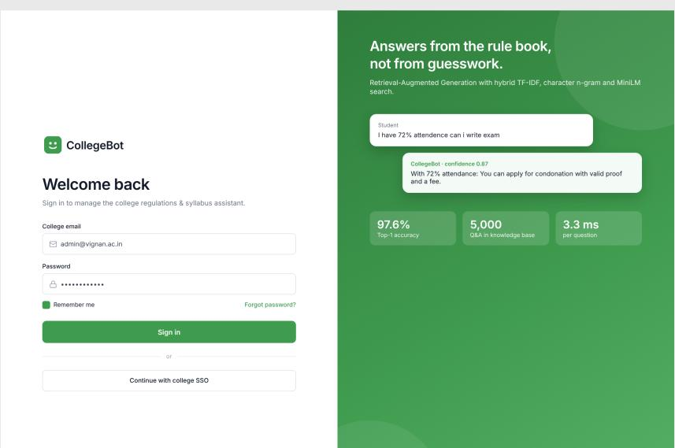
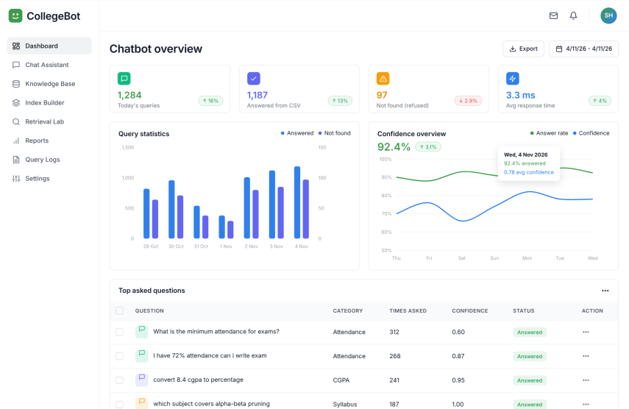
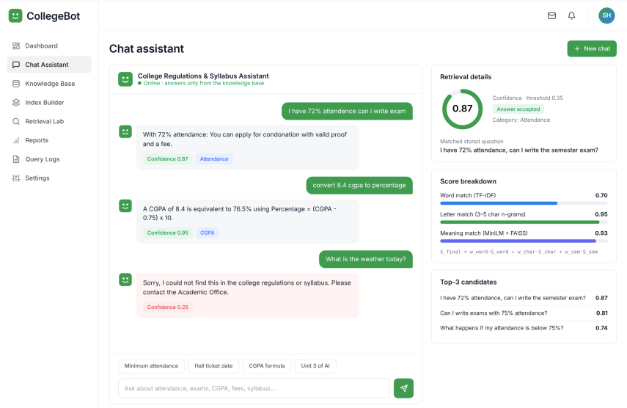
8. User Interface (1/4)
Student asks → Bot answers from the CSV!
CollegeBot web app – sign in, monitor the chatbot and chat with it
Screen 01 · Login
Screen 02 · Dashboard overview
Screen 03 · Chat assistant
Secure Sign-in
Live Overview
Answers with Evidence
Admin sign-in with college email or SSO. The side panel shows the headline numbers: 97.6% Top-1, 5,000 Q&As and 3.3 ms per question.
Today’s queries, answered-from-CSV count, refused questions and response time, with query and confidence charts and the top asked questions.
Replies come only from the knowledge base. The side panel shows confidence (0.87 vs threshold 0.35), score breakdown and top-3 matches; unrelated questions get “not found”.
Notes:
UI screens 1-3: login, dashboard overview and the chat assistant with retrieval details (confidence, score breakdown, top-3 candidates).

Slide 11
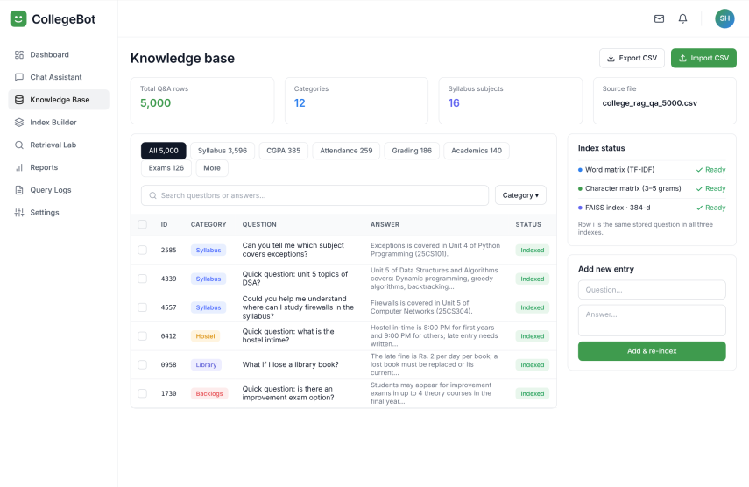
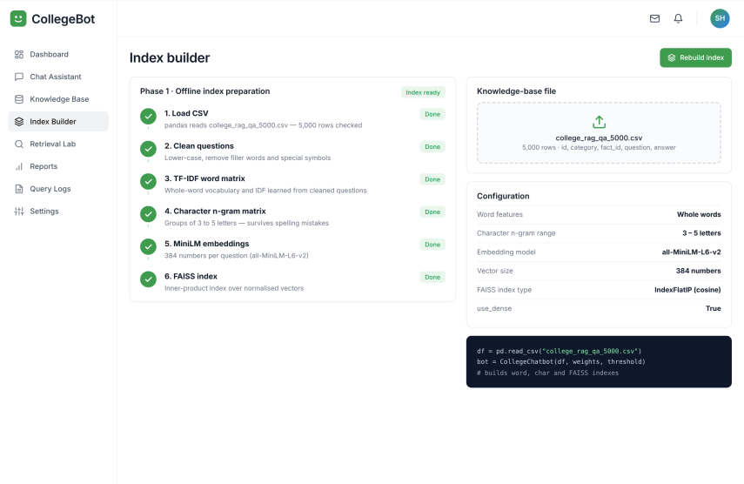
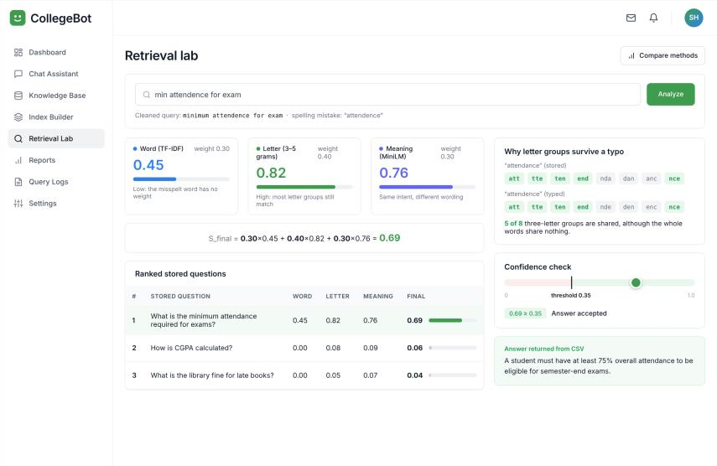
8. User Interface (2/4)
See how every answer is found!
Knowledge base, index building and the hybrid retrieval lab
Screen 04 · Knowledge base
Screen 05 · Index builder – Phase 1
Screen 06 · Retrieval lab
Manage the Knowledge Base
Offline Index Preparation
Hybrid Score Breakdown
Browse and search the 5,000-row CSV across 12 categories, check word, character and FAISS index status, and add a new Q&A with re-index.
Load CSV → clean → TF-IDF word matrix → character n-grams → MiniLM embeddings → FAISS index, shown with the configuration used (384 numbers per question).
A typo query (“attendence”) is scored by word 0.45, letter 0.82 and meaning 0.76; the weights give a final 0.69, above the 0.35 threshold.
Notes:
UI screens 4-6: knowledge base table, Phase 1 index builder, and the retrieval lab showing word, letter and meaning scores combining into the final score.

Slide 12
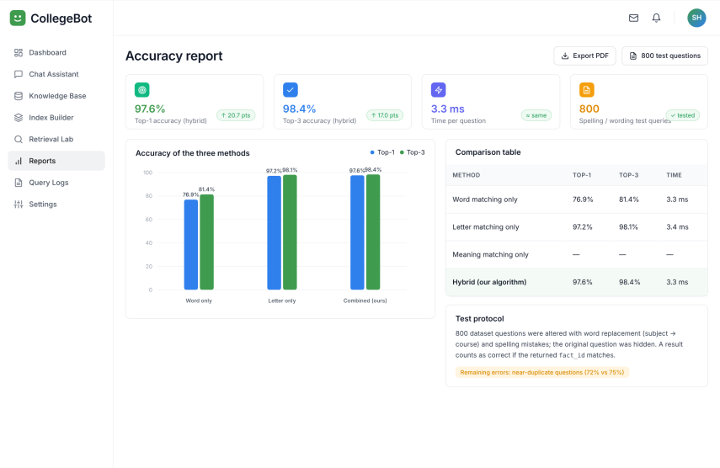
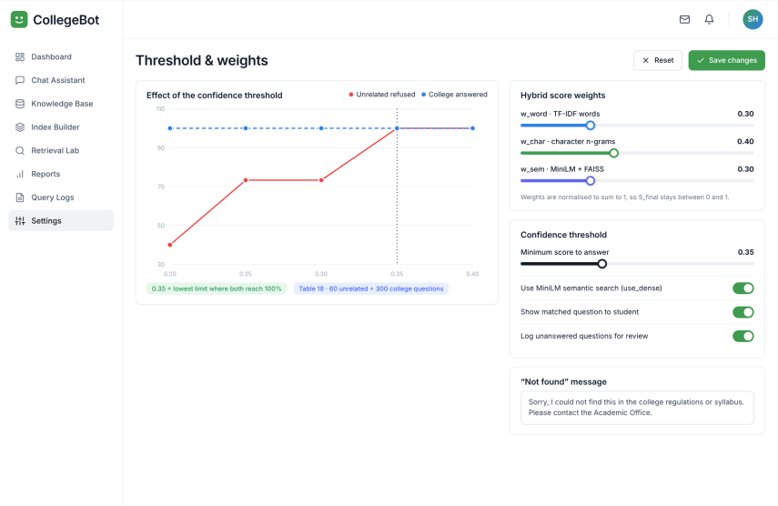
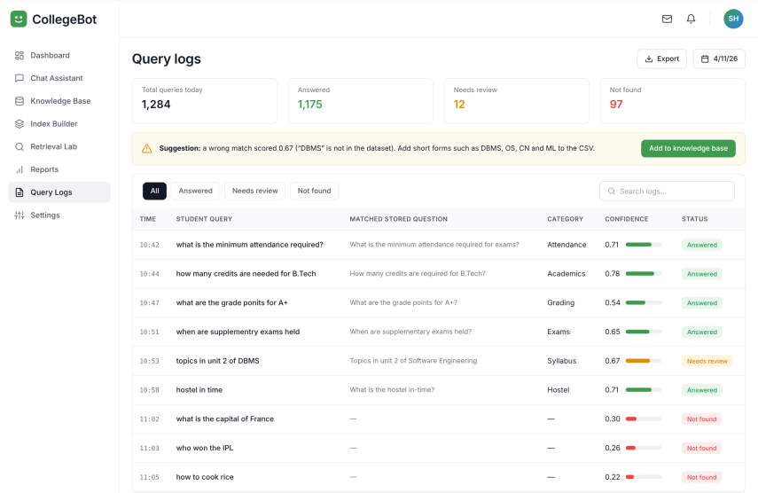
8. User Interface (3/4)
Measure → Tune → Improve!
Accuracy report, tuning settings and query logs
Screen 07 · Accuracy report
Screen 08 · Threshold & weights
Screen 09 · Query logs
Accuracy at a Glance
Tune the Algorithm
Learn from Real Queries
97.6% Top-1 and 98.4% Top-3 on 800 test questions at 3.3 ms, with a comparison of word-only, letter-only and the hybrid method.
Sliders for the three score weights (0.30 / 0.40 / 0.30) and the confidence threshold (0.35), plus the editable “not found” message.
Every query is logged with its matched question, confidence and status. Unanswered ones are flagged so they can be added to the knowledge base.
Notes:
UI screens 7-9: accuracy report, threshold and weights settings, query logs with unanswered questions.

Slide 13
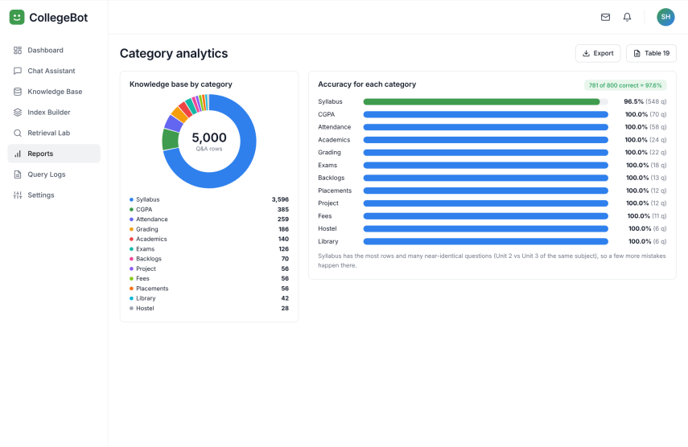
8. User Interface (4/4)
Right Information, Right Answer!
Category analytics – where the knowledge base is strong and where to improve
5,000 Q&As · 12 categories
Knowledge base split by category on a donut chart
Syllabus 96.5% · others 100%
Accuracy for each category on the test questions
Why Syllabus is lower
Near-identical questions across Unit 2 and Unit 3
All 10 screens
Login · Dashboard · Chat assistant
Knowledge base · Index builder · Retrieval lab
Accuracy report · Threshold & weights
Query logs · Category analytics
Screen 10 · Category analytics
Notes:
UI screen 10: category analytics - knowledge base by category and accuracy per category. Syllabus is lower because of near-identical questions.

Slide 14

9. Results & Discussion
Accurate Answers + Relevant Information = Happy Students!
Reported by the team from Google Colab experiments on 800 questions with spelling mistakes and different wording
Sample Chatbot Interaction
Accuracy of the three methods (%)
97.6% Top-1 · 98.4% Top-3
vs 76.9% / 81.4% word-only
I have 72% attendance can i write exam
With 72% attendance: You can apply for condonation with valid proof and a fee.
Confidence 0.87
≈ 3 ms per question
replies instantly
60/60 unrelated refused
300/300 college answered (0.35)
What is the weather today?
Sorry, I could not find this in the college regulations or syllabus. Confidence 0.25 < 0.35
17 of 18 test cases correct
Syllabus 96.5%; other categories 100%
Key Insights & Discussion
• Word matching alone loses about 1 in 4 answers – a typo or changed word breaks the match.
• Letter matching already reaches 97.2%; the hybrid gain over it is small (+0.4 pts Top-1) on this test set, large over words (+20.7).
• Threshold 0.35 is the lowest tested limit refusing 100% unrelated questions while answering 100% college questions.
• Remaining errors: near-identical questions (72% vs 75% attendance) and short forms like “DBMS” (test case 8, score 0.67). MiniLM’s own gain was not measured separately.
Notes:
All numbers were measured by the team in Google Colab on 800 test questions with spelling mistakes and replaced words; they are reported, not independently re-run. Hybrid 97.6% Top-1 / 98.4% Top-3 vs word-only 76.9% / 81.4% and letter-only 97.2% / 98.1%, about 3 ms per question. Threshold 0.35 refused all 60 unrelated questions and answered all 300 college questions. 17 of 18 manual test cases were correct; case 8 (DBMS short form) was wrong with score 0.67. MiniLM was not measured separately.

Slide 15








10. Application
Smarter information for a smoother college journey!
Quick, accurate and easy access to college rules and syllabus – only the CSV changes for a new institution
Where Can It Be Used?
Your College Information Assistant!
Beyond the Campus
Student Help Desk
24×7 chatbot on the college website or WhatsApp.
Teachers
Quick look-up of syllabus, credits and exam pattern.
Admission & Fee Office
Eligibility, fees, scholarships and hostel questions.
Other Colleges & Schools
Only the CSV file needs to be replaced.
Examination Cell
Hall ticket, revaluation, supplementary exam and backlog rules.
Companies
HR-policy and customer-support FAQ chatbots with the same idea.
Quick Answers · Anytime · Anywhere – a step towards a smarter, more connected campus!
Notes:
Applications from the report: student help desk (24x7 on website or WhatsApp), admission and fee office, examination cell, teachers, other colleges and schools by replacing the CSV, and companies for HR policy and customer-support FAQs.

Slide 16








12. Limitations
Understanding limitations helps us build a better solution!
While the chatbot is helpful, it does have certain limitations
Areas to Improve…
Sample Dataset
The CSV is a sample; the college’s real regulations must be added before use.
No Conversation Memory
Each question is answered separately.
Answers Only from the CSV
Cannot combine several rules to think out a new answer.
Near-Identical Questions
A wrong match above 0.35 is not caught (test case 8: “DBMS” scored 0.67).
English Only
Questions are expected in English.
Short Forms & First Run
DBMS, OS work only if in the CSV; MiniLM downloads on first run.
Remedies: add short forms (DBMS, OS, CN, ML) to the CSV; read official PDFs directly; add an LLM, more languages and conversation memory (see Future Scope).
Notes:
Honest limitations from the report: sample dataset; answers only what is in the CSV; English only; no conversation memory; near-identical questions can be mismatched above the threshold (test case 8, DBMS); short forms only if present in the dataset; the MiniLM model must be downloaded on first run; the threshold experiment was measured with word and letter matching.

Slide 17







13. Future Scope
More Features… More Intelligence… Greater Impact!
From a retrieval-based chatbot to a smarter, personalised and multilingual assistant
Read Official PDFs
Read the regulation PDFs directly – no hand-written CSV.
Telugu, Hindi & Voice
Multilingual support and voice input.
LLM-Written Answers
Friendly answers that also show which rule was used.
Conversation Memory
Remember previous questions in a chat.
Short Forms & Nicknames
Add DBMS, OS, CN, ML etc. to the dataset.
Website, WhatsApp & Personal Answers
Deploy online; connect to the college database for a student’s own attendance status.
These enhancements will make the chatbot more powerful, user-friendly and widely accessible!
Notes:
Future scope from the report: read the regulation PDFs directly, use an LLM to rewrite answers in a friendly way and show the rule used, support Telugu and Hindi and voice input, remember earlier questions, add short forms and nicknames to the dataset, deploy on the college website or WhatsApp, and give personal answers by connecting to the college database.

Slide 18



14. Conclusion
Smarter Access for a Smoother Academic Journey!
A simple solution with a big impact – college information that is accessible, accurate and easy for every student
Knowledge Base
CSV of 5,000 Q&As on college regulations and syllabus (12 categories).
Benefits & Impact
For Students
Saves time, reduces confusion; handles typos and different wording.
Hybrid Retrieval Algorithm
TF-IDF + char N-Grams + MiniLM/FAISS; cosine scores combined; answer if confidence ≥ 0.35.
For College
Reduces repeated queries; update rules by editing the CSV – no training.
Chatbot
Stored answers only – no made-up information; unrelated questions refused.
Overall Impact
97.6% Top-1 (98.4% Top-3) vs 76.9% word-only; ~3 ms; 60/60 unrelated refused.
Final Thought
With the right information, every student can achieve more – and the same idea works for any college or company.
Notes:
Conclusion: the RAG chatbot answers college regulation and syllabus questions from a 5,000-row CSV using the hybrid retrieval algorithm. It is accurate with typos (97.6% Top-1 vs 76.9% for word matching), fast, easy to update, and never makes up answers. References: Lewis et al. (RAG, 2020); Vaswani et al. (Attention Is All You Need, 2017); Reimers & Gurevych (Sentence-BERT, 2019); Johnson et al. (FAISS, 2019); Russell & Norvig (AI: A Modern Approach).

Slide 19

Thank You
Big dreams start with small steps…
For your time, attention and valuable feedback!
Together towards a smarter academic journey!
Questions?
Notes:
Thank the audience and invite questions. Every team member can explain the full working of the chatbot.

