Slide 1
PCCCS504 SOFTWARE ENGINEERING & PROJECT MANAGEMENT LAB • ACADEMIC YEAR 2026-27
IEM Admission System Software
A Resilient, Dual-Engine College Admissions & Verification Platform
Team Number: P4 | Team Name: Nexus | Batch: 2024-2028 (Section A, 5th Sem) | Institute of Engineering & Management, Kolkata
Susnata Maiti
Roll: A-11 • CSE
Role: Frontend Developer
maitisusnata135531@gmail.com
Responsibilities: UI/UX design, client-side validation, 4-step wizard form, and REST API integration.
Deliverables: Responsive SPA, error toasts, and student dashboard.
Sreejita Dey
Roll: A-29 • CSE
Role: Backend Developer
sreejitad05@gmail.com
Responsibilities: FastAPI ASGI API, PBKDF2 hashing, JWT tokens, and finite-state machine.
Deliverables: Async API routes, RBAC security, transition validation logic.
Swapnil Ghosh
Roll: A-04 • CSE
Role: Database Lead
swapnilghosh2005@gmail.com
Responsibilities: Dual-engine database layer, MongoDB Atlas, SQLite3 offline failover.
Deliverables: SRV DNS auto-recovery, schema design, document storage.
Debadrita Dutta
Roll: A-12 • CSE
Role: Test Lead
debadritadutta831@gmail.com
Responsibilities: Software test strategy & plan, McCabe basis path testing, BVA/ECP design.
Deliverables: 16 automated test fixtures, 100% path coverage, defect log.
Faculty In-Charge: Prof. Sangeeta Sarkar & Prof. Saikat Dutta | Project Sponsor & Director: Dr. Satyajit Chakrabarti

Slide 2
PROJECT CONTEXT & SCOPE
Problem Statement & Project Charter Overview
The Problem & Operational Challenges
Legacy Bottlenecks: Paper forms and unvalidated portals cause application loss and processing delays.
Network Fragility: Campus network drops and DNS filters disrupt cloud database connections during rush periods.
Validation Vulnerabilities: Unchecked file formats and oversized files crash application handlers and consume storage.
Core Mission: Deliver a unified admissions platform with zero downtime and immutable data governance.
6-Stage Admission Workflow Lifecycle
▸ 1. Account Registration: Applicant enters name, email (@gmail.com enforced), and password; salted PBKDF2 hash.
▸ 2. 4-Step Form Wizard: Student inputs personal details, academic scores (Class 10/12), and course selection.
▸ 3. PDF Marksheet Upload: FastAPI validates PDF MIME type and enforces strict <5MB size ceiling before saving.
▸ 4. Immutable Final Submit: Application state locks permanently into 'Submitted' state; timestamp and audit log stored.
▸ 5. Admin Triage & Review: Admission officers inspect credentials, preview marksheets, and update status with remarks.
▸ 6. Live Student Tracking: Applicant tracks decision timeline (Under Review, Accepted, Rejected) in real time.
Project Charter Constraints & Governance
Strict 20-Day Timeline: Accelerated development lifecycle from charter approval to full cloud deployment.
Target Client Environment: Exclusively optimized for Windows 11 Desktop on Google Chrome and Microsoft Edge.
Fixed Technology Stack: Next.js / Vanilla JS Frontend, FastAPI Python ASGI backend, and Dual DB layer.
Autonomous Governance: Separation of duties across Frontend, Backend, Database, and Testing teams.
IEM Admission System • Team Nexus (P4) • PCCCS504 Software Engineering & Project Management Lab
Slide 2 of 10

Slide 3
SYSTEM REQUIREMENTS & GOVERNANCE
Software Requirements Specification & Actor Matrix
Requirements Baseline: 20 Functional Requirements (FR-01 to FR-20) + 5 Non-Functional Requirements (NFR-01 to NFR-05)
Explicit Scope Boundary: Out-of-scope for 20-day delivery: Online payment gateways, SMS/OTP gateways, biometric auth, and screen resolutions below 1366×768.
1. Student / Applicant Portal
FR-01/02: Registration & login with password policy (>=8 chars, uppercase, special char).
FR-03/04: Personal bio data capture and academic programme selection.
FR-05/06: Document upload limited strictly to PDF format (<=5MB).
FR-08/09: Final submission and permanent immutable application locking.
FR-10/11: Personal dashboard displaying live application lifecycle status.
2. Administrator Workspace
FR-14/15: Role-based authentication & full applications triage queue.
FR-16: Instant search & filtering by candidate name, course, or status.
FR-17/18: Deep application inspection and direct PDF marksheet download.
FR-19: State transition execution (Under Review, Accepted, Rejected).
NFR-03: Dual view toggle: Compact Table Mode vs Detailed Card View.
3. Executive Director Oversight
FR-20: Executive dashboard summarizing real-time admission counts by status.
FR-12: One-click CSV data export of applicant records for offline analysis.
Role Guard: Enforced read-only mode preventing unauthorized status changes.
Ergonomics: Designed specifically for rapid executive reviews without deep triage.
Non-Functional Quality Benchmarks (NFR Compliance)
• NFR-01 (Performance): Dashboard loads in <3s • NFR-02 (Security): Salted PBKDF2 cryptography & JWT tokens • NFR-03 (Usability): Search filter in <1s with dual view toggle
• NFR-04 (Reliability): 98%+ PDF upload success rate • NFR-05 (Compatibility): Windows 11 Chrome & Edge
IEM Admission System • Team Nexus (P4) • PCCCS504 Software Engineering & Project Management Lab
Slide 3 of 10

Slide 4
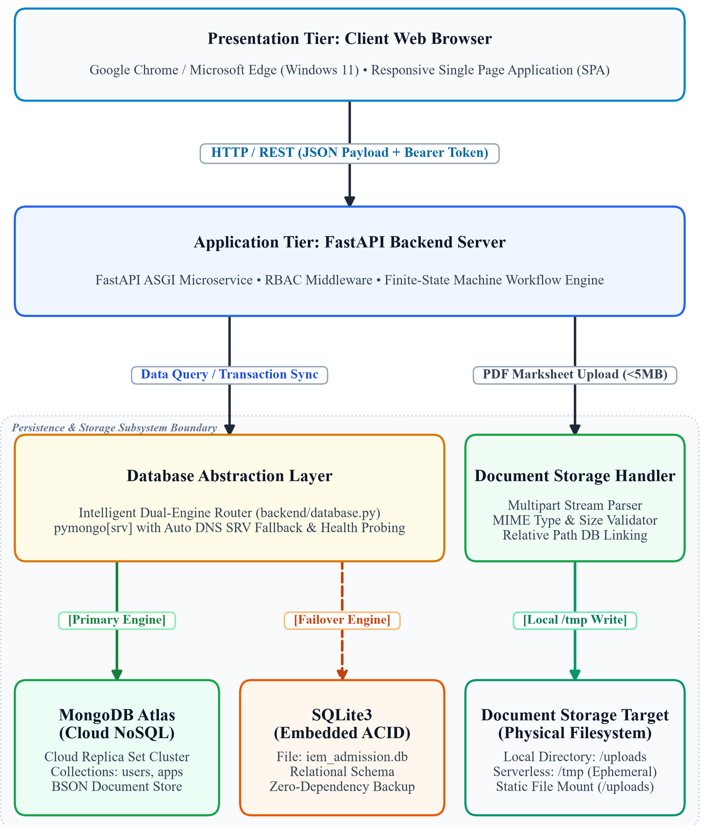
HIGH-LEVEL ARCHITECTURE (HLD)
System Architecture & Dual-Engine Database Abstraction
Presentation & Application Tiers
Presentation Layer: Responsive Single Page Application (SPA) in Chrome/Edge on Windows 11 using asynchronous JSON REST over TLS.
FastAPI ASGI Server: High-concurrency microservice with Pydantic validation schemas, RBAC auth middleware, and CORS security.
Dual-Engine Database Abstraction Layer
Intelligent Router: Unified database layer in database.py encapsulating both MongoDB Atlas Cloud and SQLite3 embedded engines.
Automatic DNS Resolution: Injects public nameservers (8.8.8.8, 1.1.1.1) to overcome Windows SRV DNS record failures in campus networks.
Zero-Downtime Failover: If MongoDB ping fails or exceeds 4000ms, seamlessly defaults to SQLite (iem_admission.db) without dropping requests.
Decoupled Document Storage Subsystem
MIME & Boundary Guard: Verifies magic byte headers to prevent malicious execution and enforces 5MB limit.
Hybrid Persistence: Saves files to local /uploads or serverless /tmp, storing lightweight URI references in DB.
IEM Admission System • Team Nexus (P4) • PCCCS504 Software Engineering & Project Management Lab
Slide 4 of 10

Slide 5
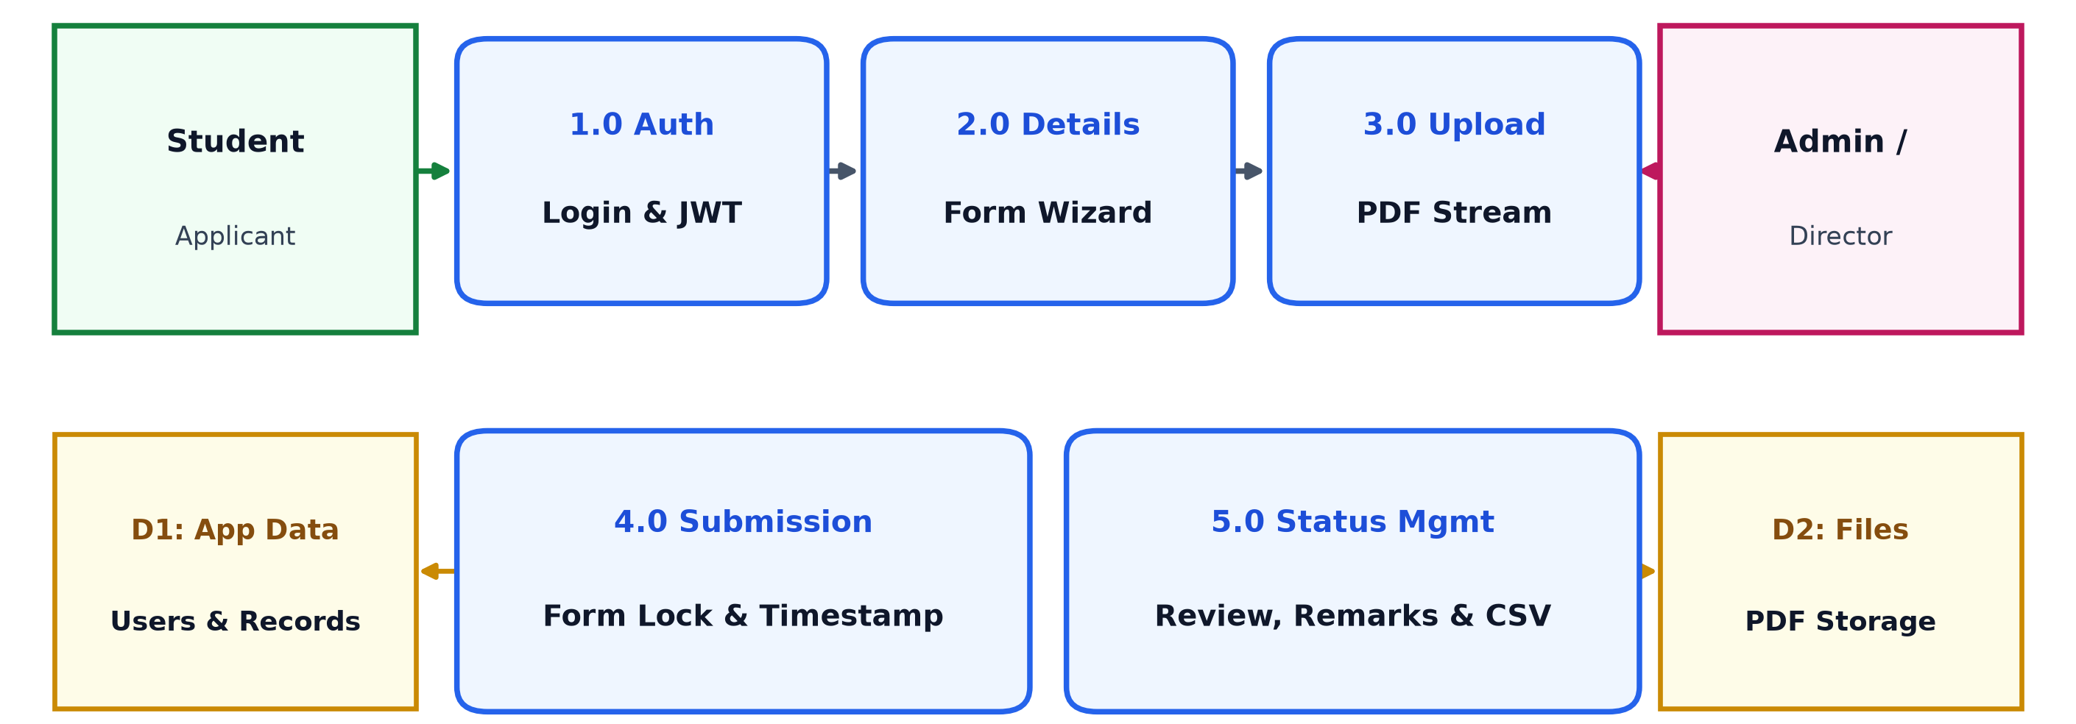
SYSTEM DATA FLOW & STORES
Data Flow Architecture & Subsystem Interaction (DFD)
1.0 - 3.0 Core Admission Pipeline
1.0 Manage Auth: Verifies credentials, hashes passwords, reads/writes D1, and issues signed JWT tokens.
2.0 Manage Details: Validates personal details, Class 10/12 marks, and course selection; updates draft in D1.
3.0 Process Upload: Validates PDF stream, writes binary to D2 Document Storage, and links URI in D1.
4.0 - 5.0 Submission & Triage
4.0 Manage Submission: Freezes draft, stamps submission timestamp, and irreversibly sets status to 'Submitted'.
5.0 Status Management: Enables admin to search/filter candidates, inspect marksheets from D2, and update status with audit logs.
Executive Queries: Director requests aggregated metrics and downloads filtered CSV reports directly from 5.0.
Data Stores D1 & D2 Specifications
D1: Student/Application Data: Persists user credentials, applicant profiles, academic percentages, application statuses, and audit logs.
D2: Document Storage: Physical filesystem (/uploads) storing PDF marksheets with sanitized unique identifiers.
Referential Integrity: D1 holds relative URI path references to D2 file objects.
IEM Admission System • Team Nexus (P4) • PCCCS504 Software Engineering & Project Management Lab
Slide 5 of 10

Slide 6
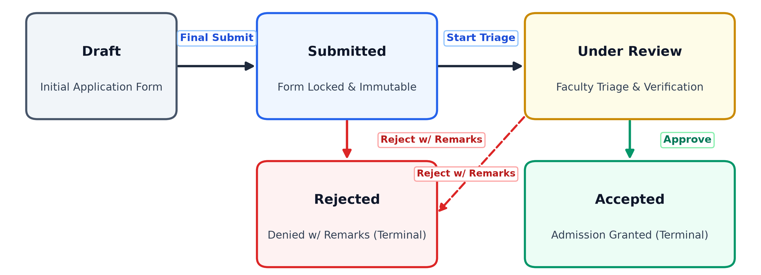
STATE MACHINE & BUSINESS LOGIC
Admission Workflow Engine & Finite-State Machine
BR-01 & BR-02: Form Immutability
BR-01 Password Policy: Passwords must be >=8 characters, contain >=1 uppercase letter, and >=1 special character.
BR-02 Application Edit Lock: Once an applicant submits, personal details, academic scores, and documents are locked permanently.
Server-Side Guard: Any post-submission mutation attempts trigger HTTP 403 Forbidden.
BR-03: Legal State Transitions
Valid Workflow: Draft -> Submitted -> Under Review -> Accepted / Rejected.
Direct Rejection Guard: Applications in 'Submitted' state may be rejected directly ONLY if explanatory remarks are provided.
Terminal States: Both 'Accepted' and 'Rejected' are terminal; no further status reversals are permitted.
BR-04 & Audit Trail Logging
BR-04 Academic Score Bounds: Class 10 and 12 percentages must fall strictly between 0.0% and 100.0%.
Audit Trail Logging: Every state change records timestamp, actor email, previous state, new state, and remarks.
Compliance: Guarantees transparency and audit-readiness for university accreditation.
IEM Admission System • Team Nexus (P4) • PCCCS504 Software Engineering & Project Management Lab
Slide 6 of 10

Slide 7
FRONTEND ENGINEERING & ERGONOMICS
UI/UX Architecture & Responsive Desktop Interfaces
1. Authentication & Onboarding Portal
Institutional Branding: Displays the official IEM laurel wreath crest and professional Google Sans typography.
Domain Validation: Enforces @gmail.com email domain constraints and client-side password strength checking.
Session Security: Stores authenticated session tokens securely, redirecting students to dashboard upon login.
2. 4-Step Student Application Wizard
Guided Stepper: Step 1: Personal Details • Step 2: Academic Scores • Step 3: Document Upload • Step 4: Final Review.
Interactive Progress Bar: Visual step indicators guide students with real-time feedback on mandatory form fields.
Drag-and-Drop Upload: Intuitive PDF upload container with live size validation and file replacement preview.
3. Student Application Status Dashboard
Live Timeline Tracker: Chronological progress stepper showing submission date, document verification, and final decision.
Application Summary Card: Displays unique Application ID (e.g. IEM-2026-0847), chosen course, and submitted scores.
Integrated Document Viewer: One-click preview and download of uploaded PDF marksheets directly from the browser.
4. Administrator Workspace & Dual View Modes
Real-time Metric Cards: Top KPI counters showing Total, Pending Review, Accepted, and Rejected application volumes.
Dual View Toggle (NFR-03): Switch smoothly between Compact Table Mode (fast triage) and Detailed Card Mode (in-depth inspection).
Live Search & Status Updater: Instant sub-second applicant search with modal dialog for status updates, remarks, and CSV export.
IEM Admission System • Team Nexus (P4) • PCCCS504 Software Engineering & Project Management Lab
Slide 7 of 10

Slide 8
TESTING STRATEGY & QUALITY GOVERNANCE
Software Verification, Testing Strategy & Quality Metrics
White-Box Testing: McCabe's Basis Path Analysis
Target Logic Module: validate_status_transition(current, new, remarks) in backend/workflow.py.
Control Flow Graph (CFG): Nodes (N) = 20, Edges (E) = 27, Decision Predicates (P) = 9.
Cyclomatic Complexity: V(G) = E - N + 2P = 27 - 20 + 2(1) = 9 (or P + 1 = 10 independent paths).
100% Path Coverage: Codified all 10 linearly independent paths into automated unit test assertions.
Automated Test Suite (backend/test_suite.py)
Test Execution Status: 16 out of 16 Automated Test Fixtures Passing (100% Pass Rate).
Multi-Database Parity: Executed identically against both SQLite3 and live MongoDB Atlas without regressions.
Sandwich Integration: Lightweight synthetic JWT tokens and mock PDF byte buffers used as stubs and drivers.
Zero Defect Escape: Automated regression suite executed on every code commit.
Black-Box Test Design (BVA & ECP)
Equivalence Partitioning: Password complexity (min 8 chars, uppercase, special character) and phone format partitions.
Boundary Value Analysis: Academic percentages tested at 0.0%, 100.0%, -0.1%, and 100.1%.
File Upload Thresholds: Tested 4.99MB (accepted), 5.00MB (accepted boundary), and 5.01MB (rejected with HTTP 422).
Test Governance & Roles
Unit Testing: Executed by Sreejita Dey (Backend) and Debadrita Dutta (Test Lead).
Integration Testing: Managed by Susnata Maiti (Frontend/Integration) and Sreejita Dey (Backend).
System Testing: Managed by Debadrita Dutta; verified against all 20 FRs and 5 NFRs on Windows 11 with sponsor sign-off.
IEM Admission System • Team Nexus (P4) • PCCCS504 Software Engineering & Project Management Lab
Slide 8 of 10

Slide 9
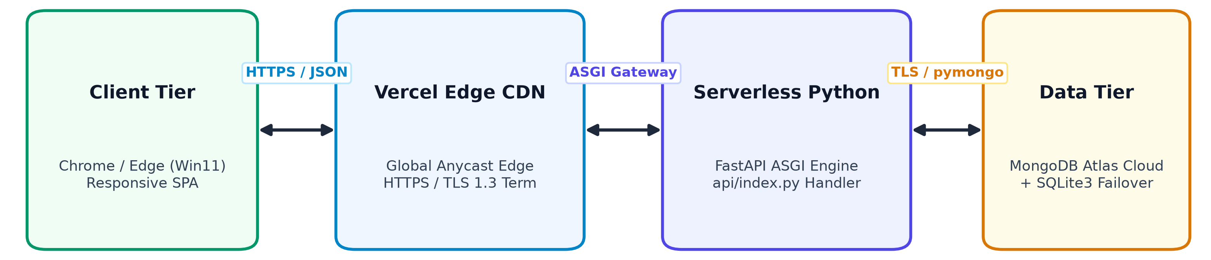
CLOUD ARCHITECTURE & LIVE DEMONSTRATION
Cloud Deployment, Serverless Edge & Live Demonstration
Live Production Deployment
Live Vercel Production URL: https://iem-admission-system-nexus-p4.vercel.app/
Global CDN Edge Routing: Static assets served from global edge caches with automated HTTPS/TLS 1.3 termination.
Serverless ASGI Handler: api/index.py bridges Vercel serverless requests into the FastAPI ASGI application seamlessly.
Hybrid Execution & Portability
Dual Environment Parity: Runs identically locally on Windows 11 via python run_server.py and on Vercel Cloud Serverless.
Zero Code Mutation: Dynamic environment inspection detects host runtime and adjusts static routes automatically.
Ephemeral File Handling: Utilizes /tmp on serverless instances to ensure PDF processing without local disk dependency.
Fault Isolation & Resilience
MongoDB Atlas Connectivity: Connects to cloud replica set; auto-injects public DNS to bypass SRV query failures.
Offline Graceful Fallback: If network isolation occurs, application continues servicing requests using local SQLite storage.
Zero Data Loss Guarantee: Student submissions and audit trails remain intact across all failure scenarios.
IEM Admission System • Team Nexus (P4) • PCCCS504 Software Engineering & Project Management Lab
Slide 9 of 10

Slide 10
PROJECT EVALUATION & NEXT STEPS
Project Milestones, Value Delivered & Future Roadmap
20-Day Project Milestone Execution Schedule (100% Completed on Schedule)
• Days 1–3 (Planning): Requirements gathering, Project Charter sign-off, SRS & HLD drafting, UML modeling.
• Days 4–10 (Frontend): Figma wireframe alignment, responsive UI development, 4-step wizard form building.
• Days 11–15 (Backend & DB): FastAPI endpoints, PBKDF2 hashing, dual-engine DB abstraction, PDF upload handling.
• Days 16–18 (Testing & QA): End-to-end integration, Basis Path analysis (10 paths), 16 automated tests execution.
• Days 19–20 (Delivery): Final documentation, user acceptance testing on Windows 11, and Vercel cloud deployment.
Key Achievements & Value Delivered
Academic Excellence: Engineered a robust admissions system fulfilling all 20 FRs and 5 NFRs within 20 days.
Fault Tolerant Persistence: Dual-engine persistence layer eliminates downtime risks from campus DNS outages.
Rigorous Quality Assurance: 100% pass rate across automated regression fixtures with complete basis path coverage.
Stakeholder Alignment: Delivered dedicated workspaces for Students, Admins, and Executive Directors.
Future Roadmap & Technological Extensions
Online Payment Gateway: Integrate Razorpay/Stripe API for automated admission fee processing with digital receipts.
Multichannel Alerts: Automated SMS, WhatsApp, and Email triggers for real-time application milestone notifications.
AI Document Verification: Deploy Vision OCR microservices to automatically parse and verify marks from marksheets.
Enrolment Analytics: Predictive enrolment yield modeling for academic department capacity planning.
Thank You! Questions & Discussion
Team Nexus (P4) • Susnata Maiti | Sreejita Dey | Swapnil Ghosh | Debadrita Dutta
IEM Admission System • Team Nexus (P4) • PCCCS504 Software Engineering & Project Management Lab
Slide 10 of 10

