Slide 1
Multimodal Deep Learning for Depression Detection Using Text and Image Data
NAME: SUSRITA PANDA
ROLL NO: CB.AI.P2DSC25032

Slide 2
INTRODUCTION
Depression Is One Of The Most Common Mental Health Problems, And Early Detection Is Important For Proper Support And Treatment.
People often express their feelings online more freely than in real life, so social media can give honest emotional clues..
Most systems use only text or images, so they miss the full emotional meaning that comes from combining both.
Combining text and image data with advanced deep learning helps understand emotions better and detect depression more accurately.

Slide 3
PROBLEM STATEMENT
Many existing systems use text and image data for depression detection, but they fail to combine both effectively.
However, many of these systems use weak fusion methods and simple text models, which do not capture the deep relationship between text and images.
As a result, multimodal models often do not perform better than strong text-only models, limiting their effectiveness.
To develop an improved multimodal system using advanced text models and effective fusion techniques for accurate depression detection.

Slide 4
LITERATURE REVIEW
Journal and Year | Task | Method | Key Findings | Relevance to my work
Computation (MDPI) – 2025 | Multimodal depression detection | Multimodal data fusion using deep learning | Fusion techniques improve detection performance compared to single modality models | Supports using multimodal fusion methods such as attention and concatenation in our model
Nature – npj Mental Health Research, 2024 | Depression detection using text and facial expressions | LLM-based text analysis with facial expression features | Combining textual and visual features improves depression prediction accuracy | Motivates combining text data with visual information in our system
Sensors (MDPI) – 2024 | Mental health assessment | Deep learning using audio, video, and text modalities | Multimodal sensing improves prediction accuracy compared to single-modality systems | Shows the importance of multimodal learning for mental health analysis

Slide 5
LITERATURE REVIEW
Journal and Year | Task | Method | Key findings | Relevance to my work
Electronics (MDPI), 2025 | Depression severity detection | Multimodal AI model using audio and video signals | Integrating speech and facial features improves depression severity prediction | Supports using deep learning to combine multiple data sources
Frontiers in Psychiatry, 2025 | Multimodal depression detection | Integrative Multimodal Depression Detection Network (IMDD-Net) | Combining video, audio, and text features captures emotional cues effectively | Supports our approach of integrating multiple modalities (text + image)

Slide 6
RESEARCH GAP
Most multimodal studies use basic text models and do not combine transformers with sequential models, for deep contextual understanding.
Most multimodal models use simple fusion methods like concatenation or addition, without capturing deeper relationships between text and images.
Most existing works do not compare multiple transformer-based text models, making it unclear which one performs best for depression detection.
Gap Addressed In This Work:
This work combines transformer models with BiGRU to better capture emotional patterns from text.
This work systematically explores and compares six fusion strategies — Add, Concat, Attention, Concat+Attention, Bilinear, and Cross Residual Fusion — to identify the most effective combination for depression detection.
This work compares RoBERTa, BERT, and DistilBERT with BiGRU in the same pipeline for fair evaluation.

Slide 7
OBJECTIVE
Study and identify the specific weaknesses in existing text and image fusion approaches used for depression detection on social media data.
To Extract Textual Features Using Bert, Roberta, And Distilbert With Bigru.
To Extract Visual Features From Images Using Resnet18.
Implement and systematically compare six different fusion techniques — Add, Concat, Attention, Concat+Attention, Bilinear, and Cross Residual Fusion — to identify the most effective strategy for combining text and image features.
Develop a complete deep learning system that combines preprocessing, feature extraction, fusion, and depression classification in one pipeline
To Evaluate The Performance Of Different Fusion Models Using Accuracy, Precision, Recall, And F1-score And Select The Best Performing Model.
Find the best combination of text , image model and fusion method together for accurate and reliable depression detection.

Slide 8
System Architecture: Multimodal Depression Detection
(a) Input
Text Data
(Reddit Depression Dataset)
Image Data
(Roboflow: Facial Expression)
(b) Preprocessing
Text Preprocessing
Image Preprocessing
Cleaning · Tokenization
Padding · Attention Mask
Train 70% / Val 15% / Test 15%
Resize 224×224 · Normalization
Augmentation (Flip / Rotation
/ Color Jitter) · Class Balancing
(c) Feature
Extraction
RoBERTa+ BiGRU+ Attention
BERT+ BiGRU+ Attention
DistilBERT + BiGRU+ Attention
ResNet18
Embeddings (768-dim)
→ BiGRU → Dropout
→ FC Layer
Embeddings (768-dim)
→ BiGRU → Attn
→ FC Layer
Embeddings (768-dim)
→ BiGRU → Dropout
→ FC Layer
Pretrained CNN
18 layers-Feature Map (512-dim)
→ FC Layer
(d) Fusion
Module
Fusion Module (Text Feature 512-dim ⊕ Image Feature 512-dim)
Add
Concat
Attention
Concat+
Attention ★
Bilinear
Cross
Residual
(e) Training
Classifier
Training Configuration
Dropout → FC Layer (256→2)
Softmax → Class Logits
Loss: CrossEntropyLoss · Optimizer: AdamW · Dropout · Gradient Clipping · Early Stopping
(f) Evaluation
Evaluation Metrics
(g) Results
Accuracy · Precision · Recall · F1 Score · ROC-AUC · Confusion Matrix · ROC Curve
Results
(h) Output
DistilBERT+BiGRU
F1: 98.78% ★
BERT+BiGRU+Attn
F1: 98.43%
RoBERTa+BiGRU
F1: 98.26%
Multimodal
(Concat+Attn): 95.65%
Output: Depression (1) / Non-Depression (0) — Best Overall: DistilBERT + BiGRU (F1: 98.78%)

Slide 9
DATASET OVERVIEW
Atrribute | Text Details | Image Details
File Name | Depression_dataset_reddit_cleaned | Roboflow_depression
Total Records | 7731, After removing duplicates 7,650 | 562
Label Type | Binary-0(Non-Depression),1(Depression) | Binary-0(Non-Depression),1(Depression)
Class 0(Non-Depression) | 3900 | 314
Class 1(Depression) | 3831 | 248
Split(Train(50%),Val(15%),Test(15%) | 5355,1147,1147 | 492,47,23

Slide 10
DATA PREPROCESSING
Modality | Step | Before | After
Text | Duplicate Removal | 7731 rows | 7650 rows
Text | Null, Noise Removal | Empty,URLs,HTML | Clean Text
Text | Normalization | Mixed, Noisy Text | Standardized text
Text | Stopwords and Lemmatization | Common and inflected words | Meaningful root words
Text | Tokenization | Raw Sentences | Model Tensors
Image | Resizing | Varied sizes(100×100) | Uniform 224×224
Image | Normalization | Skewed pixel values | Centered values
Image | Tensor conversion | PIL image | Tensor [3,224,224]
Image | Augmentation | Fixed orientation | Flip & rotated images
Image | Augmentation (color) | Fixed lighting | Varied brightness & contrast
Fusion | Text encoding | Raw text | 512-dim text vectors
Fusion | Image encoding | Raw images | 512-dim image vectors
Fusion | Pairing | Separate datasets | Paired image–text data

Slide 11
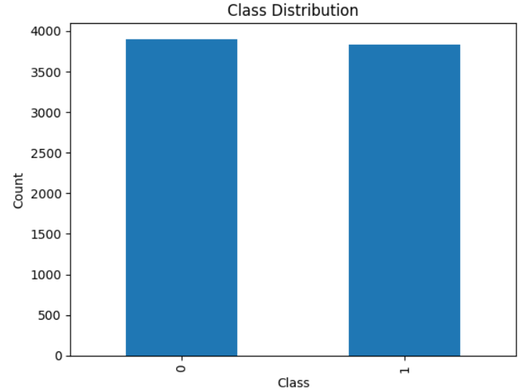
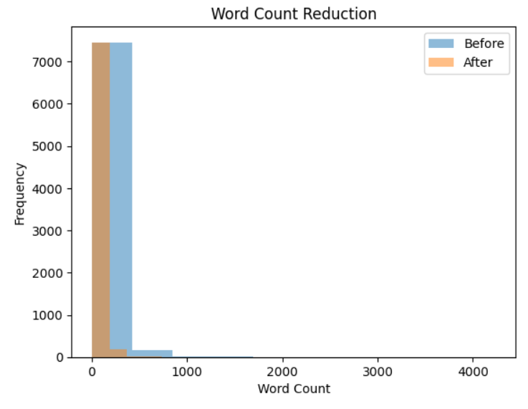
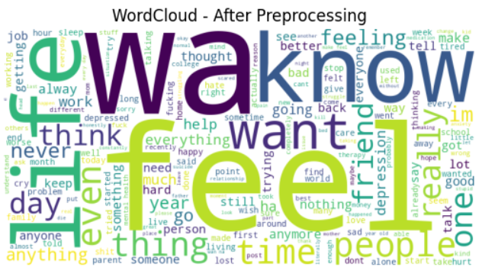
TEXT EDA
CLASS DISTRIBUTION
WORD CONT REDUCTION, TOP WORDS
The dataset is well balanced between Class 0 and Class 1.
Both classes have almost equal counts (~3.8k each). So the model won’t be biased toward one class.
Most texts become shorter after preprocessing, and the noise becomes more consistent and suitable for modelling.
Frequent words like “feel”, “depression”, “life”, “help” show depressive context.

Slide 12
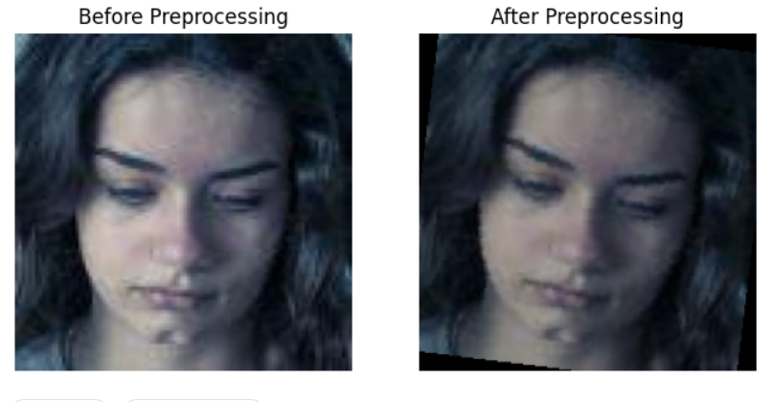
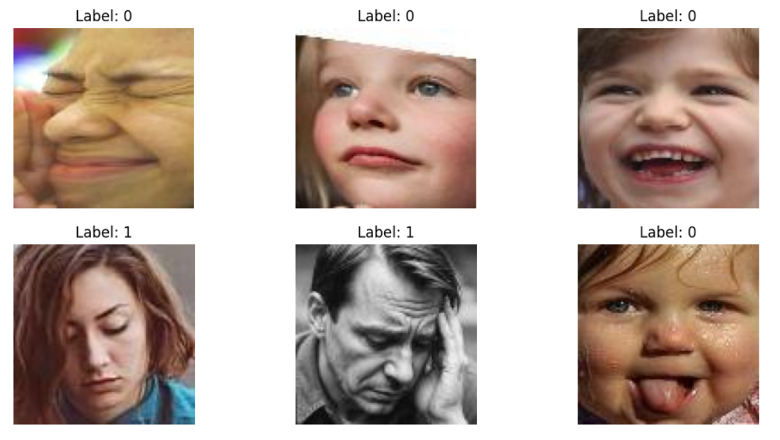
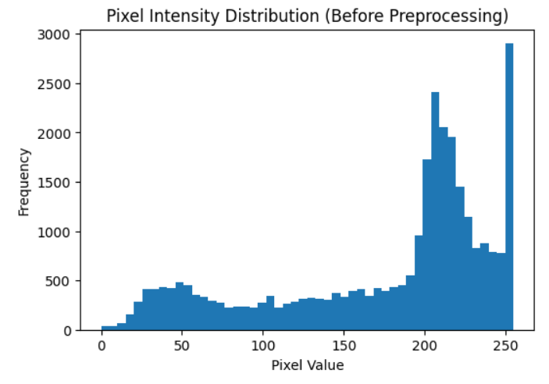
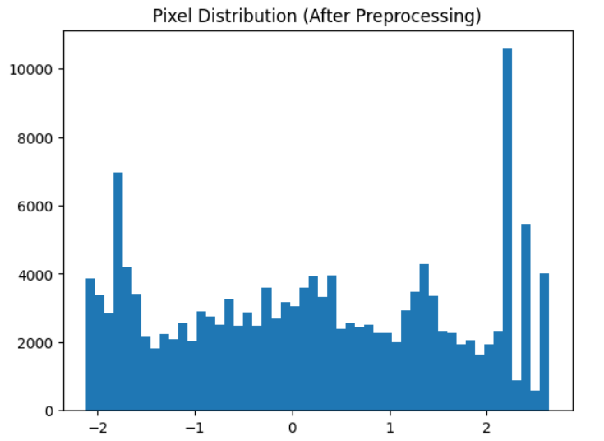
IMAGE EDA
SAMPLE IMAGES AND AFTER AUGMENTATION
BEFORE AND AFTER PIXEL DISTRIBUTION
The dataset shows clear visual differences between classes, with Class 1 images displaying more sad, stressed, or low expressions.
After Preprocessing Images become uniform (same size, normalized) and easier for the model to learn from.
Pixel values change from skewed/uneven distribution to a centered, normalized distribution, improving model learning and stability.

Slide 13
EXPERIMENTS
Experiment | Objective | Method | Expected Outcome
Text Model Evaluation | Compare transformer models for textual feature extraction | Train BERT, RoBERTa, and DistilBERT with BiGRU on Reddit text data | Identify the best model for detecting depression-related textual patterns
Image Model Evaluation | Analyze visual features related to depression | Use ResNet18 to extract image features from depression-related images | Evaluate how visual cues contribute to depression detection
Multimodal Feature Fusion | Improve detection using text + image features | Combine text features with image features using Add, Concat, Attention, Bilinear, Cross-Residual, and Concat+Attention | Identify best fusion strategy and improve performance over single-modality models

Slide 14
TEXT DATA MODELS PERFORMANCE
MODEL EVALUATION
CONFUSION MATRIX
DistilBERT + BiGRU has the lowest false positives (1) → best at avoiding incorrect depression predictions (high precision).
BERT + BiGRU has the lowest false negatives (12) → best at correctly identifying depression cases (high recall).
Overall, all models are reliable and consistent. BERT + BiGRU is the best model overall.
All models achieve very high and nearly identical performance (~98.5%), indicating strong text classification capability.
BERT + BiGRU is the best model overall. As it achieves the highest TP (552) and lowest FN (12)
Model | Accuracy | Precision | Recall | F1
DistilBert + BiGRU | 0.9852 | 0.9855 | 0.9852 | 0.9852
RoBERTa + BiGRU | 0.9843 | 0.9845 | 0.9843 | 0.9843
BERT + BiGRU | 0.9852 | 0.9853 | 0.9852 | 0.9852
Model | TN | FP | FN | TP
DistilBert + BiGRU | 583 | 1 | 16 | 548
BERT + BiGRU | 579 | 5 | 12 | 552
RoBERTa + BiGRU | 580 | 4 | 14 | 550

Slide 15
IMAGE DATA MODEL PERFORMANCE
ResNet18 MODEL EVALUATION
CONFUSION MATRIX
The model shows good overall performance (Accuracy: ~86.96%) on a small dataset.
It performs better on Non-Depression (higher precision: 0.91) but slightly lower recall, meaning some cases are missed.
For the Depression class, recall is higher (0.90). → The model is good at detecting depression cases, but precision is lower, leading to some false positives.
The model achieves high accuracy (20/23 correct predictions), indicating strong overall performance.
It correctly identifies most Non-Depression cases (11/13) and Depression cases (9/10).
Low false negatives (1) → good detection; slightly higher false positives (2) → minor misclassification.
ResNet18 | Accuracy | Precision | Recall | F1
Non-Depression | 0.86 | 0.91 | 0.84 | 0.88
Depression | 0.86 | 0.81 | 0.90 | 0.85
 | Predicted: Non-Depression | Predicted: Depression
Actual: Non-Depression | 11 | 2
Actual: Non-Depression | 1 | 9

Slide 16
FUSION RESULTS
Model | Accuracy | Precision | Recall | F1
Text + Image (concat_attention) | 0.95 | 0.96 | 0.95 | 0.95
Text + Image (bilinear) | 0.86 | 0.87 | 0.86 | 0.87
Text + Image (attention) | 0.86 | 0.87 | 0.86 | 0.94
Text + Image (add) | 0.82 | 0.83 | 0.82 | 0.82
Text + Image (concat) | 0.82 | 0.83 | 0.82 | 0.82
Text + Image (cross_residual) | 0.82 | 0.83 | 0.82 | 0.82

Slide 17
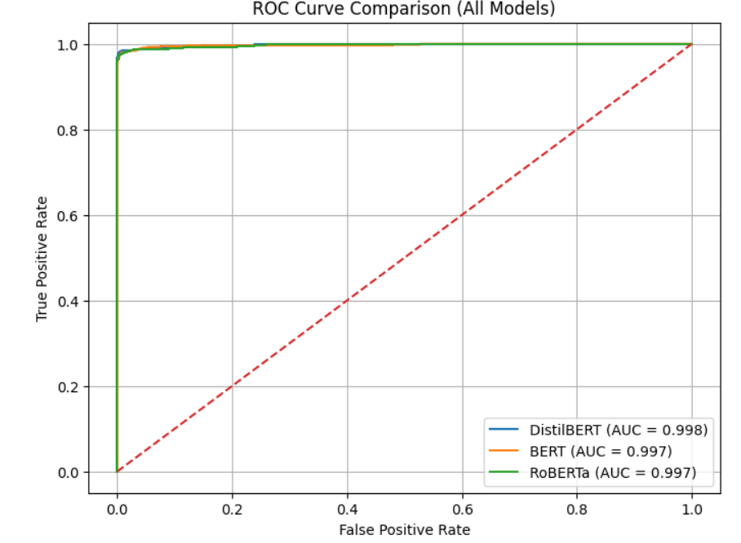
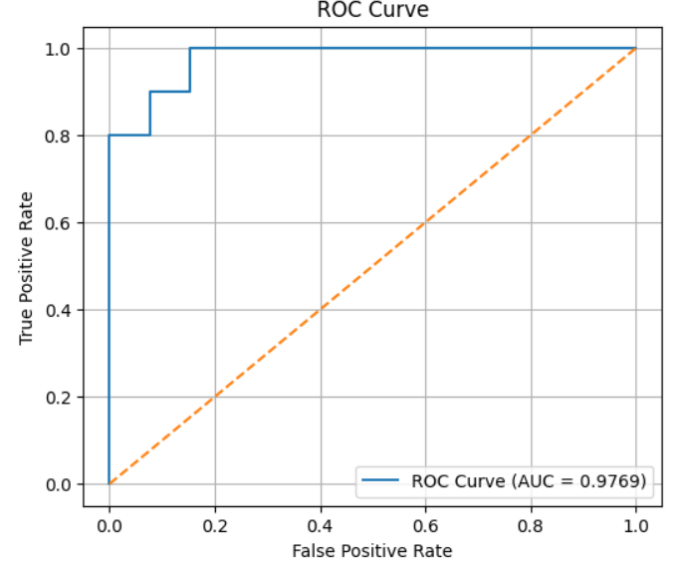
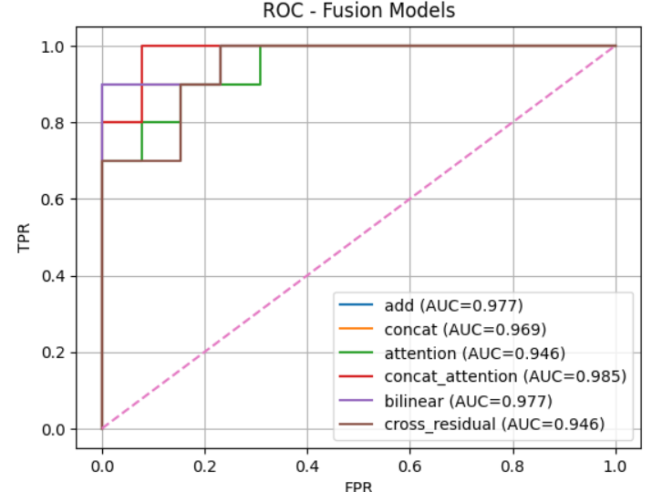
ROC CURVE ANALYSIS
All text models show excellent performance (AUC ≈ 0.997–0.998), with DistilBERT slightly best.
The single model ROC (AUC ≈ 0.9769) still shows strong classification ability, well above random.
In fusion models, Concat + Attention performs best (AUC ≈ 0.985), outperforming other fusion methods.

Slide 18
OVERALL MODELS COMPARISON
MODEL NAME | FUSION TYPE | PRECISION | RECALL | F1 SCORE
DistiliBert + BiGRU | Text Only | 0.9855 | 0.9851 | 0.9851
BERT + BiGRU | Text Only | 0.9852 | 0.9851 | 0.9851
RoBERTa + BiGRU | Text Only | 0.9844 | 0.9843 | 0.9844
Text + Image (concat_attention) | Concat_attention | 0.9604 | 0.9565 | 0.9566
ResNet Model | Image Only | 0.8738 | 0.8695 | 0.8700
Text + Image (bilinear) | Bilinear | 0.8738 | 0.8695 | 0.8700
Text + Image (attention) | Attention | 0.8709 | 0.8695 | 0.8685
Text + Image (add) | Add | 0.8399 | 0.8260 | 0.8267
Text + Image (concat) | Concat | 0.8399 | 0.8260 | 0.8267
Text + Image (cross_residual) | Cross_residual | 0.8399 | 0.8260 | 0.8267

Slide 19
CONCLUSION
Data preprocessing (text cleaning, image resizing, normalization, augmentation) improved data quality and consistency.
Text models achieved the highest performance (~98.5%), with BERT + BiGRU as the top performer.
Image-only model showed moderate performance (~87% accuracy), indicating limited effectiveness alone.
Multimodal fusion improved over image-only models (~95.6% best with Concat + Attention), but still did not surpass text-only models.
Contribution-wise:
Text ≈ 98.5% (dominant)
Fusion ≈ 95.6% (moderate gain)
Image ≈ 87% (least contribution)

Slide 20
REFERENCES
Mariia Nykoniuk, Oleh Basystiuk, Nataliya Shakhovska,andNataliia Melnykova, “Multimodal Data Fusion for Depression Detection,” Computation, MDPI, vol. 13, no. 1, 2025.
H. Wang, Z. Zhang, Y. Li, et al., “Harnessing Multimodal Approaches for Depression Detection Using Large Language Models and Facial Expressions,” npj Mental Health Research, Nature, 2024.
Zhenwei Zhang, Shengming Zhang, Dong Ni, Zhaoguo Wei, Kongjun Yang, Shan Jin “Multimodal Sensing for Depression Risk Detection,” Sensors, MDPI, vol. 24, 2024.
L. Zhang, S. Zhang, X. Zhang, and Y. Zhao, “A Multimodal Artificial Intelligence Model for Depression Severity Detection Based on Audio and Video Signals,” Electronics, MDPI, 2025.
Y. Li, X. Yang, M. Zhao, J. Wang, Y. Yao, and W. Qian, “Predicting Depression by Using a Novel Deep Learning Model and Video-Audio-Text Multimodal Data,” Frontiers in Psychiatry, 2025.

Slide 21
THANK YOU

