Slide 1
Data-driven Marketing using K-Means Algorithm
Susrutha Vishal Koyyalamudi Ashish Padavala

Slide 2
What is Data-Driven Marketing?
A marketing approach that uses data analytics to understand customer behaviors, preferences, and trends, enabling businesses to create personalized and effective campaigns based on actionable insights from real-world data.
What kind of Data?
Data that includes customer purchase history, trends, and spending habits.

Slide 3
Dataset
The dataset used is a collection of transactions from the UCI Machine Learning Repository.
It includes the details of the transaction, details of the products purchased, temporal data, and the details of the customer.
Extra features about the customer behavior is derived from the transaction data after performing Preprocessing and Cleaning.
Derived features include Recency features, Frequency features and Monetary features.

Slide 4
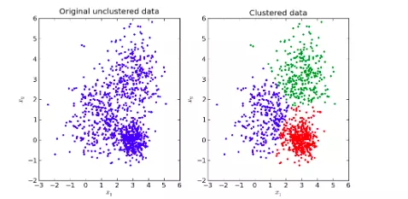
Model
A clustering algorithm in machine learning that groups data points into distinct clusters based on their similarities.
Clusters customers with similar shopping behaviors together.

Slide 5
Better than Random Forest?
K-Means is specialized for clustering and segmentation tasks, while Random Forest is for Classification and Regression tasks.
Can work with unlabeled data which is how most of the data is available as.
Faster than Random Forest with large datasets.

Slide 6
Thank You

