Slide 1
Fundamentals of Deep Learning
Part 3: Convolutional Neural Networks
Notes:
Welcome to convolutional neural networks. Whether you’re following our beginners series or are jumping straight into this lesson, welcome! Today we’re going to talk about how computers learn to see.

Slide 2
Agenda
Part 1: An Introduction to Deep Learning
Part 2: How a Neural Network Trains
Part 3: Convolutional Neural Networks
Part 4: Data Augmentation and Deployment
Part 5: Pre-trained Models
Part 6: Advanced Architectures

Slide 3
Agenda – Part 3
Kernels and Convolution
Kernels and Neural Networks
Other Layers in the Model

Slide 4
Recap of the exercise
Trained a dense neural network model
Training accuracy was high
Validation accuracy was low
Evidence of overfitting
Notes:
We found that our model was able to attain high accuracy with the training data, but not with the testing/validation data. We’re passing our image in as one long string of pixels. Why might that not be such a good idea? There is important information contained in how pixels are organized around each other. When we flatten the picture into a single array, we lose that information

Slide 5
KERNELS and CONVOLUTION
Notes:
It’s time to upgrade our model to one that’s designed for pulling spatial information out of an image

Slide 6



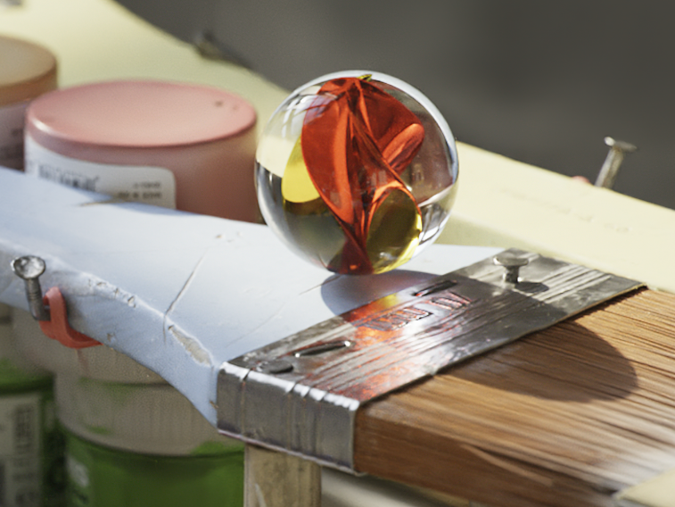




Kernels and Convolution
Blur
Sharpen
Brighten
Darken
Original Image
Notes:
Before we get into neural networks, lets talk about how Computer Vision experts used to approach this type of problem. If you played with Photoshop, MS Paint, or GIMP a lot as a kid making .gifs or memes or stilly pictures: good news! Understanding how computers represent and manipulate photos is a great foundation for modern day computer vision.
For example, let’s look at the blur, sharpen, brighten and darken tools. In a drawing program, the area around where we click that manipulates our image is called the kernel. Convolution is when our kernel is multiplied with our image, and that is what’s happening when we select these tools and drag it across our image. To be technical, convolution is when we apply one function to another function, but we can think of our base image as a function of color, and our kernel as a function of pixels.

Slide 7
Kernels and Convolution
Blur
.06 | .13 | .06
.13 | .25 | .13
.06 | .13 | .06
Sharpen
0 | -1 | 0
-1 | 5 | -1
0 | -1 | 0
Brighten
0 | 0 | 0
0 | 1.5 | 0
0 | 0 | 0
Darken
0 | 0 | 0
0 | 0.5 | 0
0 | 0 | 0
Original Image
Notes:
The kernel is just a small matrix, blurring is a weighted averaging of the numbers that represent the pixels. Sharpen brightens the pixel in the center of it, but subtracts the pixels directly adjacent to it. Brighten makes the center pixel’s color values bigger (if 255 is white) or smaller (if 0 is white). Darken does the opposite. Let’s take a look at a smaller image and break it down.

Slide 8


Kernels and Convolution
Blur Kernel
Original Image
Convolved Image
1 | 0 | 1 | 1 | 0 | 1
0 | 1 | 0 | 0 | 1 | 0
0 | 1 | 1 | 1 | 1 | 0
0 | 1 | 1 | 1 | 1 | 0
1 | 0 | 1 | 1 | 0 | 1
1 | 1 | 0 | 0 | 1 | 1
.06 | .13 | .06
.13 | .25 | .13
.06 | .13 | .06
$$∗$$
$$=$$
Notes:
Ok, we have a picture of a heart. Not obvious? Sorry, only had 6 x 6 pixels to work with.
We’re going to step through a convolution. The fancy star in the center is the convolution operator. The resulting image is going to be 4 x 4. It’ll be more obvious in a bit.

Slide 9
Kernels and Convolution
Blur Kernel
Original Image
Convolved Image
1 | 0 | 1 | 1 | 0 | 1
0 | 1 | 0 | 0 | 1 | 0
0 | 1 | 1 | 1 | 1 | 0
0 | 1 | 1 | 1 | 1 | 0
1 | 0 | 1 | 1 | 0 | 1
1 | 1 | 0 | 0 | 1 | 1
.06 | .13 | .06
.13 | .25 | .13
.06 | .13 | .06
$$∗$$
$$=$$
Notes:
Let’s start in the top left corner. We call the section that we’re about to convolve, the red box here, the window. Notice how it has the same shape as our kernel.

Slide 10
Kernels and Convolution
Blur Kernel
Original Image
Convolved Image
1 | 0 | 1 | 1 | 0 | 1
0 | 1 | 0 | 0 | 1 | 0
0 | 1 | 1 | 1 | 1 | 0
0 | 1 | 1 | 1 | 1 | 0
1 | 0 | 1 | 1 | 0 | 1
1 | 1 | 0 | 0 | 1 | 1
Multiply
.06 | 0 | .06
0 | .25 | 0
0 | .13 | .06
.06 | .13 | .06
.13 | .25 | .13
.06 | .13 | .06
$$∗$$
$$=$$
Notes:
We’re going to take our kernel and multiply each cell in the kernel with the respective cell in the window.

Slide 11
Kernels and Convolution
Blur Kernel
Original Image
Convolved Image
1 | 0 | 1 | 1 | 0 | 1
0 | 1 | 0 | 0 | 1 | 0
0 | 1 | 1 | 1 | 1 | 0
0 | 1 | 1 | 1 | 1 | 0
1 | 0 | 1 | 1 | 0 | 1
1 | 1 | 0 | 0 | 1 | 1
.06 | 0 | .06
0 | .25 | 0
0 | .13 | .06
.56
.06 | .13 | .06
.13 | .25 | .13
.06 | .13 | .06
$$∗$$
$$=$$
Total
Notes:
We’re then going to total the results of that multiplication

Slide 12
Kernels and Convolution
Blur Kernel
Original Image
Convolved Image
1 | 0 | 1 | 1 | 0 | 1
0 | 1 | 0 | 0 | 1 | 0
0 | 1 | 1 | 1 | 1 | 0
0 | 1 | 1 | 1 | 1 | 0
1 | 0 | 1 | 1 | 0 | 1
1 | 1 | 0 | 0 | 1 | 1
0 | .13 | .06
.13 | 0 | 0
.06 | .13 | .06
.56 | .57
.06 | .13 | .06
.13 | .25 | .13
.06 | .13 | .06
$$∗$$
$$=$$
Notes:
Next, we move or window over by 1…

Slide 13
Kernels and Convolution
Blur Kernel
Original Image
Convolved Image
1 | 0 | 1 | 1 | 0 | 1
0 | 1 | 0 | 0 | 1 | 0
0 | 1 | 1 | 1 | 1 | 0
0 | 1 | 1 | 1 | 1 | 0
1 | 0 | 1 | 1 | 0 | 1
1 | 1 | 0 | 0 | 1 | 1
.56 | .57 | .57 | .56
.7 | .82 | .82 | .7
.69 | .95 | .95 | .69
.64 | .69 | .69 | .64
.06 | .13 | .06
.13 | .25 | .13
.06 | .13 | .06
$$∗$$
$$=$$
Notes:
.. and we repeat the process until we’ve calculated the convolution for the whole image.
https://mathworld.wolfram.com/Convolution.html

Slide 14
STRIDE
Stride 1
1 | 0 | 1 | 1 | 0 | 1
0 | 1 | 0 | 0 | 1 | 0
0 | 1 | 1 | 1 | 1 | 0
1 | 0 | 1 | 1 | 0 | 1
0 | 1 | 0 | 0 | 1 | 0
0 | 1 | 1 | 1 | 1 | 0
.56 | .57 | .57 | .56
Stride 2
1 | 0 | 1 | 1 | 0 | 1
0 | 1 | 0 | 0 | 1 | 0
0 | 1 | 1 | 1 | 1 | 0
1 | 0 | 1 | 1 | 0 | 1
0 | 1 | 0 | 0 | 1 | 0
0 | 1 | 1 | 1 | 1 | 0
.56 | .57
Stride 3
1 | 0 | 1 | 1 | 0 | 1
0 | 1 | 0 | 0 | 1 | 0
0 | 1 | 1 | 1 | 1 | 0
1 | 0 | 1 | 1 | 0 | 1
0 | 1 | 0 | 0 | 1 | 0
0 | 1 | 1 | 1 | 1 | 0
.56 | .56
Notes:
There are a few parameters we can play with for convolution. One is stride, which is by how many cells should we move our window by when doing convolution. Let’s chop our heart in half to see what we mean. Oh no, broken heart!
Let’s assume we had the same kernel as before.
With a stride of 2, we skip starting convolution at every other column and every other row. When we do this, we also generate less data, which has pros and cons. The good is that means we have less data to analyze, but if we increase our stride too much, we might miss important information.
The other thing to look for is with a stride of 2, we don’t have enough columns to do a convolution for the right side our image.

Slide 15
Padding
Original Image
Zero Padding
0 | 0 | 0 | 0 | 0 | 0 | 0 | 0
0 | 1 | 0 | 1 | 1 | 0 | 1 | 0
0 | 0 | 1 | 0 | 0 | 1 | 0 | 0
0 | 0 | 1 | 1 | 1 | 1 | 0 | 0
0 | 0 | 1 | 1 | 1 | 1 | 0 | 0
0 | 1 | 0 | 1 | 1 | 0 | 1 | 0
0 | 1 | 1 | 0 | 0 | 1 | 1 | 0
0 | 0 | 0 | 0 | 0 | 0 | 0 | 0
1 | 0 | 1 | 1 | 0 | 1
0 | 1 | 0 | 0 | 1 | 0
0 | 1 | 1 | 1 | 1 | 0
0 | 1 | 1 | 1 | 1 | 0
1 | 0 | 1 | 1 | 0 | 1
1 | 1 | 0 | 0 | 1 | 1
Notes:
If we want enough data to make sure all pixels are used in convolution, or if we want the resulting image to be the same size as our input image, we can do something called padding. A quick and easy way to do this is called “zero” padding, where we add a border of zeros around our image. This can be sufficient in many cases, but in some where the image is small, it can have an impact on the convolution.
https://setosa.io/ev/image-kernels/
https://glassboxmedicine.com/2019/04/13/a-short-history-of-convolutional-neural-networks/

Slide 16
Padding
Original Image
Mirror Padding
1 | 1 | 0 | 1 | 1 | 0 | 1 | 1
1 | 1 | 0 | 1 | 1 | 0 | 1 | 1
0 | 0 | 1 | 0 | 0 | 1 | 0 | 0
0 | 0 | 1 | 1 | 1 | 1 | 0 | 0
0 | 0 | 1 | 1 | 1 | 1 | 0 | 0
1 | 1 | 0 | 1 | 1 | 0 | 1 | 1
1 | 1 | 1 | 0 | 0 | 1 | 1 | 1
1 | 1 | 1 | 0 | 0 | 1 | 1 | 1
1 | 0 | 1 | 1 | 0 | 1
0 | 1 | 0 | 0 | 1 | 0
0 | 1 | 1 | 1 | 1 | 0
0 | 1 | 1 | 1 | 1 | 0
1 | 0 | 1 | 1 | 0 | 1
1 | 1 | 0 | 0 | 1 | 1
Notes:
There are many other types of padding too. Many frameworks have “mirror padding” that instead duplicates the top and bottom rows, and the left and right columns.

Slide 17
KERNELS and Neural Networks
Notes:
So how does this apply to neural networks?

Slide 18
Kernels and Neural Networks
Kernel
w₁ | w₂ | w₃
w₄ | w₅ | w₆
w₇ | w₈ | w₉
Notes:
So before neural networks, computer vision researchers would play around with the numbers within a kernel to see if it can be used to find any interesting features in images. So far, we’ve only used 3 x 3 kernels, but they can be any size, and researchers would try to do things like make a kernel that returned a high value if it convolved a cat ear. So, you could have a cat ear kernel, a cat nose kernel, a cat eye kernel, and if you ran all those through an image and found matches, you might guess there was a cat!
But as neural networks got more and more powerful, people made the connection that, woah. Kernels are these devices that multiply weights to an input, and then adds the results together. What else does that?

Slide 19

Kernels and Neural Networks
Kernel
Neuron
x₁
x₂
w₁ | w₂ | w₃
w₄ | w₅ | w₆
w₇ | w₈ | w₉
w₂
w₃
w₁
w₄
w₅
w₆
$$\hat{y}$$
Notes:
Oh yeah, neurons do that too! That’s exactly what Convolutional Neural Networks are. They map the inputs of a neuron to a kernel with trainable weights.
Interesting history: https://glassboxmedicine.com/2019/04/13/a-short-history-of-convolutional-neural-networks/
How backpropagation works for CNNs: https://www.jefkine.com/general/2016/09/05/backpropagation-in-convolutional-neural-networks/

Slide 20
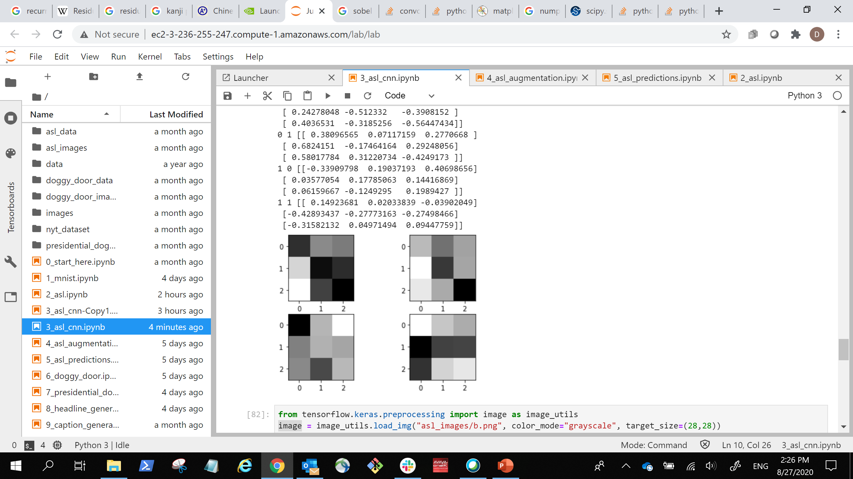
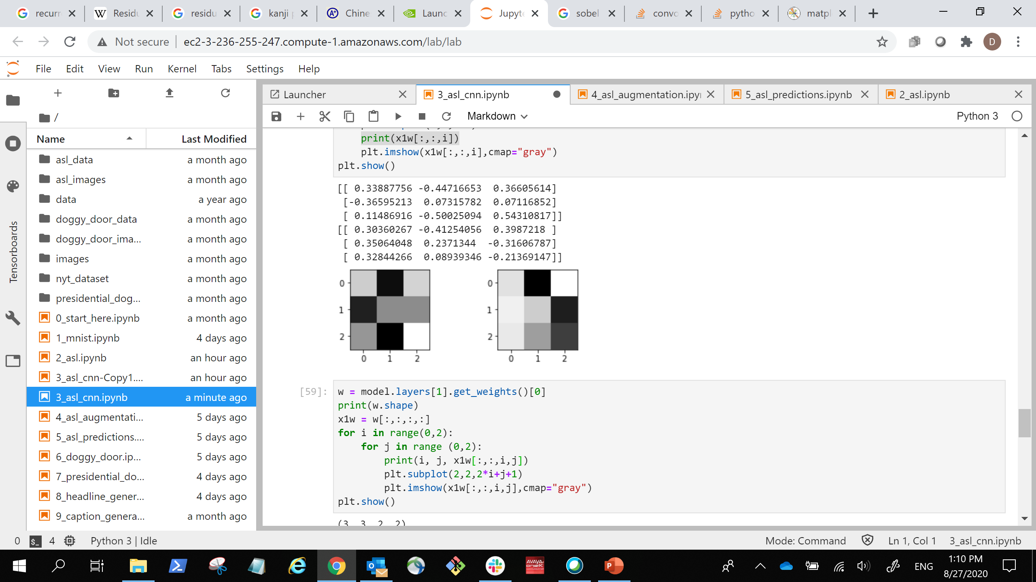
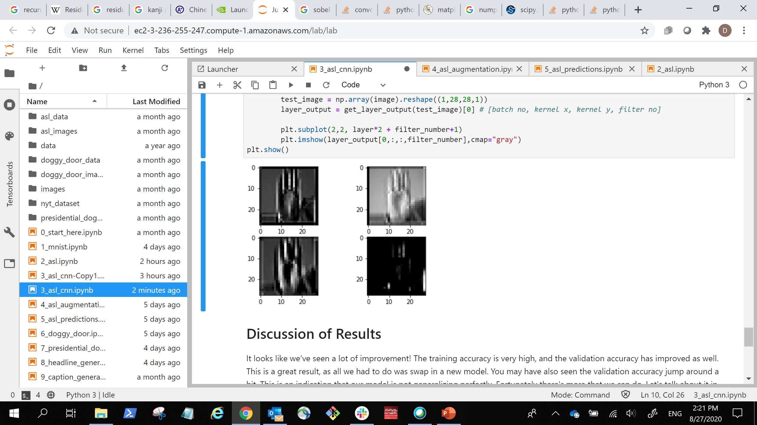
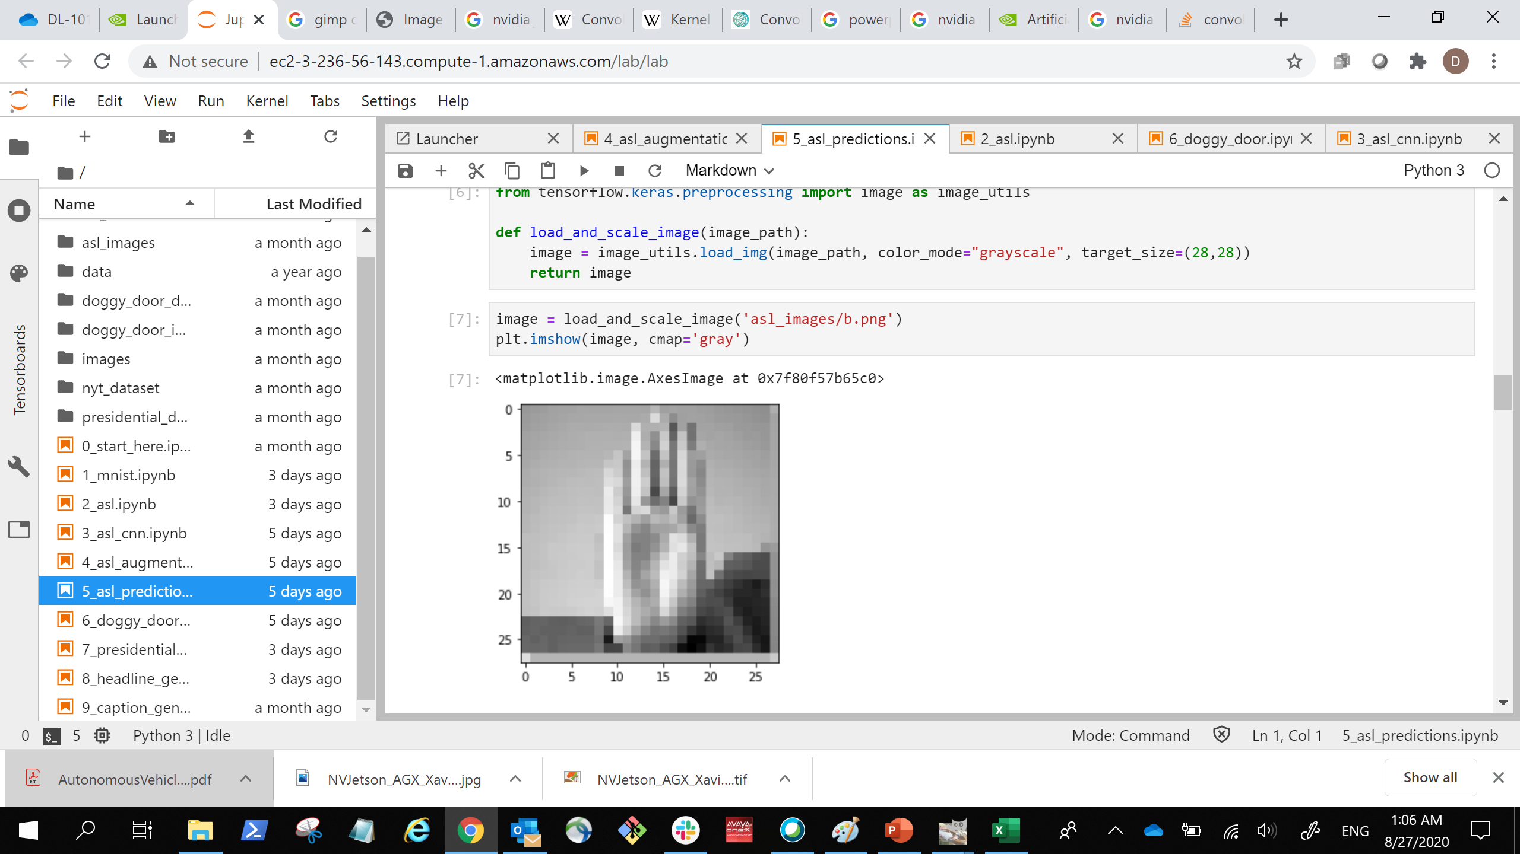
Kernels and Neural Networks
… …
… …
(28, 28, 2)
Stacked Images
(28, 28, 2)
Stacked Images
(3, 3, 1, 2)
Kernels
(3, 3, 2, 2)
Kernels
(512)
Dense
(512)
Dense
(28, 28, 1)
Image Input
(1568)
Flattened Image
Vector
(24)
Output Prediction
Notes:
This is our new neural network architecture. This is a bit smaller than what we’ll do in the lab, but the structure is similar. First, we have our input image. We’re going to start with a variable number of convolutional layers (in this case 2 3x3x1 greyscale filters). We can have as many as we want, and each one of them is going to produce a new image by trying to extract interesting features out of the original image.
We’re then going to stack these images on top of each other, so we end up with a three-dimensional image, but not 3d in the way that humans perceive it. We can then send this new image through a new set of filters. When convolving, even though we’re technically doing a 2D convolution because we’re in black and white, we’re actually convolving a 3D object that is our window size by the number of stacked images. Because we have two stacked images, our kernels are digesting a 3x3x2 slice of the stacked images. In the picture above, we have 2 3x3x2 filters.
When we’re done convolving, we’ll flatten everything out, and feed the results through our neural net as normal.
It used to be that data scientists would toy around with the kernel sizes more, and that’s still useful in some cases, but empirically, sticking with 3x3 works well. Let’s go back to computer vision theory to understand why.
Great stack overflow on how to visualize kernels: https://stackoverflow.com/questions/43305891/how-to-correctly-get-layer-weights-from-conv2d-in-keras
Another stack overflow on the dimensions of the kernels: https://stackoverflow.com/questions/46480699/why-are-my-keras-conv2d-kernels-3-dimensional#:~:text=I%20understand%20the%20mechanics%20of,kernels%20of%20size(7x7x8).
A more advanced topic, but here we’re doing conventional convolution, but there are many ways to do it.
An article diving into the different types: https://towardsdatascience.com/a-comprehensive-introduction-to-different-types-of-convolutions-in-deep-learning-669281e58215
An article explaining the math: http://d2l.ai/chapter_convolutional-neural-networks/channels.html

Slide 21
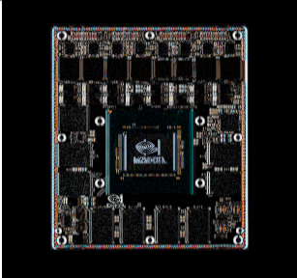
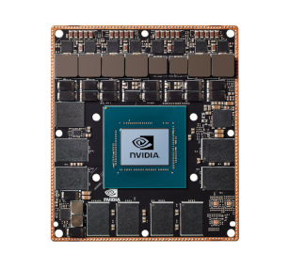
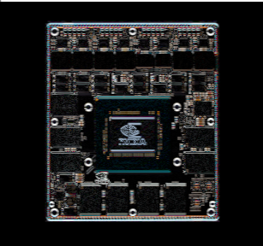
Finding Edges
Vertical Edges
Original Image
Horizontal Edges
1 | 0 | -1
2 | 0 | -2
1 | 0 | -1
0 | 0 | 0
0 | 1 | 0
0 | 0 | 0
1 | 2 | 1
0 | 0 | 0
-1 | -2 | -1
Notes:
So when researchers first came up with these kernels before neural networks, they also realized that you can use them to essentially calculate the derivative of these images. What in the world does that mean? Well there is a special class of kernels that can pick up edges, places where the change in color of an image is changing rapidly. For instance, the kernel on the left picks ups vertical edges and the kernel on the right picks up horizontal edges
(notice how the horizontal lines are gone in the left? That’s because if there’s a horizontal line, there’s no horizontal change).
By combining the information from both the horizontal and vertical changes, bam! We now have a direction of change for each point. (Ever thought of where the term “Color Gradient” comes from?)
We can do some cool things with this information, like be able to identify any circles in our image (like our marble from earlier), but rather than figure out the fancy math for this ourselves, we’ll let the neural network do it.
Here’s a great demo website showing these concepts in action: https://setosa.io/ev/image-kernels/

Slide 22
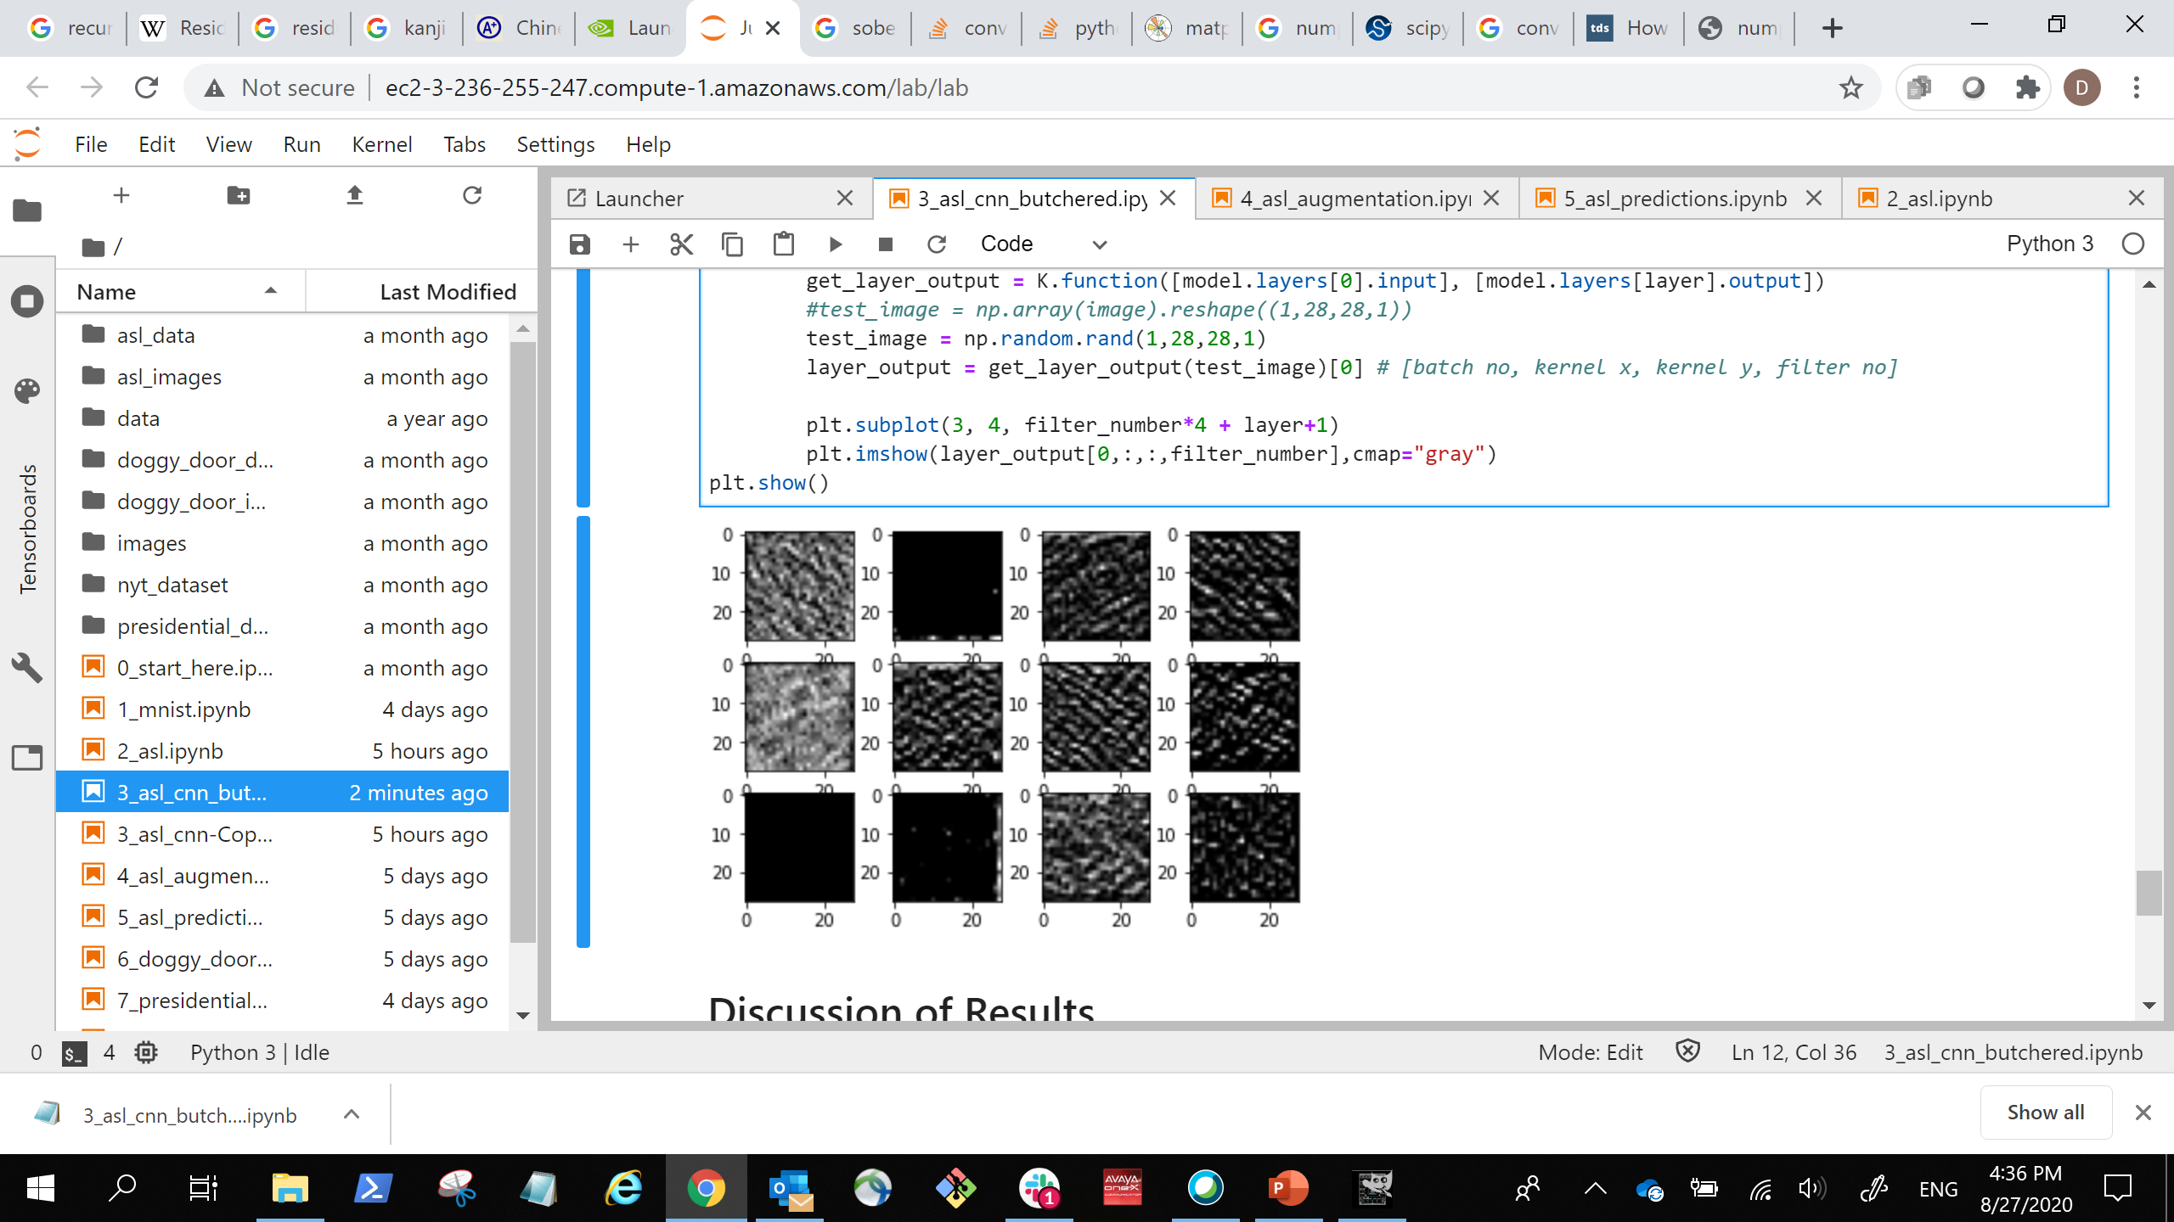
Neural Network Perception
Input
Convolution
Convolution
Convolution
Convolution
Dense
Dense
Output
Edges
Textures
Objects
Notes:
So if we’re willing to get weird for a second, the way artificial neural work is very similar to how our own brains processes images. Both our brain and the artificial brain will take the edge detectors and feed the results into the next layer which will detect intersections between edges and will be good at detecting textures and patterns. Those feed into the next layer and next layer, becoming more and more developed until entire objects can be recognized.
Here is the result of using four layers of three neurons each on our ASL dataset. Nothing too fancy here because our images are small …

Slide 23


Neural Network Perception
Notes:
… so I also ran our marble through https://deepdreamgenerator.com/, which is built using a much larger network on plenty of high-resolution photos of many types of objects. It will enhance the patterns or objects it’s able to detect. Any interpretation here is trying to mind read an artificial intelligence, which is as unscientific as it sounds, but I can almost make out a cartoon dog. Google’s inception network was originally trained on a lot of dog photos, so the tools to visualize the intermediate layers ended up displaying many dream-like dog photos.
https://towardsdatascience.com/how-to-visualize-convolutional-features-in-40-lines-of-code-70b7d87b0030

Slide 24
Other layers in the model
Notes:
We’re almost ready for the next lab, there’s just a few more tricks to help us out.

Slide 25
Max Pooling
110 | 256 | 153 | 67
12 | 89 | 88 | 43
10 | 15 | 50 | 55
23 | 9 | 49 | 23
256 | 153
23 | 55
Notes:
Pooling is where we look at all the values in our window and do a simple statistical computation. The most common one is Max Pooling where we take the largest value in the window and discard the rest. This trick is especially useful when working with large images because it’s a way to shrink images down to a smaller size, and smaller images mean less computation, which is quicker and cheaper.

Slide 26
Dropout
rate = 0
rate = .2
rate = .4
Notes:
Dropout is another interesting tool which in a way, reflects ensemble learning. During training, we’re going to randomly shutoff neurons at a rate we specify, meaning, it’s unable to learn for that step of training. This prevents overfitting be eliminating overreliance on any particular input or neuron. Just be careful not to set the rate to 1! Then all the neurons will be shut off, and the model won’t be able to learn.
During validation or prediction, all the neurons are then turned back on.
https://www.tensorflow.org/api_docs/python/tf/nn/dropout

Slide 27
Whole architecture
Input
Convolution
Max Pooling
Convolution
Dropout
Max Pooling
Convolution
Max Pooling
Dense
Dense
Output
Notes:
Ok, so here’s the network we’ll be using in the next lab!
We’re also going to do something called batch normalization, where we normalize the amount weights change between layers during training. Batch normalization was made to prevent something called internal covariate shift, but turns out, it doesn’t actually do that. Even so, empirically it seems to help with object detection networks.
https://blog.paperspace.com/busting-the-myths-about-batch-normalization/
https://papers.nips.cc/paper/7515-how-does-batch-normalization-help-optimization.pdf
So this is what we’ll do in the next lab:
Shape the data correctly
Create the CNN model
Train as before

Slide 28
Let’s go!
Notes:
Let’s get to it!

