Slide 1
Fundamentals of Deep Learning
Part 5: Pre-trained Models

Slide 2
Agenda
Part 1: An Introduction to Deep Learning
Part 2: How a Neural Network Trains
Part 3: Convolutional Neural Networks
Part 4: Data Augmentation and Deployment
Part 5: Pre-trained Models
Part 6: Advanced Architectures

Slide 3
Agenda – Part 5
Review so far
Pre-trained Models
Transfer Learning

Slide 4
Review so far
Notes:
Let’s take a moment to go over a few of the concepts we’ve learned so far.

Slide 5
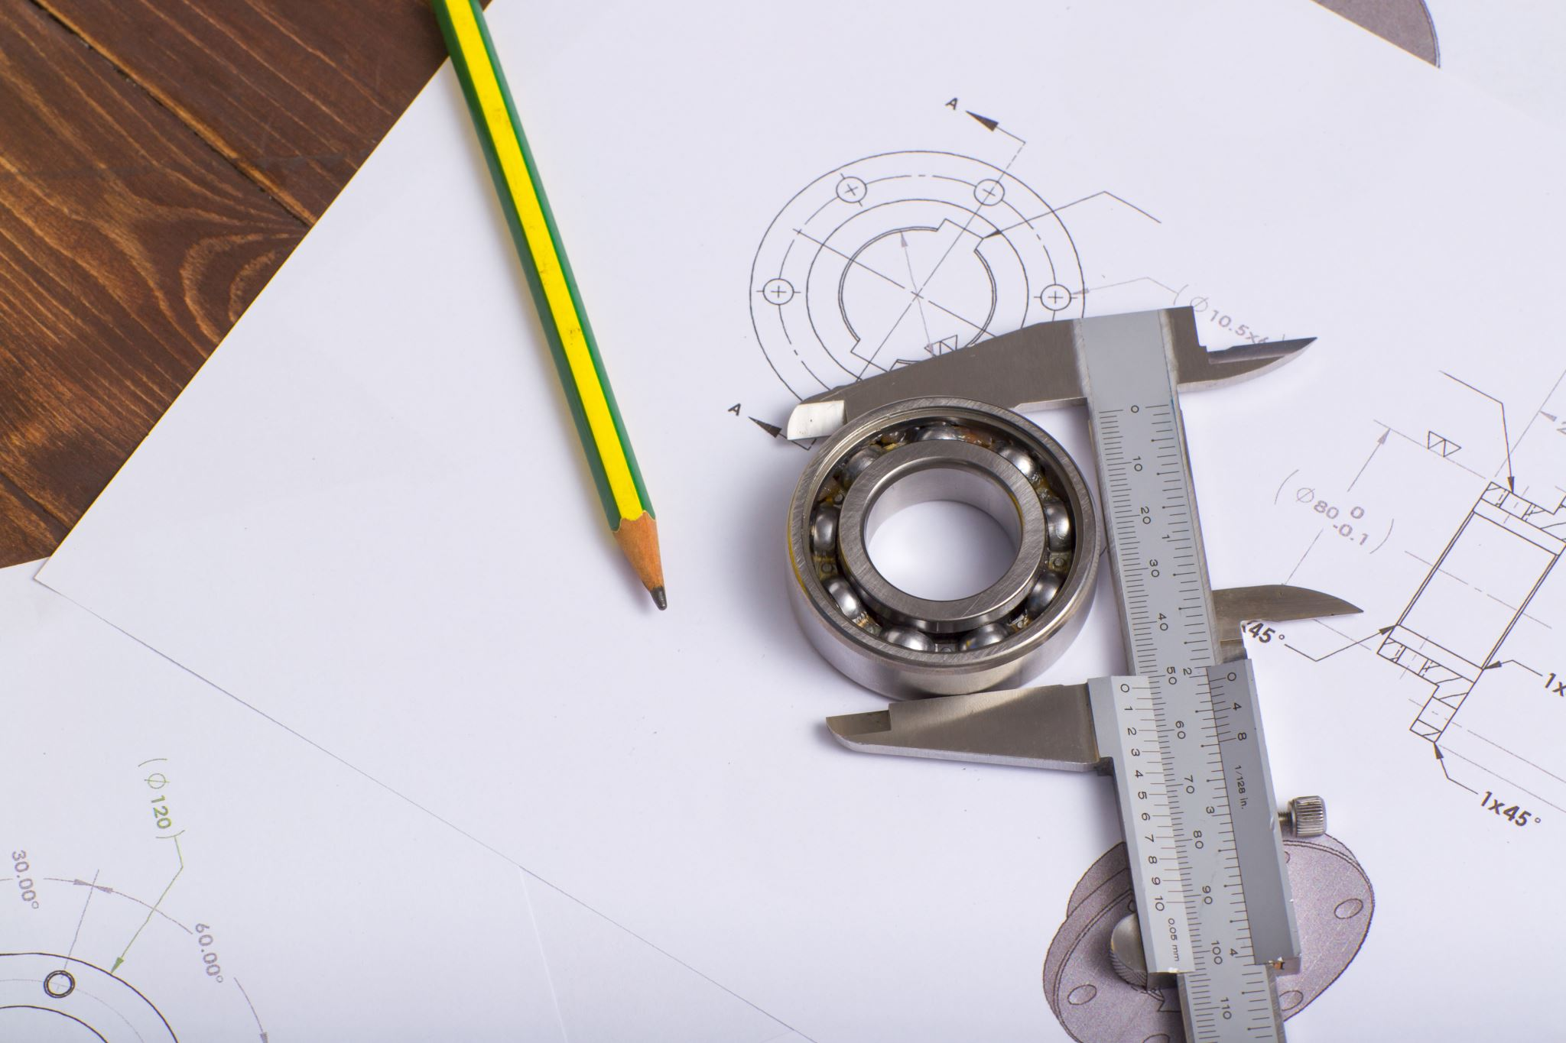
Review So Far
Learning Rate
Number of Layers
Neurons per Layer
Activation Functions
Dropout
Data
Notes:
Question: What are all of these, and what do they do?
Answer:
The learning rate is the amount we change our parameters (weights) during gradient descent
The number of layers is the depth to our neural network
The number of neurons is the width of a neural network layer
The activation function is how we transform the output of a neuron
Dropout randomly turns off neurons during training to prevent overfitting
Data is the examples we train our model on. If the data isn’t clean or varied enough, the model won’t be able to generalize to real world situations.
It’s a lot of work designing a machine learning model!

Slide 6
Pre-Trained Models
Notes:
Wouldn’t it be great if we didn’t have to do all that work?

Slide 7



Pre-Trained Models
PYTORCH HUB
Notes:
The great news is that more and more teams and researchers are making their models readily available. Not only are there websites like NVIDIA’s GPU Cloud where you can download ready to go models, but TensorFlow and PyTorch have modules within their framework to load a model into python given the model’s URL on either the TensorFlow Hub or PyTorch Hub websites. Keras itself comes with models prepackaged.
Even better news? All of these models are free!

Slide 8
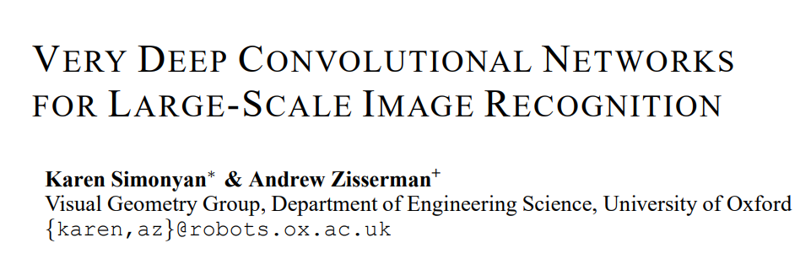
Pre-Trained Models
IM GENET
Notes:
The model we’ll be experimenting with is called VGG16 which was proposed in an appropriately titled paper, “Very Deep Convolutional Networks for Large-Scale Image Recognition”. It was a winning architecture for the 2014 ImageNet challenge. ImageNet is a database of millions of photos that have been labeled for thousands of categories including animals, food, trees, sports and people. Recently these object detection models perform better than humans, having over a 95% accuracy
VGG16 paper: https://arxiv.org/abs/1409.1556
ImageNet: http://www.image-net.org/
ImageNet tree traversal: http://imagenet.stanford.edu/synset?wnid=n03769722

Slide 9
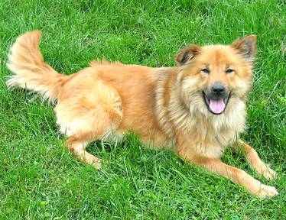
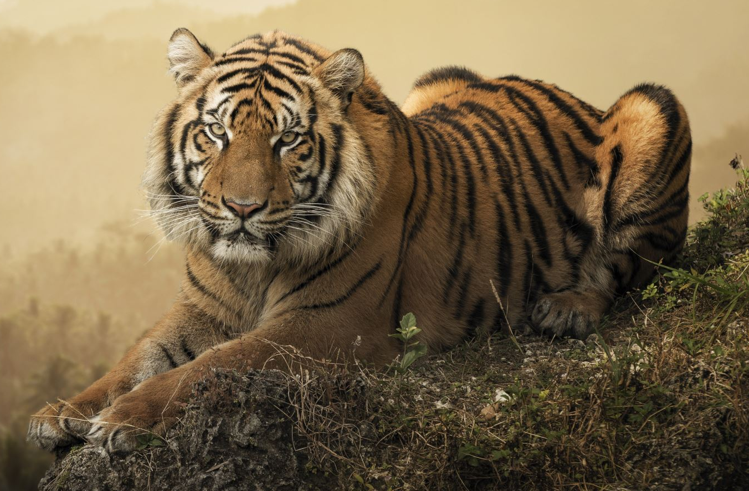


The next challenge
An Automated Doggy Door
Notes:
What better use for this model to make an automated doggy door? We no longer need to get up in the middle of the night to let our pets out!
Since ImageNet has many pictures of animals, we’re going to use it to recognize our canine friends and to keep all other critters out.

Slide 10
Transfer Learning
Notes:
After you complete the doggy door, we're going to take on another challenge using an approach called transfer learning.

Slide 11
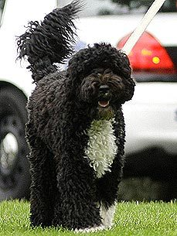
The challenge After
An Automated Presidential Doggy Door
Notes:
Good news everyone! The United States Secret Service has learned of our great machine learning skills and has contracted us to make a Doggy Door for the White House. To help us, they’ve given us a few pictures of Bo, the Portuguese Water Dog that served as “First Dog” from 2009 – 2017.
We need to make sure this door only recognizes Bo, and not any other dogs trying to sneak into the White House.

Slide 12
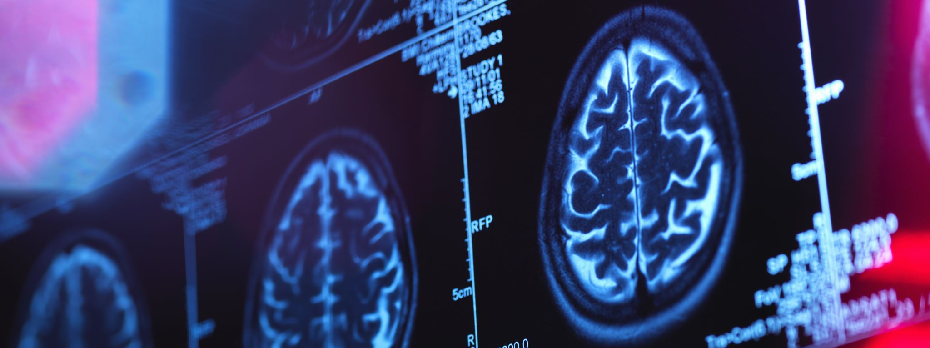
Transfer Learning
Notes:
The trouble is, we can’t use our pretrained model because it can only recognize dogs in general. VGG16 can’t tell the difference between Bo and other kinds of dogs.
But if a model can already tell what a dog is, wouldn’t it be great to use that as a starting point? It turns out, we can! We just have to do a little brain surgery to make it happen.

Slide 13
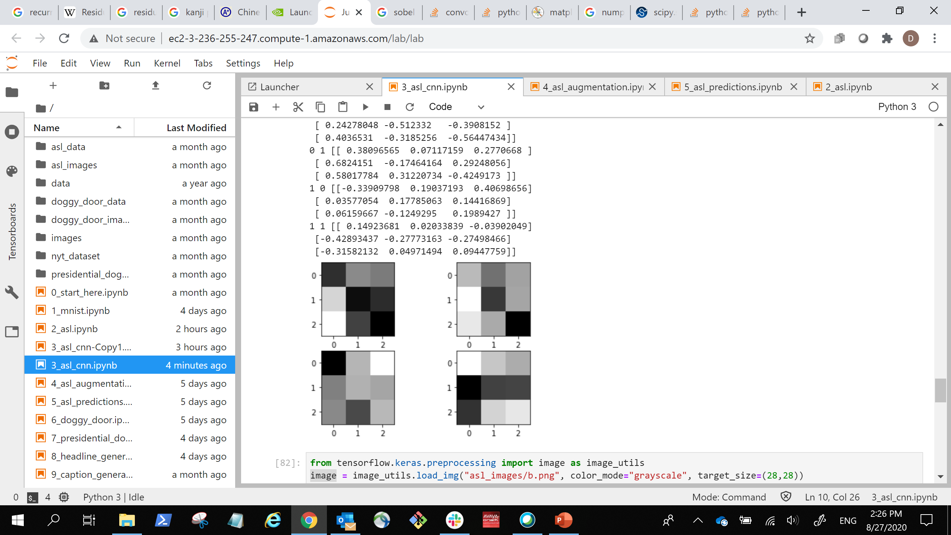
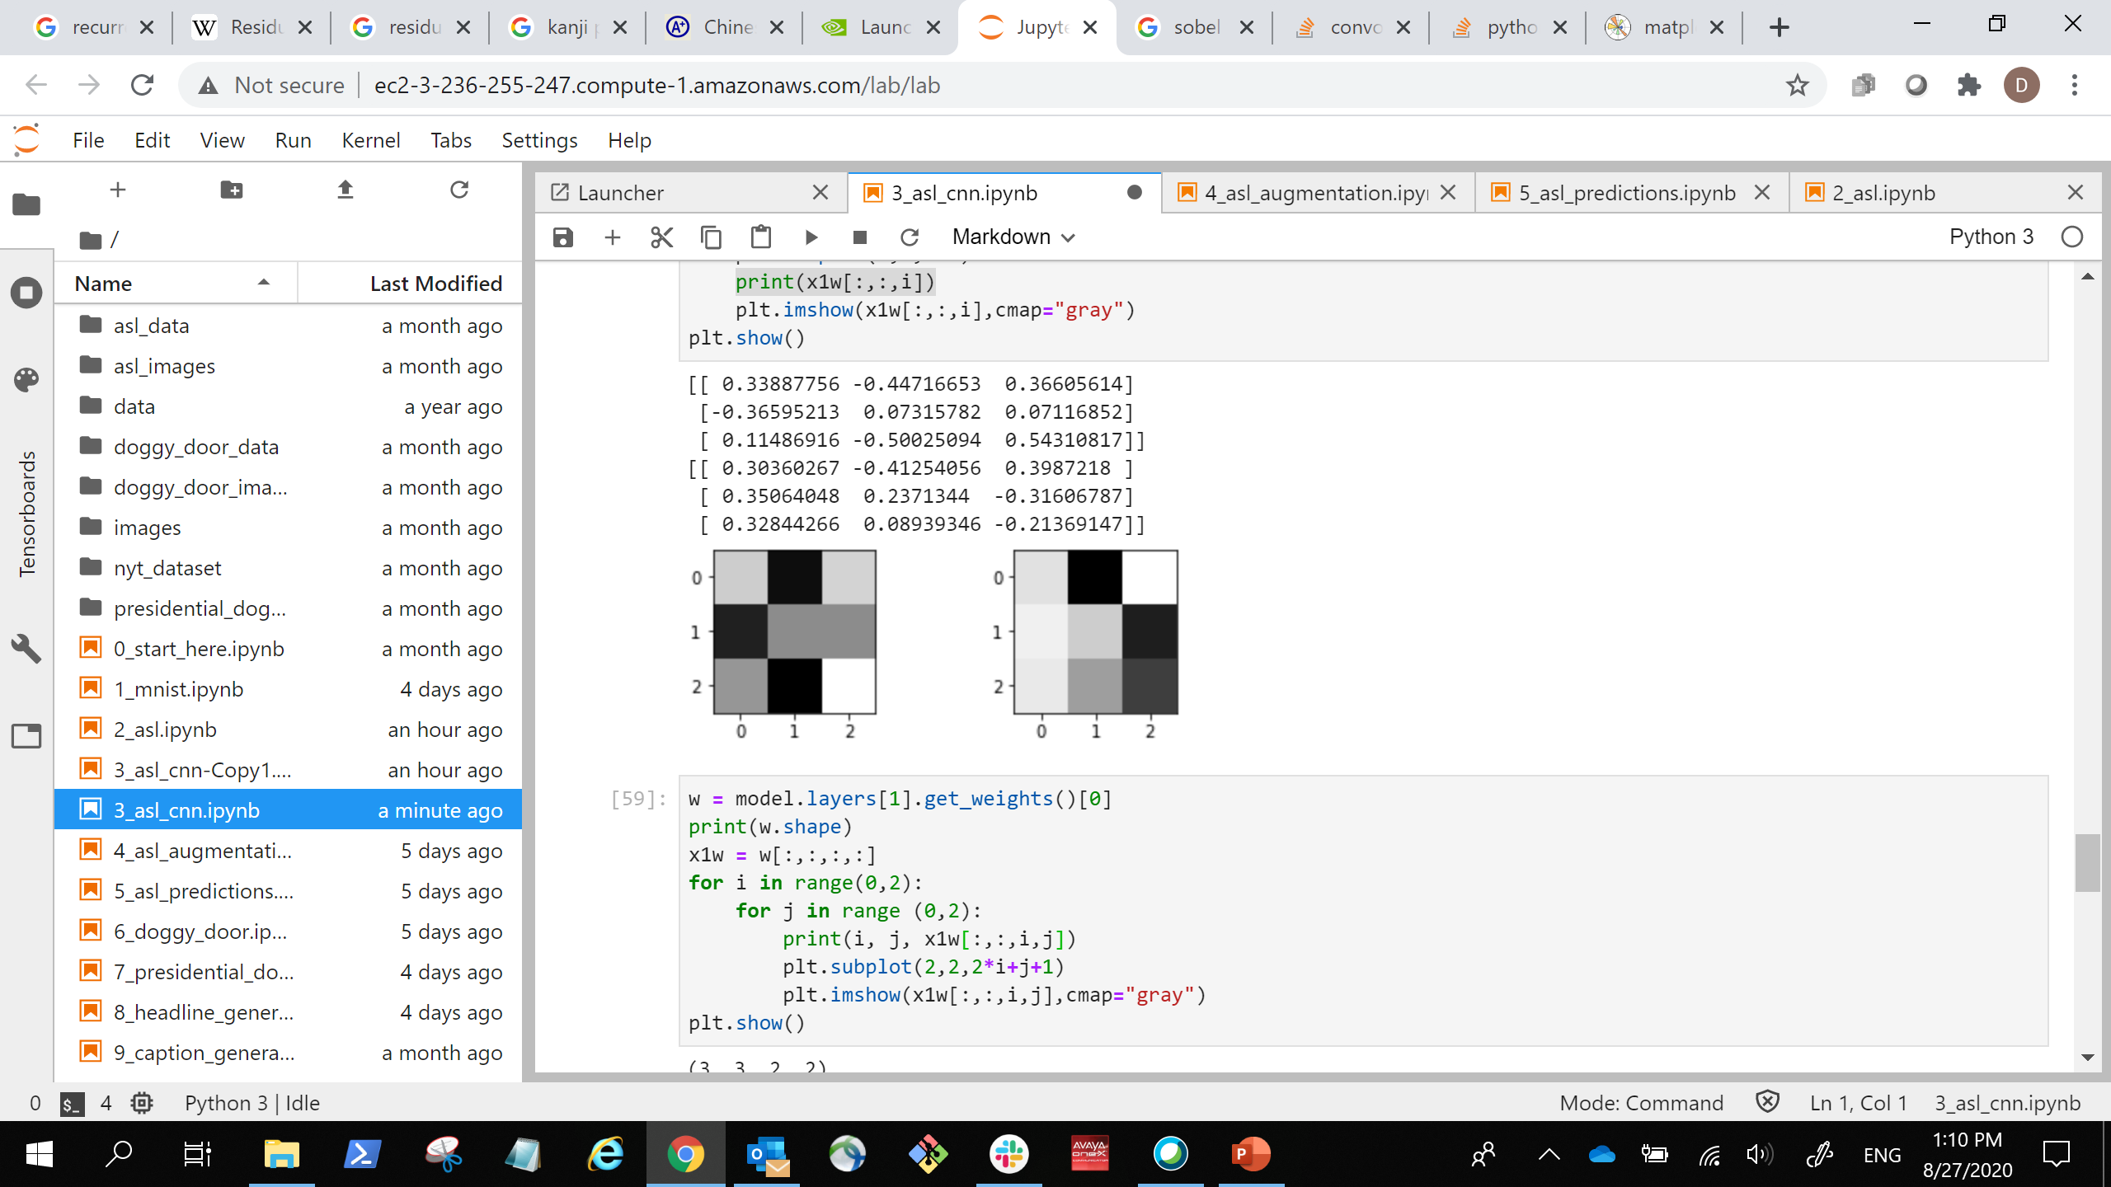
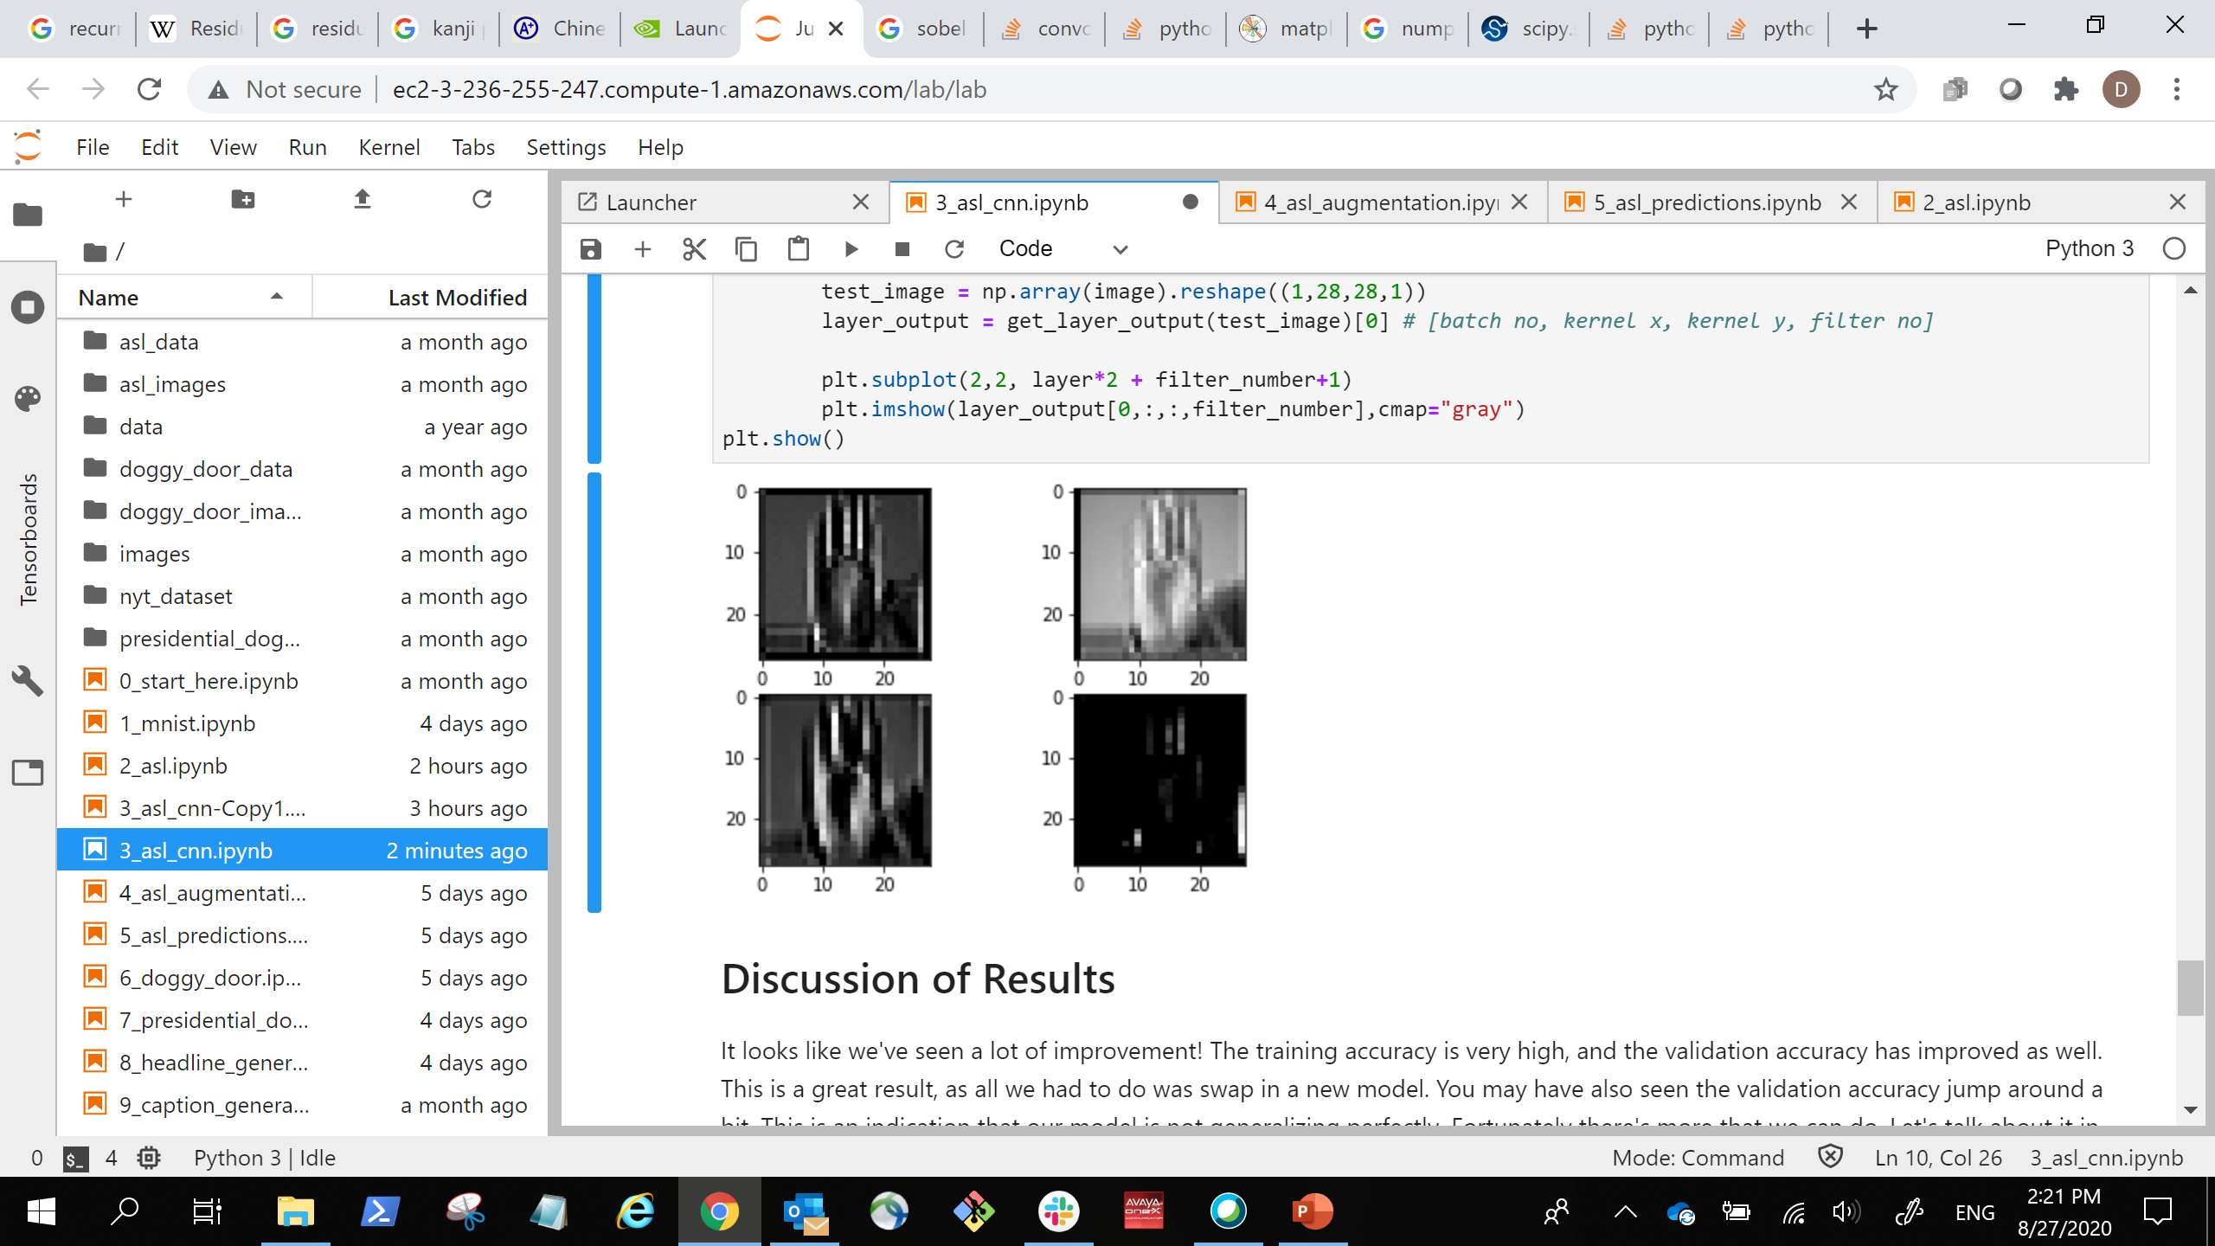
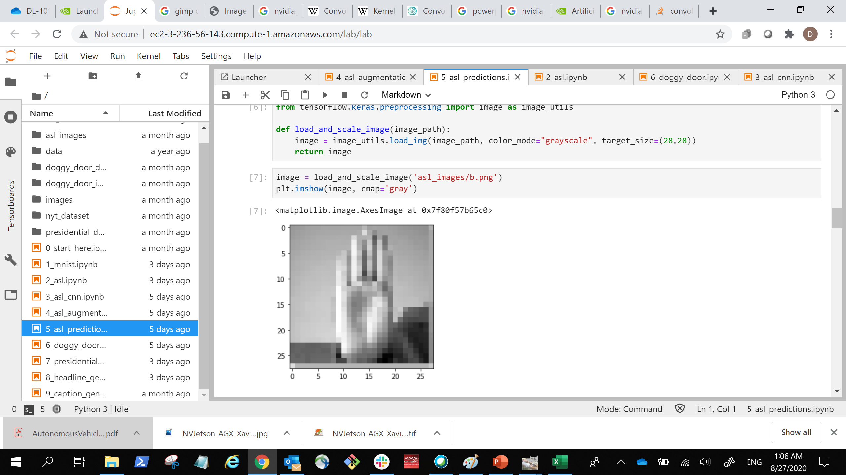

Transfer Learning
… …
… …
(28, 28, 2)
Stacked Images
(28, 28, 2)
Stacked Images
(3, 3, 1, 2)
Kernels
(3, 3, 2, 2)
Kernels
(512)
Dense
(512)
Dense
(28, 28,1)
Image Input
(1568)
Flattened Image
Vector
(10)
Output Prediction
Notes:
Thankfully, the surgery we’re doing on our machine learning models is a lot easier than actual brain surgery. We’ll take a pretrained model and essentially cut the end off of it. We’ll use the top layers of the old model, and then build out our own new layers on the bottom.
Technically, we can slice and dice these layers any way that we want, but there is a practical reason for using the top of the old model instead of the bottom.

Slide 14
Transfer Learning
Input
Convolution
Max Pooling
Convolution
Dropout
Max Pooling
Convolution
Max Pooling
Dense
Dense
Output
More Generalized
More Specialized
Notes:
As we move from the beginning of our model to the end (from left to right in this case), our models go from more generalized to more specific. Remember how we talked about how the top of the convolutional model picks up edges, and each layer builds on the last to build more complicated shapes?
The more layers in the model, the more specialized those shapes are going to be based on the data it’s trained on. These earlier patterns are more generalizable, so when it comes to transfer learning, it tends to be more useful to copy the building blocks found in the earlier layers.

Slide 15
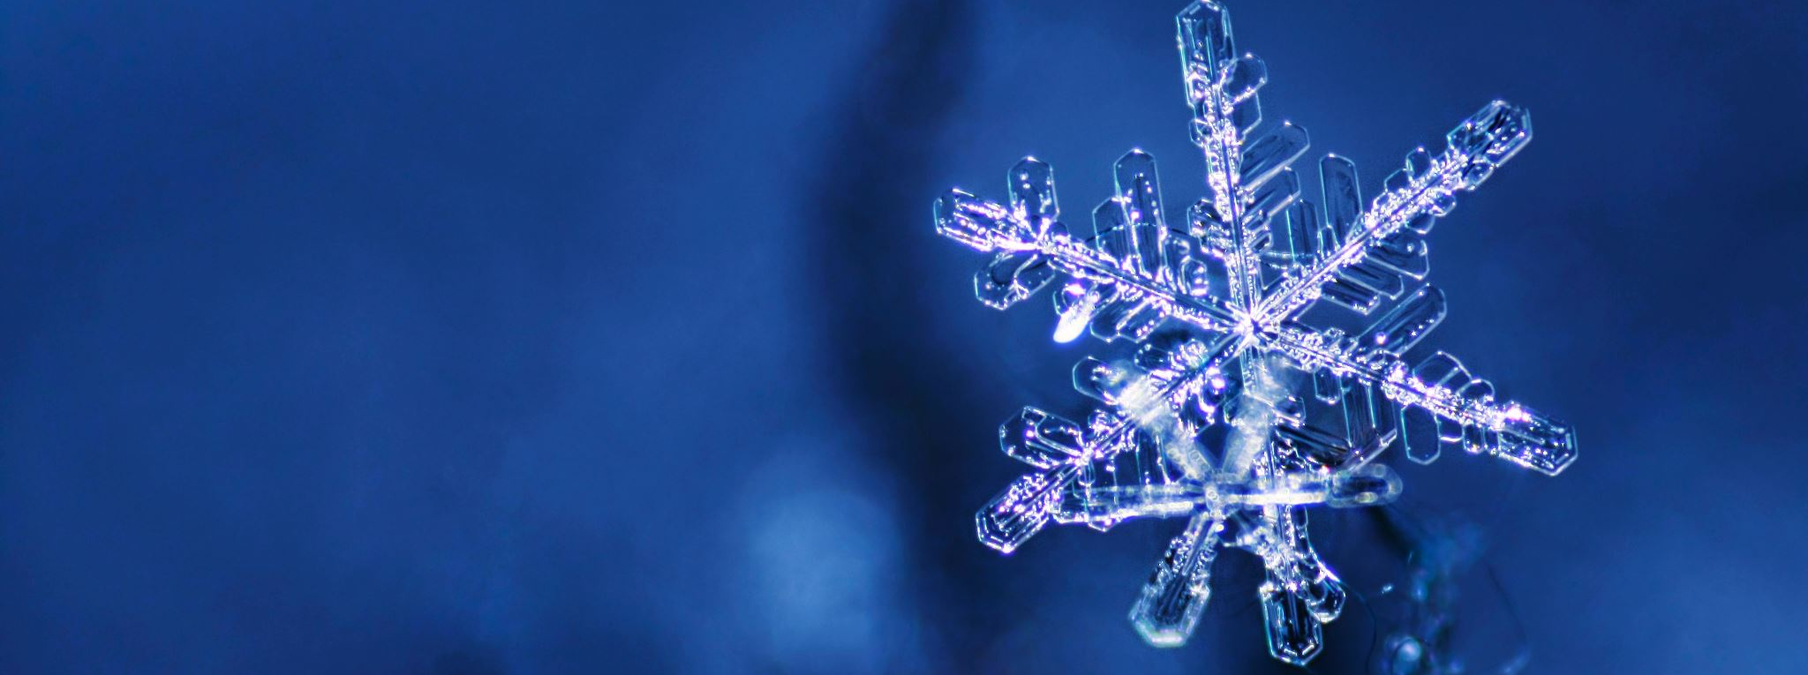
Transfer Learning
Freezing the Model?
Notes:
Another thing we should consider is whether or not we want to freeze the weights from the old model we’re building off of. Freezing is another way to say we’re going to prevent the weights from updating during training, or to make them untrainable.
Making the weights of the old model trainable can help specialize the new model for the new dataset coming in, but be warned! If the old model is large like the VGG16 model, the high number of weights will easily result in overfitting if our new dataset is too small.
This would also be a good time to talk about data bias. Data bias is when a subset of our data is overrepresented. For instance, if we’re making a model to determine the manufacturer of a car, and we mostly have trucks in our dataset, our model will have a hard time identifying vans, sports cars, and sedans. If our dataset is biased, our resulting model will be too. This has come up frequently with discussion on the ethical use of artificial intelligence. If models are only trained on one ethnic group than it can result in some embarrassing predictions in the underrepresented groups.
This is something to think about when using transfer learning, as our new model can pick up biases of the old one.

Slide 16
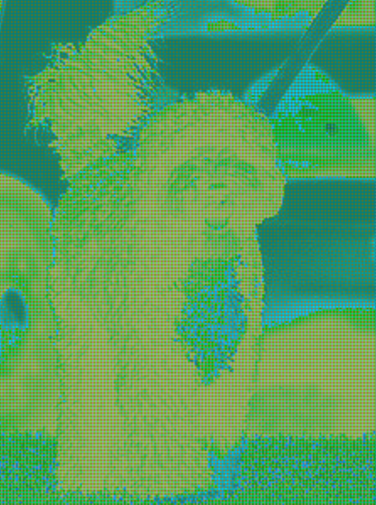
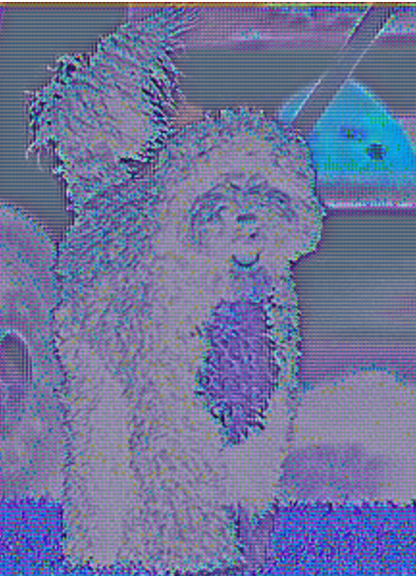
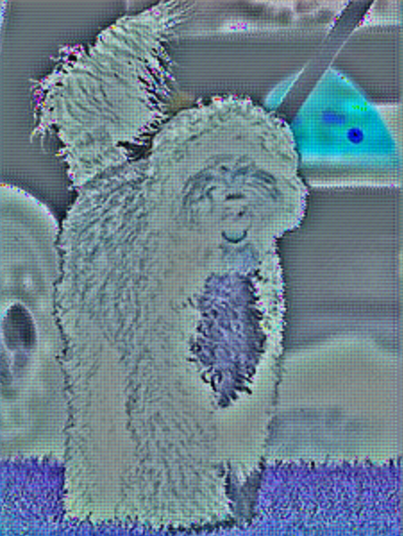
Transfer Learning
Notes:
To end on a fun note, transfer learning is a great opportunity to do something called dreaming. We talked about it briefly earlier when we first went over CNNs. This is done by feeding an image through layers in a neural network, but instead of doing gradient descent, we’re going to maximize our loss through gradient ascent. The goal is to exaggerate the patterns that the model sees in our image.
Here, Bo has been fed through the first three convolutional layers from the InceptionV3 model, and what we’re seeing here are the gradients. We can see as it progresses, the layers slowly start picking up more and more detail.
Unfortunately, the full breakdown of the mechanisms would take more time than we have, but we’ve linked the tutorial on how to do it if you’re up for the challenge!
https://www.tensorflow.org/tutorials/generative/deepdream

Slide 17
Let’s get Started!
Notes:
First things first, though. Let’s make our doggy door and our presidential doggy door.

