Slide 1
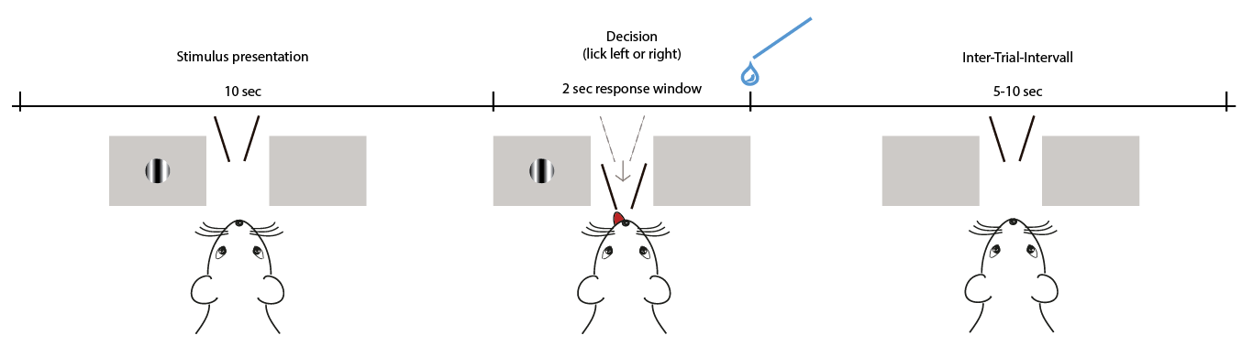

Slide 2
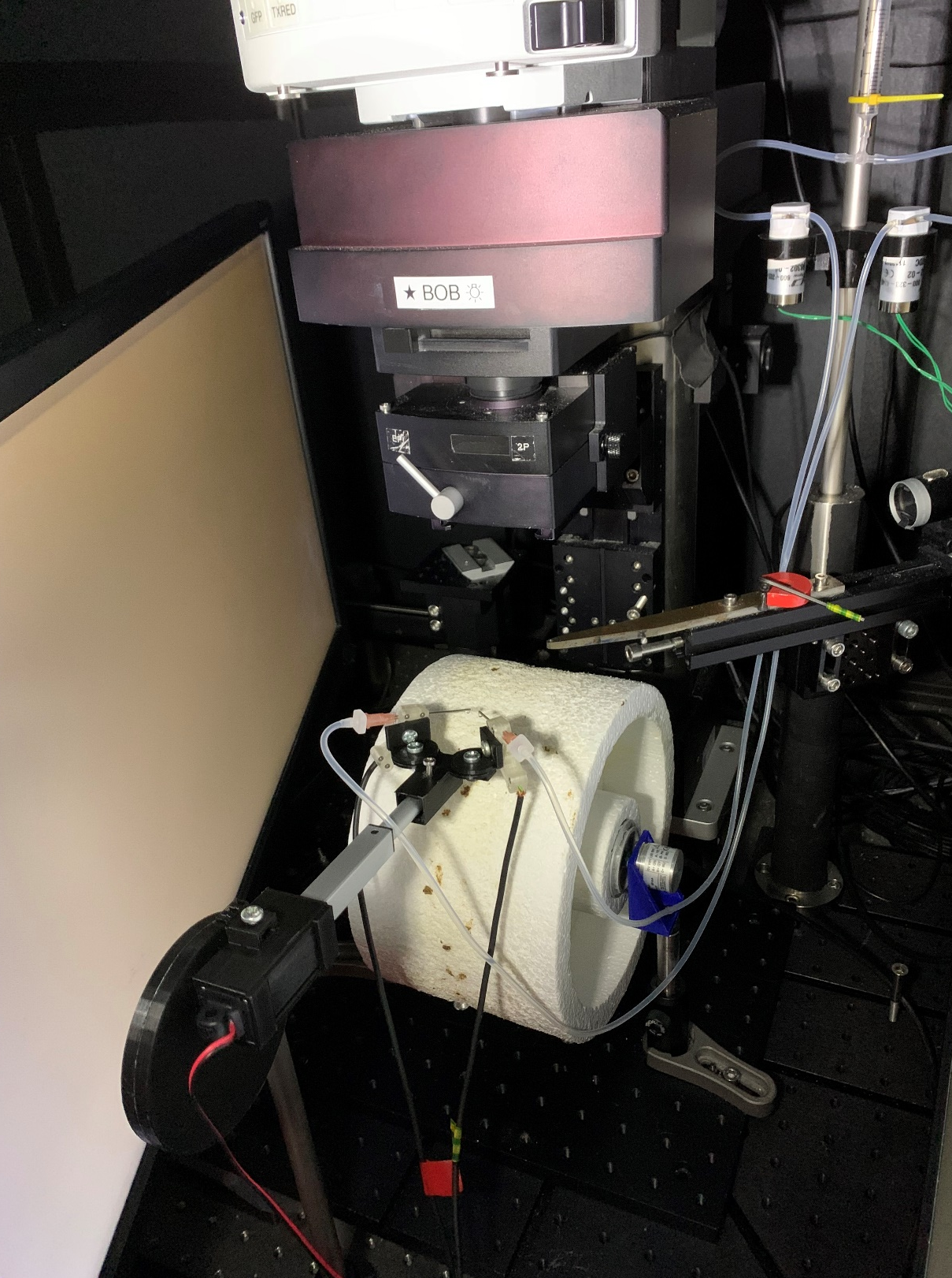
Solenoids
Lick sensors
Actuator
Treadmill

Slide 3
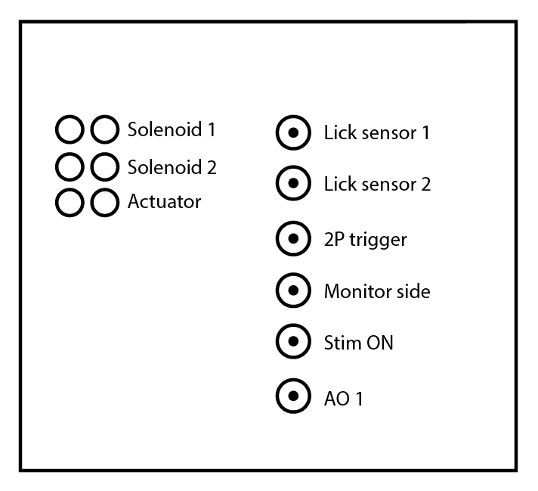
Solenoids
Lick sensors
Actuator
Treadmill

Slide 4
Solenoids
Computer
Psychopy/Python
Labjack
Lick sensors
Amplifier
Actuator
Stimulus time
Solenoid side/time
Lick side/time
Treadmill
Rot. encoder
DAQ/ Scanimage

Slide 5
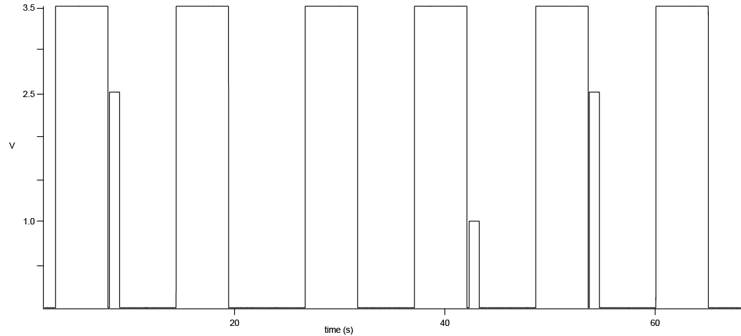
Stimulus left
Stimulus right
Solenoid left
Solenoid right

