Slide 1
Fundamentals of Statistical Testing
The last petrol station before the Highway to Hell
Dr. Martina Sladekova

Slide 2


Slide 3
Housekeeping

Slide 4

Register your Kahoot username:
https://canvas.sussex.ac.uk/courses/31714/quizzes

Slide 5
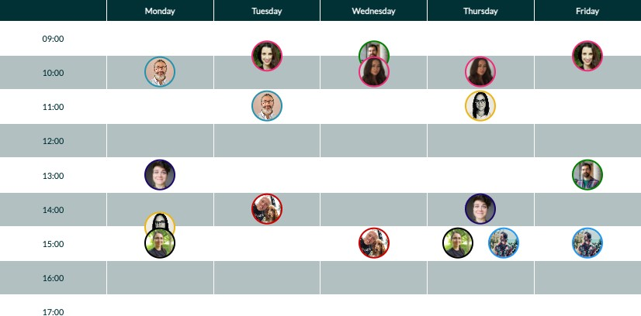
The R-Helpdesk is up and running:
https://canvas.sussex.ac.uk/courses/31714/pages/module-contacts

Slide 6
Where are we going?

Slide 7
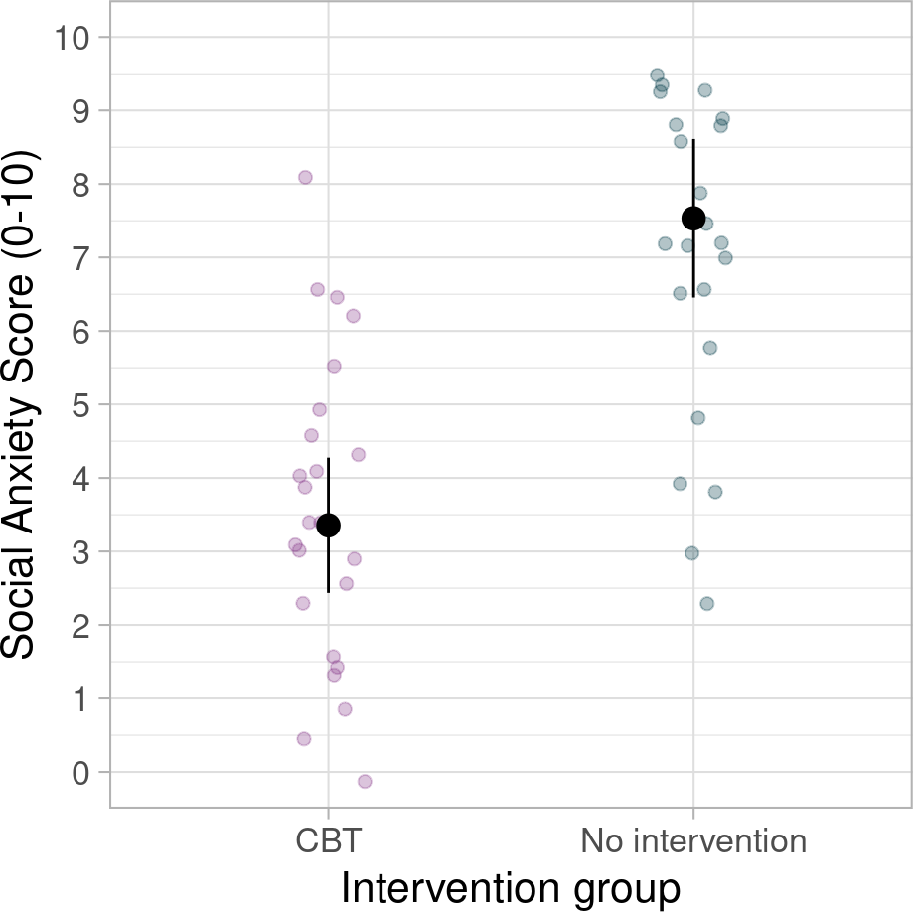
Research questions and hypotheses
We want to answer a research question or be able to make decision about a hypothesis
Research question:
Is CBT (Cognitive Behavioural Therapy) effective for treating social anxiety?
Hypothesis:
Participants who receive the CBT intervention will show lower social anxiety levels than participants who don’t receive an intervention.

Slide 8

PollEverywhere:
What are some other examples of research questions?
Poll link:
PollEv.com/martinasladek

Slide 9
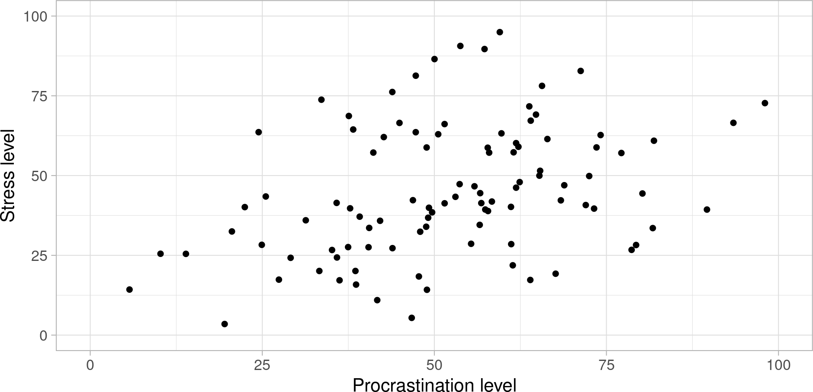
Research questions and hypotheses
Some other examples [made up data]:
Hypothesis: The more we procrastinate, the more stressed we feel.

Slide 10
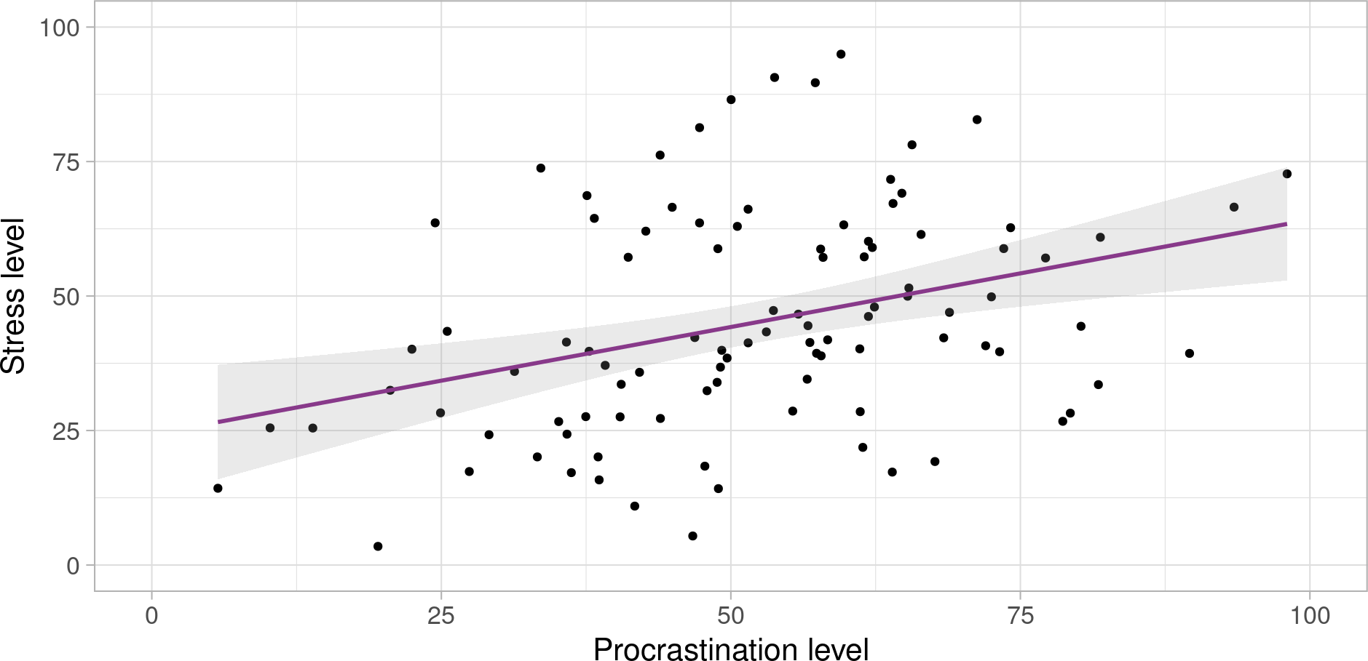
Research questions and hypotheses
Some other examples [made up data]:
Hypothesis: The more we procrastinate, the more stressed we feel.

Slide 11
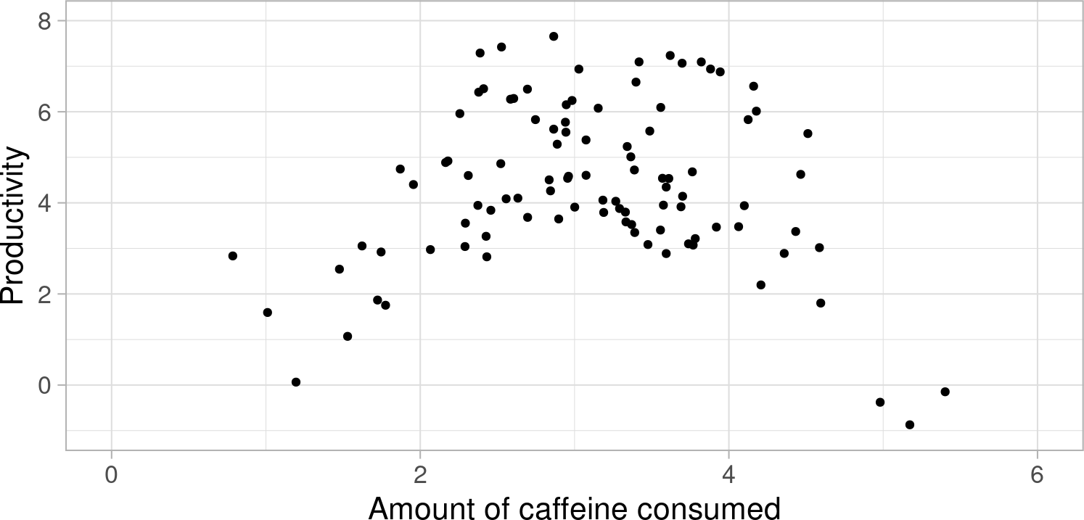
Research questions and hypotheses
Some other examples [made up data]:
Research question: Is there a relationship between caffeine consumption and productivity?

Slide 12
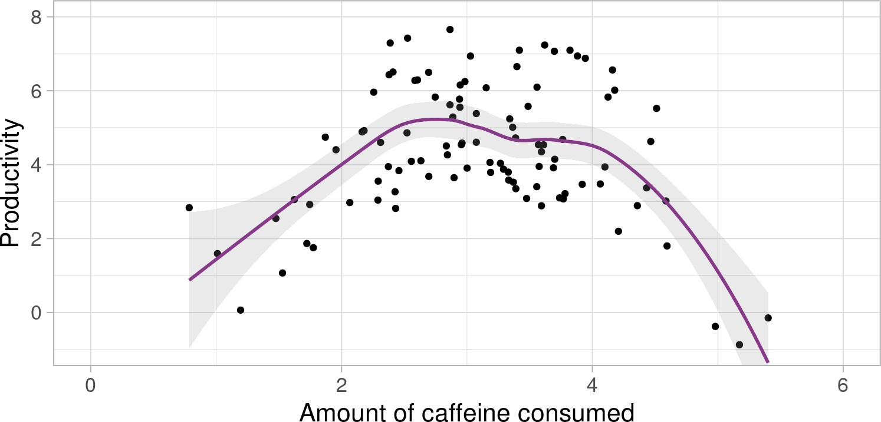
Research questions and hypotheses
Some other examples [made up data]:
Research question: Is there a relationship between caffeine consumption and productivity?

Slide 13
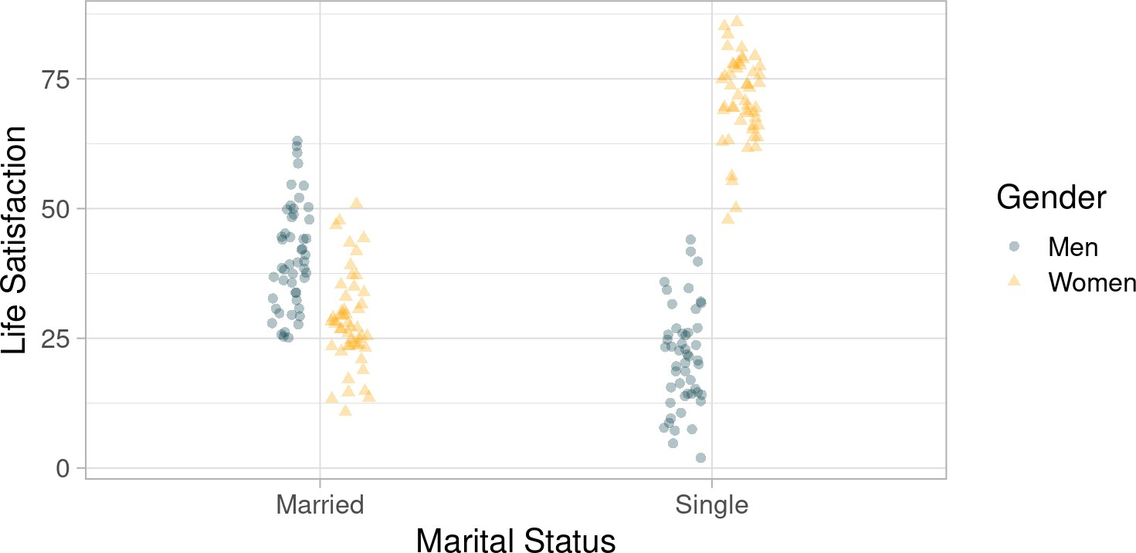
Research questions and hypotheses
Some other examples [made up data, though some studies have found this pattern]:
Hypothesis: The relationship between happiness and marriage is moderated by gender in heterosexual relationships.

Slide 14
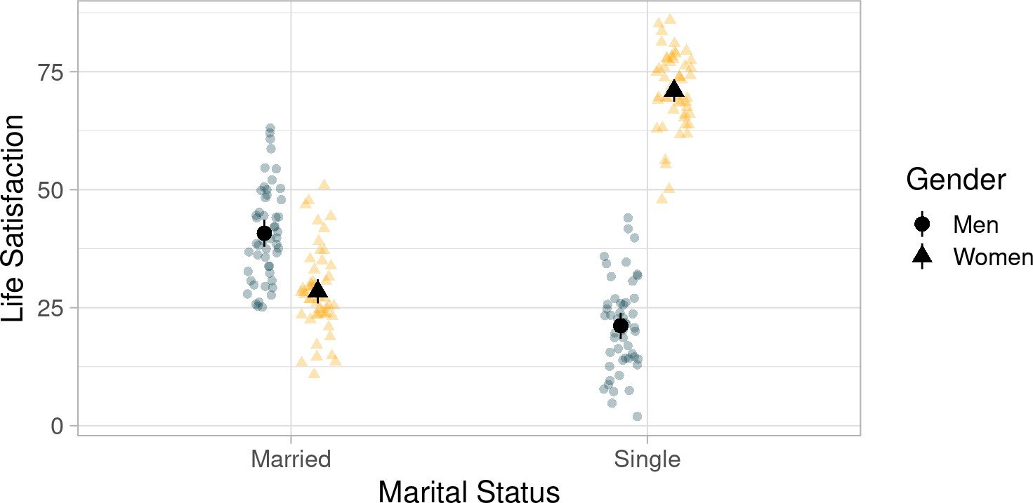
Research questions and hypotheses
Some other examples [madu up data, though some studies have found this pattern]:
Hypothesis: The relationship between happiness and marriage is moderated by gender in heterosexual relationships.

Slide 15

Research questions and hypotheses
Often the data will not show a clear cut difference
“p-value”:
a hypothesis testing tool
a value that we calculate to “formally” decide whether our hypothesis is supported
The next three weeks - building blocks of hypothesis testing

Slide 16
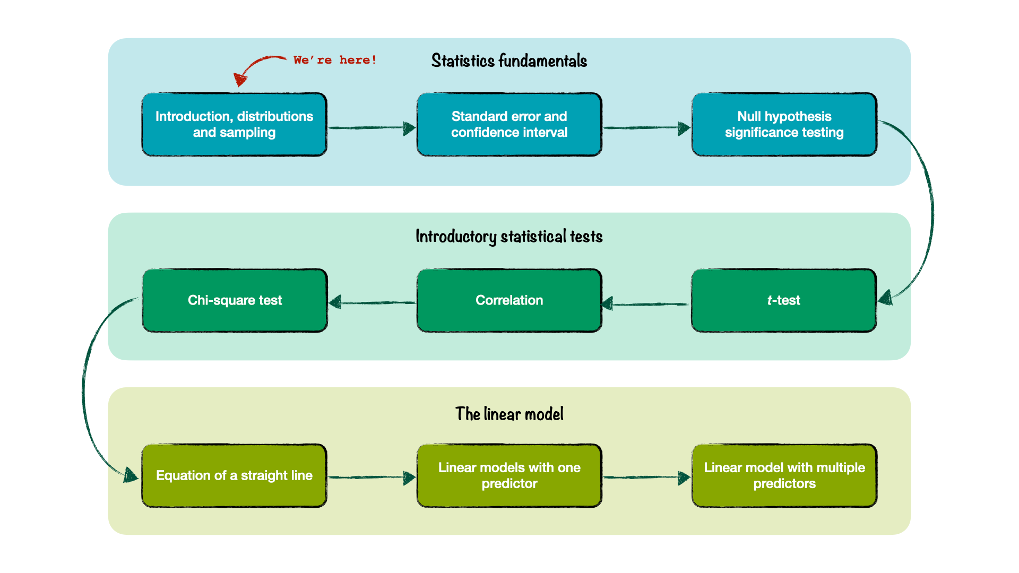
Analysing Data Roadmap

Slide 17
Where did we come from?

Slide 18
Quantitative research
In quantitative research, we often (but not always): Start with a theory,
Devise an experiment to test that theory Collect data
Describe our sample <- last term
Test hypotheses <- this term

Slide 19
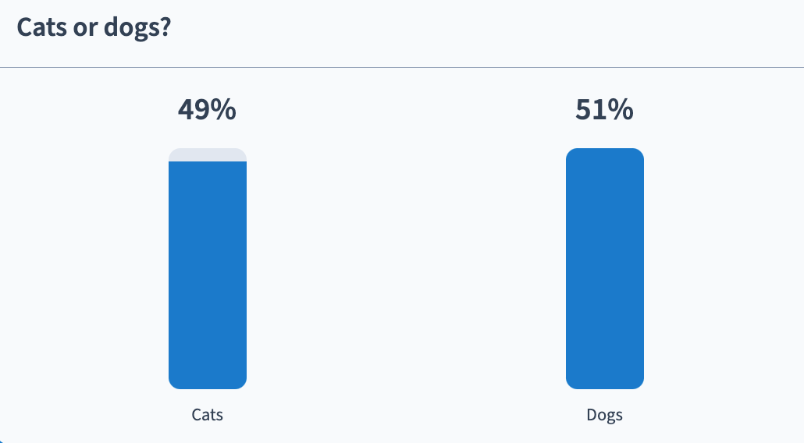
Cats or dogs

Slide 20

A study
Forman and Leavens (2024) - The Effect of Transparency on Unsolvable Task Engagement in Domestic Cats (Felis catus) using Citizen Science
A study of social behaviours - e.g. looking at the owner while completing an unsolvable puzzle
Sample of 21 cats (each cat completed multiple trials)

Slide 21
What can we say about this sample?
On average, how long do cats spend on a task before looking at their owner? What is the shortest and longest time?
What is the variance of scores in our sample? How do scores in our sample differ from each other? Are there any “unusual” cats in our sample?

Slide 22
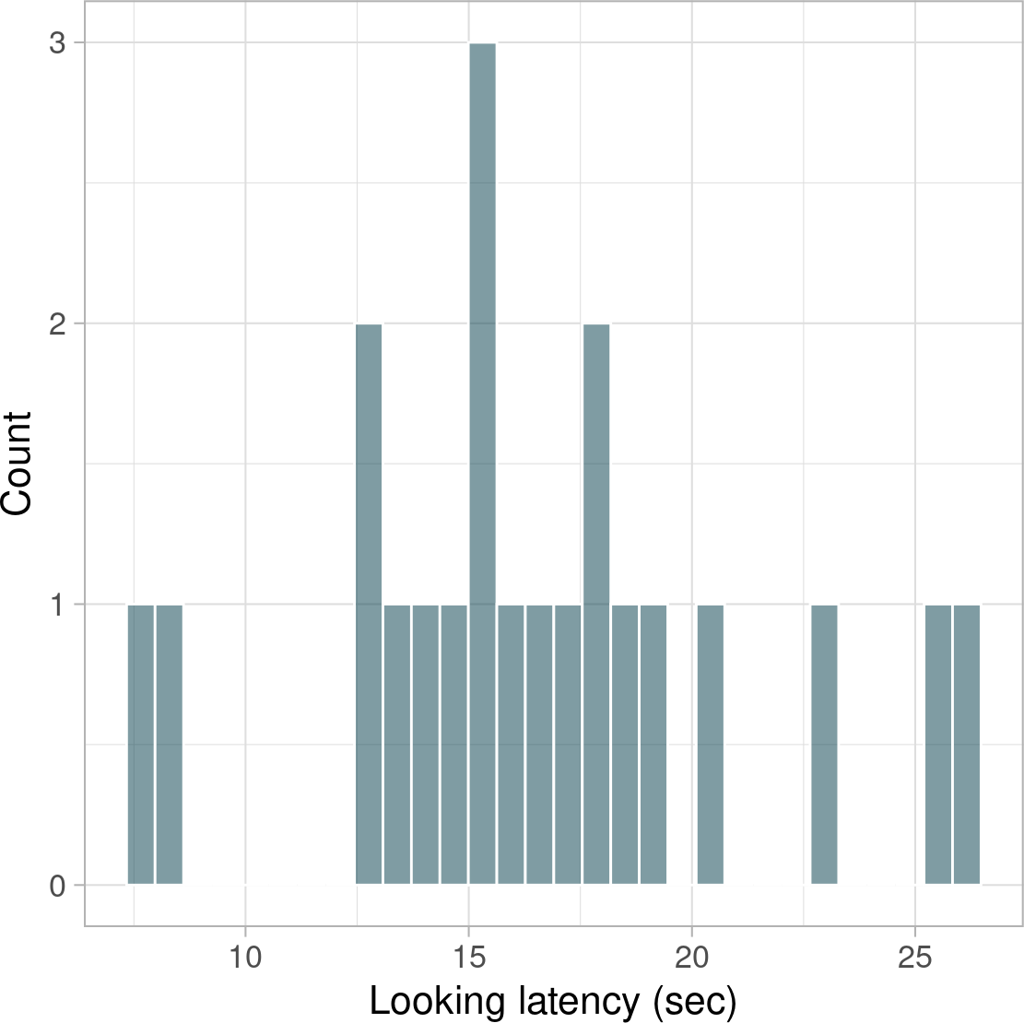
The mean, the median and the mode
Measures of central tendency:
Mean: the average value ^{∑ 𝑥𝑖}
𝑛
Median: the value exactly in the middle
Mode: the most common value

Slide 23
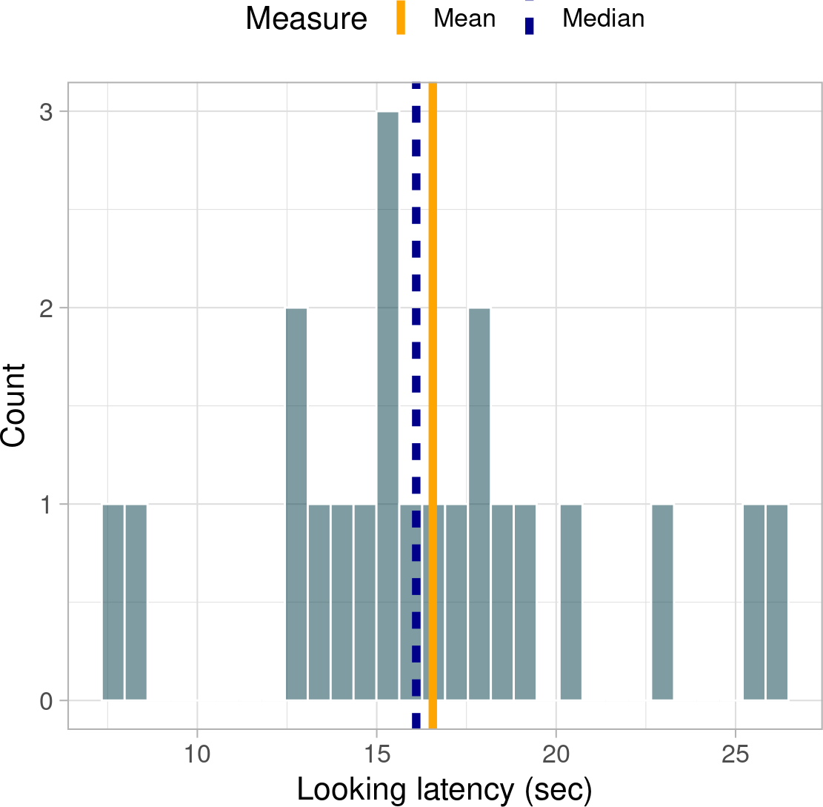
The mean, the median and the mode
Measures of central tendency:
Mean: the average value ^{∑ 𝑥𝑖} = 16.56
𝑛
Median: the value exactly in the middle = 16.1
Mode: the most common value (around 15)

Slide 24
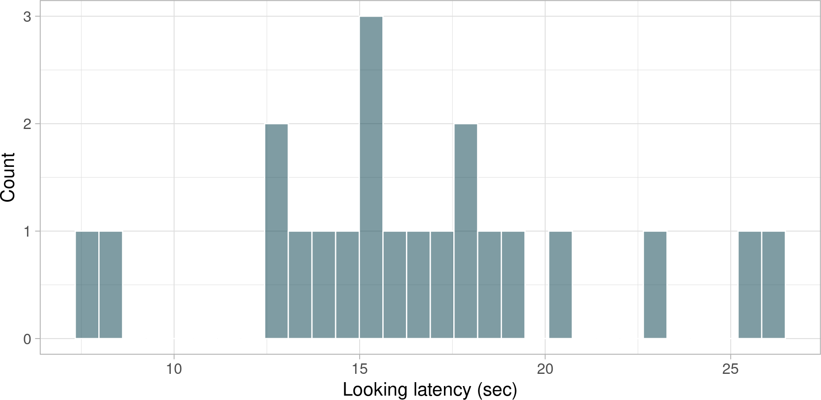
Minimum, maximum, and variance shenanigans
Minimum - smallest value
Maximum - largest value

Slide 25
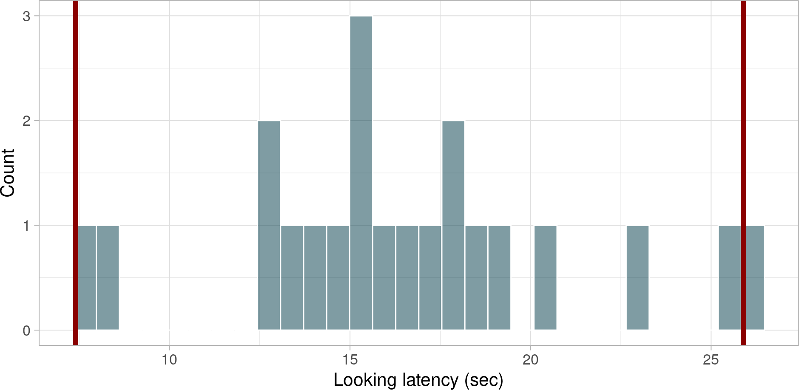
Minimum, maximum, and variance shenanigans
Minimum - smallest value: 7.4
Maximum - largest value: 25.9

Slide 26
Minimum, maximum, and variance shenanigans
2
Variance - how scores differ from each other ^{∑ (𝑋 𝑖 −𝑋)} . Alternatively:
𝑛−1
1 var(cat_sample$look_latency)
[1] 22.17848

Slide 27
Minimum, maximum, and variance shenanigans
∑ (𝑋 −𝑋)
2
Standard deviation - on average, by how much do scores differ from the mean?
√
𝑖
. Alternatively:
𝑛−1
sd_sample <- sd(cat_sample$look_latency)
sd_sample
[1] 4.709403

Slide 28
Unusual cases?
Given our sample, how unusual is a cat who took longer than 25 seconds to look at their owner
1 nrow(cat_sample)
[1] 21
There are 21 cats in our sample
dplyr::filter(
cat_sample,
look_latency > 25
4 )
cat_name
look_latency
Bubbles
25.3
Commodore
2 cats out of 21 represents a proportion of 2/21 = 0.095.
25.9
The empirical probability that a cat takes more than 25s to look at owner is 0.095, or 9.5 percent.

Slide 29


Populations vs samples
Sample =/= Population
Population distribution
Sample distribution
Describes the frequency with which scores of a variable occur in the population.
Describes the frequency with which scores of a variable occur in the sample.
Two cornerstones of statistical research:
A distribution of a sample from a given population will resemble the shape of that population.
A lot of variables have population distributions with a predictable shape.

Slide 30
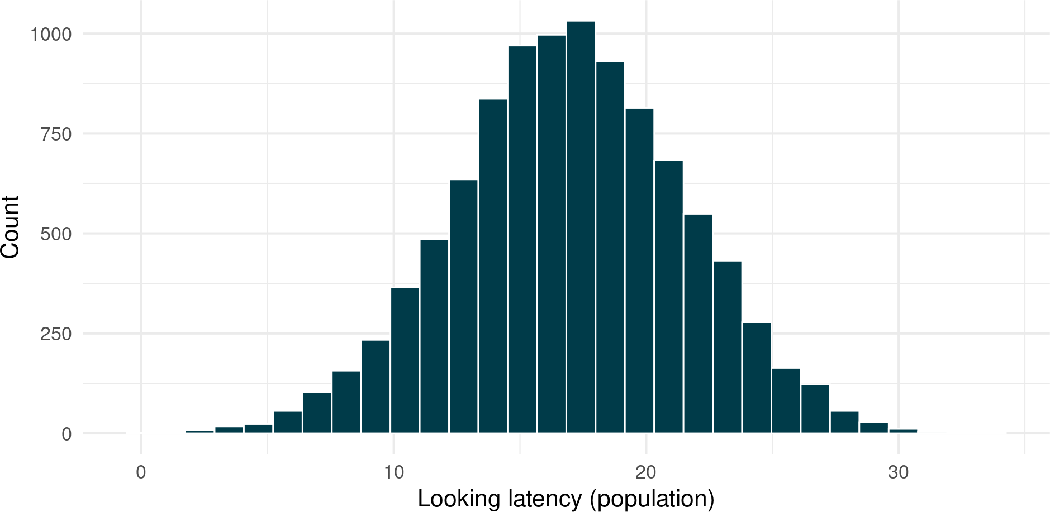
Populations vs samples
1. A distribution of a sample from a given population will resemble the shape of that population.
The larger our sample, the closer it will resemble the population distribution.

Slide 31
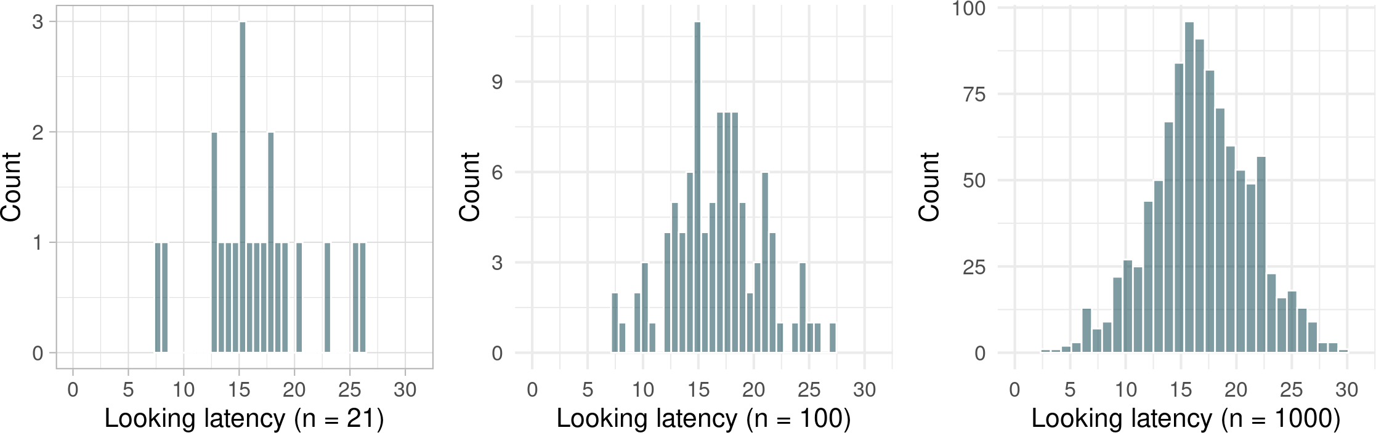
Populations vs samples
1. A distribution of a sample from a given population will resemble the shape of that population.
The larger our sample, the closer it will resemble the population distribution.

Slide 32
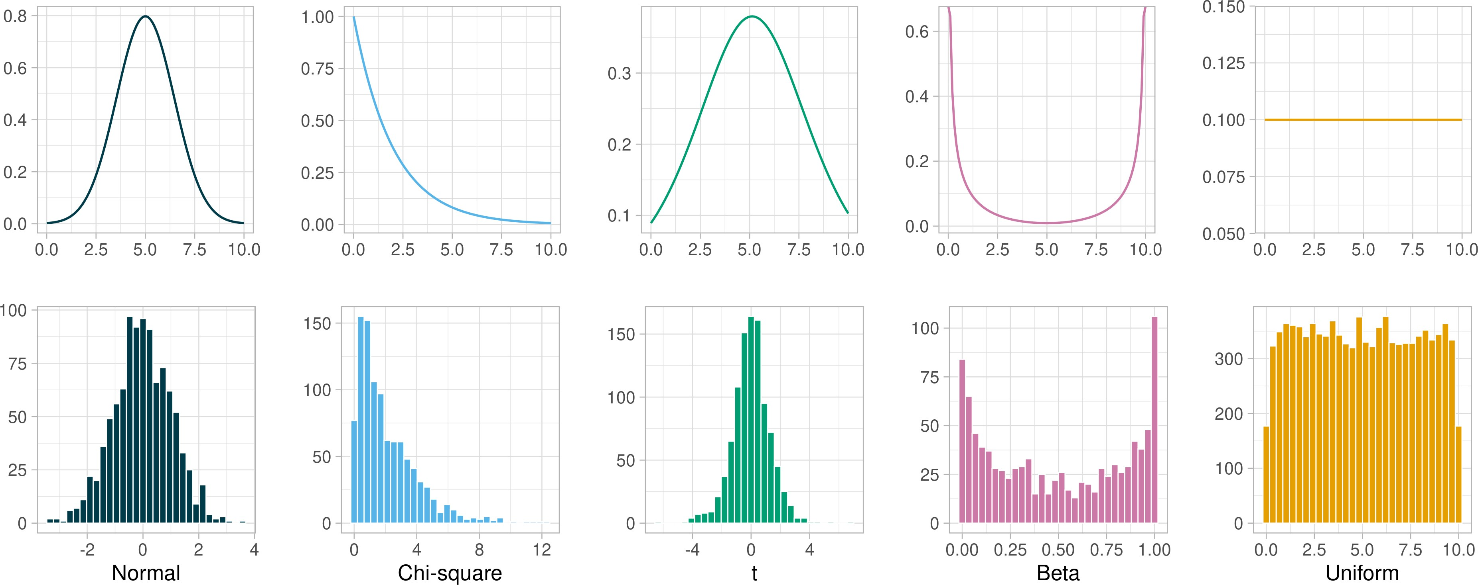
Known distributions
2. A lot of variables have population distributions with a predictable shape.

Slide 33
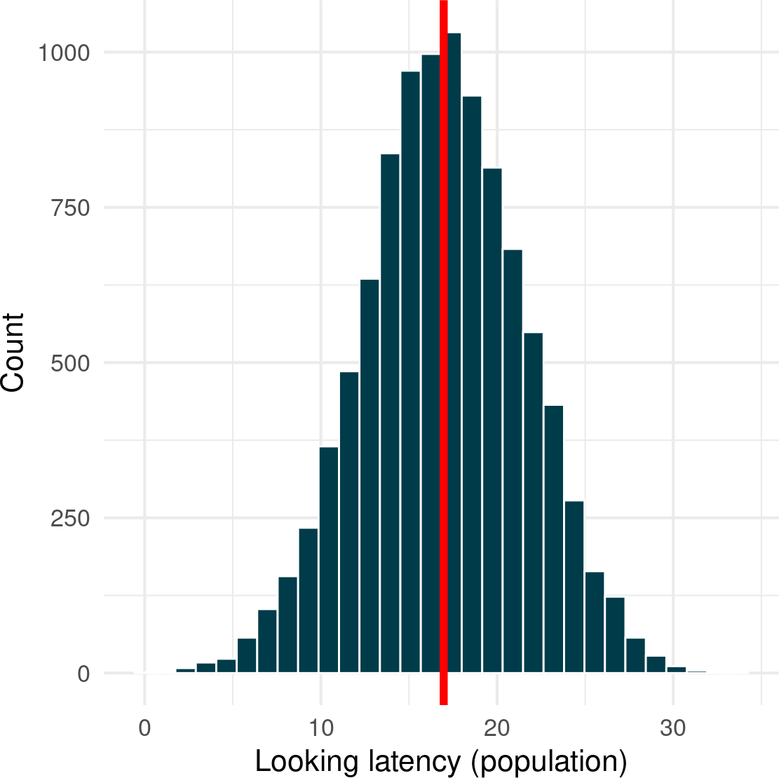
One shape to rule them all
Normal distribution is : Symmetrical (skewness of 0) Bell-shaped
Unimodal (only has one mode)
Defined by mean and standard deviation
Mean, median, and mode converge on one value

Slide 34
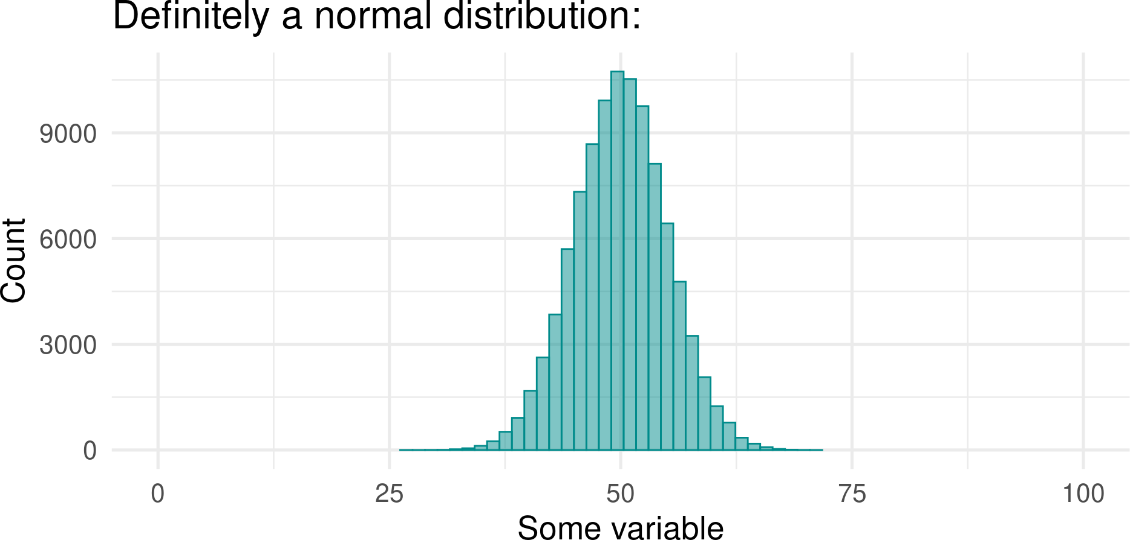
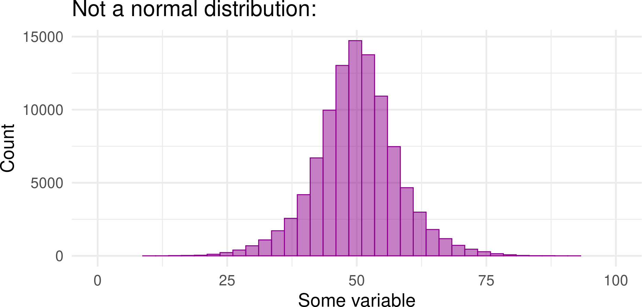
Sneaky distributions
There are infinite possible combinations of means and standard deviations Therefore there are infinite possible normal distributions
But not every bell-shaped distributions is a normal distribution
Proportions matter

Slide 35
How to tell whether something is actually normally distributed
We know that normal distribution has: More scores in the middle
Fewer and fewer scores in the tails, the further away we get from the mean - the centre of the distribution
Proportions matter
We expect certain proportions of scores at certain distances away from the mean:
~68% of scores will be within 1 standard deviation of the mean
~95% of scores will be within 1.96 standard deviations of the mean
~99% of scores will be within 2.58 standard deviations of the mean

Slide 36
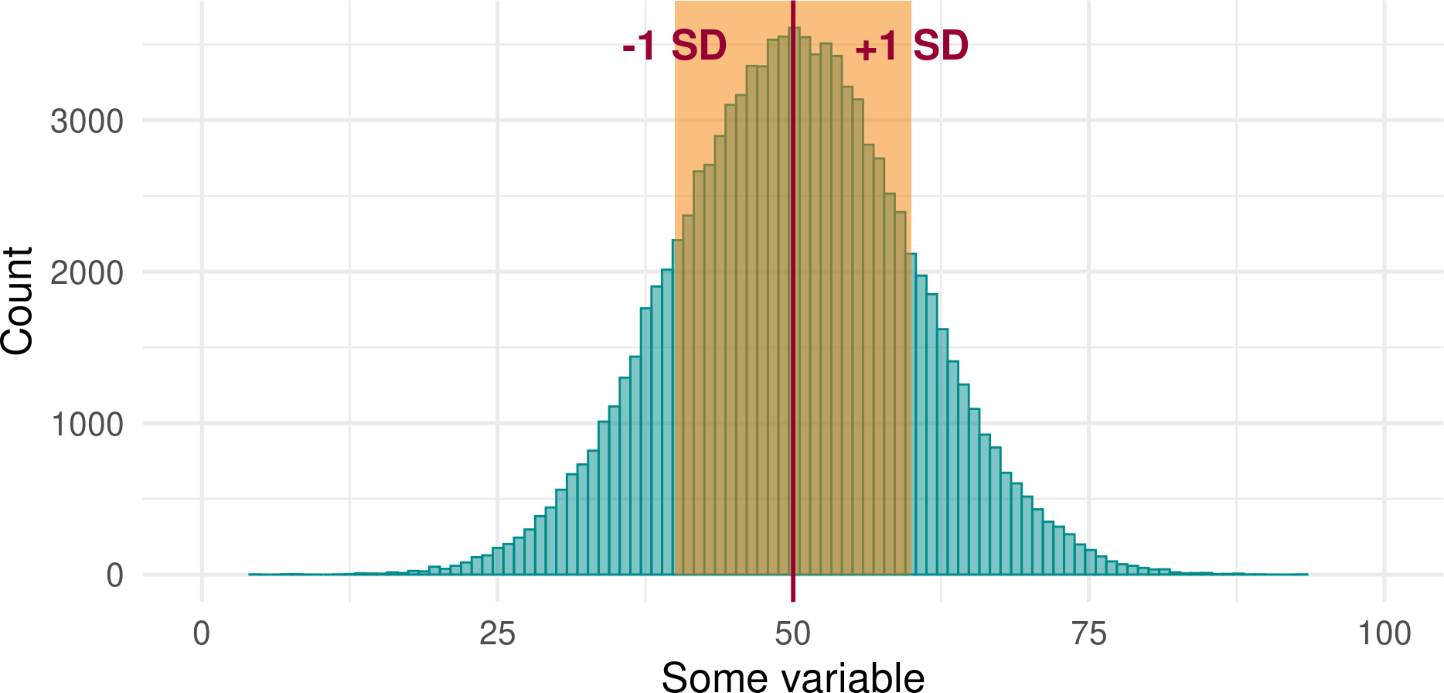
How to tell whether something is actually normally distributed
~68% of scores will be within 1 standard deviation of the mean:
This means that shaded area contains approximately ~68% of the scores.

Slide 37
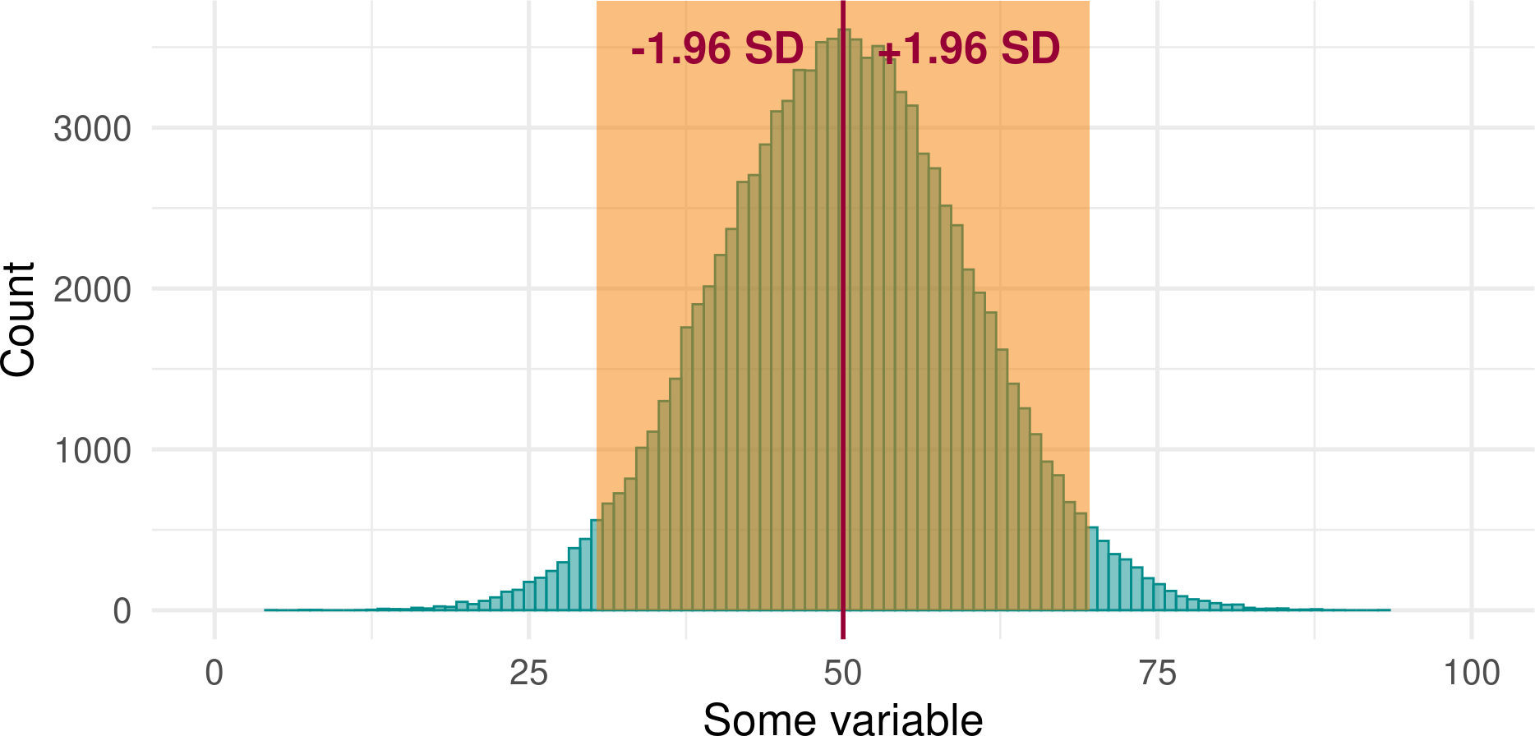
How to tell whether something is actually normally distributed
~95% of scores will be within 1.96 standard deviations of the mean:
This means that the shaded area contains approximately ~95% of the scores.

Slide 38
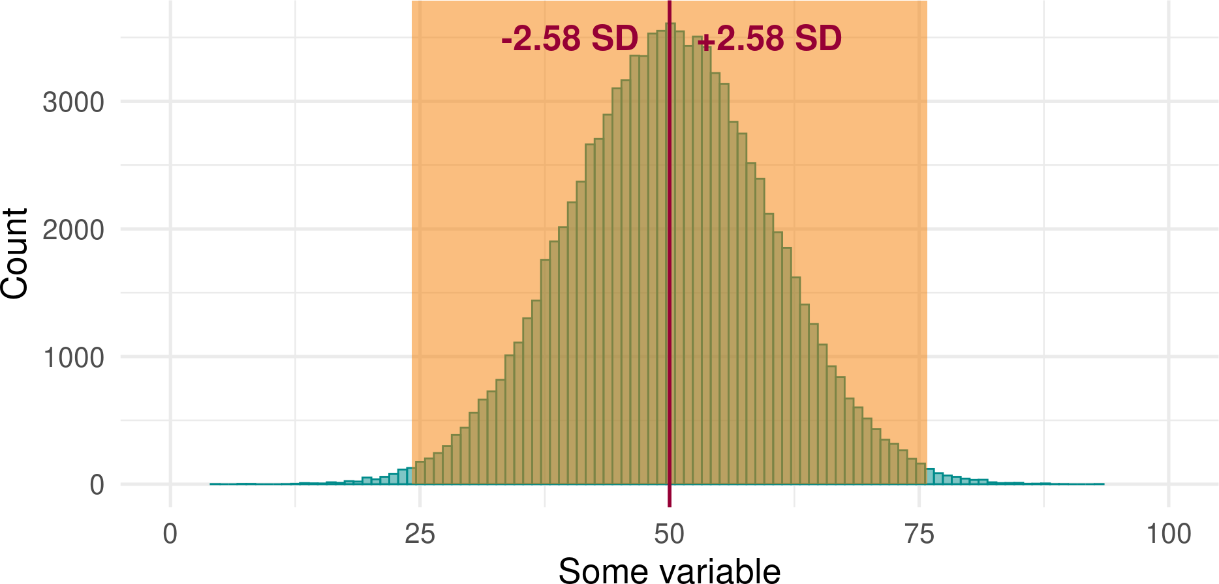
How to tell whether something is actually normally distributed
~99% of scores will be within 2.58 standard deviations of the mean:
This means that the shaded area contains approximately ~99% of the scores. The remaining <1% will be a the unshaded tails.
39

Slide 39
Critical Values

Slide 40
Proportions to Probability
The proportions are always the same in a normal distribution If we know that a particular quantity is normally distributed…
We know something about the probability of observing a particular value!
This allows us to quantify whether something “unusual” or “surprising” with reference to the population.

Slide 41
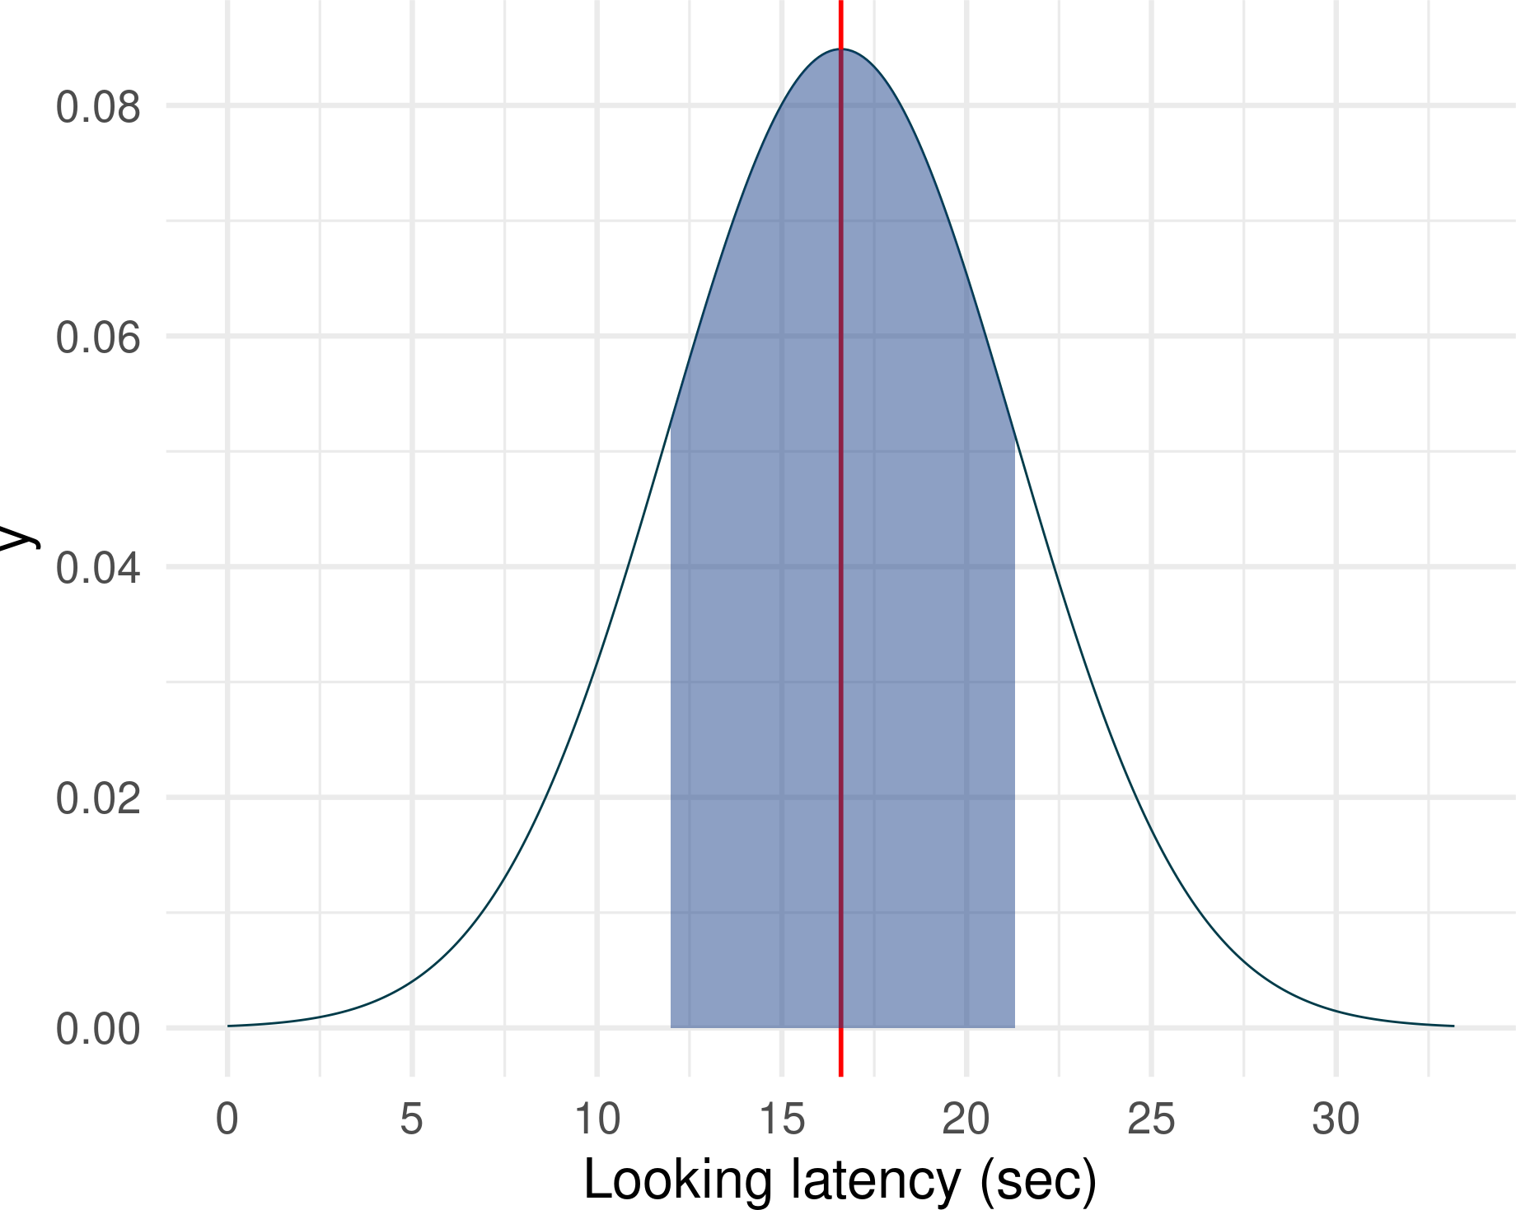
What’s “unusual”?
Let’s assume that the cat population has the same mean and SD (for looking latency) as our sample.
Mean = 16.6
SD = 4.7
Then:
16.6 - 4.7 = 11.9
16.6 + 4.7 = 21.3
68% of cats take between 11.9 and 21.3 to look at their owner when completing a task.

Slide 42
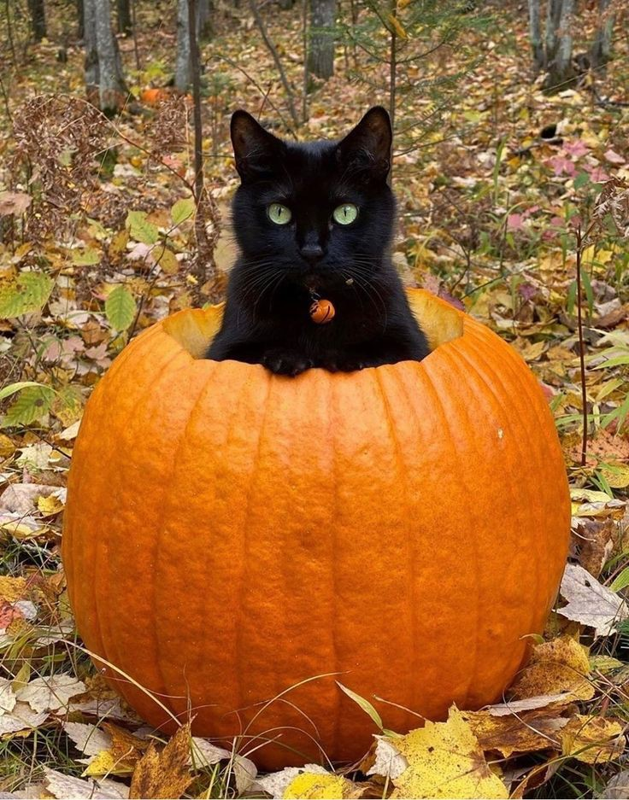
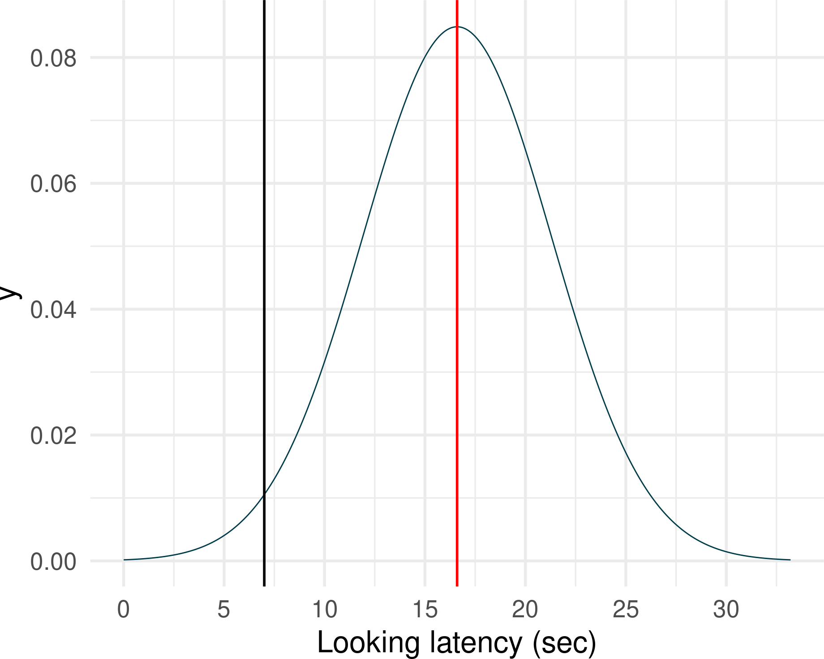
What’s “unusual”?
Pumpkin is a cat from our sample
Pumpkin only spent 7 seconds on a task before turning to his owner
Is pumpkin unusual?

Slide 43
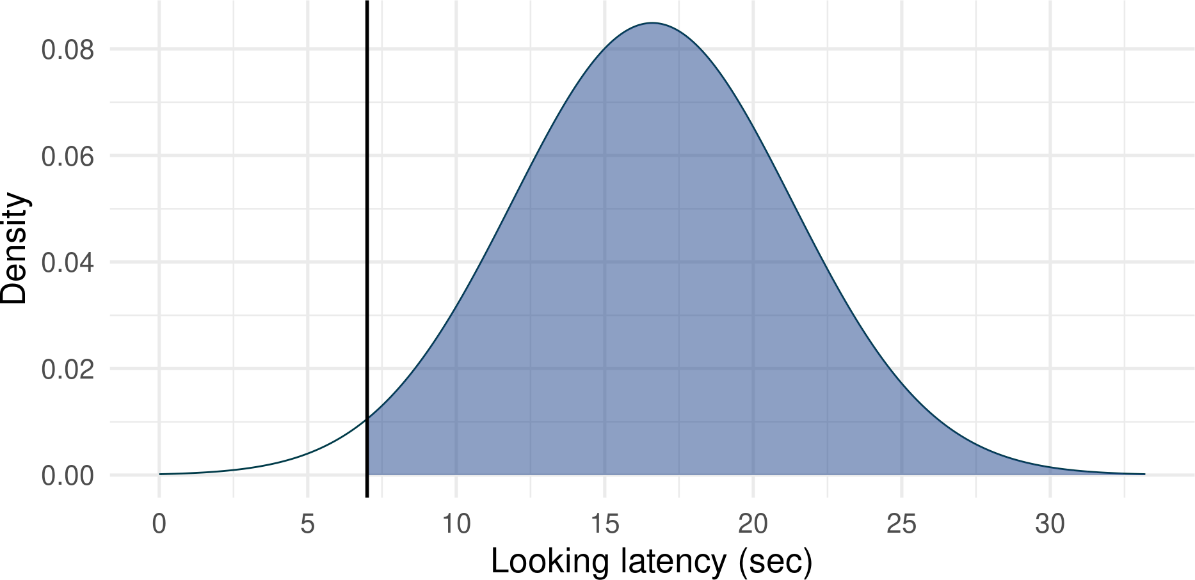
What’s “unusual”?
How common is Pumpkin’s score of 7 ?
Shaded area: proportion of the cat population that spend more time on a task than Pumpkin
Non-shaded area: proportion of cats who spent less time on a task

Slide 44

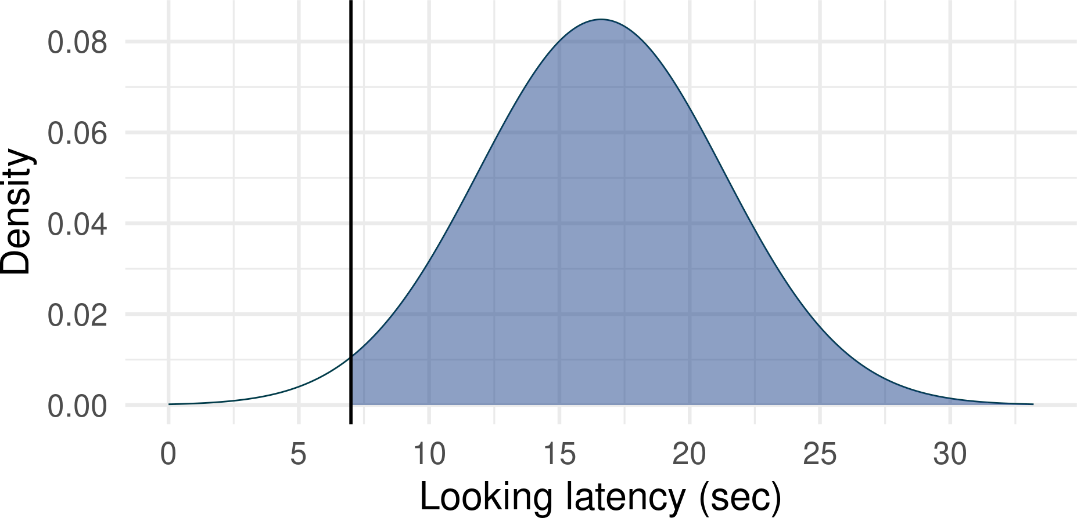
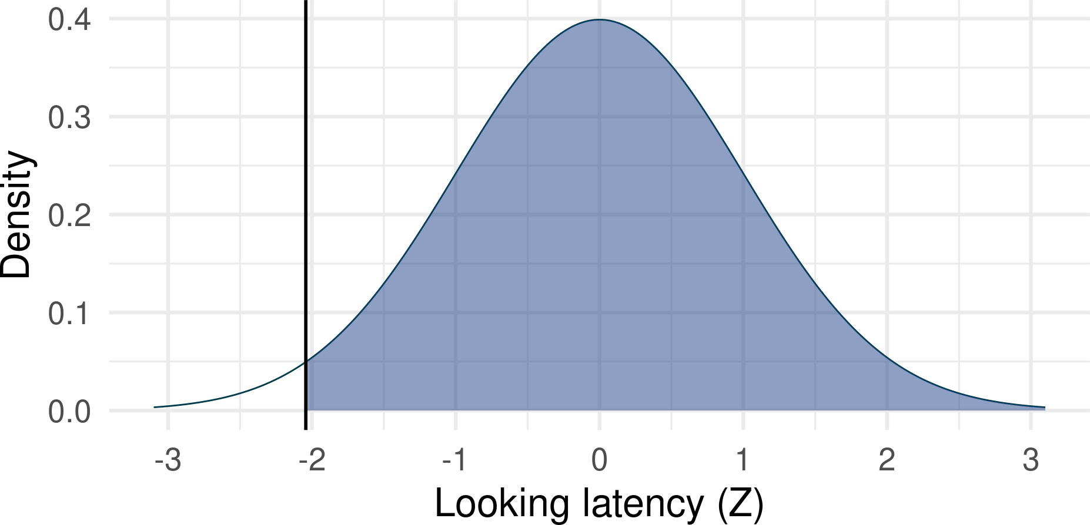
Working out probabilities
Option 1: Good old Z-scores
𝑋 _{𝑖} − 𝑀𝑒𝑎𝑛
𝑍 =
7 − 16.56
=
= −2.03
𝑆𝐷
4.71
Reminder
Transforming into Z-scores is called standardisation. If we transform the whole distribution, it will have (1) the same shape, (2) mean of 0 and SD of exactly 1

Slide 45
Working out probabilities
Option 1: Good old Z-scores
𝑋 _{𝑖} − 𝑀𝑒𝑎𝑛
𝑍 =
7 − 16.56
=
= −2.03
𝑆𝐷
4.71
Look up Z-scores in a Z-table
A table of probabilities associated with Z-scores
0.00 |  | 0.01 | 0.02 | 0.03 | 0.04 | 0.05 | 0.06 | 0.07 | 0.08 | 0
0.0 | 0.50000 | 0.50399 | 0.50798 | 0.51197 | 0.51595 | 0.51994 | 0.52392 | 0.52790 | 0.53188 | 0.535
0.1 | 0.53983 | 0.54380 | 0.54776 | 0.55172 | 0.55567 | 0.55962 | 0.56356 | 0.56749 | 0.57142 | 0.575
0.2 | 0.57926 | 0.58317 | 0.58706 | 0.59095 | 0.59483 | 0.59871 | 0.60257 | 0.60642 | 0.61026 | 0.614
0.3 | 0.61791 | 0.62172 | 0.62552 | 0.62930 | 0.63307 | 0.63683 | 0.64058 | 0.64431 | 0.64803 | 0.651
0.4 | 0.65542 | 0.65910 | 0.66276 | 0.66640 | 0.67003 | 0.67364 | 0.67724 | 0.68082 | 0.68439 | 0.687
0.5 | 0.69146 | 0.69497 | 0.69847 | 0.70194 | 0.70540 | 0.70884 | 0.71226 | 0.71566 | 0.71904 | 0.722

Slide 46
Working out probabilities
Option 1: Good old Z-scores
𝑋 − 𝑀𝑒𝑎𝑛
7 − 16.56
𝑍 =
=
= −2.03
𝑆𝐷
4.71
Look up Z-scores in a Z-table
Z-scores
0.03
2.0
0.97882

Slide 47

Working out probabilities
Alternatively…
1 pnorm(-2.03, lower.tail = FALSE)
[1] 0.9788217
Shaded area: 97.88%
Unshaded area: 2.12%
Assuming our cat population has the shape we specified, there’s only 0.021 probability (or 2.12%) of finding a cat like Pumpkin. He’s quite unusual!

Slide 48
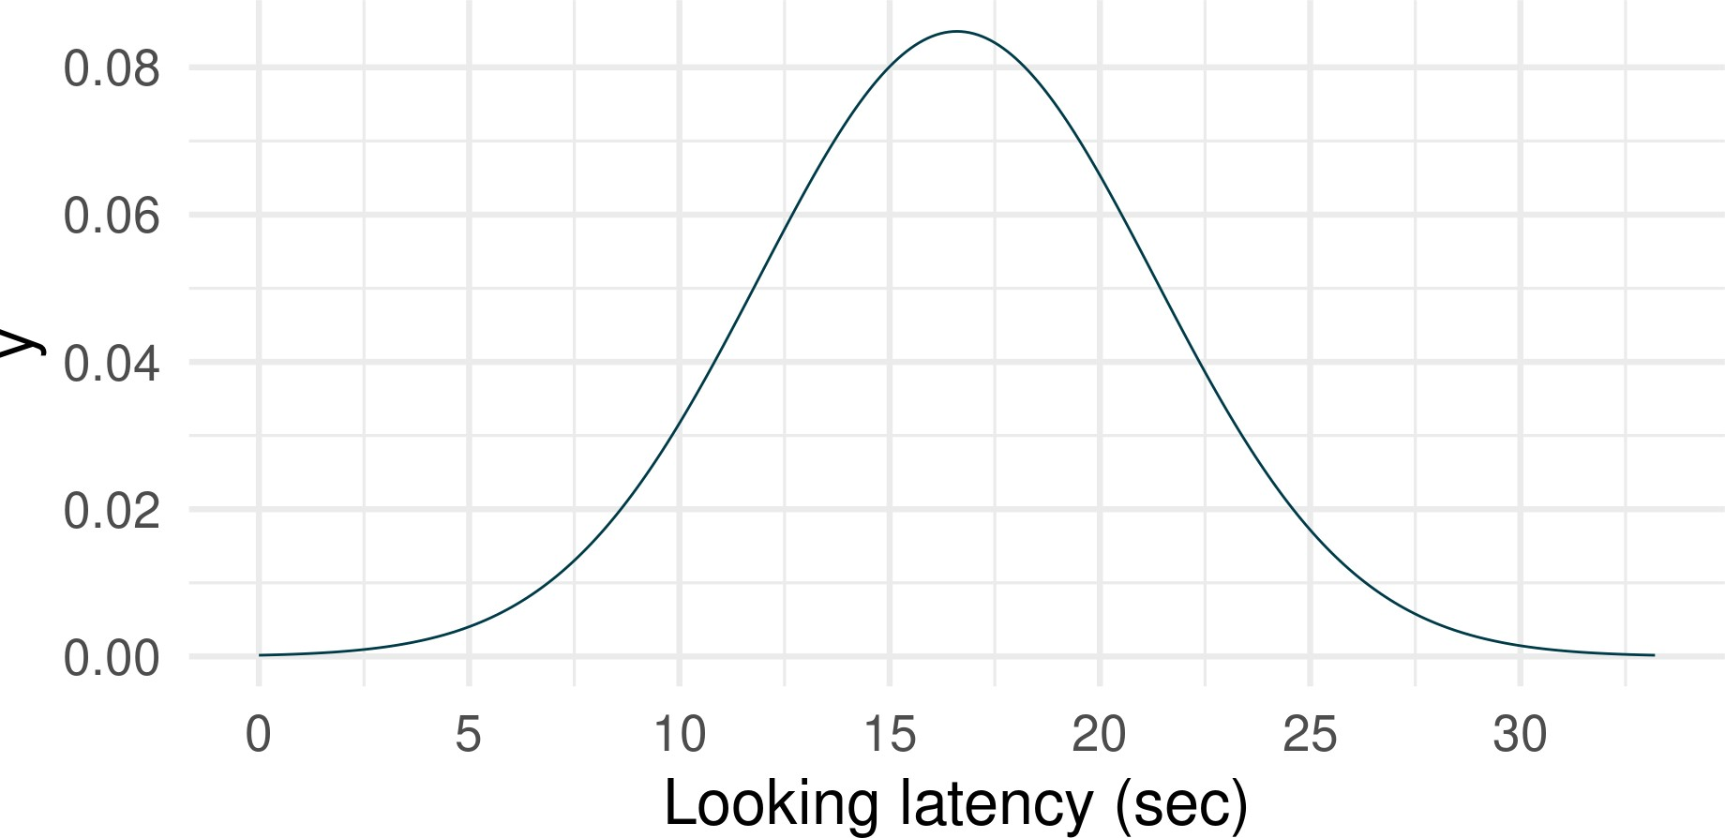
Another example
Oreo looked at his owner after 22.8 seconds. Is Oreo unusual - e.g. in the top 5% ? 👍 👎

Slide 49
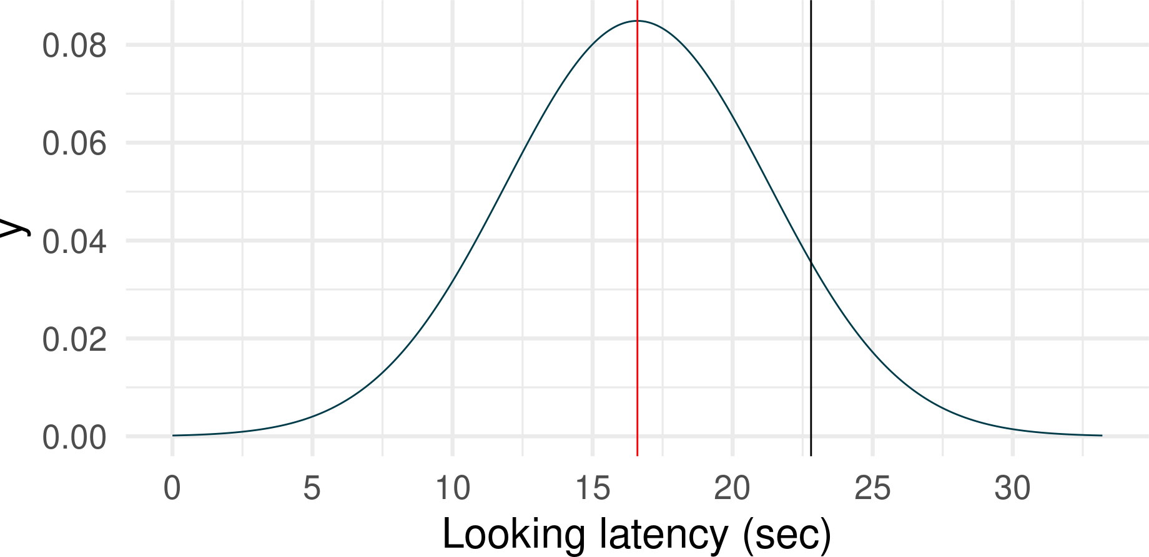
Another example
Oreo looked at his owner after 22.8 seconds. Is Oreo unusual - e.g. in the top 5% ? 👍 👎

Slide 50
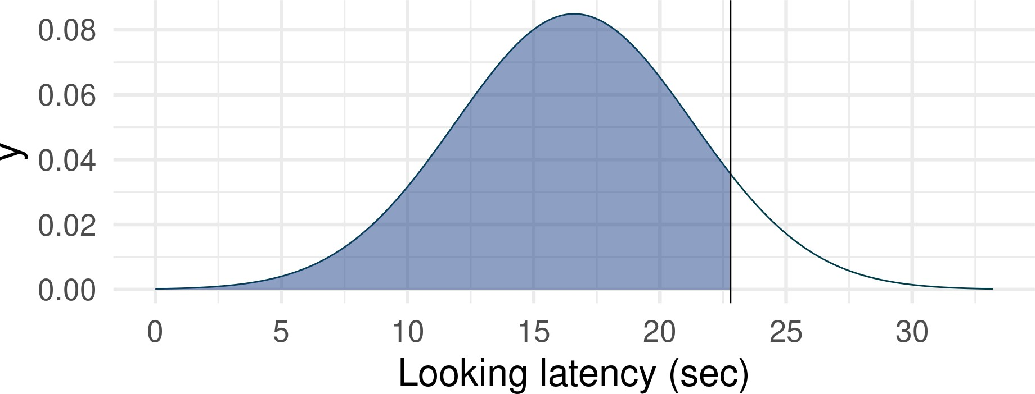
Another example
Oreo looked at his owner after 22.8 seconds. Is Oreo unusual - e.g. in the top 5% ? 👍 👎
1 pnorm(22.8, mean = 16.6, sd =
Shaded area: 90.64 % Unshaded area: 9.36 %
[1] 0.9064403

Slide 51
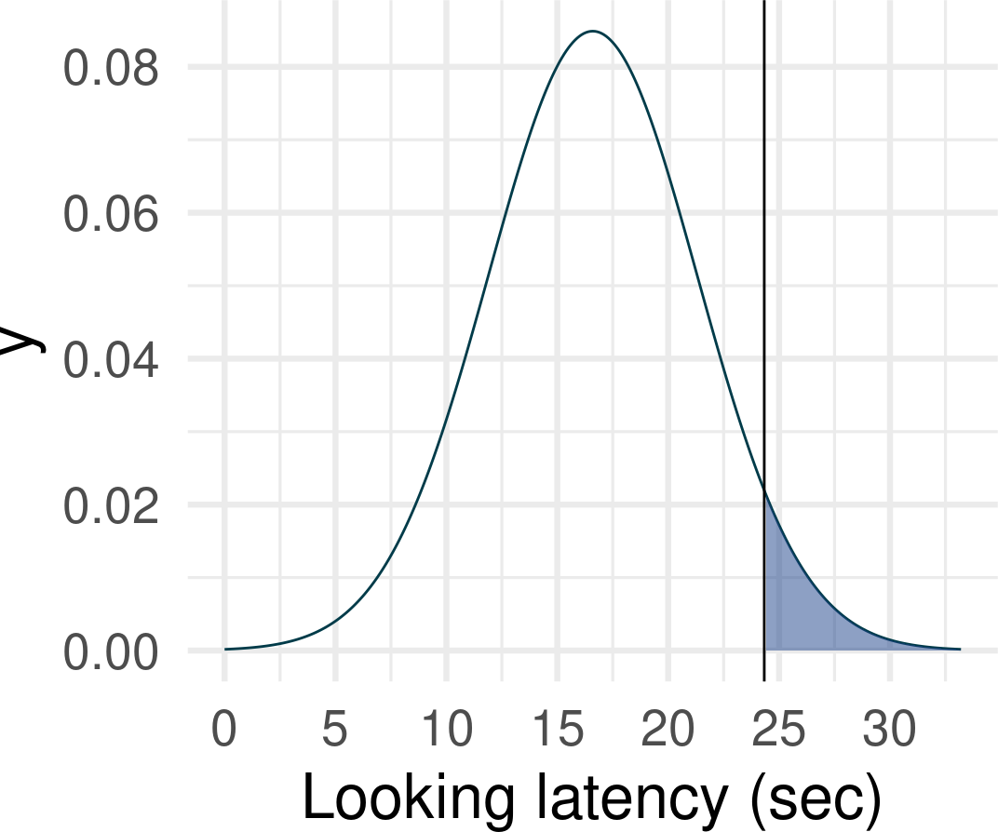
The other way around …
How long would Oreo have to wait before looking at his owner to be in top 5%?
We can reverse the math (or use a different R function) and calculate a critical cut-off for a specific probability, assuming some population mean and SD:
1 qnorm(p = 0.05, mean = 16.6, sd = 4.7,
[1] 24.33081

Slide 52
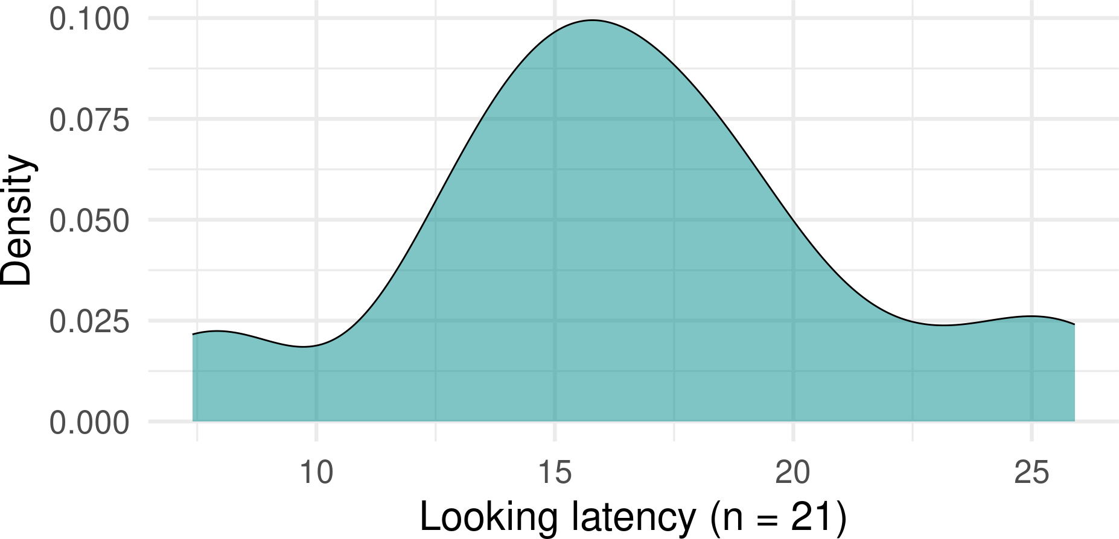

Assuming that…
We calculated these probabilities assuming a certain shape of the population distribution - we don’t know whether this assumption is reasonable.

Slide 53
Summary
Samples resemble populations - larger samples resemble them better
This allows us make assumptions about what the population looks might look like and calculate probabilities.
We assume some version of the reality (the population) and then we check whether what we observed is sufficiently unusual/interesting in this version of the reality.
Normal distribution is one of many “mathematically defined” distributions - we’ll meet more in the weeks to come.
NEXT WEEK:
Quantifying uncertainty

Slide 54
References
Forman, Jemma, and David Leavens. 2024. “The Effect of Transparency on Unsolvable Task Engagement in Domestic Cats (Felis Catus) Using Citizen Science.” http://dx.doi.org/10.21203/rs.3.rs-3834933/v1.

