Slide 1
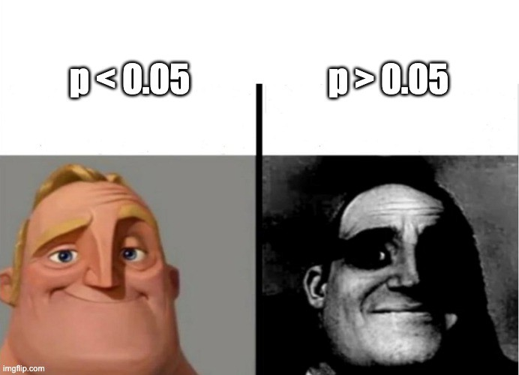
Null Hypothesis Significance Testing
Dr. Martina Sladekova

Slide 2


Slide 3


Session links
linktr.ee/analysingdata

Slide 4
Today
Recap of sampling from distributions and confidence intervals Forming a research question
Moving from research questions to hypotheses Formally testing hypotheses with statistics (Some of many) pitfalls of NHST

Slide 5
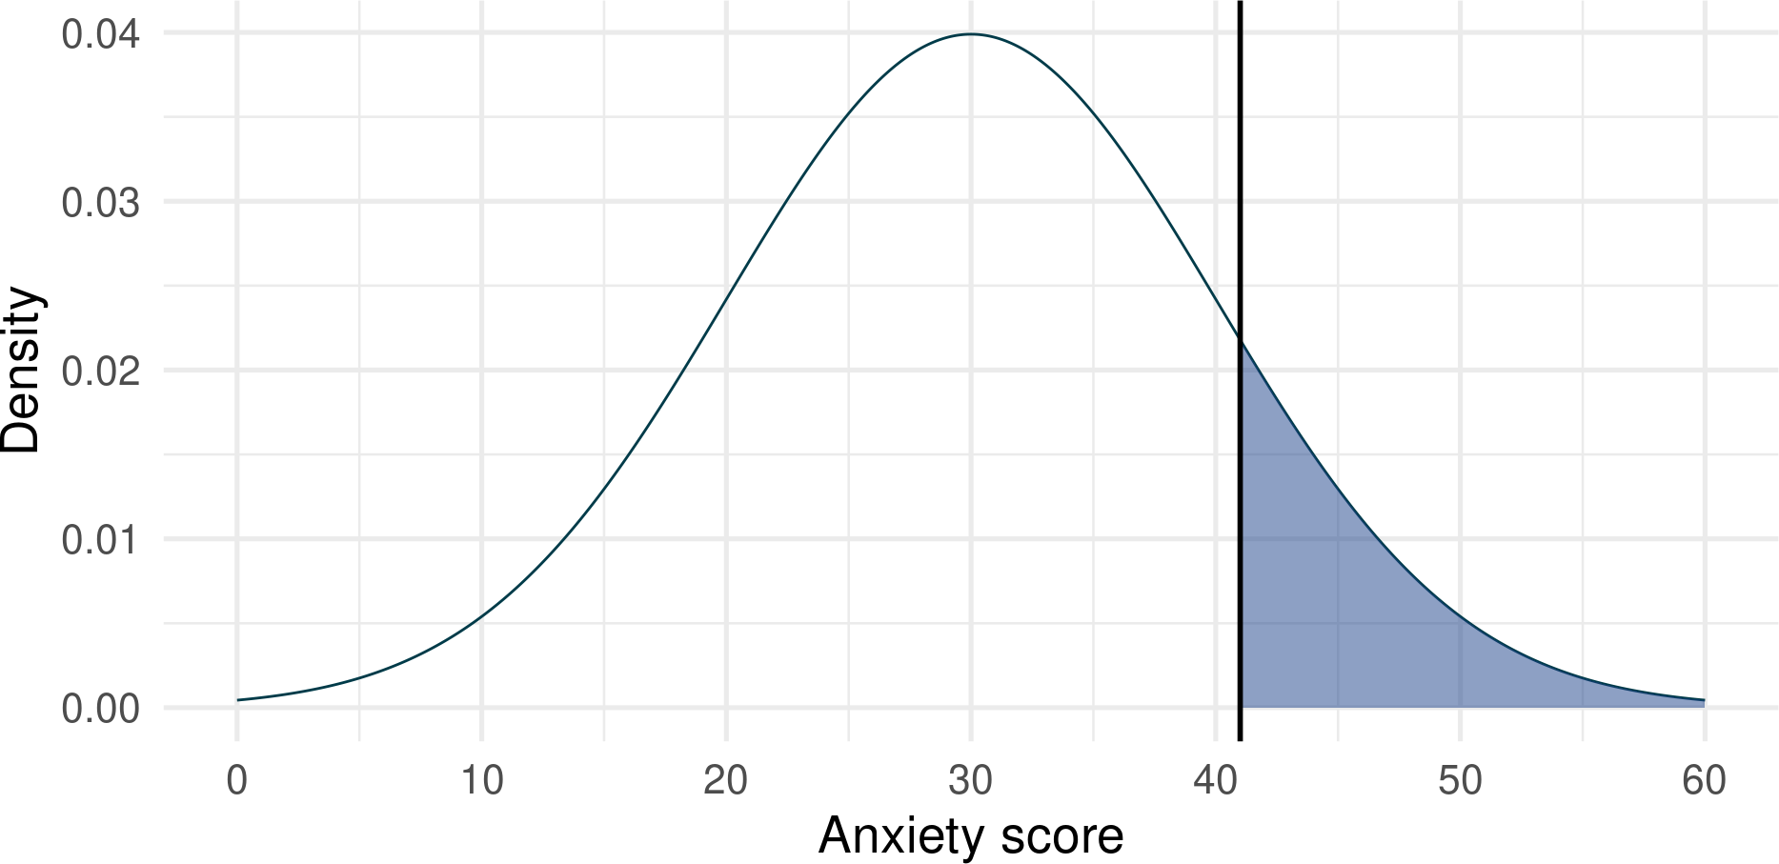
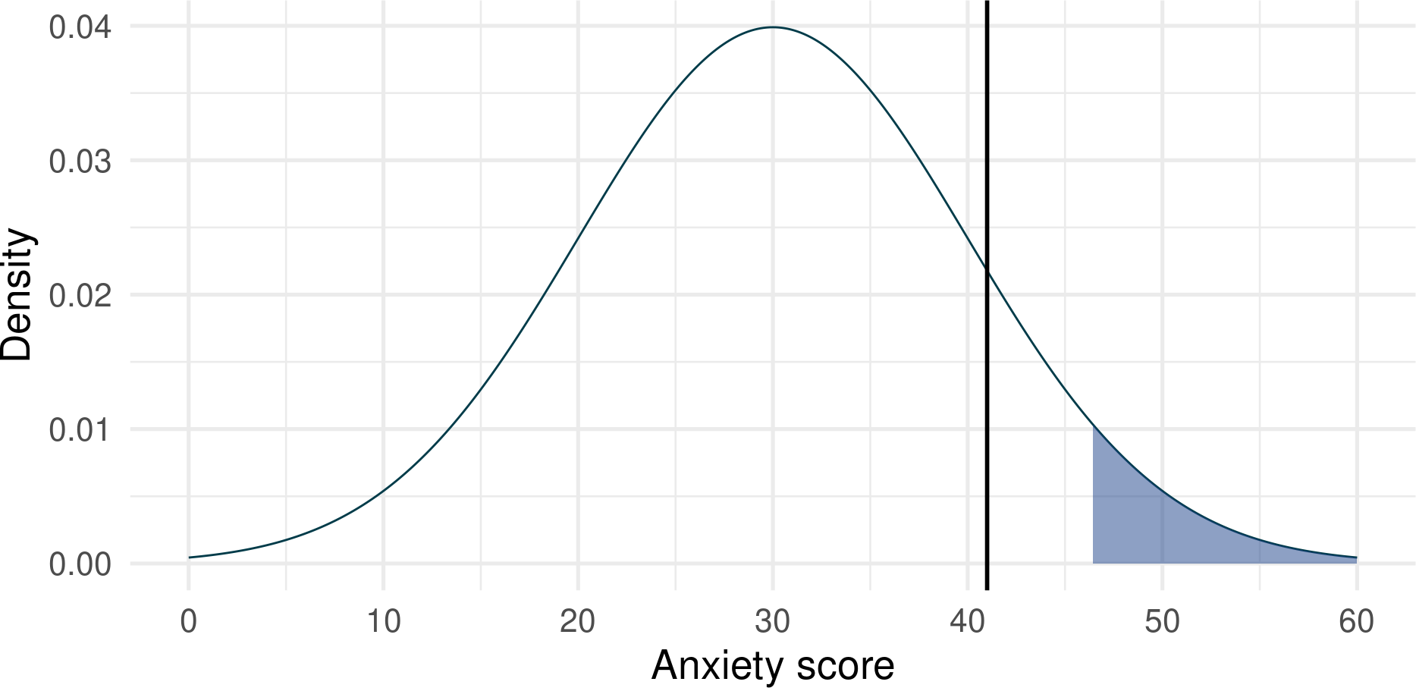
Recap
WEEK 2: Determining whether an individual’s score is unusual given a distribution with known characteristics.
If a population distribution of anxiety scores is normally distributed with a M = 30 and SD = 10, how common or unusual is an individual with a score of 41?
If a population distribution of anxiety scores is normally distributed with a M = 30 and SD = 10, what score would an individual need to get to be in the top 5%?
1 pnorm(41, mean = 30, sd = 10, lower.tail = FALSE)
1 qnorm(p = 0.95, mean = 30, sd = 10)
[1] 0.1356661
[1] 46.44854

Slide 6
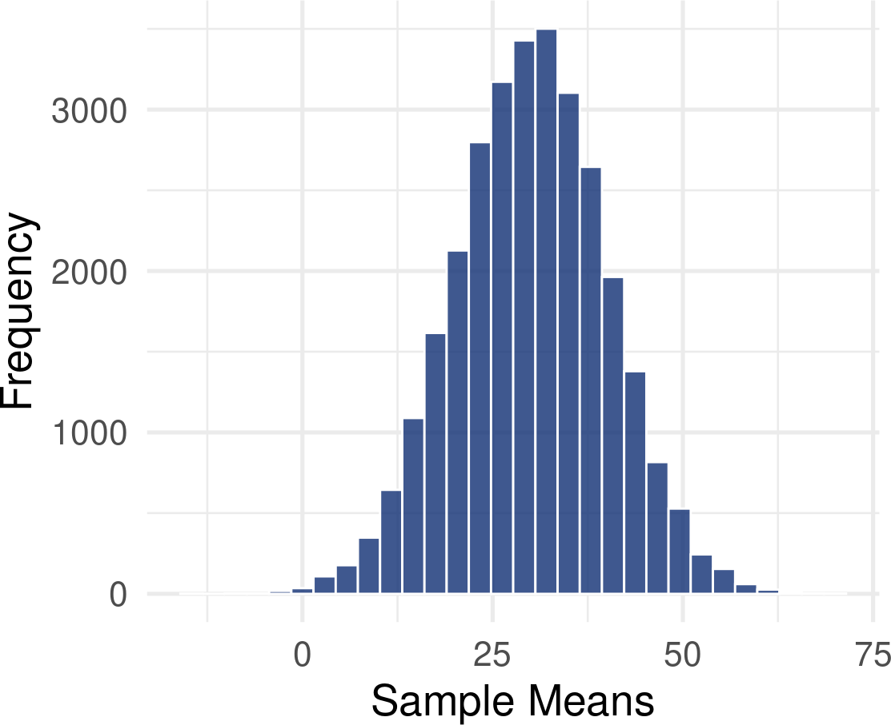
Recap
WEEK 3: Estimating population distribution properties from the sample and quantifying uncertainty around our estimates.
Sample estimate - best guess of the population parameter based on our samples
Sampling distribution -
Distribution of (infinite) sample estimates (e.g. means) - normal regardless of sample or population shape.
Centred on the population value

Slide 7
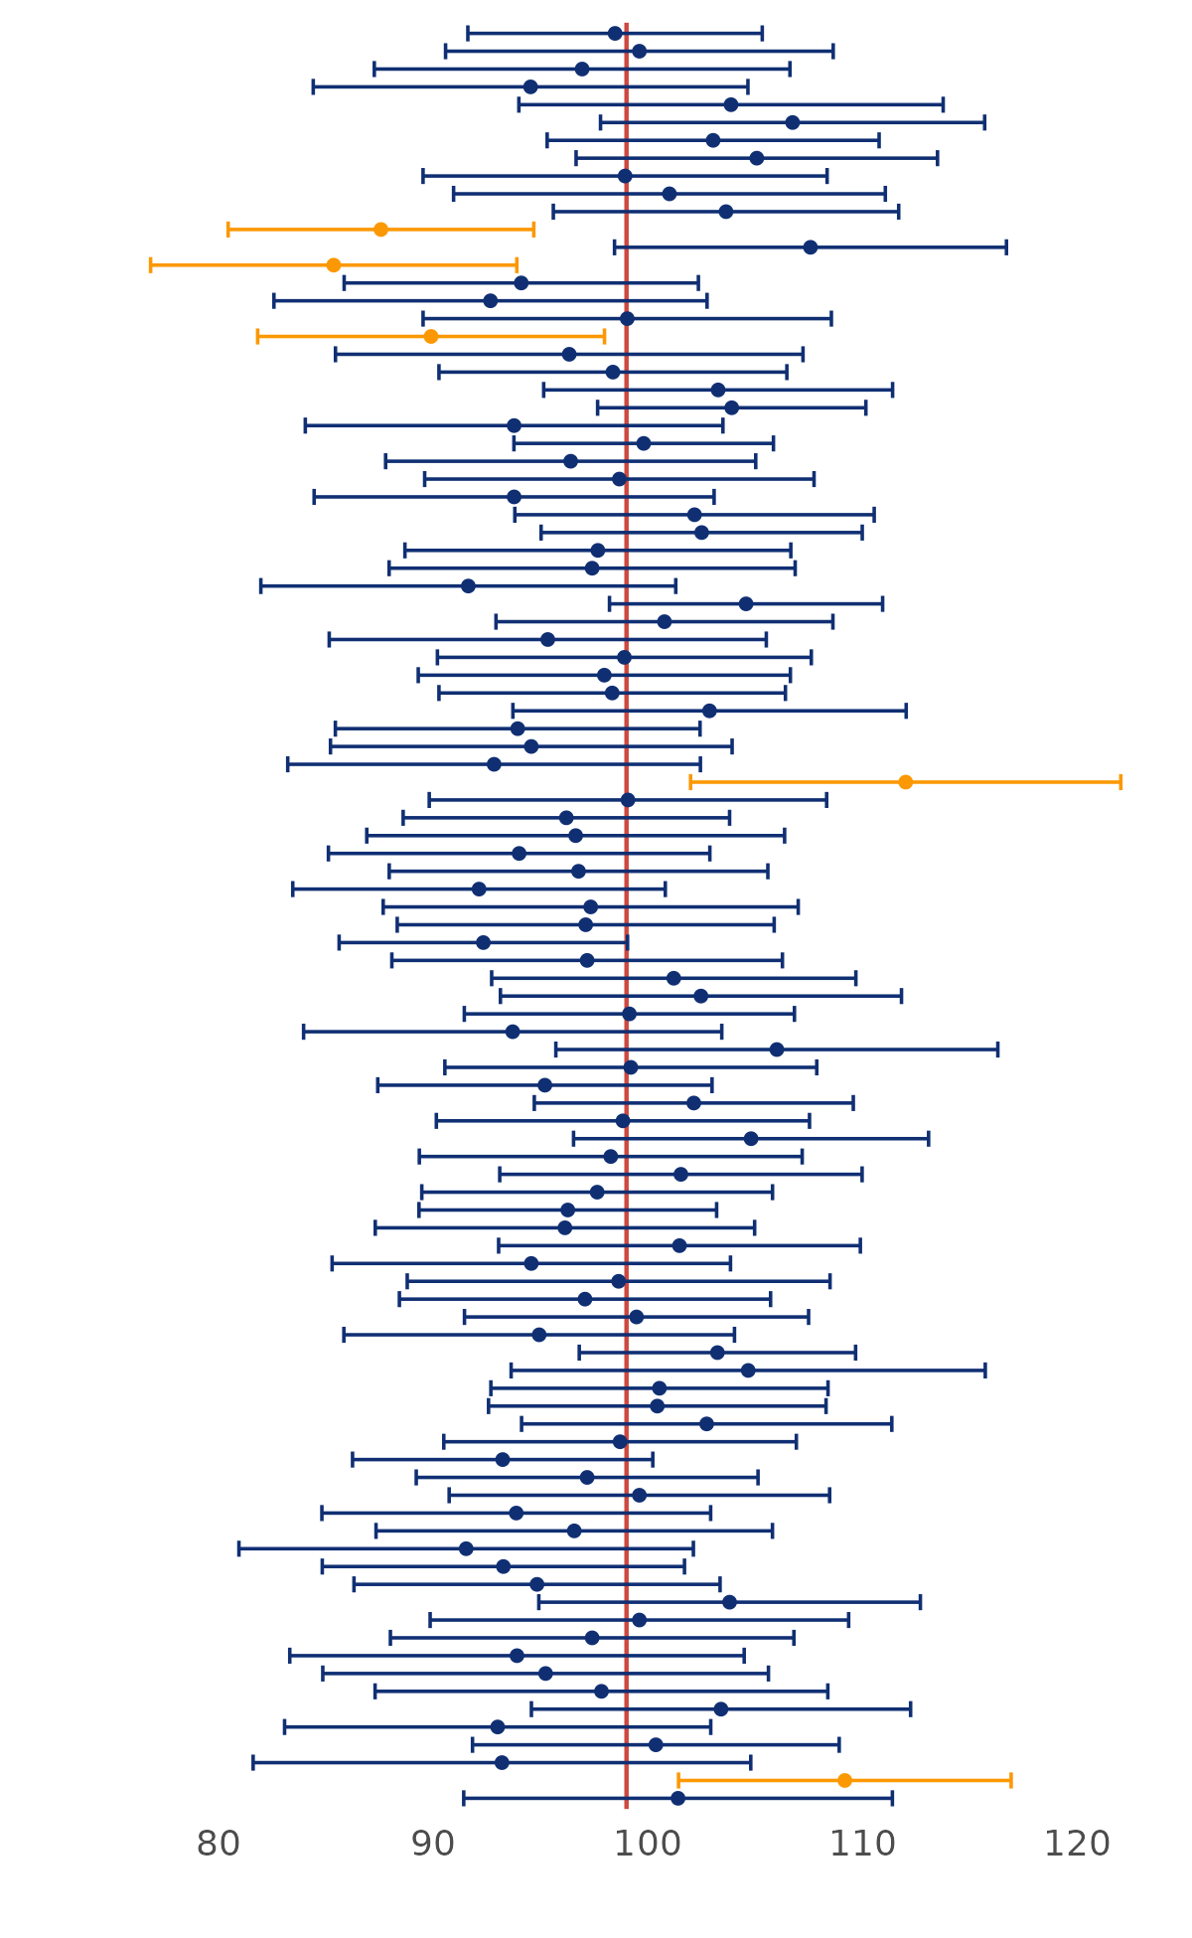
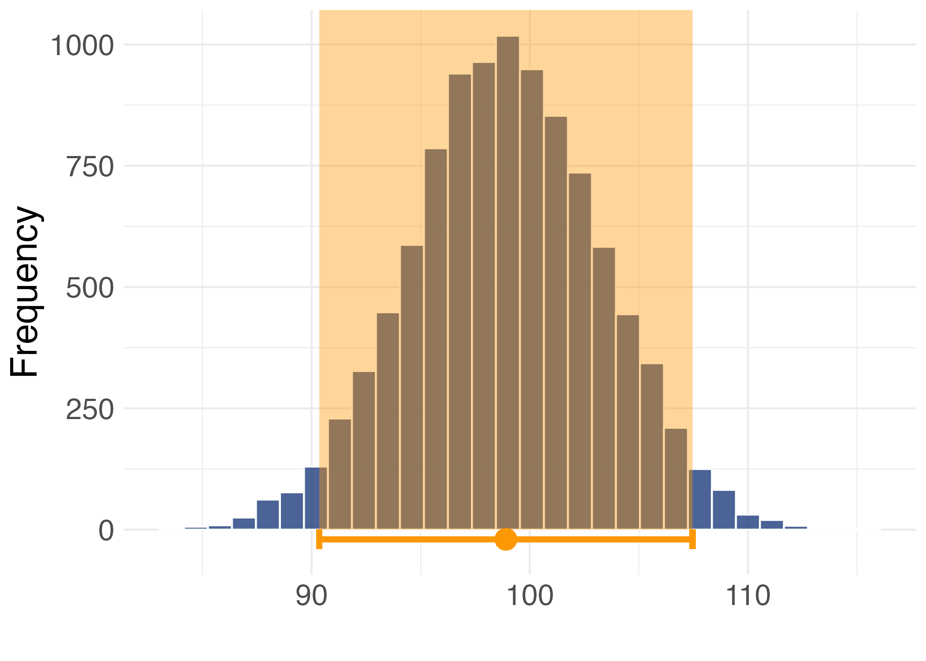
Standard error is the standard deviation of sample means in a sampling distribution
Recap
Constructing confidence intervals around our sample estimate.

Slide 8
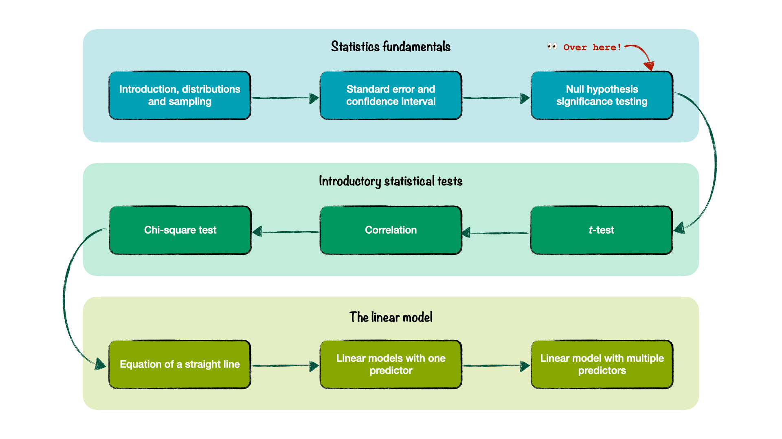
Where are we?

Slide 9
The research process

Slide 10
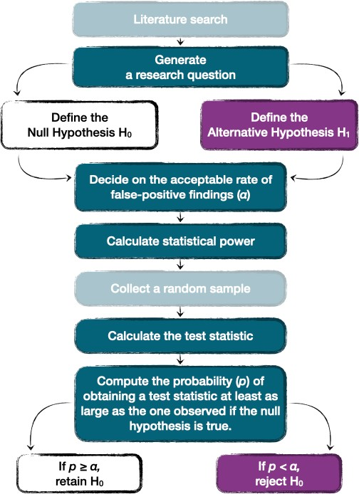
The (quantitative) research process

Slide 11
Confirmatory vs exploratory research
CONFIRMATORY RESEARCH
Hypothesis is determined before we run any statistical tests
Follows formula on the right.
“Null Hypothesis Significance Testing” (NHST)
Other approaches also exist

Slide 12
Confirmatory vs exploratory research
EXPLORATORY RESEARCH
No hypothesis prior to running tests
Useful for generating hypotheses, but statistical tests can be difficult to interpret.
You should still have some analysis plan specifying how you’re going to explore the data
Should be followed up with replication to confirm the findings.
Fishing for results
If you torture your data for long enough, some “findings” will emerge eventually. These findings will not necessarily be reliable.

Slide 13
Generate a research question
A good research question:
Researchable and realistic
Informed by the prior research (a gap in the literature or a need for replication)
Not too broad and not too narrow - proportional to the project at hand
What’s too broad for one project can be just right for another!

Slide 14



Generate a research question
How can we address the global mental health crisis? ❌ - Too broad
What are the key factors contributing to the mental health crisis among PhD students? (Woolston 2019) ✅ - Better!
Some other examples:
Can domesticated cats play fetch? (Forman, Renner, and Leavens 2023)
How do word frequency and semantic transparency influence synaesthetic colouring of compound words? (Mankin et al. 2016)
Can embedding statistical teaching within a fictional narrative help to reduce anxiety and increase comprehension? (Field and Terry 2018) What are the effects of breathwork on stress and mental health? (Fincham et al. 2023)
What are the roles of socioeconomic status, ethnicity and teacher beliefs in academic grading? (Doyle, Easterbrook, and Harris 2023) Can a digital intervention be helpful for individuals with subthreshold borderline personality disorder? (Drews-Windeck et al. 2022)

Slide 15
Define the hypotheses
A good research question allows us to generate testable predictions (hypotheses) that are relevant to our research aims.
Vocabulary
Hypothesis: A testable prediction - a statement about what we reasonably believe our data will show.
The prediction is based on some prior information (literature and prior research)
A hypothesis can be defined on different levels - conceptual, operational, statistical

Slide 16
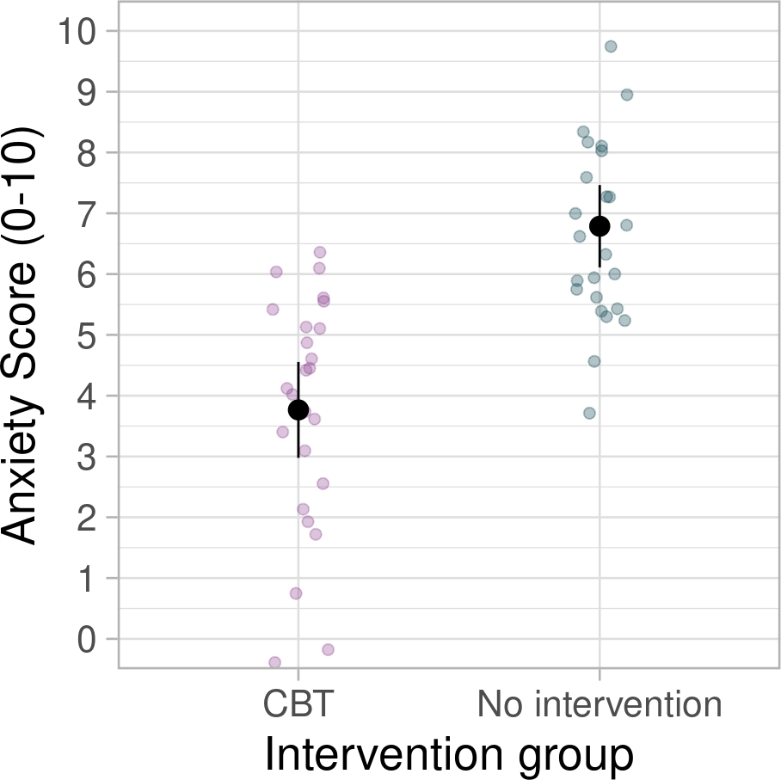
Define the hypotheses
CONCEPTUAL HYPOTHESIS
Describes our prediction in conceptual terms. Can be defined in terms of the direction of the effect that we’re studying:
Non-directional: “There will be differences in anxiety levels between participants in group A and group B”
Directional: “Participants in group A will show higher levels of anxiety than those in group B”

Slide 17
Define the hypotheses
OPERATIONALISATION - the process of translating concepts into measures - i.e. how are we going to measure the concepts that we’re studying?
CONCEPTUAL HYPOTHESIS ➞ OPERATIONAL HYPOTHESIS
“Participants in group A will show higher levels of anxiety than those in group B.”
“Participants in group A will score higher on the State-trait anxiety inventory than those in group B” OR:
“Participants in group A will show higher skin conductance response than those in group B”
STATISTICAL HYPOTHESIS
What do we expect to happen numerically? E.g.
𝑀 GroupA ≠ 𝑀 GroupB OR 𝑀 GroupA > 𝑀 GroupB

Slide 18
PollEverywhere: Operationalising variables
We’re interested in a relationship between wearing a hat and confidence.
How can we operationalise (merasure) someone’s confidence?
linktr.ee/analysingdata

Slide 19
Null vs alternative hypothesis
Once we know the operational hypothesis, we can define the null and the alternative hypotheses.
ALTERNATIVE HYPOTHESIS - our prediction, denoted as H₁.
NULL HYPOTHESIS - denoted as H₀. It represents the negation of the prediction that we’re making. Often describes a reality where the effect we’re interested in doesn’t exist.

Slide 20
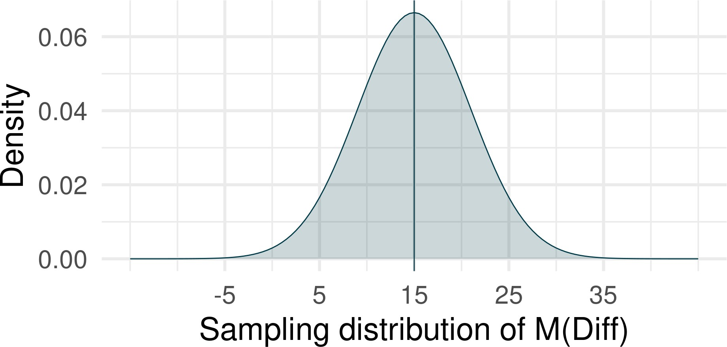
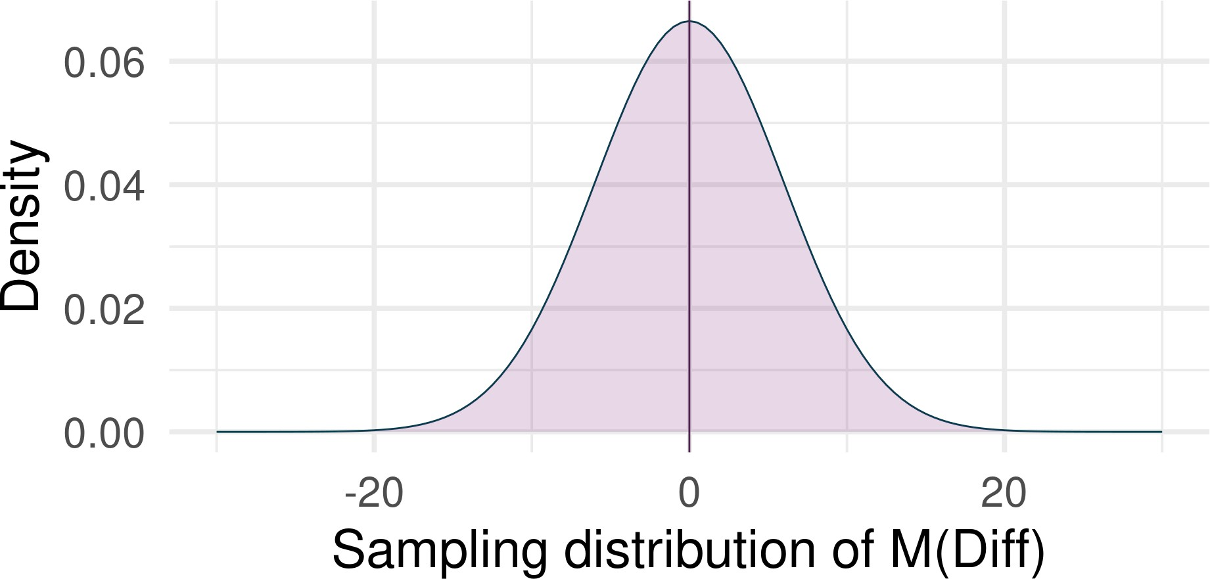
Two realities
Reality 1: H₁ is true
Effect we’re interested in exists. e.g. “There will be a difference in scores between group A and group B”
Sampling distribution is centred at the population value for this difference:
Reality 2: H₀ is true
Effect we’re interested in doesn’t exist. e.g. “There will be no difference in scores between group A and group B.”
Sampling distribution is centred at 0:

Slide 21
Two realities
Null Hypothesis Significance Testing
If H₀ is true, how likely/unlikely is the result (e.g. the group difference) we observed?
Can we reject H₀ based on what we observed in our data?
“Statistically significant result” - result that is sufficiently unlikely under the null hypothesis
Reality 2: H₀ is true
Effect we’re interested in doesn’t exist. e.g. “There will be no difference in scores between group A and group B.”
Sampling distribution is centred at 0:

Slide 22


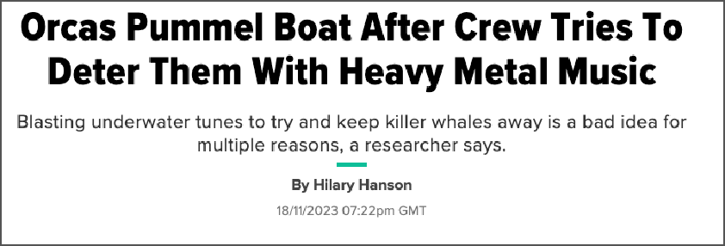
Example: Heavy metal orcas 🤘
Increased orca attacks on boats crossing the Gibraltar Strait Sailors started using heavy metal to deter them
Some (less than reputable) sources claim it works. Others advise against doing so!

Slide 23

Example: Heavy metal orcas 🤘
RESEARCH QUESTION: Does heavy metal music affect hostile behaviour in orcas?
Boat 1: Martina is blasting heavy metal music
Boat 2: Jennifer is blasting Shrek music (control group)
CONCEPTUAL HYPOTHESIS: Playing heavy metal music will be associated with reduced hostility in orcas.
Reduced hostility in orcas ➞
Shorter orca attack duration
OPERATIONAL HYPOTHESIS: Playing heavy metal music will be associated with shorter orca attack duration compared to Shrek music.

Slide 24
Our hypotheses
H₁: Orca attacks will be signif,cantly shorter when playing heavy metal music compared to playing Shrek soundtracks.
H₀: There will be no signif,cant difference in attack duration between the two music styles.

Slide 25
Our hypotheses
STATISTICAL HYPOTHESES:
H₁:
𝑀 (Shrek) − 𝑀 (Metal) ≠ 0
𝑀 (Shrek) > 𝑀 (Metal)
H₀:
𝑀 (Shrek) − 𝑀 (Metal) = 0
𝑀 (Shrek) = 𝑀 (Metal)

Slide 26
Decide on the α (alpha) level
𝛼α level - the rate of false-positive findings that we’re willing to accept if we’re living in a reality where the null hypothesis is true.
If we were to repeat our experiment over and over again, how often are we willing to incorrectly reject the null hypothesis?¹
The decision should be based on a cost benefit analysis - how risky is it to be wrong?
Psychologists often use the 𝛼α rate of 5% as a blanket rule with no justification ¯\_(ツ)_/¯

Slide 27
Calculate statistical power
It’s a way of deciding how large a sample you need to get meaningful results on a statistical test.
Let’s come back to this later!

Slide 28
Calculate the test statistic
Some numeric value that we use to test the hypothesis
There are different test statistics for different situations.
Some examples you might see reported in a paper: t, F, 𝜒2χ2
In our case, we can look at the mean difference between the two music styles i.e.:
𝑀𝐷𝑖𝑓𝑓=𝑀(𝑆ℎ𝑟𝑒𝑘)−𝑀(𝑀𝑒𝑡𝑎𝑙)

Slide 29
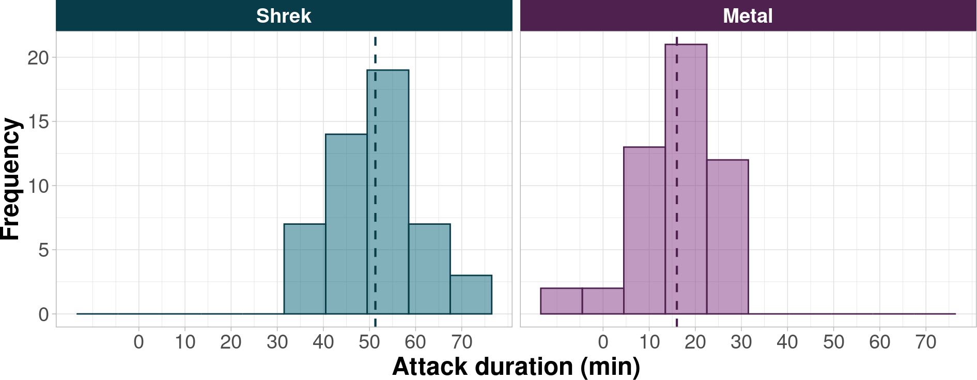
Calculate the test statistic
Example 1:
𝑀 𝐷𝑖𝑓𝑓 = 𝑀 (𝑆ℎ𝑟𝑒𝑘) − 𝑀 (𝑀𝑒𝑡𝑎𝑙)
𝑀 𝐷𝑖𝑓𝑓
= 51.28 − 16.00 = 35.28
Over 35 minutes of different is quite a lot!

Slide 30
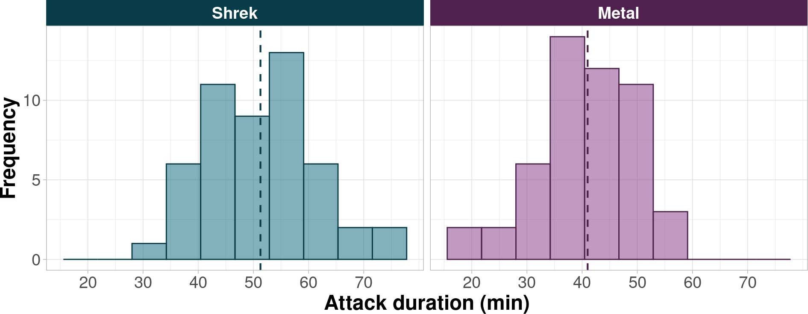
Calculate the test statistic
Example 2:
𝑀 𝐷𝑖𝑓𝑓
𝑀 𝐷𝑖𝑓𝑓
= 𝑀 (𝑆ℎ𝑟𝑒𝑘) − 𝑀 (𝑀𝑒𝑡𝑎𝑙)
= 51.28 − 41 = 10.28
How about this difference? Large? Small? Could we realistically find this difference if the null hypothesis is true?

Slide 31
p-values

Slide 32
Compute the p-value
H₀: There will be no significant difference in attack duration between the two music styles.
We want to know the probability of observing the test statistic at least as large as the one we observed if the null hypothesis is true - the p-value.
In our case, the “test statistic” is the mean difference between the two groups.
What kind of difference would we expect to find if there the null hypothesis is true?

Slide 33
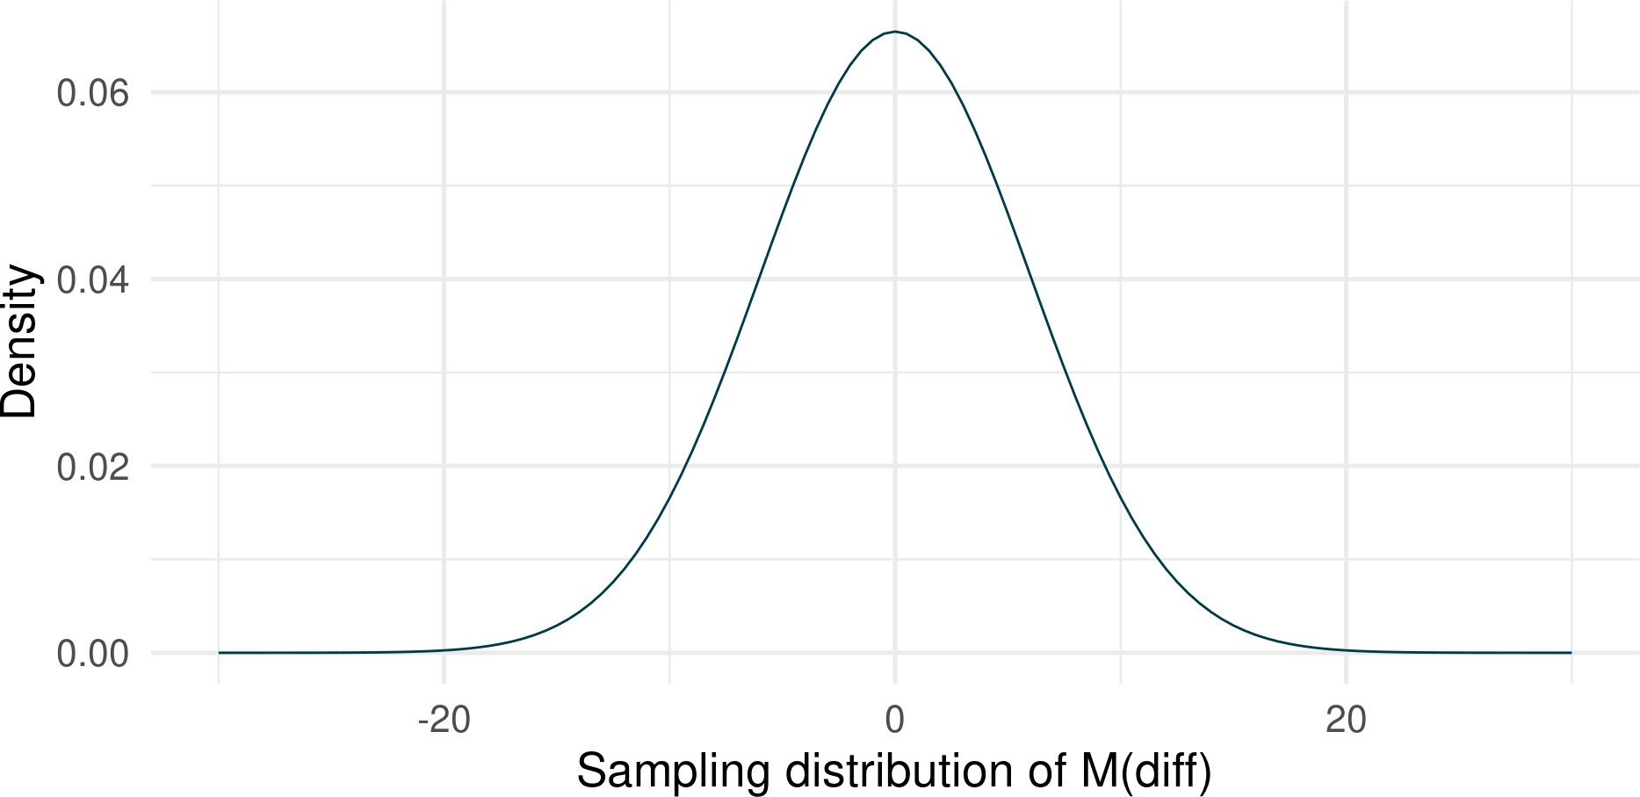
Compute the p-value
If the null hypothesis is true, we would expect a difference of 0
But we’re taking a random sample - so 0 is the most probable value under the null hypothesis but other values are also possible.

Slide 34
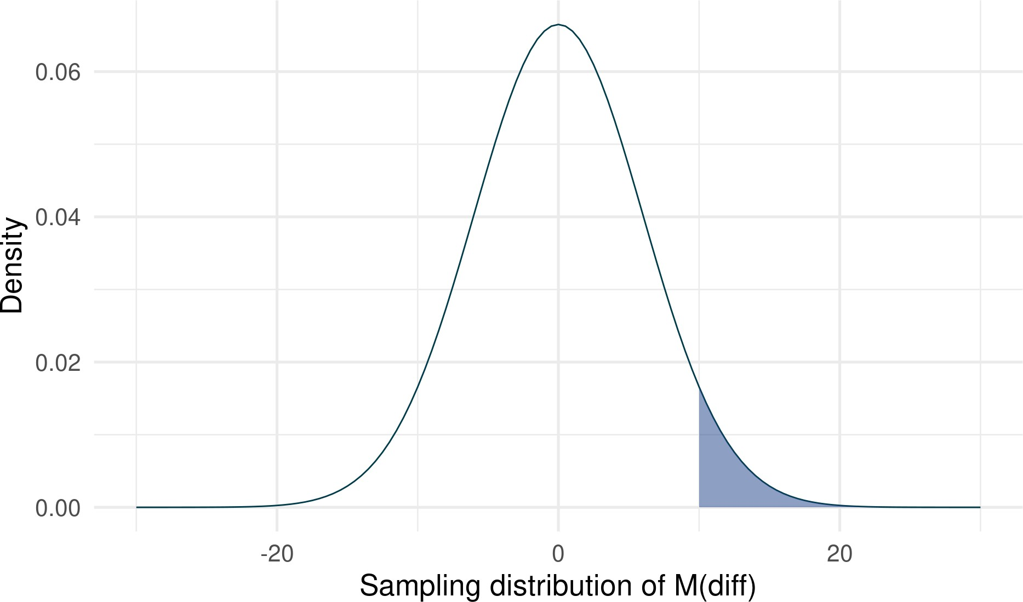
Compute the p-value
The difference in attack duration between Shrek music and Metal music detected in our sample was equal to 10.28.
Familiar territory: Given a normal sampling distribution centred at 0, how common is the value of 10.28 ?
The shaded proportion is 0.05 - top 5% of possible samples

Slide 35
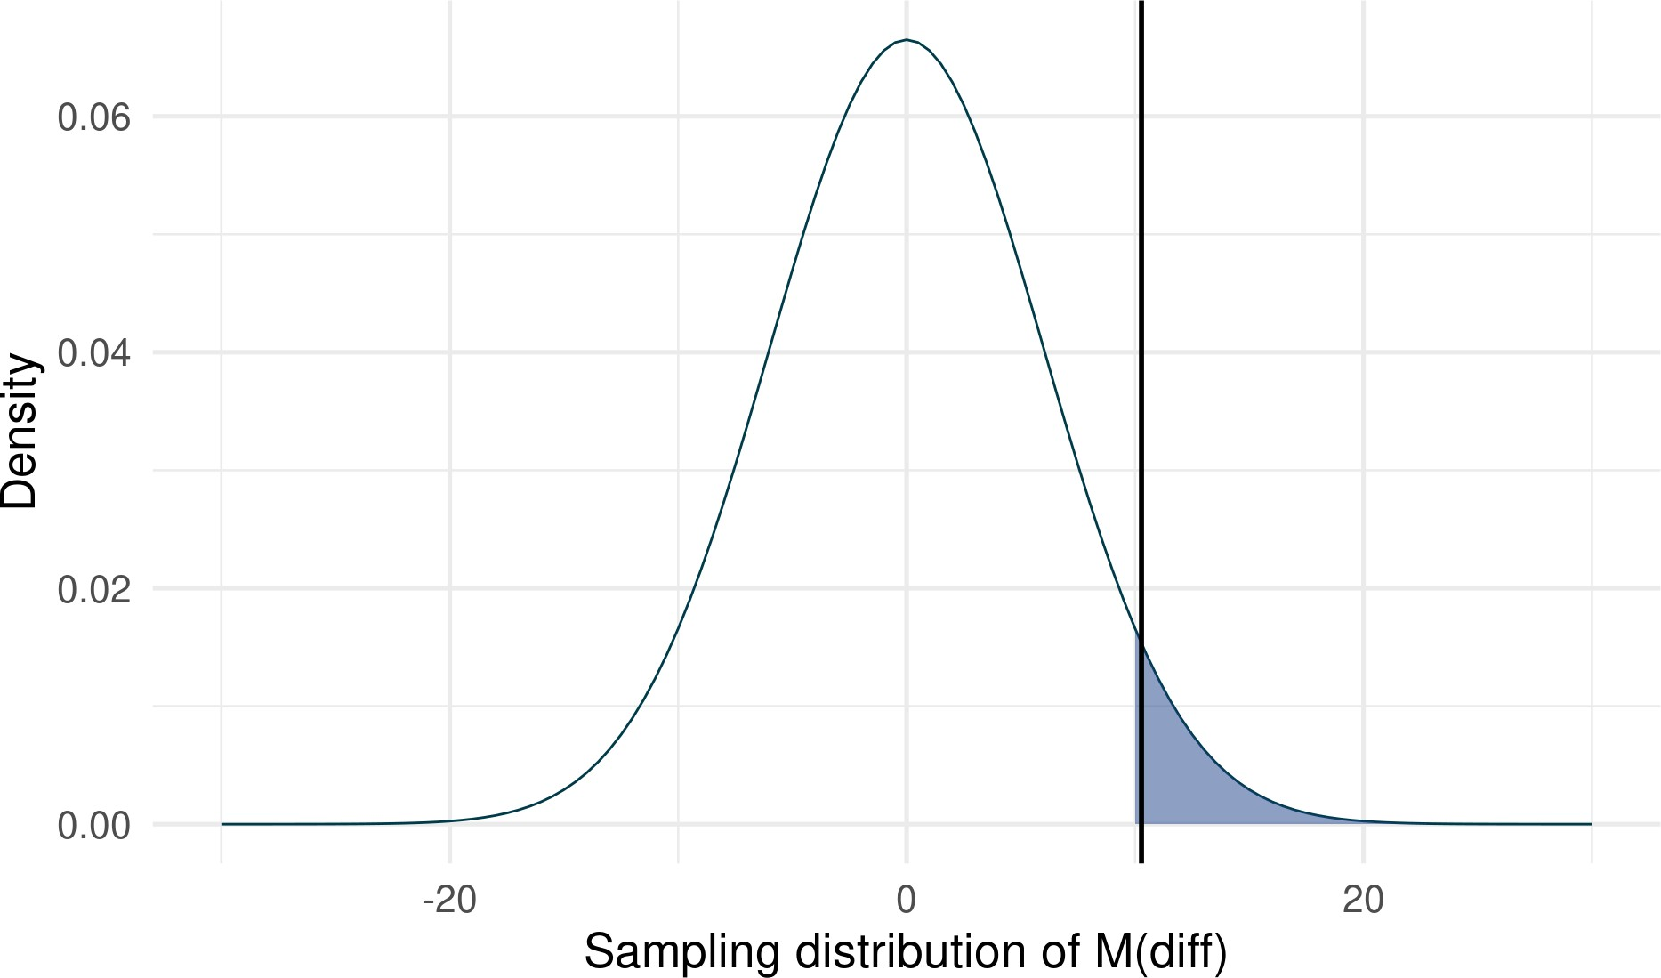

Compute the p-value
The probability of obtaining difference of 10.28 under the null hypothesis is 0.043 × 100 = 4.3%.
Therefore, given a distribution centred at 0, we would expect to find a difference of 10.28 in 4.3% of cases
Vocab
p-value: The probability of observing a test statistic at least as large as the one observed if the null hypothesis is true.
1 pnorm(10.28, mean = 0, sd = 6, lower.tail = FALSE)
[1] 0.04332562

Slide 36
Retain or reject the null hypothesis
H₀: There will be no significant difference in attack duration between the two music styles.
Critical 𝛼α: 5% (0.05 in probability terms)
To reject the null hypothesis, the probability of obtaining our test statistic (10.28) under the null hypothesis needs to be less than the critical 𝛼α
Our p-value was 0.043
0.043 is smaller than 0.05 ➞ we reject the null hypothesis and conclude that this difference is statistically significant at 𝛼α of 0.05.

Slide 37
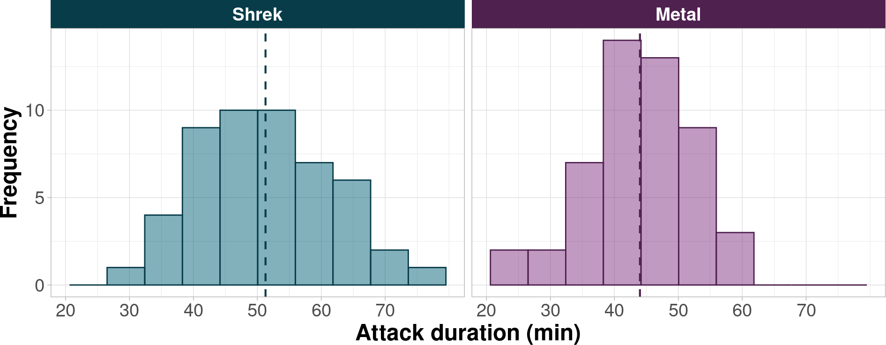
One more example…
Example 3:
𝑀 𝐷𝑖𝑓𝑓 = 𝑀 (𝑆ℎ𝑟𝑒𝑘) − 𝑀 (𝑀𝑒𝑡𝑎𝑙)
𝑀 𝐷𝑖𝑓𝑓
= 51.28 − 44 = 7.28

Slide 38
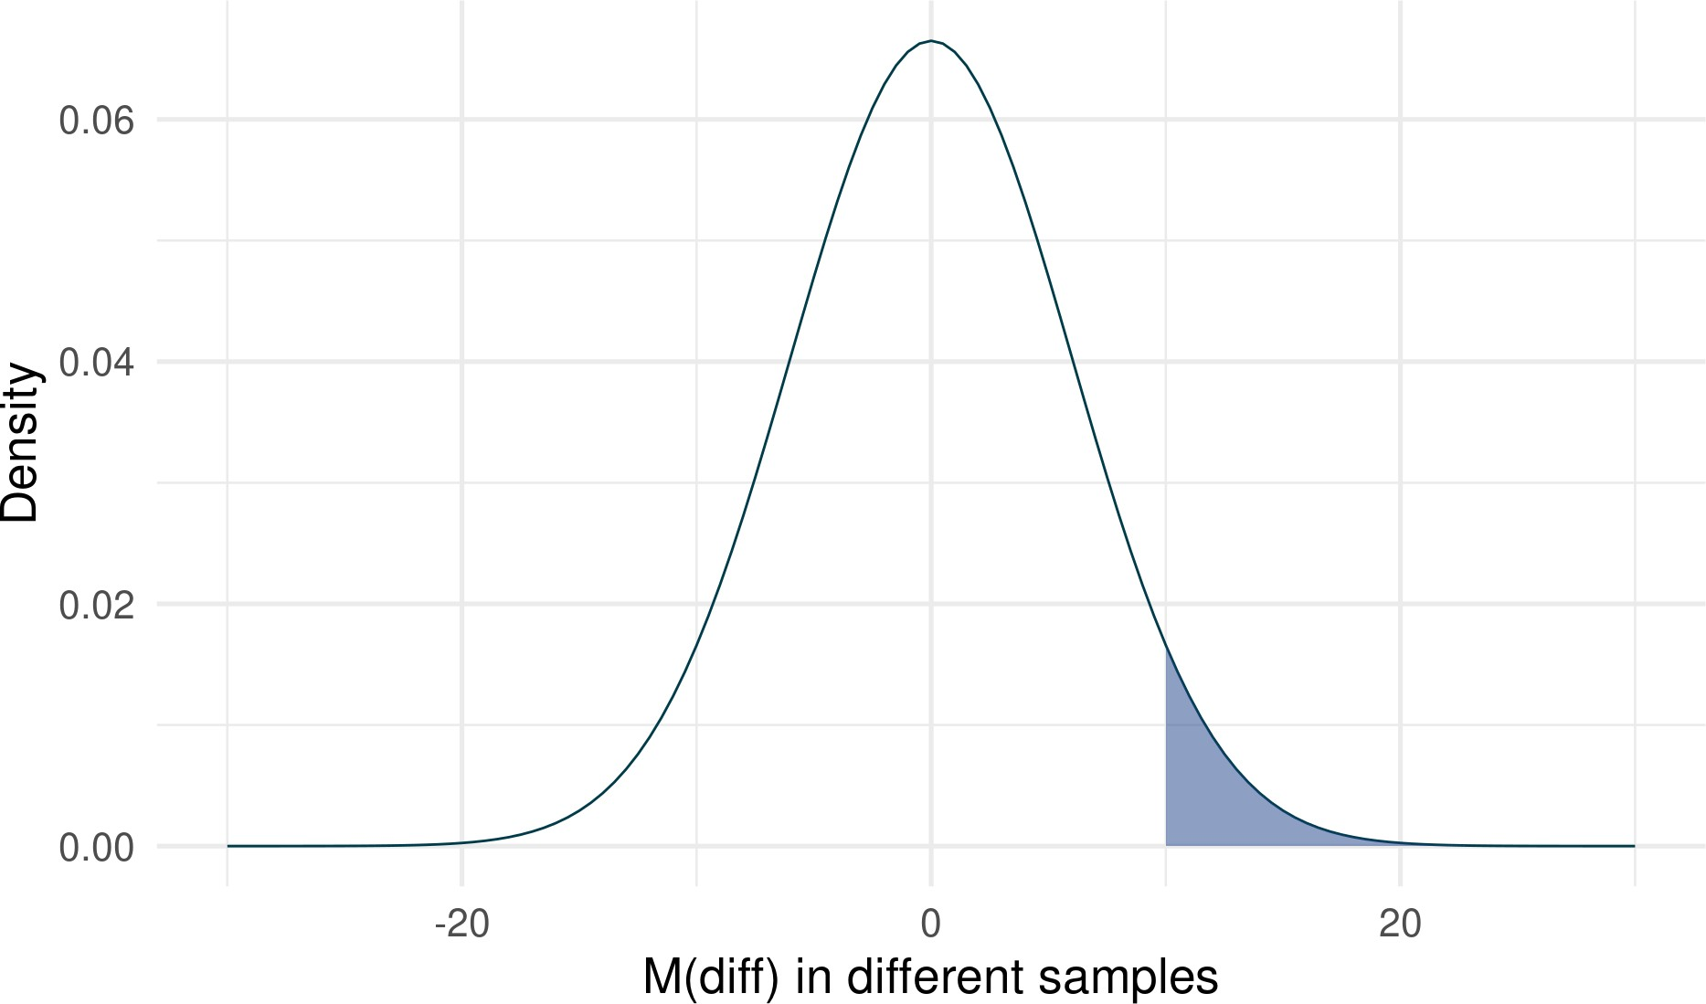
One more example…
Shaded area is top 5%
The probability of finding a difference of 7.28 in a distribution centred at 0 is 0.112 (or in 11.2% of samples)
Is the difference of 7.28 in the shaded area?
1 pnorm(7.28, 0, 6, lower.tail = FALSE)
[1] 0.1125012

Slide 39
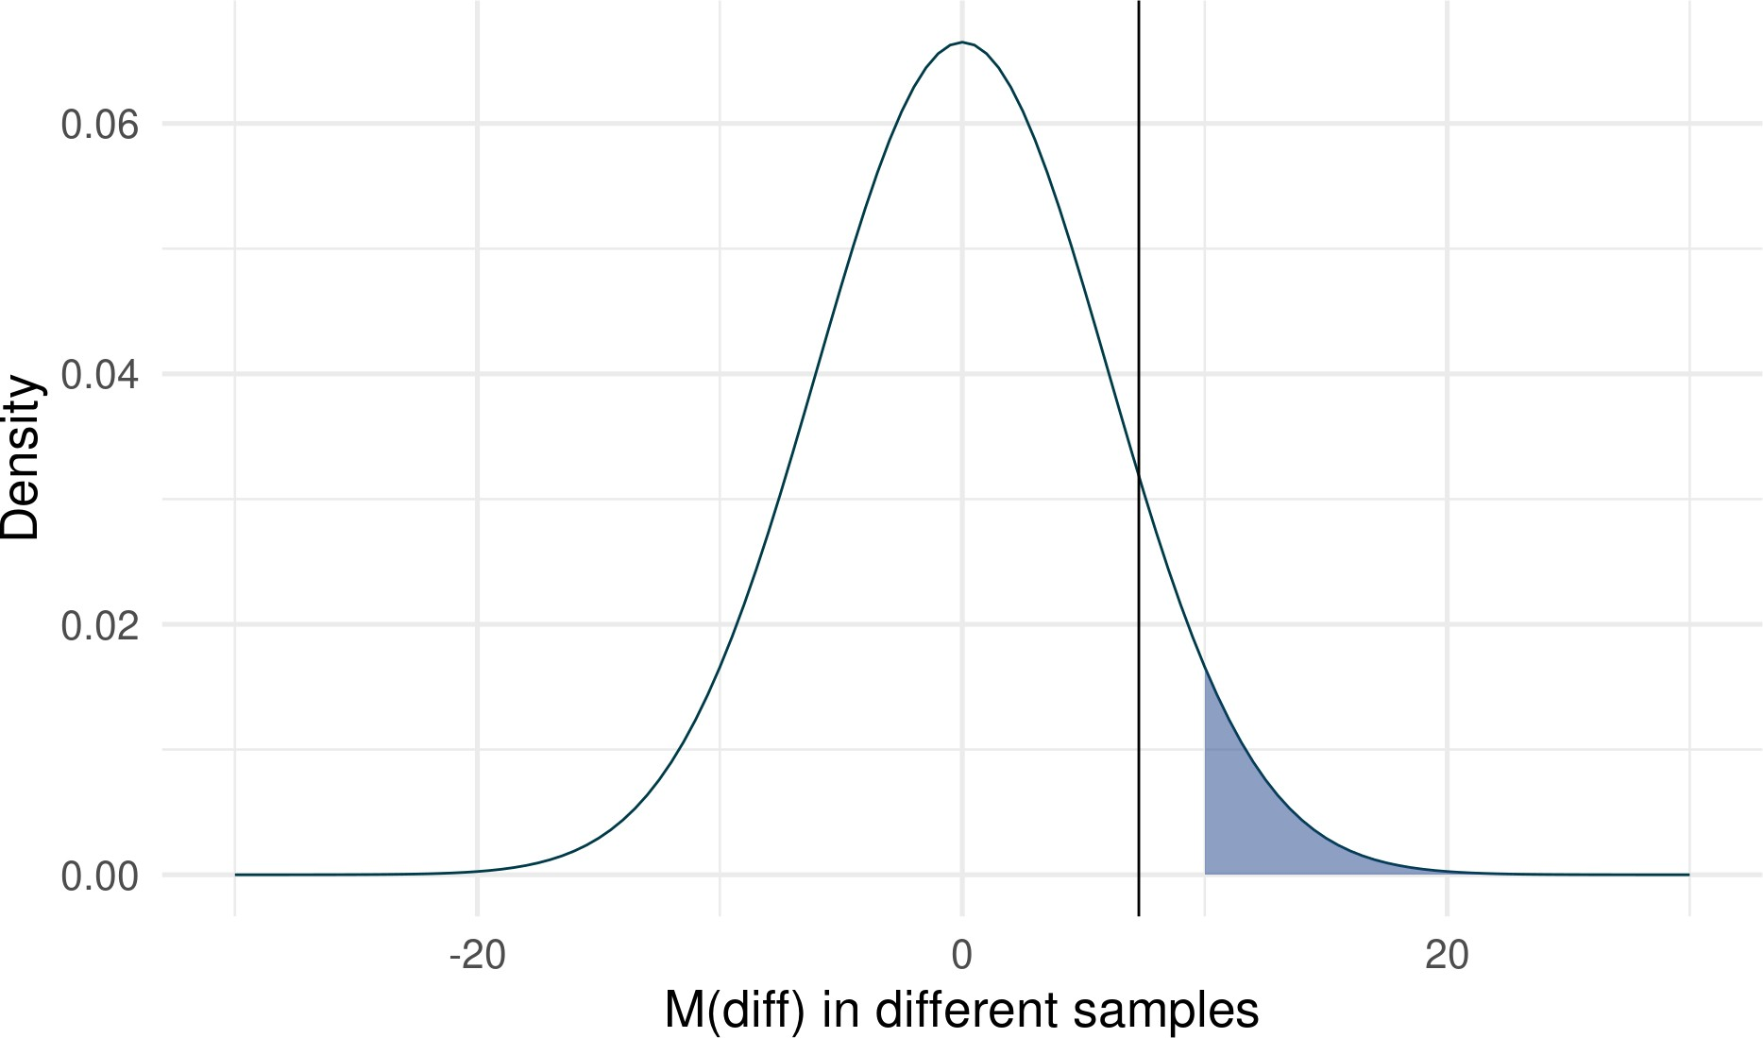
One more example…
The value of 0.11 is greater than 0.05, which is our acceptable threshold of false-positives.
The difference between the means we detected (M_{Diff} = 7.28) is not considered statistically significant at 𝛼 of 0.05. We therefore cannot reject the null hypothesis.
1 pnorm(7.28, 0, 6, lower.tail = FALSE)
[1] 0.1125012

Slide 40
PollEverywhere
Practising statistical significance
linktr.ee/analysingdata

Slide 41
Let’s practice (1)
We set the alpha level to be 0.05 (or 5%)
After receiving an intervention, a group of patients reports average anxiety score of 25. The control group reports a score of 31, M_{diff} = 6
If the null hypothesis is true, probability of finding a difference of 6 is p = 0.02, or 2%. Is this difference statistically significant?

Slide 42
Let’s practice (2)
We set the alpha level to be 0.05
We randomly sample and find that individuals who spend time with puppies report stress levels of 16, while individuals without puppies report stress levels of 19, M_{diff} = 3
We work out that: p = 0.04
Is this difference statistically significant?

Slide 43
Let’s practice (3)
Reported in a journal:
Participants in the active control group (M = 645, SD = 112) showed slower reaction times in milliseconds compared to those in the intervention group (M = 598, SD = 132), M_{diff} = 47, p = 0.073.
We set the alpha to be 0.05
Is this difference statistically significant?

Slide 44


What if we’re wrong?
Type I error: False-positive
Concluding that an effect exists when it doesn’t
Incorrectly rejecting the null hypothesis
Type II error: False-negative
Concluding that an effect doesn’t exist when it does
Failing to reject the null hypothesis

Slide 45
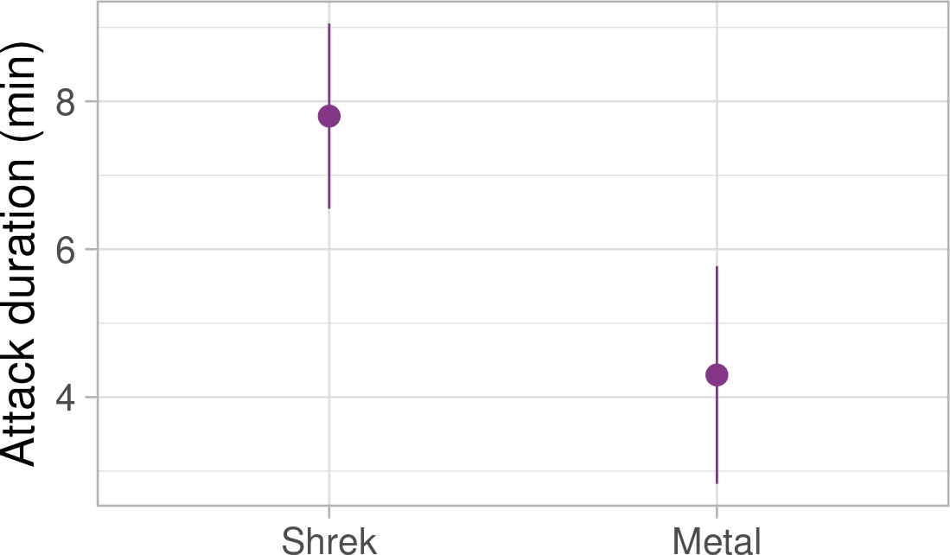
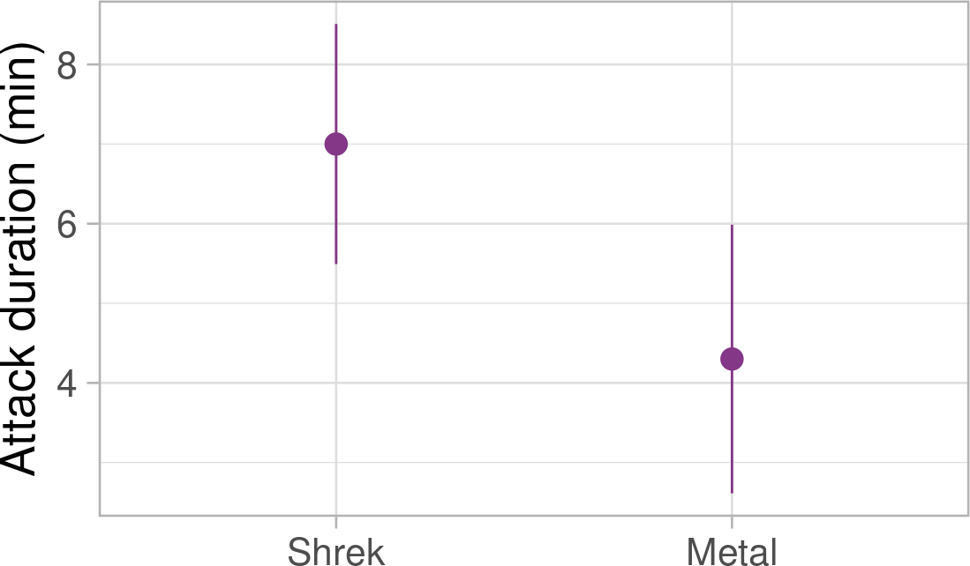
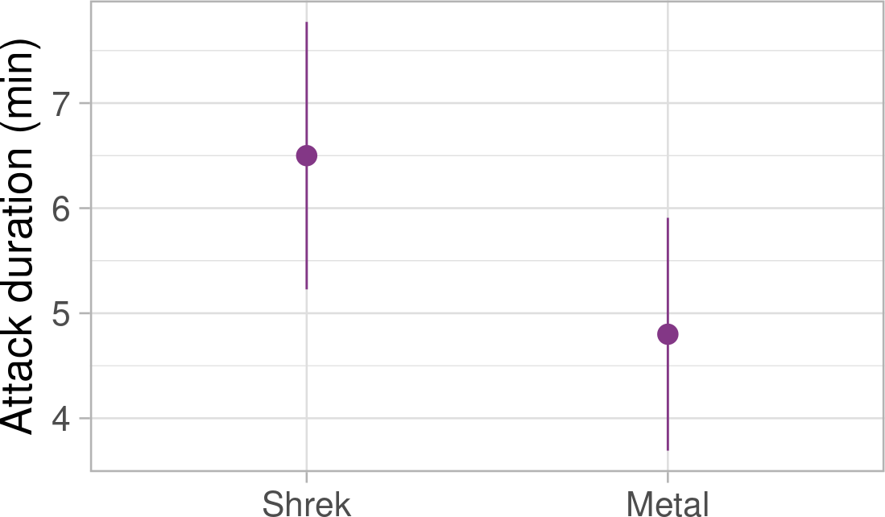
P-values and confidence intervals
Closely interlinked concepts
Extent of overlap of confidence intervals is indicative of statistical (non) significance

Slide 46
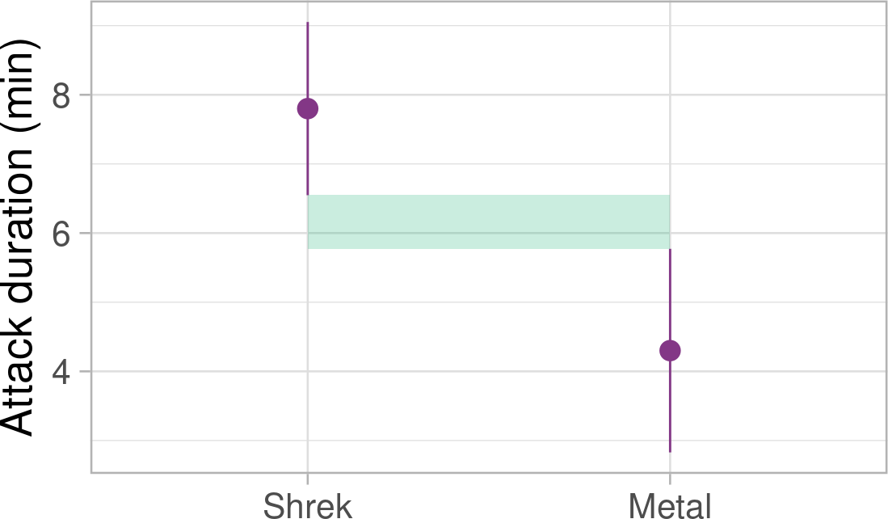
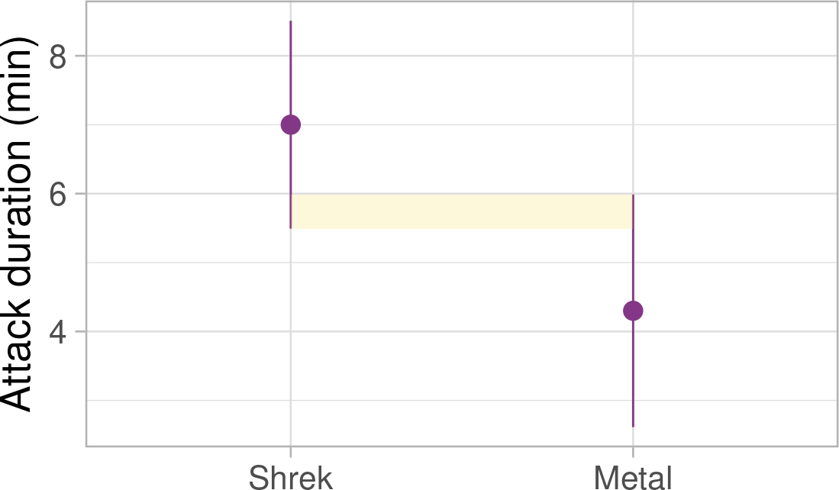
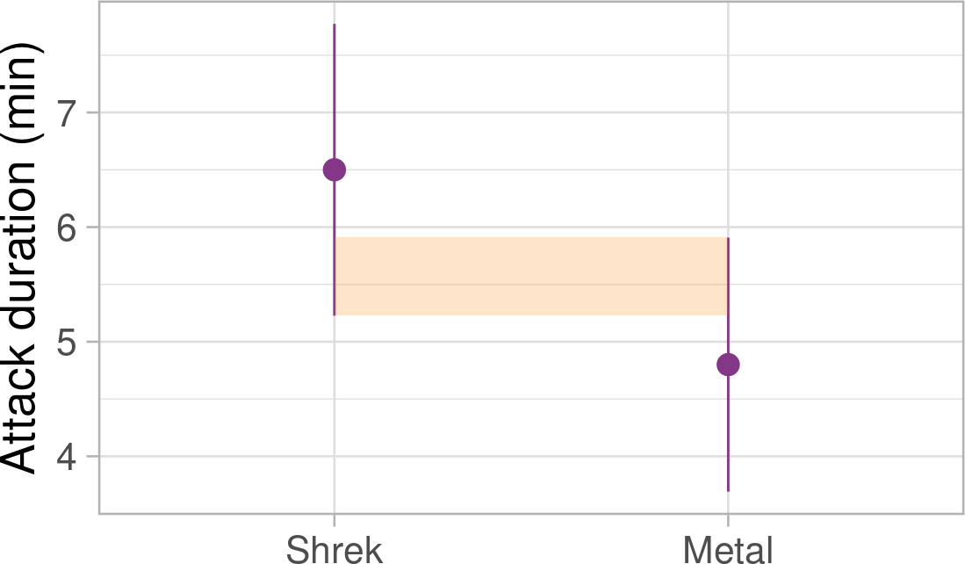
P-values and confidence intervals
Closely interlinked concepts
Extent of overlap of confidence intervals is indicative of statistical (non) significance
No overlap - statistically significant
Up to half the length of CI whisker overlap statistically significant p < 0.05 About a half overlap - p value close to 0.05

Slide 47
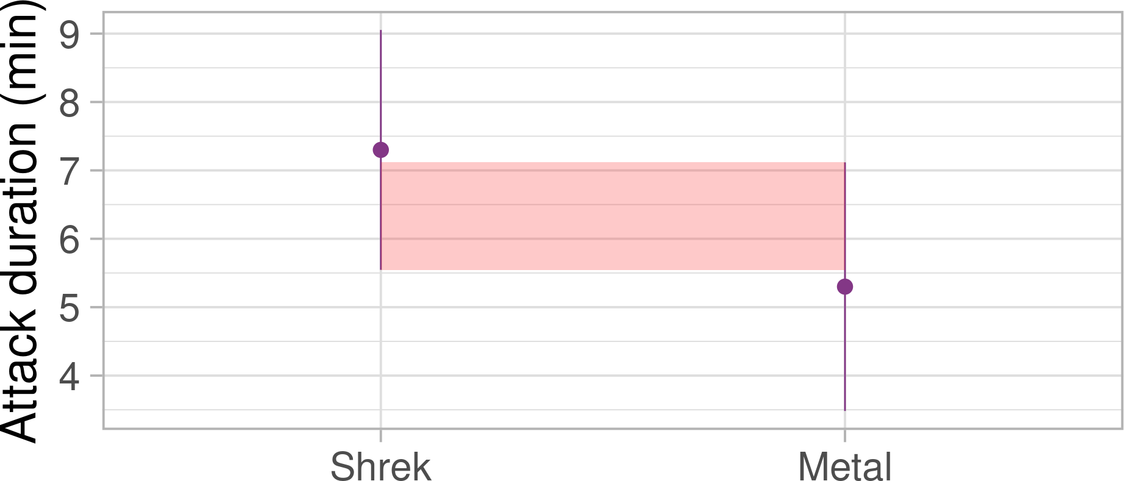
P-values and confidence intervals
More than half CI whisker overlap - non-significant

Slide 48
Interpreting p-values

Slide 49
Interpreting p-values
Tip
p-value is the probability of obtaining a test statistics at least as large as the one observed if the null hypothesis is true.
If the p-value is smaller than some pre-defined 𝛼 cut-off (often 0.05), we reject the null hypothesis Like confidence intervals, p-values should be interpreted in the context of wider research
If the effect (difference in means, correlation, etc.) is really 0, we can still find a whole range of effects in different samples because of random sampling.
With p-values, we’re answering the question: “If the sampling distribution of this effect is centered at 0, how probable is the effect that we found in our sample”?

Slide 50
PollEverywhere:
What even are p-values?
linktr.ee/analysingdata

Slide 51

🚨 Some INCORRECT definitions of p-values 🚨
Many(!) researchers find p-values difficult to interpret (Haller and Krauss 2002)
Warning
The p-value is NOT the probability of a chance result.
Warning
The p-value is NOT the probability of the alternative hypothesis being true.
Warning
The p-value is NOT the probability of the null hypothesis being true.

Slide 52
The inverse probability fallacy
Warning
The p-value is NOT the probability of the null hypothesis being true.
p-value doesn’t tell us anything about the probability of null or alternative hypothesis. It tells us how likely the detected effect is IF the null is true.
We don’t know whether the null is true or not
Other statistical approaches - like Bayesian hypothesis testing - can tells more about the probability of null/alternative hypothesis, but we don’t cover them on this module.

Slide 53
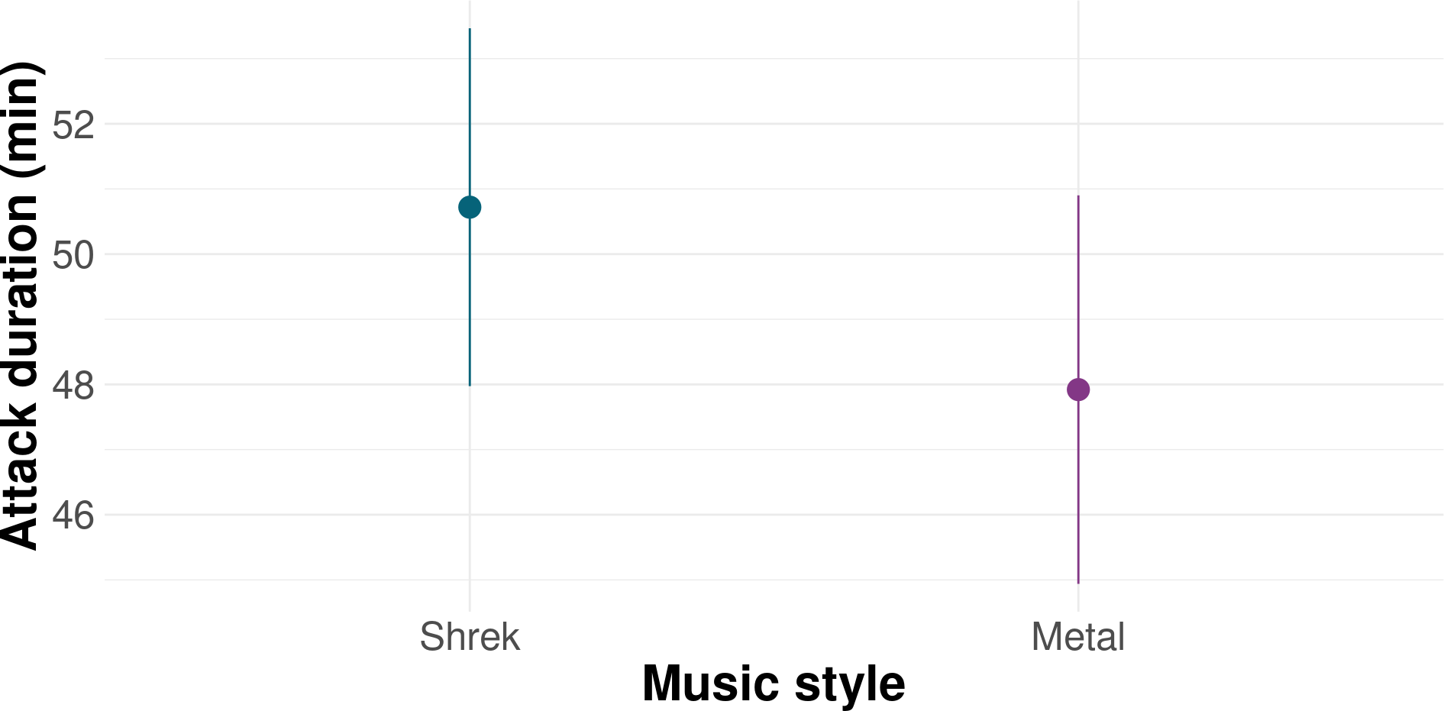
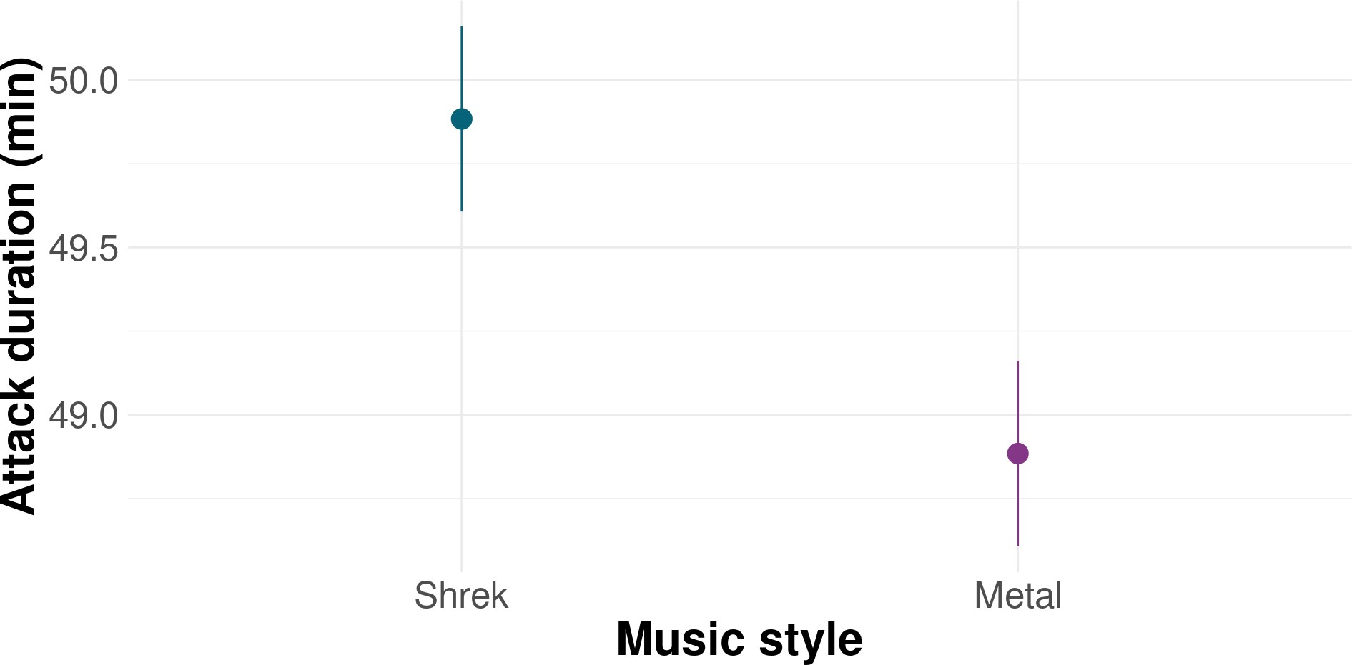
Some pitfalls of NHST
p-values are sensitive to sample size - any tiny difference can be statistically significant with large enough sample
𝑛 = 50
= 2 minutes
𝑛 = 10000
𝑀 𝐷𝑖𝑓𝑓
𝑀 𝐷𝑖𝑓𝑓
= 2 minutes
𝑝 = 0.17
𝑝 = 0.0000006

Slide 54
Some pitfalls of NHST
All or nothing thinking - is there a practical difference between 0.049 and 0.051?
🥳 “The mean difference between the groups was statistically significant,
M_{Diff} = 10.4, p = 0.049.”
🥴 “The mean difference between the groups was not statistically significant,
M_{Diff} = 10.2, p = 0.051.”
🤯 “The mean difference between the groups was *&%@@!%)£)@)! !&^%_()!(!,
M_{Diff} = 10.3, p = 0.05.”
A non-significant result is still a result

Slide 55
Getting the most out of p-values
EFFECT SIZES - how large/meaningful is the effect (e.g. mean difference or other estimate) that we found
E.g. a group difference of 2 of a scale 1-10 vs same group difference on a scale 1-100
CONFIDENCE INTERVALS - what are the plausible limits of our effect?
POWER ANALYSIS - determining the necessary sample size before we begin data collection

Slide 56
Power analysis
POWER ANALYSIS - determining the necessary sample size before we begin data collection to make sure we don’t under- or over-sample
STATISTICAL POWER - the probability of detecting an effect of a certain size as statistically significant, assuming the effect exists.
We assume a certain effect size - say that we’re only interested in an effect if it’s at least a difference of 10 minutes between Metal and Shrek music
We calculate the sample size necessary to detect this effect.
More participants are needed for (1) smaller effects and (2) complicated designs

Slide 57
Power analysis
Power analysis makes non-significant effects easier to interpret
Reduces the probability of missing an important finding (false-negative finding)¹
Reduces over-sampling and wasting resources
Generally, a statistical power of 80% is considered the standard to aim for

Slide 58
In a nutshell…
NHST is the most commonly used way of testing hypotheses, but other methods exist
We start by defining our research questions and hypotheses.
We decide whether or not reject the null hypothesis based on the p-value associated with our test statistic
p-values can be a useful tool when combined with effect sizes, confidence intervals, and power analysis

Slide 59
In a nutshell…
A p-value is:
The probability of observing a test statistic at least as large as the one we observed in our sample if the null hypothesis is true.
A p-value is NOT:
The probability that the null hypothesis is true
The probability that the alternative hypothesis is true
The probability of a chance result

Slide 60
Next week
Statistical foundations are over 🥳
Lectures, skills labs and tutorials start overlapping
Applying the NHST principles in practice - testing group differences using the t-test

Slide 61
References
Doyle, Lewis, Matthew J. Easterbrook, and Peter R. Harris. 2023. “Roles of Socioeconomic Status, Ethnicity and Teacher Beliefs in Academic Grading.” British Journal of Educational Psychology 93 (1): 91–112. https://doi.org/https://doi.org/10.1111/bjep.12541.
Drews-Windeck, Elea, Lindsay Evans, Kathryn Greenwood, and Kate Cavanagh. 2022. “The Implementation of a Digital Group Intervention for Individuals with Subthreshold Borderline Personality Disorder.” Procedia Computer Science 206: 23–33.
https://doi.org/https://doi.org/10.1016/j.procs.2022.09.082.
Field, Andy P., and Jenny Terry. 2018. “A Pilot Study of Whether Fictional Narratives Are Useful in Teaching Statistical Concepts.” RSS Conference. https://discoveringstatistics.com/docs/rss_poster_2018.pdf.
Fincham, Guy William, Clara Strauss, Jesus Montero-Marin, and Kate Cavanagh. 2023. “Effect of Breathwork on Stress and Mental Health: A Meta-Analysis of Randomised-Controlled Trials.” Scientif,c Reports 13 (1): 432. https://doi.org/10.1038/s41598-022-27247-y.
Forman, Jemma, Elizabeth Renner, and David A. Leavens. 2023. “Fetching Felines: A Survey of Cat Owners on the Diversity of Cat (Felis Catus) Fetching Behaviour.” Scientif,c Reports 13 (1): 20456. https://doi.org/10.1038/s41598-023-47409-w.
Haller, Heiko, and Stefan Krauss. 2002. “Misinterpretations of Significance: A Problem Students Share with Their Teachers.” Methods of
Psychological Research 7 (1): 1–20.
Mankin, Jennifer L., Christopher Thompson, Holly P. Branigan, and Julia Simner. 2016. “Processing Compound Words: Evidence from Synaesthesia.” Cognition 150: 1–9. https://doi.org/https://doi.org/10.1016/j.cognition.2016.01.007.
Woolston, Chris. 2019. “PhDs: The Tortuous Truth.” Nature. https://www.nature.com/articles/d41586-019-03459-7.

