Slide 1
Chi-squared
Week 07 Jennifer Mankin

Slide 2
TAP Debrief
We did it!!! 🎉
. . .
This afternoon I will post the Set Analysis on the TAP Information page under “TAP Materials”
The Set Analysis is the output you must use for your Psychobiology report
You MUST NOT use the output from your own TAP!
. . .
Important
The numbers and output on the Set Analysis WILL BE DIFFERENT than what you produced for the TAP.
DO NOT PANIC!

Slide 3
Looking Ahead (and Behind)
Previously: t-test and correlation
. . .
This week: Chi-Square ( $χ^{2}$ )
. . .
The linear model to infinity and beyond!

Slide 4
Objectives
After this lecture you will understand:
The concepts behind tests of goodness-of-fit and association
How to read tables and figures of counts
How to calculate the $χ^{2}$ statistic
How to interpret and report significance tests of $χ^{2}$
The relationship between association and causation

Slide 5
Goodness-of-fit Test
To start, an dicey 🎲 example to get the key ideas
Refresh concepts of probability, frequencies, and counts
Introduction to the $χ2$ test statistic

Slide 6
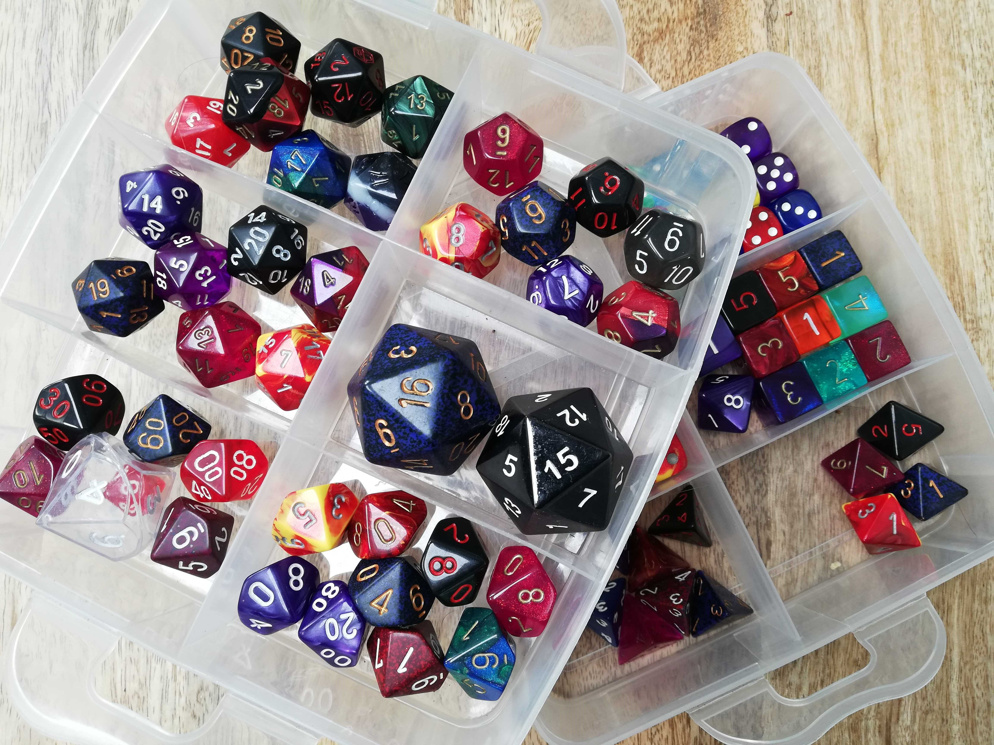
Roll of the Dice

Slide 7
Roll of the Dice
I want to know if my four-sided die (d4) is fair
If it is, each number should come up with equal probability
Four numbers = 100%/4 = 25% probability of rolling each number
So, if I roll the dice 100 times, each number should come up (approximately) 25 times

Slide 8
Roll of the Dice

Slide 9
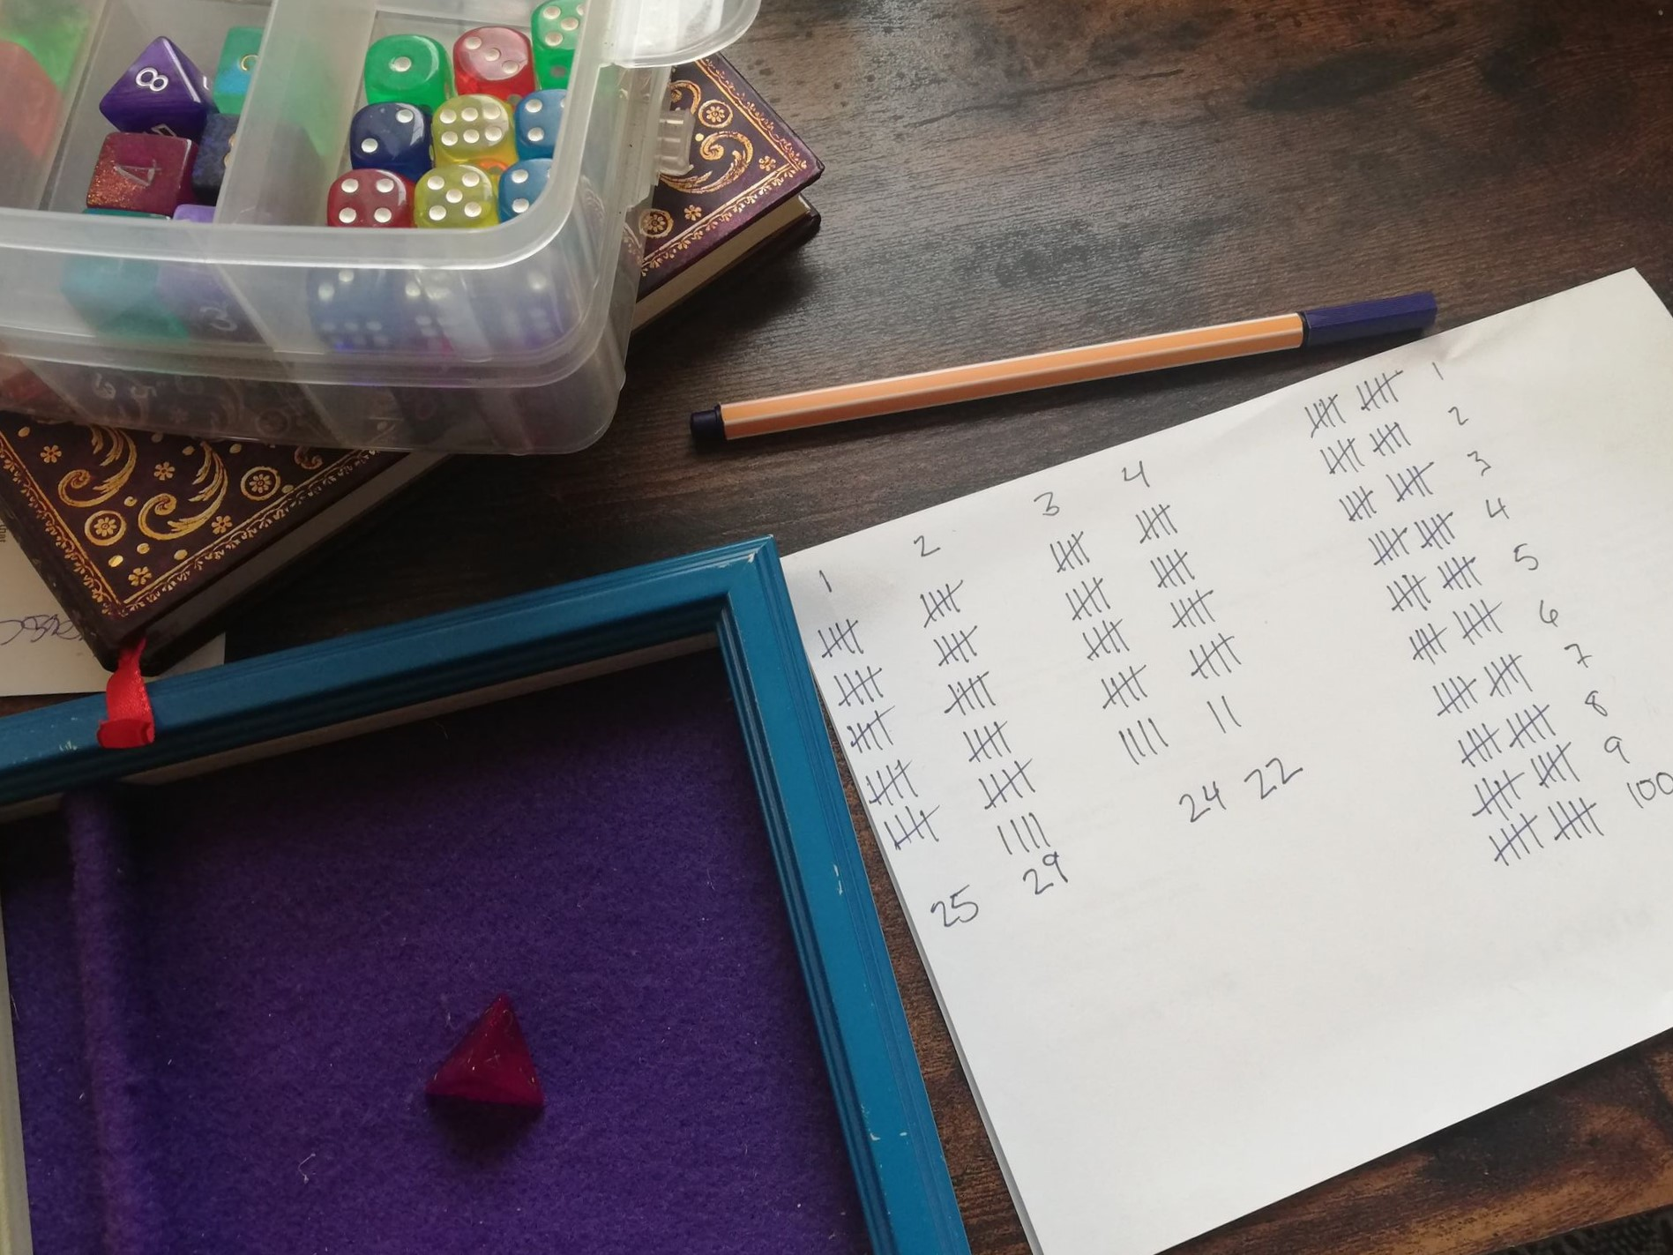
Dice Roll | Observed Count
1 | 25
2 | 29
3 | 24
4 | 22

Slide 10
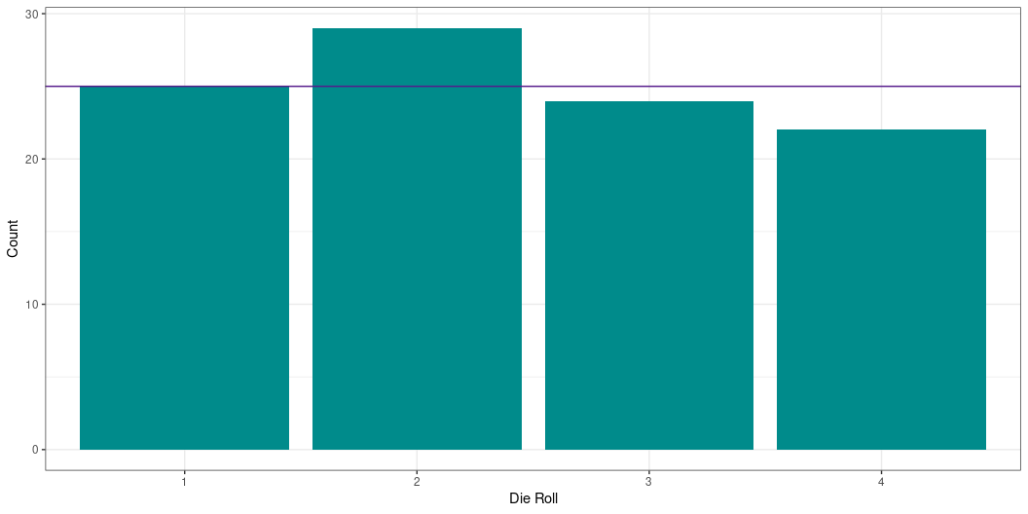
A Fair Shake?
These numbers are not exactly 25 each
But we live in a random universe!

Slide 11
. . .
The Fundamental Question
Are these proportions what we would expect if the die were fair? Are they different enough to believe the die is not fair?

Slide 12
Steps of the Analysis
Obtain Data, from which we calculate…
. . .
A test statistic that represents the relationship of interest, which we compare to…
. . .
The distribution of that test statistic under the null hypothesis to get…
. . .
The probability p of getting a test statistic as large as the one we have (or larger) if the null hypothesis is true so that we can…
. . .
Evaluate our competing hypotheses using a previously decided $α$ level.

Slide 13
Calculate a Test Statistic
How different are the observed counts from the expected counts?

Slide 14
Dice Roll | Obs. Count | Exp. Count
1 | 25 | 25
2 | 29 | 25
3 | 24 | 25
4 | 22 | 25
$χ^{2}=\frac{{\left(25−25\right)}^{2}}{25}+\frac{{\left(29−25\right)}^{2}}{25}+\frac{{\left(24−25\right)}^{2}}{25}+\frac{{\left(22−25\right)}^{2}}{25}$
$χ^{2}=\frac{0}{25}+\frac{16}{25}+\frac{1}{25}+\frac{9}{25}$
$χ^{2}=0+0.64+0.04+0.36$
$χ^{2}=1.04$

Slide 15
Vocabulary: Observed counts
The number of occurrences in each category observed in the sample.
Vocabulary: Expected counts
The number of occurrences in each category expected under the null hypothesis.

Slide 16
Compare to the Distribution
We’ve calculated a test statistic, $χ^{2}$, that represents the thing we are trying to test
Is this test statistic big or small in the grand scheme of things?
. . .
Compare our test statistic to the distribution of that statistic
IMPORTANT: These distributions assume that the null hypothesis is true!
Here, our null hypothesis is that the die IS fair

Slide 17
The Chi-Square (χ2) Distribution
Unfortunately test statistics like the one we have are not normally distributed
No problem - we just have to use a different distribution!

Slide 18
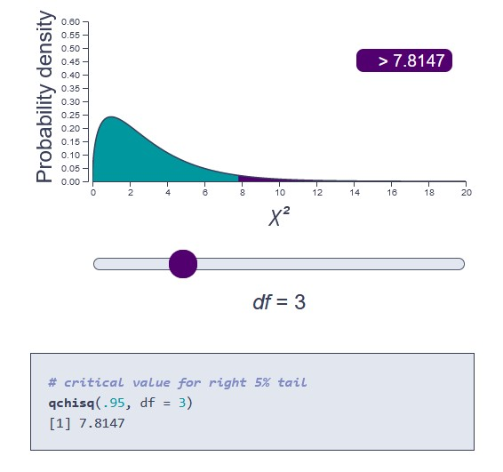
The Chi-Square (χ2) Distribution
Meet the $χ^{2}$ distribution
The sum of squared normal distributions
See this excellent Khan Academy explainer for more!

Slide 19
Detour: Degrees of Freedom
Degrees of freedom determine the distribution’s shape and proportions
At base, they are the number of values that are free to vary
. . .
Consider your module quiz scores: let’s say you want an overall quiz mark of 5/7 (or 71.43%)
Let’s further imagine there’s no “drop lowest two” rule (it just complicates things!)

Slide 20
Detour: Degrees of Freedom
Week of Term | Quiz Score | Rolling Mean
Week 3 | 6 | 6
Week 4 | 4 | 5
Week 5 | 2.5 | 4.17
Week 6 | 6.5 | 4.75
Week 8 | 4 | 4.6
Week 9 | 7 | 5
Week 10 | 3 | 4.71
Week 11 | ??? | ???
The last value must have a particular value in order to work out to the desired mean
$$\frac{6+4+2.5+6.5+4+7+3+???}{8}=5$$
Here, df = 7
One less than the number of scores
Other degrees of freedom have a similar idea, just calculated differently

Slide 21
. . .
Important
You do NOT need to know how to calculate degrees of freedom!
You must know how to report it from the output, and have some idea of what it does.

Slide 22
Obtain the Probability p
Look at the distribution for 3 degrees of freedom
What percentage of the distribution is greater than or equal to 1.04?

Slide 23
Interpreting the Results
The sum of squared differences between our expected and observed counts ( $χ^{2}$ ) was 1.04
For a $χ^{2}$ distribution with 3 degrees of freedom, this value is extremely common under the null hypothesis!
If our die is fair, our data are extremely likely
To believe that the die was not fair, we would have to observe test statistic of > ~7.8 ($α$ = .05)
If only there were an easier way to do this…!
. . .
chisq.test(dice_table$obs_count)
Chi-squared test for given probabilities data: dice_table$obs_count X-squared = 1.04, df = 3, p-value = 0.7916

Slide 24
Interim Summary
$χ^{2}$ quantifies how different a set of observed frequencies are from expected frequencies
We can follow the usual steps of our analysis:
Obtain data
Calculate test statistic
Compare to distribution
Obtain p-value
Evaluate hypotheses

Slide 25
More χ2
We just saw a goodness of fit test
Vocabulary: $χ^{2}$ Goodness of Fit Test
Tests whether a sample of frequency data came from a population with a specific, known distribution.
Next, let’s look at a test of association, or independence
Are two categorical variables associated or not?

Slide 26
Quick Refresher: Variable Types

Slide 27
Vocabulary: Continuous data
Represent some measurement or score on a scale. Examples: Reaction time to press a button, mean anxiety scor
Answers the question: how much?
Vocabulary: Categorical data
Represent membership in a particular group or condition. Examples: control vs experimental group, year of uni
Answers the question: which one?

Slide 28
χ2 Test of Association
This time we will have two variables, both categorical
Data: counts of how many observations fall into each combination of categories

Slide 29
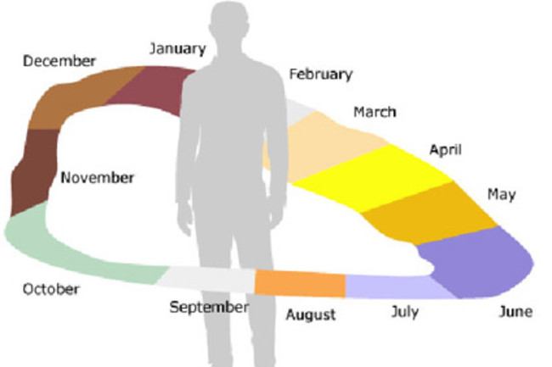
Sequence-Space Synaesthesia
Spatial orientation of sequences, such as numbers, months, or days of the week
“When Senses Collide” visualisation

Slide 30
Image Source

Slide 31
Sequence-Space Synaesthesia
“Calendars” of spatial orientations of months of the year
Brang et al. (2011): Is the orientation of the calendar related to the synaesthete’s handedness?
Orientation: months progress clockwise or counterclockwise in space
Handedness: left or right handed
. . .

Slide 32
Each synaesthete has one value for orientation and one value for handedness
Data: counts of how many synaesthetes fall into each combination of categories
# A tibble: 5 × 2 Orientation Handedness <chr> <chr> 1 clock right 2 clock right 3 clock right 4 anti right 5 anti left

Slide 33
Let’s Think About This…
Our study is investigating the relationship between handedness (right or left) and direction of a synaesthete’s spatial orientation (clockwise or counterclockwise)
What is the alternative hypothesis?
What is the null hypothesis for this study?
What do you think we will find?

Slide 34
Let’s Think About This…
Alternative hypothesis
Clockwise and anticlockwise calendar orientations will occur in different proportions in left- and right-handed syanesthetes
Slight rephrase: Calendar orientation is associated with synaesthete handedness
. . .
Null hypothesis
Both calendar orientations will occur in equal proportions in left- and right-handed syanesthetes
Slight rephrase: Calendar orientation is not associated with synaesthete handedness
. . .
Prediction
From the Brang et al. paper:
Right-handed synaesthetes will tend to have a clockwise calendar
Left-handed synaesthetes will tend to have an anticlockwise calendar

Slide 35
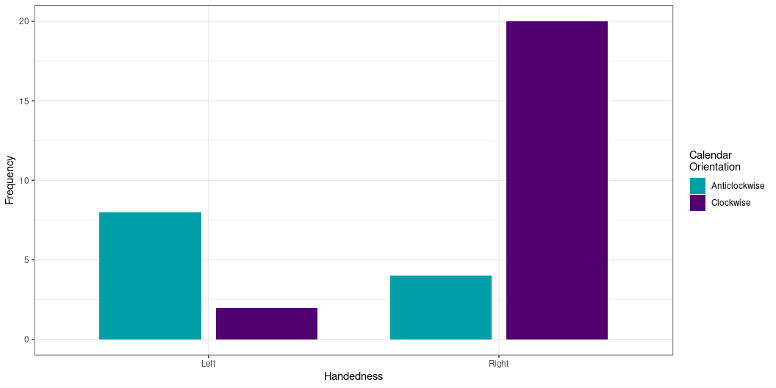
Visualising the Data
Left-handed synaesthetes have more anti-clockwise than clockwise
Right-handed synaesthetes have the reverse

Slide 36
Test Result
Do our results indicate that there may be an association between orientation and handedness?
Pearson's Chi-squared test with Yates' continuity correction data: seq_space$orientation and seq_space$handedness X-squared = 9.7798, df = 1, p-value = 0.001764
Interpretation
What can you conclude from this result?

Slide 37
Test Result
Do our results indicate that there may be an association between orientation and handedness?
Pearson's Chi-squared test with Yates' continuity correction data: seq_space$orientation and seq_space$handedness X-squared = 9.7798, df = 1, p-value = 0.001764
Interpretation
“There was a significant association between calendar orientation and handedness ( $χ^{2}$(1) = 9.78, p = .002).”

Slide 38
Interpreting the Result
Our hypothesis is supported by the data
Furthermore, the association is in the direction we predicted

Slide 39
Expected Frequencies
Orientation | Left | Right
Anti-Clockwise | 3.53 | 8.47
Clockwise | 6.47 | 15.53
One of the assumptions of $χ^{2}$ is that all expected frequencies are greater than 5
Otherwise this test can give you a drastically wrong answer 😱
We can get these easily out of R!
. . .

Slide 40
. . .
😬😬😬😬😬
In this case, use Fisher’s exact test (fisher.test()) instead

Slide 41
A Portent of Things To Come
We have just had our first glimpse of statistical assumptions
A huge and complex topic…for next year! 🎉
Vocabulary: Statistical Assumption
A precondition that must be true in order for a statistical test to work as expected. If these assumptions are violated (i.e. not true), then the test may give inaccurate or misleading estimates or results.

Slide 42
Final Overview
The $χ^{2}$ test quantifies the difference between observed and expected frequencies
Goodness of Fit
Tests whether a sample of data came from a population with a specific distribution 🎲
Test of Association/Independence
Tests whether two categorical variables are associated with each other 🔄🙌🌈
Like with correlation, association is not causation
. . .
For quizzes/exam:
You will not be expected to calculate $χ^{2}$ by hand!
You will be expected to interpret the output of chisq.test() for tests of association
More in the tutorial!

