Slide 1
Linear Model 2: The F Awakens
Week 09 Jenny Terry

Slide 2


Slide 3
Survey Study on Statistics Attitudes & Career Goals
Please help my Junior Research Associate student! 🙏
Complete a short 10 minute survey and earn 1 SONA credit and some research karma!
Take part here: https://sussexpsychology.sona-systems.com/default.aspx?p_return_experiment_id=1852
Interested in a Research Career?
Check out the JRA scheme
Approach lecturers that are doing research you’re interested in and ask if you can assist

Slide 4
Looking Ahead (and Behind)
The story so far…
Fundamentals of NHST & Statistical Tests
The Linear Model - Using the Equation of a Line to Make Predictions
. . .
This week:
The Linear Model - Evaluating the Model
. . .
Coming up:
The Linear Model - Models with Multiple Predictors
Questionable Research Practices

Slide 5
Today’s Objectives
First, a recap:
Linear model
Recap of how we can use the model to makes predictions
The model error term & other Lecture 08 questions answered
After this lecture, you will (begin to) understand:
Evaluating model fit (conceptually) with $R^{2}$ and the $F$-statistic
Evaluating the statistical significance of the prediction with p-values and CIs
. . .
Talk to Me!
Open the Lecture Google Doc: bit.ly/and24_lecture09

Slide 6
Using the Linear Model to Make Predictions (Recap)

Slide 7
The Linear Model as a Statistical Model
Models take sample data and use known mathematical properties of the world around us to make predictions about the population from which our sample came from.
Vocabulary: The General Model Equation
A conceptual representation of all statistical models, with the following form:
$$outcome=model+error$$
Vocabulary: The Linear Model Equation
A particularly common type of statistical model, with the following form:
$$y_{i}=b_{0}+b_{1}×x_{1i}+e_{i}$$

Slide 8
The (Pesky) Error Term
The error term includes everything that separates your model from actual reality (e.g., individual differences, unmeasured variables, and measurement errors).
It is different to - but often conflated with - model residuals (which we touch on today, but you’ll meet formally next semester)
The error term represents the way observed data differs from the actual population (unobservable)
A residual represents the way observed data differs from sample population data (observable)
So, we can not use the linear model error term when calculating predictions, but we know it is there so it is represented in the equation.

Slide 9
The Linear Model Equation
Term | Meaning
$y_{i}$ = | The outcome ($y$) for an individual’s actual score ($i$) is equal to (or, is predicted by)…
$b_{0}$ | … the value of beta-zero (the model’s intercept)…
+ | … plus…
$b_{1}$ | … the value of beta-one (the model’s slope)…
$×$ | … multiplied by…
$x_{1i}$ | … the value of the predictor ($x_{1}$) for an individual’s actual score ($i$)…
$+$ | … plus…
$e_{i}$ | … the error ($e$) for the individual’s actual score ($i$).
$$y_{i}=b_{0}+b_{1}×x_{1i}+e_{i}$$

Slide 10
The Linear Model Equation
$$y_{i}=b_{0}+b_{1}×x_{1i}+e_{i}$$
$b_{0}+b_{1}×x_{1i}$ is the model
$b_{0}$ (intercept) is the value of $y$ when $x$ is 0
$b_{1}$ (slope) is the change in $y$ for every unit change in $x$
The model uses sample data to estimate $b_{0}$ and $b_{1}$ in the population
Once we know $b_{0}$ and $b_{1}$, we can estimate $y_{i}$ (outcome) for any value of $x_{1i}$

Slide 11
Your Questions from Lecture 08
1) Does $y_{i}=b_{0}+b_{1}×x_{1i}+e_{i}$ apply to the whole dataset or each participants scores?
Models take sample data and use known mathematical properties of the world around us to make predictions about the population from which our sample came from using the sample data
So, the model uses information from the whole dataset to set $b_{0}$ and $b_{1}$
We then use $b_{0}$ and $b_{1}$ to make predictions about the outcome ($y$) value for any individual score on the predictor variable ($x_{1}$)

Slide 12
Using the Model to Predict Masculinity
Insert our outcome and predictor
$$Masculinity_{i}=b_{0}+b_{1}×Femininity_{1i}+e_{i}$$
. . .
Add the $b$ values (that we got from R in Lecture 8):
Intercept ($b_{0}$): the predicted value of masculinity when femininity is 0
= 8.82
Slope ($b_{1}$): change in masculinity associated with a unit change in femininity (note the sign change)
= -0.80
$$Masculinity_{i}=\hat{8.82}−\hat{0.8}×Femininity_{1i}+e_{i}$$

Slide 13
Your Questions from Lecture 08
2) How come it doesn’t use - - 0.08? Doesn’t this turn it into a +?
Two negatives do make a positive…
. . .
… but there is initially a $+$ in the equation…
$$Masculinity_{i}=b_{0}+b_{1}×Femininity_{1i}+e_{i}$$
. . .
… so we’re adding a positive and a negative…
… which gives us a negative.
$$Masculinity_{i}=\hat{8.82}−\hat{0.8}×Femininity_{1i}+e_{i}$$

Slide 14
Using the Model to Predict Masculinity
$$Masculinity_{i}=\hat{8.82}−\hat{0.8}×Femininity_{1i}+e_{i}$$
. . .
For someone with a fairly low (on a scale of 1-9) femininity rating of 3:
$$Masculinity_{i}=\hat{8.82}−\hat{0.8}×3+e_{i}$$
. . .
$$Masculinity_{i}=6.42+e_{i}$$
. . .
For someone with a fairly high (on a scale of 1-9) femininity rating of 8:
$$Masculinity_{i}=\hat{8.82}−\hat{0.8}×8+e_{i}$$
. . .
$$Masculinity_{i}=2.42+e_{i}$$

Slide 15
Evaluating our Model: Is it any Good?

Slide 16
Statistical Models
When we’ve been using the linear model so far, we’ve been using a model to make predictions about individuals from a population by extrapolating from a sample of that population
In psychology, we don’t usually use it to make predictions as such, but we tend to focus on what $b_{1}$ (the slope) tells us about the strength and direction of the relationship between our predictor and outcome
But, how do we know if what our model is telling us about $b_{1}$ is meaningful?
First, is the model itself any good?
$R^{2}$ and the $F$-statistic
Next, is the value of the slope ($b_{1}$) important?
p-values and confidence intervals

Slide 17
The Simplest Model
A good linear model should fit the data better than the simplest possible model
The simplest model is the null (aka, intercept-only) model - where there is no relationship between the predictor(s) and outcome
Here’s our linear model again: $y_{i}=b_{0}+b_{1}×x_{1i}+e_{i}$
If there is no relationship between the predictor and outcome then $b_{1}=0$
If we replace $b_{1}$ with $0$ then we get: $y_{i}=b_{0}+0×x_{1i}+e_{i}$
But $0×x_{1i}=0$ so we can then drop $b_{1}×x_{1i}$ from the equation to get: $y_{i}=b_{0}+e_{i}$
When there are no predictors, $b_{0}$ is the model (which is just the mean of $y$)
So, a linear model with no predictors predicts the outcome by the mean of the outcome

Slide 18
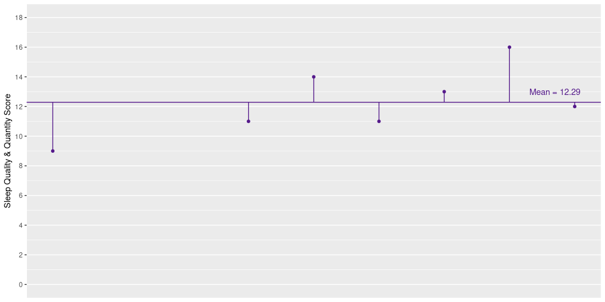
Mean Model Residuals
The lines from each point to the mean represent the distance between the sleep score of each participant and the mean sleep score for the sample (aka the residual error)
We can use these residuals to calculate the overall amount of error and, therefore, variance in our mean model

Slide 19
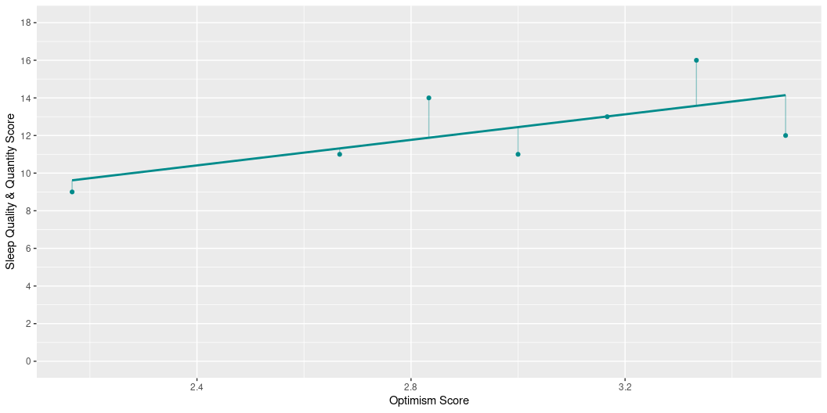
Linear Model Residuals
The lines from each point to the mean represent the distance between the sleep score of each participant and the model’s predicted sleep score for the sample (aka the residual error)
So, we can also calculate the overall amount of error and, therefore, variance in our linear model

Slide 20
Goodness of Fit with $R^{2}$
Vocabulary: $R^{2}$
$R^{2}$ = how much of the variance in the outcome is explained by the model
In other words, do our predictors do a good job of explaining changes in the outcome?
$R^{2}$ portions out the variance in the linear model from the mean model
$R^{2}$ is a Goodness of Fit measure for linear models
$R^{2}$ will appear in your output as a decimal, but is usually reported as a percentage on a 0 -100% scale
e.g., “… the model explains $x$ % of the variance in the outcome…”
The higher the $R^{2}$ value, the better the model (but, low values are not always a cause of concern)
. . .
But, is that amount of variance sufficiently large that we would conclude the effect is meaningful in the population?

Slide 21
The $F$-statistic
Vocabulary: $F$-statistic
$F$ = whether the variance explained significantly differs from zero
The $F$-statistic also uses (a slightly different, but related) comparison of the amount of error in the mean model and the amount of error in your linear model
So, using null hypothesis significance testing (NHST), we can get an associated p-value for our $F$-statistic

Slide 22
NHST Recap
To get a p-value…
We first obtain data, from which we calculate…
. . .
A test statistic that represents the relationship of interest, which we compare to…
. . .
The distribution of that test statistic under the null hypothesis (where there is no relationship) to get…
. . .
The probability (p) of getting a test statistic at least as large as the one we have if the null hypothesis is true so that we can…
. . .
Evaluate our competing hypotheses using a previously decided alpha ($α$) level (usually 0.05)
. . .
If our p-value is lower than $α$, we say that is statistically significant and fail to reject the null hypothesis

Slide 23
The $F$-statistic
In this case, the $F$-statistic is our test statistic that represents the relationship of interest, which we compare to…
. . .
The distribution of the $F$-statistic under the null hypothesis (where there is no relationship between the predictor and the outcome) to get…
. . .
The probability (p) of getting an $F$-statistic as large as the one we’ve observed if the null hypothesis is true
. . .
Evaluate our competing hypotheses using a previously decided $α$ level (usually 0.05)
. . .
If our p-value is lower than $α$, we say that is statistically significant and fail to reject the null hypothesis
. . .
The F-statistic and it’s p-value will appear in your R output, so let’s have a quick look…

Slide 24
Example: Predicting Better Sleep from Positive Psychology
Research Question
Are positive psychology attributes (e.g., gratitude, optimism, mindfulness) associated with better sleep?
Operationalisation
Predictor: Positive psychology attributes
Outcome: Sleep quality & quantity
Model: $Sleep_{i}=b_{0}+b_{1}×PositivePsychology_{1i}+e_{i}$

Slide 25
Is it a Good Model?
Call: lm(formula = sleep ~ pos_psy, data = sleep_tib) Residuals: Min 1Q Median 3Q Max -12.526 -1.706 0.408 1.978 5.389 Coefficients: Estimate Std. Error t value Pr(>|t|) (Intercept) 3.5202 1.1502 3.060 0.00239 ** pos_psy 2.2872 0.3149 7.262 2.74e-12 *** --- Signif. codes: 0 '***' 0.001 '**' 0.01 '*' 0.05 '.' 0.1 ' ' 1 Residual standard error: 2.855 on 331 degrees of freedom Multiple R-squared: 0.1374, Adjusted R-squared: 0.1348 F-statistic: 52.74 on 1 and 331 DF, p-value: 2.744e-12
How much of the variance in sleep is accounted for by positive psychology attributes? 🤔
Is the $F$-statistic statistically significant? 🤔
What does this suggest about the fit of the model? 🤔
. . .
🤫Scientific Notation Converter 🤫

Slide 26
Interim Summary
How do we know if what our model is telling us about $b_{1}$ is important?
First, is the model itself any good?
$R^{2}$ and the $F$-statistic ✅
. . .
Specifically, a good model will:
Fit the data better than the simplest possible model ($R^{2}$ & $F$-statistic)
Explain a lot of variance in the outcome ($R^{2}$)
Explain an amount of variance that significantly differs from zero ($F$-statistic)
. . .
How do we know if what our model is telling us about $b_{1}$ is important?
Next, is the value of the slope ($b_{1}$) meaningful?
p-values and confidence intervals

Slide 27
Evaluating our Model: Is $b_{1}$ Meaningful?

Slide 28
What is so Special about $b_{1}$?
It is a (parameter) estimate of the true relationship in the population
When we’ve been using the linear model so far, we’ve been making predictions
In psychology, we don’t usually make predictions as such, but instead interpret what $b_{1}$ tells us about the strength and direction of the relationship between our predictor and outcome
In other words, we treat $b_{1}$ as an effect size

Slide 29
$b_{1}$ as an Effect Size

Slide 30
Example: Predicting Better Sleep from Positive Psychology
Research Question
Are positive psychology attributes (e.g., gratitude, optimism, mindfulness) associated with better sleep?
Operationalisation
Predictor: Positive psychology attributes
Outcome: Sleep quality & quantity
Model: $Sleep_{i}=b_{0}+b_{1}×PositivePsychology_{1i}+e_{i}$
Hypotheses
What is the null hypothesis? 🤔
What is the alternative hypothesis? 🤔

Slide 31
Hypotheses
Null Hypothesis
No relationship between $x$ and $y$
No relationship between positive psychology and sleep
$b_{1}=0$
Alternative Hypothesis
Relationship between $x$ and $y$
Relationship between positive psychology and sleep
$b_{1}≠0$

Slide 32
Significance of b₁
Is our estimate of b₁ different enough from 0 to believe that it is not 0 in the population?
We - well, R - tests this with NHST.
First, we need a test statistic, so we…:
1) Scale the estimate of b₁ by its standard error (variation of estimates)
ChallengR!
What do you get when you divide a normally distributed value by its standard error? 🤔

Slide 33
Calculating the Test Statistic for $b_{1}$
1) Scale the estimate of b₁ by its standard error (variation of estimates):
$$\frac{b_{1}}{SE_{b_{1}}}=t$$
. . .
2) Compare the value of t to the t-distribution to get p, just as we’ve seen before
. . .
3) If p is smaller than our chosen $α$ level, our predictor is considered to be statistically significant

Slide 34
Confidence Intervals (Recap)
We can also compute a confidence interval (CI) for $b_{1}$ (see Lecture 3)
Assuming that our sample is one of the 95% of samples producing confidence intervals that contain the population value, then the population value for the estimate of interest falls somewhere between the lower limit the upper limit of the interval we’ve computed for our sample
But, we cannot know if our sample is one of the 95% producing a confidence interval that contains the population value
So, they do NOT mean we can be 95% confident that the result lies between the lower and upper limits of our computed interval

Slide 35
Confidence Intervals for $b_{1}$
CIs are useful as a measure of uncertainty in our estimate
Is there a relatively large difference between the upper and lower limits?
If yes, there is a large amount of uncertainty
If no, there is a small amount of uncertainty
For example:
95% CI = [1.28, 10.34] is a wide CI with a large amount of uncertainty
95% CI = [1.28, 1.34] is a narrow CI with a small amount of uncertainty

Slide 36
Confidence Intervals for $b_{1}$
CIs can also tell us about the statistical significance of $b_{1}$
Does the CI cross (contain) 0?
If it does, and our sample contains the population value, it is possible the population value is 0.
If it doesn’t, and our sample contains the population value, it is unlikely the population value is 0.
For example:
95% CI = [-1.28, 1.34] crosses 0 (tip: look for a negative sign)
95% CI = [1.28, 1.34] does not cross 0

Slide 37
Is $b_{1}$ (Statistically) Significant?
Call: lm(formula = sleep ~ pos_psy, data = sleep_tib) Residuals: Min 1Q Median 3Q Max -12.526 -1.706 0.408 1.978 5.389 Coefficients: Estimate Std. Error t value Pr(>|t|) (Intercept) 3.5202 1.1502 3.060 0.00239 ** pos_psy 2.2872 0.3149 7.262 2.74e-12 *** --- Signif. codes: 0 '***' 0.001 '**' 0.01 '*' 0.05 '.' 0.1 ' ' 1 Residual standard error: 2.855 on 331 degrees of freedom Multiple R-squared: 0.1374, Adjusted R-squared: 0.1348 F-statistic: 52.74 on 1 and 331 DF, p-value: 2.744e-12
Is the p-value associated with $b_{1}$ statistically significant? 🤔
🤫Scientific Notation Converter 🤫

Slide 38
Where’s the CI?!
# A tibble: 2 × 7 term estimate std.error statistic p.value conf.low conf.high <chr> <dbl> <dbl> <dbl> <dbl> <dbl> <dbl> 1 (Intercept) 3.52 1.15 3.06 2.39e- 3 1.26 5.78 2 pos_psy 2.29 0.315 7.26 2.74e-12 1.67 2.91
Is there much uncertainty in the estimate of $b_{1}$, according to the CI? 🤔
What can we infer about the statistical significance of $b_{1}$ from the CI? 🤔

Slide 39
$b_{1}$ as an Effect Size
Call: lm(formula = sleep ~ pos_psy, data = sleep_tib) Residuals: Min 1Q Median 3Q Max -12.526 -1.706 0.408 1.978 5.389 Coefficients: Estimate Std. Error t value Pr(>|t|) (Intercept) 3.5202 1.1502 3.060 0.00239 ** pos_psy 2.2872 0.3149 7.262 2.74e-12 *** --- Signif. codes: 0 '***' 0.001 '**' 0.01 '*' 0.05 '.' 0.1 ' ' 1 Residual standard error: 2.855 on 331 degrees of freedom Multiple R-squared: 0.1374, Adjusted R-squared: 0.1348 F-statistic: 52.74 on 1 and 331 DF, p-value: 2.744e-12
The value of b₁ is also a useful and interpretable value by itself
It can tell us the direction of the relationship between the predictor and outcome
Is the direction of the relationship positive or negative? 🤔
It can also tell us the strength of the relationship between the predictor and outcome
More on this next week!

Slide 40
Putting It All Together
$R^{2}$ tells us the percentage of outcome variance our model explains
The $F$-statistic and its associated p-value tells is whether the amount of variance explained is significantly different from 0
We can also get an associated p-value and confidence interval for $b_{1}$ that tells us whether $b_{1}$ is significantly different from 0
We can also use the confidence interval as a measure of uncertainty
$b_{1}$ is also an effect size that tells us the strength and direction of the relationship between the predictor and the outcome
Reporting Results in APA Style
The model explained a statistically significant proportion of the variance in sleep quality and quantity, $R^{2}$ = 13.7%, F(1, 331) = 52.74, p < 0.001. Positive psychology attributes positively and statistically significantly predicted sleep quality and quantity, $b_{1}$ = 2.29 [1.67, 2.91], t(331) = 7.26, p < 0.001.

Slide 41
Further Support
The linear model will be crucial for the rest of your degree, so if that was a bit of a blur to you, it’s highly recommended that you spend some time working through it slowly, until it clicks.
Here are some additional (to those at the end of Lecture 08) recommendations for extra sources of support:
Statistics by Jim blog/videos (beginner): https://statisticsbyjim.com/regression/linear-regression-equation/
Andy Field’s YouTube channel (intermediate): https://youtu.be/7cSArk7tU4w?si=XBl2CORBn2CMmvZd
CenterStat YouTube channel (advanced): https://youtube.com/playlist?list=PLQGe6zcSJT0V4xC1NDyQePkyxUj8LWLnD&si=BQMJwNC9JDeINAwk
They cover a few points we don’t get into on AnD (especially the Andy Field and CenterStat stuff), but these are the some of the clearest explanations of the linear model and associated concepts I’ve ever encountered, so I highly recommend them.

