Slide 1



Slide 2



Slide 3
Take-Away Paper
You will have some data, which you must use to:
Ensure the data contains the necessary measures and values
Decide on and create a summary and visualisation
Perform an appropriate statistical test
You should be prepared to explain and justify your analytic decisions!
Use Your Resources!
Everything we ask you to do in the TAP, you will have practiced multiple times in tutorials, skills labs, and worksheets. To prep or get help, come to Skills Labs and practicals!

Slide 4
Take-Away Paper
Technicalities:
Only available for 48 hours from Monday to Wednesday of Week 7
You can work on it as long as you want in the time available
Submit the rendered HTML file on Canvas
Read the TAP Information page on Canvas!
Important
THERE IS NO LATE SUBMISSION PERIOD!!!

Slide 5









Slide 6


Slide 7
Comparing Two Means
Extremely common and fundamental testing paradigm
The Fundamental Question
Do people in one group score, perform, react, behave (etc.) differently than in another group?
Two types (for today!)
Independent: different entities/participants in each groups
Paired: same entities/participants in both groups
Very similar logic and interpretation, slightly different maths!
7

Slide 8


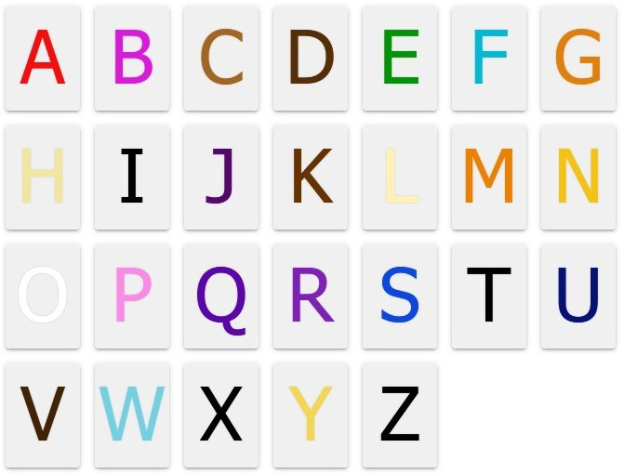
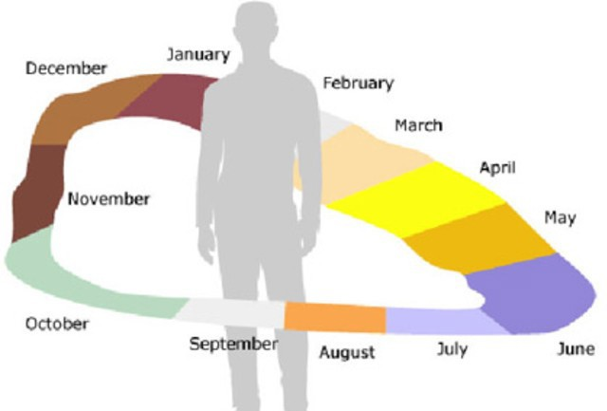


Slide 9
Grapheme-Colour Synaesthesia
Association between letters/words and particular colours
Tends to be consistent throughout life, beginning in childhood
So, synaesthetes might tend to notice language/spelling more often
Research Question
Do synaesthetes have a different cognitive style, compared to non-synaesthetes?
Conceptual hypothesis
Grapheme-colour synaesthetes have a more language-oriented cognitive style than non-synaesthetes

Slide 10
Data and Design: SCSQ
Mealor et al (2016): Sussex Cognitive Styles Questionnaire
Includes measures of imagery, language ability, and more
Example items: "I tend to notice if a word has the same letter repeated in its spelling)); "I enjoy learning new languages))
Validated on people with and without synaesthesia
Operational hypothesis
Synaesthetes will, on average, have a different score on the Language subscale of the SCSQ than non-syn aesthetes
What is the null hypothesis?

Slide 11
Summary of Design
Research Question
Do synaesthetes have a different cognitive style, compared to non-synaesthetes?
Conceptual hypothesis
Grapheme-colour synaesthetes have a more language-oriented cognitive style than non-synaesthetes
Operational hypothesis
Grapheme-colour synaesthetes will have, on average, a different score on the Language subscale of the SCSQ than non-synaesthetes
Null hypothesis
Grapheme-colour synaesthetes will have, on average, the same score on the Language subscale of the SCSQ as non-synaesthetes

Slide 12

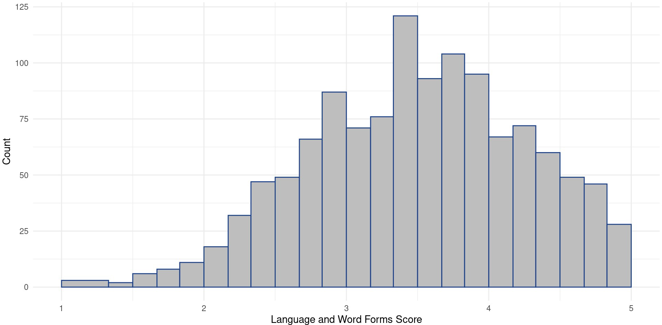

Slide 13
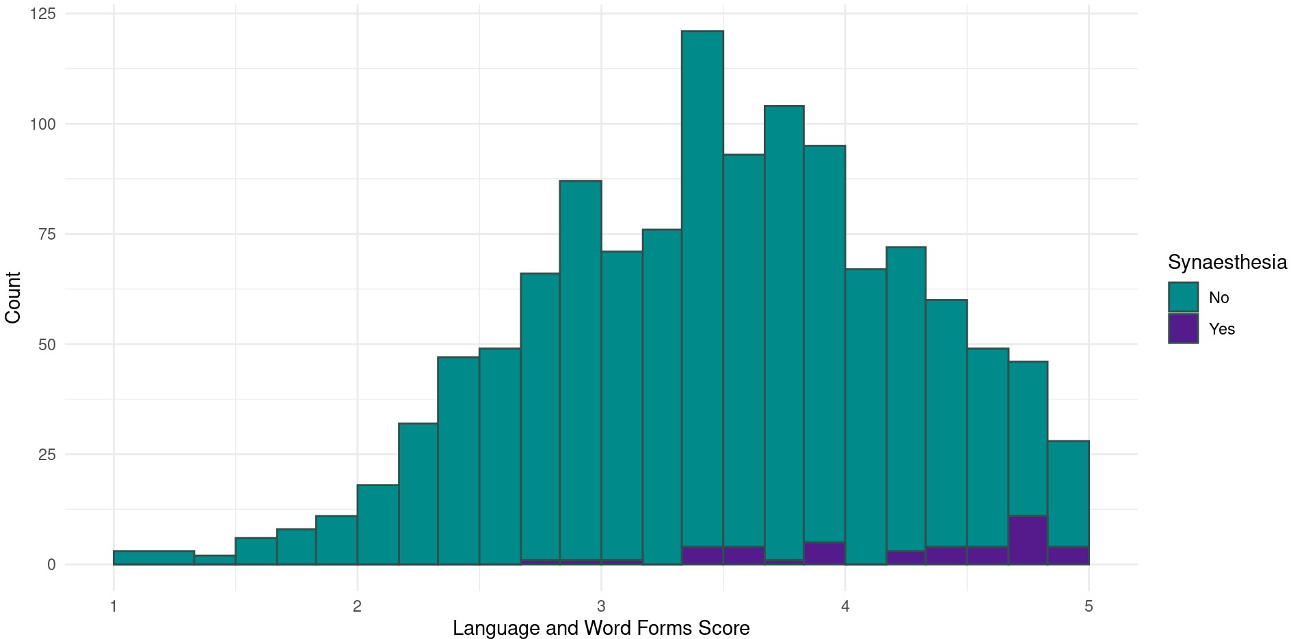

Slide 14
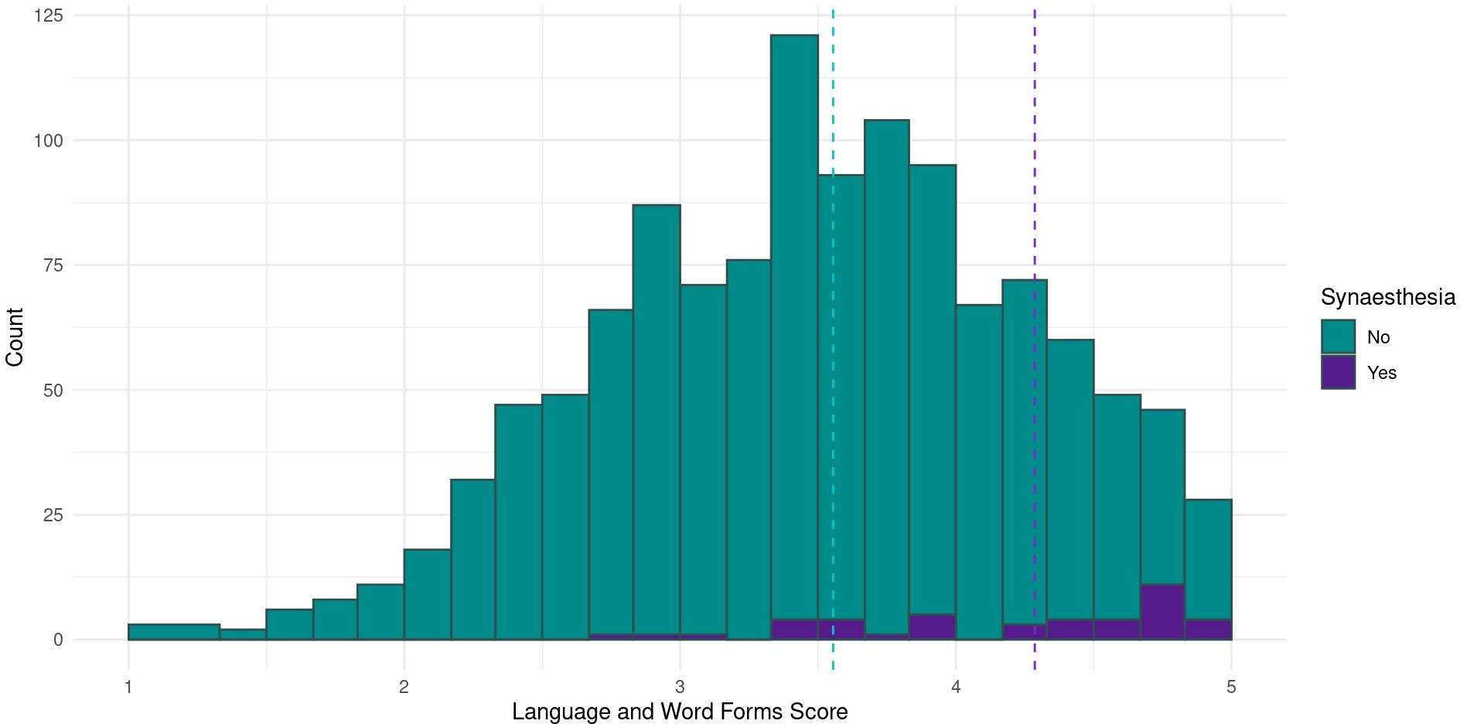

Slide 15







Slide 16
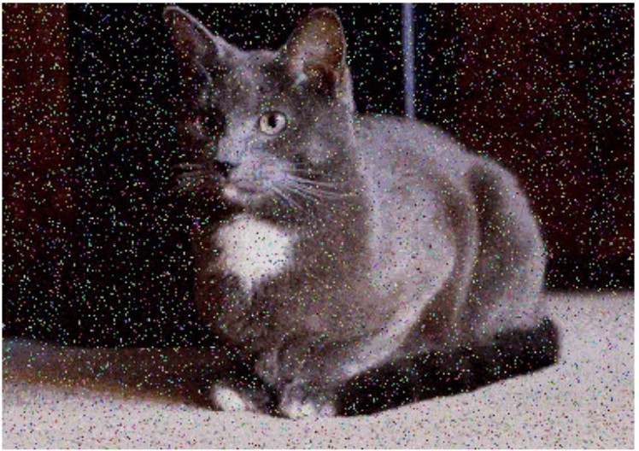
Steps of the Analysis
Calculate the test statistic (signal-to-noise ratio)
Compare that test statistic to its distribution under the null hypothesis
Obtain the probability p of encountering a test statistic of the size we have, or larger, assuming the null hypothesis is true
Vocabulary: Ratio
A number that captures the relative size of two quantities, expressed as how many times bigger the first quantity is than the second.
Calculated as the first divided by the second.
e.g., if the seagull-to-human ratio in Brighton is 3, then there are 3 seagulls for every 1 human, or 3 times as many seagulls as humans.
16

Slide 18
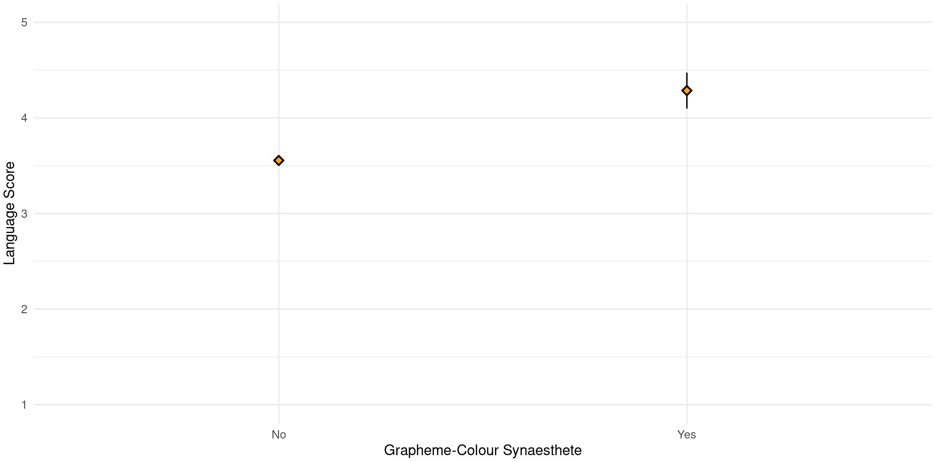

Slide 19


Slide 20




Slide 21
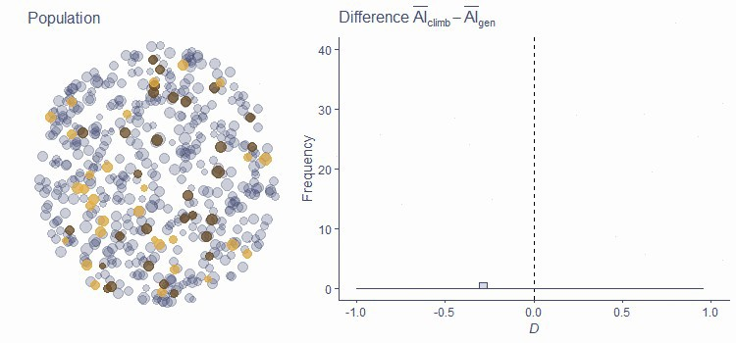

Slide 22
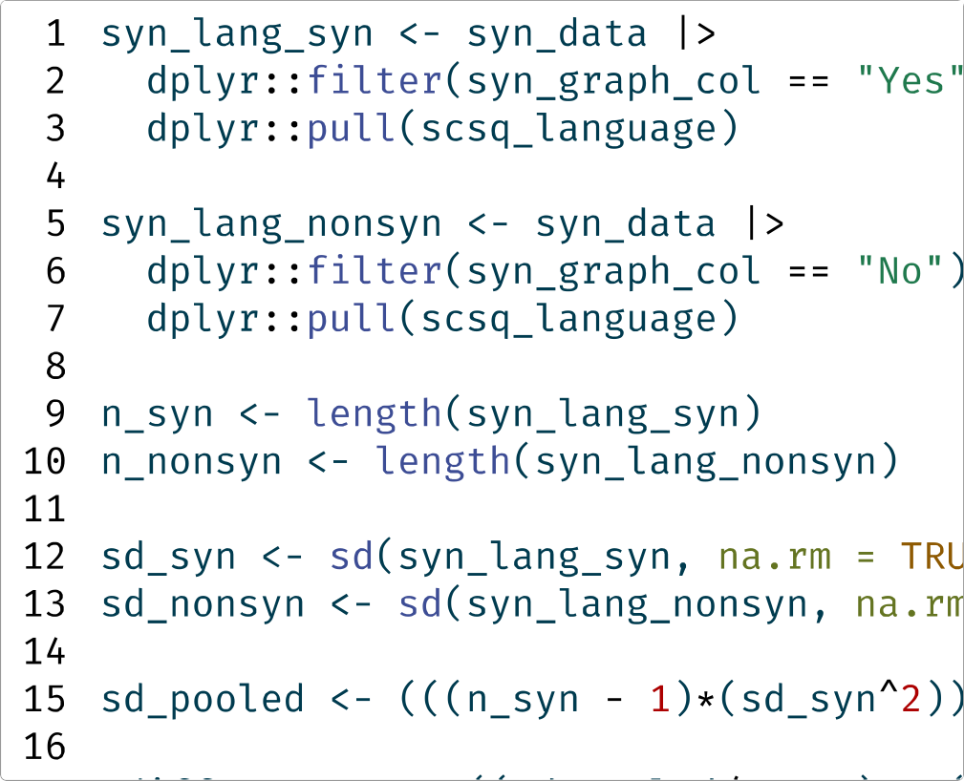








Slide 23
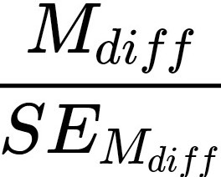
Steps of the Analysis, Redux
Calculate the (standardised) difference between mean scores
Divide the signal (difference in means)= 0.74...
By the noise (standard error of the difference in means)= 0.12
This is our "test statistic)) t, or signal-to-noise ratio
_{t ==} signal
0.74 == 6.43
.
noise 0.12
Vocabulary: Test Statistic
A number that captures the relationship or comparison of interest. Common examples include t, r, x², F. Typically has the general form:
estimate of the relationship or difference signal
estimate of the variation in estimates ^{or} noise
23

Slide 24





Slide 25
What's the Point?
The test statistic tis the difference in group means divided by their standard error
So, t represents how big the signal is compared to the noise
Each test statistic has its own known distribution under the null hypothesis
Known probability of encountering any given test statistic under the null hypothesis
Including t, which is (surprise) t-distributed
Important
Larger values oft are increasingly unlikely under the null hypothesis (ie. when the "signal" is, in reality, O)
25

Slide 26
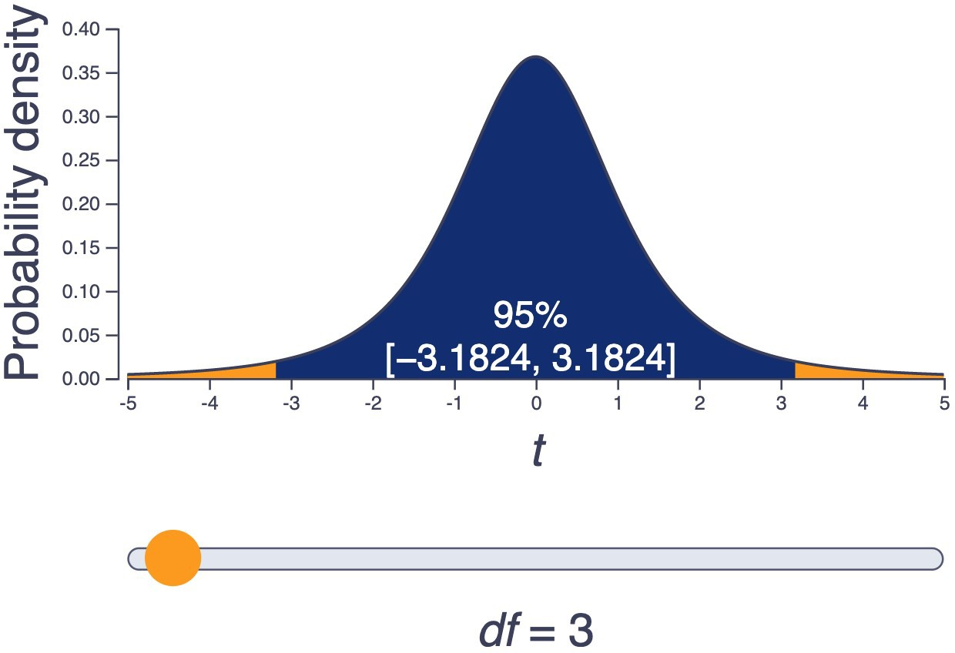

Slide 27












Slide 28
Side Note: It's Exactly Backwards
The word "significant)) implies
Big
Noticeable
Having a large impact
So we might expect that "significant)) means bigger than 0.05 It is the exact opposite of that!
Important
Statistical significance expresses surprisingness: the probability of unlikely events So, small µ-values are "significant", not large ones

Slide 29
That's the t
After all of that work...R can do it for us instantaneously!
Two Sample t-test
data: scsq_language by syn_graph_col
t = -6.3394, df = 1209, p-value = 3.25e-10
alternative hypothesis: true difference in means between group No and group Yes is not equal to 0
95 percent confidence interval:
-0.9576637 -0.5049972
sample estimates:
mean in group No mean in group Yes 3.554949 4.286279
What do you think?
What should we conclude?

Slide 30
Would You Like Some t?
Two Sample t-test
data: scsq_language by syn_graph_col
t = -6.3394, df = 1209, p-value = 3.25e-10
alternative hypothesis: true difference in means between group No and group Yes is not equal to 0
95 percent confidence interval:
-0.9576637 -0.5049972
sample estimates:
mean in group No mean in group Yes 3.554949 4.286279
Reporting the Results
"On average, grapheme-colour synaesthetes scored higher on the Language subscale of the SCSQ (M = 4.29, SO= 0.61) than non­ synaesthetes (M = 3.55, SO= 0.75). An independent samples t-test indicated that this difference was statistically significant (t(1209) = -6.34, p
< .001, Mdiff = -0.74, 95% Cl [-0.96, -0.5]):'

Slide 31
Interim Summary
Independent samples t-tests
Tests the null hypothesis that two samples come from the same population (i.e. Mdiff = 0)
Calculate test statistic t, which expresses signal-to-noise ratio
Size of the difference in means divided by the standard error of the difference in means
Then, evaluate the probability p of obtaining t of this size (or larger) under the null hypothesis
If p < a, we might conclude that group membership is associated with some difference
No Maths Required
You will not need to memorise, and will not be assessed on, the equations for pooled SO or SEMdiff!

Slide 32
Interlude
Consider This
Does this constitute evidence that group membership (ie being a synaesthete or not) CAUSES a difference in language ability?
Next up: paired samples t-test

Slide 33







Slide 34
Scenario
You are on a Psychology placement with an NHS service, working with children and their parents. The service provides a "Connections Day" for these families to meet and share their experiences. Before and after the Connections Day, the parents are asked to fill out a questionnaire, which includes a measure of stress.
Your tasks are:
Find out whether the Connections Day event reduces stress in the families who attend
Prepare and report the evidence as part of a funding bid to NHS England to continue offering Connection Days
Note
This scenario is not real, but is inspired by real NHS placements and real tasks that our current Placement students are doing this year. If this sounds interesting, consider checking out Psychology Placements.

Slide 35
Summary of Design
Research Question
Does the Connections Day help parents to reduce stress?
Conceptual hypothesis
Parents will report reduced levels of stress after the Connections Day, compared to before.
Operational hypothesis
Parents will have, on average, a different score on the stress questionnaire after the Connections Day than before.
Null hypothesis
Parents will have, on average, the same score on the stress questionnaire after the Connections Day than before.

Slide 36
Paired (Repeated) Design
Key difference: the same people participate in both conditions
The "groups)) are no longer groups of people but of timepoints: before and after
Note
This is not real data!
10
9
8
Q) 7
0
()
6
(/)
UJ 5
C
<1l
Q)
4
3
2
Pre
Timepoint
Post

Slide 37




Slide 38





Slide 39






Slide 40








