Slide 1




Slide 2






Slide 3





Slide 4



Slide 5




Slide 6



Slide 7




Slide 8
The Core of Correlation
Quantifies how two quantities change in relation to each other
When one variable changes, does the other...
Change in a similar way?
Change in the opposite way?
Not change very much at all?
The Fundamental Question
To what degree do two variables behave the same way- do they covary?
8

Slide 9
Putting the Co in Covariance
Variance should be familiar already! See PAAS for a refresher
Covariance ("cd' = with) is a similar idea - and calculated in a similar way
Vocabulary: Variance
Vocabulary: Covariance
How much pairs of scores deviate from their (respective) means in the same way, on average
Calculate how far each data point is from the mean for both x and y,
multiply them together, add all those together, divide by N - 1
How much scores deviate from the mean, on average
Calculate how far each data point is from the mean of x, multiply the deviations by themselves (i.e. square them), add them all together, divide by N - 1
variance = s² = ^{"L'1...n1=l (x·i}
T
N
- x_{r}·) x·_{i} - £_{i}·)
"'n (x·
covanancexy = ^{L..,,i=l i -} ..
x·_{i} 1(y·_{i -} ,
I
l
N-
1
•Let's look at an example to make this more concrete!
9

Slide 10
Gender and Sexuality Questionnaire
Psychology very frequently collects gender as a variable
Typically categorical, e.g. "woman)), "man)), "non-binary/third gender))
Is this a useful way to categorise people?
Do these discrete categories capture gender as people perceive it?
Gender and Sexuality Questionnaire about gender and attraction
Completed by two previous cohorts of Psychology first years
Research Question
Are femininity and masculinity actually dichotomous? What is the nature of the relationship between them?
10

Slide 11
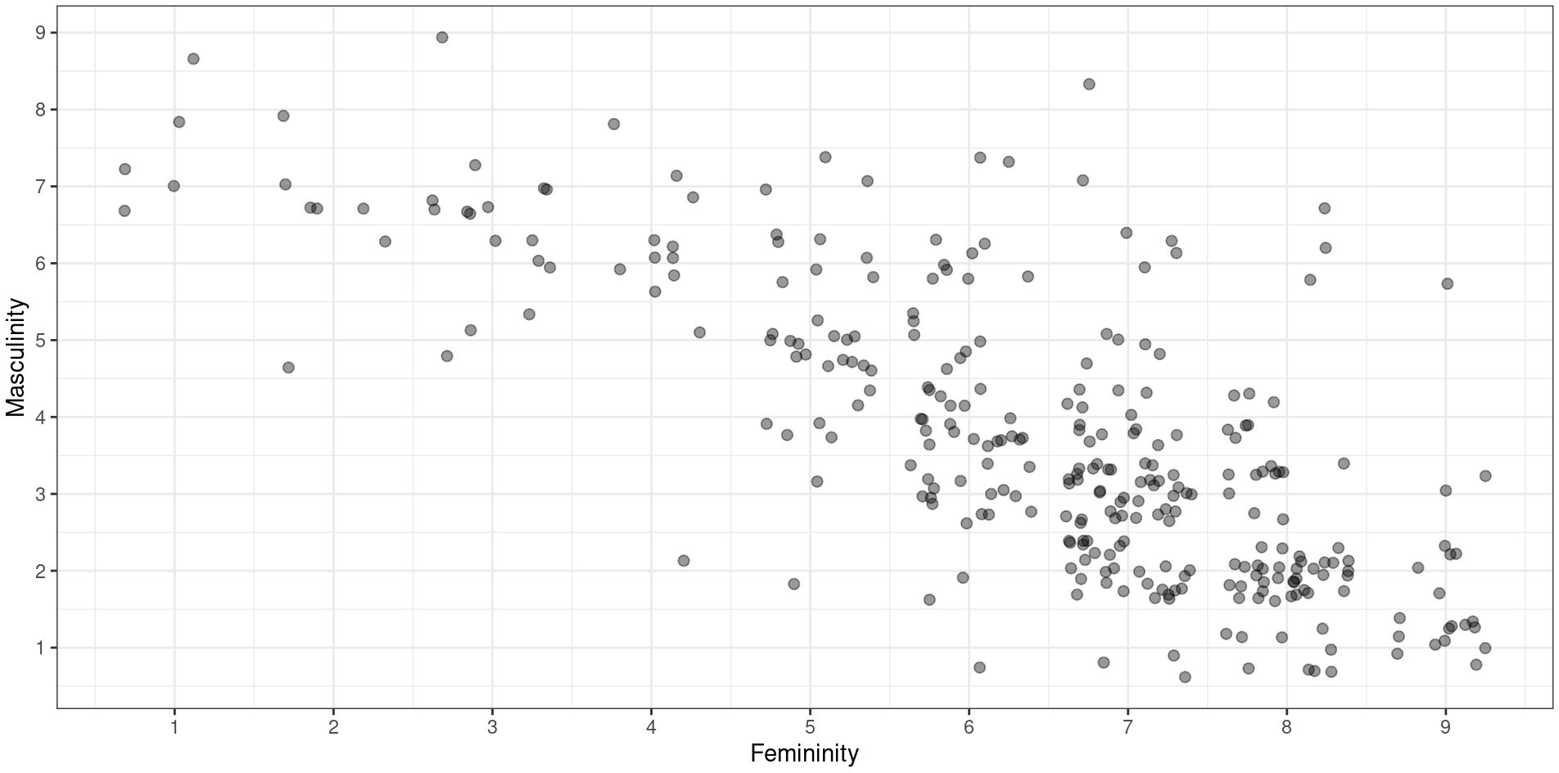

Slide 12


Slide 13








Slide 14


Slide 15













Slide 16

Let's Try It!
•
•
.
...
•. . . .. , ..•
..
.
•. .
.. ..
..
.
r 95%CI
.....
... •
•
..
.....
•
.
•
•
:
. ..
. •
•
••
••
,.
••
•
.. ....
•
-0.76 [-0.8, -0.7]
So, our correlation coefficient
.
•
..
. ... ,,....·..
.... •• .
•
•
r.
).
•
' ·....
.' 1:
.
• ·"•
··:...
.
•••••
A •
.,
....
.
• '•·
•
..
.
•
··=\,
., . .
.
·:--
r
-.76
•
•
..
·•·· ..
-..
••••
..
•
•
5
Femininity
Pop Quiz
How can we interpret this value of r?
16

Slide 17


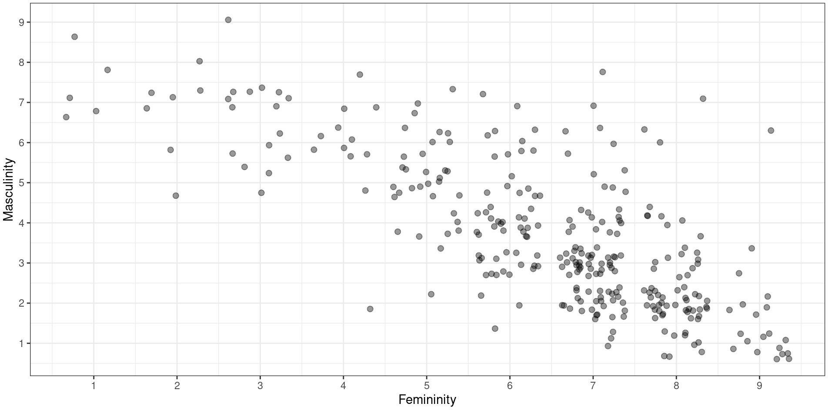

Slide 18







Slide 19
Correlation: Significance
Parameter1 | Parameter2 | r | 95% Cl | t(304) | p
gender _fem | gender _masc | -0.76 | [-0.8, -0.7] | -20.1 | < .001
Reporting Correlation
There was a significant negative correlation between femininity and masculinity, r(304) = -.76, p < .001.
Leading Os
We reported both rand p without leading Os (e.g. as -.76 and not -0.76). The rule is this:
Statistics that can have a value greater than 1 get a leading O when they are less than 1 (e.g. t, F)
Statistics that cannot have a value greater than 1 do not (e.g. r, p)
19

Slide 20
Correlation Matrices
Correlations are often presented in matrices
Each cell contains the correlation coefficient rfor the variables in that row and column
gender_comfortable gender_masc gender_fem gender_stability
gender_comfortable | 1.00 | -0.31 | 0.17 | 0.61
gender_masc | -0.31 | 1.00 | -0.76 | -0.28
gender_fem | 0.17 | -0.76 | 1.00 | 0.18
gender_stability | 0.61 | -0.28 | 0.18 | 1.00
Pop Quiz
Why is there a diagonal line of 1s?
20

Slide 21
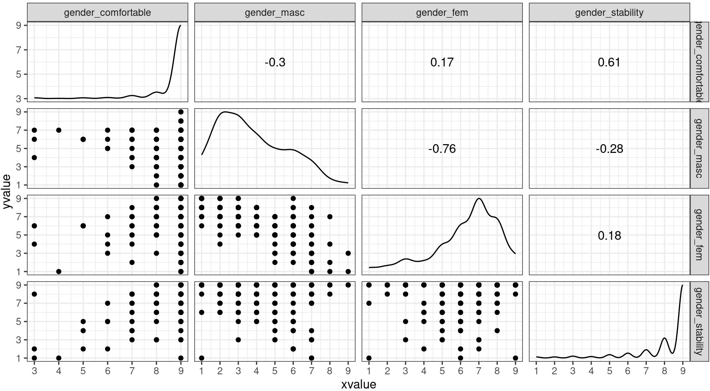

Slide 22



Slide 23




≠

Slide 24


Slide 25
How many quid?
"Parallels)), "linked td', etc. are common-language synonyms for "correlated with))
This study says that they looked at changes in mental health between 2005 and 2017
What third thing might have influenced negative mental health outcomes during this time?
Vocabulary: Tertium quid
An unmeasured third variable that inf1uences two other measured quantities
25

Slide 26





Slide 27
Correlation: VOCAB ALERT!
In everyday language, "correlated)) means "related to in someway, usually causally))
In statistics, it has a very specific, technical definition
Vocabulary: Correlation
The (standardised) degree to which two variables covary. Calculated as covariance divided by the product of the standard deviations. Quantifies both the strength (absolute value) and direction (sign) of the relationship between -1 and 1.
"Correlation)) is a technical term!
Do not say two things are "correlated)) unless you report r as evidence!
Instead: variables "have a relationship))/"are related to each other))
27

Slide 28



Slide 29




Slide 30




Slide 31









Slide 32




