Slide 1
Linear Model 1: A New Equation
Week 08
Dr Jenny Terry

Slide 2

Looking Ahead (and Behind)
The story so far…
Fundamentals of NHST & Statistical Tests
This week:
The Linear Model - Equation of a Line
Coming up:
The Linear Model - Evaluating the Model with p-values, CIs, F & R²
The Linear Model - Models with Multiple Predictors Questionable Research Practices
“Is it bad if I don’t understand anything from the lectures?”

Slide 3

Today’s Objectives
After this lecture, you will (begin to) understand:
What a statistical model is and why they are useful The equation for a linear model with one predictor
b₀ (the intercept)
b₁ (the slope)
How to use the equation to predict an outcome How to read scatterplots and lines of best fit
Talk to Me!
Open the Lecture Google Doc: https://bit.ly/AnD_lecture_08

Slide 4
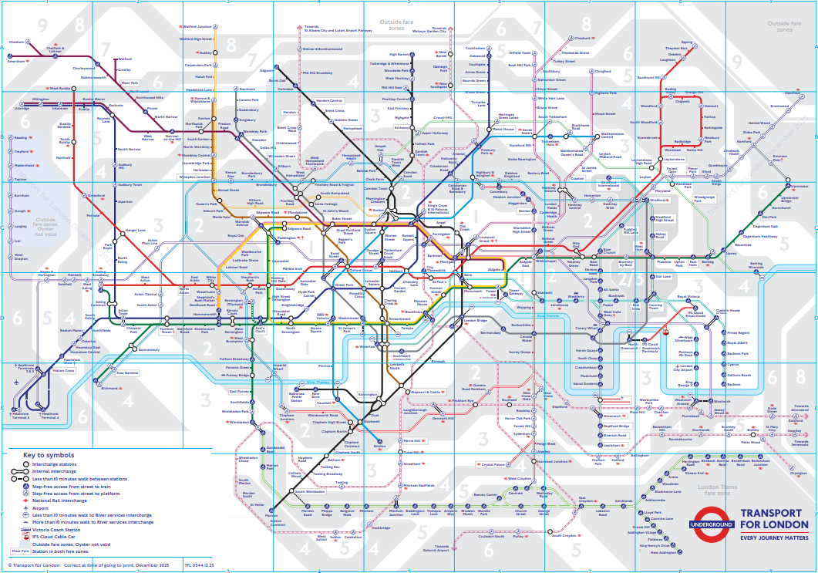
Statistical Models
Psychological reality is like Google Earth
Statistical models are like the London Tube map — a simplified, distorted version of reality but incredibly useful
When we build a statistical model, we intentionally ignore a lot of the detail so we can focus on the relationship we care about
They are never perfectly true representations of reality, but they can still be extremely useful for:
understanding relationships
making predictions
testing theories

Slide 5

Statistical Models
Vocabulary: The General Model Equation
A conceptual representation of all statistical models, with the following form:
outcome = model + error
We can use statistical models to predict the outcome for a particular case (e.g., an individual)
The model itself is a set of mathematical assumptions (i.e., an equation) that assume properties about a population
This is always subject to some degree of error

Slide 6
The Error Term
The error term includes everything that separates your model from actual reality (e.g., individual differences, unmeasured variables, and measurement error)
The error term represents the way observed data differs from the actual population (which is unobservable - we cannot calculate)
So, we can not and do not use the error term for statistical modelling, but we know it is there so it is represented in the equation.

Slide 7
One Equation to Rule Them All!
The linear model is fundamental and extremely common statistical model
Most common statistical tests (e.g., t-tests and chi-squared) are some form of linear model Allows us to predict an outcome from one or more predictor variables
This is our first (explicit) contact with statistical modelling

Slide 8

All the World’s a Model…
… and our variables merely players.
Vocabulary: Predictor(s)
The variable(s) that you hypothesise will predict the outcome.
In experimental studies, this is usually the treatment variable (the variable that is being manipulated).
In observational studies (e.g., cross-sectional surveys), this will be one of the variables you’ve measured.
Also - and commonly in experimental research - called the
independent variable, or IV.
Vocabulary: Outcome
The variable that we hypothesise will vary, depending on the predictor.
In experimental studies, this is what you think will change because of your manipulation.
In observational studies (e.g., cross-sectional surveys), this will also
be one of the variables you’ve measured!
Also - and commonly in experimental research - called the
dependent variable, or DV.

Slide 9
The Linear Model Equation
The linear model is essentially the equation for a straight line:
y = mx + b
It is usually written like this:
yi = b₀ + b₁ x₁i + ei
I will write it in full for now, so you can get used to it:
yi = b₀ + b₁ × x₁i + ei

Slide 10
The Linear Model Equation
yi = b₀ + b₁ × x₁i + ei
Term Meaning
y_{i} = The outcome (y) for an individual’s actual score (i) is equal to (or, is predicted by)…
b₀
… the value of beta-zero (the model’s intercept)…
+
… plus…
b₁
… the value of beta-one (the model’s slope)…
×
… multiplied by…
x1i
… the hypothethical value of the predictor (x₁ ) for an individual (i)…
+
… plus…
e_{i}
… the error (e) for the individual’s actual score (i)…

Slide 11
Using the Linear Model to Make Predictions

Slide 12
Overview
Example 1: Predicting Masculinity from Femininity
A recognisable example (from your correlation lecture)
Visual, approximate representation (so you can get a sense of where the numbers come from) Computational, precise calculations (where we actually get the numbers from)
Example 2: Predicting Better Sleep from Positive Psychology
A new example for extrapolation
Visual, approximate representation (so you can get a sense of where the numbers come from) Computational, precise calculations (where we actually get the numbers from)

Slide 13
Example 1: Predicting Masculinity from Femininity
Dr Mankin was interested in the relationship between femininity and masculinity
Participants took part in a cross-sectional, self-report survey that asked them to rate their: Femininity
Masculinity
& a bunch of other things not relevant for today’s example
Hypothesis: Previous research (your correlation lecture!) suggests that… femininity will have a negative relationship with masculinity

Slide 14
Operationalisation
Hypothesis: Femininity will have a negative relationship with masculinity
Predictor (x₁ ): Femininity Outcome (y) : Masculinity
Model: Masculinityi = b₀ + b₁ × Femininity₁i + ei
Masculinity doesn’t have a value because that is what we’re estimating
Femininity will be given a value, but we can pick different values and plug them in to solve the equation to get the value of masculinity for whatever value of femininity we choose
We can’t estimate error, so we don’t need to worry about that But, where do the b₀ and b₁ come from?! 🤔
Hint: Remember that the linear model is the equation for a straight line…

Slide 15
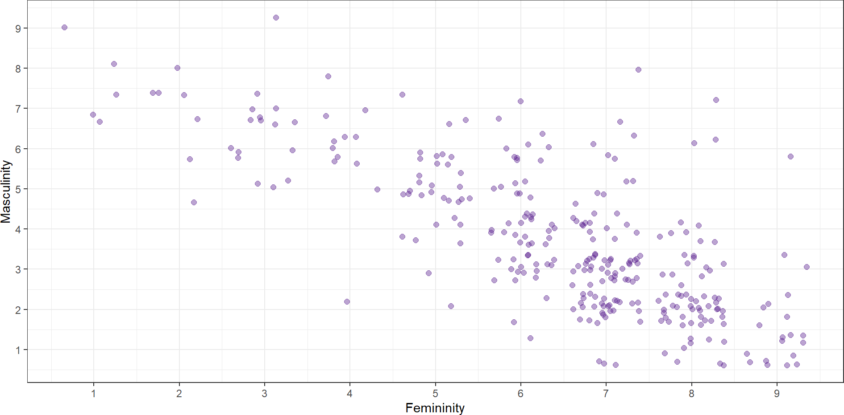
Visualising our Model (the Line)
Where would you draw a straight line through these dots to best capture where they tend to fall?

Slide 16
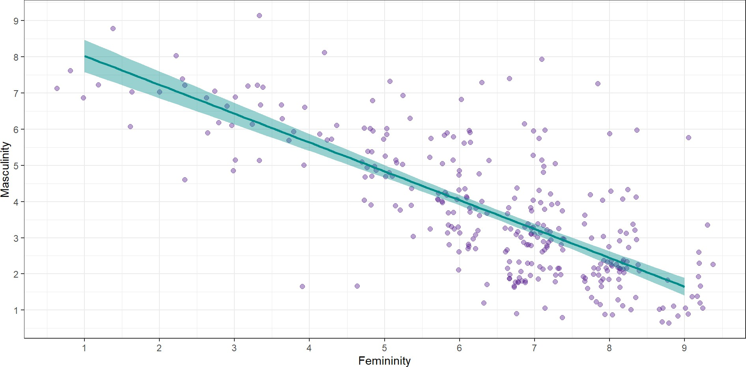
Visualising our Model (the Line)
The line is our statistical model - it is not the data itself, but it is using the data to make a prediction

Slide 17

Visualising our Model (the Line)
The individual scores (data points) tend to be higher up on the left and lower down on the right
As the variable on x increases (here, ratings of femininity)…
… the variable on y tends to decrease (here, ratings of masculinity)
This represents a negative relationship between x and y - as one goes up, the other goes down The slope is fairly steep so this also tells us there is a strong relationship
ChallengR: Why Not Correlation?
You already saw this same data, and relationship, with the correlation analysis you did with this data in a previous lecture. Why are we doing something different? What do we get from the linear model that we don’t get from our correlation analysis?

Slide 18

Visualising our Model (the Line)
b₀ - the intercept (where the line crosses 0 the x-axis)
b₁ - the slope (the gradient of the line - the difference in y for every unit increase in x)
What would we estimate these values to be?

Slide 19
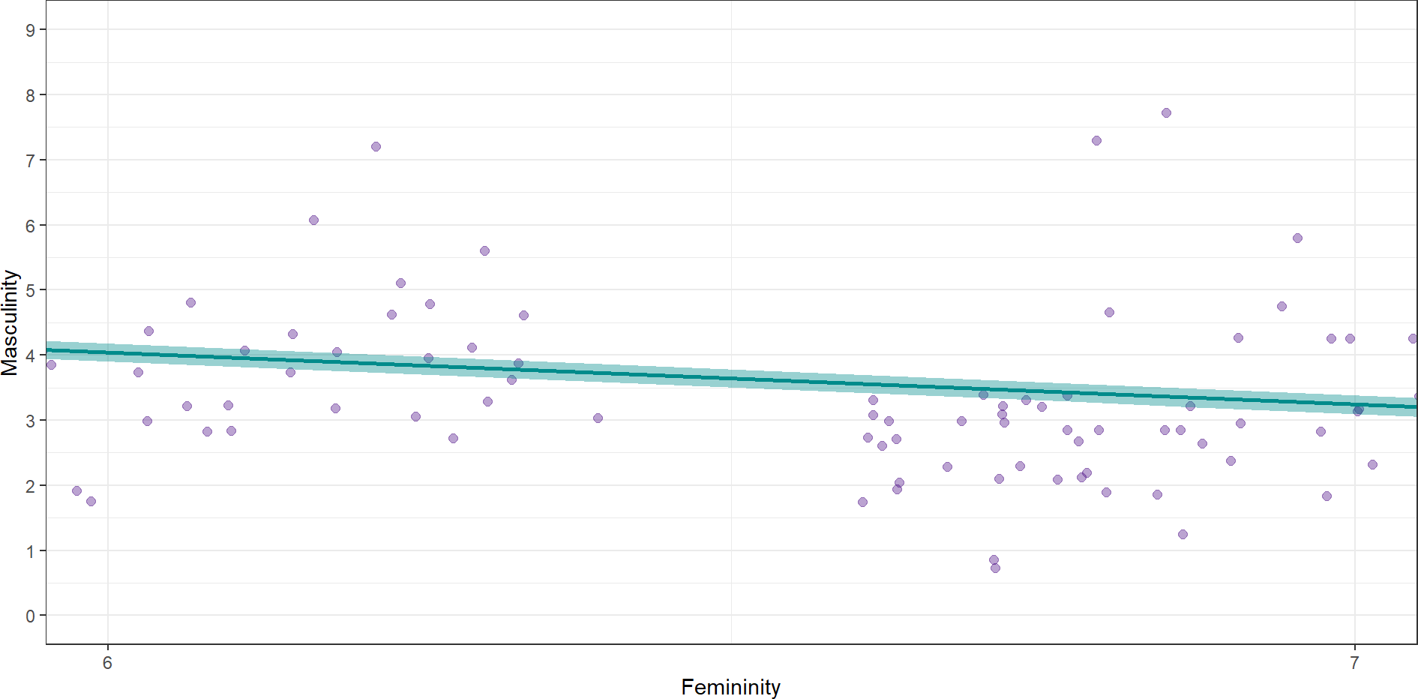
Estimating the Slope

Slide 20
Using the Model to Predict Masculinity
We can make some guesses based on the plot:
The line would cross 0 on the x-axis (aka, the y-axis) somewhere between 8 and 9
b₀ ≈ 8.5
For every unit increase on the femininity (predictor, x) scale, masculinity (outcome, y) decreases by a little less than one point
b₁ ≈ −0.8

Slide 21
Using the Model to Predict Masculinity
We can then plug those values into our model…
We have already plugged in our outcome (masculinity) and predictor (femininity):
Masculinity_{i} = b₀ + b₁ × Femininity₁i + e_{i}
We also know the intercept (aka b₀ , aka the predicted value of masculinity when femininity is 0) is ≈
8.5, so we can plug that in:
Masculinityi = 8.5 + b₁ × Femininity₁i + ei
We also know the slope (aka b₁ , aka the change in masculinity associated with a unit change in femininity) is ≈ -0.8, so we can plug that in (note the sign change):
Masculinity_{i} = 8.5 − 0.8 × Femininity₁i + e_{i}

Slide 22
Using the Model to Predict Masculinity
Before we use the equation to predict masculinity, let’s get the real beta values from R…
Call:
lm(formula = gender_masc ~ gender_fem, data = gensex)
Coefficients: (Intercept) gender_fem
8.8246 -0.7976
Adapt our equation to include the real b values:
Intercept (b₀ ): the predicted value of masculinity when femininity is 0
= 8.82
Slope (b₁ ): change in masculinity associated with a unit change in femininity
= -0.80
Masculinity_{i} = 8.82 − 0.8 × Femininity₁i + e_{i}

Slide 23
Using the Model to Predict Masculinity
Masculinity_{i} = 8.82 − 0.8 × Femininity₁i + e_{i}
For someone with a fairly low (on a scale of 1-9) femininity rating of 3:
Masculinity_{i} = 8.82 − 0.8 × 3 + e_{i} Masculinity_{i} = 6.42 + e_{i}
For someone with a fairly high (on a scale of 1-9) femininity rating of 8:
Masculinity_{i} = 8.82 − 0.8 × 8 + e_{i} Masculinity_{i} = 2.42 + e_{i}

Slide 24
Why Not Correlation?
ChallengR: Why Not Correlation?
You already saw this same data, and relationship, with the correlation analysis you did with this data in a previous lecture. Why are we doing something different? What do we get from the linear model that we don’t get from our correlation analysis?
Both correlation and the linear model can tell us about the strength and direction of the relationship…
… but only the linear model can predict the outcome for any value of the predictor Correlation and the linear model are related though - see this interactive visualisation!

Slide 25
Example 2: Predicting Better Sleep from Positive Psychology
Tout et al. (2023) were interested in the effect of positive psychology upon sleep Participants took part in a cross-sectional, self-report survey that asked them to rate their:
Positive psychology attributes (a composite of gratitude, optimism, self-compassion, and mindfulness)
Sleep quality and quantity (a composite of subjective sleep quality, sleep literacy, sleep duration, sleep efficiency, sleep disturbances, sleep medication, daytime dysfunction)
& a bunch of other things not relevant for today’s example
Hypothesis: Based on the evidence that other positive psychology attributes positively impacted sleep, Tout hypothesised that… positive psychology attributes will have a positive relationship with sleep quality and quantity

Slide 26
Operationalisation
Hypothesis: Positive psychology attributes are associated with better sleep
Predictor (x₁ ): Positive psychology attributes Outcome (y) : Sleep quality & quantity
Where would our predictor and outcome fit into the linear model equation:
yi = b₀ + b₁ × x₁i + ei ?
Talk to Me!
Open the Lecture Google Doc: https://bit.ly/AnD_lecture_08
Model: Sleepi = b₀ + b₁ × PositivePsychology₁i + ei
What about b₀ and b₁ …?

Slide 27
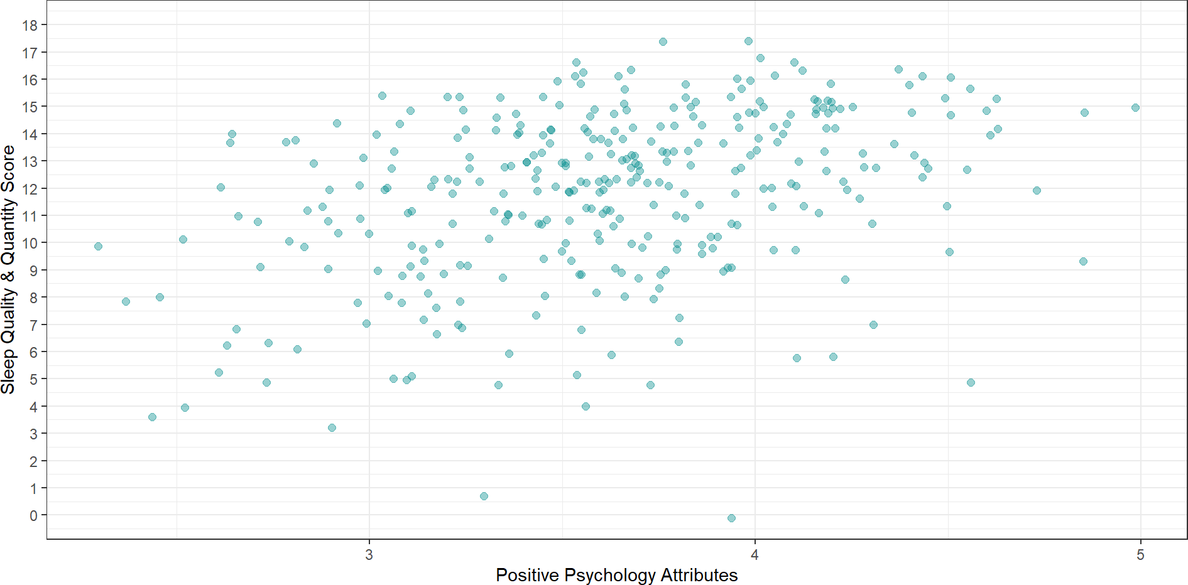
Visualising our Model (the Line)
Where would you draw a line through these dots that best captures where they tend to fall?

Slide 28
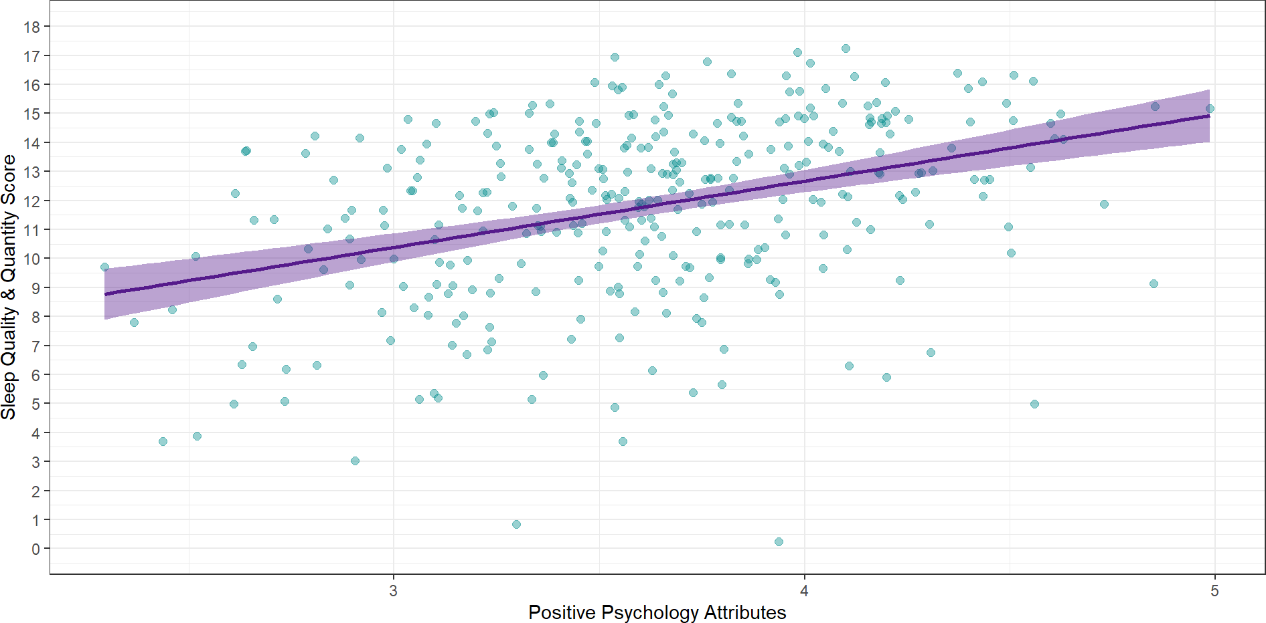
Visualising our Model (the Line)
Is this a positive or a negative relationship? How do we know?

Slide 29
Visualising our Model (the Line)
The individual scores (data points) tend to be higher up on the right and lower down on the left
As the variable on x (here, positive psychology attributes) increases…
… the variable on y (here, sleep quality & quantity) also increases
This represents a positive relationship between x and y: as one goes up, the other goes up

Slide 30
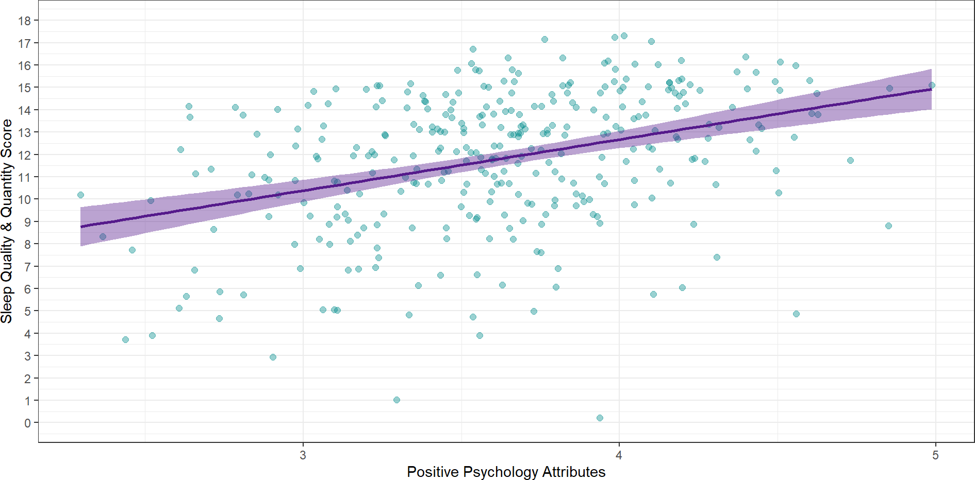
Visualising our Model (the Line)
Two key elements:
b₀ - the intercept (where the line crosses 0 on the x-axis)
b₁ - the slope (the gradient of the line - the difference in y for every unit increase in x)
What would you estimate these values to be?

Slide 31
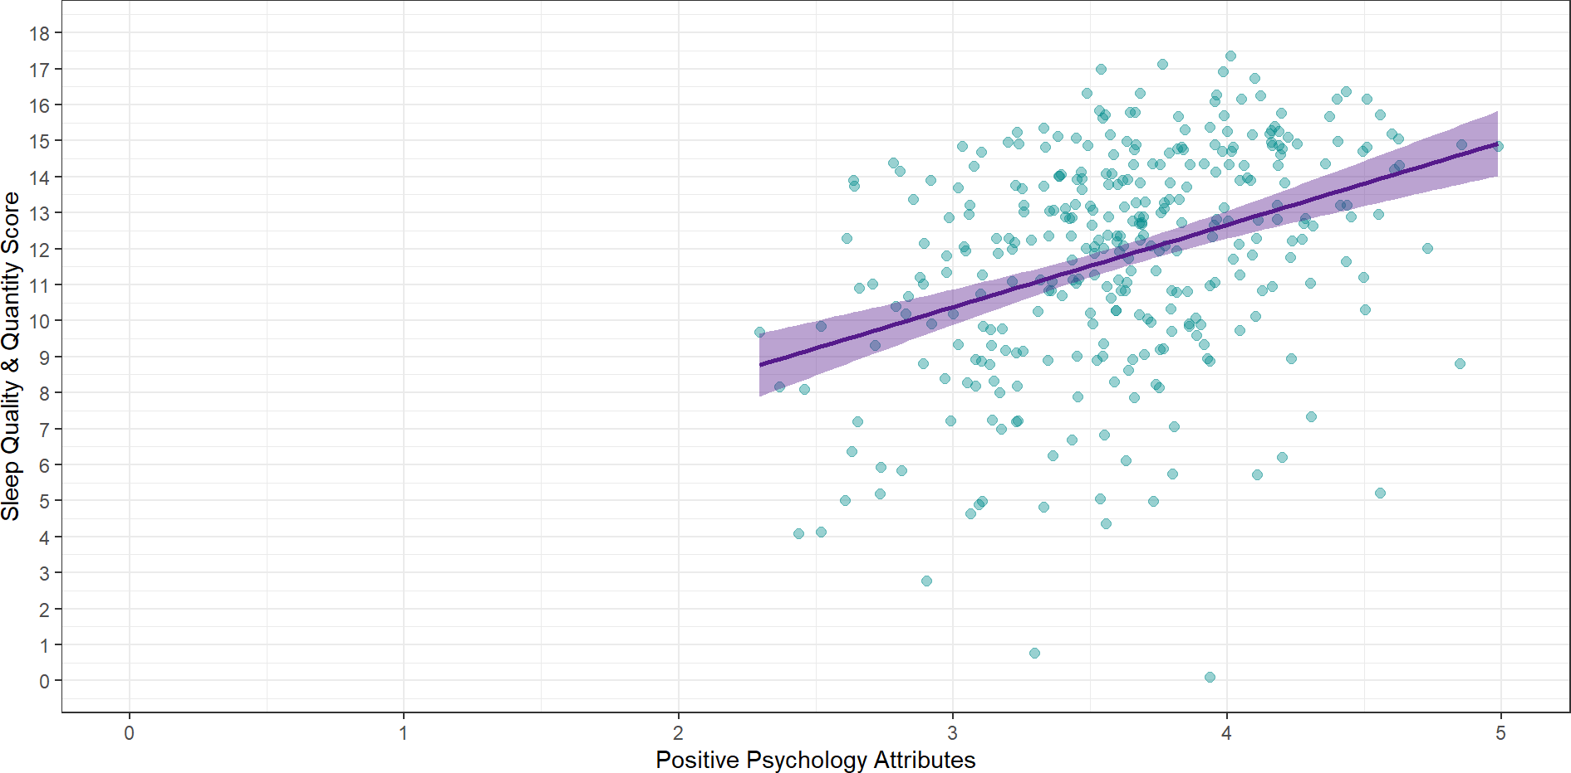
Estimating the Intercept

Slide 32
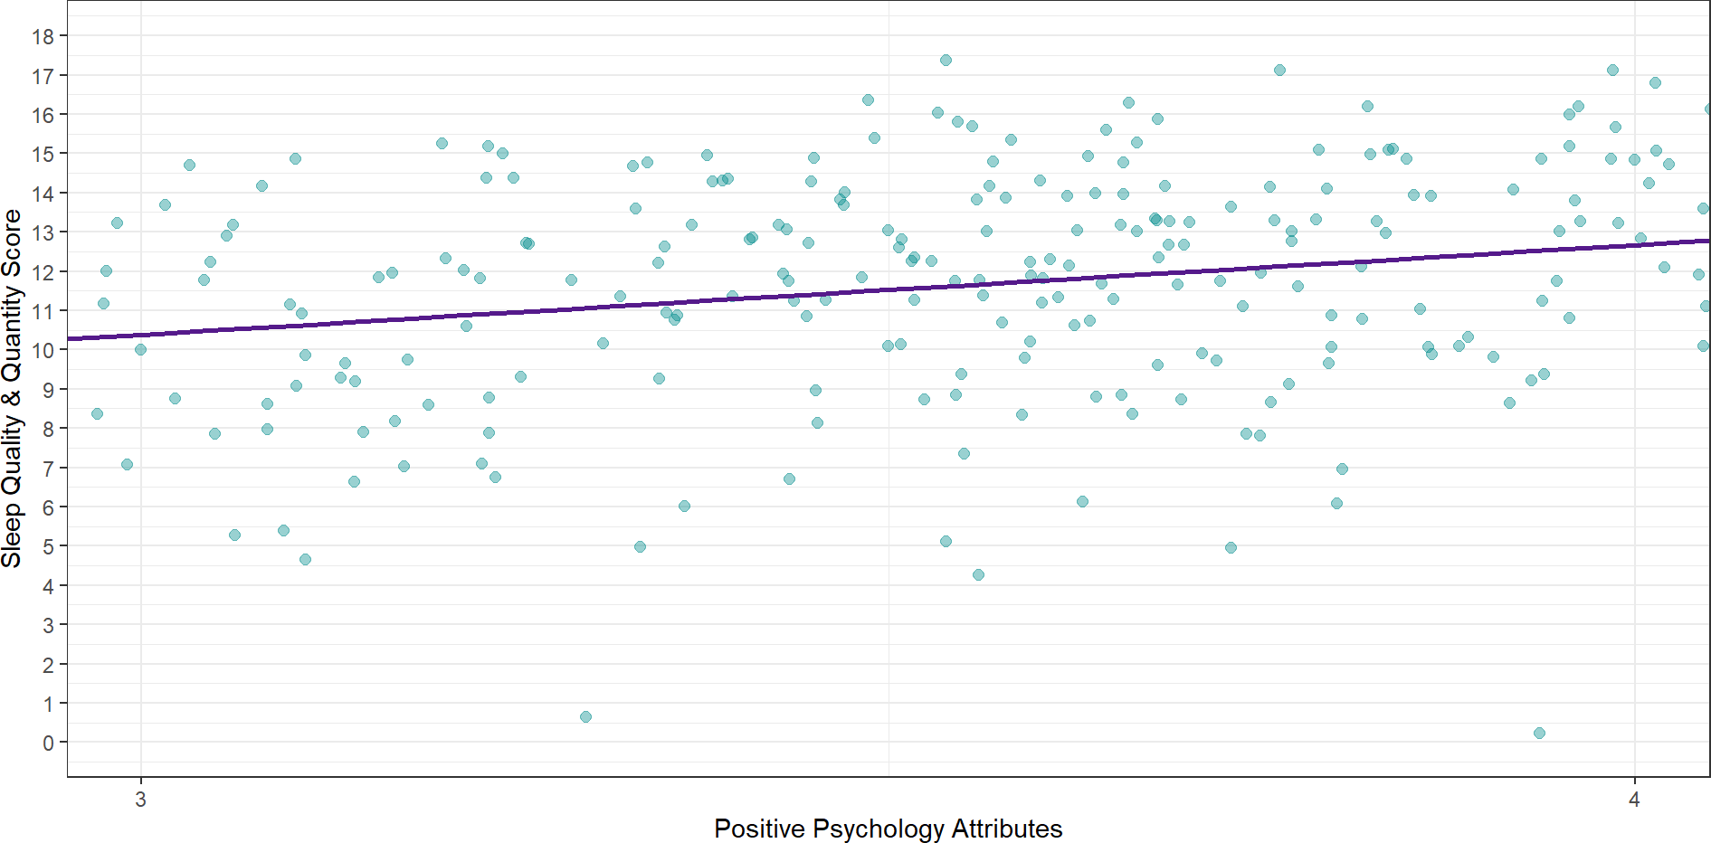
Estimating the Slope

Slide 33
Using the Model to Predict Sleep
Sleep = b₀ + b₁ × PositivePsychology₁i + e_{i}
Predictor (x₁ ): Positive psychology attributes Outcome (y) : Sleep quality & quantity
Intercept (b₀ ): the predicted value of sleep when positive psychology is 0
≈ 3.5
Slope (b₁ ): change in sleep associated with one unit change in positive psychology
≈ 2.2

Slide 34
Using the Model to Predict Sleep
Before we plug the intercept and slope into the equation, let’s get the more precise beta values from R…
Call:
lm(formula = sleep ~ pos_psy, data = sleep_tib)
Coefficients: (Intercept)
3.520
pos_psy 2.287
Can you adapt our equation to include the real b values?
Sleep = b₀ + b₁ × PositivePsychology₁i + e_{i}
Intercept (b₀ ): the predicted value of sleep when positive psychology is 0
= 3.52
Slope (b₁ ): change in sleep associated with a unit change in positive psychology
= 2.29

Slide 35
Using the Model to Predict Sleep
Sleep_{i} = 3.52 + 2.29 × PositivePsychology₁i + e_{i}
For someone with a fairly low positive psychology rating (on a scale of 1-5) of 1.5:
Sleep_{i} = 3.52 + 2.29 × 1.5 + e_{i} Sleep_{i} = 6.95 + e_{i}
For someone with a fairly high positive psychology rating (on a scale of 1-5) of 4:
Sleep_{i} = 3.52 + 2.29 × 4 + e_{i} Sleep_{i} = 12.68 + e_{i}

Slide 36
Summary
Vocabulary: The Linear Model
y_{i} = b₀ + b₁ × x_{1i} + e_{i}
A statistical model representing the linear relationship between a predictor and outcome
y_{i} : the (predicted value of the) outcome for an individual case What we’re trying to estimate
b₀ : the intercept - the value of the outcome when the predictor is 0 Obtained from our model, based on the data
b₁ : the slope - the change in the outcome for every unit change in the predictor Obtained from our model, based on the data
x_{1i} : (any individual case value for) the predictor
We can plug in any value of the predictor to get the predicted outcome
e_{i} : the (unknown and unknowable) error in prediction

Slide 37
Welcome to the World of Linear Modelling
The linear model will be crucial for the rest of your degree, so if that was a bit of a blur to you, it’s highly recommended that you spend some time working through it slowly, until it clicks.
Here are some recommendations for extra sources of support: Statistics by Jim blog/videos (beginner)
Khan Academy’s introduction to linear equations (beginner)
Learning Statistics with R - see Section V, Chapter 15, Linear Regression (intermediate) Andy Field’s YouTube channel (intermediate)
CenterStat YouTube channel (advanced)
They cover a few points we don’t get into on AnD (especially the intermediate and advanced stuff), but these are the some of the clearest explanations of the linear model and associated concepts I’ve ever encountered, so I highly recommend them.

Slide 38
Next Week
Recap of the Linear Model
How do we know if it is a good model? How do we know if it is a good prediction?

