Slide 1
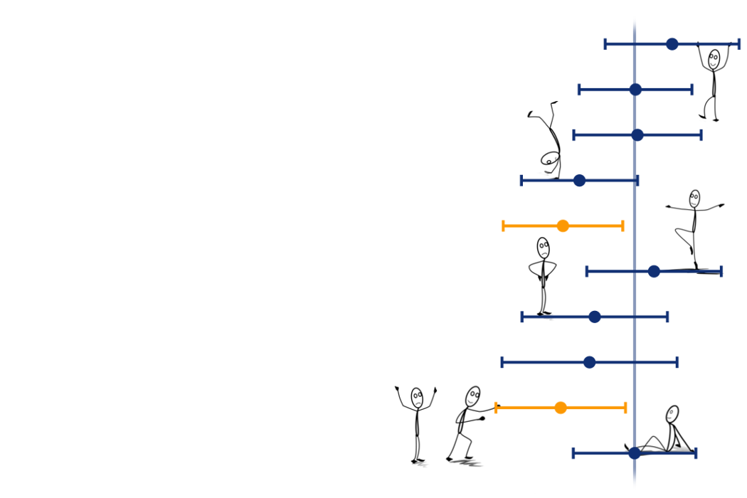
Uncertainty, standard errors and confidence intervals
Dr. Martina Sladekova

Slide 2


Slide 3


linktr.ee/analysingdata
Session links

Slide 4
Recap

Slide 5
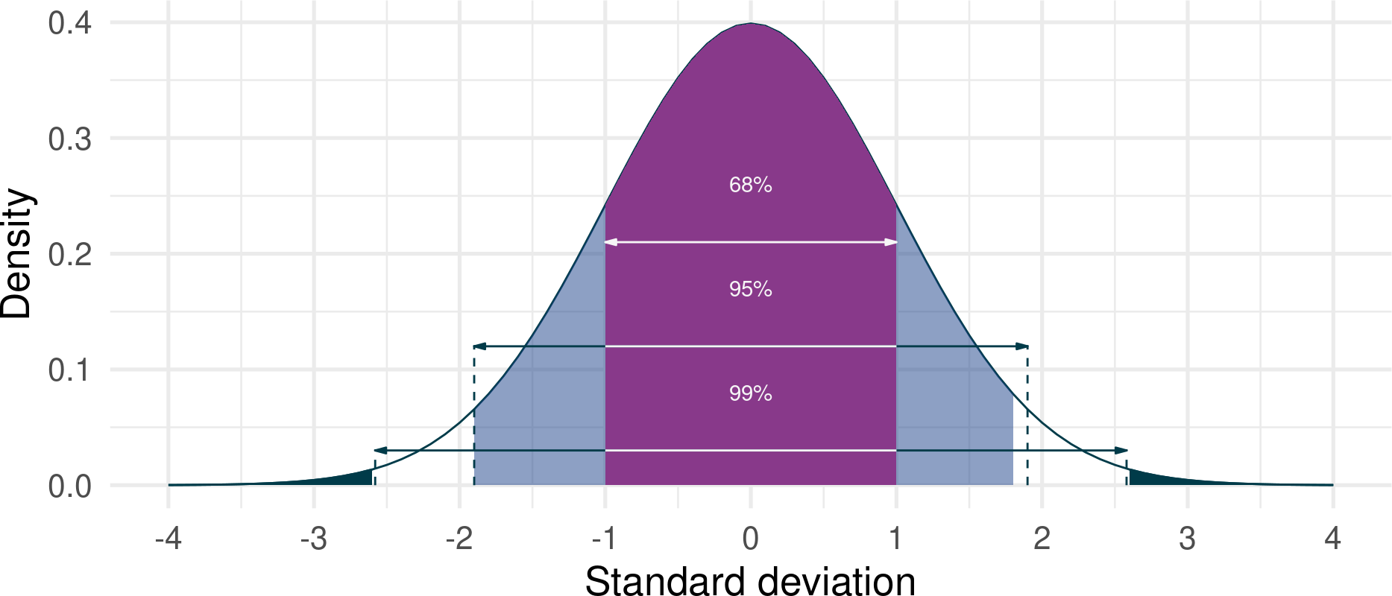
Recap
Distributions describe how often different values occur - in a sample or a population. “Mathematically defined” dsitribution are useful - we kow how probable scores are.
Normal distribution - defined by mean, standard deviation, and proportions of scores expected above/below critical values

Slide 6

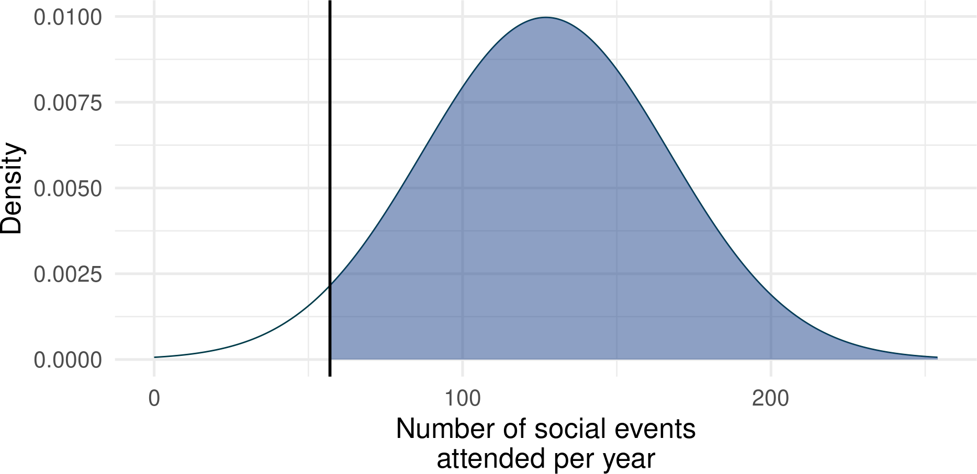
Recap
Key idea
Assuming a distribution of a particular shape, how common is a given value?
Average individual attends 127 social events per year.
Assume a population with M = 127 and SD
= 40 (e.g. based on collected sample)
Is an individual who attends 57 social events per year unusual?
In the assumed normal distribution, only 4 % of people attend less than 57 events per year.
1 1-pnorm(57, mean = 127, sd = 40, lower.tail = FALSE)
[1] 0.04005916

Slide 7
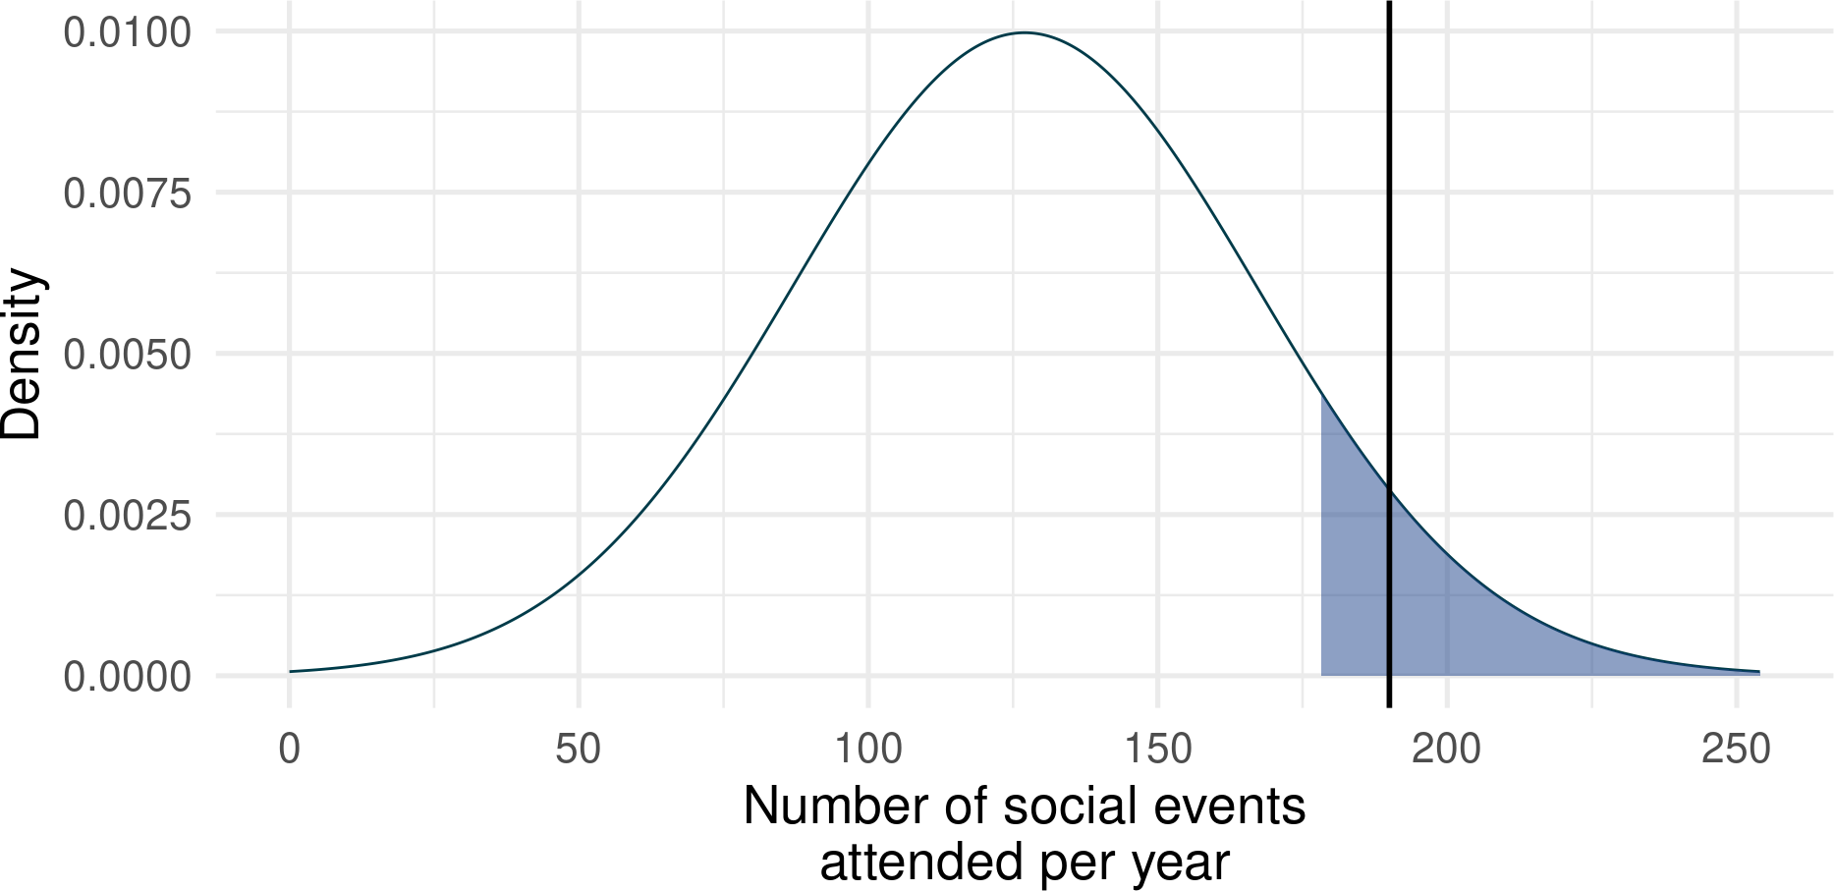
Recap
Key idea
Assuming a distribution of a particular shape, is the value we’re interested in above or below a specific cut-off point?
Assuming the same distribution (M = 127, SD = 40) is an individual who attends 190 social events per year among the top 10% of event-goers?
In the assumed normal distribution, an individual would have to attend 178 events or more to be in the top 10% of event goers.
Therefore a person who attends 190 events is in the top 10%.
1 qnorm(p = 0.9, mean = 127, sd = 40)
[1] 178.2621
How many social events cut-off the top 5%?
1 qnorm(p = 0.05, mean = 127, sd = 40, lower.tail = FA
[1] 192.7941
7

Slide 8
PollEverywhere:
Let’s practice probability and critical values
Link tree:
linktr.ee/analysingdata

Slide 9
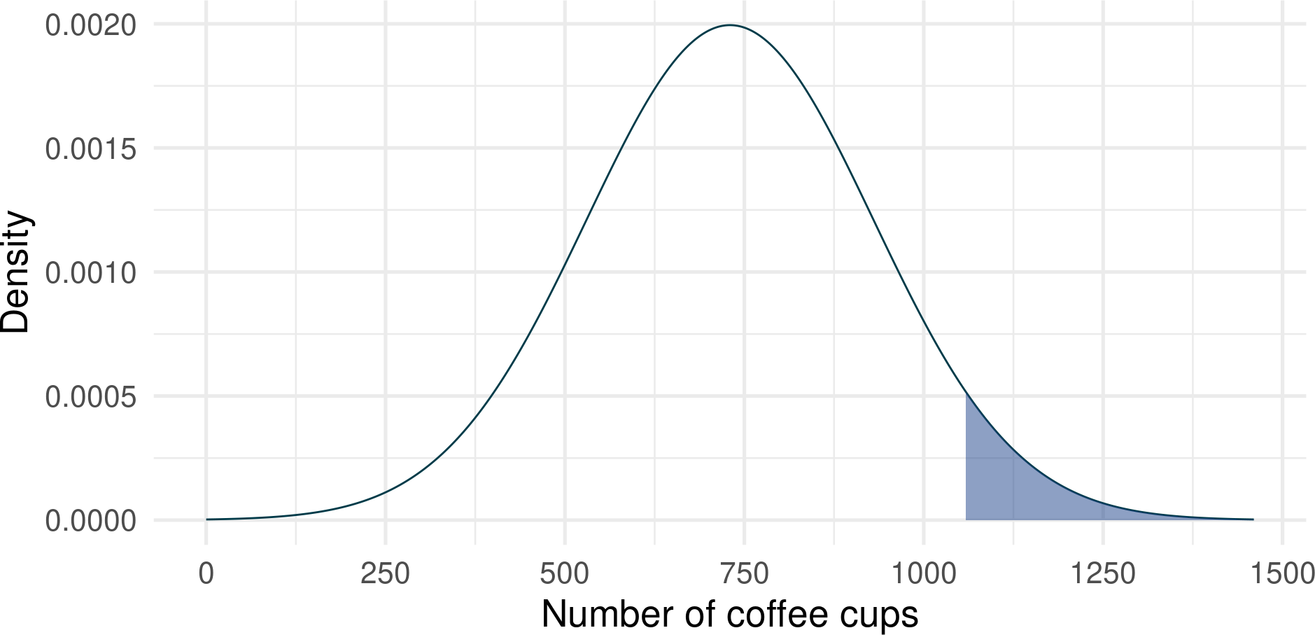
Let’s practice (1)
Example 1: Average individual drinks 730 cups of coffee per year. Jennifer drinks 1100 cups of coffee per year. Is Jennifer in top 5% of the distribution (shaded)?

Slide 10
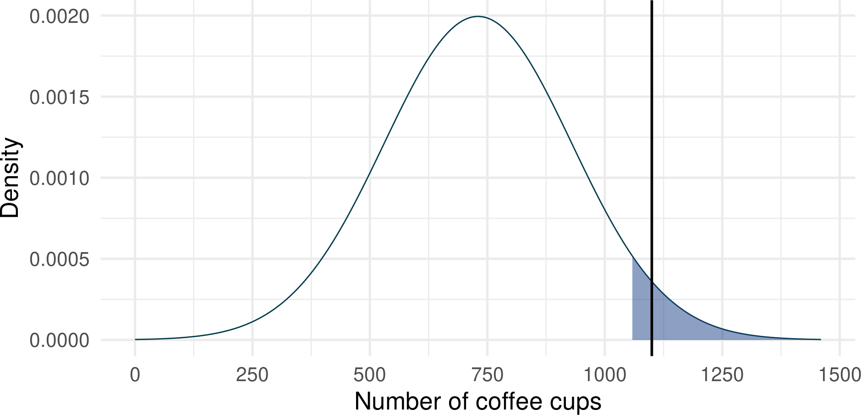
Let’s practice (1)
Example 1: Average individual drinks 730 cups of coffee per year. Jennifer drinks 1100 cups of coffee per year. Is Jennifer in top 5% of the distribution (shaded)?

Slide 11
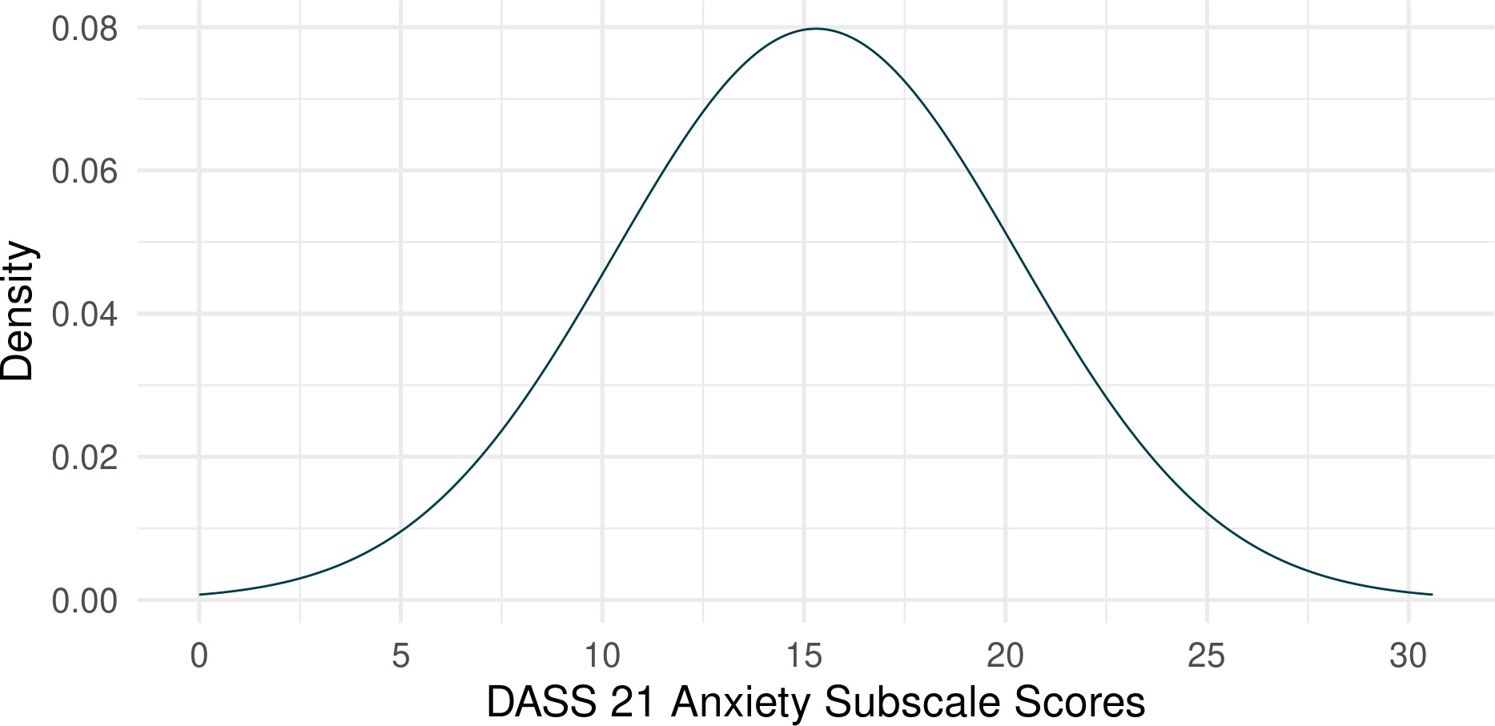
Let’s practice (2)
Example 2: A critical value for the bottom 5% on an anxiety scale is 7.08. A study participant receives a score of 8. Are they in the bottom 5%?

Slide 12
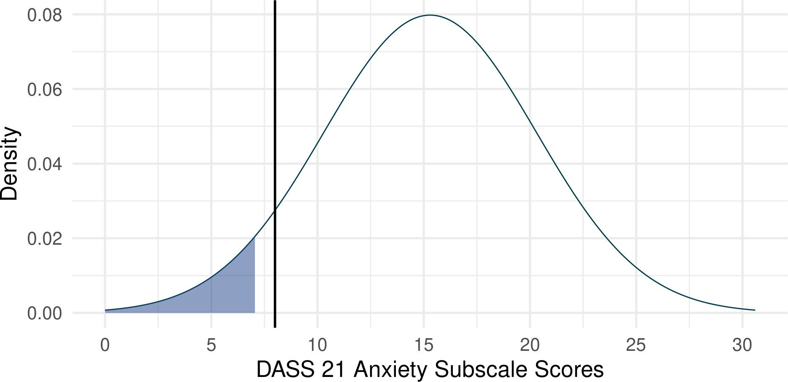
Let’s practice (2)
Example 2: A critical value for the bottom 5% on an anxiety scale is 7.08. A study participant receives a score of 8. Are they in the bottom 5%?

Slide 13
Today
Sampling from populations - the broader picture
Uncertainty in research and estimation
Sampling distributions and the Central Limit Theorem
Standard error of the mean
Confidence intervals: what they are, and what they are not

Slide 14
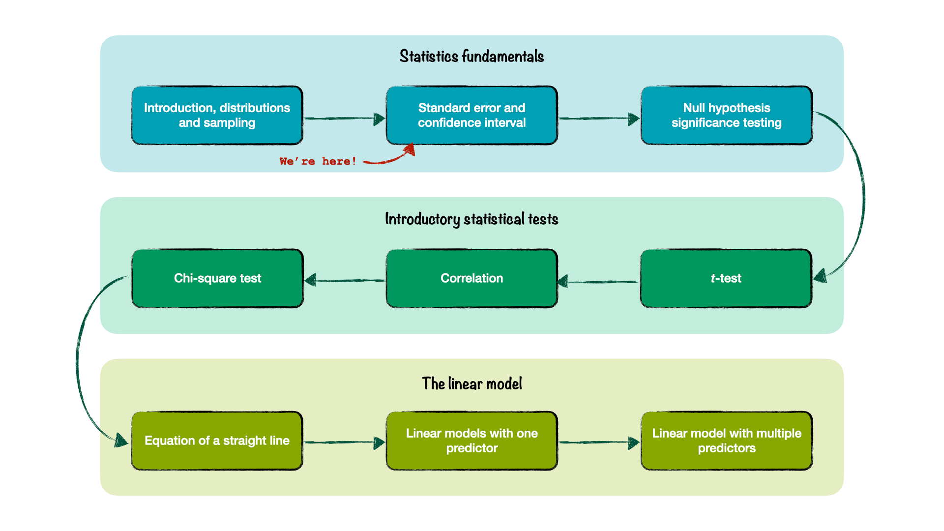
Where are we?

Slide 15
Uncertainty in estimation

Slide 16
Samples and populations
So far we:
Described a sample
Assumed a mean and standard deviation for a population
Looked at individuals How unusual are they?
Are they far from the mean?
Are they above or below some critical value?

Slide 17
Samples and populations
In research, we often want to know:
How well does our sample represent the population?
Is our sample unusual (under certain assumptions we make about the population)?

Slide 18
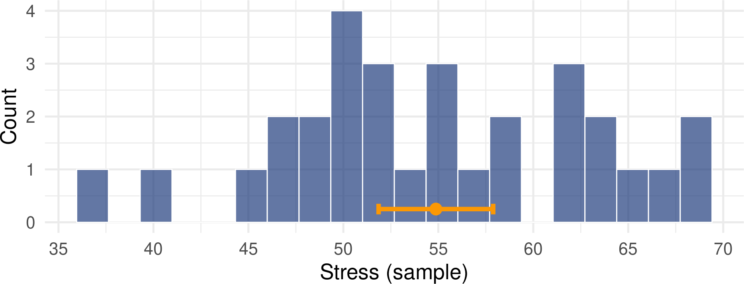
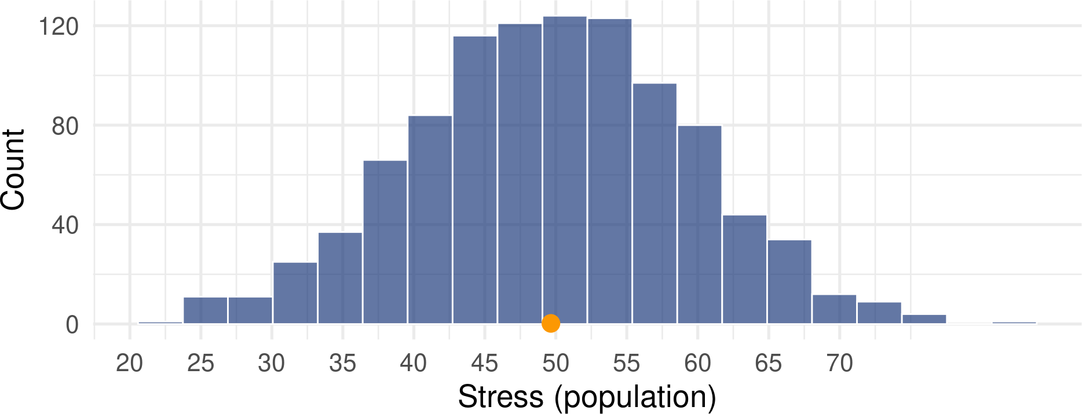
Samples and populations
THE PROBLEM: Samples are not perfect representations of populations
There is uncertainty around how close the sample mean matches true population value.
Standard errors and confidence intervals are tools we use to quantify that uncertainty.

Slide 19
Samples and populations
The sample estimate is our best guess
The population value we’re trying to estimate is called the parameter

Slide 20

Parameter estimates
What is an estimate?
A parameter estimate can take many different forms. We might want to:
Estimate a typical value of a single variable in a population
Estimate group differences for a variable
Estimate strength of association between two or more variables (e.g. a correlation coefficient, or slope of a straight line).
The average person…
drinks 730 cups of coffee per year (twice as much for academics, incl. students) ☕
spends 192 minutes a day watching TV 📺 eats 250 cloves of garlic per year 🧄 takes 3500 steps each day 🚶
falls asleep in 7 minutes 😴

Slide 21
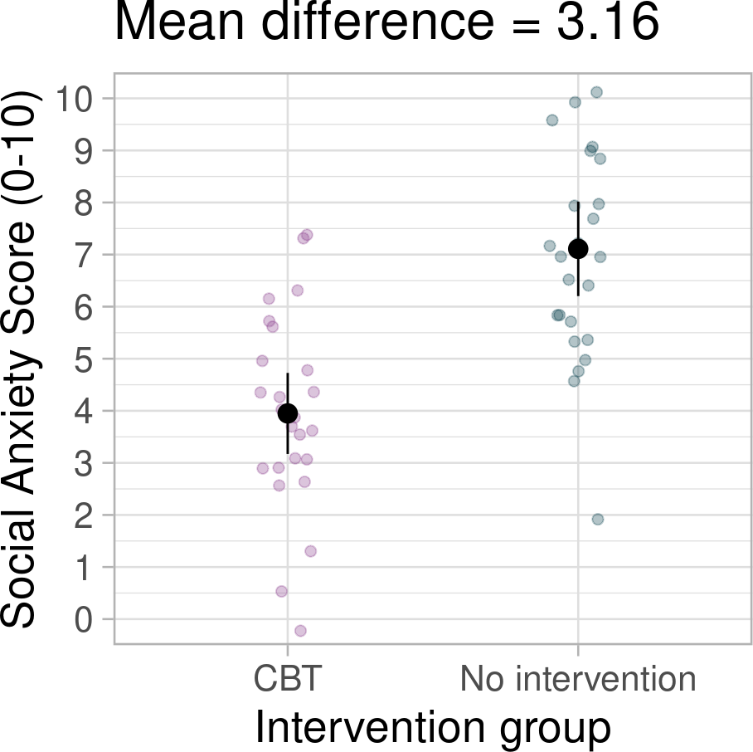
Parameter estimates
What is an estimate?
A parameter estimate can take many different forms. We might want to:
Estimate a typical value of a single variable in a population
Estimate group differences for a variable
Estimate strength of association between two or more variables (e.g. a correlation coefficient, or slope of a straight line).

Slide 22
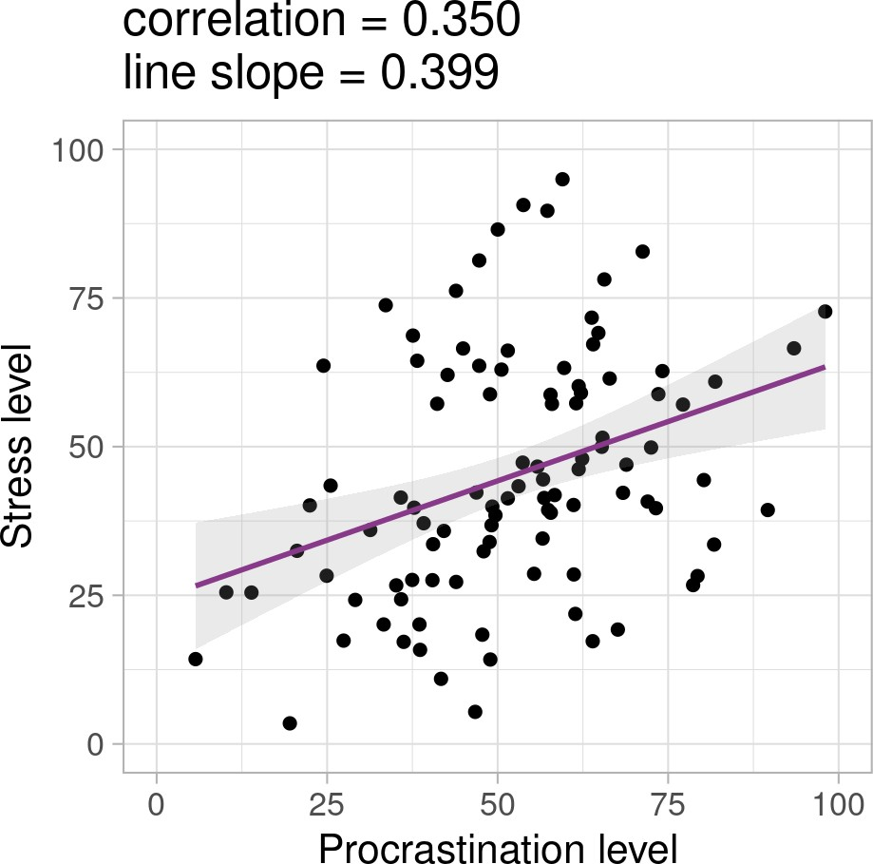
Parameter estimates
What is an estimate?
A parameter estimate can take many different forms. We might want to:
Estimate a typical value of a single variable in a population Estimate group differences for a variable
Estimate strength of association between two or more variables (e.g. a correlation coefficient, or slope of a straight line).

Slide 23

Today’s example
Doomscrolling
“… refers to a unique media habit where social media users persistently attend to negative information in their newsfeeds about crises, disasters, and tragedies.”
- Sharma, Lee, and Johnson (2022)
Research question…
How much does an average person doomscroll?

Slide 24
Doomscrolling poll
Group 1: Right side of the room Group 2: Middle of the room Group 3: Left side of the room
linktr.ee/analysingdata

Slide 25
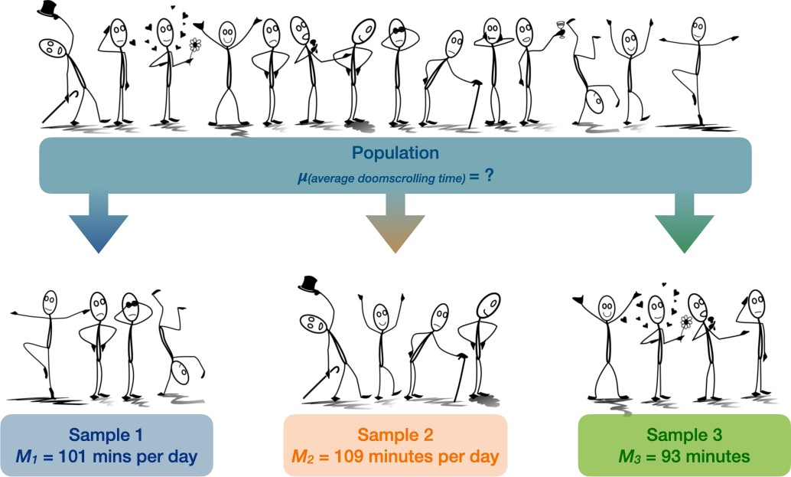

Slide 26
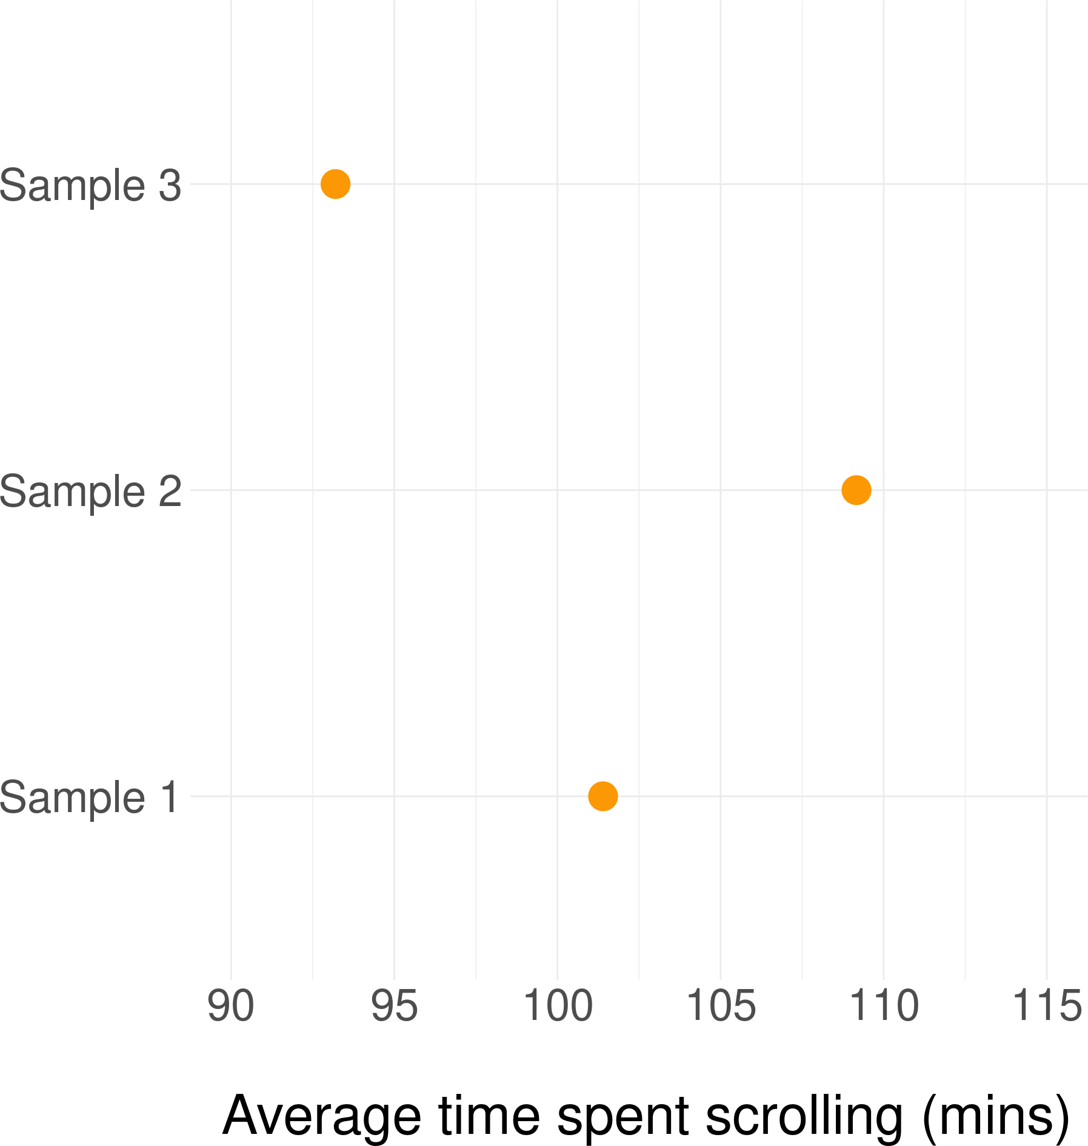
Uncertainty in research and estimation
Each time we take a sample, we get a different estimate
This is because of random sampling
How do we know if our estimate is accurate and close to the real population value?

Slide 27
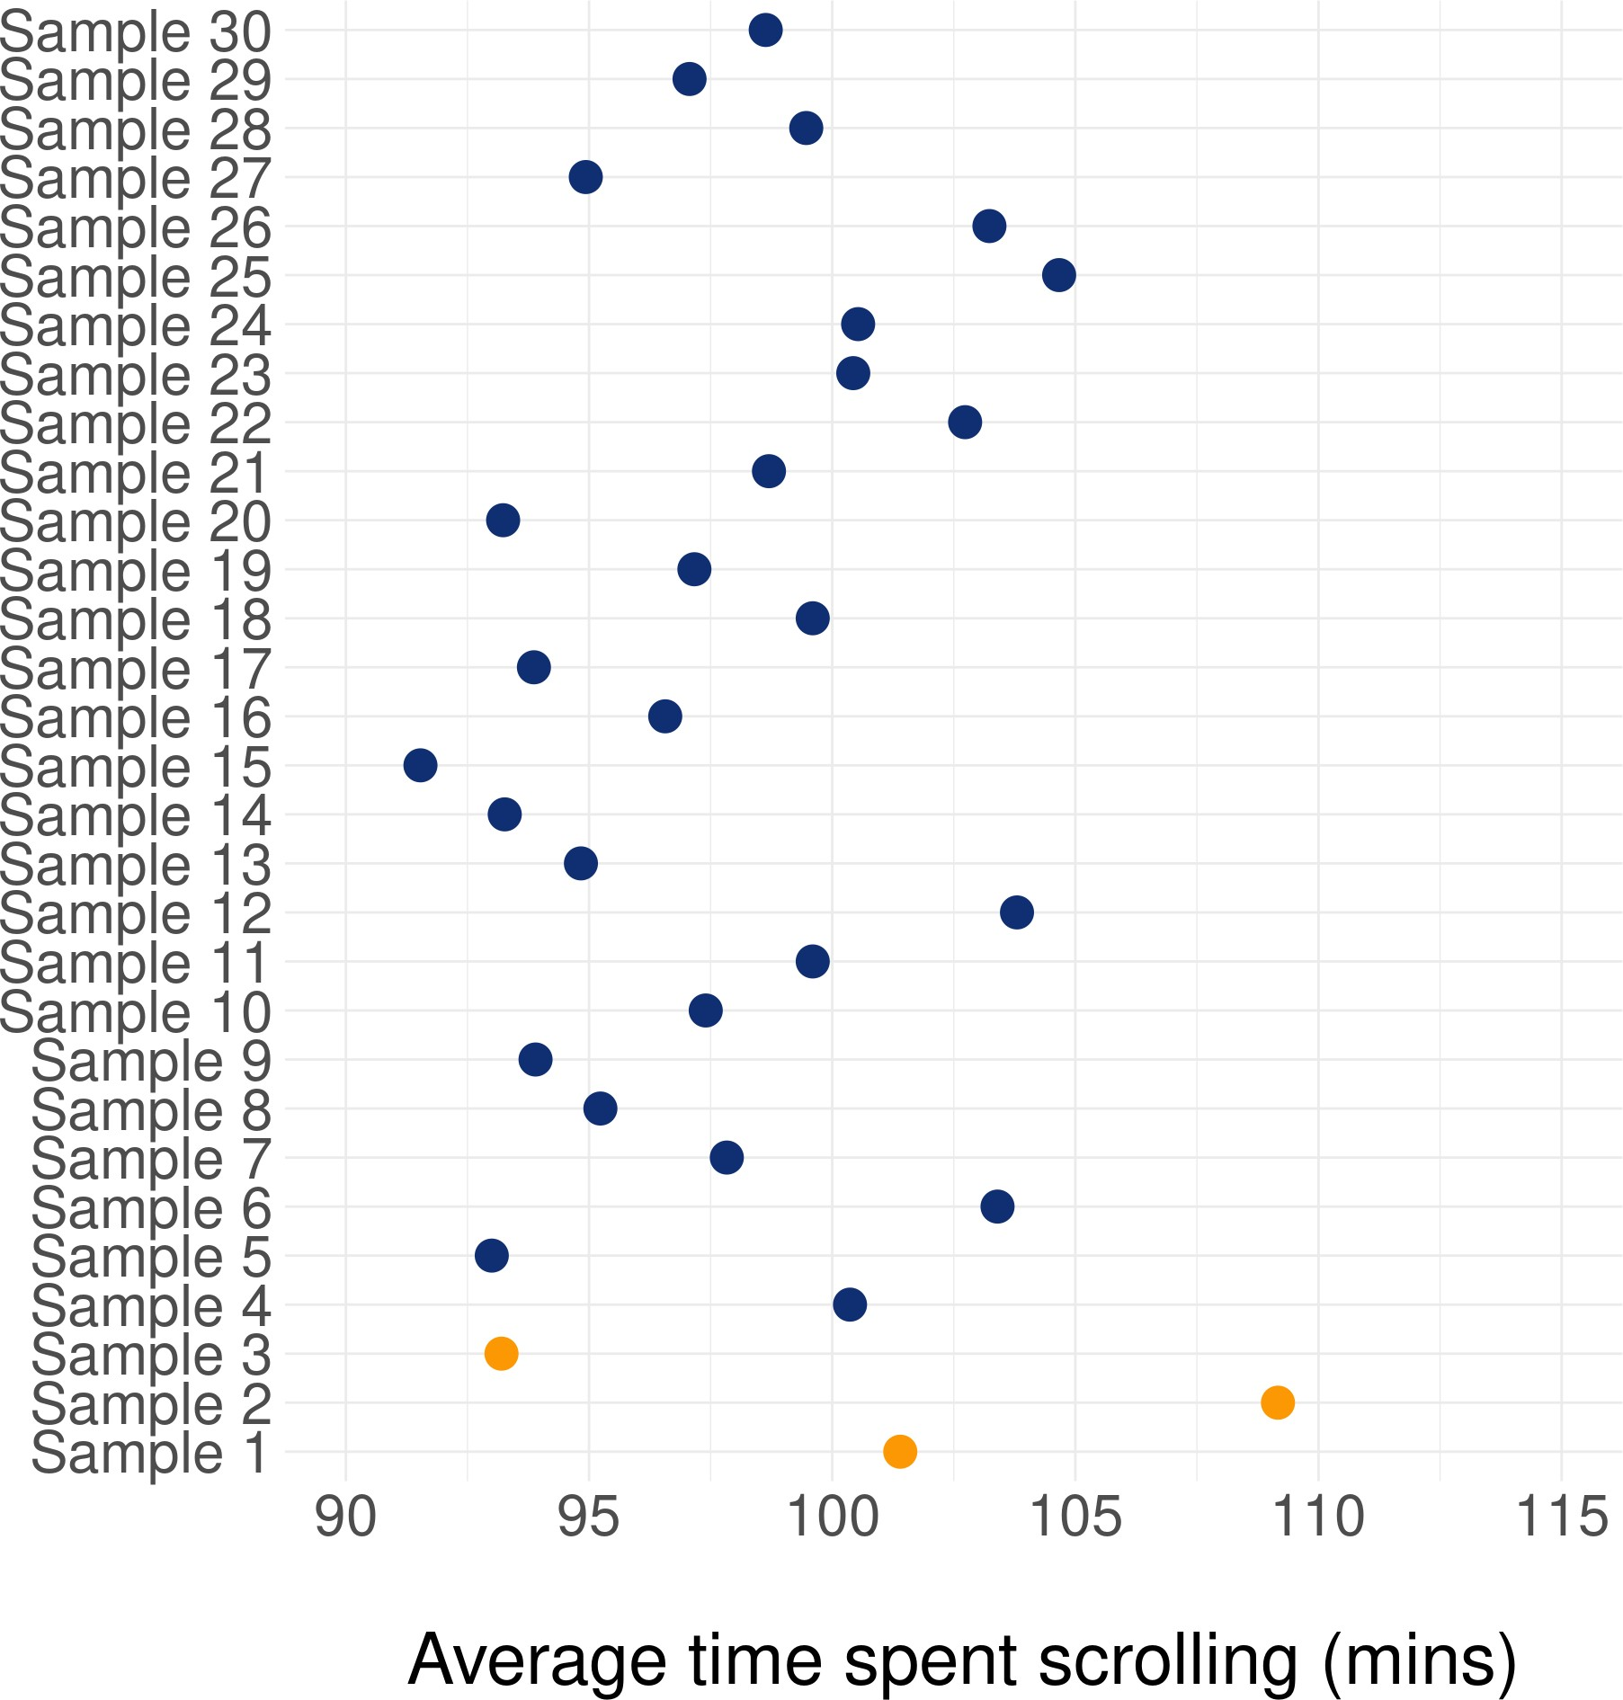
Uncertainty in research and estimation
Each time we take a sample, we get a different estimate
This is because of random sampling
How do we know if our estimate is accurate and close to the real population value?
We can never be certain - we need to be able to quantify this uncertainty

Slide 28
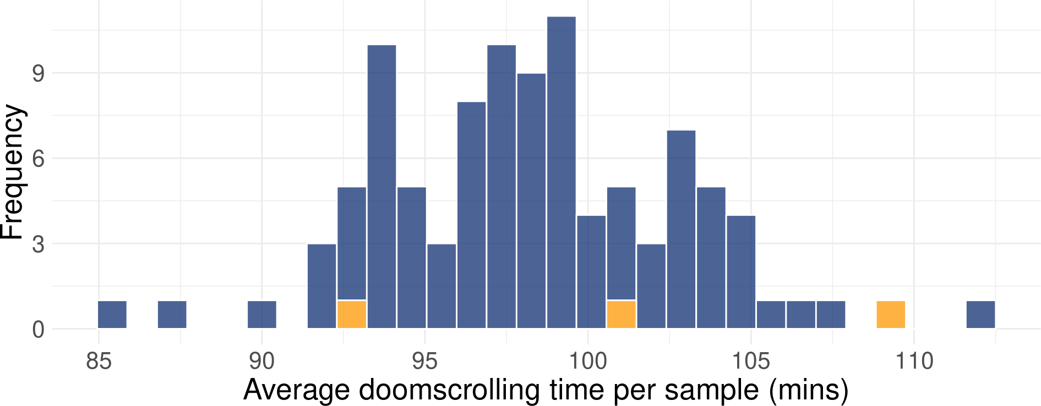
Sampling distributions
We can plot the sample estimates in a histogram to see how they’re distributed
We’re now working with sample means, not the scores of individual people. Therefore the plot below shows a sampling distribution.

Slide 29
The Central Limit Theorem
Describes how sampling distributions arise
Imagine we repeat the following process thousands (infinite) number of times:
Collect a sample of individuals
Calculate mean doom-scrolling time in that sample
Save this mean value and put it on the plot
Repeat

Slide 30
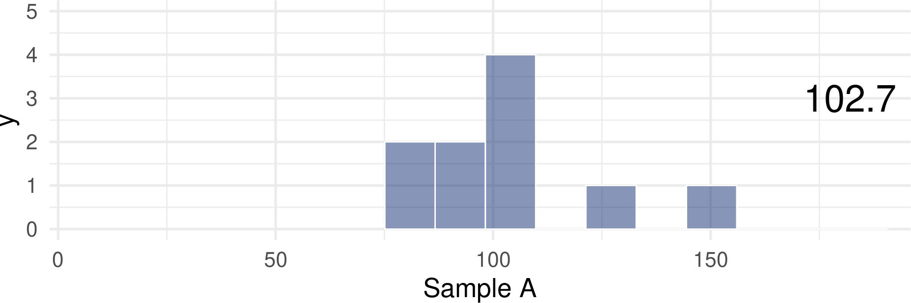

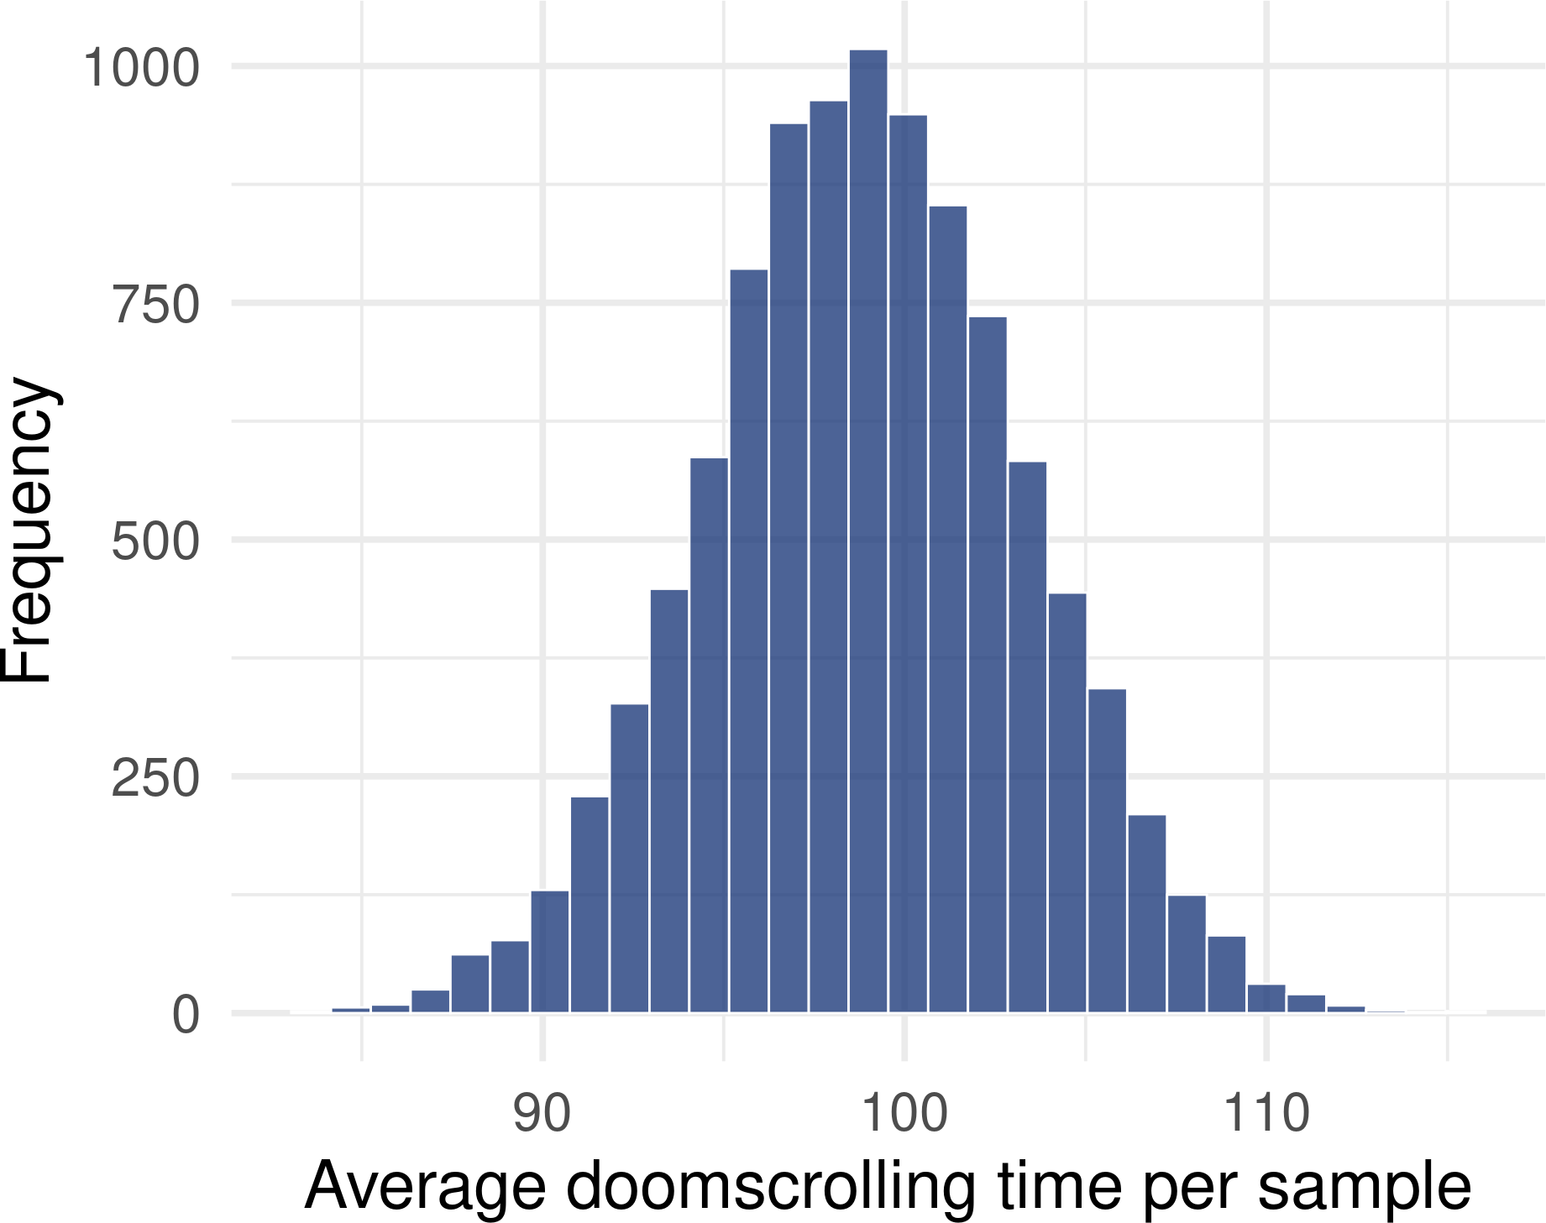
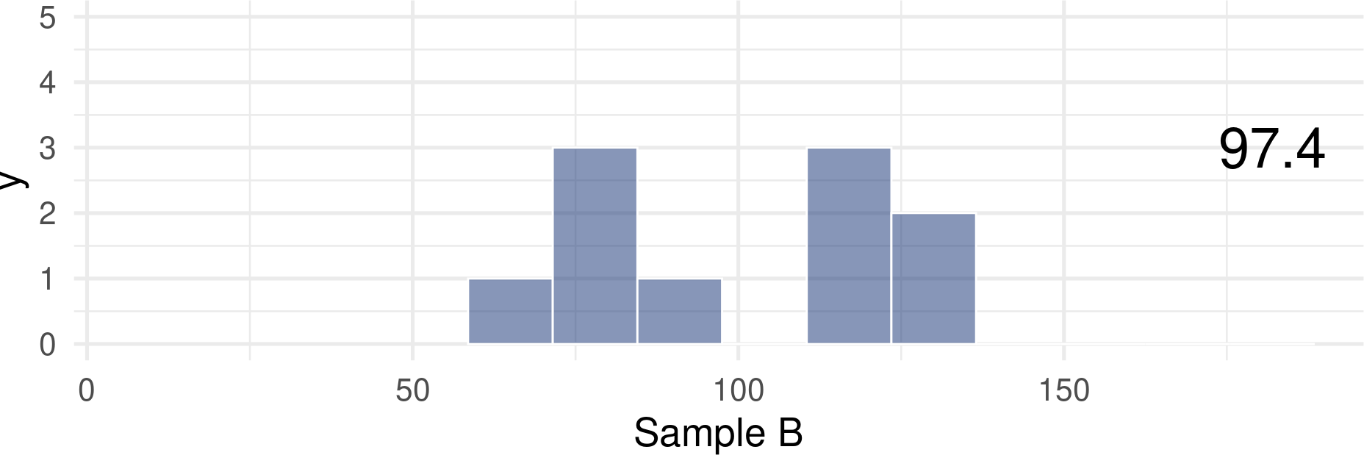
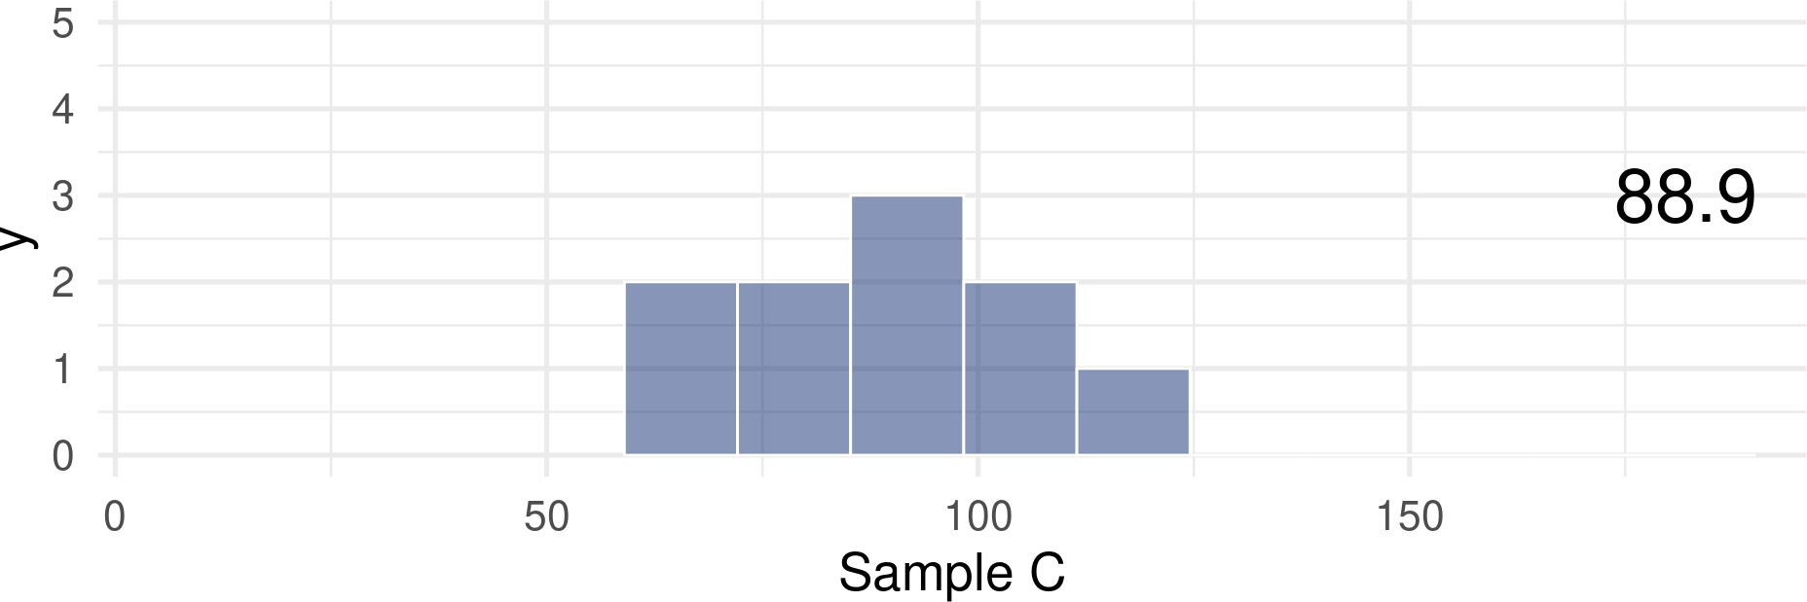
The Central Limit Theorem

Slide 31
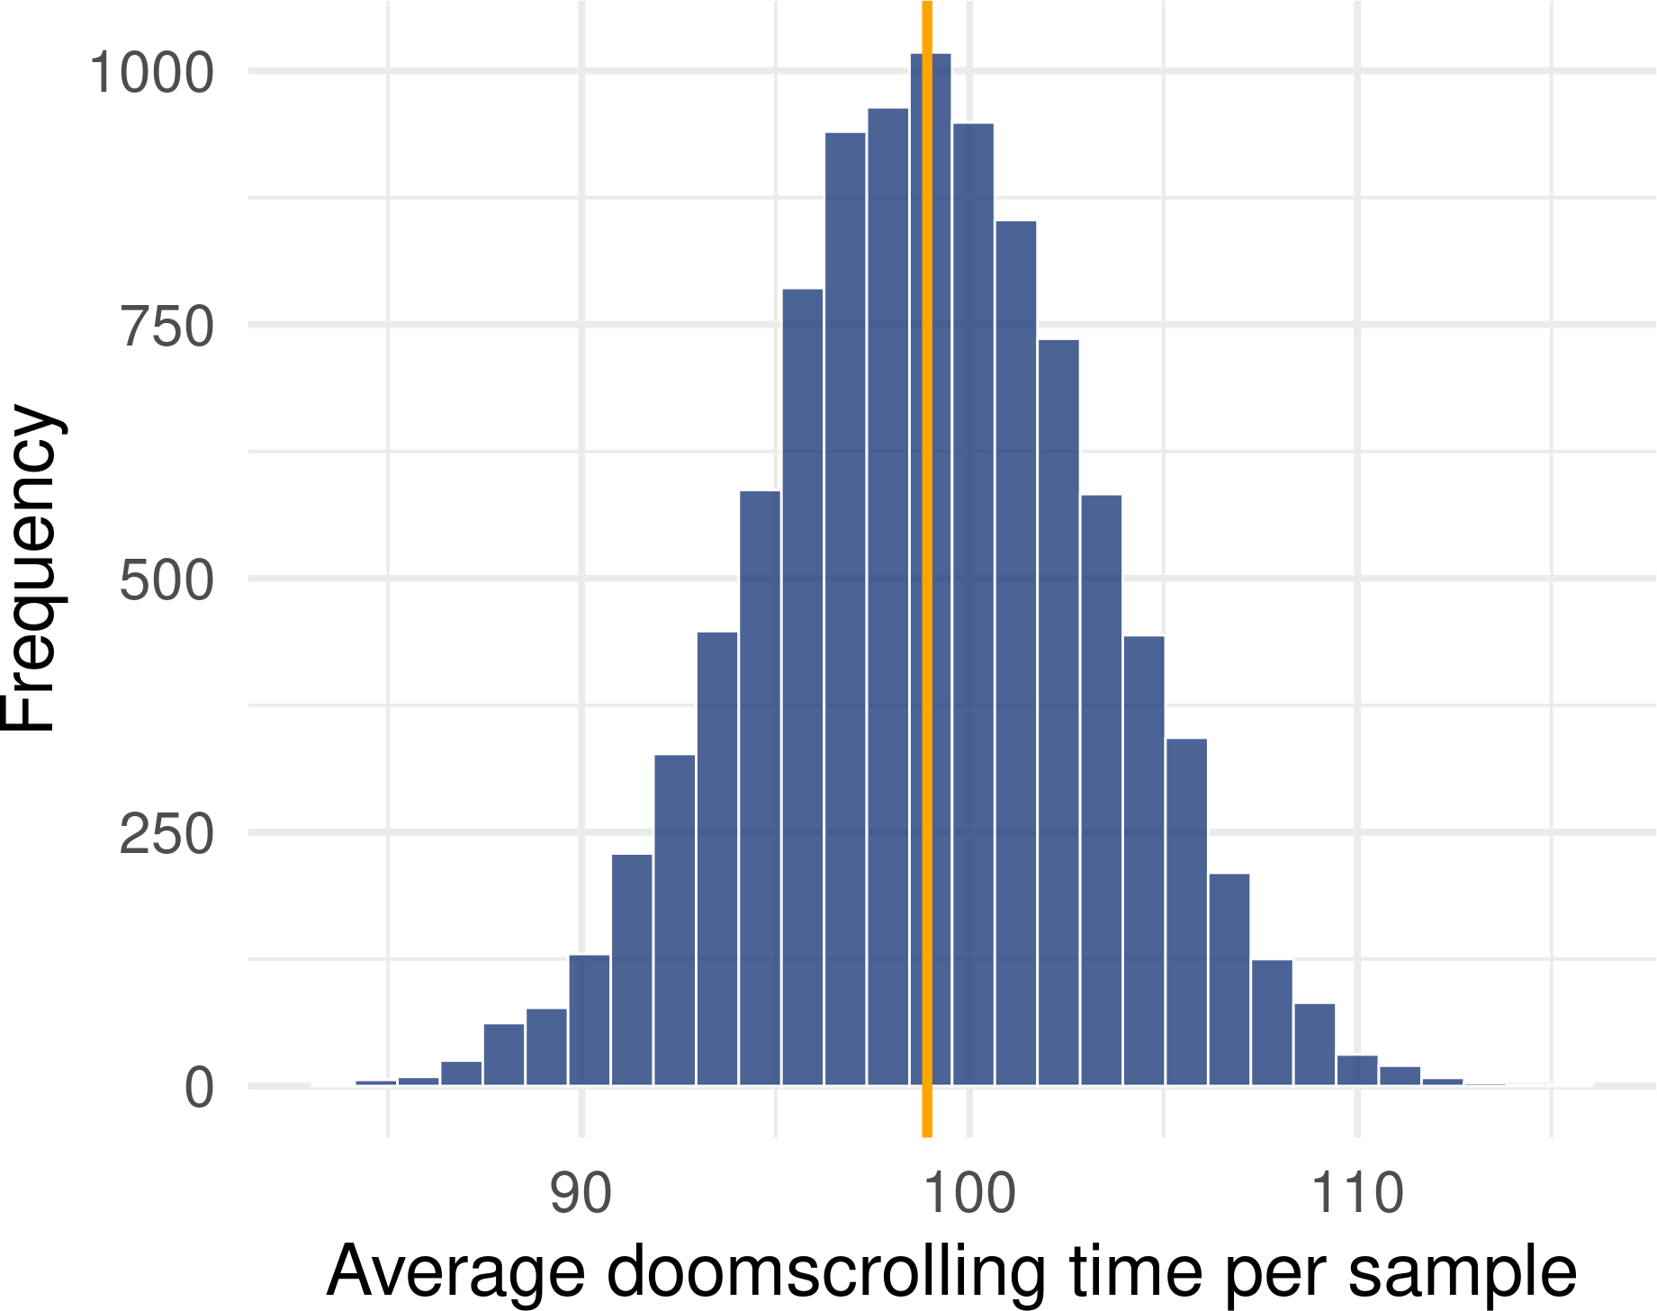
The Central Limit Theorem
For many types of estimates, including means, the sampling distribution will be normal
The centre of the sampling distribution will be the
population parameter
True regardless of the sample distribution or the population distribution.
As long as the samples that we’re taking are large enough
If each sample has only 3 participants, the sampling distribution might not end up being normal
Textbooks often say that 30 is enough, but there are situations when we might need more
Let’s put a pin in this and we’ll get back to it later
📌

Slide 32
📌Attendance pin🧷

Slide 33
Standard error

Slide 34
Normal distribution - what we already know
We can describe every normal distribution using:
Mean - the central value
Standard deviation (SD) - the average difference from the mean
Proportions of scores at cut-off points
Around 68% of scores are within 1 SD of the mean 95% of scores are within ± 1.96 SDs of the mean

Slide 35
Normal sampling distribution
Same rules apply!
The mean of a sampling distribution will be centered on the population value
LANGUAGE CHANGE: when talking about standard deviation in the context of a sampling distribution, we call it standard error.
Standard deviation
The average difference between each score and the sample mean
Standard error
Standard deviation of sample means
The average difference between each sample mean and the population value

Slide 36
Normal sampling distribution
We know that 95% of sample means will fall within 1.96 standard errors from the population mean
We can use this knowledge to construct an interval around the mean - 95% of sample means will fall within this interval.

Slide 37
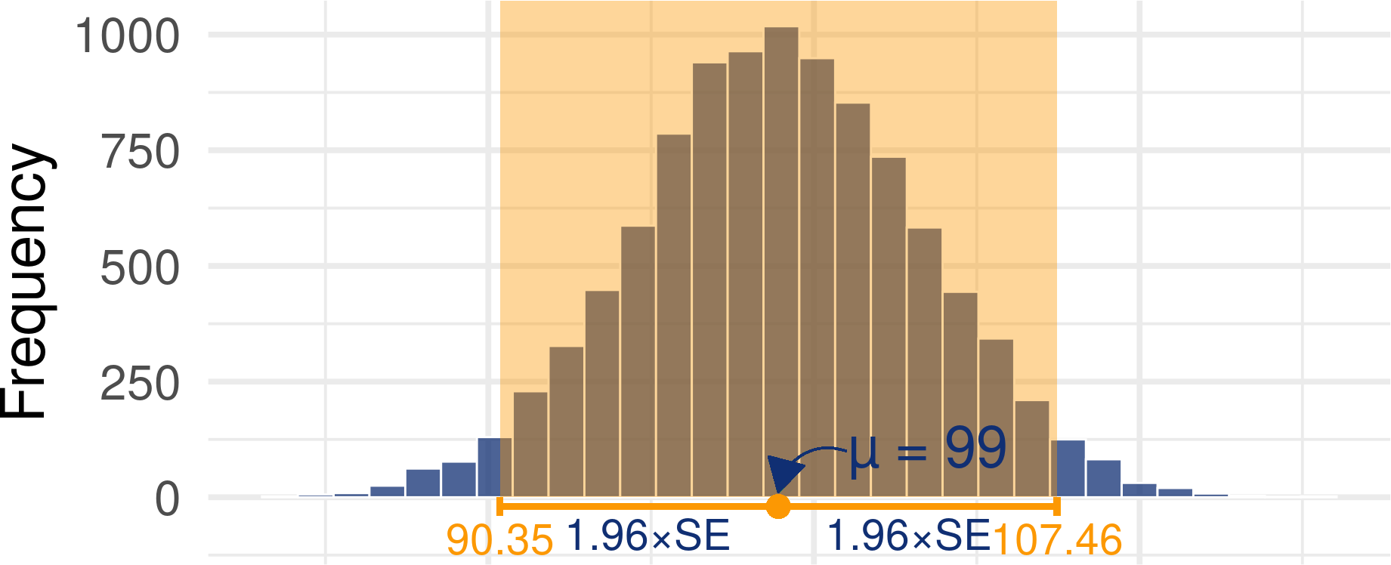
Normal sampling distribution
We know that 95% of scores will fall within 1.96 standard errors from the population mean
We can use this knowledge to construct an interval around the mean - 95% of sample means will fall within this interval.

Slide 38
Standard error
Standard error is a useful metric for quantifying uncertainty in estimates - it describes the extent to which samples differ from each other in a sampling distribution
We can use it to construct an interval within which a certain percentage of sample means will fall However…

Slide 39
Estimating the standard error from the sample
Sampling distributions don’t exist “in the wild”. They are a hypothetical statistical concept.
Remember: standard error refers to the standard deviation of the sampling distribution (created by re-sampling and computing the mean infinite number of times), but we only have access one sample with one mean.
Therefore, if we want to use the standard error to construct an interval, we need to estimate it from our sample.

Slide 40
Estimating the standard error from the sample
Equation:
𝑆𝐷
𝑆𝐸 =
√𝑁
Translation:
sample standard deviation ^{standard error =} (the square root of) the sample size
In R:
1 se = sd(data$variable) / sqrt(n)
Note that the SE will be smaller for larger samples (because we’re dividing by a larger number).

Slide 41
Estimating the standard error from the sample
Example:
We collect a sample of 4 individuals.
Each person reports their daily doomscrolling time (in minutes): 86, 114, 97, 107 The mean for the sample is 101 minutes
The standard deviation is:
∑(𝑥_{𝑖} − 𝑥)²
(86 − 101)² + (114 − 101)² + (97 − 101)² + (107 − 101)²
𝑆𝐷 = √
= √
= 12.19
𝑁
4
Which makes the standard error:
𝑆𝐷
𝑆𝐸 =
= ^{12.19} = 6.095
√𝑁
√4

Slide 42
Confidence intervals

Slide 43


Confidence intervals
Average doomscrolling time for the sample: 101 minutes
Standard deviation: 12.19
Standard error: 6.095
Lower CI limit = sample mean − 1.96 × SE Upper CI limit = sample mean + 1.96 × SE
Lower CI limit = 101 − 1.96 × 6.095 = 89.054
Upper CI limit = 101 + 1.96 × 6.095 = 112.946
You might see in a paper…
“The average doomscrolling time in our sample was 101 minutes (SD = 12.19) 95% CI [89.05, 112.95].”

Slide 44
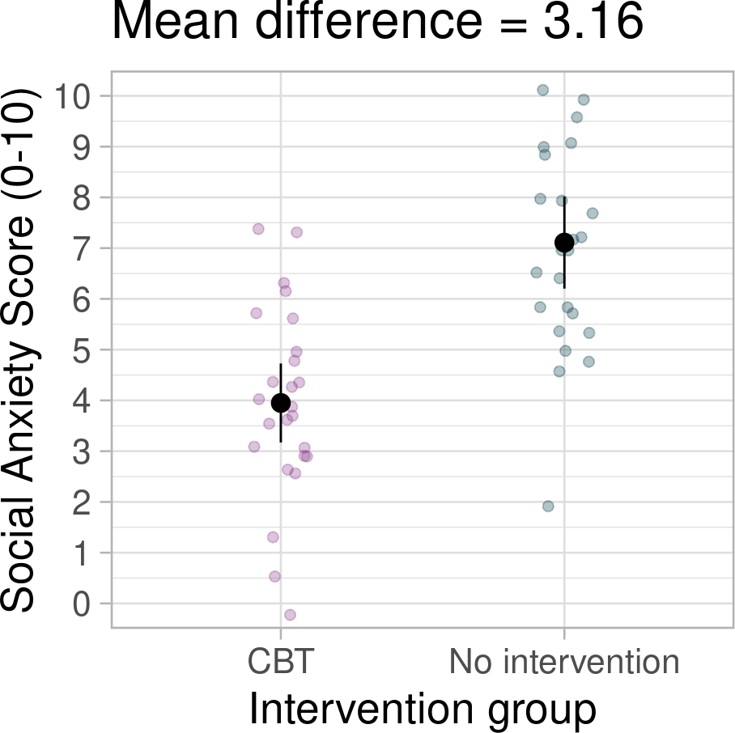
Confidence intervals
In papers:
“Error bars” on plots will often represent confidence intervals - labelled as “CI”
Sometimes they might represent standard errors - labelled as “SE” or “SEM” - always check the plot description.
Other times the authors just keep it a secret

Slide 45
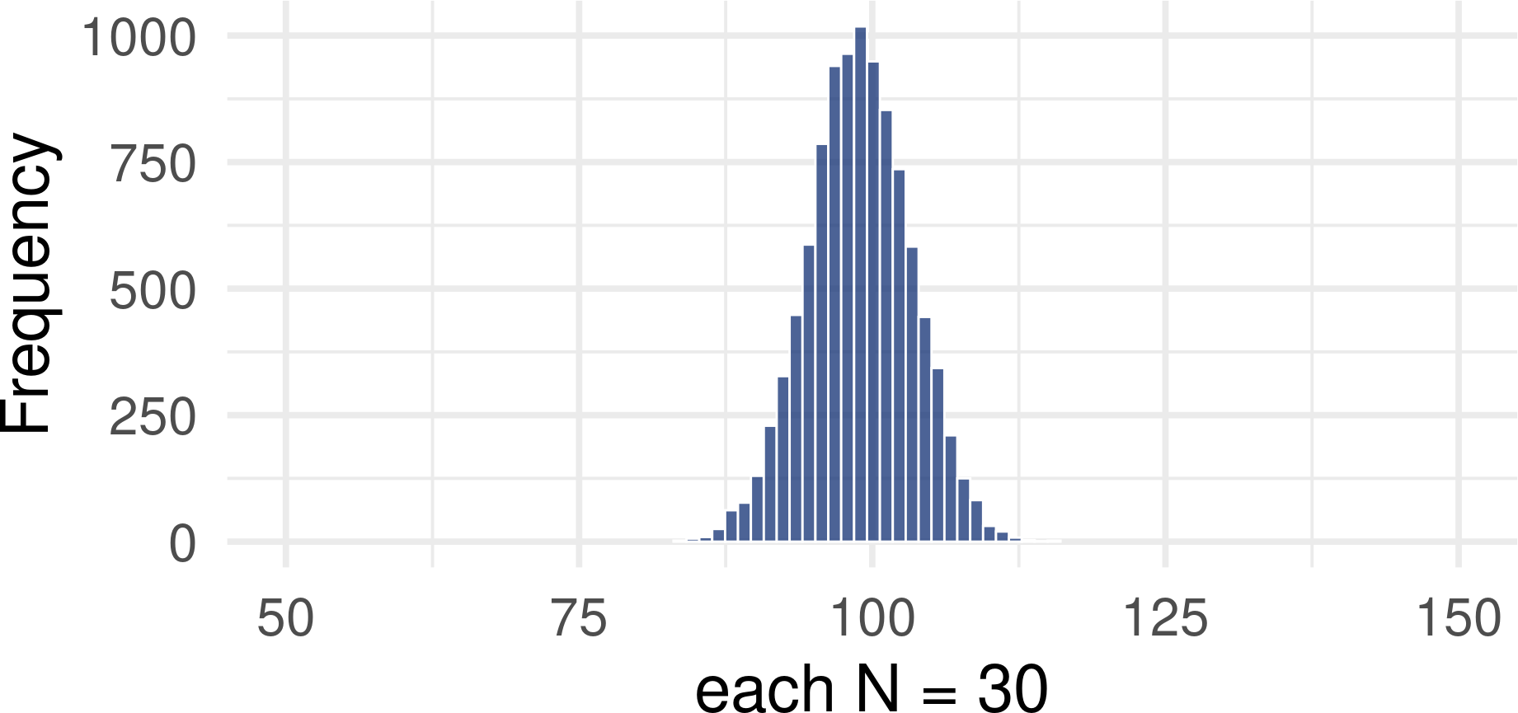
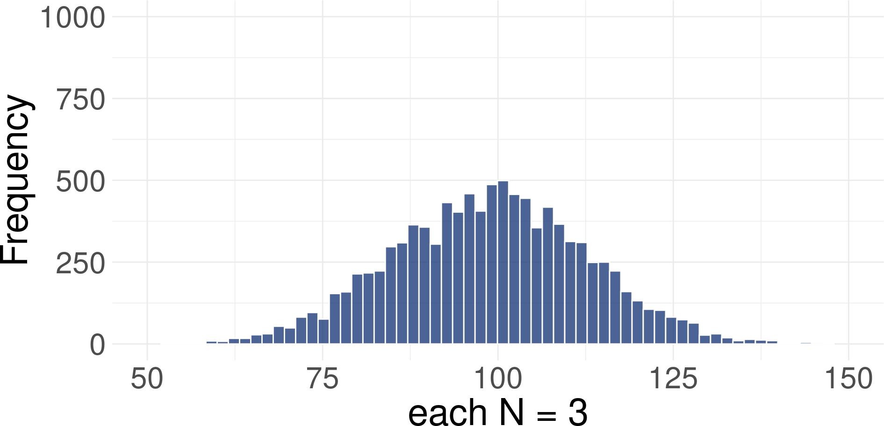

Confidence intervals for small samples
📌 Sampling distribution of the mean will have a normal shape as long as the sample size large enough
Smaller samples don’t approximate the normal sampling distribution very well. Because of this, we can’t rely on the value 1.96 to give us accurate intervals.

Slide 46
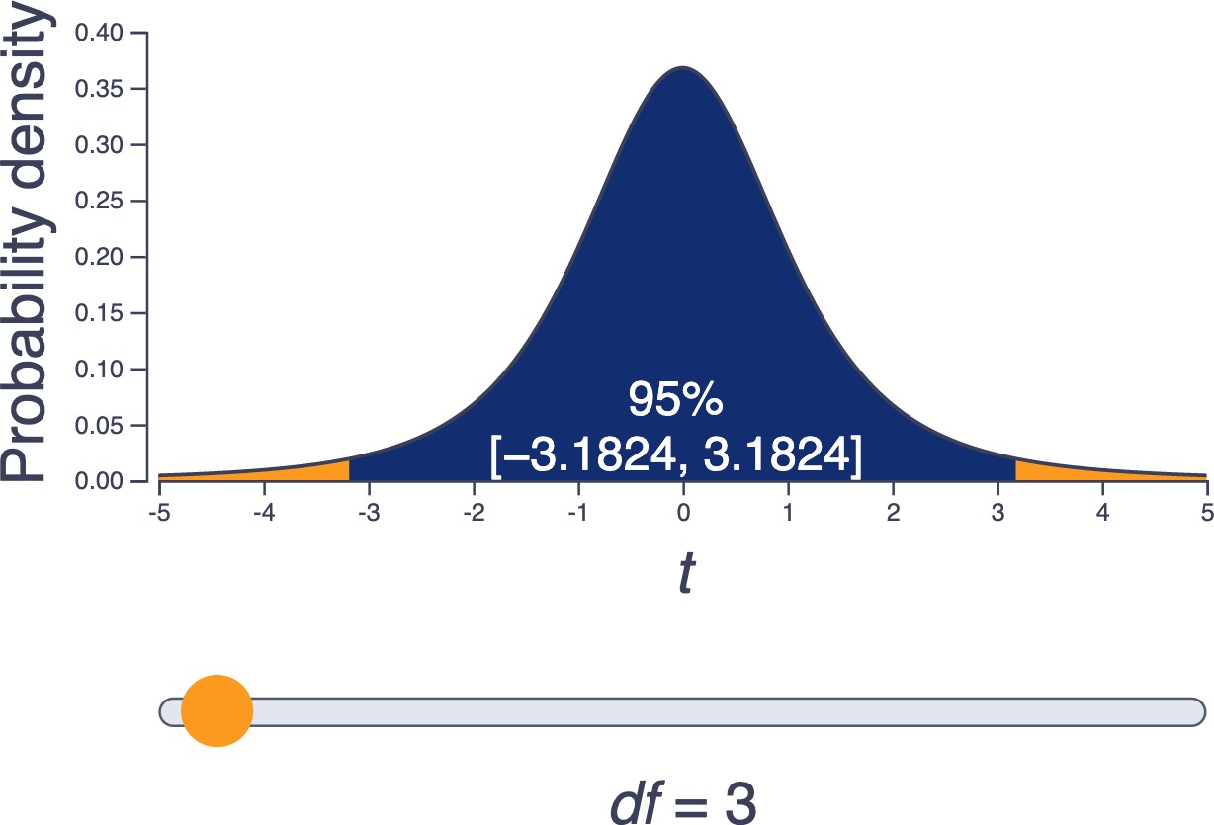
The t-distribution
Instead, we can use the t-distribution
Looks like normal, by isn’t.
Defined by degrees of freedom (df) - calculated as N-1 (number of observations minus 1)
The “critical t value” will change for different degrees of freedom.
It’s the value we use instead of 1.96 to calculate 95% confidence intervals

Slide 47
The t-distribution
Instead of multiplying the standard error by 1.96, we multiply by the critical t value.
Critical t gets closer to 1.96 with larger sample - the t- distribution itself will approximate normal distribution more closely
For example, in our sample of 4, the df is 4 - 1 = 3. Move the slider to df = 3 to see that the critical t value for 3 is 3.182

Slide 48
t-based confidence intervals:
Average doomscrolling time for the sample: 101 minutes Standard error: 6.095
Critical t value: 3.182
CI Limits = mean ± 3.182 × SE CI Limits = 101 ± 3.182 × 6.095
CI Limits = [81.606, 120.394]

Slide 49
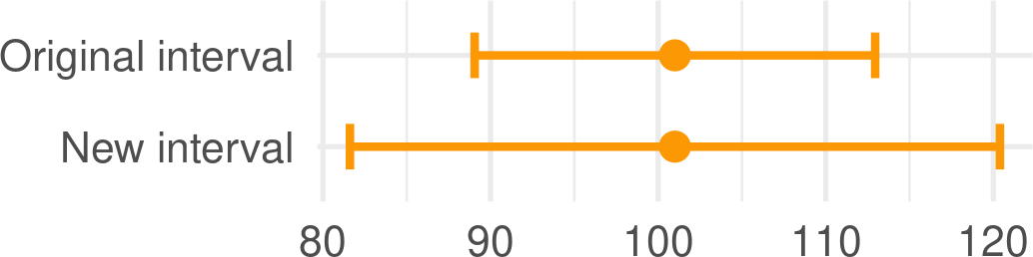
t-based confidence intervals
Compare the intervals: Original: [81.61, 120.394]
t-based: [89.05, 112.95].
The new CI is wider!

Slide 50
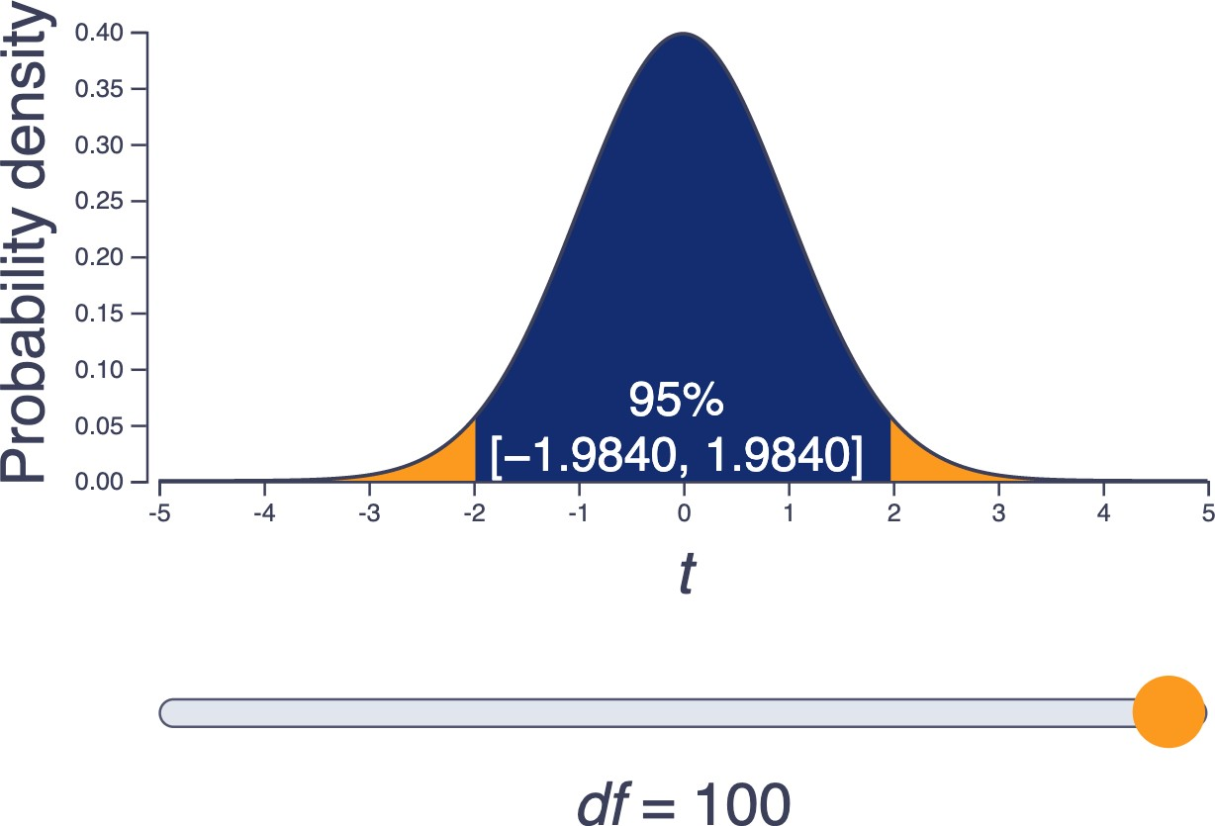
t-based confidence intervals:
CIs will generally be wider in smaller samples - more uncertainty
t-distribution additionally accounts for the fact that small samples don’t always generate normal sampling distributions.
The larger the sample, the narrower the confidence intervals
note how t approaches 1.96 as the sample size (df) increases

Slide 51
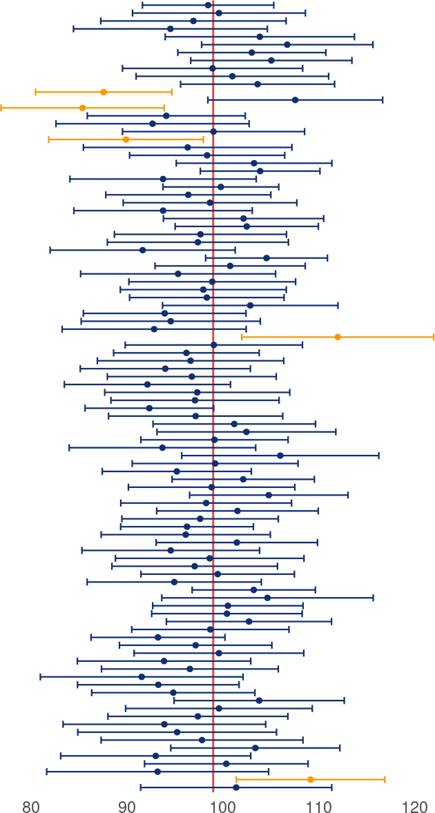
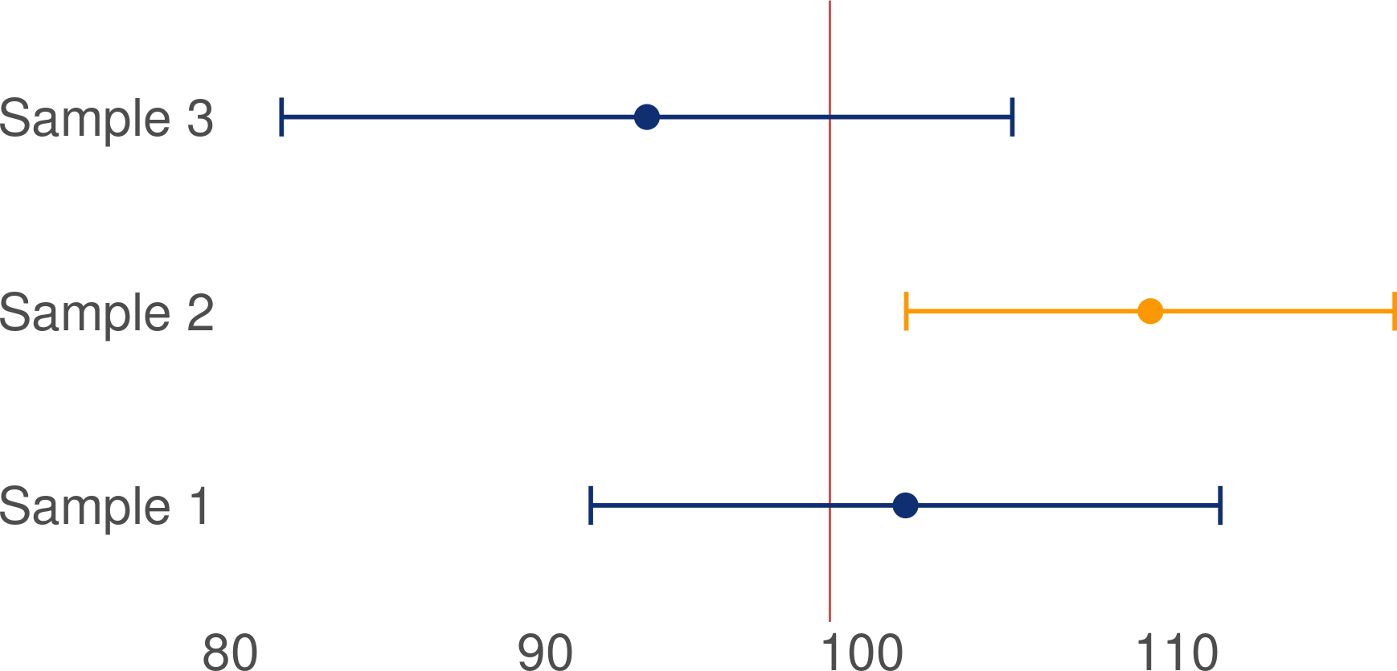
Confidence intervals across samples
We take samples over and over again, compute the mean for each, and construct confidence intervals around that mean - 95% of them will contain the population value, the remaining 5% will not.
This is known as an interval with 95% coverage. 95% is the most common value that we choose, but it can take on other values as well (e.g 50%, 90%, 99%).

Slide 52
Confidence intervals across samples
If we use the wrong critical value for calculation - e.g. assuming normal sampling distribution when it’s not there - the coverage will be inaccurate
I.e. we might expect 95% of CIs to contain the population value, when in reality the coverage is lower.

Slide 53
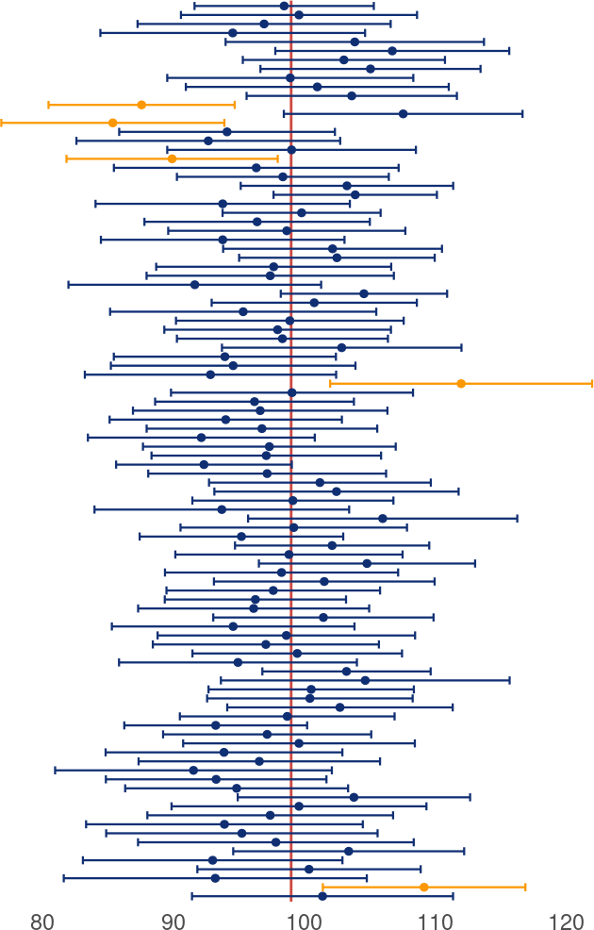

How to interpret confidence intervals
"The average doomscrolling time in our sample was 101 minutes (SD = 12.19) 95% CI [81.61, 120.39]."
Correct interpretation
ASSUMING THAT our sample is one of the 95% producing confidence intervals that contain the population value, then the population value for time spent doomscrolling per day falls somewhere between 81.61 and 120.39 minutes.
However…
There is no guarantee that the assumption above is correct! And we just have to live our lives not knowing…

Slide 54

Researchers (mis)interpreting confidence intervals
Hoekstra et al. (2014) :
Both researchers and students endorsed, on average, more than three [incorrect] statements [about confidence intervals], indicating a gross misunderstanding of CIs. Self- declared experience with statistics was not related to researchers’ performance […] Researchers hardly outperformed the students, even though the students had not received any education on statistical inference whatsoever.

Slide 55

How *not* to interpret confidence intervals
No:
“We can be 95% confident that the population value falls between 81.61 and 120.39.”
“95%” in the name refers to coverage, not to how confident we’re feeling.
Also no:
“There is 95% probability that the population value falls between 81.61 and 120.39.”
Think back to the “ladder” of confidence intervals - each of the intervals on that plot shows different limits. So the probability cannot be 95% for every single one of them.

Slide 56
How to interpret confidence intervals
Correct interpretation
ASSUMING THAT our sample is one of the 95% producing confidence intervals that contain the population value, then the population value for time spent doomscrolling per day falls somewhere between 81.61 and 120.39 minutes.
More general correct interpretation
ASSUMING THAT our sample is one of the 95% producing confidence intervals that contain the population value, then the population value for the estimate of interest falls somewhere between the lower limit the upper limit of the interval we’ve computed for our sample.
Memorise and practice!

Slide 57
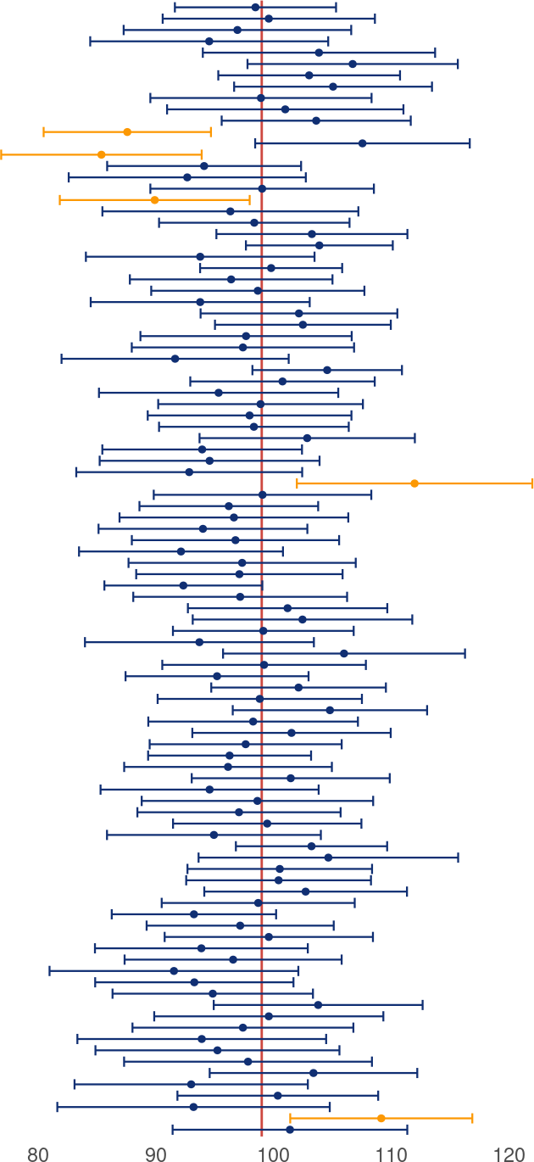
The bigger picture…
When interpreting estimates and confidence intervals for your sample - always consider them as just one of many different possible estimates
This is why replication is important in science - our sample could easily be the one that misses the population value
Always be vary of studies placing too much certainty on a single finding

Slide 58

Summary
We want to use our sample estimate some population value (e.g. some average value - a mean)
Confidence intervals help us quantify uncertainty around that estimate
To construct a confidence interval, we use the standard error which we can estimate as:
𝑆𝐸 =
𝑆𝐷
√𝑁
Lower and upper limits of a 95% confidence interval can be estimated as (replacing 1.96 with critical t for small samples):
CI limits = 𝑚𝑒𝑎𝑛 ± (1.96 × 𝑆𝐸)
When sampling repeatedly, 95% of samples produce confidence intervals that contain the true population value. We don’t know if our sample is one of them - we only (rightly or wrongly) assume that it does.

Slide 59
Next week:
Putting it all into practice:
Research questions
Good and less good hypotheses
Testing hypotheses with Null Hypothesis Significance Testing
A disappointing answer to why we’re so obsessed with the value 95%.

Slide 60
References
Hoekstra, Rink, Richard D. Morey, Jeffrey N. Rouder, and Eric-Jan Wagenmakers. 2014. “Robust Misinterpretation of Confidence Intervals.”
Psychonomic Bulletin & Review 21 (5): 1157–64. https://doi.org/10.3758/s13423-013-0572-3.
Sharma, Bhakti, Susanna S. Lee, and Benjamin K. Johnson. 2022. “The Dark at the End of the Tunnel: Doomscrolling on Social Media Newsfeeds.” Technology, Mind, and Behavior 3 (1). https://doi.org/10.1037/tmb0000059.

