Slide 1
Correlation
Week 06 Jennifer Mankin

Slide 2
Announcements/Reminders
Studies ongoing
Hybrid teaching and disability support: rebrand.ly/hybrid_ds
ChatGPT and AI at University: rebrand.ly/gpt_uni
Nominate faculty for a University Education Award!
Nominate staff who have inspired you, or made a positive difference to your experience
Nominated staff see all nominations - makes a huge difference!
Deadline: Friday 8 March (tomorrow)
Nominate classmates for a SavioR Award!
Thank someone who has helped you with R

Slide 3
The Take-Away Paper
Preparing for the TAP
Read the Take-Away Paper Information page carefully!
Attempt the sample take-away paper (on the Cloud)
Tonight’s Skills Lab will talk through some portions of the paper, do Q&A

Slide 4
Practicals Next Week
Practice-only Quiz
We will still run practicals and quizzes as normal (including taking attendance)
Next week’s quiz mark will not count toward your module mark.
Short (Fun and Completely Optional) Study
Possible difference in the code revision portion of the session
Invitation to complete a short survey after the quiz
Help us understand what helps you learn!

Slide 5
Looking Ahead
This week: Correlation
. . .
Week 7: Chi-Square ($χ^{2}$)
. . .
Week 8: The Linear Model
. . .
Week 9: The Linear Model
. . .
Week 10: The Linear Model…
(You get the idea)

Slide 6
Today’s Objectives
After this lecture you will understand:
The concepts behind statistical correlation
How to interpret the values of the correlation coefficient r
How to read a correlation matrix
How to interpret and report significance tests of r
The relationship between correlation and causation 👀

Slide 7
Distributions, Test Statistics, and NHST
Putting our statistical “grammar” into practice
For each statistical analysis, we will have the same elements:
Data, from which we calculate…
. . .
A test statistic that represents the relationship of interest, which we compare to…
. . .
The distribution of that test statistic under the null hypothesis to get…
. . .
The probability p of getting a test statistic as large as the one we have (or larger) if the null hypothesis is true so that we can…
. . .
Evaluate our competing hypotheses using a previously decided $α$ level.

Slide 8
Overall Reminder
We want to believe true things about the world, and disbelieve false things
More accurately: we should believe things that are well-founded in reliable evidence, and disbelieve things that are not
Statistics is a system to help us make decisions about whether, and to what degree, we believe something is supported by evidence

Slide 9
The Core of Correlation
Quantifies how two quantities change in relation to each other
When one variable changes, does the other…
Change in a similar way?
Change in the opposite way?
Not change very much at all?
. . .
The Fundamental Question
To what degree do two variables behave the same way - do they covary?

Slide 10
Putting the Co in Covariance
Variance should be familiar already!
Check out PAAS Lecture 7 for a refresher
Covariance (“co” = with) is a similar idea - and calculated in a similar way
. . .

Slide 11
Vocabulary: Variance
How much scores deviate from the mean, on average
Calculate how far each data point is from the mean of x, multiply the deviations by themselves (i.e. square them), add them all together, divide by N - 1
$$\text{variance}=s^{2}=\frac{\sum_{i=1}^{n}{\left(x_{i}−\overset{‾}{x_{i}}\right)\left(x_{i}−\overset{‾}{x_{i}}\right)}}{N−1}$$
Vocabulary: Covariance
How much pairs of scores deviate from their (respective) means in the same way, on average
Calculate how far each data point is from the mean for both x and y, multiply them together, add all those together, divide by N - 1
$${\text{covariance}}_{xy}=\frac{\sum_{i=1}^{n}{\left(x_{i}−\overset{‾}{x_{i}}\right)\left(y_{i}−\overset{‾}{y_{i}}\right)}}{N−1}$$

Slide 12
. . .
Let’s look at an example to make this more concrete!

Slide 13
Gender and Sexuality Questionnaire
Psychology very frequently collects gender as a variable
Typically categorical, e.g. “woman”, “man”, “non-binary/third gender”
Is this a useful way to categorise people?
Do these discrete categories capture gender as people perceive it?
. . .
Gender and Sexuality Questionnaire about gender and attraction
Completed by two previous cohorts of Psychology first years
. . .
Research Question
Are femininity and masculinity actually dichotomous? What is the nature of the relationship between them?

Slide 14
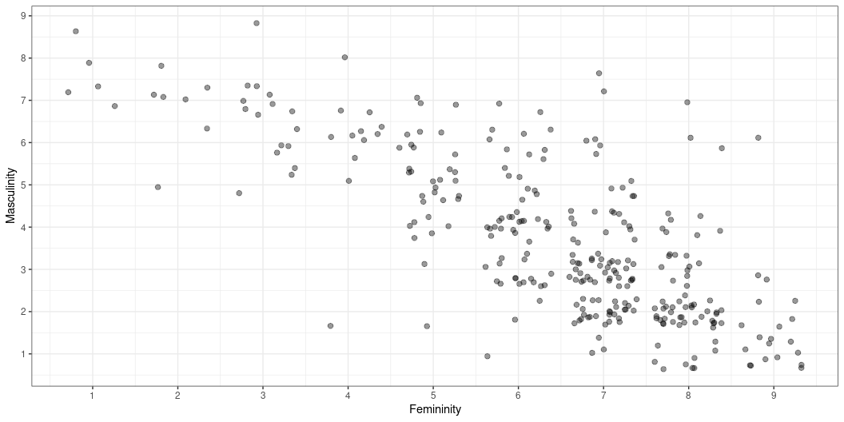
Visualisation: Gender Ratings
Plot of ratings of femininity vs masculinity

Slide 15
What’s r Got To Do With It?
People who rated their femininity high tended to rate their masculinity low, and vice versa
We might like to know:
What is the nature of this relationship?
How strong is it? What direction does it go?
Should we believe that it’s real (ie representative of people/first-year psychology students in general?)

Slide 16
Covariance to Correlation
We talked a moment ago about covariance
How much pairs of scores deviate from their (respective) means in the same way, on average
$${\text{covariance}}_{xy}=\frac{\sum_{i=1}^{n}{\left(x_{i}−\overset{‾}{x_{i}}\right)\left(y_{i}−\overset{‾}{y_{i}}\right)}}{N−1}$$
This is the signal - the effect or relationship of interest (sound familiar…??)

Slide 17
What’s r Got to Do With It?
Same problem as last week with the difference in the means
Is the covariance big? Small? In comparison to what?
. . .
Let’s standardise by dividing by an estimate of the noise
Here: the product of the two variables’ standard deviations
. . .
$$r=\frac{covariance_{xy}}{s_{x}s_{y}}$$
What do you know! It’s a signal to noise ratio, Pearson’s correlation coefficent r

Slide 18
Understanding r
Typically used with two (or more) continuous variables
Can be used when one is categorical!
r quantifies the strength and direction of the relationship
ALWAYS has a value between -1 and 1
. . .

Slide 19
Strength
Absolute value of r between 0 and 1
0: no relationship at all
1: perfect relationship
Direction
The sign of r (positive or negative)
Positive: as one variable increases, the other tends to increase
Negative: as one variable increases, the other tends to decrease

Slide 20
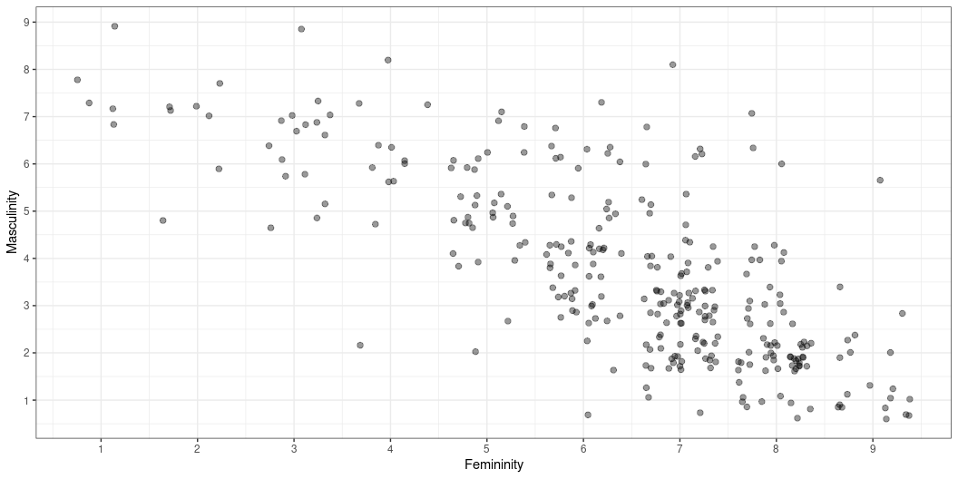
Let’s Try It!
r | 95% CI
-0.76 | [-0.8, -0.7]
So, our correlation coefficient $r=−.76$

Slide 21
Pop Quiz
How can we interpret this value of r?

Slide 22
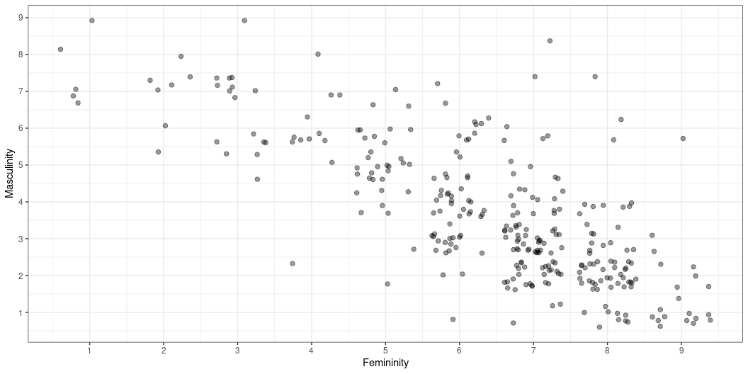
Correlation: Interpretation
The negative sign (-) means as femininity increases, masculinity tends to decrease (and vice versa)
The absolute value of .76 is very strong!

Slide 23
Correlation: Significance
We now have our data, from which we calculated…
Our test statistic r (-.76)
We also know the distribution of r with different degrees of freedom
Or, rather…of t, for Reasons (TM)
. . .
How likely is an r of -.76 (or larger) if in fact femininity and masculinity have a true r of 0
i.e. the null hypothesis is in fact true
We will again use $α$ = .05 in this case

Slide 24
Correlation: Significance
Parameter1 | Parameter2 | r | 95% CI | t(304) | p
gender_fem | gender_masc | -0.76 | [-0.8, -0.7] | -20.1 | < .001

Slide 25
. . .
Reporting Correlation
There was a significant negative correlation between femininity and masculinity, r(304) = -.76, p < .001.
. . .
Leading 0s
We reported both r and p without leading 0s (e.g. as -.76 and not -0.76). The rule is this:
Statistics that can have a value greater than 1 get a leading 0 when they are less than 1 (e.g. t, F)
Statistics that cannot have a value greater than 1 do not (e.g. r, p)

Slide 26
Correlation Matrices
Correlations are often presented in matrices
Each cell contains the correlation coefficient r for the variables in that row and column
gender_comfortable gender_masc gender_fem gender_stability gender_comfortable 1.00 -0.31 0.17 0.61 gender_masc -0.31 1.00 -0.76 -0.28 gender_fem 0.17 -0.76 1.00 0.18 gender_stability 0.61 -0.28 0.18 1.00
. . .
Pop Quiz
Why is there a diagonal line of 1s?

Slide 27
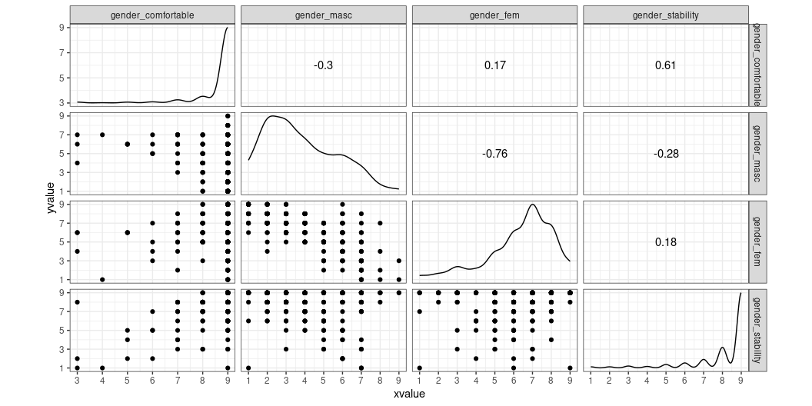
Correlation Matrices
More useful version with GGally::ggscatmat()
Scatterplots, distributions, and r values

Slide 28
Correlation = Causation?
Our analysis showed that higher ratings of femininity tended to correspond to lower ratings of masculinity, and vice versa
Can we conclude from this that being more feminine causes you to be more masculine?
. . .
❌🙅💥🚨 ABSOLUTELY NOT!!! 🚨💥🙅❌

Slide 29
Correlation ≠ Causation!
Why not? :(
. . .
No distinction between cause and effect
Which is the chicken and which is the egg?
Which came first: femininity or masculinity?
. . .
No experimental manipulation (randomisation)
. . .
The problem of tertium quid

Slide 30
Consider This…
A new study shows a rise in depression and stress among young people parallels the growth in smartphone and social media use.https://t.co/AxyseUyBxn
— NPR (@NPR) March 14, 2019

Slide 31
How many quid?
“Parallels”, “linked to”, etc. are common-language synonyms for “correlated with”
This study says that they looked at changes in mental health between 2005 and 2017
. . .
What third thing might have influenced negative mental health outcomes during this time?
. . .
Vocabulary: Tertium quid
An unmeasured third variable that influences two other measured quantities

Slide 32
How many quid?
As it turns out…
The original study didn’t measure or have access to data on social media and smartphone use
They did measure changes in mental health outcomes in different groups
They then suggested this could be due to social media
. . .
Nurture a healthy skepticism of claims that two things are “linked”
What evidence do they have? Or NOT have?
What other explanations have not be considered or accounted for?

Slide 33
Correlation: VOCAB ALERT!
In everyday language, “correlated” means “related to in some way, usually causally”
In statistics, it has a very specific, technical definition
Vocabulary: Correlation
The (standardised) degree to which two variables covary. Calculated as covariance divided by the product of the standard deviations. Quantifies both the strength (absolute value) and direction (sign) of the relationship between -1 and 1.
. . .
“Correlation” is a technical term!
Do not say two things are “correlated” unless you report r as evidence!
Instead: variables “have a relationship”/“are related to each other”

Slide 34
More Examples
Website that collects examples of spurious correlations
Can you suggest a “third thing” that might influence both?
Content warning: examples involve death rates, self-harm rates
More practice with interpreting r with this fun little game

Slide 35
Say It With Me
❌🙅🚨 CORRELATION DOES NOT IMPLY CAUSATION!🚨🙅❌

Slide 36
Correlation: Summary
The correlation coefficient r quantifies the strength and direction of relationships between variables
The p-value associated with r is the probability of encountering a value of r as large as the one we have, or larger, if in fact the true value of r in the population is 0
Correlation DOES NOT IMPLY CAUSATION!!!!!!!

Slide 37
Reminders!
Hybrid teaching and disability support study: rebrand.ly/hybrid_ds
ChatGPT and AI at University study: rebrand.ly/gpt_uni
Nominate someone for a SavioR award
Nominate staff for the Education Awards
Prepare for the TAP!
Read the TAP Information page
Sample TAP in Skills Lab TONIGHT
Next week’s (07) practicals will:
Contain a short and optional study
Have a quiz that is practice only (i.e. will not contribute to your quiz mark)!
Be based only on this week’s lecture and tutorial

Slide 38
✨Good luck!!!✨

