Slide 1
Linear Model 3: Return of the yi
Week 10 Jenny Terry

Slide 2


Slide 3
Survey Study on Statistics Attitudes & Career Goals
Please help my Junior Research Associate student! 🙏
Do a 10 minute survey and earn 1 SONA credit and some research karma!
Take part here: https://sussexpsychology.sona-systems.com/default.aspx?p_return_experiment_id=1852
Interested in a Research Career?
Check out the JRA scheme
Approach lecturers that are doing research you’re interested in and ask if you can assist

Slide 4
Looking Ahead (and Behind)
The story so far…
The Linear Model - Equation of a Line
The Linear Model - Evaluating the Model with p-values, CIs, $F$, & $R^{2}$
. . .
This week:
The Linear Model - Adding predictors; Comparing models; Comparing predictors
. . .
Coming up:
Questionable Research Practices

Slide 5
Objectives
After this lecture, you will (begin to) understand:
How to extend the linear model equation to two, three, or more predictors
How to compare linear models using the $R^{2}$-change and $F$- change statistics
How to interpret the relationship of each predictor with the outcome
How to compare predictors using standardised beta coefficients
. . .
Talk to Me!
Open the Lecture Google Doc: bit.ly/and24_lecture10

Slide 6
Three Types of Research Questions
When we are using linear models with more than one predictor (aka “multiple regression”), there are usually three stages we go through, each of which align with slightly different research questions:
Which model is better (e.g., a model with one predictor vs. a model with three predictors)?
. . .
Does each predictor in the better model have a statistically significant relationship with the outcome (and which direction will those relationships be in)?
. . .
Which predictor in the better model has the biggest impact upon the outcome?
. . .
We’ll look at these in turn, but first, let’s just see what the linear model looks like with more than one predictor…

Slide 7
Adding Predictors to the Linear Model

Slide 8
Extending the Equation
The equation:
One-predictor model: $y_{i}=b_{0}+b_{1}×x_{1i}+e_{i}$
Predicts the outcome $y$ based on a predictor $x_{1}$
. . .
Two-predictor model: $y_{i}=b_{0}+b_{1}×x_{1i}+b_{2}×x_{2i}+e_{i}$
Predicts the outcome $y$ based on a predictor $x_{1}$ and another predictor $x_{2}$
. . .
Three–predictor model: $y_{i}=b_{0}+b_{1}×x_{1i}+b_{2}×x_{2i}+b_{3}×x_{3i}+e_{i}$
Predicts the outcome $y$ based on a predictor $x_{1}$ and $x_{2}$ and $x_{3}$
. . .
$n$-predictor model: $y_{i}=b_{0}+b_{1}×x_{1i}+...+b_{n}×x_{ni}+e_{i}$
Predicts the outcome $y$ based on as many predictors as you like!

Slide 9
1. Comparing Linear Models

Slide 10
Comparing Linear Models
We can compare linear models with different numbers of predictors as long as they are hierarchical (aka nested)
Hierarchical models must be the same except for the addition of something new
The model with one predictor is nested in the two and three predictor models because they are the same except for the addition of the extra predictor(s)
Similarly, a two-predictor model would be nested in a three-predictor model
However, we couldn’t remove a variable from the two-predictor model and replace it with a different one to create a different two-predictor model and compare those
In that case, changing the variable would mean it is no longer the same and, therefore, no longer nested

Slide 11
What is a ‘good’ model?
In Lecture 09, we learned that a good model will:
Fit the data better than the simplest possible model ($R^{2}$ & $F$-statistic)
Explain a lot of variance in the outcome ($R^{2}$)
Explain an amount of variance that significantly differs from zero ($F$-statistic)
When we are comparing models, we can use the $R^{2}$ and $F$ values to instead ask, which is the better fitting model?

Slide 12
It’s all Greek to me!
Vocabulary: $Δ$
$Δ$ just means “change”

Slide 13
$R^{2}$ Change
How do we interpret $R^{2}$? 🤔
. . .
Vocabulary: $R^{2}$
$R^{2}$ = percentage of the variance in the outcome explained by the model
A larger value means better fit (more variance is explained)
. . .
Vocabulary: $R^{2}$ Change
$R^{2}Δ=R_{\text{Model 1}}^{2}−R_{\text{Model 2}}^{2}$
The difference in $R^{2}$ values between two models
The model with the larger $R^{2}$ value is the better fitting model (more variance is explained)
The larger the $R^{2}Δ$ value, the greater the improvement in the better fitting model

Slide 14
$F$ Change
How do we interpret $F$? 🤔
. . .
Vocabulary: $F$-statistic
$F$ = whether the variance explained significantly differs from zero
Compares a model with predictor(s) to the null model
An $F$-statistic with a p-value lower than 0.05 means that it is statistically significant, so we can reject the null hypothesis that the null model fits as well as the predictor model
. . .
Vocabulary: $F$ Change
$FΔ=F_{\text{Model 1}}−F_{\text{Model 2}}$
Compares models with predictors to one another
The model with the larger $F$-statistic is the better fitting model
An $FΔ$ with an a p-value lower than 0.05 means that the model is statistically significantly better, so we can reject the null hypothesis that one model fits as well as the other model
. . .
Let’s look at an example to see how this looks in practice…

Slide 15
Example: Predicting Sleep from 1 vs. 3 Predictors
Tout et al. (2023) were interested in the effect of positive psychology and emotional regulation upon sleep
Participants took part in a cross-sectional, self-report survey that asked them to rate their:
Positive psychology attributes (a composite of gratitude, optimism, self-compassion, and mindfulness)
Adaptive emotional regulation strategies (a composite of acceptance, positive refocusing, refocus on planning, positive reappraisal, perspective taking)
Maladaptive emotional regulation strategies (a composite of self-blame, rumination, catastrophising, other-blame)
Sleep quality and quantity (a composite of subjective sleep quality, sleep literacy, sleep duration, sleep efficiency, sleep disturbances, sleep medication, daytime dysfunction)

Slide 16
Research Question & Hypothesis
Research Question
Which model is better, a model with just positive psychology attributes as a predictor or a model with positive psychology attributes and adaptive emotional regulation strategies and maladaptive emotional regulation?
Hypotheses
The model with positive psychology attributes and adaptive emotional regulation strategies and maladaptive emotional regulation will fit the data better than a model with just positive psychology attributes.

Slide 17
Operationalisation - Model 1
Predictors:
Positive psychology attributes ($PosPysch$)
Outcome: Sleep quality & quantity ($Sleep$)
Model 1: $Sleep_{i}=b_{0}+b_{1}×PosPsych_{1i}+e_{i}$

Slide 18
Operationalisation - Model 2
Predictors:
Positive psychology attributes ($PosPysch$)
Adaptive emotion regulation attributes ($AdaptEmoReg$)
Maladaptive emotion regulation attributes ($MalEmoReg$)
Outcome: Sleep quality & quantity ($Sleep$)
So, what will our 3-predictor model equation look like? 🤔
. . .
Model 2: $Sleep_{i}=b_{0}+b_{1}×PosPsych_{1i}+b_{2}×AdaptEmoReg_{2i}+b_{3}×MalEmoReg_{3i}+e_{i}$

Slide 19
Running the Analysis
We run the analysis in a series of stages:
Fit Models
Fit Model 1
Fit model 2
Compare $R^{2}$ Values
Calculate $R^{2}$ for Models 1 & 2
Calculate $R^{2}Δ$
Calculate $FΔ$

Slide 20
Running the Analysis
Step 1a: Fit Model 1
Model 1
sleep_lm1 <- sleep_tib |> lm(sleep ~ pos_psy, data = _) summary(sleep_lm1)
Call: lm(formula = sleep ~ pos_psy, data = sleep_tib) Residuals: Min 1Q Median 3Q Max -12.526 -1.706 0.408 1.978 5.389 Coefficients: Estimate Std. Error t value Pr(>|t|) (Intercept) 3.5202 1.1502 3.060 0.00239 ** pos_psy 2.2872 0.3149 7.262 2.74e-12 *** --- Signif. codes: 0 '***' 0.001 '**' 0.01 '*' 0.05 '.' 0.1 ' ' 1 Residual standard error: 2.855 on 331 degrees of freedom Multiple R-squared: 0.1374, Adjusted R-squared: 0.1348 F-statistic: 52.74 on 1 and 331 DF, p-value: 2.744e-12

Slide 21
Running the Analysis
Step 1b: Fit Model 2
Model 2
sleep_lm2 <- sleep_tib |> lm(sleep ~ pos_psy + adapt_er + mal_er, data = _) summary(sleep_lm2)
Call: lm(formula = sleep ~ pos_psy + adapt_er + mal_er, data = sleep_tib) Residuals: Min 1Q Median 3Q Max -12.2262 -1.5042 0.3768 2.0303 4.7376 Coefficients: Estimate Std. Error t value Pr(>|t|) (Intercept) 8.5671 2.0735 4.132 4.57e-05 *** pos_psy 2.1531 0.4154 5.183 3.82e-07 *** adapt_er -0.5004 0.3316 -1.509 0.13229 mal_er -0.9886 0.3690 -2.679 0.00776 ** --- Signif. codes: 0 '***' 0.001 '**' 0.01 '*' 0.05 '.' 0.1 ' ' 1 Residual standard error: 2.823 on 329 degrees of freedom Multiple R-squared: 0.1621, Adjusted R-squared: 0.1545 F-statistic: 21.22 on 3 and 329 DF, p-value: 1.371e-12

Slide 22
Running the Analysis
Step 2a: Get the $R^{2}$ values for each model
Model 1
broom::glance(sleep_lm1)
# A tibble: 1 × 12 r.squared adj.r.squared sigma statistic p.value df logLik AIC BIC <dbl> <dbl> <dbl> <dbl> <dbl> <dbl> <dbl> <dbl> <dbl> 1 0.137 0.135 2.86 52.7 2.74e-12 1 -821. 1648. 1659. # ℹ 3 more variables: deviance <dbl>, df.residual <int>, nobs <int>
Model 2
broom::glance(sleep_lm2)
# A tibble: 1 × 12 r.squared adj.r.squared sigma statistic p.value df logLik AIC BIC <dbl> <dbl> <dbl> <dbl> <dbl> <dbl> <dbl> <dbl> <dbl> 1 0.162 0.154 2.82 21.2 1.37e-12 3 -816. 1642. 1661. # ℹ 3 more variables: deviance <dbl>, df.residual <int>, nobs <int>

Slide 23
Running the Analysis
Step 2b: Calculate the $R^{2}Δ$ value from the $R^{2}$ values
$R^{2}Δ=R_{\text{Model 1}}^{2}−R_{\text{Model 2}}^{2}$
$R^{2}Δ=0.137−0.162$
$R^{2}Δ=−0.025$
$R^2 \Delta = 2.5\text %$
$R^{2}$ for Model 2 accounts for 2.5% more of the variance in sleep, indicating Model 2 is the better fitting model

Slide 24
Running the Analysis
Step 3: Get & interpret the $FΔ$ and associated p-value
anova(sleep_lm1, sleep_lm2) |> broom::tidy()
# A tibble: 2 × 7 term df.residual rss df sumsq statistic p.value <chr> <dbl> <dbl> <dbl> <dbl> <dbl> <dbl> 1 sleep ~ pos_psy 331 2698. NA NA NA NA 2 sleep ~ pos_psy + adapt_er +… 329 2621. 2 77.2 4.85 0.00844
$FΔ$ = 4.85, p < 0.01, so we can conclude that Model 2 accounts for statistically significantly more variance and is, therefore, the better fitting model

Slide 25
2. Relationships Between the Predictors & the Outcome

Slide 26
Three Types of Research Questions
Now we know that Model 2 is the better fitting model, we can turn to examining the relationships between the predictors and the outcome
We can do this by examining the slope values ($b_{n}$) for each predictor and asking whether they are statistically significantly different from 0 (see Lecture 09 for a refresher)?
This is very similar to how we interpret a linear model with one predictor - let’s take a look…

Slide 27
Interpreting the Model Intercept & Slope
Intercept ($b_{0}$):
One predictor model: value of $y$ when $x_{1}$ is 0
. . .
Two predictor model: value of $y$ when $x_{1}$ and $x_{2}$ are 0
Three predictor model: value of $y$ when $x_{1}$ and $x_{2}$ and $x_{3}$ are 0
. . .
Slopes ($b_{1}$, $b_{2}$… $b_{n}$):
One predictor model: $b_{1}$ = change in $y$ for every unit change in $x_{1}$
. . .
Two predictor model: $b_{2}$ = change in $y$ for every unit change in $x_{2}$ … when the other predictor in the model is held constant (i.e., when the other variables do not change)
Three predictor model: $b_{3}$ = change in $y$ for every unit change in $x_{3}$ … when the other predictors in the model are held constant

Slide 28
Interpreting the Model Intercept & Slope
The interpretation of $b_{0}$ (the intercept) doesn’t change
It is always the value of $y$ (the outcome) when the predictor(s) are at 0
The interpretation of $b_{n}$ coefficients (a given slope) changes a little
They always represent the change in $y$ (the outcome) for every unit change in $x_{n}$ (a given predictor)…
… but when there are other predictors in the model, the relationship between the outcome and predictor assumes the other predictors are held constant
It doesn’t matter if there are two, five, ten, or fifty predictors - the $b$-values will always be interpreted in this same way
Let’s have a look at our example…

Slide 29
Research Question & Hypothesis
Research Question
Does each predictor in the better model have a statistically significant relationship with sleep (and which direction will those relationships be in)?
Hypotheses
Positive psychology attributes and adaptive emotional regulation strategies have a positive relationship with sleep quality and quantity
Maladaptive emotional regulation strategies would have a negative relationship with sleep quality and quantity

Slide 30
Operationalisation - Model 2
Predictors:
$x_{1}$ Positive psychology attributes ($PosPysch$)
$x_{2}$ Adaptive emotion regulation attributes ($AdaptEmoReg$)
$x_{3}$ Maladaptive emotion regulation attributes ($MalEmoReg$)
Outcome ($y$): Sleep quality & quantity ($Sleep$)
Model: $Sleep_{i}=b_{0}+b_{1}×PosPsych_{1i}+b_{2}×AdaptEmoReg_{2i}+b_{3}×MalEmoReg_{3i}+e_{i}$

Slide 31
Running the Analysis
# A tibble: 4 × 7 term estimate std.error statistic p.value conf.low conf.high <chr> <dbl> <dbl> <dbl> <dbl> <dbl> <dbl> 1 (Intercept) 8.57 2.07 4.13 0.0000457 4.49 12.6 2 pos_psy 2.15 0.415 5.18 0.000000382 1.34 2.97 3 adapt_er -0.500 0.332 -1.51 0.132 -1.15 0.152 4 mal_er -0.989 0.369 -2.68 0.00776 -1.71 -0.263
$b_{0}$ (intercept) = 10.79 (the value of sleep when all predictors are at 0)
$b_{1}$ (slope for $PosPysch$) = 2.15, p < 0.001, 95% CI [1.34, -2.97]
$b_{2}$ (slope for $AdaptEmoReg$) = 0.50, p = 0.132, 95% CI [-1.15, 0.15]
$b_{3}$ (slope for $MalEmoReg$) = 0.99, p < 0.001, 95% CI [-1.71, -0.26]
Each slope represents the relationship between the predictor and the outcome when the other predictors in the model are held constant

Slide 32
3. Comparing Predictors

Slide 33
Three Types of Research Questions
First, we determined that the model with 3 predictors was the better fitting model
Second, we determined that positive psychology and maladaptive emotional regulation are statistically significant predictors of sleep
We also learned that positive psychology had a positive relationship with sleep and maladaptive emotional regulation had a negative relationship with sleep
Now we can ask, which is the best predictor?

Slide 34
Comparing Predictors
We can compare predictors to ascertain which is the “best” predictor
However, we cannot compare the beta values in their current (raw, unstandardised) form, because they are in different units
These different units reflect how the predictor variables are measured
e.g., seconds, kilograms, centimetres, pound stirling etc.
In psychology, we often use self-report scales where the units are Likert scale points…

Slide 35
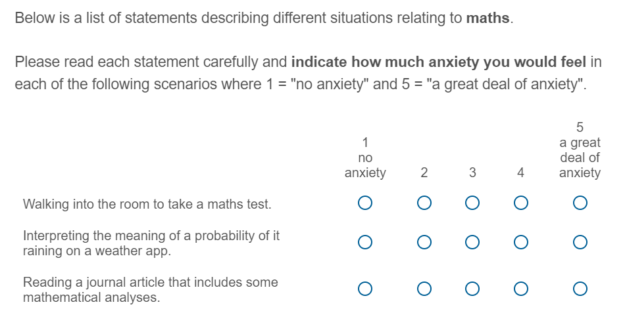
Likert Scales - Maths Anxiety

Slide 36
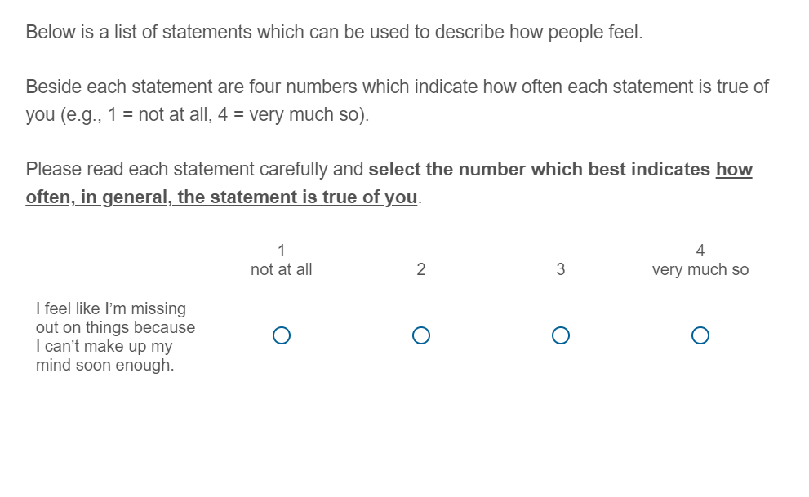
Likert Scales - Trait Anxiety

Slide 37
Comparing Predictors
The two Likert Scales use different units of measurement, so cannot be directly compared
Similarly, we couldn’t directly compare reaction time in seconds with the amount of money someone earns, or the distance someone walks with their Likert Scale responses, etc.
. . .
However, we can make them comparable by standardising the slope values

Slide 38
Unstandardised vs Standardised Betas
Vocabulary: Unstandardised Betas
Change in the outcome for each unit change in the predictor
Depends on original scale of measurement
Usually denoted by $b$
Vocabulary: Standardised Betas
Change in the outcome for each standard deviation change in the predictor
Does not depend on original scale of measurement
Usually denoted by $β$

Slide 39
Research Question & Hypothesis
Research Question
Which predictor in the better model has the biggest impact upon sleep?
Hypotheses
Positive psychology attributes will predict sleep quality and quantity better than maladaptive emotional regulation strategies
. . .
Note that we’ve dropped the non-significant predictor, adaptive emotional regulation strategies
Note we’re not saying anything about the direction of the effect here, just the magnitude

Slide 40
Operationalisation - Model 2
Predictors:
$x_{1}$ Positive psychology attributes ($PosPysch$)
$x_{2}$ Adaptive emotion regulation attributes ($AdaptEmoReg$)
$x_{3}$ Maladaptive emotion regulation attributes ($MalEmoReg$)
Outcome ($y$): Sleep quality & quantity ($Sleep$)
Model: $Sleep_{i}=b_{0}+b_{1}×PosPsych_{1i}+b_{2}×AdaptEmoReg_{2i}+b_{3}×MalEmoReg_{3i}+e_{i}$

Slide 41
Running the Analysis
Parameter | Coefficient | SE | CI | CI_low | CI_high | t | df_error | p
(Intercept) | 0.000 | 0.050 | 0.95 | -0.099 | 0.099 | 0.000 | 329 | 1.000
pos_psy | 0.349 | 0.067 | 0.95 | 0.217 | 0.481 | 5.183 | 329 | 0.000
adapt_er | -0.092 | 0.061 | 0.95 | -0.212 | 0.028 | -1.509 | 329 | 0.132
mal_er | -0.154 | 0.057 | 0.95 | -0.267 | -0.041 | -2.679 | 329 | 0.008
Statistical Interpretation

Slide 42
Look at the absolute values of $β$ (ignore positive/negative sign) and decide which is the ‘bigger’ predictor of sleep? 🤔
Remember, we can assume non-statistically significant $β$ values are not important predictors of the outcome (we’d report them, but not interpret them as meaningful)

Slide 43
Running the Analysis
Applied Interpretation
What should people focus on for better sleep quality/quantity? 🤔
This analysis suggests that the best thing we can do to improve sleep is to focus on increasing positive psychology attributes
Decreasing maladaptive emotional regulation strategies will also help, but not as much
Working on adaptive emotional regulation strategies would not have any impact on sleep (because it was non-significant)

Slide 44
Lecture Summary
You can extend the linear model to include multiple predictors: $y_{i}=b_{0}+b_{1}×x_{1i}+...+b_{n}×X_{ni}+e_{i}$
. . .
We can ask three main types of question to evaluate multiple–predictor linear models:
. . .
Hierarchical models can be compared with $R^{2}Δ$ and $FΔ$ to determine which model is best
. . .
We can then examine the statistical significance of each predictor to establish whether it is an important predictor of the outcome
. . .
We can also interpret the relative importance of the predictors in the best model using standardised betas ($β$)

Slide 45
Next Week
Next week, there are unfortuantely no statistics! 😭
Martina and I are going to tell you all about Questionable Research Practices (QRPs)
QRPs are “a range of activities that intentionally or unintentionally distort data in favour of a researcher’s own hypotheses…” (Fortt 2021)
At best, bad science. At worst, academic misconduct and outright fraud! 😈
We’ll explore some different QRPs, look at some famous examples, tell you how the field is trying to solve the problems (i.e., Open Science), and consider some emerging critiques of that movement.

