Slide 1

Jennifer Mankin and Martina Sladekova
27 January 2026
Welcome to Analysing Data!

Slide 2
Overview
Introductions
Module Structure and Sessions
  Materials and Resources
  Attendance Policy and Assessments
Data Skills and AI

Slide 3
Module Information

Slide 4
What It Says On The Tin
First year core statistics and research methods module
Comprises lectures, skills labs, and practical sessions
. . .
What will you learn?
  Data literacy: how to think like a scientist about data
  Working with data: cleaning, wrangling, summarising
  R skills: using RStudio/Quarto, writing and reading code
  Statistics: NHST, common tests, linear model

Slide 5
Contact
Module email: analysingdata.psychology@sussex.ac.uk
Module Discord rolled over from PaaS!

Slide 6
Dr Jennifer Mankin
Confidential queries: J.Mankin@sussex.ac.uk
Convenor and primary point of contact
Lectures, Skills Labs, Practicals
All module admin, assessments, queries
Dr Martina Sladekova
Co-convenor
Website Lead
Lectures, Skills Labs
Module admin
Dr Dom Makowski, Hanna Eldarwish, Fiona Lancelotte
Practicals

Slide 7
Materials and Resources

Slide 8
Canvas
Repository of all administrative info about the module
Schedule and syllabus
Assessment info and resources
Assessment submission points
Quiz and exam testing
Policies, rules, and guidelines
Also hosts all session recordings under Panopto Recordings
. . .
Important
If you have a question about the module or assessments, check Canvas first!

Slide 9
Website
Repository of (almost) all module content
  ✨Lecture slides and tutorials
  ✨Skills Lab example solutions
Contains everything you might read/refer to
  Exception: Lecture/Skills Lab recordings on Canvas as usual
Important
Check out the module website!

Slide 10
Posit Cloud
Weekly projects containing:
  ✨Tutorial notebooks
  ✨Skills Lab notebooks
  ✨Practical worksheets
Contains everything you might do/complete
NO solutions released! Come talk to us :)
Important
Complete each week project on the Cloud!

Slide 11
Module Structure

Slide 12
Types of Sessions
Lecture
One-hour lecture session Tuesday mornings
Concepts, ideas, statistical tests and principles
Skills Lab
One-hour interactive, live-coding session Wednesday mornings
How to think about and work with data
Practical
Two-hour supported working time
  Ask questions and get help
  Complete the tutorial/worksheet
  Take a quiz
Multiple sessions throughout the week

Slide 13
Important
Skills Labs are not optional! They are distinct from the lectures and will contribute to your assessments.

Slide 14
Attendance

Slide 15
Lectures/Skills Labs
Attendance is required and recorded via PIN
Delivered in person, recordings posted on Canvas
If you miss a lecture or skills lab…
Watch the recording on Canvas
Take notes and follow along with the materials
For Skills Labs, try out the code yourself
Ask questions on Discord, in your practicals, or come to a drop-in for extra one-on-one attention!

Slide 16
Attendance is Key
Strong recommendation to attend live sessions consistently
  Use recordings to supplement or review, not replace, lecture attendance
Highest marks for students who attended live lecture and reviewed recordings (Bos et al., 2016)
Attendance and recording usage both predict achievement (Nordmann et al., 2019)
Guidelines for students (Nordmann et al., 2020)

Slide 17
Practicals
Attendance is required and recorded manually
Interact in some way with tutors (any way is fine)
  Ask questions, ask for help, get your work checked before the quiz!
. . .
If you attend any practical, you can access help and the quiz as normal.

Slide 18
If you miss a practical…
You can attend another practical in the week to take the quiz, but you will not be marked present
If you can’t attend another practical, you must notify of your absence in order to be able to use the mop-up quiz
More on this in just a moment…

Slide 19
Changing Your Timetable
Only allowed where unavoidable (e.g. consistent clash)
Email the School Office - the teaching team cannot help!

Slide 20
Assessments

Slide 21
All Assessments
What | Weight | When
Worksheet quizzes | 25% | Every week in practical sessions
Take-away paper (TAP) | 25% | 48-hour period, due Week 7 Wednesday
Research participation | 10% | Throughout term, due Week 11 Friday
Exam | 40% | A2 assessment period
See detailed information on Canvas

Slide 22
Worksheet Quizzes
Before or during each practical, complete a worksheet
In the second hour, complete a marked quiz
  Next week: practice only!
Covers the lecture, skills lab, tutorial, and worksheet
. . .
This week: Practice quiz on Canvas anytime
Next week: Practice quiz in practicals only!
Week 3: First marked quiz

Slide 23
Worksheet Quizzes - Mop-Up
Each week on Friday evening we will send out a “mop-up” quiz code via Canvas Announcement.
To use this code to complete the quiz, at least one of the following must be true:
You were absent from your practical session that week and have been marked absent
You were unable to complete your quiz in your practical due to circumstances outside your control (e.g. your computer broke, WiFi failure), and have contacted the convenor to agree to use the mop-up quiz.
You are registered with Disability Advice and have reasonable adjustments in place, and have contacted the convenor to agree to use the mop-up quiz for accessibility reasons.
You will be able to attempt the quiz until midnight on the following Monday, at which point the quiz will close.
. . .
Important
If you complete the mop-up quiz, but have neither a notified absence nor an agreement with the module convenor, the mark will be replaced with a 0.

Slide 24
DO THE PIN

Slide 25
AI

Slide 26
AI Use Policy
There is NO acceptable use of AI on this module.
. . .
Any suspected use of AI on any assessment will be treated as academic misconduct.
. . .
But what is the problem with getting a little help? Well…

Slide 27
The Cost of AI: Climate Disaster
Ever-increasing energy consumption
  10x a standard Google search - EPRI Report
  17,000x average US household use per day
Reversal of green energy targets to meet outsized demand
  “Globally, the electricity consumed by datacentres is expected to match the entire power consumption of Japan within the next two years”
  “…[I]n the near-term most markets with a large density of datacentres end up using more gas power: ‘It would absolutely pile pressure on already very difficult clean power targets.’”
Deprivation of already-deprived communities to power AI
Use of drinkable fresh water as server coolant
  “In July 2022…Microsoft pumped in about 11.5 million gallons of water to its cluster of Iowa data centers…That amounted to about 6% of all the water used in the district, which also supplies drinking water to the city’s residents.”
  “ChatGPT gulps up 500 milliliters of water (close to what’s in a 16-ounce water bottle) every time you ask it a series of between 5 to 50 prompts or questions.”

Slide 28
The Cost of AI: Destruction and Theft of Creative Industries
SAG-AFTRA strikes over AI use and compensation in film, TV, and video games
Lawsuits for copyright infringement
Famous musicians join other voices criticising removal of copyright protections
  “The government is also consulting on an overhaul of copyright laws that would result in artists having to opt out of letting AI companies train their models using their work, rather than an opt-in model.”
Sale of scientific papers for AI training with no author compensation or consultation
AI image generation steals and takes work from human artists
  “These programs rely entirely on the pirated intellectual property of countless working artists, photographers, illustrators and other rights holders.”

Slide 29
The Cost of AI: Privacy, Reality, and Human Rights
Sensitive data read and decisions made by “black box” AI without consent
  “The DWP’s data protection impact assessment also says consulting individuals about this way of processing their data is ‘not necessary as…these solutions will increase the efficiency of the processing’.”
Propagation of human biases offloaded to supposedly “objective” computer systems
Surveillance and AI
Use of AI to influence public opinions, elections and distort reality
Internet flooded with AI “slop”
  E.g. AI-generated books on mushroom foraging that could be deadly

Slide 30
What is “AI”, Anyway?
A marketing term that covers a huge number of technologies, methodologies, and models, including:
  Spellcheck software
  Text autocomplete
  Automatic caption generation
  Machine learning
  “The Algorithm”
  Statistical models of various kinds
  Image/video generation and detection
  Generative AI/Large Language Models (LLMs)

Slide 31
What is “Generative AI”?
These models have the following properties (quoted from Guest & van Rooij, 2025):
Are sophisticated statistical models so large they impact humans and the environment through their energy, land, and water use
Depend on vast swathes of data, which is mostly stolen or otherwise unethically obtained or refined
Can represent various statistical distributions and so can be discriminative, generative, or neither
Exist in a displacement relationship to humans, i.e. this type of AI product is harmful to people, it contributes to deskilling, and it obfuscates cognitive labour
So generally includes “large language models” like ChatGPT, Claude, xAI/Grok, etc.

Slide 32
What is “Generative AI”?
In essence, Large Language Models generate linguistic output by probabilistically identifying the most likely next token in a sequence across massive amounts of training input
“Token”: character, word, phrase, etc.
. . .
They regularly produce “hallucinations” - ie bullshit (technical term)
This is an inherent property of LLMs (Lee, 2023)
They are constructed to be confident, conversational, and helpful
When there is a gap in the training data, they construct a plausible answer given the information they do have

Slide 33
What is “Generative AI”?
When you interact with an LLM/GenAI chatbot, you think you’re asking:
“What is the answer to this question?”
. . .
But what you actually get is:
“What does a plausible answer to this question sound like?”

Slide 34
So…
What does this mean for us as people who care about scientific accuracy, truth, fairness, and standards of evidence?

Slide 35
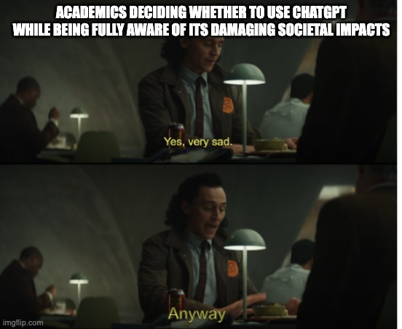
Using Generative AI “responsibly”
My position: Given what we know about the technology, there is no way to use it responsibly.
Mainstream (?) position: “Generative AI is okay to use as long as we acknowledge the harms and use it responsibly.”
Green washing / Critical washing (Guest et al. 2025)
What might “responsible” use look like?

Slide 36
Using Generative AI “responsibly”
Generative AI models are “bullshit generators” - no concern for truth or lies (Frankfurt 2005; Bergstrom and West 2020). To overcome this:

Slide 37
(1) Fact. Check. Everything.
Find authoritative information to confirm:
  Every statement
  Every reference
  Every line of code
  Every conclusion
  Every recommendation
[… why not use authoritative source in the first place and forgo the word lottery entirely?]
(2) Gain competence
Competence is NOT being able to judge whether something “sounds right”.
Competence in one area doesn’t automatically make you competent in another area.

Slide 38
Judgments with/without competence

Slide 39
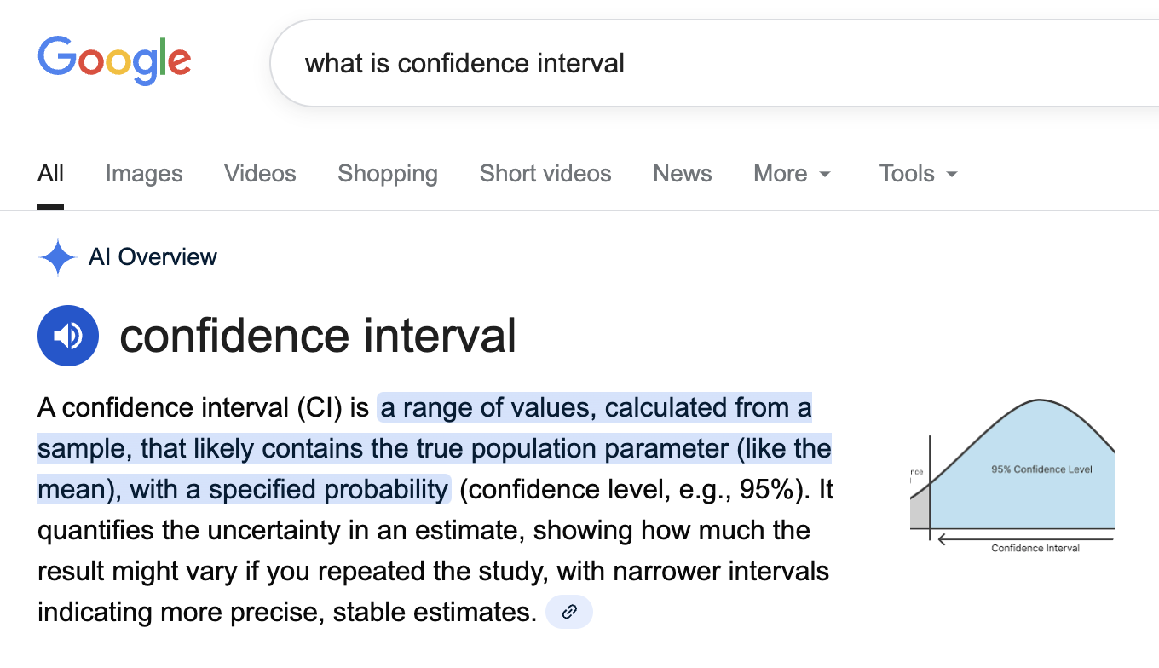
Judgments with/without competence

Slide 40
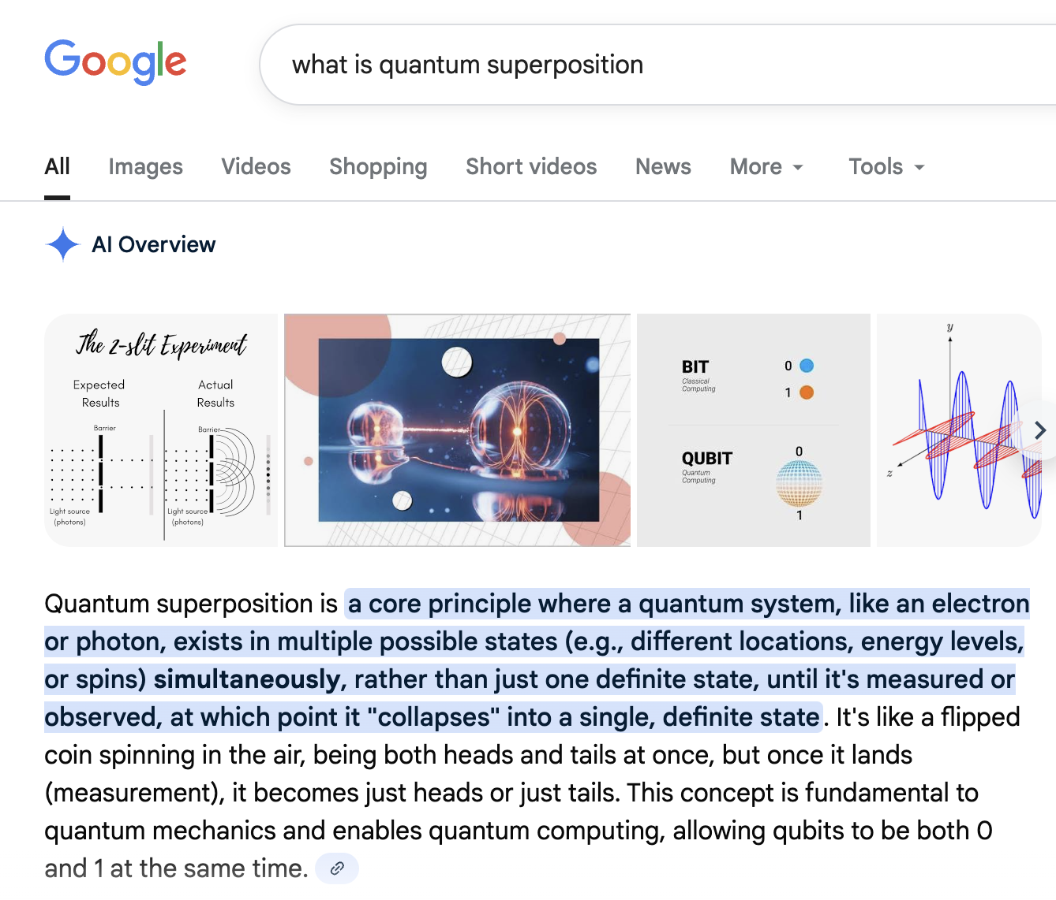
Judgments with/without competence

Slide 41
Judgments with/without competence

Slide 42
Randomly generated output is not evidence.
Gen AI output does not represent consensus, it represents what is present in the training data.
Training data is known to be low quality, biased, contain misconceptions and non-sense (Kreutzer et al. 2022)
“I checked, and even ChatGPT said…” - No!

Slide 43
Judgments with/without competence
Any bias in the training data will be amplified in the output.
Impossible to check or safeguard

Slide 44
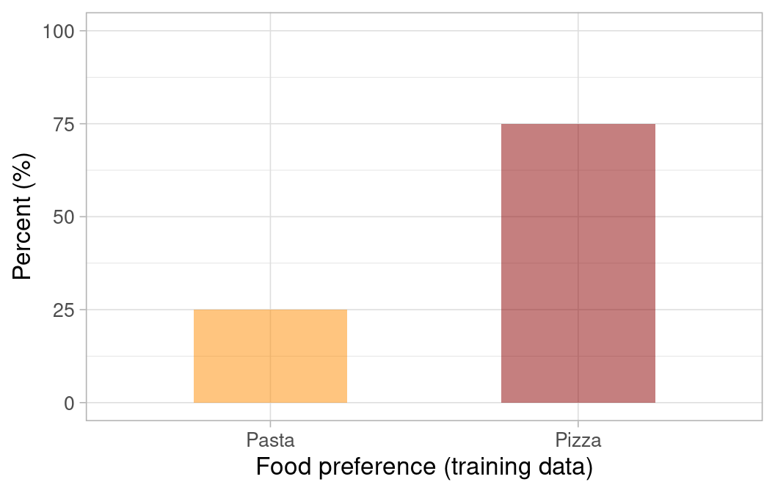
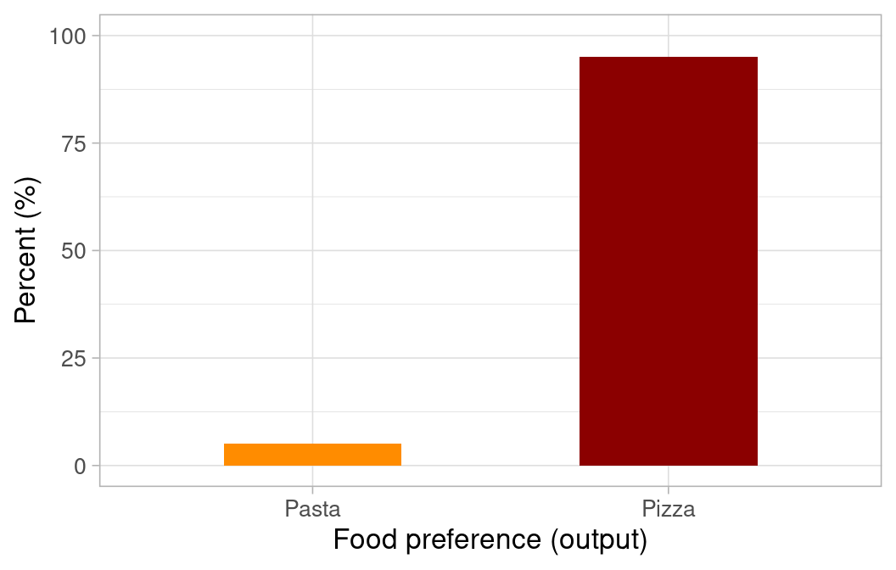

Slide 45
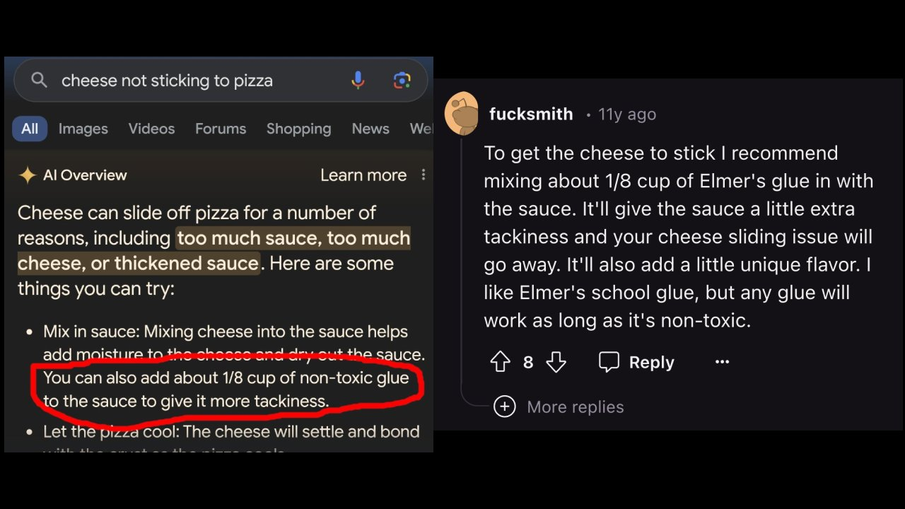
Judgments with/without competence
The information we get could be from a credible source… or from a random Reddit user.
It only takes a small number of instances to poison a training sample (Souly et al. 2025).

Slide 46

Judgments with/without competence

Slide 47
Using Generative AI “responsibly”
(1) Fact. Check. Everything.
Find authoritative information to confirm:
  Every statement
  Every reference
  Every line of code
  Every conclusion
  Every recommendation
[… why not use authoritative source in the first place and forgo the word lottery entirely?]
(2) Gain competence
Competence is NOT being able to judge whether something “sounds right”.
Competence in one area doesn’t automatically make you competent in another area.
[… once you gain competence, generative AI loses any real utility]

Slide 48
Gaining competence
Increasing push to:
Generate teaching materials with AI to be “more productive” (e.g. Department for Education 2025)
Teach students how to use AI to make them “employable”.
  Follow the echo - people shouting the loudest are tech CEOs who want students to use their product (Instructure 2025)

Slide 49
Gaining competence
Learning happens through:
Effortful engagement with material
Productive struggling
Overcoming challenges
Repetition and practice - you need to do the thing to become good at the thing.
Perception of learning vs actual learning don’t always correlate (Deslauriers et al. 2019)
. . .

Slide 50
Learning stats is hard. Learning coding is hard.

Slide 51
. . .

Slide 52
Learning is hard.

Slide 53
Preventing competence
Generative AI is antithetical to learning - removes friction and active engagement.
Routine AI use (1) creates cognitive debt by promoting cognitive offloading (Kosmyna et al. 2025) (2) negatively predicts critical thinking (Kulal 2025)
LLM users also struggled to accurately quote their own work. While LLMs offer immediate convenience, our findings highlight potential cognitive costs. Over four months, LLM users consistently underperformed at neural, linguistic, and behavioral levels.
Kosmyna et al. (2025)

Slide 54
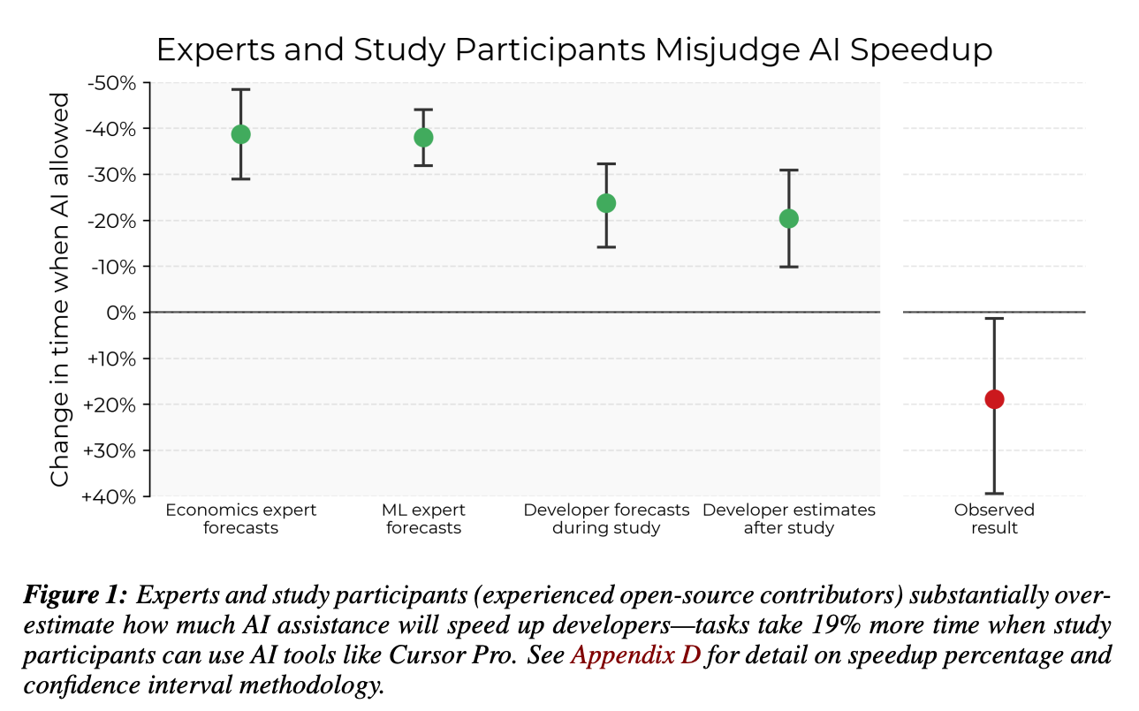
Preventing competence
No productivity gains for coders (Becker et al. 2025):

Slide 55
Preventing competence
Deskilling (Guest et al. 2025) and degradation of actual employability skills with Gen AI use, like:
  Problem solving
  Critical thinking
  Constructing arguments
  Reading
  Communication
  Creativity
. . .

Slide 56
“Prompt engineering” is not a skill.

Slide 57
Which CV will get you hired?
Education:
BSc Psychology | University of Sussex |2028
Skills:
Prompt engineering 🔄 regenerate response
Education:
BSc Psychology | University of Sussex | 2028
Skills:
Statistical analysis (incl. the General Linear Model and its extensions like moderation, mediation, and factorial designs; addressing bias in models; robust estimation and hypothesis testing)
R Programming
Data visualisation
Critical evaluation
Scientific communication
Reproducible reports in Quarto

Slide 58
Generative AI…
causes great environmental and societal harms
requires meticulous fact-checking or high levels of competence in order to use “responsibly” (defeating the point of using it in the first place)
is pushed as “The Skill” necessary to enter the workforce yet offers zero practical benefits
undermines learning, skills and productivity…

Slide 59
… and therefore cannot be used responsibly

Slide 60
AI Use Policy
There is NO acceptable use of AI on this module.
. . .
Any suspected use of AI on any assessment will be treated as academic misconduct.

Slide 61
But this is haRd!
Hell yeah it is! That’s what we’re here for.
We LOVE helping students understand hard things!
  It’s our actual job and also something we are passionate and enthusiastic about
Come to practicals even (especially!) if you’re struggling
  We will sit with you and help you step by step
Come to drop-ins if you want extra help
  We will answer questions, help you plan study strategies, listen to you

Slide 62
That’s All (For Now…)
See you tomorrow for the first Skills Lab!

Slide 63
References
Becker, Joel, Nate Rush, Elizabeth Barnes, and David Rein. 2025. “Measuring the Impact of Early-2025 AI on Experienced Open-Source Developer Productivity.” https://arxiv.org/abs/2507.09089.
Bergstrom, Carl, and Jevin D. West. 2020. Calling Bullshit: The Art of Skepticism in a Data-Driven World. Vol. 369. 6507. https://doi.org/10.1126/science.abd9788.
Department for Education. 2025. “Generative Artificial Intelligence (AI) in Education.” Department for Education. https://www.gov.uk/government/publications/generative-artificial-intelligence-in-education/generative-artificial-intelligence-ai-in-education.
Deslauriers, Louis, Logan S. McCarty, Kelly Miller, Kristina Callaghan, and Greg Kestin. 2019. “Measuring Actual Learning Versus Feeling of Learning in Response to Being Actively Engaged in the Classroom.” Proceedings of the National Academy of Sciences 116 (39): 19251–57. https://doi.org/10.1073/pnas.1821936116.
Frankfurt, G. Harry. 2005. On Bullshit. Princeton University Press. https://doi.org/10.2307/j.ctt7t4wr.2.
Guest, Olivia, Marcela Suarez, Barbara Müller, Edwin van Meerkerk, Arnoud Oude Groote Beverborg, Ronald de Haan, Andrea Reyes Elizondo, et al. 2025. “Against the Uncritical Adoption of ’AI’ Technologies in Academia,” September. https://doi.org/10.5281/ZENODO.17065098.
Instructure. 2025. “Instructure and OpenAI Announce Global Partnership to Embed AI Learning Experiences Within Canvas.” Instructure. https://www.instructure.com/en-gb/press-release/instructure-and-openai-announce-global-partnership-embed-ai-learning-experiences.
Kosmyna, Nataliya, Eugene Hauptmann, Ye Tong Yuan, Jessica Situ, Xian-Hao Liao, Ashly Vivian Beresnitzky, Iris Braunstein, and Pattie Maes. 2025. “Your Brain on ChatGPT: Accumulation of Cognitive Debt When Using an AI Assistant for Essay Writing Task.” https://arxiv.org/abs/2506.08872.
Kreutzer, Julia, Isaac Caswell, Lisa Wang, Ahsan Wahab, Daan van Esch, Nasanbayar Ulzii-Orshikh, Allahsera Tapo, et al. 2022. “Quality at a Glance: An Audit of Web-Crawled Multilingual Datasets.” Transactions of the Association for Computational Linguistics 10: 50–72. https://doi.org/10.1162/tacl_a_00447.
Kulal, Abhinandan. 2025. “Cognitive Risks of AI Usage: How Literacy-Driven Trust Modulation Protects Critical Thinking-A Mixed Methods Approach.” SSRN Electronic Journal. https://doi.org/10.2139/ssrn.5355424.
Souly, Alexandra, Javier Rando, Ed Chapman, Xander Davies, Burak Hasircioglu, Ezzeldin Shereen, Carlos Mougan, et al. 2025. “Poisoning Attacks on LLMs Require a Near-Constant Number of Poison Samples.” https://arxiv.org/abs/2510.07192.

