Slide 1
Linear Model 3: Return of the y_{i}
Week 10
Dr Jenny Terry

Slide 2


Slide 3
Looking Ahead (and Behind)
The story so far…
The Linear Model - Equation of a Line
The Linear Model - Evaluating the Model with p-values, CIs, F, & R²
This week:
The Linear Model - Adding predictors; Comparing models; Comparing predictors
Coming up:
Questionable Research Practices

Slide 4

Objectives
After this lecture, you will (begin to) understand:
How to extend the linear model equation to two, three, or more predictors How to compare linear models using the R² -change and F- change statistics How to interpret the relationship of each predictor with the outcome
How to compare predictors using standardised beta coefficients
Talk to Me!
Open the Lecture Google Doc: bit.ly/and25_lecture10

Slide 5
Your Questions from Last Week
This isn’t quite a question, but the PowerPoint slides don’t appear to have the graphs or r chunks on them
How does the R^2 value know how to calculate the variance? Where is it taking its data from?

Slide 6
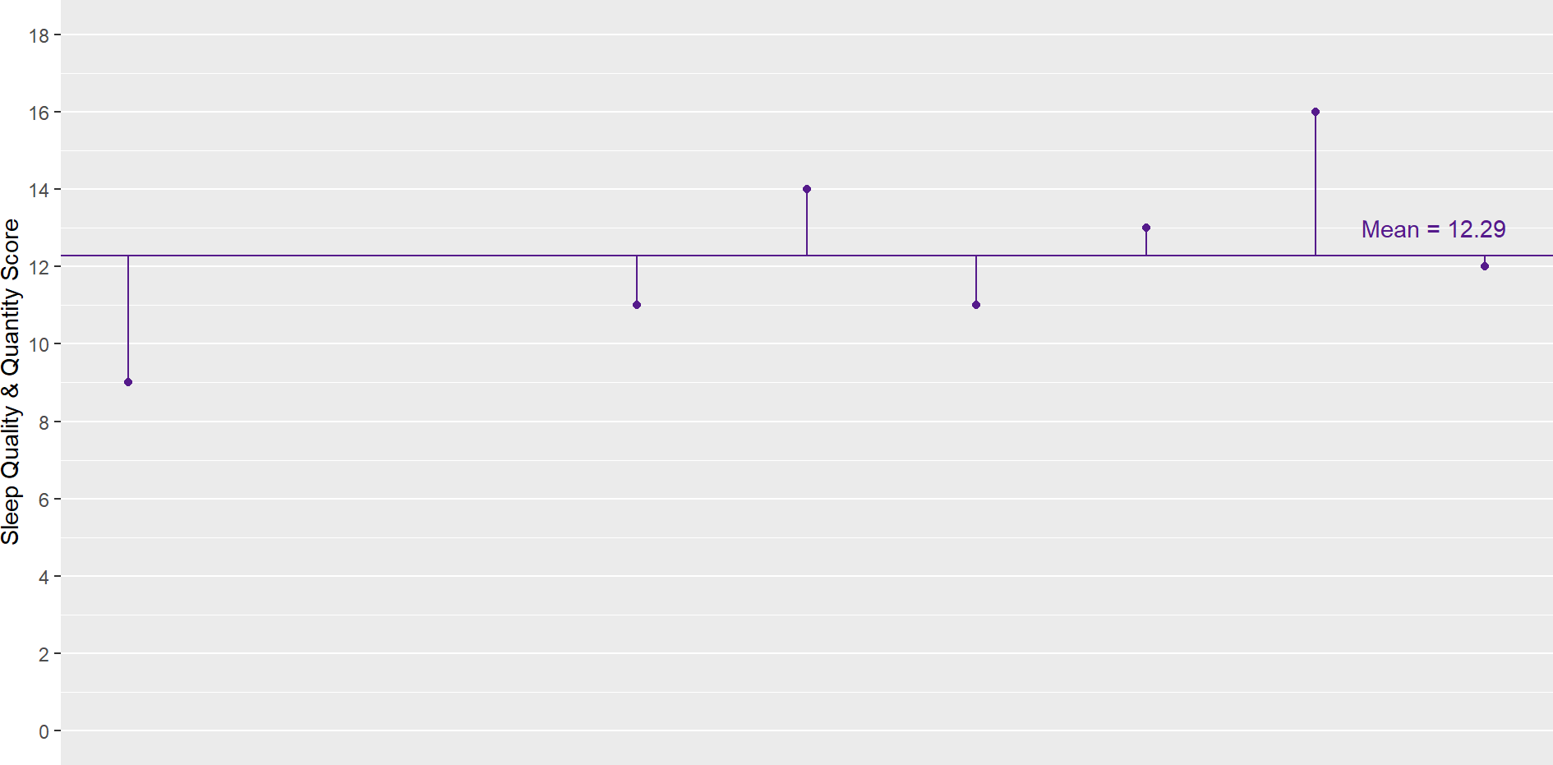
Mean Model Residuals
The lines from each point to the mean represent the distance between the sleep score of each participant and the mean sleep score for the sample (aka the residual error)
We can use these residuals to calculate the overall amount of error and, therefore, variance in our
mean model

Slide 7
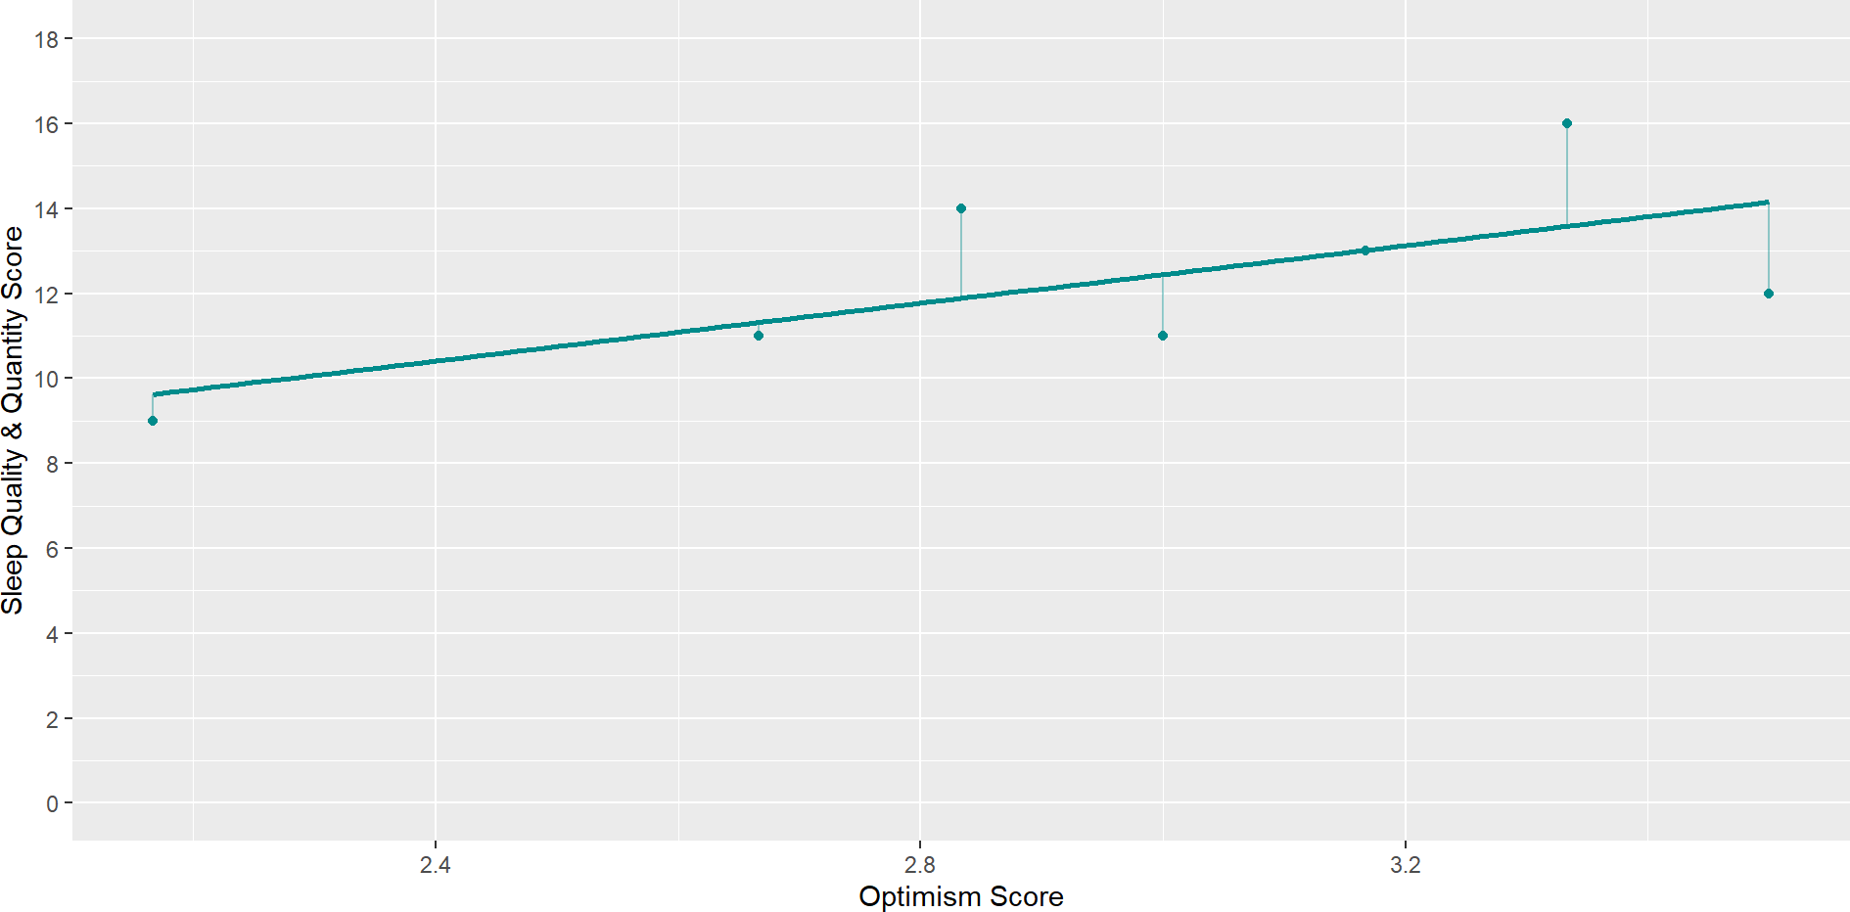
Linear Model Residuals
The lines from each point to the mean represent the distance between the sleep score of each participant and the model’s predicted sleep score for the sample (aka the residual error)
So, we can also calculate the overall amount of error and, therefore, variance in our linear model

Slide 8
Three Types of Research Questions
When we are using linear models with more than one predictor (aka “multiple regression models”), there are usually three stages we go through, each of which align with slightly different research questions:
Which model is better (e.g., a model with one predictor vs. a model with three predictors)?
Does each predictor in the better model have a statistically significant relationship with the outcome (and which direction will those relationships be in)?
Which predictor in the better model has the biggest impact upon the outcome?
We’ll look at these in turn, but first, let’s just see what the linear model equation looks like with more than one predictor…

Slide 9
Adding Predictors to the Linear Model

Slide 10
Extending the Equation
The equation:
One-predictor model: y_{i} = b₀ + b₁ × x_{1i} + e_{i}
Predicts the outcome y based on a predictor x₁
Two-predictor model: y_{i} = b₀ + b₁ × x_{1i} + b₂ × x_{2i} + e_{i}
Predicts the outcome y based on a predictor x₁ and another predictor x₂
Three–predictor model: y_{i} = b₀ + b₁ × x_{1i} + b₂ × x_{2i} + b₃ × x_{3i} + e_{i}
Predicts the outcome y based on a predictor x₁ and x₂ and x₃
n-predictor model: y_{i} = b₀ + b₁ × x_{1i} +. . . +b_{n} × x_{ni} + e_{i}
Predicts the outcome y based on as many predictors as you like!

Slide 11
1. Comparing Linear Models

Slide 12
Comparing Linear Models
We can compare linear models with different numbers of predictors as long as they are
hierarchical (aka nested)
Hierarchical models must be the same except for the addition of something new
For example, the model with one predictor is nested in the two and three predictor models because they are the same except for the addition of the extra predictor(s)
Similarly, a two-predictor model would be nested in a three-predictor model
However, we couldn’t remove a variable from the two-predictor model and replace it with a different one to create a different two-predictor model and compare those
In that case, changing the variable would mean it is no longer the same and, therefore, no longer nested

Slide 13
What is a ‘good’ model?
In Lecture 09, we learned that a good model will:
Fit the data better than the simplest possible model (R² & F-statistic) Explain a lot of variance in the outcome (R² )
Explain an amount of variance that significantly differs from zero (F-statistic)
When we are comparing models, we can use the R² and F values to instead ask, which is the better
fitting model?

Slide 14

It’s all Greek to me!
Vocabulary: Δ
Δ (or, “delta”) means change

Slide 15
R² Change
How do we interpret R² ? 🤔
Vocabulary: R²
R² = percentage of the variance in the outcome explained by the model A larger value means better fit (more variance is explained)
Vocabulary: R² Change
R²Δ = R² − R²
Model 1 Model 2
The difference in R² values between two models
The model with the larger R² value is the better fitting model (more variance is explained) The larger the R²Δ value, the greater the improvement in the better fitting model

Slide 16
F Change
How do we interpret F? 🤔
Vocabulary: F-statistic
F = whether the variance explained significantly differs from zero Compares a model with n predictor(s) to the null model
An F-statistic with a p-value lower than 0.05 means that it is statistically significant, so we can reject the null hypothesis that the null model fits as well as the predictor model
Vocabulary: F Change
FΔ = FModel 1 − FModel 2
Compares models with predictors to one another
The model with the larger F-statistic is the better fitting model
An FΔ with an a p-value lower than 0.05 means that the model is statistically significantly better, so we can reject the null hypothesis that one model fits as well as the other model

Slide 17
Let’s look at an example to see how this looks in practice…

Slide 18
Example: Predicting Sleep from 1 vs. 3 Predictors
Tout et al. (2023) were interested in the effect of positive psychology and emotional regulation upon sleep
Participants took part in a cross-sectional, self-report survey that asked them to rate their:
Positive psychology attributes (a composite of gratitude, optimism, self-compassion, and mindfulness)
Adaptive emotional regulation strategies (a composite of acceptance, positive refocusing, refocus on planning, positive reappraisal, perspective taking)
Maladaptive emotional regulation strategies (a composite of self-blame, rumination, catastrophising, other-blame)
Sleep quality and quantity (a composite of subjective sleep quality, sleep literacy, sleep duration, sleep efficiency, sleep disturbances, sleep medication, daytime dysfunction)

Slide 19
Research Question & Hypothesis
Research Question
1. Which model is better, a model with just positive psychology attributes as a predictor or a model with positive psychology attributes and adaptive emotional regulation strategies and maladaptive emotional regulation?
Hypothesis
The model with positive psychology attributes and adaptive emotional regulation strategies and maladaptive emotional regulation will fit the data better than a model with just positive psychology attributes.

Slide 20
Operationalisation - Model 1
Predictors:
1. Positive psychology attributes (PosPysch) Outcome: Sleep quality & quantity (Sleep)
Model 1: Sleep_{i} = b₀ + b₁ × PosPsych_{1i} + e_{i}

Slide 21
Operationalisation - Model 2
Predictors:
Positive psychology attributes (PosPysch)
Adaptive emotion regulation attributes (AdaptEmoReg)
Maladaptive emotion regulation attributes (MalEmoReg) Outcome: Sleep quality & quantity (Sleep)
So, what will our 3-predictor model equation look like? 🤔
Model 2: Sleep_{i} = b₀ + b₁ × PosPsych_{1i} + b₂ × AdaptEmoReg_{2i} + b₃ × MalEmoReg_{3i} + e_{i}

Slide 22
Running the Analysis
We run the analysis in a series of stages:
Fit Models
Fit Model 1
Fit model 2
Compare R² Values
Calculate R² for Models 1 & 2
Calculate R² Δ
Calculate FΔ

Slide 23
Running the Analysis
Step 1a: Fit Model 1
Model 1
sleep_lm1 <- sleep_tib |>
lm(sleep ~ pos_psy, data = _)
3
4 summary(sleep_lm1)
Call:
lm(formula = sleep ~ pos_psy, data = sleep_tib)
Residuals: Min
1Q Median 0.408
3Q
1.978
Max 5.389
-12.526 -1.706
Coefficients:
Estimate Std. Error t value Pr(>|t|)
(Intercept) | 3.5202 | 1.1502 | 3.060 | 0.00239 | **
pos_psy | 2.2872 | 0.3149 | 7.262 | 2.74e-12 | ***
---
Signif. codes: | 0 '***' | 0.001 '**' 0.01 |  | '*' 0.05 | '.' 0.1 ' ' 1
Residual standard error: 2.855 on 331 degrees of freedom
Multiple R-squared: 0.1374, Adjusted R-squared:
0.1348
F-statistic: 52.74 on 1 and 331 DF, p-value: 2.744e-12

Slide 24
Running the Analysis
Step 1b: Fit Model 2
Model 2
sleep_lm2 <- sleep_tib
lm(sleep ~ pos_psy +
3
4 summary(sleep_lm2)
|>
adapt_er + mal_er, data = _)
Call: lm(formula = sleep | ~ pos_psy | + adapt_er + mal_er, data = sleep_tib)
Residuals: Min 1Q | Median | 3Q Max
-12.2262 -1.5042 | 0.3768 | 2.0303 4.7376
Coefficients:
Estimate Std. Error t value Pr(>|t|)
(Intercept) | 8.5671 |  | 2.0735 | 4.132 | 4.57e-05 | ***
pos_psy | 2.1531 |  | 0.4154 | 5.183 | 3.82e-07 | ***
adapt_er | -0.5004 |  | 0.3316 | -1.509 | 0.13229
mal_er | -0.9886 |  | 0.3690 | -2.679 | 0.00776 | **
---
Signif. codes: |  | 0 '***' | 0.001 '**' 0.01 |  | '*' 0.05 | '.' 0.1 | ' ' 1
Residual standard error: 2.823 on 329 degrees of freedom Multiple R-squared: 0.1621, Adjusted R-squared: 0.1545
F-statistic: 21.22 on 3 and 329 DF, p-value: 1.371e-12

Slide 25
Running the Analysis
Step 2a: Get the R² values for each model
Model 1
1 broom::glance(sleep_lm1)
r.squared | adj.r.squared | sigma | statistic | p.value | df | logLik | AIC
0.1374355 | 0.1348296 | 2.855112 | 52.73944 | 0 | 1 | -820.8574 | 1647.715 | 1659
Model 2
1 broom::glance(sleep_lm2)
r.squared | adj.r.squared | sigma | statistic | p.value | df | logLik | AIC
0.1621142 | 0.1544739 | 2.822512 | 21.21831 | 0 | 3 | -816.0243 | 1642.049 | 1661

Slide 26
Running the Analysis
Step 2b: Calculate the R² Δ value from the R² values
R² Δ = R² − R²
Model 1 Model 2
R² Δ = 0.137 − 0.162
R² Δ = −0.025
R² Δ = 2.5%
R² for Model 2 accounts for 2.5% more of the variance in sleep, indicating Model 2 is the better fitting model

Slide 27
Running the Analysis
Step 3: Get & interpret the FΔ and associated p-value
1 anova(sleep_lm1, sleep_lm2) |> broom::tidy()
term | df.residual | rss | df | sumsq | statistic | p.value
sleep ~ pos_psy | 331 | 2698.200 | NA | NA | NA | NA
sleep ~ pos_psy + adapt_er + mal_er | 329 | 2621.002 | 2 | 77.19761 | 4.845095 | 0.0084371
FΔ = 4.85, p < 0.01, so we can conclude that Model 2 accounts for statistically significantly more
variance and is, therefore, the better fitting model

Slide 28
Attendance Pin

Slide 29
2. Relationships Between the Predictors & the Outcome

Slide 30
Three Types of Research Questions
Now we know that Model 2 is the better fitting model, we can turn to examining the relationships between the predictors and the outcome
We can do this by examining the slope values (b_{n}) for each predictor and asking whether they are statistically significantly different from 0 (see Lecture 09 for a refresher)
This is very similar to how we interpret a linear model with one predictor - let’s take a look…

Slide 31
Interpreting the Model Intercept & Slope
Intercept (b₀ ):
One predictor model: value of y when x₁ is 0
Two predictor model: value of y when x₁ and x₂ are 0
Three predictor model: value of y when x₁ and x₂ and x₃ are 0
Slopes (b₁ , b₂ … b_{n}):
One predictor model: b₁ = change in y for every unit change in x₁
Two predictor model: b₂ = change in y for every unit change in x₂ … when the other predictor in the model is held constant (i.e., when the other variables do not change)
Three predictor model: b₃ = change in y for every unit change in x₃ … when the other predictors in the model are held constant

Slide 32
Interpreting the Model Intercept & Slope
The interpretation of b₀ (the intercept) doesn’t change
It is always the value of y (the outcome) when the predictor(s) are at 0 The interpretation of b_{n} coefficients (a given slope) changes a little
The slope always represents the change in y (the outcome) for every unit change in x_{n} (a given predictor)…
… but when there are other predictors in the model, the relationship between the outcome and predictor assumes the other predictors are held constant
It doesn’t matter if there are two, five, ten, or fifty predictors - the b-values will always be interpreted in this same way
Let’s have a look at our example…

Slide 33
Research Question & Hypothesis
Research Question
2. Does each predictor in the better model have a statistically significant relationship with sleep (and which direction will those relationships be in)?
Hypotheses
Positive psychology attributes and adaptive emotional regulation strategies will have a positive relationship with sleep quality and quantity
Maladaptive emotional regulation strategies will have a negative relationship with sleep quality and quantity

Slide 34
Operationalisation - Model 2
Predictors:
x₁ Positive psychology attributes (PosPysch)
x₂ Adaptive emotion regulation attributes (AdaptEmoReg) x₃ Maladaptive emotion regulation attributes (MalEmoReg) Outcome (y): Sleep quality & quantity (Sleep)
Model: Sleep_{i} = b₀ + b₁ × PosPsych_{1i} + b₂ × AdaptEmoReg_{2i} + b₃ × MalEmoReg_{3i} + e_{i}

Slide 35
Running the Analysis
term | estimate | std.error | statistic | p.value | conf.low | conf.high
(Intercept) | 8.5670973 | 2.0734842 | 4.131740 | 0.0000457 | 4.488138 | 12.6460569
pos_psy | 2.1530694 | 0.4154330 | 5.182711 | 0.0000004 | 1.335829 | 2.9703095
adapt_er | -0.5003627 | 0.3316101 | -1.508889 | 0.1322869 | -1.152706 | 0.1519809
mal_er | -0.9885696 | 0.3690450 | -2.678724 | 0.0077616 | -1.714555 | -0.2625841
b₀ (intercept) = 8.57 (the value of sleep when all predictors are at 0)
b₁ (slope for PosPysch) = 2.15, p < .001, 95% CI [1.34, -2.97]
b₂ (slope for AdaptEmoReg) = -0.50, p = .132, 95% CI [-1.15, 0.15]
b₃ (slope for MalEmoReg) = -0.99, p < .001, 95% CI [-1.71, -0.26]
Each slope represents the relationship between the predictor and the outcome when the other predictors in the model are held constant

Slide 36
3. Comparing Predictors

Slide 37
Three Types of Research Questions
First, we determined that the model with 3 predictors was the better fitting model
Second, we determined that positive psychology and maladaptive emotional regulation are statistically significant predictors of sleep
We also learned that positive psychology had a positive relationship with sleep and maladaptive emotional regulation had a negative relationship with sleep
Now we can ask, which is the best predictor?

Slide 38
Comparing Predictors
We can compare predictors to ascertain which is the “best” predictor
However, we cannot compare the beta values in their current (raw, unstandardised) form, because they are in different units
These different units reflect how the predictor variables are measured e.g., seconds, kilograms, centimetres, pound stirling etc.
In psychology, we often use self-report scales where the units are Likert scale points…

Slide 39
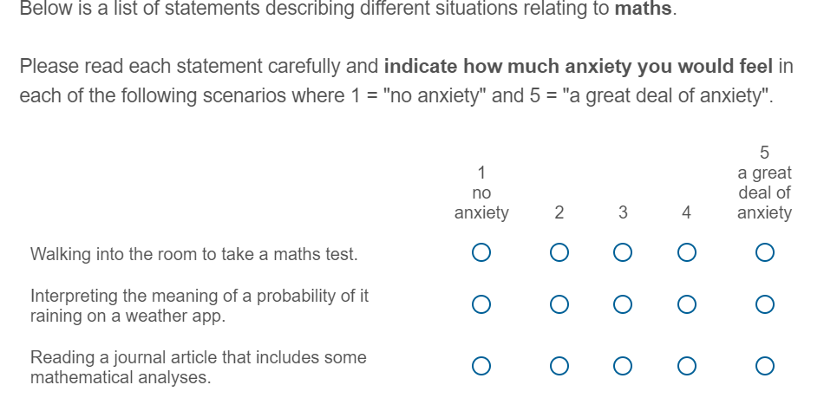
Likert Scales - Maths Anxiety

Slide 40
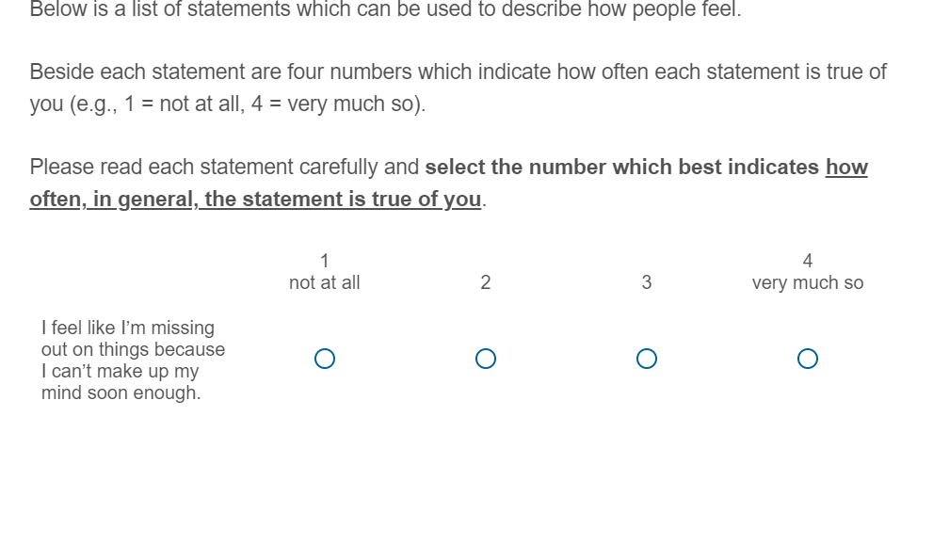
Likert Scales - Trait Anxiety

Slide 41
Comparing Predictors
The two Likert Scales use different units of measurement, so cannot be directly compared
Similarly, we couldn’t directly compare reaction time in seconds with the amount of money someone earns, or the distance someone walks with their Likert Scale responses, etc.
However, we can force them to be comparable by standardising the slope values

Slide 42
Unstandardised vs Standardised Betas
Vocabulary: Unstandardised Betas
Change in the outcome for each unit change in the predictor Depends on original scale of measurement
Usually denoted by b
Vocabulary: Standardised Betas
A standard deviation change in the outcome for each standard deviation change in the predictor Does not depend on original scale of measurement
Usually denoted by β

Slide 43
Research Question & Hypothesis
Research Question
3. Which predictor in the better model has the biggest impact upon sleep?
Hypotheses
Positive psychology attributes will predict sleep quality and quantity better than maladaptive emotional regulation strategies
Note that we’ve dropped the non-significant predictor from our prediction, adaptive emotional regulation strategies (because we already know it is non-significant)
Note we’re not saying anything about the direction of the effect here, just the magnitude
(because we’re interested in absolute values)

Slide 44
Operationalisation - Model 2
Predictors:
x₁ Positive psychology attributes (PosPysch)
x₂ Adaptive emotion regulation attributes (AdaptEmoReg) x₃ Maladaptive emotion regulation attributes (MalEmoReg) Outcome (y): Sleep quality & quantity (Sleep)
Model: Sleep_{i} = b₀ + b₁ × PosPsych_{1i} + b₂ × AdaptEmoReg_{2i} + b₃ × MalEmoReg_{3i} + e_{i}

Slide 45
Running the Analysis
Statistical Interpretation
Parameter | Coefficient | SE | CI | CI_low | CI_high | t | df_error | p
(Intercept) | 0.000 | 0.050 | 0.95 | -0.099 | 0.099 | 0.000 | 329 | 1.000
pos_psy | 0.349 | 0.067 | 0.95 | 0.217 | 0.481 | 5.183 | 329 | 0.000
adapt_er | -0.092 | 0.061 | 0.95 | -0.212 | 0.028 | -1.509 | 329 | 0.132
mal_er | -0.154 | 0.057 | 0.95 | -0.267 | -0.041 | -2.679 | 329 | 0.008
Look at the absolute values of β (ignore positive/negative sign) and decide which is the ‘bigger’ (absolute) predictor of sleep? 🤔
Remember, we can assume non-statistically significant β values are not important predictors of the outcome (we’d report them, but not interpret them as meaningful)

Slide 46
Running the Analysis
Applied Interpretation
What should people focus on for better sleep quality/quantity? 🤔
This analysis suggests that the best thing we can do to improve sleep is to focus on increasing positive psychology attributes
Decreasing maladaptive emotional regulation strategies will also help, but not as much
Working on adaptive emotional regulation strategies would not have any impact on sleep (because it was non-significant)

Slide 47
Lecture Summary
You can extend the linear model to include multiple predictors:
y_{i} = b₀ + b₁ × x_{1i} +. . . +b_{n} × X_{ni} + e_{i}
We can ask three main types of question to evaluate multiple–predictor linear models:
Hierarchical models can be compared with R² Δ and FΔ to determine which model is best
We can then examine the statistical significance of each predictor to establish whether it is an important predictor of the outcome
We can also interpret the relative importance of the predictors in the best model using standardised betas (β)

Slide 48
Next Week
Next week, there are unfortunately no statistics! 😭
Martina and I are going to tell you all about Questionable Research Practices (QRPs)
QRPs are “a range of activities that intentionally or unintentionally distort data in favour of a researcher’s own hypotheses…” (Fortt 2021)
At best, bad science. At worst, academic misconduct and outright fraud! 😈
We’ll explore some different QRPs, look at some famous examples, tell you how the field is trying to solve the problems (i.e., Open Science), and consider some emerging critiques of that movement.
Before next week, please complete the end of module evaluation (check your emails for a personal link). 🙏

