Slide 1
Welcome to Analysing Data!
Lecture 01 Jennifer Mankin and Martina Sladekova

Slide 2

Welcome to Analysing Data!
Lecture 01
Jennifer Mankin, Jenny Terry, and Martina Sladekova
1 February 2024

Slide 3
Overview
Introductions
Module Structure and Sessions
Attendance Policy and Assessments
Materials and Resources
Kahoot! Points and Hex Awards
How to Succeed with Martina
Note
Differences from PaaS highlighted with ✨sparkles!✨

Slide 4
Module Information

Slide 5
What It Says On The Tin
First year core statistics and research methods module
Comprises lectures, skills labs, and practical sessions
. . .
What will you learn?
Data literacy: how to think like a scientist about data
Working with data: cleaning, wrangling, summarising
R skills: using RStudio/Quarto, writing and reading code
Statistics: NHST, common tests, linear model

Slide 6
Contact
✨Module email: analysingdata.psychology@sussex.ac.uk

Slide 7
Jennifer Mankin
Confidential queries: J.Mankin@sussex.ac.uk
Convenor and primary point of contact
Lectures, skills labs, practical teaching
All module admin, assessments, queries
Martina Sladekova
Lectures, skills labs, practical teaching
Jenny Terry
Lectures only
Joanna McLaren
Practical lead

Slide 8
Module Structure

Slide 9
Types of Sessions
Lecture
One-hour lecture session Tuesday evenings
Concepts, ideas, and understanding statistical tests and principles
✨Skills Lab
One-hour interactive, live-coding session Thursday mornings
Demonstrates how to think about and work with data
✨Practical
Two-hour supported working time
Ask questions and get help
Complete the tutorial/worksheet
Take a quiz
Multiple sessions throughout the week, switches between online and in person

Slide 10
Important
Skills Labs are not optional! They are distinct from the lectures and will contribute to your assessments.

Slide 11
Topics Structure
Teaching sessions are grouped around topics, which cover two weeks

Slide 12
First Week
Materials released on Wednesdays
Lecture and tutorial in the morning
Tutorial and worksheet on Cloud in the evening
Lecture Thursday morning
Skills Lab Thursday evening
Second Week
Practical session
Complete tutorial
Complete worksheet
Worksheet quiz

Slide 13
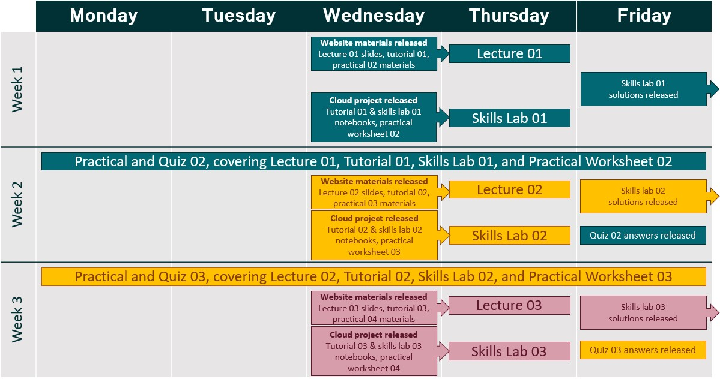
Topics Structure

Slide 14
Topics by Week
Week | Lecture | Skills Lab
1 | Introduction | Logical assertions, filter()
2 | Sampling and Distributions | Cleaning with mutate()
3 | Uncertainty and CIs | Using the pipe |>
4 | NHST | Summarising data
5 | t-tests | t-tests
6 | Correlation | Correlation
7 | Chi-squared | Chi-squared
8 | Linear model 1 | Linear model 1
 | SPRING | HOLIDAY
9 | Linear model 2 | Linear model 2
10 | Linear model 3 | Linear model 3
11 | QPRs | Kahoot revision

Slide 15
Attendance

Slide 16
Lectures/Skills Labs
Attendance is required, but not marked (no PIN or register)
Hybrid delivery: in-person, simultaneously on Zoom, recorded
Important
If you are on a visa in the UK, you must attend teaching sessions in person!

Slide 17
Why Hybrid?
Accessibility and engagement are priorities!
Hybrid allows live captions, chat, Zoom surveys etc.
Support needs and preferences are very different for different people
We want you to have options to learn most effectively
However…

Slide 18

Attendance is Key
Strong recommendation to attend live sessions consistently
Use recordings to supplement or review, not replace, lecture attendance
Highest marks for students who attended live lecture and reviewed recordings (Bos et al., 2016)
Attendance and recording usage both predict achievement (Nordmann et al., 2019)
Guidelines for students (Nordmann et al., 2020)

Slide 19
Practicals
Alternate in person or online
Interact in some way with tutors (any way is fine)
Ask questions, ask for help, get your work checked before the quiz!
Important
✨We do not use PIN attendance on this module!
. . .
If you attend any practical, you can access help and the quiz as normal.
. . .
✨You will be marked present if you attend a practical in your same timeslot (but different mode)
. . .
You will not be marked present if you attend a practical in a different timeslot (either mode)

Slide 20
Changing Your Timetable
Only allowed where unavoidable (e.g. consistent clash)
Email the School Office - the teaching team cannot help!

Slide 21
Assessments

Slide 22
All Assessments
What | Weight | When
Worksheet quizzes | 20% | Every week in practical sessions
Take-away paper (TAP) | 20% | 48-hour period, due Week 7 Wednesday
Research participation | 10% | Throughout term, due Week 11 Friday
Exam | 50% | A2 assessment period
See Assessment Information on Canvas

Slide 23
Worksheet Quizzes
Worksheet Information on Canvas
In the first hour of each practical, complete a worksheet
In the second hour, complete a marked quiz
Next week: practice only!
✨Covers the lecture, skills lab, tutorial, and worksheet
. . .
✨You must attend a practical in order to access the quiz
We will not give out access codes to individual students!

Slide 24
Worksheet Quizzes
Final mark: mean of your best quiz scores
Lowest two scores dropped automatically, including 0s due to absence
You can only submit an EC claim after >2 missed quizzes
This week: Practice quiz on Canvas anytime
Next week: Practice quiz in practicals only!
Week 3: First marked quiz
Answers will be released at the end of each week

Slide 25
✨Take-Away Paper
Take-Away Paper Information released around Week 5
48 hours Monday - Wednesday Week 7
Series of tasks which may include:
Making and justifying data analysis decisions
Data inspection/cleaning, describing
Data manipulation and summarising
Performing and reporting a statistical analysis
To best prepare, complete tutorials and worksheets, and come to Skills Labs!

Slide 26
Research Participation
SONA information on Canvas and on the Psychology website
Complete five hours of research participation before the end of term
Via SONA, same as last term
Requirement to complete credits live
You must complete 20% of your credits in “live” studies (in person, or over Zoom)
Students registered with the Student Support Unit are exempted automatically
Can participate in live studies but are not required to

Slide 27
Exam
Exam Information to be released near the end of term
Two-hour, 50-question MCQ exam in A2 (May)
✨Covers everything on the module, both stats and R!
Will take place online

Slide 28
Materials and Resources

Slide 29
Canvas
Repository of all administrative info about the module
Schedule and syllabus
Assessment info and resources
Assessment submission points
Quiz and exam testing
Policies, rules, and guidelines
Also hosts all session recordings under Panopto Recordings
. . .
Important
If you have a question about the module or assessments, ✨check Canvas first!

Slide 30
Website
Repository of (almost) all module content
✨Lecture slides
✨Tutorial and practical materials
✨Skills Lab example solutions
Contains everything you might read/refer to
Exception: Lecture/Skills Lab recordings on Canvas as usual
Important
Check out the module website at https://and-sussex.netlify.app!

Slide 31
Posit Cloud
Weekly projects containing:
✨Tutorial notebooks
✨Skills Lab notebooks
✨Practical worksheets
Contains everything you might do/complete
Important
Complete each week project on the Cloud!

Slide 32
Fun Stuff

Slide 33

Hex Stickers
Hexagonal (“hex”) stickers are collected by R enthusiasts and used to display their pRide.
Choose one for each Methods module you pass
If you don’t have one yet, get one before you leave!

Slide 34
Kahoot! Points
Two main ways to collect:
Play Kahoot! at the end of each Skills Lab
You must register your Kahoot! username to collect points
Complete ChallengR tasks in tutorials
Every 25,000 points, choose a new hex sticker of your choice (including shinies), with ExtRa pRizes at the end of term for top scorers!

Slide 35
Hex Awards
Special hex stickers that have been designed by the Methods teaching team
Some weekly and some at the end of the module:
Weekly - SavioR
Termly - ClimbR & High FlyR

Slide 36


Weekly
Keen Bean
SavioR
Awarded for enthusiasm, dedication, and curiosity.
Everyone earned this one last term! Get one at the end of the lecture.
Students who go out of their way to help other students learn.
Recipients will be chosen by the teaching team and/or from nominations from fellow students.
Use the SavioR Award Nomination form in Canvas Quizzes to nominate someone.

Slide 37


End of Term
High FlyR
ClimbR
Goes to the students who get the highest final overall marks on Analysing Data.
Awarded once overall marks are confirmed at the end of the module.
Goes to students who have the biggest improvement between their final overall mark on Psychology as a Science and their final overall mark on Analysing Data.
Awarded once overall marks are confirmed at the end of the module.

Slide 38
Why Fun Stuff?
It’s fun!
Research shows that it helps you learn
Better attainment when combined with traditional methods (e.g., Legaki et al., 2020)
More info on the Games and Awards page

Slide 39
Data Skills - in Psychology
Core of findings in Psychology come from quantitative research
We’re able to challenge and update existing research because our tools are improving
The type of data we collect is becoming increasingly more complex - “back of the envelope” calculations no longer enough.
Replicability crucial for improving research

Slide 40
Data Skills - in Psychology
Clinical - Is an intervention for a mental health condition effective?
Developmental - Given a child's score on a test, is their development unusual?
Cognitive - How can we program an experiment to study a complicated cognitive process?
Social - What is the engagement of social media users with posts about specific topics?
Meta-Science - Are psychology findings reported in published papers reproducible?
Organisational - What are the predictors of employee retention in a company?
Neuroscience - Which brain area is more active under certain conditions?
Educational - Does a new teaching method improve educational outcomes?

Slide 41
Data Skills - in the world
Being able to make sense of data is a crucial skill outside of academia.
Potential career trajectories for Psychology graduates with data-skills:

Slide 42
Data analyst
Data scientist
Insights analyst
Quantitative specialist
Civil Service
Market research
UX research
Industry research
Academic research
Working with start-up companies
Administrative positions
Professional services positions

Slide 43
(and many more)

Slide 44
Getting Help
Tip
If you’re finding the module challenging, it doesn’t mean that you’re failing - it means you’re learning.
For the quickest help, ask questions about anything on Discord
Book onto the R Help Desk to set up a one-on-one help session with one of the teaching team.
Come to your weekly practical session to get help from a lecturer or doctoral tutor.

Slide 45
✨Questions?✨

