Slide 1
Linear Model 2: The F Awakens
Week 09 Dr Jenny Terry

Slide 2
Looking Ahead (and Behind)
The story so far…
Fundamentals of NHST & Statistical Tests
The Linear Model - Using the Equation of a Line to Make Predictions
. . .
This week:
The Linear Model - Evaluating the Model
. . .
Coming up:
The Linear Model - Models with Multiple Predictors
Questionable Research Practices

Slide 3
Today’s Objectives
First, a recap:
Linear model
Recap of how we can use the model to makes predictions
After this lecture, you will (begin to) understand:
Evaluating model fit (conceptually) with $R^{2}$ and the $F$-statistic
Evaluating the statistical significance of the prediction with p-values and CIs
. . .
Talk to Me!
Open the Lecture Google Doc: bit.ly/and25_lecture09

Slide 4
Using the Linear Model to Make Predictions (Recap)

Slide 5
The Linear Model as a Statistical Model
Models take sample data and use known mathematical properties of the world around us to make predictions about the population from which our sample came from.
Vocabulary: The General Model Equation
A conceptual representation of all statistical models, with the following form:
$$outcome=model+error$$
Vocabulary: The Linear Model Equation
A particularly common type of statistical model, with the following form:
$$y_{i}=b_{0}+b_{1}×x_{1i}+e_{i}$$

Slide 7
The Linear Model Equation
$$y_{i}=b_{0}+b_{1}×x_{1i}+e_{i}$$
$b_{0}+b_{1}×x_{1i}$ is the model
$b_{0}$ (intercept) is the value of $y$ when $x$ is 0
$b_{1}$ (slope) is the change in $y$ for every unit change in $x$
The model uses sample data to estimate $b_{0}$ and $b_{1}$ in the population
Once we know $b_{0}$ and $b_{1}$, we can estimate $y_{i}$ (outcome) for any value of $x_{1i}$

Slide 8
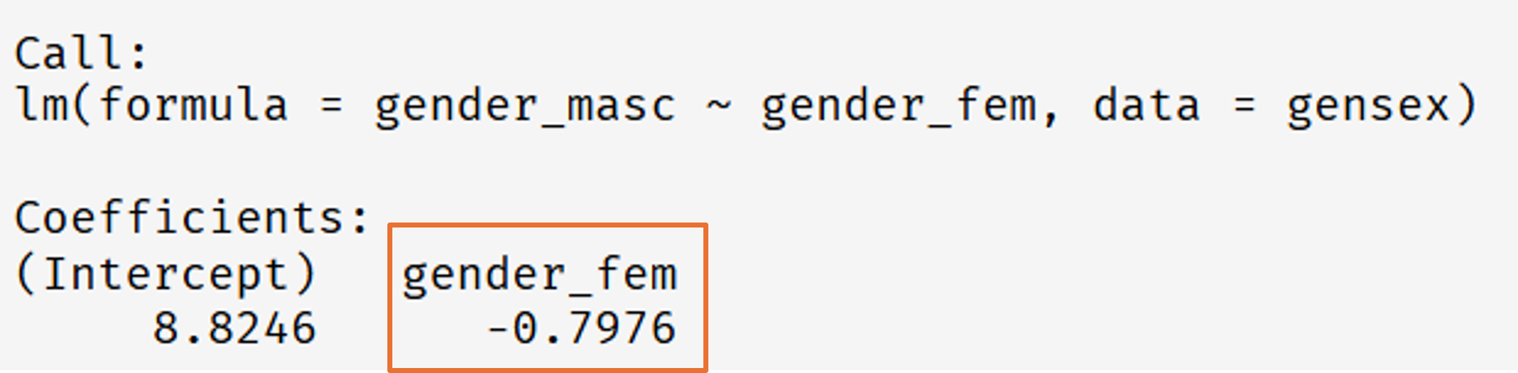
Your Questions from Lecture 08
“I’m confused about where you got -.08 from”
-0.8 was the $b_{1}$ value for the masculinity and femininity example
$b_{1}$ (slope) is the change in $y$ for every unit change in $x$
We calculated $b_{1}$ using R:

Slide 9
We also saw it represented graphically…

Slide 12
Attendance Pin

Slide 13
Evaluating our Model: Is it any Good?

Slide 14
Statistical Models
When we used the linear model last week, we were making predictions about hypothetical individuals from a population by extrapolating from a model based on a sample of data from that population
In psychology, we don’t usually use it to make predictions as such, but we tend to focus on what $b_{1}$ (the slope) tells us about the strength and direction of the relationship between our predictor and outcome
But, how do we know if what our model is telling us about $b_{1}$ is meaningful?
First, is the model itself any good?
$R^{2}$ and the $F$-statistic
Next, is the value of the slope ($b_{1}$) important?
p-values and confidence intervals

Slide 15
The Simplest Model
A good linear model should fit the data better than the simplest possible model
The simplest model is the null (aka, intercept-only) model - where there is no relationship between the predictor(s) and outcome
Here’s our linear model again: $y_{i}=b_{0}+b_{1}×x_{1i}+e_{i}$
If there is no relationship between the predictor and outcome then $b_{1}=0$
If we replace $b_{1}$ with $0$ then we get: $y_{i}=b_{0}+0×x_{1i}+e_{i}$
But $0×x_{1i}=0$ so we can then drop $b_{1}×x_{1i}$ from the equation to get: $y_{i}=b_{0}+e_{i}$
When there are no predictors, $b_{0}$ is the model (which is just the mean of $y$)
So, a linear model with no predictors predicts the outcome by the mean of the outcome

Slide 16
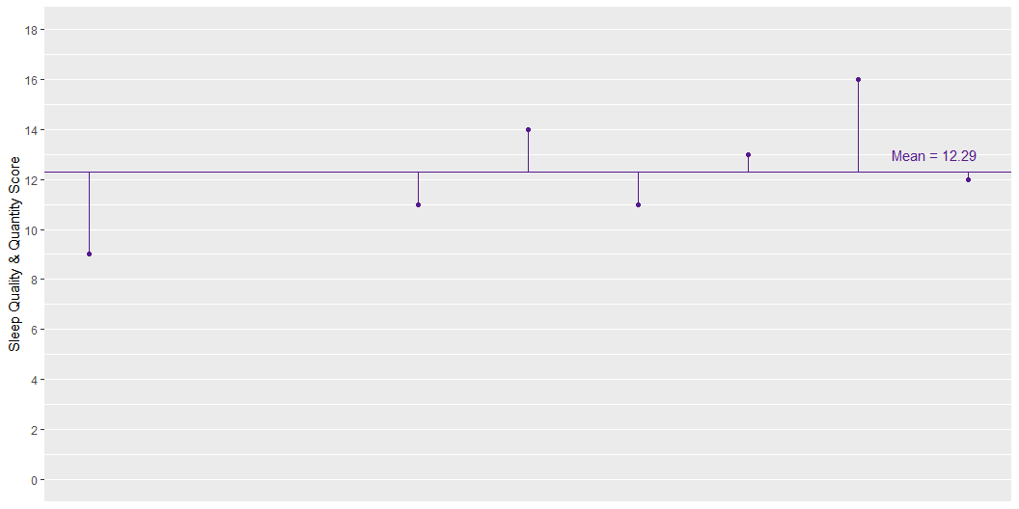
Mean Model Residuals
The lines from each point to the mean represent the distance between the sleep score of each participant and the mean sleep score for the sample (aka the residual error)
We can use these residuals to calculate the overall amount of error and, therefore, variance in our mean model

Slide 17
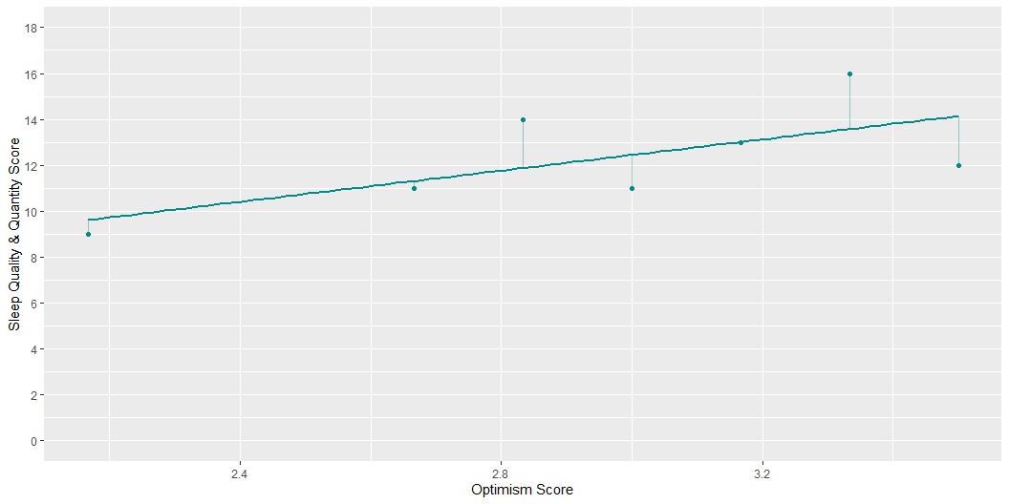
Linear Model Residuals
The lines from each point to the mean represent the distance between the sleep score of each participant and the model’s predicted sleep score for the sample (aka the residual error)
So, we can also calculate the overall amount of error and, therefore, variance in our linear model

Slide 20
NHST Recap
To get a p-value…
We first obtain data, from which we calculate…
. . .
A test statistic that represents the relationship of interest, which we compare to…
. . .
The distribution of that test statistic under the null hypothesis (where there is no relationship) to get…
. . .
The probability (p) of getting a test statistic at least as large as the one we have if the null hypothesis is true so that we can…
. . .
Evaluate our competing hypotheses using a previously decided alpha ($α$) level (usually 0.05)
. . .
If our p-value is lower than $α$, we say that is statistically significant and fail to reject the null hypothesis

Slide 22
Example: Predicting Better Sleep from Positive Psychology
Research Question
Are positive psychology attributes (e.g., gratitude, optimism, mindfulness) associated with better sleep?
Operationalisation
Predictor: Positive psychology attributes
Outcome: Sleep quality & quantity
Model: $Sleep_{i}=b_{0}+b_{1}×PositivePsychology_{1i}+e_{i}$

Slide 23
Is it a Good Model?
Call: lm(formula = sleep ~ pos_psy, data = sleep_tib) Residuals: Min 1Q Median 3Q Max -12.526 -1.706 0.408 1.978 5.389 Coefficients: Estimate Std. Error t value Pr(>|t|) (Intercept) 3.5202 1.1502 3.060 0.00239 ** pos_psy 2.2872 0.3149 7.262 2.74e-12 *** --- Signif. codes: 0 '***' 0.001 '**' 0.01 '*' 0.05 '.' 0.1 ' ' 1 Residual standard error: 2.855 on 331 degrees of freedom Multiple R-squared: 0.1374, Adjusted R-squared: 0.1348 F-statistic: 52.74 on 1 and 331 DF, p-value: 2.744e-12
How much of the variance in sleep is accounted for by positive psychology attributes? 🤔
Is the $F$-statistic statistically significant? 🤔
What does this suggest about the fit of the model? 🤔
. . .
🤫Scientific Notation Converter 🤫

Slide 24
Interim Summary
How do we know if what our model is telling us about $b_{1}$ is important?
First, is the model itself any good?
$R^{2}$ and the $F$-statistic ✅
. . .
Specifically, a good model will:
Fit the data better than the simplest possible model ($R^{2}$ & $F$-statistic)
Explain a lot of variance in the outcome ($R^{2}$)
Explain an amount of variance that significantly differs from zero ($F$-statistic)
. . .
How do we know if what our model is telling us about $b_{1}$ is important?
Next, is the value of the slope ($b_{1}$) meaningful?
p-values and confidence intervals

Slide 28
Example: Predicting Better Sleep from Positive Psychology
Research Question
Are positive psychology attributes (e.g., gratitude, optimism, mindfulness) associated with better sleep?
Operationalisation
Predictor: Positive psychology attributes
Outcome: Sleep quality & quantity
Model: $Sleep_{i}=b_{0}+b_{1}×PositivePsychology_{1i}+e_{i}$
Hypotheses
What is the null hypothesis? 🤔
What is the alternative hypothesis? 🤔

Slide 29
Hypotheses
Null Hypothesis
No relationship between $x$ and $y$
No relationship between positive psychology and sleep
$b_{1}=0$
Alternative Hypothesis
Relationship between $x$ and $y$
Relationship between positive psychology and sleep
$b_{1}≠0$

Slide 30
Significance of b₁
Is our estimate of b₁ different enough from 0 to believe that it is not 0 in the population?
We - well, R - tests this with NHST.
First, we need a test statistic, so we…:
1) Scale the estimate of b₁ by its standard error (variation of estimates)
ChallengR!
What do you get when you divide a normally distributed value by its standard error? 🤔

Slide 32
Confidence Intervals (Recap)
We can also compute a confidence interval (CI) for $b_{1}$ (see Lecture 3)
Assuming that our sample is one of the 95% of samples producing confidence intervals that contain the population value, then the population value for the estimate of interest falls somewhere between the lower limit the upper limit of the interval we’ve computed for our sample
But, we cannot know if our sample is one of the 95% producing a confidence interval that contains the population value
So, they do NOT mean we can be 95% confident that the result lies between the lower and upper limits of our computed interval

Slide 36
Where’s the CI?!
# A tibble: 2 × 7 term estimate std.error statistic p.value conf.low conf.high <chr> <dbl> <dbl> <dbl> <dbl> <dbl> <dbl> 1 (Intercept) 3.52 1.15 3.06 2.39e- 3 1.26 5.78 2 pos_psy 2.29 0.315 7.26 2.74e-12 1.67 2.91
Is there much uncertainty in the estimate of $b_{1}$, according to the CI? 🤔
What can we infer about the statistical significance of $b_{1}$ from the CI? 🤔

Slide 38
Putting It All Together
$R^{2}$ tells us the percentage of outcome variance our model explains
The $F$-statistic and its associated p-value tells is whether the amount of variance explained is significantly different from 0
We can also get an associated p-value and confidence interval for $b_{1}$ that tells us whether $b_{1}$ is significantly different from 0
We can also use the confidence interval as a measure of uncertainty
$b_{1}$ is also an effect size that tells us the strength and direction of the relationship between the predictor and the outcome
Reporting Results in APA Style
The model explained a statistically significant proportion of the variance in sleep quality and quantity, $R^{2}$ = 13.7%, F(1, 331) = 52.74, p < 0.001. Positive psychology attributes positively and statistically significantly predicted sleep quality and quantity, $b_{1}$ = 2.29 [1.67, 2.91], t(331) = 7.26, p < 0.001.

Slide 39
Further Support
The linear model will be crucial for the rest of your degree, so if that was a bit of a blur to you, it’s highly recommended that you spend some time working through it slowly, until it clicks.
Here are some recommendations for extra sources of support:
Statistics by Jim blog/videos (beginner)
Khan Academy’s introduction to linear equations (beginner)
Learning Statistics with R - see Section V, Chapter 15, Linear Regression (intermediate)
Andy Field’s YouTube channel (intermediate)
CenterStat YouTube channel (advanced)
They cover a few points we don’t get into on AnD (especially the intermediate and advanced stuff), but these are the some of the clearest explanations of the linear model and associated concepts I’ve ever encountered, so I highly recommend them.

