Slide 1
Linear Model 1: A New Equation
Week 08 Dr Jenny Terry

Slide 2
Looking Ahead (and Behind)
The story so far…
Fundamentals of NHST & Statistical Tests
. . .
This week:
The Linear Model - Equation of a Line
. . .
Coming up:
The Linear Model - Evaluating the Model with p-values, CIs, $F$ & $R^{2}$
The Linear Model - Models with Multiple Predictors
Questionable Research Practices
. . .
“Is it bad if I don’t understand anything from the lectures?”

Slide 3
Today’s Objectives
After this lecture, you will (begin to) understand:
What a statistical model is and why they are useful
The equation for a linear model with one predictor
$b_{0}$ (the intercept)
$b_{1}$ (the slope)
How to use the equation to predict an outcome
How to read scatterplots and lines of best fit
. . .
Talk to Me!
Open the Lecture Google Doc: bit.ly/and25_lecture08

Slide 4
Statistical Models
Vocabulary: The General Model Equation
A conceptual representation of all statistical models, with the following form:
$$outcome=model+error$$
We can use statistical models to predict the outcome for a particular case (e.g., an individual)
The model itself is a set of mathematical assumptions (i.e., an equation) that assume properties about a population
This is always subject to some degree of error

Slide 5
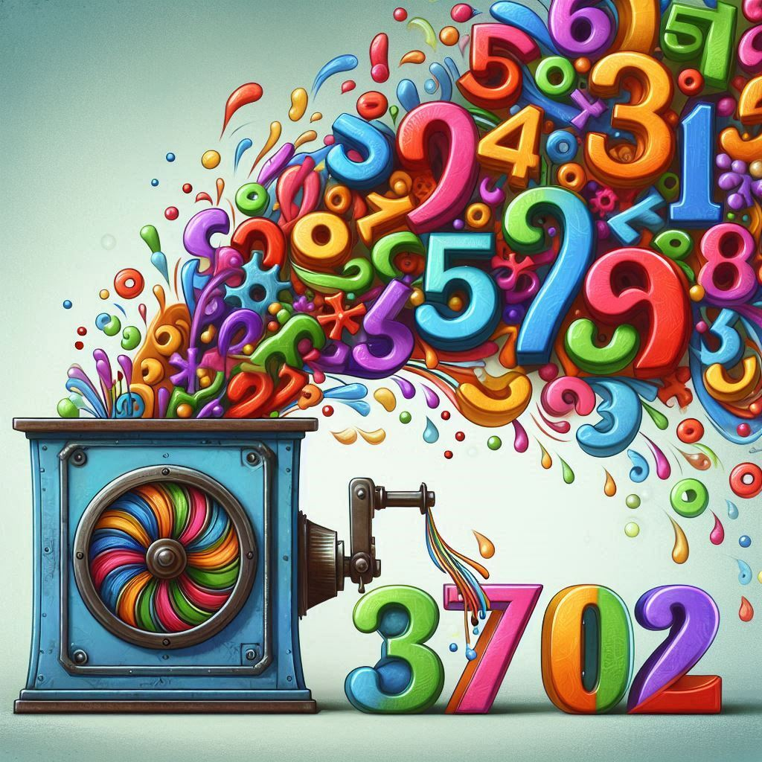
Statistical Models
Statistical models are like machines
Data from lots of different individual cases (e.g., predictor and outcome variable scores) goes into the machine (model)
The machine (model) can then use that data to work out a prediction for the outcome score of any individual case
Predictive models can be very useful IRL (here’s an example of modelling we were all too familiar with a few years back)

Slide 6
The Error Term
The error term includes everything that separates your model from actual reality (e.g., individual differences, unmeasured variables, and measurement error)
The error term represents the way observed data differs from the actual population (which is unobservable - we cannot calculate)
So, we can not and do not use the error term for statistical modelling, but we know it is there so it is represented in the equation.

Slide 7
One Equation to Rule Them All!
The linear model is fundamental and extremely common statistical model
Most common statistical tests (e.g., t-tests and chi-squared) are some form of linear model
Allows us to predict an outcome from one or more predictor variables
Our first (explicit) contact with statistical modelling

Slide 8
All the World’s a Model…
… and our variables merely players!

Slide 9
Vocabulary: Predictor(s)
The variable(s) that you hypothesise will predict the outcome.
In experimental studies, this is usually the treatment variable (the thing that is manipulated).
In observational studies (e.g., cross-sectional surveys), this will be one of the variables you’ve measured.
Also - and commonly in experimental research - called the independent variable, or IV.
Vocabulary: Outcome
The variable that we hypothesise will vary, depending on the predictor.
In experimental studies, this is what you think will change because of your manipulation.
In observational studies (e.g., cross-sectional surveys), this will also be one of the variables you’ve measured!
Also - and commonly in experimental research - called the dependent variable, or DV.

Slide 10
The Linear Model Equation
The linear model is the equation for a straight line:
$$y=mx+b$$
. . .
It is usually written like this:
$$y_{i}=b_{0}+b_{1}x_{1i}+e_{i}$$
. . .
I will write it in full for now, so you can get used to it:
$$y_{i}=b_{0}+b_{1}×x_{1i}+e_{i}$$

Slide 11
The Linear Model Equation
Term | Meaning
$y_{i}$ = | The outcome ($y$) for an individual’s actual score ($i$) is equal to (or, is predicted by)…
$b_{0}$ | … the value of beta-zero (the model’s intercept)…
+ | … plus…
$b_{1}$ | … the value of beta-one (the model’s slope)…
$×$ | … multiplied by…
$x_{1i}$ | … the hypothethical value of the predictor ($x_{1}$) for an individual ($i$)…
$+$ | … plus…
$e_{i}$ | … the error ($e$) for the individual’s actual score ($i$)…
$$y_{i}=b_{0}+b_{1}×x_{1i}+e_{i}$$

Slide 12
Using the Linear Model to Make Predictions

Slide 13
Overview
Example 1: Predicting Masculinity from Femininity
A recognisable example (from your correlation lecture)
Visual, approximate representation (so you can get a sense of where the numbers come from)
Computational, precise calculations (where we actually get the numbers from)
Example 2: Predicting Better Sleep from Positive Psychology
A new example for extrapolation
Visual, approximate representation (so you can get a sense of where the numbers come from)
Computational, precise calculations (where we actually get the numbers from)

Slide 14
Example 1: Predicting Masculinity from Femininity
Dr Mankin was interested in the relationship between femininity and masculinity
Participants took part in a cross-sectional, self-report survey that asked them to rate their:
Femininity
Masculinity
& a bunch of other things not relevant for today’s example
. . .
Hypothesis: Previous research (your correlation lecture!) suggests that… femininity will have a negative relationship with masculinity

Slide 15
Operationalisation
Hypothesis: Femininity will have a negative relationship with masculinity
. . .
Predictor ($x_{1}$): Femininity
. . .
Outcome ($y$) : Masculinity
. . .
Model: $Masculinity_{i}=b_{0}+b_{1}×Femininity_{1i}+e_{i}$
Masculinity doesn’t have a value because that is what we’re estimating
Femininity will be given a value, but we can pick different values and plug them in to solve the equation to get the value of masculinity for whatever value of femininity we choose
We can’t estimate error, so we don’t need to worry about that
But, where do the $b_{0}$ and $b_{1}$ come from?! 🤔
Hint: Remember that the linear model is the equation for a straight line…

Slide 16
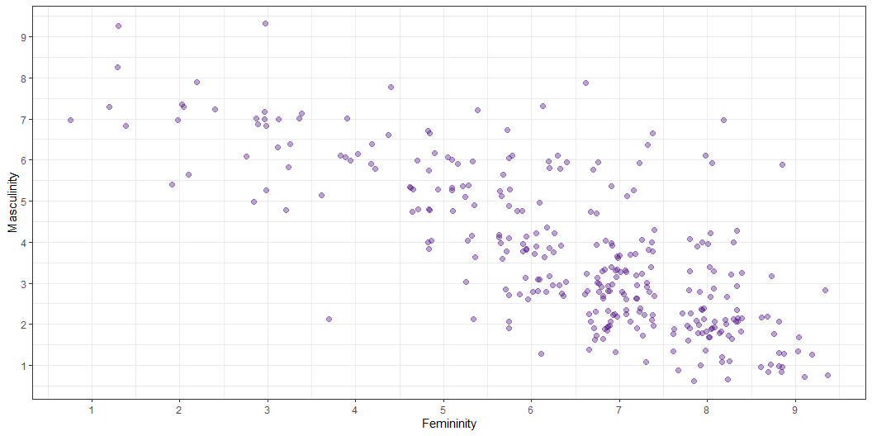
Visualising our Model (the Line)
Where would you draw a straight line through these dots to best capture where they tend to fall?

Slide 17
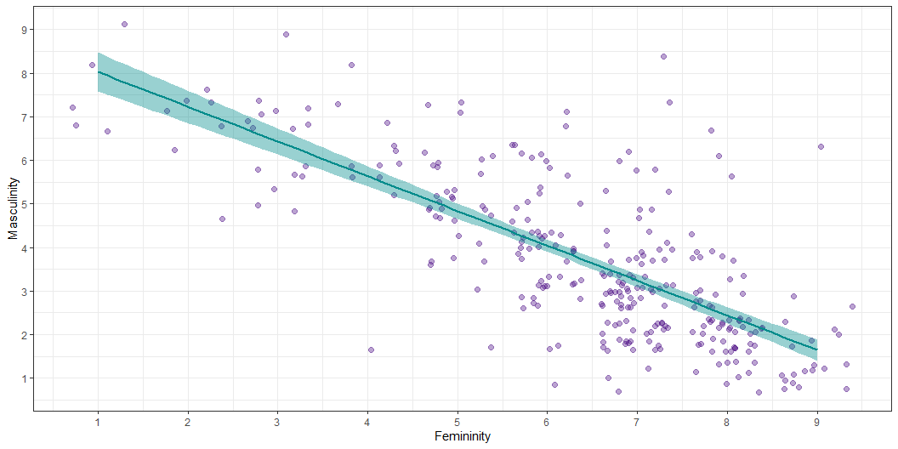
Visualising our Model (the Line)
The line is our statistical model - it is not the data itself, but it is using the data to make a prediction

Slide 18
Visualising our Model (the Line)
The individual scores (data points) tend to be higher up on the left and lower down on the right
. . .
As the variable on $x$ (here, ratings of femininity) increases…
. . .
… the variable on $y$ (here, ratings of masculinity) tends to decrease
. . .
This represents a negative relationship between $x$ and $y$ - as one goes up, the other goes down
. . .
ChallengR: Why Not Correlation?
You already saw this same data, and relationship, with the correlation analysis you did with this data in a previous lecture.
Why are we doing something different? What do we get from the linear model that we don’t get from our correlation analysis?

Slide 19
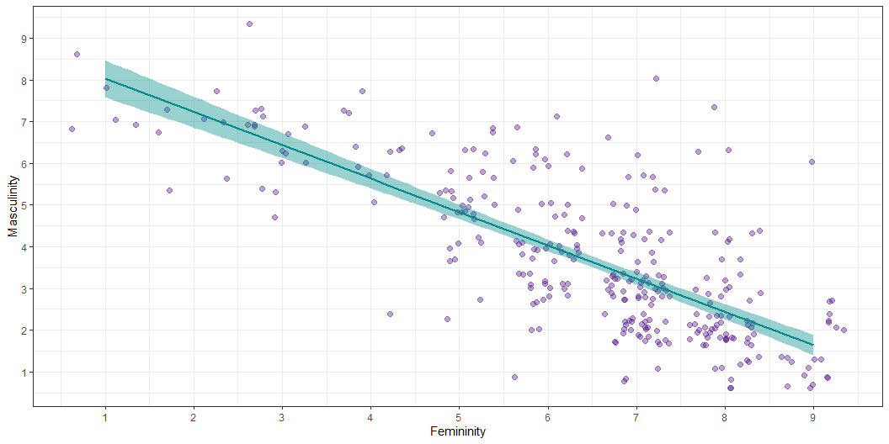
Visualising our Model (the Line)
$b_{0}$ - the intercept (where the line crosses 0 the x-axis)
$b_{1}$ - the slope (the gradient of the line - the difference in $y$ for every unit increase in $x$)
What would we estimate these values to be?

Slide 20
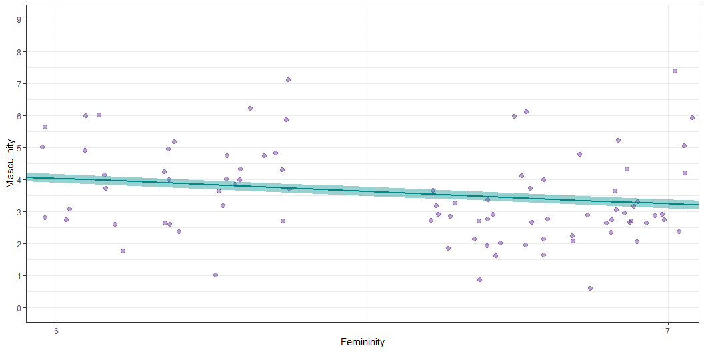
Estimating the Slope

Slide 21
Using the Model to Predict Masculinity
We can make some guesses based on the plot:
The line would cross 0 on the x-axis (aka, the y-axis) somewhere between 8 and 9
$b_{0}≈8.5$
. . .
For every unit increase on the femininity (predictor, $x$) scale, masculinity (outcome, $y$) decreases by a little less than one point
$b_{1}≈−0.8$

Slide 22
Using the Model to Predict Masculinity
We can then plug those values into our model…
We have already plugged in our outcome (masculinity) and predictor (femininity):
$$Masculinity_{i}=b_{0}+b_{1}×Femininity_{1i}+e_{i}$$
. . .
We also know the intercept (aka $b_{0}$, aka the predicted value of masculinity when femininity is 0) is $≈$ 8.5, so we can plug that in:
$$Masculinity_{i}=\hat{8.5}+b_{1}×Femininity_{1i}+e_{i}$$
. . .
We also know the slope (aka $b_{1}$, aka the change in masculinity associated with a unit change in femininity) is $≈$ -0.8, so we can plug that in (note the sign change):
$$Masculinity_{i}=\hat{8.5}−\hat{0.8}×Femininity_{1i}+e_{i}$$

Slide 23
Using the Model to Predict Masculinity
Before we use the equation to predict masculinity, let’s get the real beta values from R…
. . .
Call: lm(formula = gender_masc ~ gender_fem, data = gensex) Coefficients: (Intercept) gender_fem 8.8246 -0.7976
. . .
Adapt our equation to include the real $b$ values:
Intercept ($b_{0}$): the predicted value of masculinity when femininity is 0
= 8.82
Slope ($b_{1}$): change in masculinity associated with a unit change in femininity
= -0.80
. . .
$$Masculinity_{i}=\hat{8.82}−\hat{0.8}×Femininity_{1i}+e_{i}$$

Slide 24
Using the Model to Predict Masculinity
$$Masculinity_{i}=\hat{8.82}−\hat{0.8}×Femininity_{1i}+e_{i}$$
. . .
For someone with a fairly low (on a scale of 1-9) femininity rating of 3:
$$Masculinity_{i}=\hat{8.82}−\hat{0.8}×3+e_{i}$$
. . .
$$Masculinity_{i}=6.42+e_{i}$$
. . .
For someone with a fairly high (on a scale of 1-9) femininity rating of 8:
$$Masculinity_{i}=\hat{8.82}−\hat{0.8}×8+e_{i}$$
. . .
$$Masculinity_{i}=2.42+e_{i}$$

Slide 25
Why Not Correlation?
ChallengR: Why Not Correlation?
You already saw this same data, and relationship, with the correlation analysis you did with this data in a previous lecture.
Why are we doing something different? What do we get from the linear model that we don’t get from our correlation analysis?
. . .
Both correlation and the linear model can tell us about the strength and direction of the relationship…
. . .
… but only the linear model can predict the outcome for any value of the predictor
. . .
Correlation and the linear model are related though - see this interactive visualisation!

Slide 26
Example 2: Predicting Better Sleep from Positive Psychology
Tout et al. (2023) were interested in the effect of positive psychology upon sleep
Participants took part in a cross-sectional, self-report survey that asked them to rate their:
Positive psychology attributes (a composite of gratitude, optimism, self-compassion, and mindfulness)
Sleep quality and quantity (a composite of subjective sleep quality, sleep literacy, sleep duration, sleep efficiency, sleep disturbances, sleep medication, daytime dysfunction)
& a bunch of other things not relevant for today’s example
. . .
Hypothesis: Based on the evidence that other positive psychology attributes positively impacted sleep, Tout hypothesised that… positive psychology attributes will have a positive relationship with sleep quality and quantity

Slide 27
Operationalisation
Hypothesis: Positive psychology attributes are associated with better sleep
Predictor ($x_{1}$): Positive psychology attributes
Outcome ($y$) : Sleep quality & quantity
Where would our predictor and outcome fit into the linear model equation: $y_{i}=b_{0}+b_{1}×x_{1i}+e_{i}$?
Talk to Me!
Open the Lecture Google Doc: bit.ly/and25_lecture08
. . .
Model: $Sleep_{i}=b_{0}+b_{1}×PositivePsychology_{1i}+e_{i}$
What about $b_{0}$ and $b_{1}$…?

Slide 28
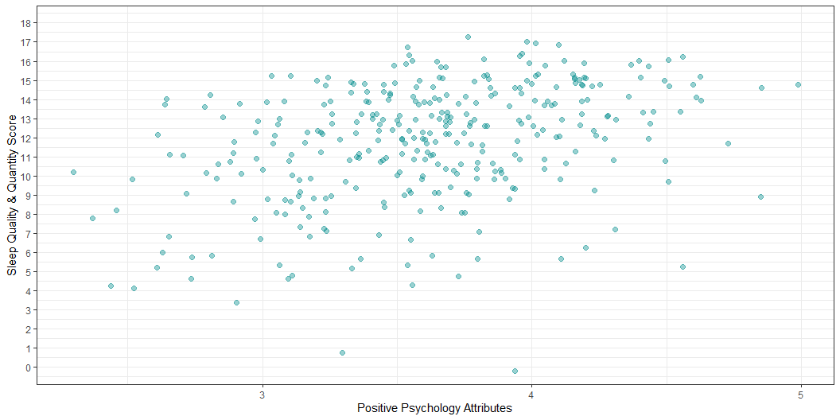
Visualising our Model (the Line)
Where would you draw a line through these dots that best captures where they tend to fall?

Slide 29
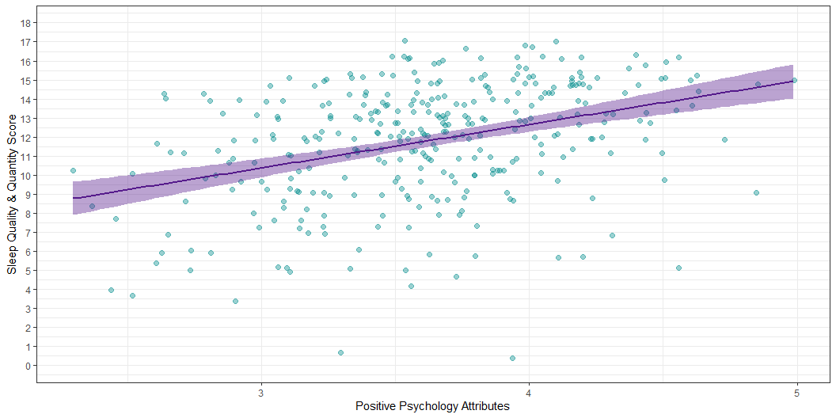
Visualising our Model (the Line)
Is this a positive or a negative relationship? How do we know?

Slide 30
Visualising our Model (the Line)
The individual scores (data points) tend to be higher up on the right and lower down on the left
As the variable on $x$ (here, positive psychology attributes) increases…
. . .
… the variable on $y$ (here, sleep quality & quantity) also increases
. . .
This represents a positive relationship between $x$ and $y$: as one goes up, the other goes up

Slide 31

Visualising our Model (the Line)
Two key elements:
$b_{0}$ - the intercept (where the line crosses 0 on the x-axis)
$b_{1}$ - the slope (the gradient of the line - the difference in $y$ for every unit increase in $x$)
What would you estimate these values to be?

Slide 32
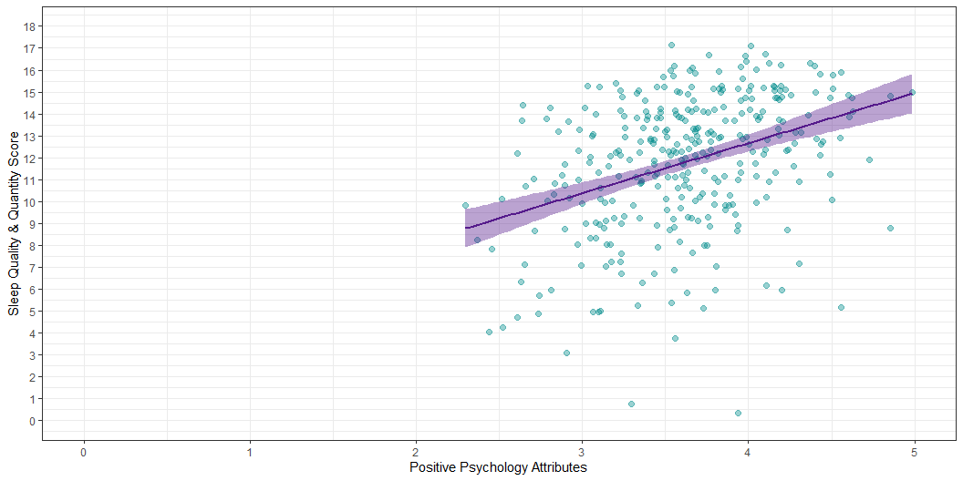
Estimating the Intercept

Slide 33
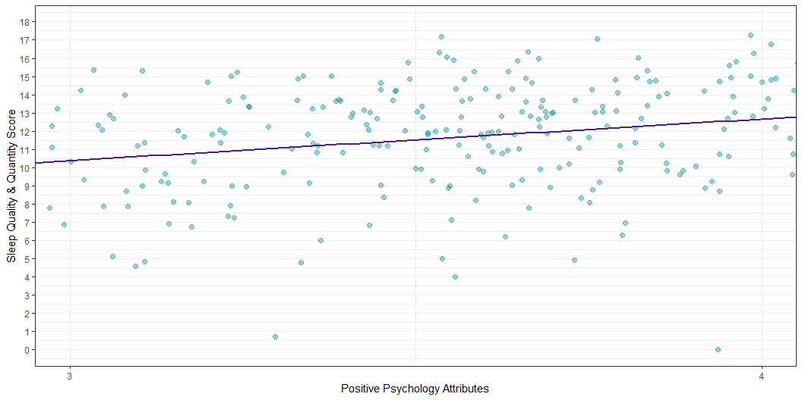
Estimating the Slope

Slide 34
Using the Model to Predict Sleep
$$Sleep=b_{0}+b_{1}×PositivePsychology_{1i}+e_{i}$$
Predictor ($x_{1}$): Positive psychology attributes
Outcome ($y$) : Sleep quality & quantity
Intercept ($b_{0}$): the predicted value of sleep when positive psychology is 0
$≈$ 3.5
Slope ($b_{1}$): change in sleep associated with a unit change in positive psychology
$≈$ 2.2

Slide 35
Using the Model to Predict Sleep
Before we plug the intercept and slope into the equation, let’s get the more precise beta values from R…
. . .
Call: lm(formula = sleep ~ pos_psy, data = sleep_tib) Coefficients: (Intercept) pos_psy 3.520 2.287
. . .
Can you adapt our equation to include the real $b$ values?
$$Sleep=b_{0}+b_{1}×PositivePsychology_{1i}+e_{i}$$
Intercept ($b_{0}$): the predicted value of sleep when positive psychology is 0
= 3.52
Slope ($b_{1}$): change in sleep associated with a unit change in positive psychology
= 2.29

Slide 36
Using the Model to Predict Sleep
$$Sleep_{i}=\hat{3.52}+\hat{2.29}×PositivePsychology_{1i}+e_{i}$$
. . .
For someone with a fairly low positive psychology rating (on a scale of 1-5) of 1.5:
. . .
$$Sleep_{i}=\hat{3.52}+\hat{2.29}×1.5+e_{i}$$
. . .
$$Sleep_{i}=6.95+e_{i}$$
. . .
For someone with a fairly high positive psychology rating (on a scale of 1-5) of 4:
. . .
$$Sleep_{i}=\hat{3.52}+\hat{2.29}×4+e_{i}$$
. . .
$$Sleep_{i}=12.68+e_{i}$$

Slide 37
Summary
Vocabulary: The Linear Model
$$y_{i}=b_{0}+b_{1}×x_{1i}+e_{i}$$
A statistical model representing the linear relationship between a predictor and outcome
$y_{i}$: the (predicted value of the) outcome for an individual case
What we’re trying to estimate
$b_{0}$: the intercept - the value of the outcome when the predictor is 0
Obtained from our model, based on the data
$b_{1}$: the slope - the change in the outcome for every unit change in the predictor
Obtained from our model, based on the data
$x_{1i}$: (any individual case value for) the predictor
We can plug in any value of the predictor to get the predicted outcome
$e_{i}$: the (unknown and unknowable) error in prediction

Slide 38
Welcome to the World of Linear Modelling
The linear model will be crucial for the rest of your degree, so if that was a bit of a blur to you, it’s highly recommended that you spend some time working through it slowly, until it clicks.
Here are some recommendations for extra sources of support:
Statistics by Jim blog/videos (beginner)
Khan Academy’s introduction to linear equations (beginner)
Learning Statistics with R - see Section V, Chapter 15, Linear Regression (intermediate)
Andy Field’s YouTube channel (intermediate)
CenterStat YouTube channel (advanced)
They cover a few points we don’t get into on AnD (especially the intermediate and advanced stuff), but these are the some of the clearest explanations of the linear model and associated concepts I’ve ever encountered, so I highly recommend them.

Slide 39
Next Week
Recap of the Linear Model
How do we know if it is a good model?
How do we know if it is a good prediction?

