Slide 1

A TA’s Reflection

Slide 2
We’ve evolved 4.84pts more evil this year ...
Maximum: 99 / Average: 58.77 / Median: 57.5
Maximum: 99 / Average: 63.61 / Median: 66

Slide 3
Somehow, ...
 | P1 | P2 | P3 | P4 | P5 | P6 | P7 | Bonus
Average | 8.88 | 6.28 | 5.60 | 5.04 | 11.87 | 8.11 | 11.87 | 1.11
Total | 15 | 10 | 9 | 12 | 19 | 18 | 17 | 3
Rate | 59.20% | 62.8% | 62.2% | 42% | 62.47% | 45.06% | 69.82% | 37.00%

Slide 4
Somehow, I unexpectedly seem ...
 | P1 | P2 | P3 | P4 | P5 | P6 | P7 | Bonus
Average | 8.88 | 6.28 | 5.60 | 5.04 | 11.87 | 8.11 | 11.87 | 1.11
Total | 15 | 10 | 9 | 12 | 19 | 18 | 17 | 3
Rate | 59.20% | 62.8% | 62.2% | 42% | 62.47% | 45.06% | 69.82% | 37.00%
One Function for All ?

Slide 5
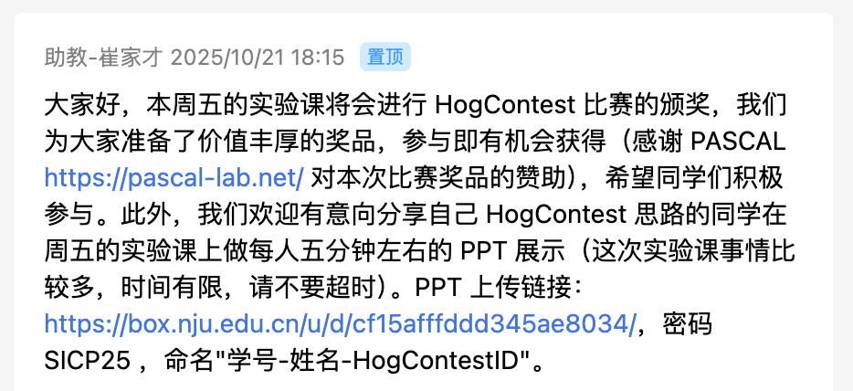
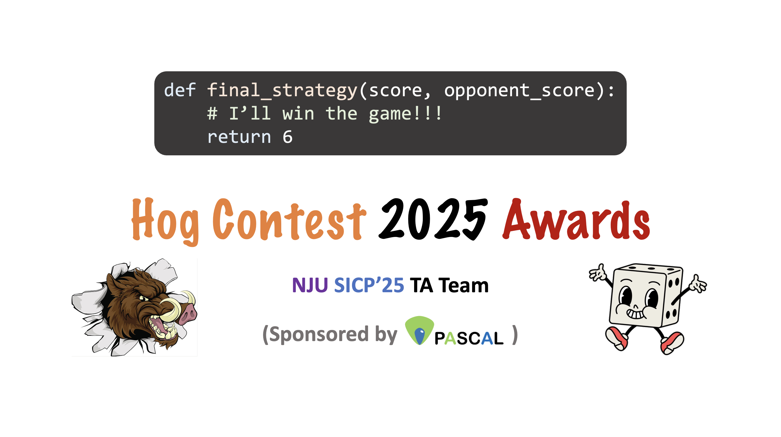
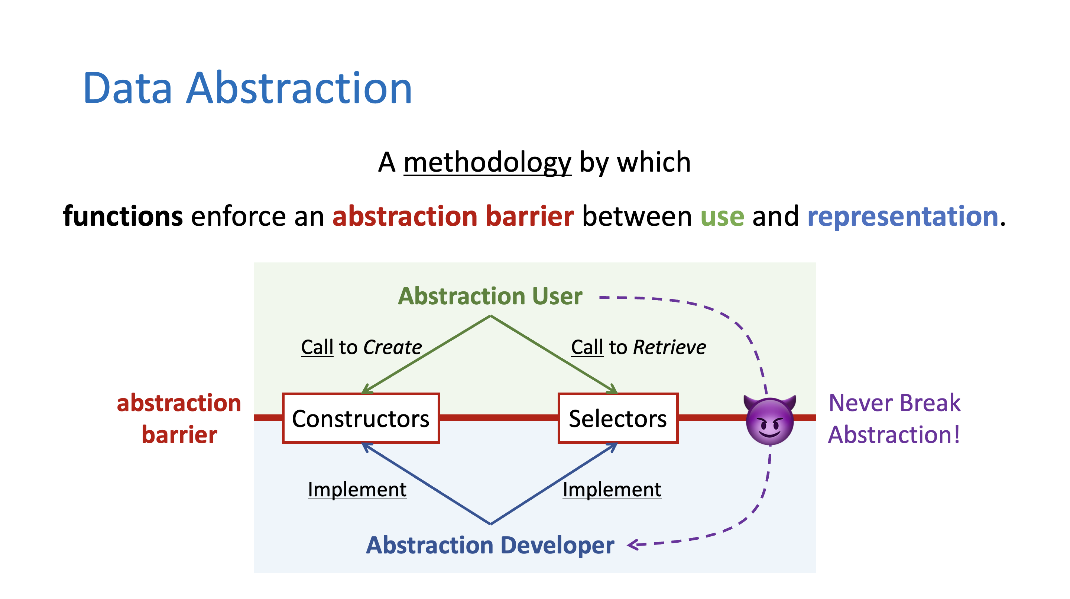

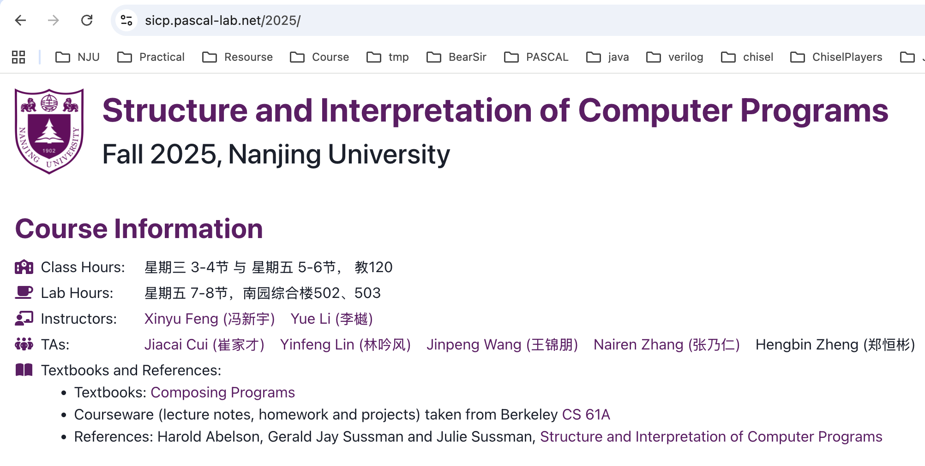
One Function for All !
Jiacai Cui
PASCAL Group @ Nanjing University

Slide 6
One Function for All !
Jiacai Cui
PASCAL Group @ Nanjing University

Slide 7
Recap: When we met higher-order functions
def sum_naturals(n):
"""Sum the first N
natural numbers."""
total, k = 0, 1
while k <= n:
total += k
k += 1
return total
def sum_cubes(n):
"""Sum the first N
cubes."""
total, k = 0, 1
while k <= n:
total += pow(k, 3)
k += 1
return total

Slide 8
Recap: When we met higher-order functions
def sum_naturals(n):
"""Sum the first N
natural numbers."""
total, k = 0, 1
while k <= n:
total += k
k += 1
return total
def summation(n, term):
"""Sum the first N
terms."""
total, k = 0, 1
while k <= n:
total += term(k)
k += 1
return total
Generalization
def sum_cubes(n):
"""Sum the first N
cubes."""
total, k = 0, 1
while k <= n:
total += pow(k, 3)
k += 1
return total

Slide 9
Recap: When we met higher-order functions
sum(n, lambda x: x)
"""Sum the first N
natural numbers."""
def summation(n, term):
"""Sum the first N
terms."""
total, k = 0, 1
while k <= n:
total += term(k)
k += 1
return total
sum(n, lambda x: x * x)
"""Sum the first N
squares."""
...
Generalization
sum(n, lambda x: pow(x, 3))
"""Sum the first N
cubes."""
sum(n, lambda x: ???)
"""Sum the first N
???s."""
... ...

Slide 10


Recap: When we met higher-order functions
One Function for All !
sum(n, lambda x: x)
"""Sum the first N
natural numbers."""
def summation(n, term):
"""Sum the first N
terms."""
total, k = 0, 1
while k <= n:
total += term(k)
k += 1
return total
sum(n, lambda x: x * x)
"""Sum the first N
squares."""
...
Generalization
Specialization
sum(n, lambda x: pow(x, 3))
"""Sum the first N
cubes."""
sum(n, lambda x: ???)
"""Sum the first N
???s."""
Powerful Abstraction Again!
(Happy Program by Specification)
... ...

Slide 11



One Function for All !
Lots of Functions (4 pts)
Maybe Not So Many Functions ... (6 pts)
Just One Function! (2 pts)
8 - 10pts
Expected

Slide 12
Lots of Functions
Old Friends for Lists
map(f, lst)
filter(p, lst)
reversed(lst)
foldl(f, z, lst)
foldr(f, z, lst)
(2 pts)
(2 pts)
New Friends for Lists

Slide 13

def foldl(f, z, lst):
"""Returns f(...f(f(z, lst[0]), lst[1])..., lst[n-1])."""
return foldl(f, ______________, _______) if lst else z
foldl(f, z, lst)
f
f
f
f
f
z
lst[0]
lst[1]
...
lst[n-2]
lst[n-1]
z
lst

Slide 14
def foldl(f, z, lst):
"""Returns f(...f(f(z, lst[0]), lst[1])..., lst[n-1])."""
return foldl(f, ______________, _______) if lst else z
lst[1:]
foldl(f, ???, lst[1:])
f
f
f
f
f
z
lst[0]
lst[1]
...
lst[n-2]
lst[n-1]
z
lst[1:]

Slide 15
def foldl(f, z, lst):
"""Returns f(...f(f(z, lst[0]), lst[1])..., lst[n-1])."""
return foldl(f, ______________, _______) if lst else z
f(z, lst[0])
lst[1:]
foldl(f, f(z, lst[0]), lst[1:])
f
f
f
f
f
z
lst[0]
lst[1]
...
lst[n-2]
lst[n-1]
f(z, lst[0])
lst[1:]

Slide 16
Lots of Functions
Old Friends for Lists
map(f, lst)
filter(p, lst)
reversed(lst)
foldl(f, z, lst)
foldr(f, z, lst)
(2 pts)
(2 pts)
New Friends for Lists

Slide 17
def foldr(f, z, lst):
"""Returns f(lst[0], f(lst[1], ... f(lst[n-1], z) ...))."""
return f(_______, ____________________) if lst else z
foldr(f, z, lst)
f
f
f
f
f
lst[0]
lst[1]
...
lst[n-2]
lst[n-1]
z
lst
z

Slide 18
def foldr(f, z, lst):
"""Returns f(lst[0], f(lst[1], ... f(lst[n-1], z) ...))."""
return f(_______, ____________________) if lst else z
foldr(f, f(lst[n-1], z), lst[:n-1])
f
f
f
f
f
lst[0]
lst[1]
...
lst[n-2]
lst[n-1]
z
lst[:n-1]
f(lst[n-1], z)

Slide 19
def foldr(f, z, lst):
"""Returns f(lst[0], f(lst[1], ... f(lst[n-1], z) ...))."""
return f(_______, ____________________) if lst else z
f(_______, ____________________)
f
f
f
f
f
lst[0]
lst[1]
...
lst[n-2]
lst[n-1]
z
lst[:n-1]
f(lst[n-1], z)

Slide 20
def foldr(f, z, lst):
"""Returns f(lst[0], f(lst[1], ... f(lst[n-1], z) ...))."""
return f(_______, ____________________) if lst else z
lst[0]
lst[0]
foldr(f, z, lst[1:]
lst[0]
f(_______, ____________________)
foldr(f, z, lst[1:])
f
f
f
f
f
lst[0]
lst[1]
...
lst[n-2]
lst[n-1]
z
lst[1:]
z

Slide 21
Lots of Functions
Old Friends for Lists
map(f, lst)
filter(p, lst)
reversed(lst)
foldl(f, z, lst)
foldr(f, z, lst)
(2 pts)
(2 pts)
New Friends for Lists

Slide 22
One Function for All !
Lots of Functions (4 pts)
Maybe Not So Many Functions ... (6 pts)
Just One Function! (2 pts)
8 - 10pts
Expected

Slide 23
Maybe Not So Many Functions ...
Reimplement Old Friends for Lists
map(f, lst)
filter(p, lst)
reversed(lst)
(2 pts)
(2 pts)
(2 pts)
def foldl(f, z, lst):
"""Returns f(...f(f(z, lst[0]), lst[1])..., lst[n-1])."""
def foldr(f, z, lst):
"""Returns f(lst[0], f(lst[1], ... f(lst[n-1], z) ...))."""

Slide 24
def
"""Returns [f(lst[0]), f(lst[1]), ..., f(lst[n-1])]."""
return foldl(______________________________, [], lst)
:
map(f, lst)
g
lambda mlst, x: ???
g = _____________________________
Observation:
mlst = foldl(g, [], lst[:n-1]) = map(f, lst[:n-1])
g
g
g
g
g
[]
lst[0]
lst[1]
...
lst[n-2]
lst[n-1]
mlst
x

Slide 25
def
"""Returns [f(lst[0]), f(lst[1]), ..., f(lst[n-1])]."""
return foldl(______________________________, [], lst)
:
map(f, lst)
g
lambda mlst, x: ???
g = _____________________________
Observation:
mlst = foldl(g, [], lst[:n-1]) = map(f, lst[:n-1])
g
g
g
g
g
[]
lst[0]
lst[1]
...
lst[n-2]
lst[n-1]
mlst = [f(lst[0]), f(lst[1]), ..., f(lst[n-2])]
x = lst[n-1]

Slide 26
def
"""Returns [f(lst[0]), f(lst[1]), ..., f(lst[n-1])]."""
return foldl(______________________________, [], lst)
:
map(f, lst)
g
lambda mlst, x: mlst + [f(x)]
g = _____________________________
Observation:
mlst = foldl(g, [], lst[:n-1]) = map(f, lst[:n-1])
g
g
g
g
g
[]
lst[0]
lst[1]
...
lst[n-2]
lst[n-1]
mlst = [f(lst[0]), f(lst[1]), ..., f(lst[n-2])]
x = lst[n-1]

Slide 27
Maybe Not So Many Functions ...
Reimplement Old Friends for Lists
map(f, lst)
filter(p, lst)
reversed(lst)
(2 pts)
(2 pts)
(2 pts)
def foldl(f, z, lst):
"""Returns f(...f(f(z, lst[0]), lst[1])..., lst[n-1])."""
def foldr(f, z, lst):
"""Returns f(lst[0], f(lst[1], ... f(lst[n-1], z) ...))."""

Slide 28
def
"""Returns [x in lst if p(x)]."""
return foldr(______________________________, [], lst)
:
filter(p, lst)
g
g =_______________________________________________
lambda x, flst: ???
Observation:
flst = foldr(g, [], lst[1:]) = filter(p, lst[1:])
g
g
g
g
g
lst[0]
lst[1]
...
lst[n-2]
lst[n-1]
[]
x
flst

Slide 29
def
"""Returns [x in lst if p(x)]."""
return foldr(______________________________, [], lst)
:
filter(p, lst)
g
g =_______________________________________________
lambda x, flst: ???
Observation:
flst = foldr(g, [], lst[1:]) = filter(p, lst[1:])
g
g
g
g
g
lst[0]
lst[1]
...
lst[n-2]
lst[n-1]
[]
x = lst[0]
flst = [x in lst[1:] if p(x)]

Slide 30
def
"""Returns [x in lst if p(x)]."""
return foldr(______________________________, [], lst)
:
filter(p, lst)
g
g =_______________________________________________
lambda x, flst: ??? if p(x) else ???
Observation:
flst = foldr(g, [], lst[1:]) = filter(p, lst[1:])
g
g
g
g
g
lst[0]
lst[1]
...
lst[n-2]
lst[n-1]
[]
x = lst[0]
flst = [x in lst[1:] if p(x)]

Slide 31
def
"""Returns [x in lst if p(x)]."""
return foldr(______________________________, [], lst)
:
filter(p, lst)
g
g =_______________________________________________
lambda x, flst: ??? if p(x) else flst
Observation:
flst = foldr(g, [], lst[1:]) = filter(p, lst[1:])
g
g
g
g
g
lst[0]
lst[1]
...
lst[n-2]
lst[n-1]
[]
x = lst[0]
flst = [x in lst[1:] if p(x)]

Slide 32
def
"""Returns [x in lst if p(x)]."""
return foldr(______________________________, [], lst)
:
filter(p, lst)
g
g =_______________________________________________
lambda x, flst: [x] + flst if p(x) else flst
Observation:
flst = foldr(g, [], lst[1:]) = filter(p, lst[1:])
g
g
g
g
g
lst[0]
lst[1]
...
lst[n-2]
lst[n-1]
[]
x = lst[0]
flst = [x in lst[1:] if p(x)]

Slide 33
Maybe Not So Many Functions ...
Reimplement Old Friends for Lists
map(f, lst)
filter(p, lst)
reversed(lst)
(2 pts)
(2 pts)
(2 pts)
def foldl(f, z, lst):
"""Returns f(...f(f(z, lst[0]), lst[1])..., lst[n-1])."""
def foldr(f, z, lst):
"""Returns f(lst[0], f(lst[1], ... f(lst[n-1], z) ...))."""

Slide 34
def
"""Returns [lst[n-1], lst[n-2], ..., lst[0]]."""
return foldl(______________________________, [], lst)
:
reversed(lst)
g
lambda rlst, x: ???
g = _____________________________
Observation:
rlst = foldl(g, [], lst[:n-1]) = reversed(lst[:n-1])
g
g
g
g
g
[]
lst[0]
lst[1]
...
lst[n-2]
lst[n-1]
rlst
x

Slide 35
def
"""Returns [lst[n-1], lst[n-2], ..., lst[0]]."""
return foldl(______________________________, [], lst)
:
reversed(lst)
g
lambda rlst, x: ???
g = _____________________________
Observation:
rlst = foldl(g, [], lst[:n-1]) = reversed(lst[:n-1])
g
g
g
g
g
[]
lst[0]
lst[1]
...
lst[n-2]
lst[n-1]
rlst = [lst[n-2], lst[n-3], ..., lst[0]]
x = lst[n-1]

Slide 36
def
"""Returns [lst[n-1], lst[n-2], ..., lst[0]]."""
return foldl(______________________________, [], lst)
:
reversed(lst)
g
lambda rlst, x: [x] + rlst
g = _____________________________
Observation:
rlst = foldl(g, [], lst[:n-1]) = reversed(lst[:n-1])
g
g
g
g
g
[]
lst[0]
lst[1]
...
lst[n-2]
lst[n-1]
rlst = [lst[n-2], lst[n-3], ..., lst[0]]
x = lst[n-1]

Slide 37
Maybe Not So Many Functions ...
Reimplement Old Friends for Lists
map(f, lst)
filter(p, lst)
reversed(lst)
(2 pts)
(2 pts)
(2 pts)
def foldl(f, z, lst):
"""Returns f(...f(f(z, lst[0]), lst[1])..., lst[n-1])."""
def foldr(f, z, lst):
"""Returns f(lst[0], f(lst[1], ... f(lst[n-1], z) ...))."""

Slide 38
def
"""Returns [lst[n-1], lst[n-2], ..., lst[0]]."""
return foldr(______________________________, [], lst)
:
reversed(lst)
g
g =____________________________
lambda x, rlst: ???
Observation:
rlst = foldr(g, [], lst[1:]) = reversed(lst[1:])
g
g
g
g
g
lst[0]
lst[1]
...
lst[n-2]
lst[n-1]
[]
x
rlst

Slide 39
def
"""Returns [lst[n-1], lst[n-2], ..., lst[0]]."""
return foldr(______________________________, [], lst)
:
reversed(lst)
g
g =____________________________
lambda x, rlst: ???
Observation:
rlst = foldr(g, [], lst[1:]) = reversed(lst[1:])
g
g
g
g
g
lst[0]
lst[1]
...
lst[n-2]
lst[n-1]
[]
x = lst[0]
rlst = [lst[n-1], lst[n-2], ..., lst[1]]

Slide 40
def
"""Returns [lst[n-1], lst[n-2], ..., lst[0]]."""
return foldr(______________________________, [], lst)
:
reversed(lst)
g
g =____________________________
lambda x, rlst: rlst + [x]
Observation:
rlst = foldr(g, [], lst[1:]) = reversed(lst[1:])
g
g
g
g
g
lst[0]
lst[1]
...
lst[n-2]
lst[n-1]
[]
x = lst[0]
rlst = [lst[n-1], lst[n-2], ..., lst[1]]

Slide 41
Maybe Not So Many Functions ...
Reimplement Old Friends for Lists
map(f, lst)
filter(p, lst)
reversed(lst)
(2 pts)
(2 pts)
(2 pts)
def foldl(f, z, lst):
"""Returns f(...f(f(z, lst[0]), lst[1])..., lst[n-1])."""
def foldr(f, z, lst):
"""Returns f(lst[0], f(lst[1], ... f(lst[n-1], z) ...))."""

Slide 42
One Function for All !
Lots of Functions (4 pts)
Maybe Not So Many Functions ... (6 pts)
Just One Function! (2 pts)
8 - 10pts
Expected

Slide 43
Just One Function!
Old Friends for Lists
map(f, lst)
filter(p, lst)
reversed(lst)
Specialization
foldl(f, z, lst)
foldr(f, z, lst)
New Friends for Lists

Slide 44
Just One Function!
Old Friends for Lists
map(f, lst)
filter(p, lst)
reversed(lst)
Specialization
foldl(f, z, lst)
(2 pts)
foldr(f, z, lst)
New Friends for Lists

Slide 45
def
""" Returns f(...f(f(z, lst[0]), lst[1])..., lst[n-1])."""
return foldr(step, lambda z: z, lst)(z)
:
foldl(f, z, lst)
def step(x, g):
return _______________________
Observation:
g = ???
???
step
step
step
step
step
lst[0]
lst[1]
...
lst[n-2]
lst[n-1]
lambda z: z
x = lst[0]
g = ???

Slide 46
def
""" Returns (lambda z: f(...f(f(z, lst[0]), lst[1])..., lst[n-1]))(z)."""
return foldr(step, lambda z: z, lst)(z)
:
foldl(f, z, lst)
def step(x, g):
return _______________________
Observation:
g = foldr(step, lambda z: z, lst[1:])
= lambda z: ???
lambda z: ???
step
step
step
step
step
lst[0]
lst[1]
...
lst[n-2]
lst[n-1]
lambda z: z
x = lst[0]
g = lambda z: ???

Slide 47
def
""" Returns (lambda z: f(...f(f(z, lst[0]), lst[1])..., lst[n-1]))(z)."""
return foldr(step, lambda z: z, lst)(z)
:
foldl(f, z, lst)
def step(x, g):
return _______________________
Observation:
g = foldr(step, lambda z: z, lst[1:])
= lambda z: foldl(f, z, lst[1:])
lambda z: g(???)
step
step
step
step
step
lst[0]
lst[1]
...
lst[n-2]
lst[n-1]
lambda z: z
x = lst[0]
g = lambda z: f(...f(z, lst[1])..., lst[n-1])

Slide 48
def
""" Returns (lambda z: f(...f(f(z, lst[0]), lst[1])..., lst[n-1]))(z)."""
return foldr(step, lambda z: z, lst)(z)
:
foldl(f, z, lst)
def step(x, g):
return _______________________
Observation:
g = foldr(step, lambda z: z, lst[1:])
= lambda z: foldl(f, z, lst[1:])
lambda z: g(f(z, x))
step
step
step
step
step
lst[0]
lst[1]
...
lst[n-2]
lst[n-1]
lambda z: z
x = lst[0]
g = lambda z: f(...f(z, lst[1])..., lst[n-1])

Slide 49
Just One Function!
Old Friends for Lists
map(f, lst)
filter(p, lst)
reversed(lst)
Specialization
foldl(f, z, lst)
(2 pts)
foldr(f, z, lst)
New Friends for Lists

Slide 50
def
""" Returns (lambda z: f(lst[0], ... f(lst[n-2], f(lst[n-1], z)) ... ))(z)."""
return foldl(step, lambda x: x, lst)(z)
:
foldr(f, z, lst)
def step(g, x):
return _______________________
Observation:
g = foldl(step, lambda z: z, lst[:n-1])
= lambda z: foldr(f, z, lst[:n-1])
Exercise
lambda z: g(f(x, z))
step
step
step
step
step
lambda z: z
lst[0]
lst[1]
...
lst[n-2]
lst[n-1]
g = lambda z: f(lst[0], ... f(lst[n-2], z) ...)
x = lst[n-1]

Slide 51
Just One Function!
Old Friends for Lists
map(f, lst)
filter(p, lst)
reversed(lst)
Specialization
foldl(f, z, lst)
(2 pts)
foldr(f, z, lst)
New Friends for Lists

Slide 52
One Function for All !
Lots of Functions (4 pts)
Maybe Not So Many Functions ... (6 pts)
Just One Function! (2 pts)
8 - 10pts
Expected

Slide 53
A TA’s Reflection
One Function for All !

