Slide 1
Course Introduction
2025 / 9 / 17
Slides adapted from Berkeley CS61a

Slide 2
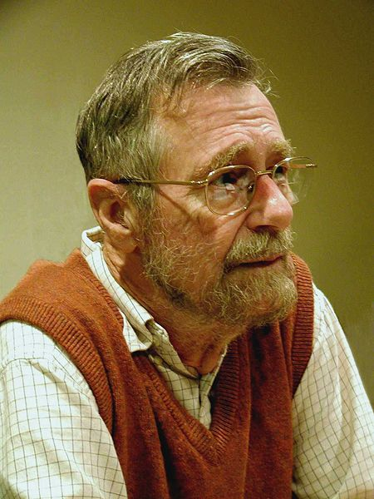
What is Computer Science?
What problems can be solved using computation?
How to solve those problems?
What techniques lead to effective solutions?
Computer Science is no more about computers than astronomy is about telescopes.
Edsger W. Dijkstra

Slide 3
What is Computer Science?
Architectures and Operating Systems
Programming Languages
Databases
Theory
Scientific Computing
Security
Networking
Artificial Intelligence
Graphics
…

Slide 4
What is Computer Science?
概率/统计
如何用计算机解决现实问题
计算理论
大模型
区块链
元宇宙
…
…
线性代数
图形学
自然语言处理
计算机视觉
机器人
微积分
数值计算
软件工程
抽象代数
计算机网络
安全
数据库/大数据
人工智能
如何让计算机变得有用、好用
操作系统 （OS）
数理逻辑
编程语言 / 编译器
离散数学
体系结构 （Computer Architecture）
…

Slide 5
What is Computer Science?
概率/统计
计算理论
大模型
区块链
元宇宙
…
…
线性代数
图形学
自然语言处理
计算机视觉
机器人
微积分
软件
数值计算
软件工程
抽象代数
计算机网络
安全
数据库/大数据
人工智能
操作系统 （OS）
数理逻辑
编程语言 / 编译器
离散数学
体系结构 （Architectures）
硬件
…

Slide 6
What is this course about?
Introduction to Programming
  Full understanding of Python fundamentals
  Combining multiple ideas in large projects
  How computers interpret programming languages
  More …

Slide 7
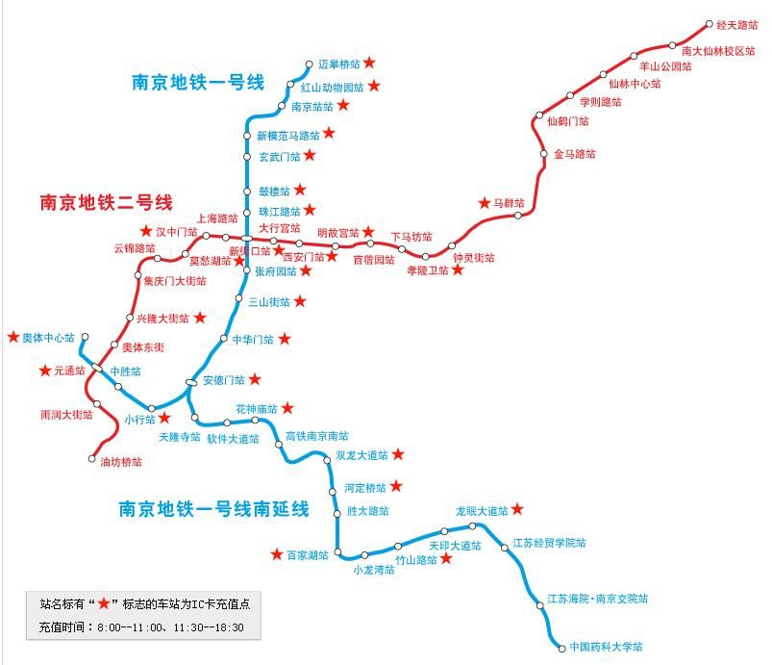
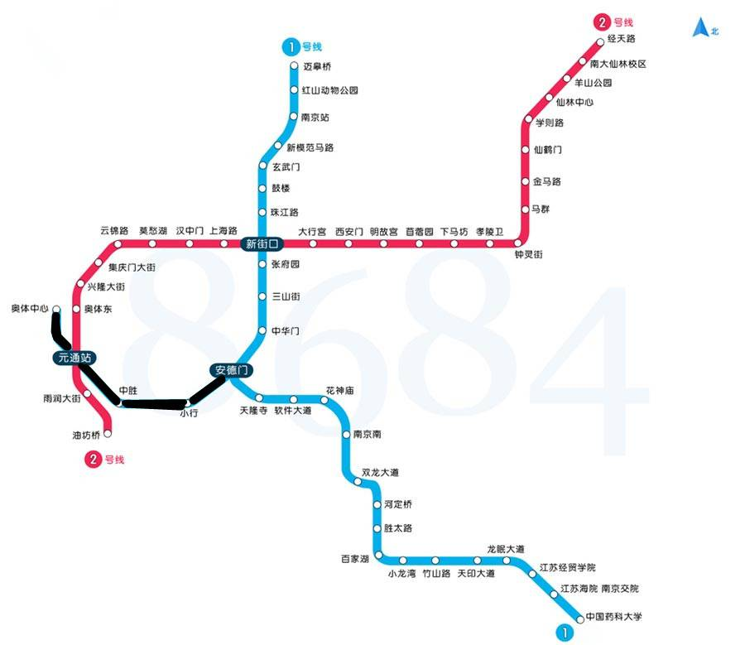
What is this course about?
Introduction to Programming
Managing Complexity
  Mastering Abstraction

Slide 8



What is this course about?
Introduction to Programming
Managing Complexity
  Mastering Abstraction
  Programming Paradigms
Python
– Multi-Paradigm
Scheme
– Functional
– Lang. Interpretation
SQL
– DSL
– Declarative

Slide 9
What is this course about?
Introduction to Programming
Managing Complexity
  Mastering Abstraction
  Programming Paradigms
A challenging course that will demand a lot from you

Slide 10
Alternative to this course
程序设计基础
  Programming in C
  Similar goals, different textbooks and languages

Slide 11
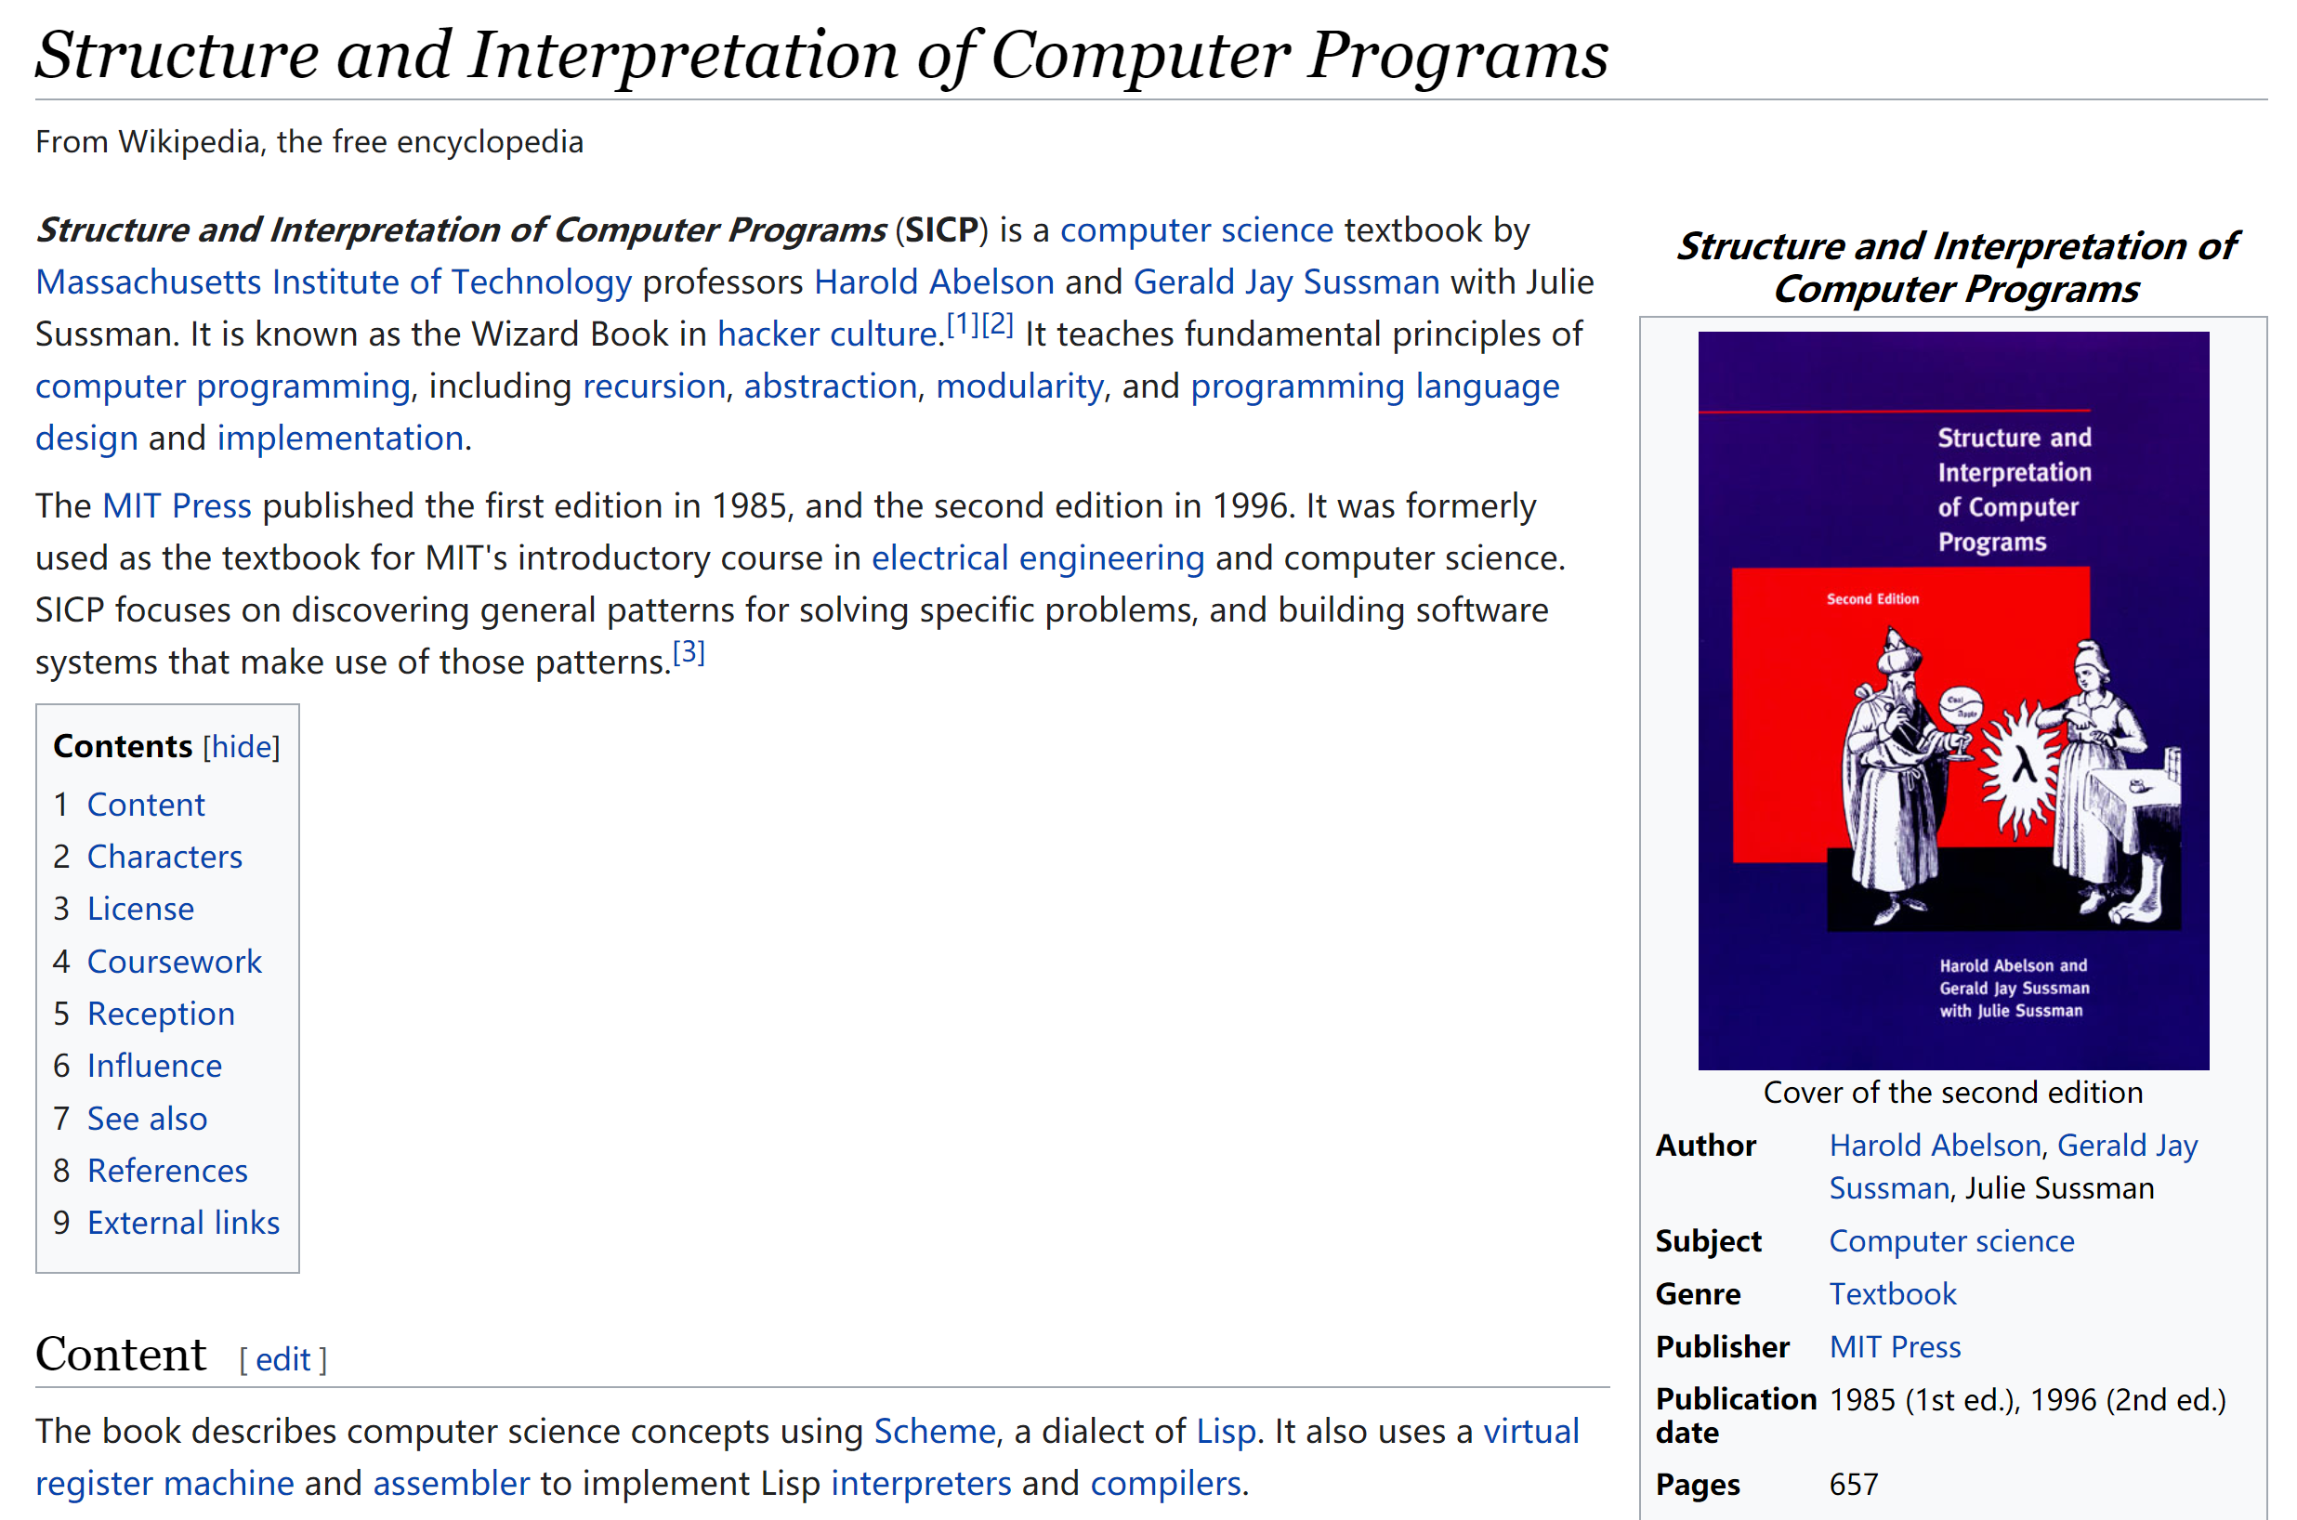
https://en.wikipedia.org/wiki/Structure_and_Interpretation_of_Computer_Programs

Slide 12
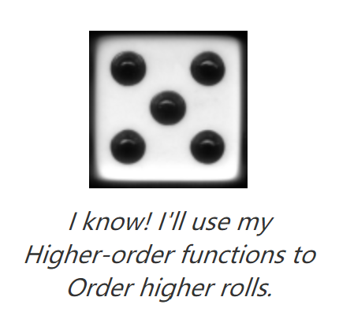


This Course: A Clone of BerkeleyCS61A
https://cs61a.org/
https://cs61a.org/resources.html#advice
教材： Composing Programs，SICP的Python版
  https://composingprograms.com/
全美最受欢迎的5门计算机课程之一
四个精心设计的Projects
  掷骰子游戏
  测打字速度并查错纠错
  蚂蚁大战蜜蜂游戏、
  Scheme（子集）的解释器

Slide 13
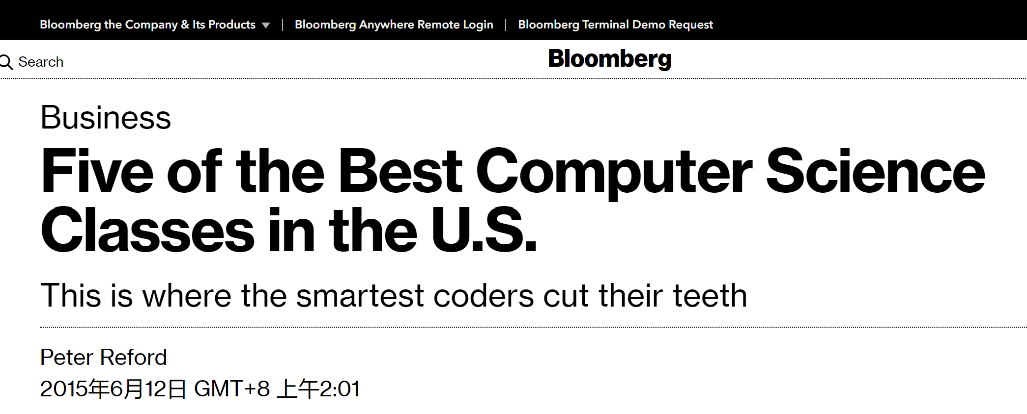
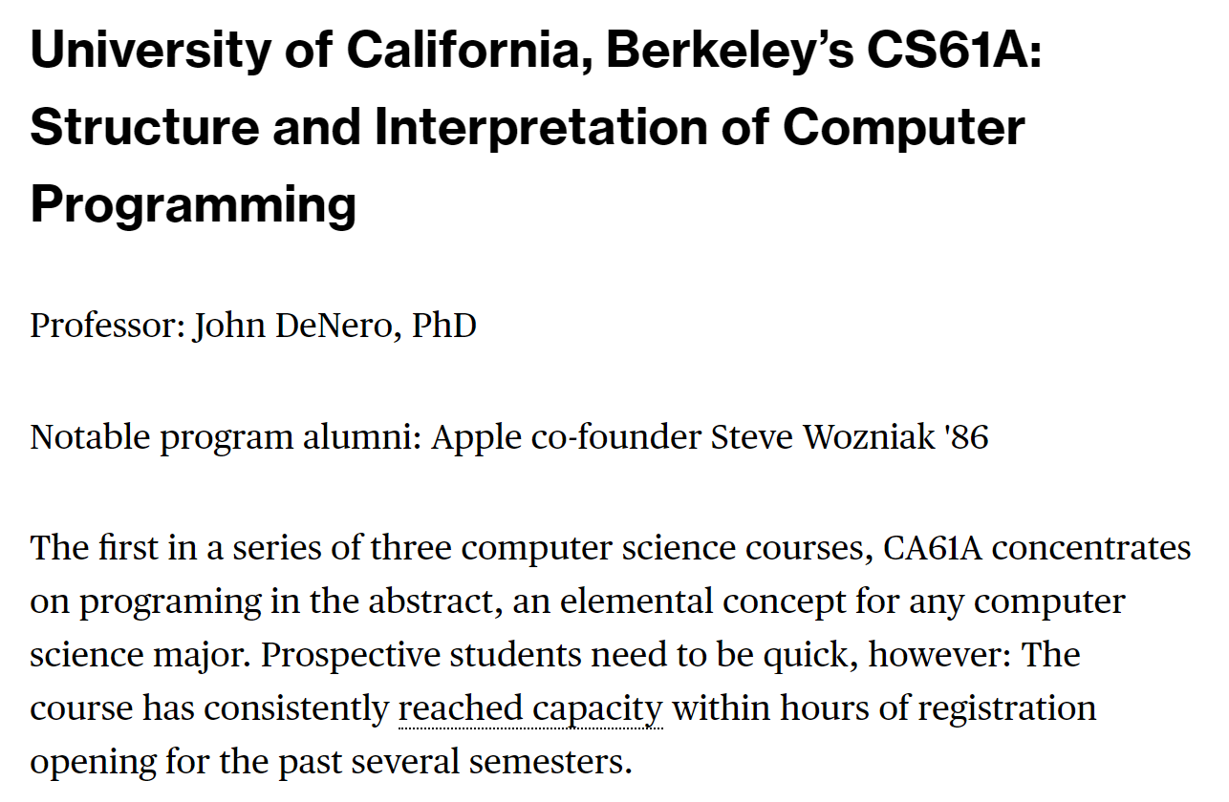

Slide 14
Course Info
Lecture: 周三，3、4节，教120
周五，5、6节， 教120
Lab section: 周五，7、8节，南园综合楼502、503
Course webpage
https://sicp.pascal-lab.net/2025
Online textbook
https://www.composingprograms.com
homework assignments
programming projects
A midterm and a final
Lots of course support

Slide 15
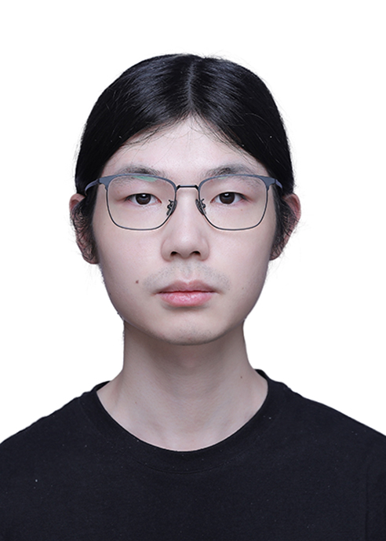
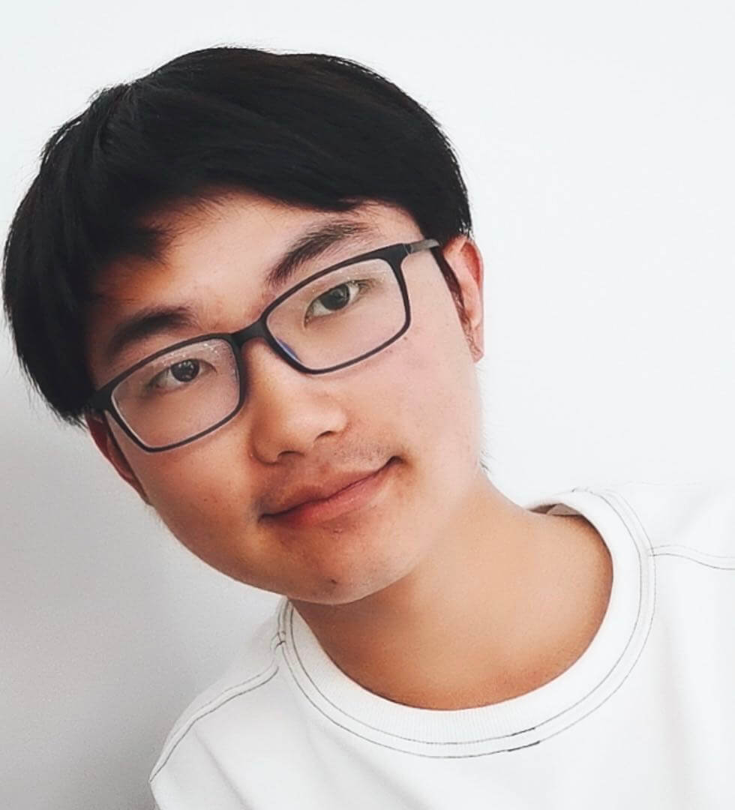
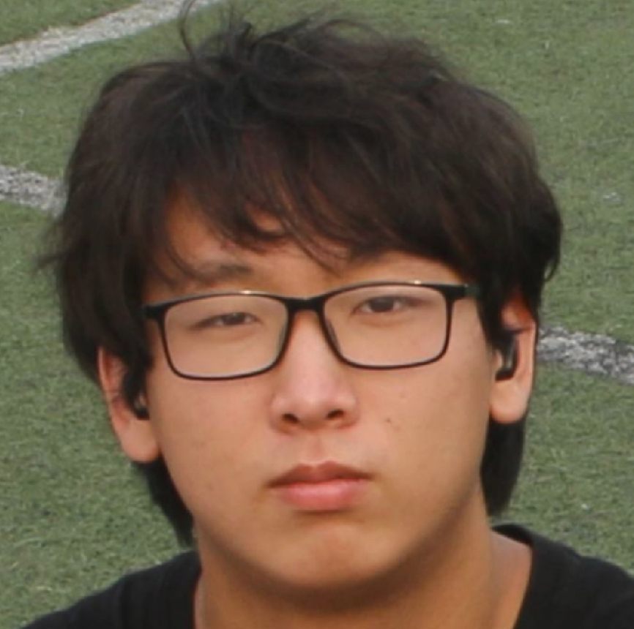
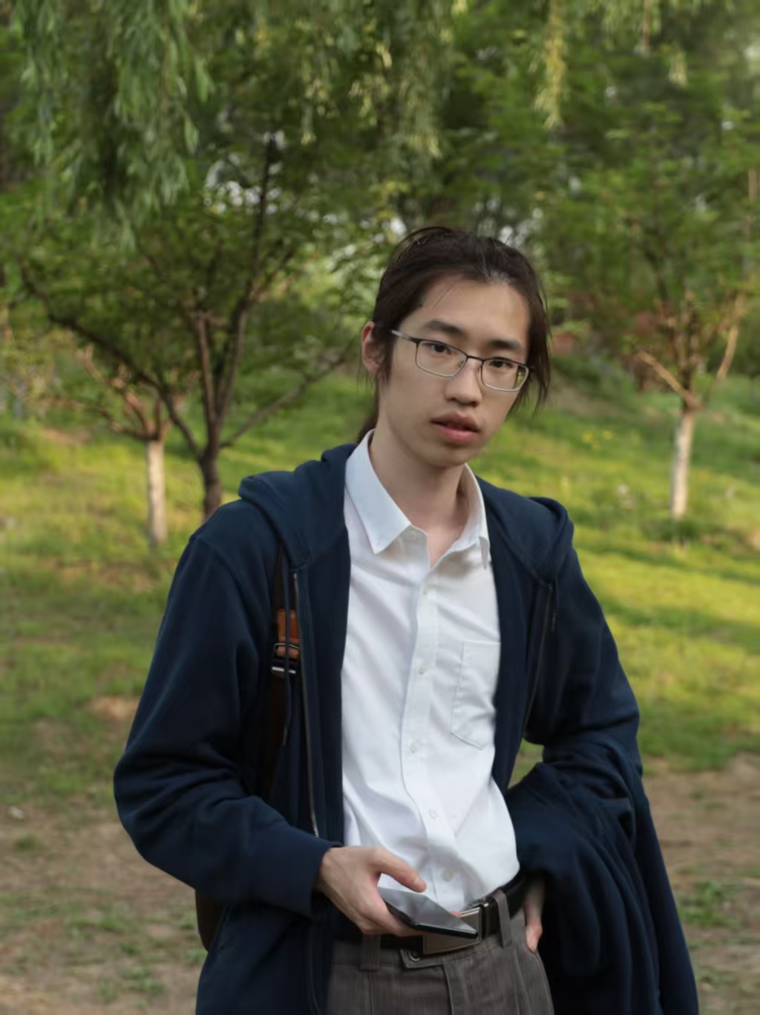
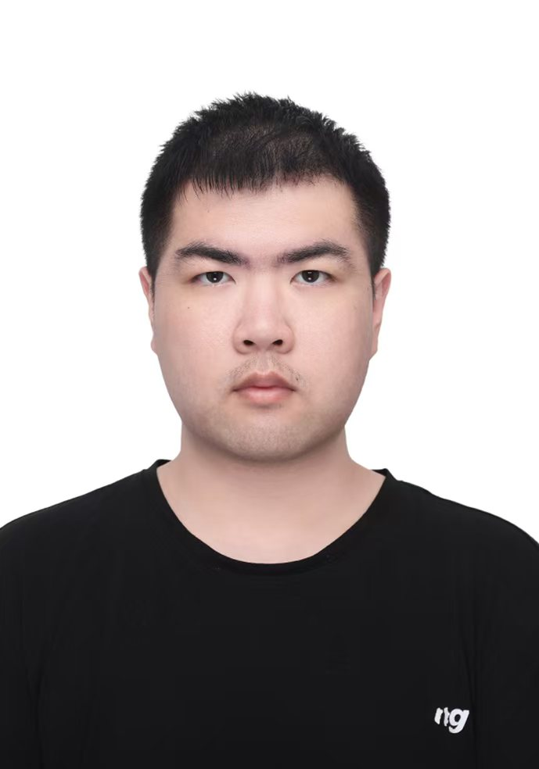
Course Info
Lecturers: 冯新宇：https://cs.nju.edu.cn/xyfeng/index.htm
李樾： https://cs.nju.edu.cn/yueli/index.htm
TAs:
崔家才
王锦鹏
林吟风
张乃仁
郑恒彬

Slide 16
Grading
Homework, 15%

Slide 17
Homeworks
Will be graded on “effort”
This approximately means, completing most of the problems and at least attempting to solve the rest
This means there’s no reason to cheat!
Ask for help if you are stuck and make a good effort on all of the homework

Slide 18
Grading
Homework, 15%
Labs, 10%
  Graded on correct completion
  Need to complete in the lab section
Projects, 25%

Slide 19
Projects
Will be graded on correctness and composition
Several of the programming projects will be partnered
Larger than homeworks

Slide 20
Grading
Homework, 15%
Labs, 10%
Projects, 25%
Midterm, 25%
Final, 25%

Slide 21
Collaboration
We highly encourage discussing / sharing ideas with each other
Limitations
  Do not share code
  The only circumstance in which a student should be looking at another student's code is if they are project partners

Slide 22
Questions?

Slide 23
Expressions

Slide 24



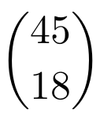



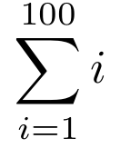

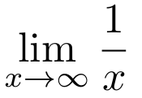


Types of Expressions
An expression describes a computation and evaluates to a value

Slide 25
Call Expressions in Python
All expressions can use function call notation
Demo

Slide 26
Anatomy of a Call Expression
add ( 2 , 3 )
Operator
Operand
Operand
Operators and operands are also expressions

Slide 27
Evaluation of a Call Expression
add ( 2 , 3 )
Operator
Operand
Operand
Evaluate
  Evaluate the operator subexpression
  Evaluate each operand subexpression
Apply
  Apply the value of the operator subexpression to the values of the operand subexpression

Slide 28
add(add(6, mul(4, 6)), mul(3, 5))

Slide 29
Humans
We like to inside inside-out
add(add(6, mul(4, 6)), mul(3, 5))
add(add(6, 24 ), mul(3, 5))
add(add(6, 24 ), mul(3, 5))
add( 30 , mul(3, 5))
add( 30 , mul(3, 5))
add( 30 , 15 )
add( 30 , 15 )
45
Python can’t jump around in the same way we do

Slide 30
Nested Call Expression
Evaluate operator Evaluate operands Apply!
1
2
3
45
add(add(6, mul(4, 6)), mul(3, 5))
add
30
15
add(6, mul(4, 6))
mul(3, 5)
24
add
6
mul(4, 6)
mul
3
5
mul
4
6
Expression Tree

Slide 31
Functions, Values, Objects, Interpreters and Data
Demo

