Slide 1
Lecture 12 - Mutable Functions & Growth

Slide 2
Review: Mutable Values

Slide 3
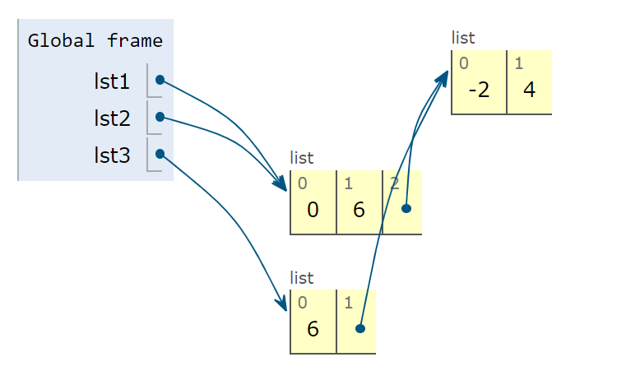
Identity vs. Equality in Environment Diagrams
Review: For assignment statements, evaluate the right side, then assign to the left.
Copying: When creating a copy, copy exactly what’s “in the box”.
>>> lst1 = [0, 6, [-2, 4]]
>>> lst2 = lst1
>>> lst3 = lst1[1:]

Slide 4
Mutating Within Functions
>>> def mystery(lst): # mutative function
... lst.pop()
... lst.pop()
>>> four = [4, 4, 4, 4]
>>> mystery(four)
>>> four
[4, 4]

Slide 5
Mutable Functions

Slide 6
Functions with behavior that changes over time
def square(x):
return x * x
>>> square(5)
25
def f(x):
...
>>> f(5)
25
>>> f(5)
26
>>> f(5)
27
>>> square(5)
25
Returns the same value when called with the same input
>>> square(5)
25
Return values are different when called with the same input

Slide 7
Example - Withdraw
Let's model a bank account that has a balance of $100
Argument:
amount to withdraw
Return value:
remaining balance
>>> withdraw(25)
75
>>> withdraw(25)
50
>>> withdraw(60)
'Insufficient funds'
>>> withdraw(15)
35
Second withdrawal of the same amount
Different
return value!
Where's this balance stored?
Within the parent frame
of the function!
A function has a body and a parent environment
>>> withdraw = make_withdraw(100)

Slide 8
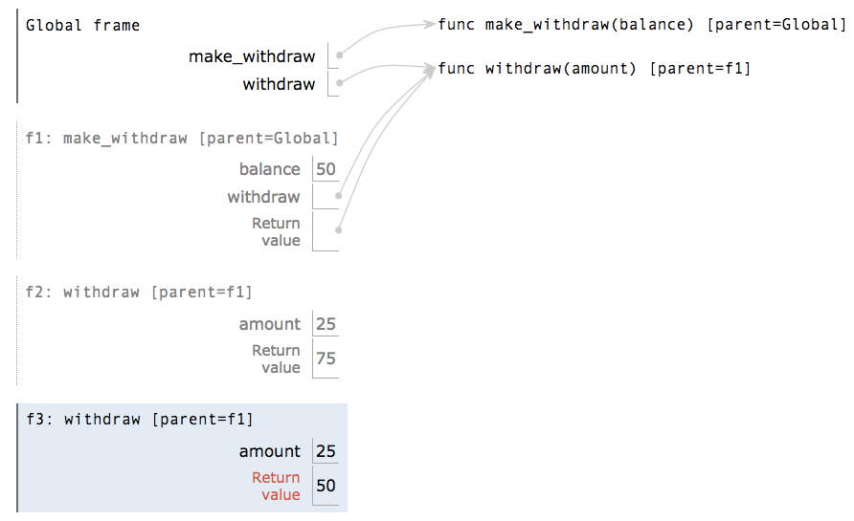
Persistent Local State Using Environments
The parent frame contains the balance, the local state of the withdraw function
All calls to the same function have the
same parent
Every call decreases the same balance by
(a possibly different) amount
Notes:
pythontutor.com/composingprograms.html#code=def%20make_withdraw%28balance%29%3A%0A%20%20%20%20def%20withdraw%28amount%29%3A%0A%20%20%20%20%20%20%20%20nonlocal%20balance%0A%20%20%20%20%20%20%20%20if%20amount%20>%20balance%3A%0A%20%20%20%20%20%20%20%20%20%20%20%20return%20'Insufficient%20funds'%0A%20%20%20%20%20%20%20%20balance%20%3D%20balance%20-%20amount%0A%20%20%20%20%20%20%20%20return%20balance%0A%20%20%20%20return%20withdraw%0A%0Awithdraw%20%3D%20make_withdraw%28100%29%0Awithdraw%2825%29%0Awithdraw%2825%29%0Awithdraw%2860%29%0Awithdraw%2815%29&mode=display&origin=composingprograms.js&cumulative=true&py=3&rawInputLstJSON=[]&curInstr=0

Slide 9
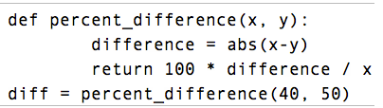
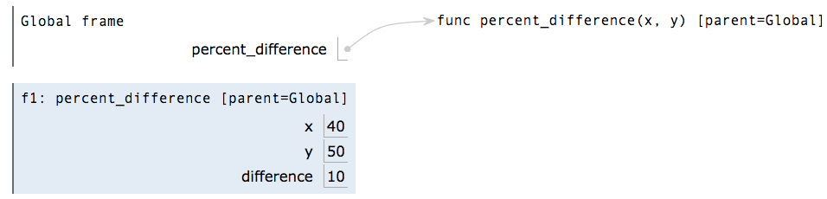
Reminder: Local Assignment
Assignment binds name(s) to value(s)
in the first frame of the current
environment
Execution rule for assignment statements:
Evaluate all expressions right of =, from left to right
Bind the names on the left to the resulting values in the current frame
Notes:
pythontutor.com/composingprograms.html#code=def%20percent_difference%28x,%20y%29%3A%0A%20%20%20%20%20%20%20%20difference%20%3D%20abs%28x-y%29%0A%20%20%20%20%20%20%20%20return%20100%20*%20difference%20/%20x%0Adiff%20%3D%20percent_difference%2840,%2050%29&mode=display&origin=composingprograms.js&cumulative=true&py=3&rawInputLstJSON=[]&curInstr=4

Slide 10
Non-Local Assignment & Persistent Local State
Demo
def make_withdraw(balance):
"""Return a withdraw function with a starting balance."""
def withdraw(amount):
nonlocal balance
if amount > balance:
return 'Insufficient funds'
balance = balance - amount
return balance
return withdraw
Declare the name "balance" nonlocal at the top of the
body of the function in which it is re-assigned
Re-bind balance in the first non-local frame
in which it was bound previously
Notes:
http://pythontutor.com/composingprograms.html#code=def%20make_withdraw%28balance%29%3A%0A%20%20%20%20def%20withdraw%28amount%29%3A%0A%20%20%20%20%20%20%20%20nonlocal%20balance%0A%20%20%20%20%20%20%20%20if%20amount%20%3E%20balance%3A%0A%20%20%20%20%20%20%20%20%20%20%20%20return%20'Insufficient%20funds'%0A%20%20%20%20%20%20%20%20balance%20%3D%20balance%20-%20amount%0A%20%20%20%20%20%20%20%20return%20balance%0A%20%20%20%20return%20withdraw%0A%0Awithdraw%20%3D%20make_withdraw%28100%29%0Awithdraw%2825%29%0Awithdraw%2825%29%0Awithdraw%2860%29%0Awithdraw%2815%29&cumulative=true&mode=edit&origin=composingprograms.js&py=3&rawInputLstJSON=%5B%5D

Slide 11
Mutable Functions

Slide 12
The Effect of Nonlocal Statements
nonlocal <name>
, <name>, ...
Effect: Future assignments to that name change its pre-existing binding in the first non-local frame of the current environment in which that name is bound.
Python Docs: an "enclosing scope"
From the Python 3 language reference:
Names listed in a nonlocal statement must refer to pre-existing bindings in an enclosing scope.
Names listed in a nonlocal statement must not collide with pre-existing bindings in the local scope.
Current frame
http://docs.python.org/release/3.1.3/reference/simple_stmts.html#the-nonlocal-statement
http://www.python.org/dev/peps/pep-3104/

Slide 13
The Many Meanings of Assignment Statements
x = 2
Status
Effect
No nonlocal statement
"x" is not bound locally
  Create a new binding from name "x" to object 2 in the first frame of the current environment
No nonlocal statement
"x" is bound locally
  Re-bind name "x" to object 2 in the first frame of the current environment
nonlocal x
"x" is bound in a non-local frame
  Re-bind "x" to 2 in the first non-local frame of the current environment in which "x" is bound
nonlocal x
"x" is not bound in a non-local frame
  SyntaxError: no binding for nonlocal 'x' found
nonlocal x
"x" is bound in a non-local frame
"x" also bound locally
  SyntaxError: name 'x' is parameter and nonlocal

Slide 14
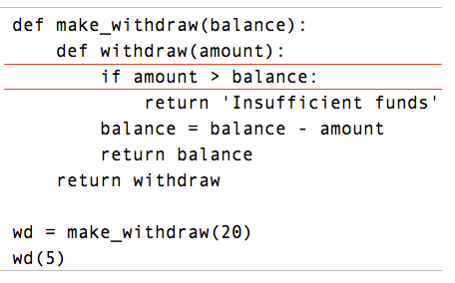
Python Particulars
Demo
Python pre-computes which frame contains each name before executing the body of a function.
Within the body of a function, all instances of a name must refer to the same frame.
Local assignment
Notes:
pythontutor.com/composingprograms.html#code=def%20make_withdraw%28balance%29%3A%0A%20%20%20%20def%20withdraw%28amount%29%3A%0A%20%20%20%20%20%20%20%20if%20amount%20>%20balance%3A%0A%20%20%20%20%20%20%20%20%20%20%20%20return%20'Insufficient%20funds'%0A%20%20%20%20%20%20%20%20balance%20%3D%20balance%20-%20amount%0A%20%20%20%20%20%20%20%20return%20balance%0A%20%20%20%20return%20withdraw%0A%0Awithdraw%20%3D%20make_withdraw%2820%29%0Awithdraw%285%29&mode=display&origin=composingprograms.js&cumulative=true&py=3&rawInputLstJSON=[]&curInstr=0

Slide 15
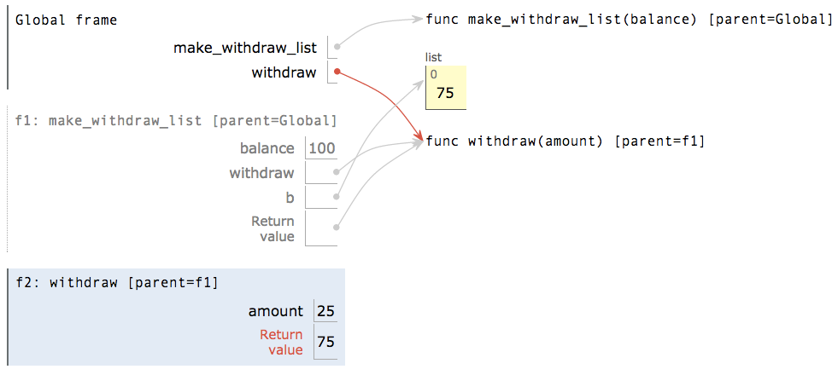
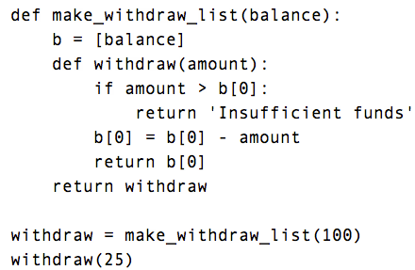
Mutable Values & Persistent Local State
Mutable values can be changed without a nonlocal statement.
Mutable value can change
Name-value binding cannot change because there is no nonlocal statement
Name bound outside
of withdraw def
Element assignment changes a list
Notes:
goo.gl/y4TyFZ

Slide 16


Referential Transparency, Lost
  Expressions are referentially transparent if substituting an expression with its value does not change the meaning of a program.
mul(add(2, mul(4, 6)), add(3, 5))
mul(add(2, 24 ), add(3, 5))
mul( 26 , add(3, 5))
Mutation operations violate the condition of referential transparency because they do more than just return a value; they change the environment.

Slide 17
def f(x):
x = 4
def g(y):
def h(z):
nonlocal x
x = x + 1
return x + y + z
return h
return g
a = f(1)
b = a(2)
total = b(3) + b(4)
Notes:
http://pythontutor.com/composingprograms.html#code=def%20f%28x%29%3A%0A%20%20%20%20x%20%3D%204%0A%20%20%20%20def%20g%28y%29%3A%0A%20%20%20%20%20%20%20%20def%20h%28z%29%3A%0A%20%20%20%20%20%20%20%20%20%20%20%20nonlocal%20x%0A%20%20%20%20%20%20%20%20%20%20%20%20x%20%3D%20x%20%2B%201%0A%20%20%20%20%20%20%20%20%20%20%20%20return%20x%20%2B%20y%20%2B%20z%0A%20%20%20%20%20%20%20%20return%20h%0A%20%20%20%20return%20g%0Aa%20%3D%20f%281%29%0Ab%20%3D%20a%282%29%0Atotal%20%3D%20b%283%29%20%2B%20b%284%29&cumulative=true&curInstr=0&mode=display&origin=composingprograms.js&py=3&rawInputLstJSON=%5B%5D

Slide 18

Summary (AKA what do I need to know for the MT)
Nonlocal allows you to modify a binding in a parent frame, instead of just looking it up
Don’t need a nonlocal statement to mutate a value
A variable declared nonlocal must:
  Exist in a parent frame (other than the global frame)
  Not exist in the current frame

Slide 19
Program Performance

Slide 20
Measuring Performance
Demo
Different functions run in different amounts of time
  Different implementations of the same program can also run in different amounts of time
How do we measure this?
  Amount of time taken to run once?
  Average time taken to run?
  Average across a bunch of different computers?
  Number of operations?

Slide 21
Improving Number of Operations
Demo
Getting better performance usually requires clever thought
  Some tools can be used to speed up programs (Ex: memoization, up next)
  Other times, need to have a different approach or incorporate some insight
def fib(n):
curr, next, i = 0, 1, 0
while i < n:
curr, next = next,
curr + next
i += 1
return curr
def fib(n):
if n <= 1:
return n
else:
return fib(n-1) +\
fib(n-2)

Slide 22
Improving Fib with Memoization
fib(5)
fib(3)
fib(4)
fib(1)
fib(2)
fib(2)
fib(3)
1
fib(0)
fib(1)
fib(0)
fib(1)
fib(1)
fib(2)
0
1
0
1
1
fib(0)
fib(1)
0
1

Slide 23
Basic Idea to Improve:
1 def better_fib(n):
2 if n == 0:
3 return 0
4 elif n == 1:
5 return 1
6 elif already called better_fib(n):
7 return stored value
8 else:
9 store & return better_fib(n - 2) + better_fib(n - 1)
Use a container to store these values!

Slide 24
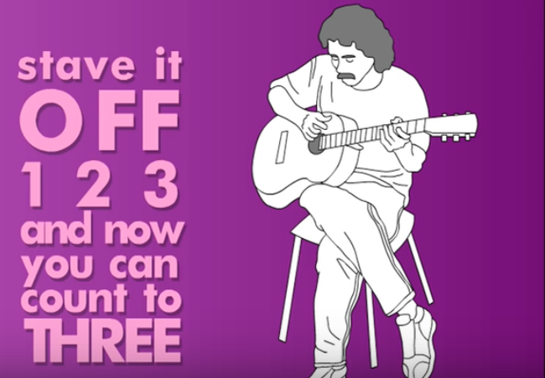
Counting

Slide 25
How to count calls
Can’t always rely on having a program to count calls
For an iterative function: step through the program, and identify how many times you need to go through the loop before exiting
For a recursive function: draw out an environment diagram/call tree
After you do this for a few example inputs, you can find patterns to estimate the number of steps for other inputs.

Slide 26
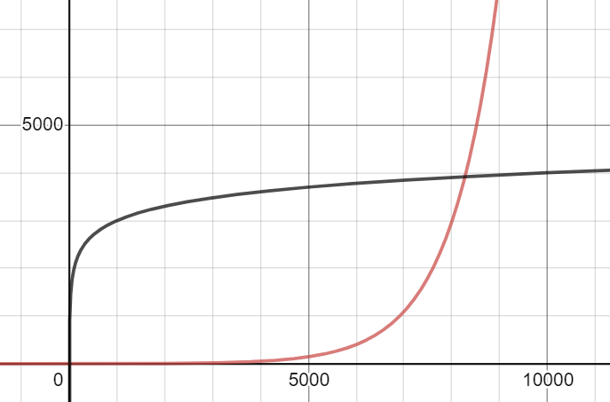
“Patterns” of Growth
There are common patterns for how functions grow
Because these patterns often aren’t linear, you often can’t use just one input to compare programs
Instead, you have to identify the overall pattern

Slide 27
Some quick notation
“a”, “b”, and “k” usually refer to constants (do not depend on any particular function call)
“x” and “n” refer to variables dependent on the input to the function (change with each function call)
So x^{b} represents x², x⁴, etc.

Slide 28
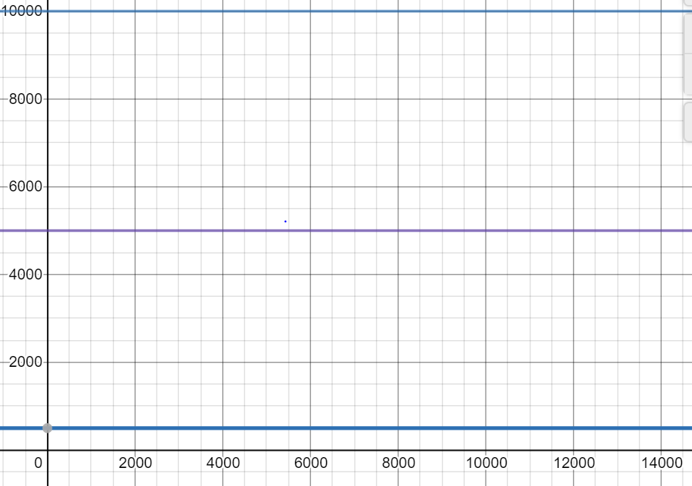
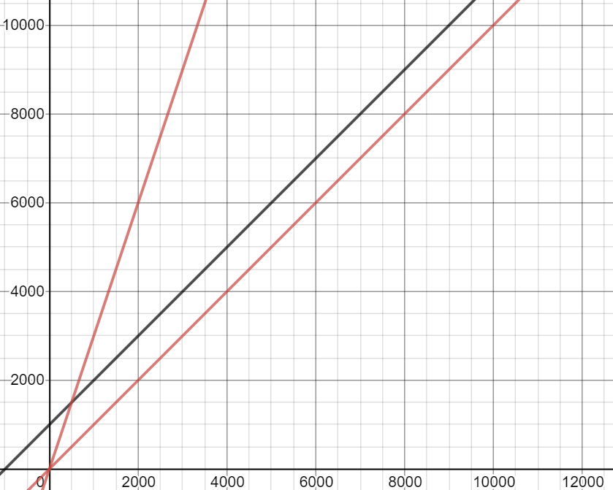
Common Patterns (I)
Constant Growth
# operations the same regardless of input size
Grows like: k
Linear Growth
Increasing input by 1 adds a constant amount to # of operations
Grows like: ax + b

Slide 29
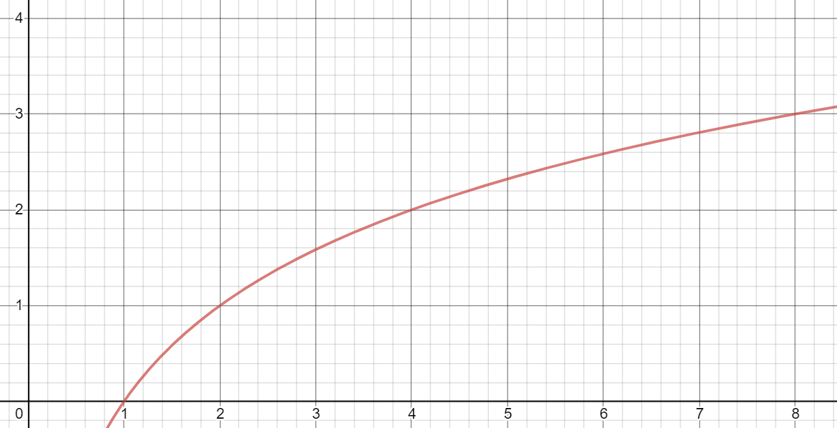
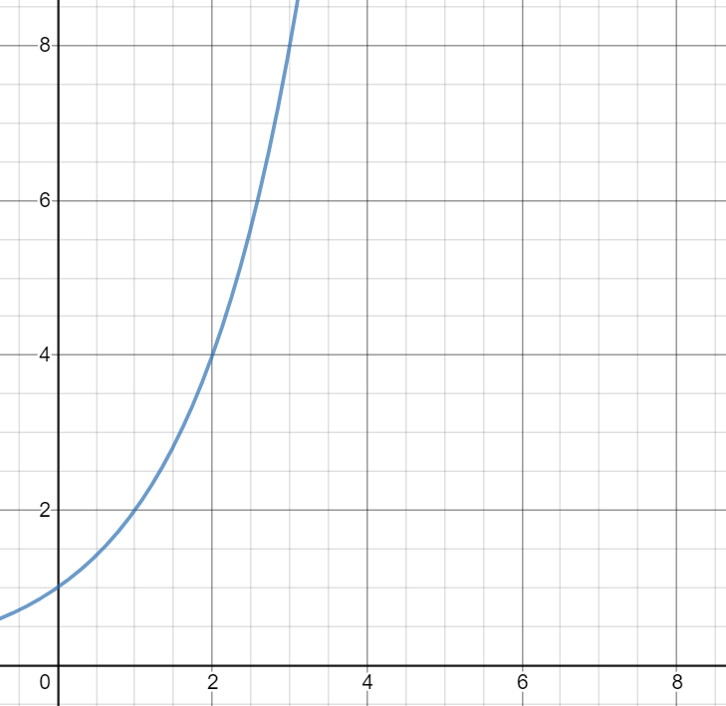
Common Patterns (II)
Demo
Logarithmic Growth
# operations grows only when input is multiplied (doubled, tripled, etc.)
Grows like: log_{b}(x)
Exponential Growth
Increasing input by 1 doubles (or triples, quadruples, etc.) # operations
Grows like: k^{x} (2^{x}, 3^{x}, etc.)

Slide 30
Exponentiation

Slide 31
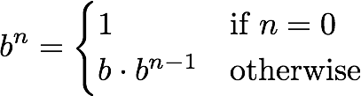
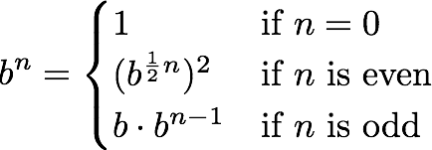
Goal: Calculate b to the power n (≥ 0).
1 def exp_slow(b, n):
2 if n == 0:
3 return 1
4 else:
5 return b * exp_slow(b, n-1)
1 sq = lambda x: x * x
2 def exp_fast(b, n):
3 if n == 0:
4 return 1
5 elif n % 2 == 0:
6 return sq(exp_fast(b, n//2))
7 else:
8 return b * exp_fast(b, n-1)

Slide 32
Demo
Goal: Calculate b to the power n (≥ 0).
1 def exp_slow(b, n):
2 if n == 0:
3 return 1
4 else:
5 return b * exp_slow(b, n-1)
How many total recursive calls do we have to make for:
  exp_slow(2)
  exp_slow(4)
  exp_slow(8)
  exp_slow(9)
How many total recursive calls do we have to make for the same inputs for exp_fast?
What pattern of growth do each of these follow?
1 sq = lambda x: x * x
2 def exp_fast(b, n):
3 if n == 0:
4 return 1
5 elif n % 2 == 0:
6 return sq(exp_fast(b, n//2))
7 else:
8 return b * exp_fast(b, n-1)

Slide 33

Summary (AKA what do I need to know)
There are different methods of programmatically or manually counting the number of operations for a function
  You should be able to do this for small inputs
There are 4 main “patterns” of growth which we can apply to sets of data
  Given the number of operations for a set of inputs, should be able to identify these

Slide 34

What don’t you need to know?
Formal notation for describing growth
  Ex. Θ(2^{n})
Identifying growth classes just by looking at code

