Slide 1
Data Abstraction
Jiacai Cui
PASCAL Group @ Nanjing University
Notes:
Abstraction is a fundamental idea in computer science.
Name Abstraction
Function Abstraction
Sequence Abstraction

Slide 2
Data Abstraction
A methodology by which
functions enforce an abstraction barrier between use and representation.
Abstraction User
Call to Create
Call to Retrieve
abstraction
barrier
a clear division of
responsibility
Constructors
Selectors
Implement
Implement
Abstraction Developer
Notes:
Definition from lecture slides
abstraction barrier
functions
use
representation
Responsibility
Never break the barrier

Slide 3
Data Abstraction
A methodology by which
functions enforce an abstraction barrier between use and representation.
Abstraction User
Call to Create
Call to Retrieve
abstraction
barrier
Never Break
Abstraction!
Constructors
Selectors
😈
Implement
Implement
Abstraction Developer

Slide 4
ADT: Abstract Data Type
Abstraction User
Call to Create
Call to Retrieve
abstraction
barrier
Never Break
Abstraction!
Constructors
Selectors
😈
Implement
Implement
Abstraction Developer
An ADT is a concrete instance of data abstraction, which is
nothing but a specification / contract.
Notes:
- ADT -> Concrete Data Abstraction

Slide 5

ADT Examples - Rational
def mul_rational(x, y):
return rational(
numer(x) * numer(y),
denom(x) * denom(y))
def add_rational(x, y):
nx, dx = numer(x), denom(x)
ny, dy = numer(y), denom(y)
return rational(
nx * dy + ny * dx,
dx * dy)
def print_rational(x):
print(numer(x), '/', denom(x))
def rationals_are_equal(x, y):
return numer(x) * denom(y) ==
numer(y) * denom(x)
Call to Create
Constructors
???
Implement
rational(n, d)
returns a rational number x = n / d
Call to Retrieve
Selectors
???
Implement
numer(x)
returns the numerator of x
denom(x)
returns the denominator of x
Abstraction User
Abstraction Developer
😈
Never Break Abstraction!
abstraction barrier

Slide 6
ADT Examples - Rational
Call to Create
Constructors
def rational(n, d):
"YOUR CODE HERE"
Implement
rational(n, d)
returns a rational number x = n / d
def numer(x):
"YOUR CODE HERE"
def denom(x):
"YOUR CODE HERE"
Call to Retrieve
Selectors
Implement
numer(x)
returns the numerator of x
denom(x)
returns the denominator of x
Rational Implemented using
???
Abstraction User
Abstraction Developer
😈
Never Break Abstraction!
abstraction barrier

Slide 7
ADT Examples - Rational
Call to Create
Constructors
def rational(n, d):
return [n, d]
Implement
rational(n, d)
returns a rational number x = n / d
def numer(x):
return x[0]
def denom(x):
return x[1]
Call to Retrieve
Selectors
Implement
numer(x)
returns the numerator of x
denom(x)
returns the denominator of x
Rational Implemented using
Lists
Abstraction User
Abstraction Developer
😈
Never Break Abstraction!
abstraction barrier

Slide 8
ADT Examples - Rational
Call to Create
Constructors
def rational(n, d):
def select(name):
if name == 'n':
return n
if name == 'd':
return d
return select
Implement
rational(n, d)
returns a rational number x = n / d
Call to Retrieve
Selectors
Implement
numer(x)
returns the numerator of x
denom(x)
returns the denominator of x
def numer(x):
return x('n')
def denom(x):
return x('d')
Abstraction User
Abstraction Developer
😈
Rational Implemented using
Higher Order Functions
Never Break Abstraction!
abstraction barrier

Slide 9
ADT Examples - Rational
Call to Create
Constructors
def rational(n, d):
return {'n': n, 'd': d}
Implement
rational(n, d)
returns a rational number x = n / d
def numer(x):
return x['n']
def denom(x):
return x['d']
Call to Retrieve
Selectors
Implement
numer(x)
returns the numerator of x
denom(x)
returns the denominator of x
Rational Implemented using
Dictionaries
Abstraction User
Abstraction Developer
😈
Never Break Abstraction!
abstraction barrier

Slide 10
ADT Examples - Rational
Call to Create
Constructors
def rational(n, d):
"YOUR MAGIC HERE"
Implement
rational(n, d)
returns a rational number x = n / d
def numer(x):
"YOUR MAGIC HERE"
def denom(x):
"YOUR MAGIC HERE"
Call to Retrieve
Selectors
Implement
numer(x)
returns the numerator of x
denom(x)
returns the denominator of x
Rational Implemented using
Magic
Abstraction User
Abstraction Developer
😈
Never Break Abstraction!
abstraction barrier

Slide 11
Data Abstraction
A methodology by which
functions enforce an abstraction barrier between use and representation.
Abstraction User
Call to Create
Call to Retrieve
abstraction
barrier
Never Break
Abstraction!
Constructors
Selectors
😈
Implement
Implement
Abstraction Developer

Slide 12
ADT: Abstract Data Type
Abstraction User
Call to Create
Call to Retrieve
abstraction
barrier
Never Break
Abstraction!
Constructors
Selectors
😈
Implement
Implement
Abstraction Developer
An ADT is a concrete instance of data abstraction, which is
nothing but a specification / contract.
Notes:
- Program by specification / contract

Slide 13
ADT Examples - Tree
def is_leaf(tree):
return not branches(tree)
def count_leaves(t):
"""Count the leaves of a tree."""
if is_leaf(t):
return 1
return sum([count_leaves(b)
for b in branches(t)])
def increment(t):
"""Return a tree like t but with
all node values incremented."""
return tree(label(t) + 1,
[increment(b)
for b in branches(t)]
Call to Create
Constructors
???
Implement
tree(label, branches=[])
returns a tree with given label and list of branches that are also trees
Call to Retrieve
Selectors
???
Implement
label(tree)
returns the label of tree
branches(tree)
returns the list of branches of tree
Abstraction User
Abstraction Developer
😈
A tree has a label value and a list of branches.
Never Break Abstraction!
abstraction barrier

Slide 14
ADT Examples - Tree
Call to Create
Constructors
def tree(label, branches=[]):
"YOUR CODE HERE"
Implement
tree(label, branches=[])
returns a tree with given label and list of branches that are also trees
def label(tree):
"YOUR CODE HERE"
def branches(tree):
"YOUR CODE HERE"
Call to Retrieve
Selectors
Implement
label(tree)
returns the label of tree
branches(tree)
returns the list of branches of tree
Tree Implemented using
???
Abstraction User
Abstraction Developer
😈
Never Break Abstraction!
abstraction barrier

Slide 15
ADT Examples - Tree
Call to Create
Constructors
def tree(label, branches=[]):
return [label] + list(branches)
Implement
tree(label, branches=[])
returns a tree with given label and list of branches that are also trees
def label(tree):
return tree[0]
def branches(tree):
return tree[1:]
Call to Retrieve
Selectors
Implement
label(tree)
returns the label of tree
branches(tree)
returns the list of branches of tree
Tree Implemented using
Lists
Abstraction User
Abstraction Developer
😈
Never Break Abstraction!
abstraction barrier

Slide 16
ADT Examples - Tree
Call to Create
Constructors
def tree(label, branches=[]):
return lambda is_label:
label if is_label else
list(branches)
Implement
tree(label, branches=[])
returns a tree with given label and list of branches that are also trees
def label(tree):
return tree(true)
def branches(tree):
return tree(false)
Call to Retrieve
Selectors
Implement
label(tree)
returns the label of tree
branches(tree)
returns the list of branches of tree
Tree Implemented using
Higher Order Functions
Abstraction User
Abstraction Developer
😈
Never Break Abstraction!
abstraction barrier

Slide 17
ADT Examples - Tree
Call to Create
Constructors
def tree(label, branches=[]):
return {'label': label,
'branches': list(branches)}
Implement
tree(label, branches=[])
returns a tree with given label and list of branches that are also trees
def label(tree):
return tree['label']
def branches(tree):
return tree['branches']
Call to Retrieve
Selectors
Implement
label(tree)
returns the label of tree
branches(tree)
returns the list of branches of tree
Tree Implemented using
Dictionaries
Abstraction User
Abstraction Developer
😈
Never Break Abstraction!
abstraction barrier

Slide 18
ADT Examples - Tree
Call to Create
Constructors
def tree(label, branches=[]):
"YOUR MAGIC HERE"
Implement
tree(label, branches=[])
returns a tree with given label and list of branches that are also trees
def label(tree):
"YOUR MAGIC HERE"
def branches(tree):
"YOUR MAGIC HERE"
Call to Retrieve
Selectors
Implement
label(tree)
returns the label of tree
branches(tree)
returns the list of branches of tree
Tree Implemented using
Magic
Abstraction User
Abstraction Developer
😈
Never Break Abstraction!
abstraction barrier

Slide 19
Data Abstraction
A methodology by which
functions enforce an abstraction barrier between use and representation.
Abstraction User
Call to Create
Call to Retrieve
abstraction
barrier
Never Break
Abstraction!
Constructors
Selectors
😈
Implement
Implement
Abstraction Developer

Slide 20
ADT: Abstract Data Type
Abstraction User
Call to Create
Call to Retrieve
abstraction
barrier
Never Break
Abstraction!
Constructors
Selectors
😈
Implement
Implement
Abstraction Developer
An ADT is a concrete instance of data abstraction, which is
nothing but a specification / contract.

Slide 21
ADT Exercises - Pair (Lab04-P1)
Call to Create
Constructors
???
Implement
pair(x, y)
returns a pair of x and y
Call to Retrieve
Selectors
???
Implement
fst(p)
returns the first element of p
snd(p)
returns the second element of p
Abstraction User
Abstraction Developer
😈
Never Break Abstraction!
abstraction barrier

Slide 22
ADT Exercises - Pair (Lab04-P1)
Call to Create
Constructors
???
Implement
pair(x, y)
returns a pair of x and y
def change_fst(p, v):
"""Change pair p’s first element
into v and return it. """
return pair(v, snd(p))
def change_snd(p, v):
"""Change pair p’s second element
into v and return it. """
return pair(fst(p), v)
Call to Retrieve
Selectors
???
Implement
fst(p)
returns the first element of p
snd(p)
returns the second element of p
Abstraction User
Abstraction Developer
😈
Never Break Abstraction!
abstraction barrier

Slide 23
ADT Exercises - Pair (Lab04-P1)
Call to Create
Constructors
def pair(x, y):
return lambda i:
x if i == 0
else y
def change_fst(p, v):
"""Change pair p’s
first element into v
and return it.
"""
return pair(v, snd(p))
def change_snd(p, v):
"""Change pair p’s
second element into v
and return it.
"""
return pair(fst(p), v)
pair(x, y)
returns a pair of x and y
Implement
def fst(p):
return p(0)
def snd(p):
return p(1)
Call to Retrieve
Selectors
fst(p)
returns the first element of p
snd(p)
returns the second element of p
Pair Implemented using
Higher-Order Functions
Abstraction User
Abstraction Developer
😈
Never Break Abstraction!
abstraction barrier

Slide 24
ADT Exercises - City (Lab04-P2)
Call to Create
Constructors
???
Implement
make_city(name, lat, lon)
returns a city with given
name, latitude, longtitude
Call to Retrieve
Selectors
???
Implement
get_name(city)
returns the city’s name
get_lat(city)
returns the city’s latitude
get_lon(city)
returns the city’s longitude
Abstraction Developer
Abstraction User
😈
Never Break Abstraction!
abstraction barrier

Slide 25
ADT Exercises - City (Lab04-P2)
Call to Create
Constructors
???
def distance(city1, city2):
"""Returns the distance between
city1 and city2."""
return sqrt(
(get_lat(city1) - get_lat(city2))**2 +
(get_lon(city1) - get_lon(city2))**2
)
def closer_city(lat, lon, city1, city2):
"""Returns the name of either city1
or city2, whichever is closest to
coordinate (lat, lon). """
target = make_city('cats', lat, lon)
return get_name(city1 if
distance(city1, target) <
distance(city2, target)
else city2)
Implement
make_city(name, lat, lon)
returns a city with given
name, latitude, longtitude
Call to Retrieve
Selectors
???
Implement
get_name(city)
returns the city’s name
get_lat(city)
returns the city’s latitude
get_lon(city)
returns the city’s longitude
Abstraction Developer
Abstraction User
😈
Never Break Abstraction!
abstraction barrier

Slide 26
ADT Exercises - Function (HW04-P1)
Call to Create
Constructors
???
Implement
fn_empty()
returns an empty function
fn_remap(f, x, y)
returns a new function g the same as f except that g(x) = y
Call to Retrieve
Selectors
???
Implement
fn_domain(f)
returns f’s domain as a sorted list
fn_call(f, x)
returns f(x) if x is in f’s domain otherwise None
Abstraction Developer
Abstraction User
😈
Never Break Abstraction!
abstraction barrier

Slide 27
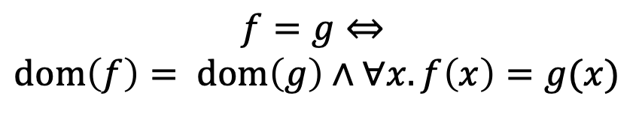
ADT Exercises - Function (HW04-P1)
Call to Create
Constructors
???
$$f=g⇔$$
$$dom\left(f\right)= dom\left(g\right)∧∀x.f\left(x\right)=g(x)$$
Implement
fn_empty()
returns an empty function
fn_remap(f, x, y)
returns a new function g the same as f except that g(x) = y
def fn_ext(f, g):
"""Returns whether f and g
represent the same function."""
f_dom = fn_domain(f)
g_dom = fn_domain(g)
if f_dom != g_dom:
return False
for x in f_dom:
if fn_call(f, x) !=
fn_call(g, x):
return False
return True
Call to Retrieve
Selectors
???
Implement
fn_domain(f)
returns f’s domain as a sorted list
fn_call(f, x)
returns f(x) if x is in f’s domain otherwise None
Abstraction Developer
Abstraction User
😈
Never Break Abstraction!
abstraction barrier

Slide 28
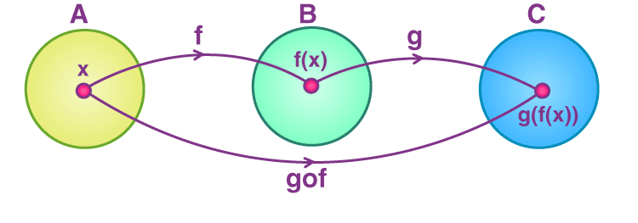
ADT Exercises - Function (HW04-P1)
Call to Create
Constructors
???
Implement
fn_empty()
returns an empty function
fn_remap(f, x, y)
returns a new function g the same as f except that g(x) = y
def fn_compose(g, f):
"""Returns a new function that is
the composition of g and f."""
g_o_f = fn_empty()
for x in fn_domain(f):
g_o_f = fn_remap(g_o_f, x,
fn_call(g,
fn_call(f, x)))
return g_o_f
Call to Retrieve
Selectors
???
Implement
fn_domain(f)
returns f’s domain as a sorted list
fn_call(f, x)
returns f(x) if x is in f’s domain otherwise None
Abstraction Developer
Abstraction User
😈
Never Break Abstraction!
abstraction barrier

Slide 29
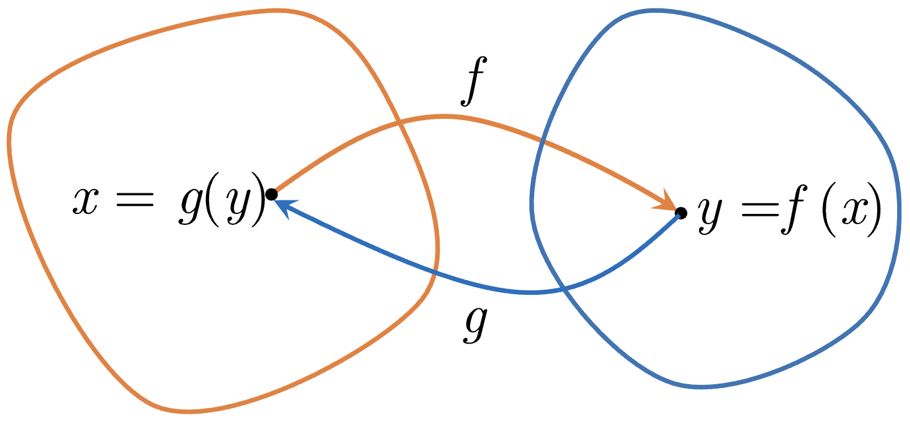
ADT Exercises - Function (HW04-P1)
Call to Create
Constructors
???
Implement
fn_empty()
returns an empty function
fn_remap(f, x, y)
returns a new function g the same as f except that g(x) = y
def fn_inverse(f):
"""Returns a new function that is
the inverse of f if it exists,
otherwise None."""
g, g_dom = fn_empty(), []
for x in fn_domain(f):
y = fn_call(f, x)
if y in g_dom:
return None
g = fn_remap(g, y, x)
g_dom.append(y)
return g
Call to Retrieve
Selectors
???
Implement
fn_domain(f)
returns f’s domain as a sorted list
fn_call(f, x)
returns f(x) if x is in f’s domain otherwise None
Abstraction Developer
Abstraction User
😈
Never Break Abstraction!
abstraction barrier

Slide 30
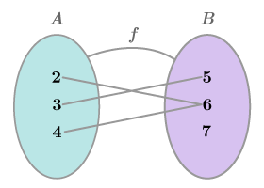
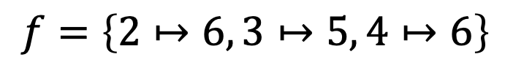
ADT Exercises - Function (HW04-P1)
Call to Create
Constructors
???
Implement
fn_empty()
returns an empty function
fn_remap(f, x, y)
returns a new function g the same as f except that g(x) = y
Call to Retrieve
Selectors
???
Implement
$$f=\left\{2↦6, 3↦5, 4↦6\right\}$$
fn_domain(f)
returns f’s domain as a sorted list
fn_call(f, x)
returns f(x) if x is in f’s domain otherwise None
f = [[2, 6], [3, 5], [4, 6]]
Abstraction Developer
Abstraction User
😈
Function Implemented using
Lists
Never Break Abstraction!
abstraction barrier

Slide 31
ADT Exercises - Function (HW04-P1)
Call to Create
Constructors
def fn_empty():
return []
def fn_remap(f, x, y):
g = deepcopy(f)
for p in g:
if p[0] == x:
p[1] = y
return g
g.append([x, y])
return g
Implement
fn_empty()
returns an empty function
fn_remap(f, x, y)
returns a new function g the same as f except that g(x) = y
def fn_domain(f):
return
sorted([p[0] for p in f
if p[1] != None])
Call to Retrieve
Selectors
Implement
fn_domain(f)
returns f’s domain as a sorted list
fn_call(f, x)
returns f(x) if x is in f’s domain otherwise None
def fn_call(f, x):
for p in f:
if p[0] == x:
return p[1]
return None
Abstraction Developer
Abstraction User
😈
Never Break Abstraction!
abstraction barrier

Slide 32
Data Abstraction
A methodology by which
functions enforce an abstraction barrier between use and representation.
Abstraction User
Call to Create
Call to Retrieve
abstraction
barrier
Never Break
Abstraction!
Constructors
Selectors
😈
Implement
Implement
Abstraction Developer

Slide 33
ADT: Abstract Data Type
Abstraction User
Call to Create
Call to Retrieve
abstraction
barrier
Never Break
Abstraction!
Constructors
Selectors
😈
Implement
Implement
Abstraction Developer
Notes:
程序员与架构师

Slide 34
ADT Examples - Rational
def mul_rational(x, y):
return rational(
numer(x) * numer(y),
denom(x) * denom(y))
def add_rational(x, y):
nx, dx = numer(x), denom(x)
ny, dy = numer(y), denom(y)
return rational(
nx * dy + ny * dx,
dx * dy)
def print_rational(x):
print(numer(x), '/', denom(x))
def rationals_are_equal(x, y):
return numer(x) * denom(y) ==
numer(y) * denom(x)
Call to Create
Constructors
???
Implement
Call to Retrieve
Selectors
???
Implement
Abstraction User
Abstraction Developer
😈
Never Break Abstraction!
abstraction barrier

Slide 35
ADT Examples - Tree
def is_leaf(tree):
return not branches(tree)
def count_leaves(t):
"""Count the leaves of a tree."""
if is_leaf(t):
return 1
return sum([count_leaves(b)
for b in branches(t)])
def increment(t):
"""Return a tree like t but with
all node values incremented."""
return tree(label(t) + 1,
[increment(b)
for b in branches(t)]
Call to Create
Constructors
???
Implement
tree(label, branches=[])
returns a tree with given label and list of branches that are also trees
Call to Retrieve
Selectors
???
Implement
label(tree)
returns the label of tree
branches(tree)
returns the list of branches of tree
Abstraction User
Abstraction Developer
😈
A tree has a label value and a list of branches.
Never Break Abstraction!
abstraction barrier

Slide 36
ADT Exercises - Pair (Lab04-P1)
Call to Create
Constructors
???
Implement
def change_fst(p, v):
"""Change pair p’s first element
into v and return it. """
return pair(v, snd(p))
def change_snd(p, v):
"""Change pair p’s second element
into v and return it. """
return pair(fst(p), v)
pair(x, y)
returns a pair of x and y
Call to Retrieve
Selectors
???
Implement
fst(p)
returns the first element of p
snd(p)
returns the second element of p
Abstraction User
Abstraction Developer
😈
Never Break Abstraction!
abstraction barrier

Slide 37
ADT Exercises - City (Lab04-P2)
Call to Create
Constructors
???
def distance(city1, city2):
"""Returns the distance
between city1 and city2."""
return sqrt(
(get_lat(city1) - get_lat(city2))**2 +
(get_lon(city1) - get_lon(city2))**2
)
def closer_city(lat, lon, city1, city2):
"""Returns the name of either city1
or city2, whichever is closest to
coordinate (lat, lon). """
target = make_city('cats', lat, lon)
return get_name(city1 if
distance(city1, target) <
distance(city2, target)
else city2)
Implement
make_city(name, lat, lon)
returns a city with given
name, latitude, longtitude
Call to Retrieve
Selectors
???
Implement
get_name(city)
returns the city’s name
get_lat(city)
returns the city’s latitude
get_lon(city)
returns the city’s longitude
Abstraction Developer
Abstraction User
😈
Never Break Abstraction!
abstraction barrier

Slide 38
ADT Exercises - Function (HW04-P1)
Call to Create
Constructors
???
$$f=g⇔$$
$$dom\left(f\right)= dom\left(g\right)∧∀x.f\left(x\right)=g(x)$$
Implement
fn_empty()
returns an empty function
fn_remap(f, x, y)
returns a new function g the same as f except that g(x) = y
def fn_ext(f, g):
"""Returns whether f and g
represent the same function."""
f_dom = fn_domain(f)
g_dom = fn_domain(g)
if f_dom != g_dom:
return False
for x in dom1:
if fn_call(f, x) !=
fn_call(g, x):
return False
return True
Call to Retrieve
Selectors
???
Implement
fn_domain(f)
returns f’s domain as a sorted list
fn_call(f, x)
returns f(x) if x is in f’s domain otherwise None
Abstraction Developer
Abstraction User
😈
Never Break Abstraction!
abstraction barrier

Slide 39
ADT Exercises - Function (HW04-P1)
Call to Create
Constructors
???
Implement
fn_empty()
returns an empty function
fn_remap(f, x, y)
returns a new function g the same as f except that g(x) = y
def fn_compose(g, f):
"""Returns a new function that is
the composition of g and f."""
g_o_f = fn_empty()
for x in fn_domain(f):
g_o_f = fn_remap(
g_o_f, x,
fn_call(g,
fn_call(f, x)))
return g_o_f
Call to Retrieve
Selectors
???
Implement
fn_domain(f)
returns f’s domain as a sorted list
fn_call(f, x)
returns f(x) if x is in f’s domain otherwise None
Abstraction Developer
Abstraction User
😈
Never Break Abstraction!
abstraction barrier

Slide 40
ADT Exercises - Function (HW04-P1)
Call to Create
Constructors
???
Implement
fn_empty()
returns an empty function
fn_remap(f, x, y)
returns a new function g the same as f except that g(x) = y
def fn_inverse(f):
"""Returns a new function that is
the inverse of f if it exists,
otherwise None."""
g, g_dom = fn_empty(), []
for x in fn_domain(f):
y = fn_call(f, x)
if y in g_dom:
return None
g = fn_remap(g, y, x)
g_dom.append(y)
return g
Call to Retrieve
Selectors
???
Implement
fn_domain(f)
returns f’s domain as a sorted list
fn_call(f, x)
returns f(x) if x is in f’s domain otherwise None
Abstraction Developer
Abstraction User
😈
Never Break Abstraction!
abstraction barrier

Slide 41
Data Abstraction
A methodology by which
functions enforce an abstraction barrier between use and representation.
Abstraction User
Call to Create
Call to Retrieve
abstraction
barrier
Never Break
Abstraction!
Constructors
Selectors
😈
Implement
Implement
Abstraction Developer

